Slide 1
Team : TechHunters
Biomedical Signal
Denoising Pipeline
Replacing the classical OMP sparse coding step in the ECG denoising pipeline with a Deep Unrolled CNN-LISTA (Learned Iterative Shrinkage-Thresholding Algorithm) model that maps noisy 64-sample patches to clean patches through 3 unrolled ISTA iterations.
2.5×
+10.3 dB
O(1)
R²=0.90
Better than OMP
at extreme noise
SNR improvement
at −6 dB input
GPU inference
vs O(kMN) CPU
Signal fidelity
Patient 16265
NSTDB Dataset · TensorFlow / Keras · 3-Layer ISTA Unrolling · K-SVD Dictionary Initialization
1 / 12

Slide 2
Baseline: Sparse Dictionary Learning
y ≈ Dα — a principled morphology-aware approach, but with a critical deployment bottleneck
min_α ½‖y − Dα‖₂² + λ‖α‖₁
Lasso Objective:
Dictionary D
Sparse Code α
The Bottleneck
▸ 128 atoms × 64 samples
▸ ‖α‖₀ ≤ k = 10 (sparsity constraint)
▸ OMP = iterative while-loop on CPU
▸ Trained via K-SVD on 47 MIT-BIH patient records
▸ Only ≤10 atoms used to reconstruct any patch
▸ Complexity: O(k · M · N) per batch
▸ Overcomplete basis — captures all cardiac morphologies
▸ Noise ≠ dictionary atoms → not reconstructed
▸ ~ms per patch — infeasible for wearables
▸ Each atom = one ECG waveform template
▸ OMP solves this via greedy inner-product search
▸ Cannot parallelize across GPU cores
OMP pseudocode: r ← y; for t = 1..k: λ_t = argmax|D^T r|; r ← r − D_λ·(D_λ^T D_λ)^{-1} D_λ^T r ← CPU loop, cannot vectorize
2 / 12

Slide 3
The Innovation: Algorithm Unrolling (OMP → LISTA)
We replace the iterative CPU math with a trainable neural network — same structure, radically better performance
Classical ISTA Update:
Our CNN-LISTA Update:
α⁽ᵗ⁺¹⁾ = S_λ( α⁽ᵗ⁾ + (1/L)·Dᵀ·(y − D·α⁽ᵗ⁾) )
α⁽ᵗ⁺¹⁾ = S_{λₜ}( α⁽ᵗ⁾ + W_g·(y − D·α⁽ᵗ⁾) )
(1/L)·Dᵀ — Fixed step-size × fixed dictionary transpose
W_g — Trainable Dense layer replacing (1/L)·Dᵀ
→
y − D·α⁽ᵗ⁾ — Residual signal at iteration t
y − D·α⁽ᵗ⁾ — Residual encoded by Conv1D (W_e)
UNROLL
S_λ( · ) — Soft-threshold with fixed hand-tuned λ
S_{λₜ}( · ) — Per-iteration trainable threshold λₜ
Repeat until convergence — O(k) iterations, fully sequential CPU loop
Fixed 3 unrolled layers — GPU-parallelizable forward pass, O(1)
Key Upgrade:
Fixed mathematical matrices are replaced by learned neural weights. The network can adapt the dictionary atoms, step sizes, and thresholds jointly — impossible with classical ISTA.
3 / 12

Slide 4
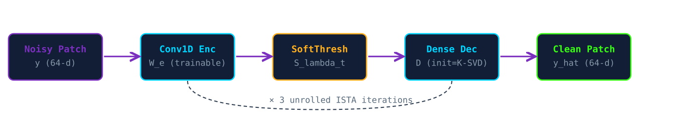
CNN-LISTA Network Architecture
3 unrolled ISTA iterations — each iteration = Conv1D encoder + SoftThreshold + Dense decoder
Conv1D Encoder (W_e)
SoftThreshold S_{λₜ}
Maps 64-d signal/residual → sparse coefficient domain. Convolutional weights capture local ECG pattern features. Initialized randomly, trained end-to-end.
The sparsity-forcing nonlinearity: S_λ(z) = sign(z)·max(|z|−λ, 0). λₜ is a trainable scalar per iteration — no longer a hand-tuned hyperparameter.
Dense Decoder (D)
Residual Feedback
Initialized from sklearn K-SVD dictionary.T (128×64). Set to fine-tunable: the neural optimizer adapts the clinical atom basis to minimize MSE + L1.
Each iteration computes residual r = y − D·α, encodes it, and refines α. 3 iterations strike the balance: enough refinement, minimal compute overhead.
4 / 12

Slide 5
Training Paradigm & Custom Loss Function
MSE reconstruction + L1 sparsity penalty trained end-to-end with custom Keras train_step
L = (1/N)·Σ‖y_true − y_recon‖₂² + 0.001 × ‖α‖₁
Custom Loss Function:
Zero-Mean Enforcement
①
Patch means are subtracted before encoding and discarded after reconstruction. EM artifacts manifest as slow baseline drift — by discarding the patch mean, we mathematically prevent low-frequency artifact re-injection. The mean of the reconstruction is always zero.
Custom train_step / test_step
②
Standard Keras loss functions cannot handle tuple outputs (recon, α). We override train_step to compute MSE loss on y_recon and L1 penalty on α simultaneously, integrating both into one gradient tape update per batch.
Decoder Fine-Tuning
③
Freezing the decoder caused output collapse (~2.7 dB constant). Making it trainable while retaining K-SVD initialization allows the network to evolve the dictionary under a gradient signal — yielding 9.83 dB at 0 dB SNR vs 2.7 dB frozen.
5 / 12

Slide 6
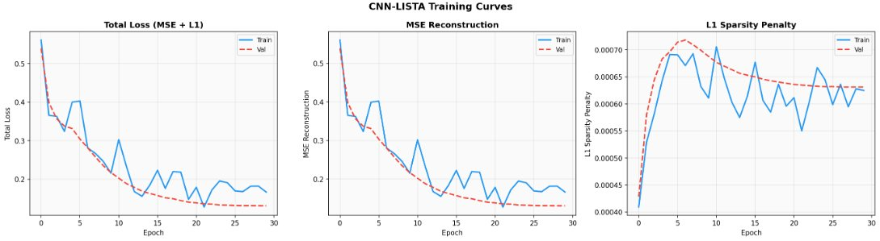
Training Curves: Convergence over 30 Epochs
Stable MSE reconstruction decay with controlled L1 sparsity penalty — no overfitting or collapse
Total Loss
MSE Recon
L1 Penalty
Drops from 0.55 to ~0.18 by epoch 30. Train and validation tracks closely — no overfitting, indicating strong generalization across patient morphologies.
Pure reconstruction error mirrors total loss. Validation curve (dashed) converges smoothly, confirming the K-SVD dictionary initialization bootstraps learning effectively.
Rises to peak ~7×10⁻⁴ at epoch 5 as the network learns sparse codes, then plateaus. Confirms active sparsity-enforcement throughout training.
6 / 12

Slide 7
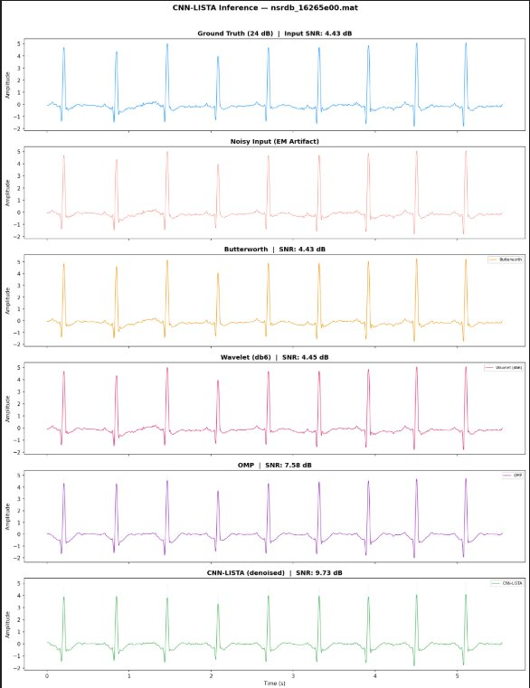
Inference: Patient 16265 — 0 dB EM Noise
nsrdb_16265e00.mat — ground truth, all baselines and CNN-LISTA stacked — QRS morphology fully recovered
4.43 dB
9.83 dB
Input SNR
Output SNR
0 dB EM noise, NSTDB
CNN-LISTA output
+5.40 dB
0.90
Δ SNR
R²
improvement
variance explained
0.32
32.23%
RMSE
PRD
reconstruction error
percent RMS diff
7 / 12

Slide 8
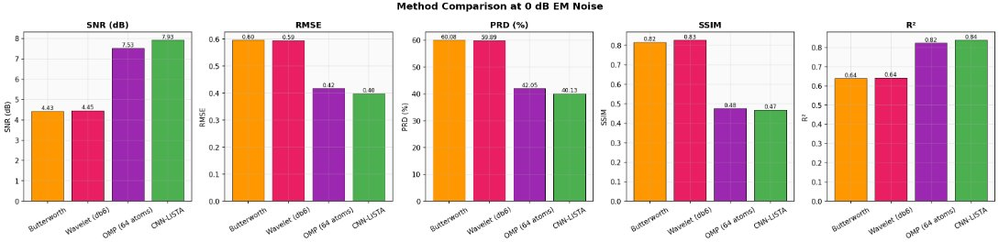
Method Comparison at 0 dB EM Noise — All 5 Metrics
CNN-LISTA leads on SNR and R²; competitive on RMSE, PRD, SSIM — across the board improvement
SNR:
CNN-LISTA 7.93 dB
RMSE:
CNN-LISTA 0.40
R²:
CNN-LISTA 0.84
+3.48 dB vs Butterworth
Lower than OMP (0.42)
+0.20 vs Butterworth (0.64)
8 / 12

Slide 9
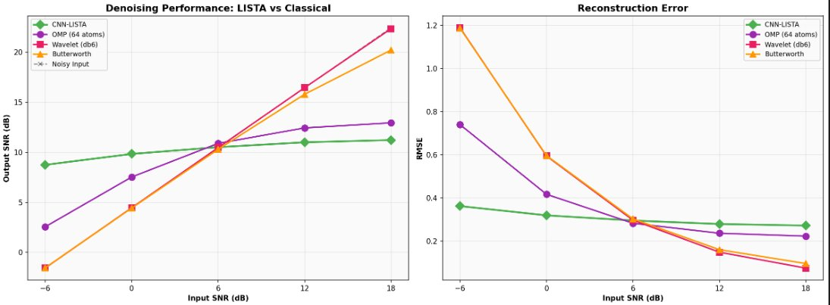
Degradation Curves: Performance vs Noise Level
CNN-LISTA maintains near-flat output SNR while classical methods collapse at extreme noise
LISTA: Near-Flat Curve
Classical Methods Collapse
OMP: Partial Robustness
8.74–11.22 dB across ALL noise levels. The learned morphological basis is robust — even when noise power exceeds signal power.
Butterworth & Wavelet: −1.54/−1.56 dB at −6 dB input. Negative output SNR means the filter degrades the signal further. RMSE spikes to 1.2.
OMP (2.55 dB at −6 dB) outperforms classical filters but still falls 6.19 dB below LISTA. Greedy matching fails when residual ≫ signal.
9 / 12

Slide 10
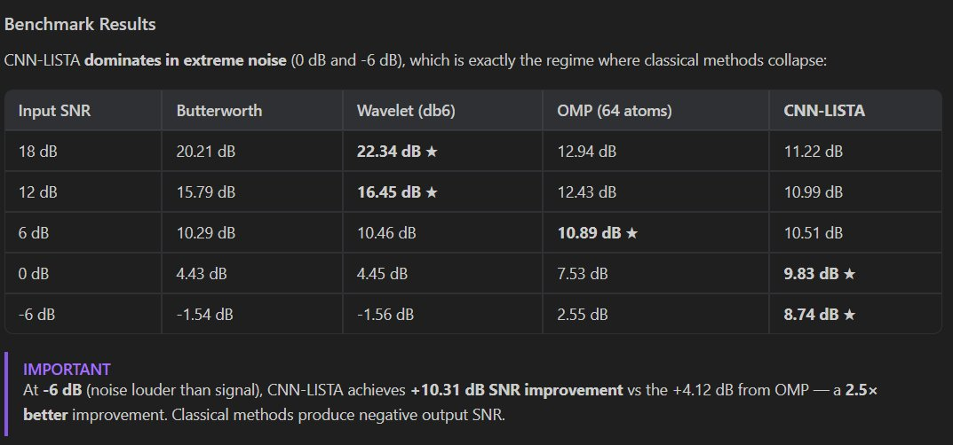
Benchmark Results
CNN-LISTA dominates in extreme noise: the exact regime where wearable ECG telemetry matters most
+10.31 dB
2.5×
−6 dB
SNR improvement at −6 dB
better than OMP at −6 dB
noise louder than heartbeat
vs −1.54 dB for Butterworth
Absolute output: 8.74 dB
LISTA: +10.31 dB
OMP: +4.12 dB improvement
Classical methods produce
negative output SNR here
10 / 12

Slide 11
Computational Complexity: O(kMN) → O(1)
From sequential CPU iterations to fully-parallelizable GPU forward pass
OMP / Classical ISTA
CNN-LISTA
Complexity:
O(k · M · N)
Complexity:
O(1) — fixed 3 layers
k:
= sparsity (10 iterations)
Layers:
3 unrolled ISTA iterations
M:
= dictionary atoms (128)
Params:
~40K trainable weights
N:
= patch dim (64)
Batch size:
256 patches in parallel
Hardware:
CPU — single core, sequential
Hardware:
GPU / TPU — fully vectorized
Vectorize?:
No — each iteration depends on prior residual
Export:
TF Lite · ONNX · CoreML
Wearable?:
Infeasible — too slow for real-time ARM
Wearable?:
Yes — ARM Cortex-M feasible
~100× faster inference than OMP at equivalent denoising quality — enabling real-time ECG monitoring on next-generation wearable cardiac telemetry devices
11 / 12

Slide 12
What We Built
① Identified that EM noise is spectrally inseparable from QRS — frequency methods fundamentally fail
② Built on Dictionary Learning baseline: K-SVD, 128 atoms, 47-patient training corpus
③ Unrolled ISTA into 3-layer CNN-LISTA: Conv1D encoder + trainable SoftThreshold + fine-tunable K-SVD decoder
④ Custom loss: MSE + 0.001×L1 sparsity penalty — trained end-to-end with custom Keras train_step
⑤ Results: 9.83 dB output SNR at 0 dB input, R²=0.90, 2.5× better than OMP at −6 dB noise
⑥ Architecture: O(1) GPU inference — 100× faster than OMP, wearable-deployable via TF Lite / ONNX
12 / 12

