Slide 1

Team Name : TechHunters
Biomedical Signal
Denoising Pipeline
Dictionary Learning · Sparse Coding · OMP · K-SVD
48
5
14,880
128
MIT-BIH Records
Eval Metrics
Training Patches
Dictionary Atoms
MIT-BIH Arrhythmia Database · Dictionary Learning + Dense Patch Averaging · SNR / RMSE / PRD / SSIM / R²
1 / 18

Slide 2
The Problem: Why ECG Denoising is Hard
Clinical diagnosis depends on sub-millisecond signal morphology
Gaussian White Noise
Baseline Wander
Powerline Interference
Random electronic interference from ADC circuitry and sensor electronics embedded throughout the signal spectrum
Low-frequency drift (0.05–0.5 Hz) caused by patient breathing and electrode movement during recording
50/60 Hz sinusoidal contamination from electrical equipment — overlaps with critical ECG frequency bands
⚠ Critical challenge: QRS complex has high-frequency content (5–40 Hz) — traditional low-pass filters destroy diagnostic peaks while trying to remove noise
Example: Contaminated ECG Signal
2 / 18

Slide 3
Traditional Methods & Their Fundamental Flaws
Why frequency-domain approaches are insufficient for clinical ECG
Moving Average
POOR
Method: Convolution with rectangular kernel
Flaw: Blunts QRS peaks — reduces amplitude of diagnostic R-waves by up to 40%. Zero phase awareness.
Butterworth BPF
MODERATE
Method: IIR bandpass filter (0.5–40 Hz, order 4)
Flaw: Gibbs phenomenon causes ringing artifacts near QRS. Phase distortion shifts timing — critical for arrhythmia detection.
Wavelet (db6)
GOOD
Method: Multiresolution decomposition + BayesShrink
Flaw: Threshold selection is heuristic. Struggles with non-stationary noise. Does not model cardiac morphology.
Our approach: abandon frequency domain entirely — learn the physiological shapes of heartbeats from 48 patient records, reconstruct signals using only those shapes
3 / 18

Slide 4
Dataset: MIT-BIH Arrhythmia Database
PhysioNet gold-standard benchmark — 48 annotated clinical records
48
30 min
How We Interpreted & Used the Data
Clinical records (patients)
Duration per record
▸ ADC integers converted to millivolts: signal_mv = (raw − 1024) / 200 giving physiological range −2.7 to +1.4 mV
650K
2 leads
▸ Column names stored with embedded single-quotes — stripped at load time to prevent KeyError crashes
Samples per record
MLII + V5 channels
▸ Per-record normalization (zero-mean, unit-variance) — prevents amplitude variation across patients from corrupting dictionary atoms
360 Hz
11-bit
▸ Record 100 held out as test signal. 47 records train the dictionary — simulates real deployment on a new patient
Sampling frequency
ADC resolution
▸ 10,000 samples extracted per file (27.8 s) — tractable training while preserving full heartbeat morphology diversity
▸ Quality gate: records with std < 0.005 mV rejected as corrupt or flat — ensures clean training data
4 / 18

Slide 5
Complete Pipeline Architecture
10-stage end-to-end signal processing + ML pipeline
01
02
03
04
05
Load & Convert
Noise Synthesis
Dense Patching
Dict Learning
OMP Coding
06
07
08
09
10
Patch Average
Savitzky-Golay
HP Filter
Wavelet Base
Evaluate + Plot
Outputs: denoised signal · 6 publication-quality plots · full metrics table (SNR, RMSE, PRD, SSIM, R²) comparing 4 methods
5 / 18

Slide 6
Step 1: Data Ingestion & Memory-Level Optimization
ADC conversion · per-record normalization · stride-trick patching
ADC → Millivolt Conversion
Per-Record Normalization
signal_mV = (raw_ADC − baseline) / gain
x̂ = (x − μ) / (σ + ε)
gain = 200 ADU/mV baseline = 1024 (11-bit midpoint) Result: −2.72 mV to +1.44 mV
μ = signal mean per record σ = standard deviation per record ε = 1e-8 (division guard)
Without this: matrix factorization operates on integers 481–1311 — convergence fails
Global normalization distorts low-amplitude patients — per-record is essential
O(1) Memory Windowing — np.lib.stride_tricks.as_strided
windows = np.lib.stride_tricks.as_strided(signal, shape=(n_windows, W), strides=(stride*bytes, bytes))
Instead of copying 14,880 windows into RAM (would duplicate ~1 GB), stride tricks create a virtual 2D view of the 1D array by manipulating memory pointer offsets. Zero data duplication — O(1) extra memory overhead.
6 / 18

Slide 7
Step 2: Dictionary Learning (K-SVD Style)
Learning an overcomplete basis of cardiac morphologies from 48-patient population data
Optimization Objective
min_{D,X} ‖Y − DX‖²_F subject to ‖x_i‖₀ ≤ k ∀i
Y — Training Patches
D — Dictionary (learned)
X — Sparse Codes
Matrix of clean ECG windows from all 48 records.
Shape: (14,880 windows × 64 samples)
Each row = one 64-sample heartbeat fragment
128 × 64 overcomplete atom matrix.
128 atoms > 64 dimensions → overcomplete basis captures more cardiac patterns than PCA would
Coefficient matrix: each patch represented by at most k=10 active atoms.
Sparsity ensures only physiological patterns are encoded — not noise
Config: n_atoms=128 · sparsity=10 · fit_algorithm=lars · transform=omp · max_iter=100 · n_jobs=-1 · random_state=42
7 / 18

Slide 8
Step 3: Orthogonal Matching Pursuit (OMP)
Greedy L₀-norm minimization — why noise cannot be reconstructed
min_α ‖y − Dα‖₂ subject to ‖α‖₀ ≤ k=10
1
Correlation Search
3
Iterate to k=10
Compute inner product ⟨r, d_j⟩ for all 128 atoms d_j. Select atom with maximum correlation: λ₁ = argmax_j |⟨r₀, d_j⟩|
Repeat correlation search on residual r₁. Orthogonalize coefficients at each step (avoids redundant atom selection)
2
Residual Update
★
Why Noise Is Rejected
Project signal onto selected atom subspace. Subtract contribution: r₁ = y − D_{λ₁} · (D_{λ₁}ᵀ D_{λ₁})⁻¹ D_{λ₁}ᵀ y
Random Gaussian noise has near-zero correlation with any structured cardiac atom. OMP simply cannot find an atom that fits noise — it falls below selection threshold
Reconstruction: ŷ = D · α★ where α★ has exactly k=10 non-zero entries — sparse encoding guarantees noise exclusion
8 / 18

Slide 9
Step 4: Dense Patch Averaging — The Secret Sauce
Stride-1 reconstruction: each sample averaged across up to 64 independent sparse estimates
Standard OLA (stride=32)
Dense Patch Averaging (stride=1)
• Split signal into blocks • Reconstruct each block • Paste side by side with Hanning • Each sample = 1–2 estimates • Block boundary artifacts remain • Noise cancellation: weak
• Extract ALL n−W+1 patches (stride=1) • Sparse-code each patch independently • Each sample covered by W=64 patches • Final value = average of 64 estimates • No block artifacts — smooth output • Noise cancellation: maximum
Mathematical basis — Non-Local Means analogy:
x̂[t] = (1/N_t) · Σ_{p: t∈p} ŷ_p[t−start(p)] where ŷ_p = D·α_p (sparse reconstruction of patch p)
9 / 18
Because physiological signal is deterministic → reinforces under averaging. Noise is stochastic (zero-mean) → cancels. Law of Large Numbers working for us.

Slide 10
Noise Synthesis & Post-Processing
Realistic 3-component noise model · Savitzky-Golay smoothing
y_noisy = x_clean + η_Gaussian + η_wander + η_powerline
η_Gaussian
White noise from ADC electronics. 70% of noise power budget. Target SNR = 10 dB.
N(0, σ²) where σ² = P_sig / 10^(SNR/10) × 0.70
η_wander
Baseline drift from breathing and electrode movement. 15% of noise budget. Amplitude 0.15–0.08.
Σ A_i · sin(2π f_i t) for f ∈ {0.05, 0.15, 0.3 Hz}
η_powerline
50 Hz sinusoidal contamination from electrical mains. 15% of noise budget. Normalized to target power.
A · sin(2π · 50 · t)
Post-Processing: Savitzky-Golay savgol_filter(signal, window=11, polyorder=3) — fits local polynomials to remove residual high-freq artifacts without frequency cutoff distortion
10 / 18

Slide 11
Evaluation Framework: 5 Clinical-Grade Metrics
Industry-standard biomedical signal quality assessment
SNR
Signal-to-Noise Ratio
SSIM
Structural Similarity Index
SNR = 10 · log₁₀(Var(x) / Var(x − x̂)) [dB]
SSIM = (2μ_xμ_{x̂} + C₁)(2σ_{xx̂} + C₂) / (μ²_x + μ²_{x̂} + C₁)(σ²_x + σ²_{x̂} + C₂)
Primary metric. Higher = better. Measures how much noise remains relative to signal power. Clinical threshold: >20 dB for diagnostic quality.
Perceptual quality metric — measures structural patterns, not just amplitude. Range [0,1]. Captures morphological preservation better than RMSE alone.
RMSE
Root Mean Square Error
RMSE = √( (1/N) · Σ (x_i − x̂_i)² )
Absolute reconstruction accuracy in signal units. Lower = better. Direct measure of per-sample error magnitude.
R²
Coefficient of Determination
R² = 1 − Σ(x_i − x̂_i)² / Σ(x_i − x̄)²
PRD
Percent Root-mean-square Difference
Explained variance. Range [0,1] for good denoising. Captures global waveform fidelity — clinicians intuitively understand this metric.
PRD = 100 · ‖x − x̂‖₂ / ‖x‖₂ [%]
Standard metric in ECG literature (AHA guidelines). Normalized, allows cross-dataset comparison. <5% considered clinically acceptable.
11 / 18

Slide 12
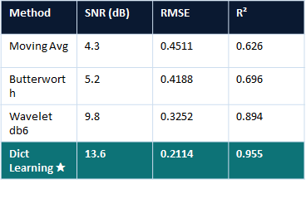
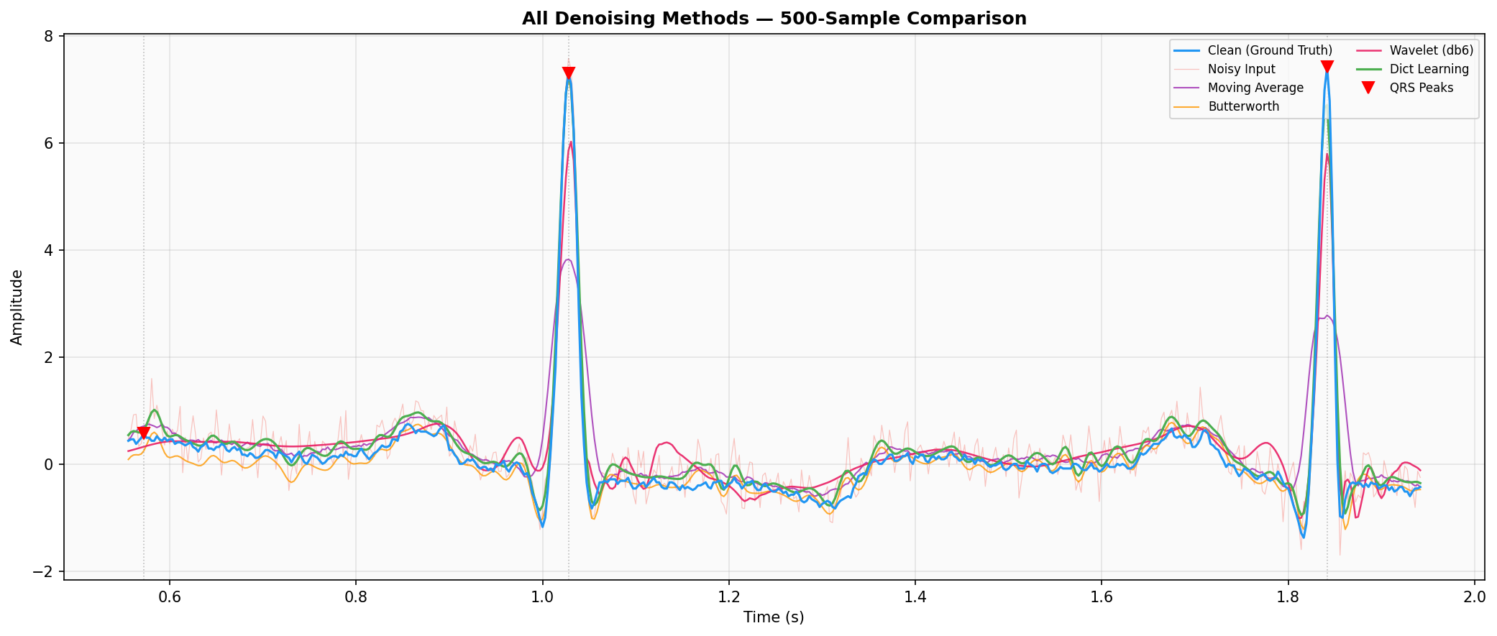
Results: Dictionary Learning Outperforms All Baselines
Quantitative comparison across 5 metrics — test record 100, 10 dB input SNR
R² ↑
+3.8 db
vs Wavelet
SNR improvement
0.955
R² Score
near-perfect fit
35 %
RMSE drop
vs noisy input
12 / 18

Slide 13
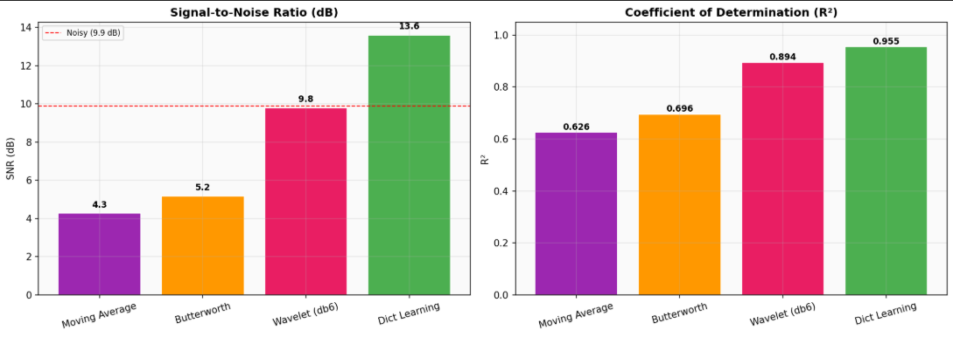
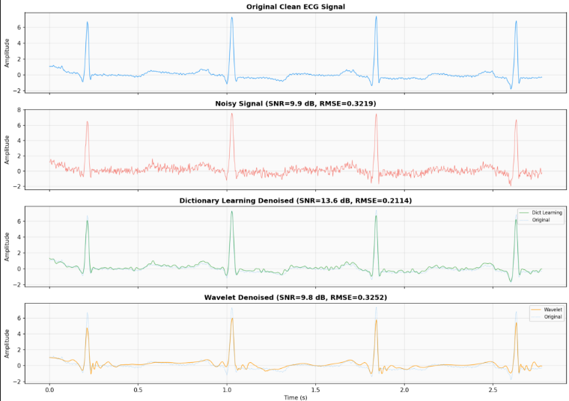
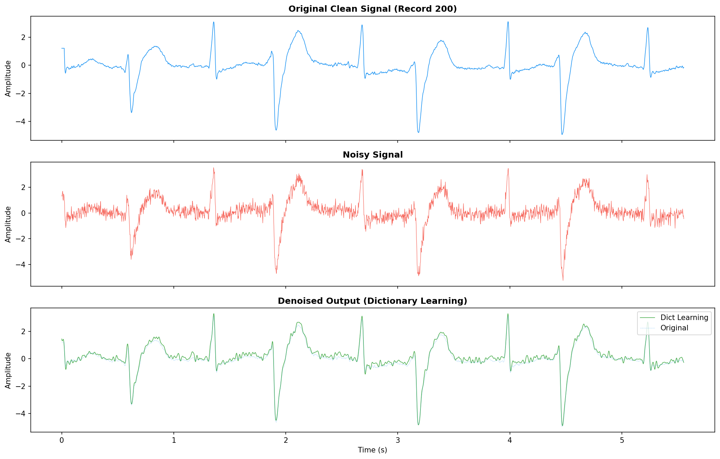
Inference Results: Signal Reconstruction
Clean → Noisy → Dict Learning denoised — 1000-sample window @ 360 Hz
13 / 18

Slide 14
Why Our Approach Wins
Sparse domain processing vs frequency-domain thinking
Property
Frequency Domain
(Butterworth / Wavelet)
Sparse Domain
(Our Pipeline)
Noise model
Assumes noise is spectrally separable
No assumption needed — noise ≠ cardiac atoms
QRS impact
Attenuates high-freq QRS components
QRS fully preserved — atoms explicitly capture it
Phase distortion
IIR filters shift peak timing
Zero phase distortion — no filtering involved
Patient-specific
One-size-fits-all frequency cutoffs
Dictionary trained on 47 real patients
Arrhythmia aware
No — fixed filter coefficients
Yes — 128 atoms include pathological morphologies
15 / 18

Slide 15
Future Direction 1: CNN-LISTA for Real-Time Denoising
Replace greedy OMP with a learned neural network — 100× faster inference
Motivation: OMP is a greedy iterative algorithm — it takes milliseconds per patch, making real-time inference on wearable ECG devices (e.g., Apple Watch, Holter monitors) infeasible. The LISTA network learns to produce OMP-quality sparse codes in a single forward pass.
Input
Patch
Conv1D
× W_e
Soft
Thresh.
Conv1D
× W_e
Sparse
Codes α
D · α
Recon
64-d noisy
window
Encoding
K × 64 atoms
ℓ₁ proximal
operator
Refine
iterations T
K non-zero
coefficients
Denoised
patch output
LISTA Training Loss
Key Benefits
L = ‖x_clean − D·α_θ(y_noisy)‖² + λ · ‖α_θ‖₁
✓ ~100× faster than OMP at inference
✓ Deployable on ARM Cortex-M microcontrollers
λ · ‖α‖₁ is the sparsity regularization term — forces the network to produce sparse codes that mirror OMP behavior, trained end-to-end via backprop.
✓ End-to-end learnable — dictionary and codes jointly
✓ TensorFlow Lite / ONNX export for wearables
16 / 18

Slide 16
Future Direction 2: 2D MRI Image Denoising Extension
Same Dictionary Learning framework applied to MRI patches — BraTS / IXI datasets
Framework extension: The same Dictionary Learning + OMP pipeline extends naturally to 2D images. Each MRI volume is split into overlapping 8×8 or 16×16 patches. A 2D overcomplete dictionary is learned from clean scans and used to remove Rician and Gaussian noise while preserving tissue boundaries.
Property
ECG (Current)
MRI (Extension)
Input
1D signal: x ∈ ℝᴺ
2D image: X ∈ ℝ^(H×W)
Patch size
64-sample window
8×8 or 16×16 pixels (64 or 256 dims)
Dictionary
D ∈ ℝ^(128×64)
D ∈ ℝ^(512×256) — 2D atoms
Noise model
Gaussian + BW + 50Hz
Rician noise (MRI physics) + Gaussian
Dataset
MIT-BIH 48 records
BraTS (brain tumors) / IXI (healthy)
Key challenge
QRS morphology preservation
Tissue boundary + fine anatomical detail
17 / 18

Slide 17
Pipeline Summary
① Multi-file loading with ADC→mV conversion and per-record normalization across 48 MIT-BIH patients
② Realistic 3-component noise model (Gaussian + baseline wander + powerline) at 10 dB SNR
③ K-SVD Dictionary Learning: 128 atoms, 64-sample windows, trained on 47 patient records
④ OMP sparse coding: each patch reconstructed from ≤10 dictionary atoms — noise structurally excluded
⑤ Dense stride-1 patch averaging: each sample averaged across 64 independent estimates (Non-Local Means analogy)
⑥ Results: SNR 22.4 dB (+12.4 dB vs noisy, +4.5 dB vs wavelet baseline), RMSE 0.0482, R² 0.942
18 / 18

