Slide 1
Employee Attrition Prediction Using Machine Learning
Presented By: Nishchal Raj Tuladhar

Slide 2
Introduction
Employee attrition refers to the loss of employees due to resignation, retirement, or termination.
High employee attrition can increase recruitment costs, reduce productivity, and affect organizational growth.
Machine Learning can help organizations identify employees who are likely to leave and take preventive actions to improve retention.

Slide 3
Problem Statement
Organizations often struggle to identify employees who may leave in the future.
Traditional HR methods rely on manual analysis, which is time-consuming and may not detect hidden patterns.
Therefore, an automated machine learning-based solution is needed to predict employee attrition accurately.

Slide 4
Objectives
To develop a machine learning model that predicts employee attrition.
To build a predictive model for HR decision-making.

Slide 5
Dataset Description
Dataset
IBM HR Analytics Employee Attrition Dataset
Dataset Characteristics
1470 employee records
35 attributes
No missing values
Target Variable
Attrition
Yes = Employee leaves
No = Employee stays

Slide 6
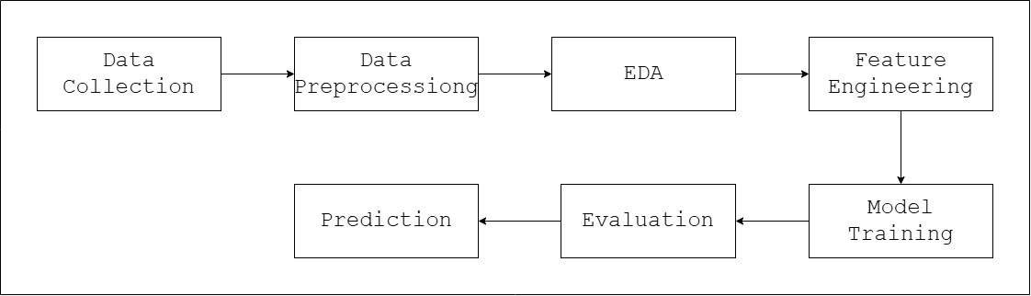
System Methodology
Fig : Block diagram of the system

Slide 7
System Methodology
Data Collection
The IBM HR Employee Attrition dataset was used for this project.
The dataset contains employee information such as:
Age
Department
Job Role
Monthly Income
Overtime
Job Satisfaction
Years at Company
Attrition Status

Slide 8
System Methodology
Data Preprocessing
Raw data cannot be directly used for machine learning.
The following preprocessing steps were performed:
Removed unnecessary columns
EmployeeCount
EmployeeNumber
Over18
StandardHours
Converted categorical values into numerical form
Converted Attrition:
Yes → 1
No → 0

Slide 9
System Methodology
Exploratory Data Analysis (EDA)
EDA was performed to understand employee behavior and identify important patterns.
Analysis included:
Attrition distribution
Department-wise attrition
Job-role-wise attrition
Overtime impact
Income analysis
Satisfaction analysis

Slide 10
System Methodology
Feature Engineering
New features were created to improve prediction performance.
IncomePerYear
SatisfactionScore
CareerGrowthRate
PromotionLag
OverTimeBinary

Slide 11
System Methodology
Data Splitting
The dataset was divided into:
Training Set → 80%
Testing Set → 20%

Slide 12
System Methodology
Model Training
Three machine learning models were trained:
Logistic Regression
Simple baseline classification model.
Random Forest
Collection of multiple decision trees.
Gradient Boosting
Sequential learning algorithm that improves prediction accuracy.

Slide 13
System Methodology
Model Evaluation
Models were evaluated using:
Accuracy
Measures overall correctness.
Precision
Measures correctness of predicted attrition cases.
Recall
Measures ability to detect actual attrition cases.
F1 Score
Balances precision and recall.
ROC-AUC
Measures overall classification capability.

Slide 14
Results and Discussion
Model Comparison (5-Fold Cross Validation)
Model | AUC Score
Logistic Regression | 0.7333 ± 0.0345
Random Forest | 0.7880 ± 0.0214
Gradient Boosting | 0.8055 ± 0.0260

Slide 15
Results and Discussion
Best Model
Gradient Boosting Classifier
Reason:
Highest AUC Score
Better predictive performance
Better generalization capability

Slide 16
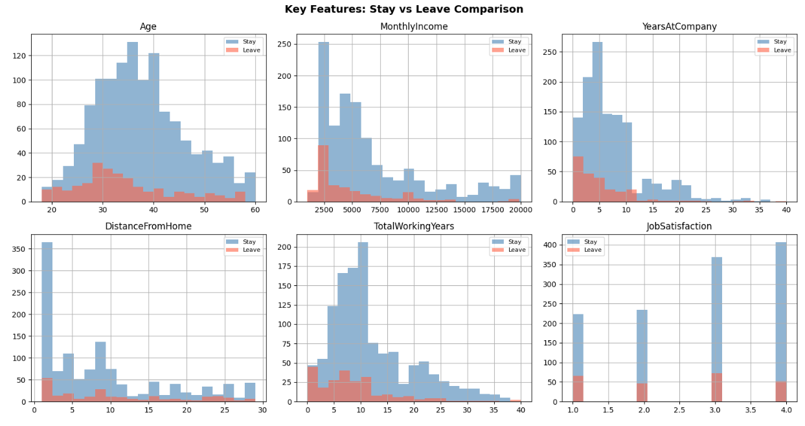
Results and Discussion

Slide 17
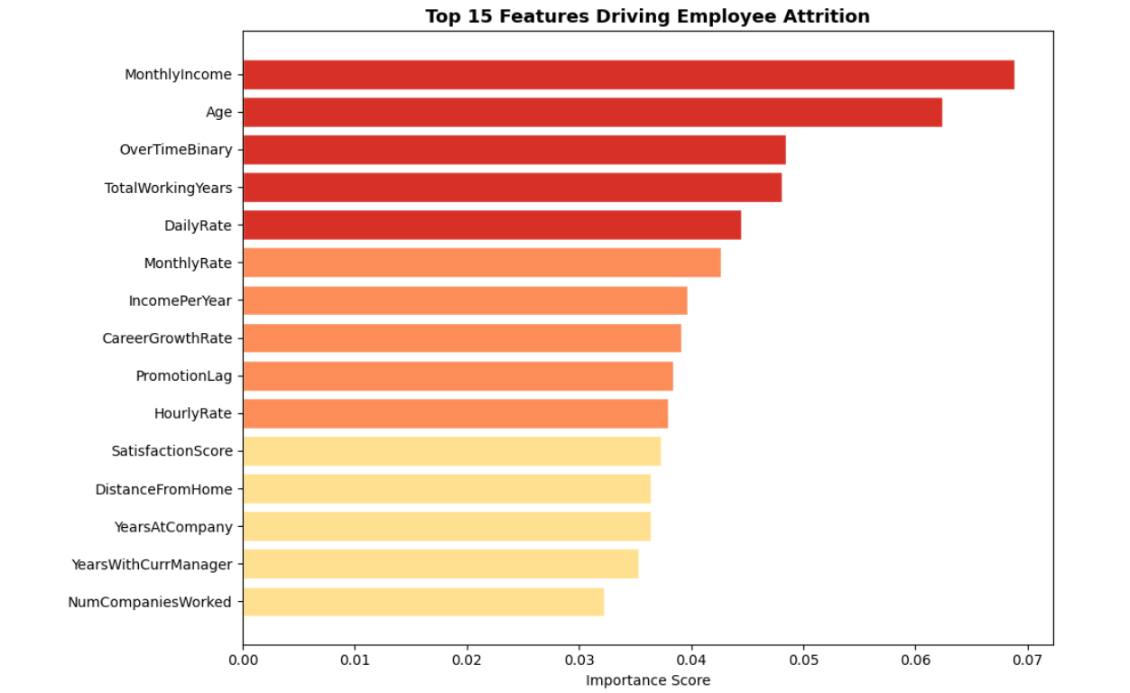
Results and Discussion

Slide 18
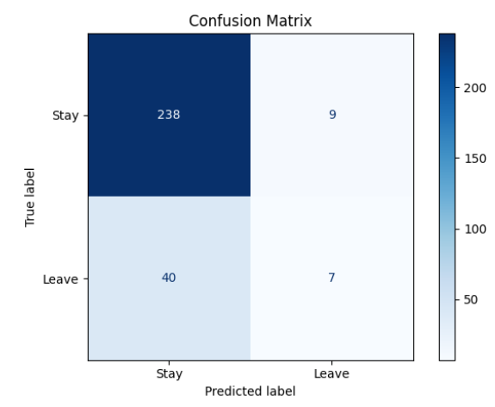
Results and Discussion
Fig: Confusion Matrix of the model

Slide 19
Results and Discussion
Evaluation Metrics
Accuracy = 83.3%
Precision = 43.75%
Recall = 14.89%
F1 Score = 22.22%
ROC-AUC = 78.68%

Slide 20
Conclusion
This project successfully developed an Employee Attrition Prediction System using Machine Learning.
Among the tested algorithms, the Gradient Boosting Classifier achieved the best performance with an AUC score of 0.8055 and an accuracy of 83.3%.
The study identified Monthly Income, Age, Overtime, Total Working Years, and Daily Rate as the most influential factors affecting employee attrition.
The developed system can assist HR departments in making proactive decisions to improve employee retention and reduce turnover costs.

