Slide 1
Wearable Sensor-Based
Sports Activity Recognition
AAI-540 · MACHINE LEARNING OPERATIONS
Predicting what someone is doing and how hard they are working from wrist, chest and ankle sensors and heart rate, delivered as a production ML pipeline on AWS SageMaker.
PAMAP2 dataset
9 subjects
18 activities
AWS SageMaker
Group 5 · Manideep Reddy, Nishchal P

Slide 2
Raw sensor streams don’t say what someone did, or how hard
THE PROBLEM
100 Hz
3.85M
Wearables output signal, not meaning. Training logs, safety monitoring and personalized feedback need an automatic read on what a person is doing and how intense it is, from the raw stream, without manual review.
SENSOR SAMPLING RATE
LABELED RAW ROWS
9
18
WHAT THE MODEL PREDICTS
Activity
18-class label per window
Intensity
light / moderate / vigorous
SUBJECTS, SO GENERALIZATION IS THE HARD PART
LABELED ACTIVITIES
Primary metric: macro-F1. Class imbalance (transient activity dominates) makes plain accuracy misleading.
Supervised multi-class classification on multivariate time series (Human Activity Recognition).

Slide 3
PAMAP2: a well-benchmarked, multimodal activity dataset
Attribute | Detail
Source | UCI ML Repository (id 231), DOI 10.24432/C5NW2H
Volume | 3,850,505 instances, 54 columns, about 656 MB
Coverage | 9 subjects, 18 labeled activities
Sensors | Accelerometer, gyroscope, magnetometer on hand / chest / ankle IMUs, plus heart rate
Sampling | 100 Hz IMU, about 9 Hz heart rate
Files | Space-separated .dat, one per subject per session (Protocol and Optional)
License | CC BY 4.0; pseudonymous subject IDs 101–109; heart rate treated as health data
WHY THIS DATASET
One of few public wearable sets that is fully labelled across sports and daily activities
Heart rate alongside 3 IMUs links movement to exertion
Published results near 0.85 macro-F1 give a clear target
Limitation: 9 lab subjects, mostly young adults, only 1 female. Disclosed in the risk section.

Slide 4
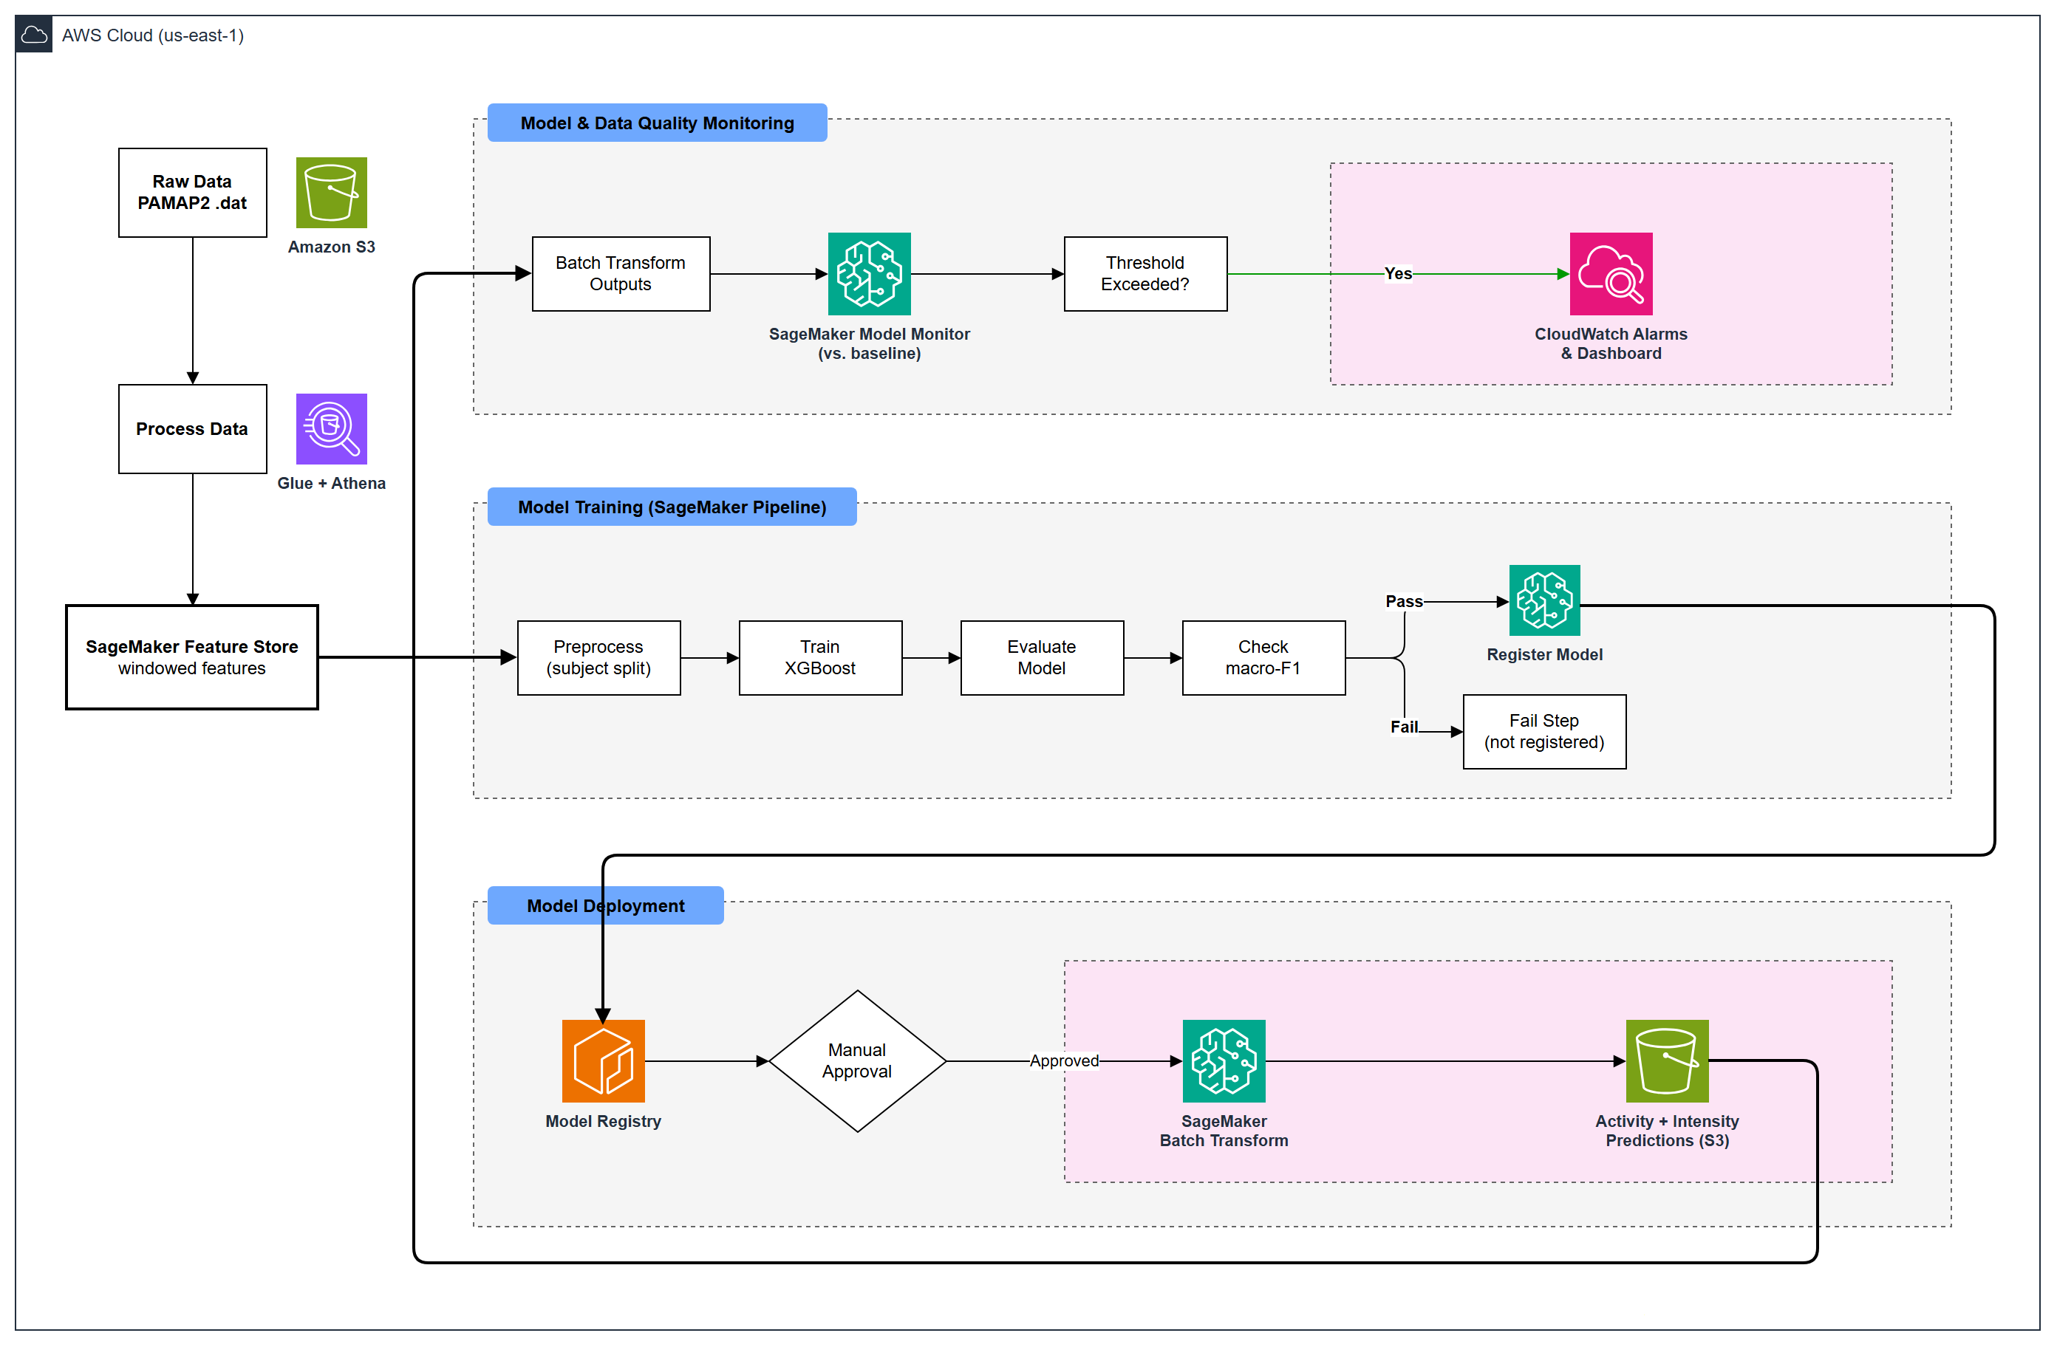
Solution architecture on AWS SageMaker

Slide 5
Data engineering: from raw files to model-ready windows
1 Ingest
2 Clean
3 Window
4 Label
Parse 54 columns against a fixed schema, drop 12 invalid orientation columns, land raw .dat and curated Parquet in S3
Forward-fill / interpolate sparse heart rate (~91% missing at 100 Hz), split sessions at gaps > 0.1 s
512 samples (5.12 s), 50% overlap: 10,639 windows across 14 subject-session files
Majority-vote activity per window; windows labelled transient (0) dropped
EXPLORED WITH ATHENA
WINDOW GEOMETRY
Class distribution: transient activity 0 is 1.13M of 3.85M rows; per-subject activity coverage; heart-rate missingness
Findings drove two decisions: drop the transient label, and use macro-F1 because several activities are missing for some subjects
512 samples × 100 Hz = 5.12 s per window, stride 256 = 50% overlap

Slide 6
Features and the intensity mapping
128 FEATURES PER WINDOW
Light (< 3 METs)
21 motion channels × 6 stats (mean, std, min, max, energy, dominant frequency) + HR mean and max
±16g accelerometer (x, y, z, magnitude) and gyroscope (x, y, z) at hand, chest and ankle
Heart rate forward-filled across gaps
Excluded: orientation, ±6g accelerometer (saturates), magnetometer, temperature, subject ID
lying, sitting, standing, watching TV, computer work, car driving, ironing, folding laundry
Moderate (3 to 6 METs)
walking, cycling, descending stairs, vacuum cleaning, house cleaning
Why frequency features: dominant frequency separates periodic activities (walking, running, rope jumping) from static ones that look similar in mean and variance.
Vigorous (> 6 METs)
running, Nordic walking, ascending stairs, playing soccer, rope jumping

Slide 7
Feature Store and the train / test / production split
FEATURE GROUP: PAMAP2-HAR-WINDOWS
CHRONOLOGICAL SPLIT PER SUBJECT + ACTIVITY (WINDOWS)
Record identifier window_id, event time event_time; 10,639 records ingested
Offline store only (batch system), queried through Glue / Athena
Latest record per window via a de-duplication window function
Deterministic split, one gap window at each boundary (318 dropped)
SELECT * FROM (
SELECT *, ROW_NUMBER() OVER (
PARTITION BY window_id
ORDER BY event_time DESC) rn
FROM offline_table) WHERE rn = 1

Slide 8
Modeling approach: a benchmark first, then a real model
Benchmark
XGBoost (production)
Planned next
Depth-3 decision tree
2 features: chest acceleration std, mean heart rate
Plus a majority-class floor (0.012 macro-F1)
Minimum viable baseline to beat
Built-in XGBoost 1.7-1, multi:softprob, 18 classes
500 rounds, early stop 20, max depth 6, eta 0.1
Debugger rules: LossNotDecreasing, Overfit, ClassImbalance
Trained on ml.m5.xlarge inside the pipeline
Hyperparameter tuning step on validation macro-F1
1-D CNN / LSTM on raw windows
Leave-one-subject-out as the gate metric
Register whichever model scores higher

Slide 9
Results: XGBoost clears the gate by a wide margin
0.871
0.881
MACRO-F1 (TEST)
ACCURACY (TEST)
+0.587
0.85
LIFT OVER BENCHMARK
GATE THRESHOLD
Train merror 0.0002 vs validation merror 0.089. Debugger flagged ClassImbalance and LossNotDecreasing; Overfit passed. Test subjects also appear in training, so the number is optimistic.

Slide 10
CI/CD pipeline: the gate fails closed
Successful run: score above threshold, model registered and scored
Preprocess
Splits
Train
Model
Evaluate
Model
Check
Macro-F1
Register
Model
Create model +
Batch Transform
Post-process
Predictions
→
→
→
→
→
→
Forced-fail demo (threshold 0.999): gate fails by design
Preprocess
Splits
Train
Model
Evaluate
Model
Check
Macro-F1
MacroF1Below
Threshold (Failed)
Register, Transform, Post-process
skipped, nothing published
→
→
→
→
→
Logged reason: “Test macro-F1 is below MacroF1Threshold 0.999”

Slide 11
Model registry and model card
Version | Approval status | Test macro-F1 | Origin
2 | Approved (manual) | 0.8715 | SageMaker Pipeline (passed gate)
1 | PendingManualApproval | earlier run | SageMaker Pipeline (passed gate)
Model package group pamap2-har-xgboost
Metrics attached
Two gates
Model card
test macro-F1 and accuracy, benchmark macro-F1, train / validation merror, training job and eval report link stored with every package
Automated macro-F1 ≥ 0.85 in the pipeline, then a person moves the version from PendingManualApproval to Approved
pamap2-har-xgboost-card: intended use, training and evaluation details, SHAP, ethical caveats; status mirrors the registry

Slide 12
Batch inference: a prediction for every production window
window_id | subject_id | activity_name | intensity | confidence | true_activity_id
106_optional_1152 | 106 | ascending stairs | vigorous | 0.94 | 12
106_optional_1408 | 106 | walking | moderate | 0.88 | 4
106_optional_1664 | 106 | sitting | light | 0.97 | 2
Illustrative rows showing the schema of predictions.parquet (4,156 rows in the latest run)
Score
Enrich
Monitor
Batch Transform runs the gated model over the 40% production split (4,156 windows)
Post-processing joins probabilities to label map, activity name and MET intensity
True labels kept alongside predictions so model quality can be tracked

Slide 13
Monitoring: data, model, pipeline and infrastructure
Data quality
Baseline from training features, checked against production. 0 violations.
Model quality
Macro-F1 0.836 vs 0.871 baseline (drop 0.036 < 0.05); 5 weighted-metric violations flagged.
Pipeline
Execution status and failed steps, including the forced-fail run.
0
0.036
OK
Infrastructure
Metrics Insights alarms on every job: CPU > 95%, memory > 90%, disk > 85%; pamap2-har-ml dashboard.
DATA VIOLATIONS
MACRO-F1 DROP
BELOW 0.05 LIMIT
Production windows share subjects with training, so this is an optimistic read.

Slide 14
Difficult issues we hit during development
WHAT WAS HARD
RISKS TO FUTURE DEVELOPMENT
Getting a managed-services pipeline to work end to end inside a restricted lab account, and keeping the evaluation honest with only nine subjects.
Scalability
Batch only today
real-time endpoint + auto-scaling for live coaching
HOW WE HANDLED IT
Technical
Seen-subject scores
Clarify rejected CreateProcessingJob in this account → exact TreeSHAP with XGBoost pred_contribs
Feature Store offline table lags ingestion by minutes → poll and verify record counts before splitting
Overlapping windows could leak across splits → one-window gap at every boundary
Shared LabRole, SDK v2 deprecations, no hosted CI → notebooks call one tested src/pamap2 library
LOSO likely lower than 0.871; train/val gap
Ethical
Health data, small cohort
bias across age, sex, body type; re-identification

Slide 15
Risks, ethics and next steps
Data and evaluation
Ethics and privacy
Future improvements
9 lab subjects, mostly young adults, 1 female
Gate uses a seen-subject split; LOSO is the planned gate
Class imbalance, so macro-F1 and per-class reports
Fitness estimate only: no medical, insurance or hiring use
Not for identifying people from gait or heart rate
Heart rate is health data under CCPA / GDPR Art. 9; data is pseudonymous, not anonymous
LOSO gate + more diverse data, per-user fine-tuning
HPO step, 1-D CNN / LSTM, HR-based intensity
GitHub Actions CI, EventBridge retraining on alarms, real-time endpoint
KMS, least-privilege IAM, CloudTrail, per-subject deletion

Slide 16
What we built
Reproducible
Gated
Cloud pipeline from raw files to registered model
macro-F1 threshold blocks bad models
Observed
Honest
Data, model, pipeline and infrastructure monitors
Seen-subject limits stated, LOSO planned as the gate
Group 5 · AAI-540

