Slide 1
PES UNIVERSITY DBMS PROJECT
TOPIC : BANKING DATABASE MANAGEMENT SYSTEM
TEAM MEMBERS :
NISHCHAL M N PES1201701523
HITESH KUMAR PES1201701511
SURAJ MM PES1201701551

Slide 2
COMPARSION WITH REAL WORLD EXAMPLE :
Similar to other bank Database, our bank provides login and sign up facilities using customer ID.
Our Database provides the entire transaction report of the customer.
One customer ID can have multiple bank accounts.
We provide account to account money transfer, wallet option and card.
We have account number, ccv, Customer ID this make the database more secure.

Slide 3
Wallet facility : A simple virtual wallet can be provided to the customer to which the money can be added from the respective bank account. This is easier to use compared to the already existing net banking facility which requires more security check ups.
This also helps in cashless transactions because, whenever required a small amount of money can be added to the wallet and can be used for various purposes. This features can also be used to transfer amount from wallet to wallet or wallet to bank account.
The above mentioned wallet facility is not provided by the real world bank.
Money transfer is easier, we have provided money transaction option in our UI.

Slide 4
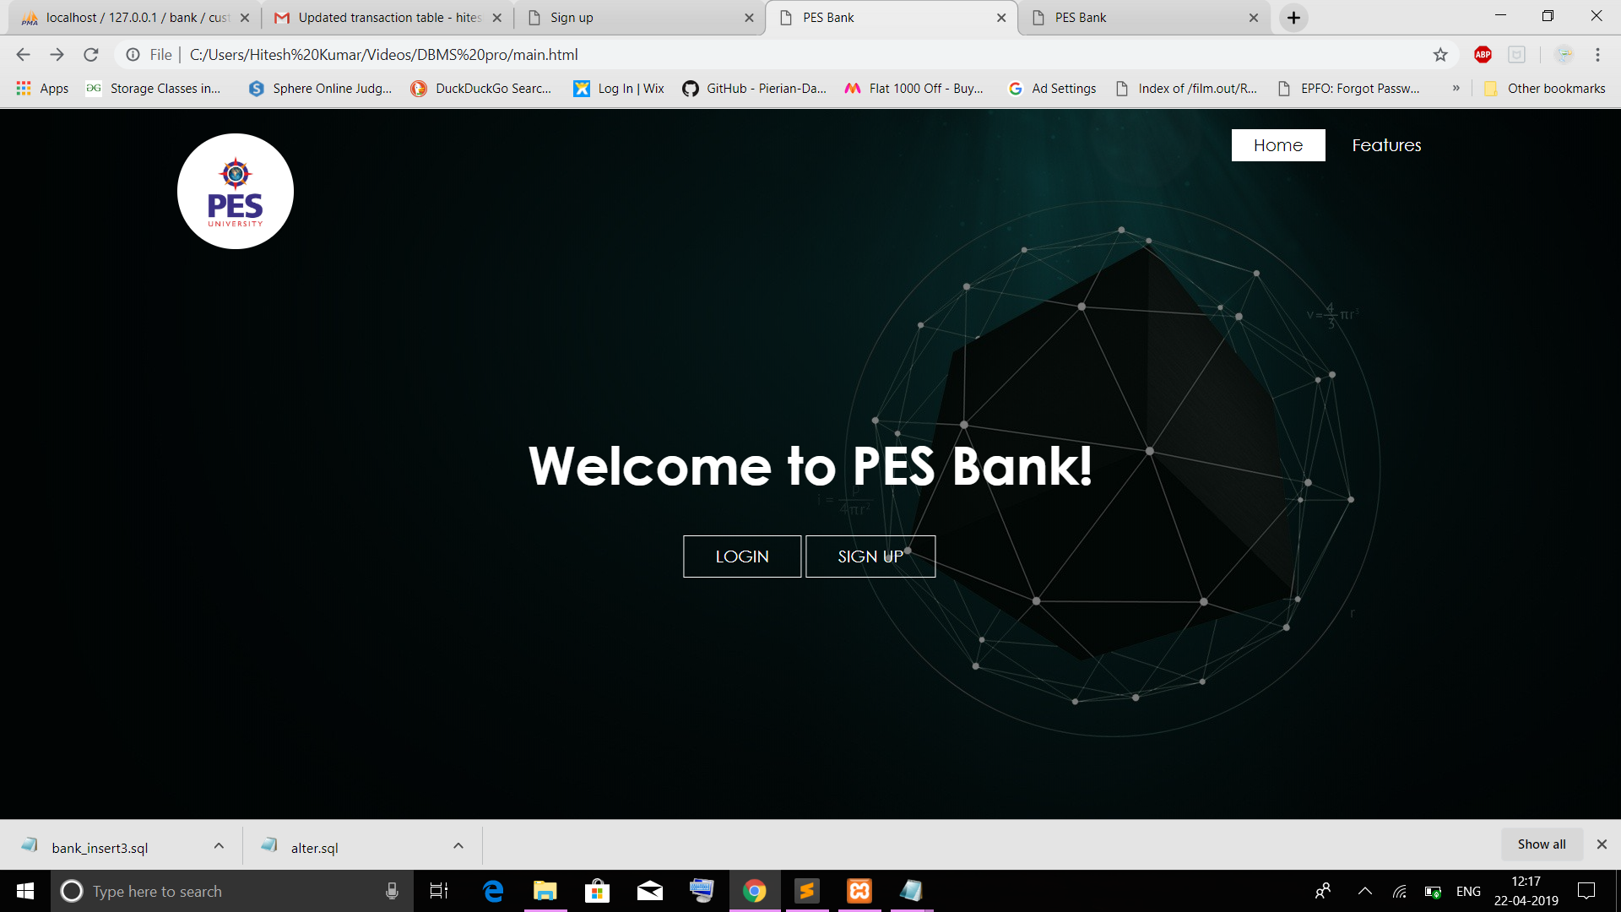
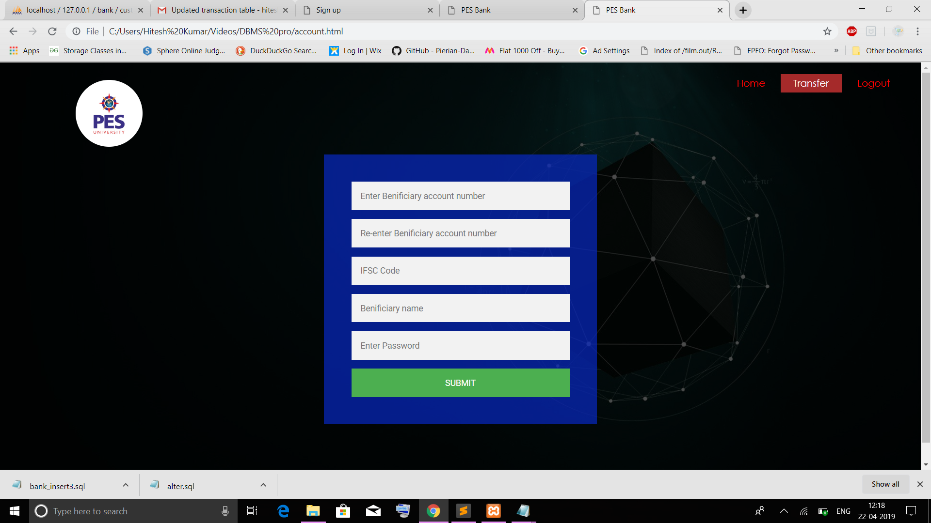
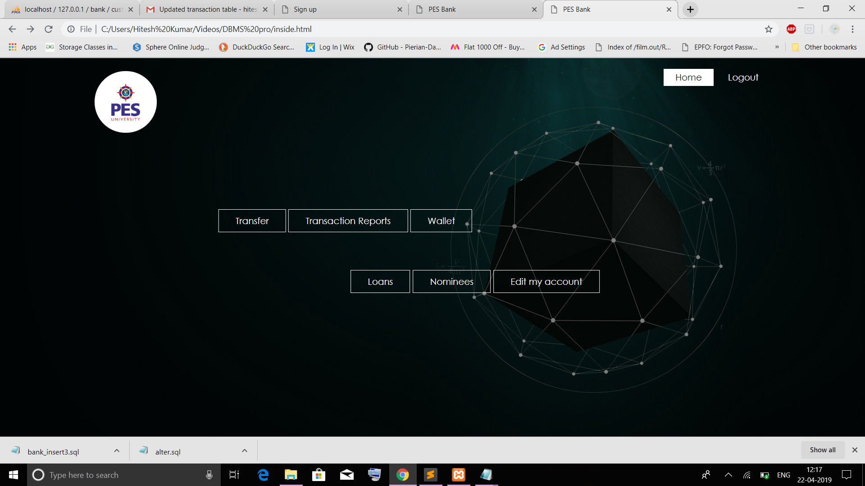
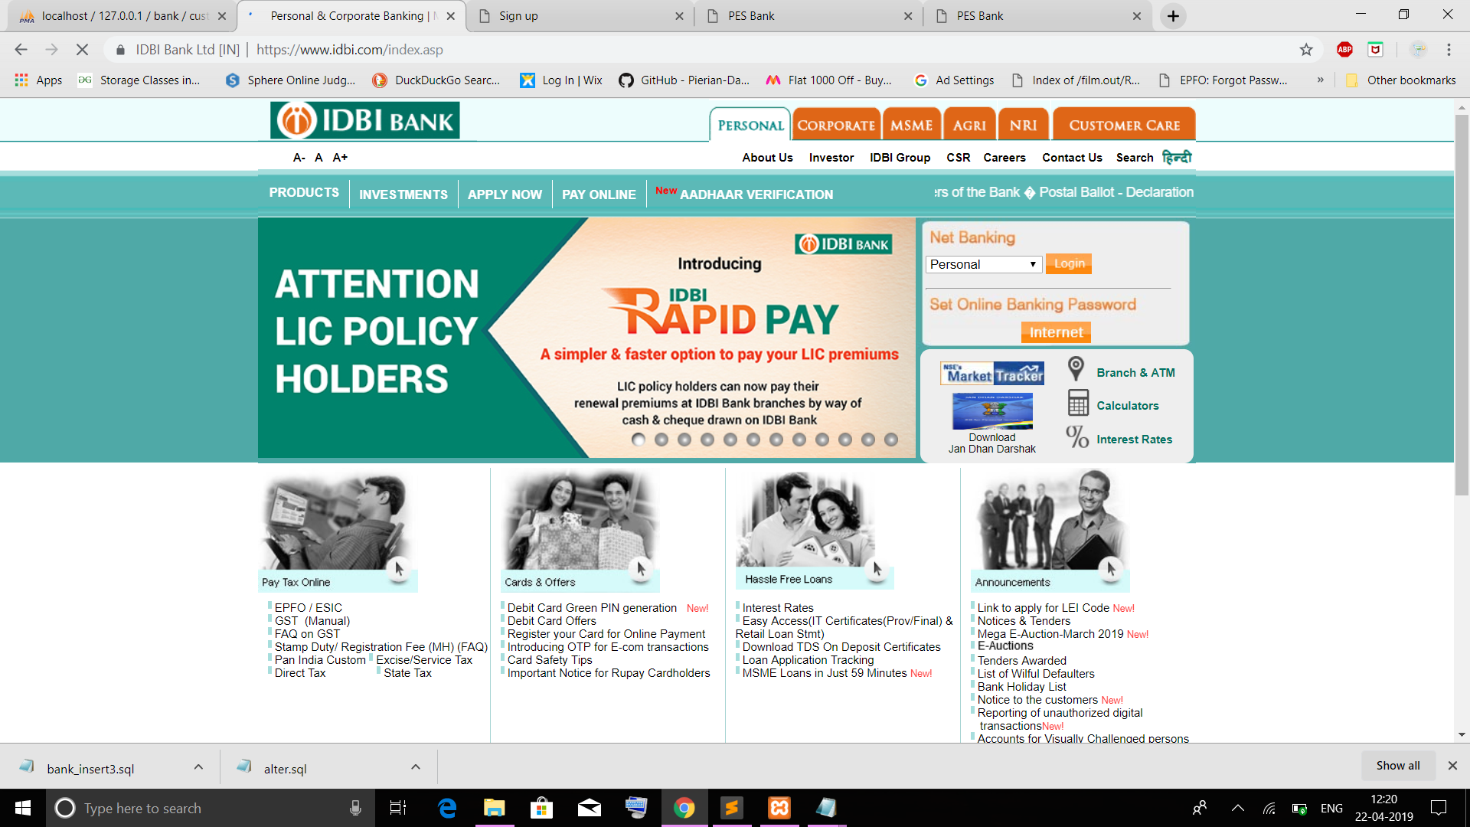

Slide 5
PROBLEMS CREATED IN DBMS :
1. TRANSACTION MANAGEMENT:
In this dbms the major problem faced is transaction management.
EXAMPLE :
When there is a transfer of money from one account to the other ,the money should be deducted from the first account and added into the second account , in case if the amount from the first account is deducted and not added into the second account , this leads the database into inconsistent state.
This problem can be resolved by either by committing i.e if all the operations are competed successfully then commit those changes to the database permanently or by Rollback i.e if any of the operation fails in Rollback all the changes done by the previous operations.

Slide 6
CONCURRENCY WHEN MUTIPLE TRANACTIONS ARE DONE SIMUNTANEOUSLY:
EXAMPLE 1 : When customer access both wallet and card at the same time lead to simultaneous access of the same account.
Example 2 :
when one of the user deposits money and other transfers it. This kind of concurrency is important because its all about multiple users accessing data at the same time without causing inconsistencies.
This could be overcome by queuing the transaction and process them in sequence.

Slide 7
THANK YOU ☺

