Slide 1
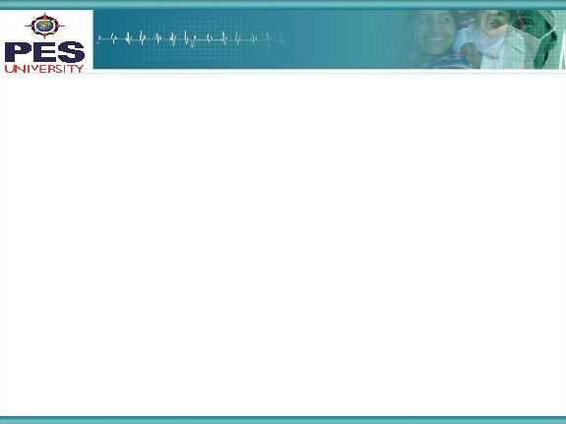

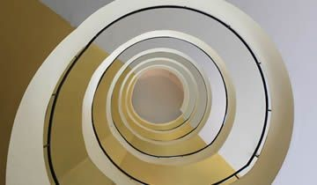
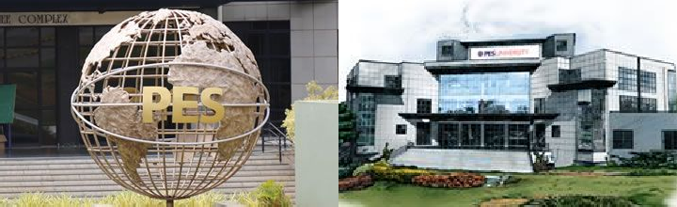
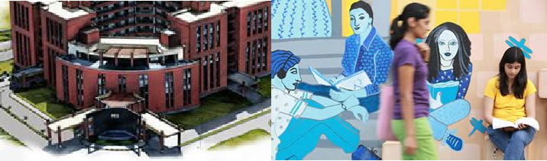

Project Presentation
(Final - ESA)
Project Title :
Image Inpainting using Convolutions and Transposed Convolutions
Project Team : Nishchal MN - PES1201701523
Hitesh Kumar - PES1201701511
Keerthan G - PES1201700963
Nahusha Acharya - PES120700044
‹#›

Slide 2
Project Abstract and Scope
Image inpainting is the process of reconstructing missing parts of an image so that observers are unable to tell that these regions have undergone restoration.
This technique is often used to remove unwanted objects from an image or to restore damaged portions of old photos.
Not only for old photos, but this can be used to get clear satellite image while tracking criminals by removing occlusions if any.
This problem is unique and not many models are available for this. The available models are either GAN based, or image processing methods.
There isn’t a transposed convolutions method to this problem and this is an approach using tensorflow.
‹#›

Slide 3
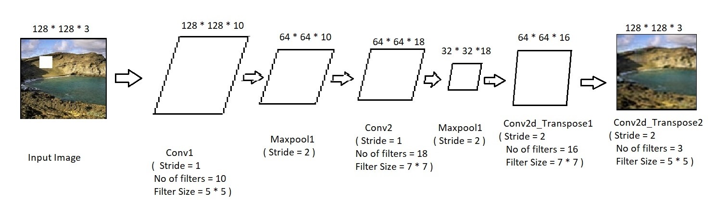
Solution Architecture
Our Architecture Model
‹#›

Slide 4
Solution-1
Dataset Description
Our model needed a dataset with images which were having artifacts or occluders in them along with the original images, which was not available in the internet for our use.
So, we took a particular scenario like mountain landscapes and we built the dataset on our own by removing certain parts of the image and saving a new copy of them as we have shown in the future slides.
We used OpenCV and numpy as the main sources for preparation of the dataset which has 3000 training and 300 testing colored images of size 128*128*3 .

Slide 5
Solution-2
Algorithm and Math
Our model is based on a series of convolutions followed by transposed convolution layers.
Input image is of shape 128*128*3 which is introduced to the first convolutional layer with 10 filters each of size 5*5 with ReLU activation function which is fed into Maxpooling layer with stride 2.
The resulting image will be of shape 64*64*10 and this will be passed to another convolutional layer with 18 filters of size 7*7 with ReLU and Maxpooling layer same as above. The resulting image will be of shape 32*32*18 .

Slide 6
Solution-3
This small sized image is then fed into the Transposed Convolution layer with stride 2 and 16 filters of size 7*7 each where the weights are trained and the resulting image will be of size 64*64*16 .
The resulting image is passed to the final Transposed Convolution layer with stride 2 and 3 filters of size 5*5 which also has the corresponding weights which are trained and then we get the final output image of shape 128*128*3 along with the restored part which almost looks like the original image but without the missing part.

Slide 7
Solution-4
After the model is built with the described architecture, it is compiled with the mean absolute error loss function which is suitable when dealing with images along with the popular Adam optimiser with learning rate 0.001
Our model is trained over 200 epochs with batch size of 32 images which is fed with the training images input and the loss training loss is calculated to be around 3.42 after the 200th epoch which is a great result as the model gave out the images in which it was almost difficult to figure out where the missing part in the image is.

Slide 8
Constraints, Assumptions & Dependencies
Unlike other solutions like image processing methods, where they fill in the parts based on the help of surrounding pixels alone and without prior understanding
of the scenario, they did not achieve great results.
GANs on the other hand need a lot of training time and also testing time because they generate new images which is also a method used by NVidia.
But our model understands the scenario in which the filling needs to take place as it has learnt to do so with the help of the trained filters which has seen the scenarios like that before and accordingly give out the output image which gave better results than other existing methods.
‹#›

Slide 9
Future work plan
Due to unavailability of dataset on the internet, we have trained only on the images that we have generated, so if we get any large dataset for our purpose, then we will train on that and can achieve better results.
We have trained and tested on a particular type of scenario which is mountain landscapes here. In future, we will try to generalize the model to different types of scenarios.
Also, the images are a bit blurry compared to the original image due to less training time and data, which can be improved if we train with a larger dataset for more time.
‹#›

Slide 10
References
https://ieeexplore.ieee.org/document/7544859
http://ieeexplore.ieee.org/document/7034008/
https://towardsdatascience.com/image-inpainting-humans-vs-ai-48fc4bca7ecc
https://www.nvidia.com/research/inpainting/
https://www.cse.unr.edu/~bebis/CS474/StudentPaperPresentations/imageinpainting.pdf
https://arxiv.org/pdf/1909.06399
https://www.kaggle.com/puneet6060/intel-image-classification#1000
https://www5.cs.fau.de/research/data/image-manipulation/

Slide 11
Thank You

