Slide 1


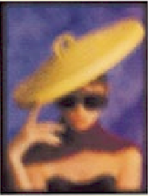
The Approximate GCD
of Inexact Polynomials
Z. Zeng and B. H. Dayton
Northeastern Illinois University, USA
ISSAC ’04, Santander, Spain, July 6, 2004

Slide 2
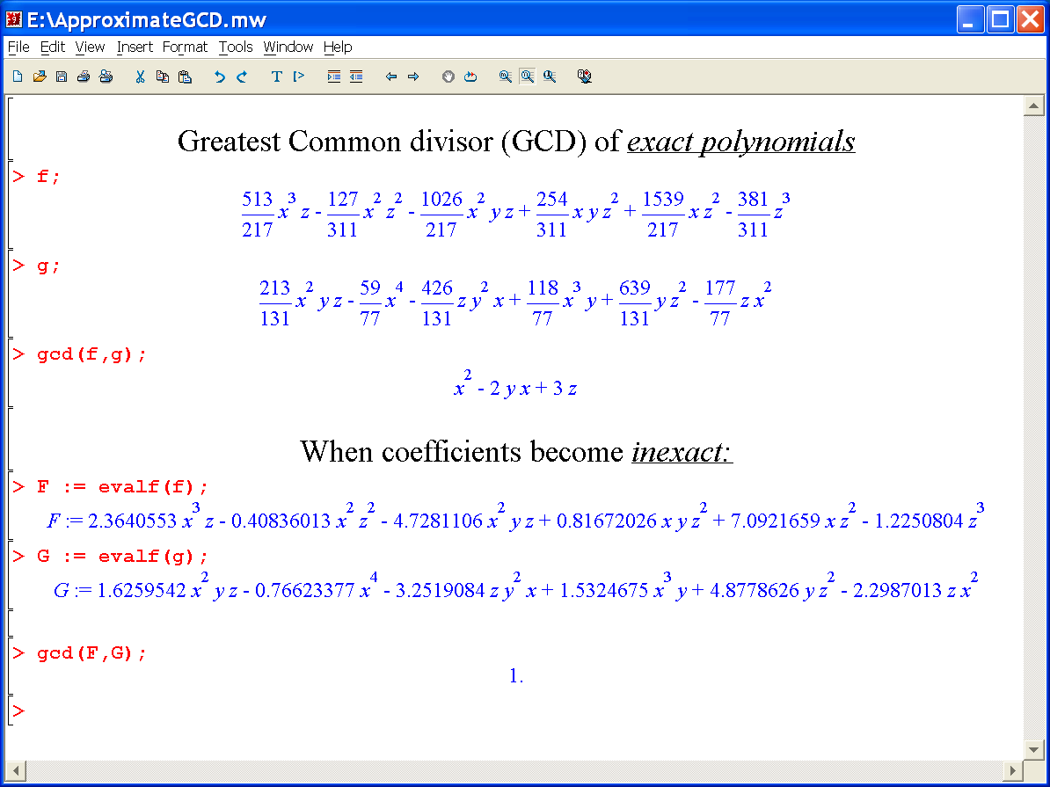
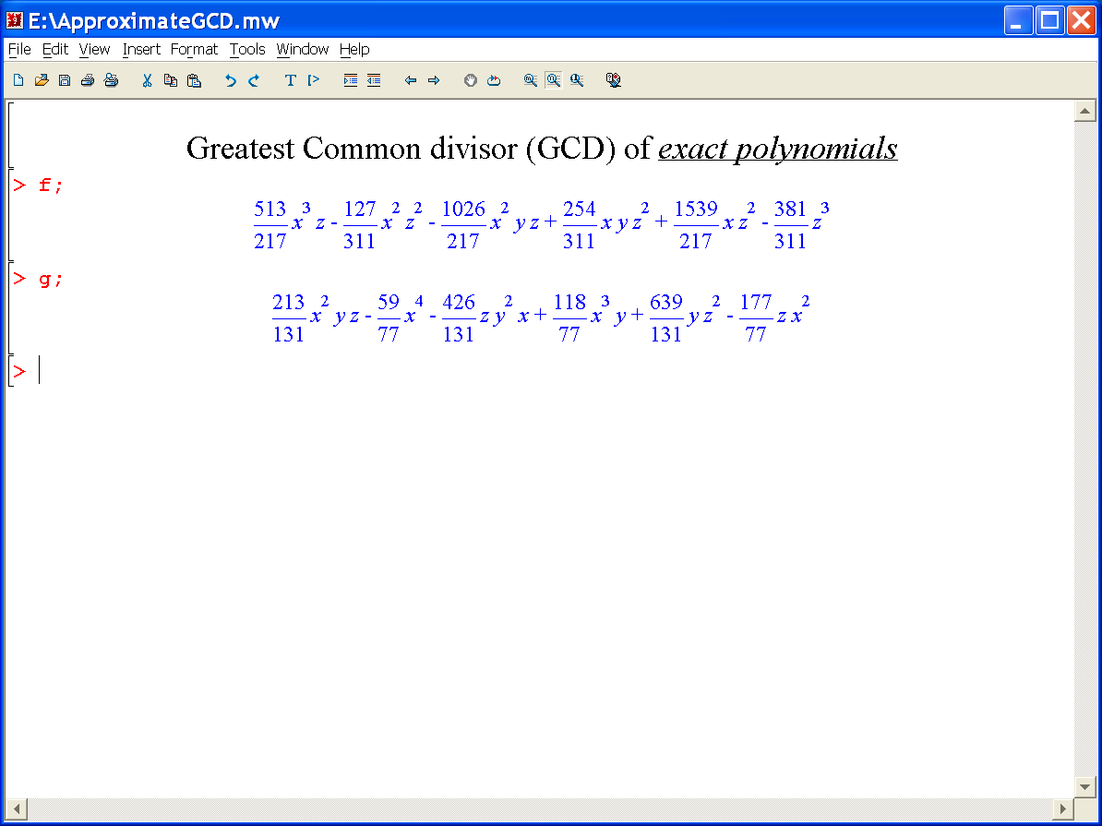
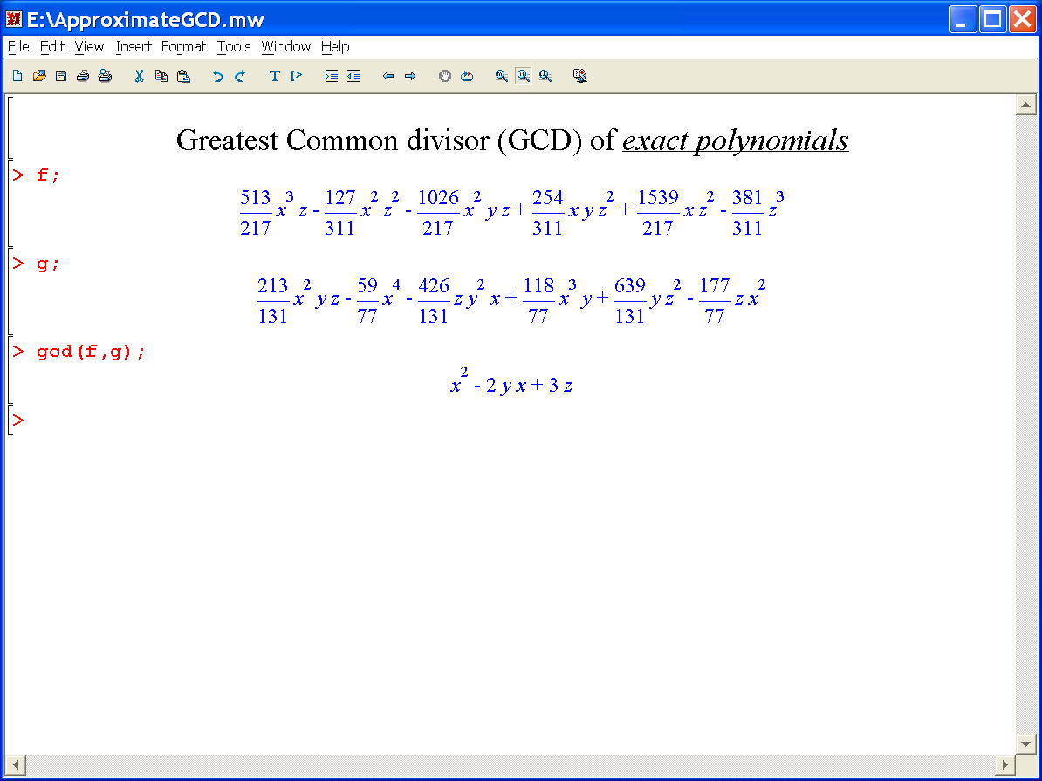
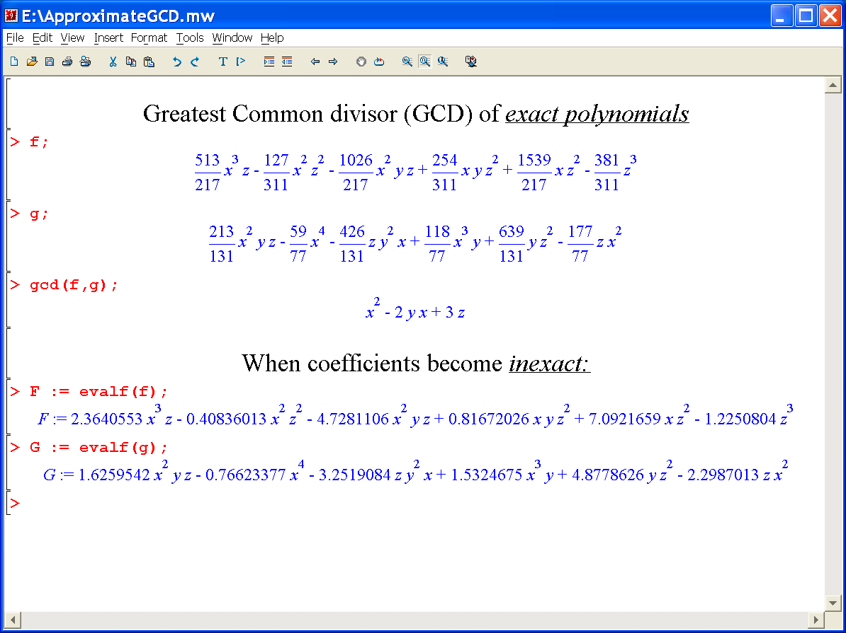

Slide 3



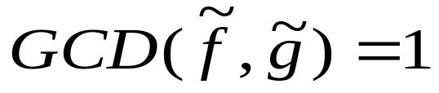
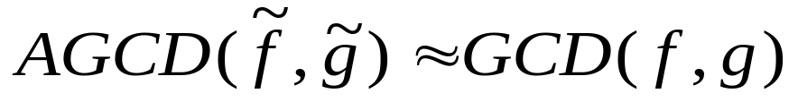
Computing exact GCD is an ill-posed problem
Objective: Computing the approximate GCD , or AGCD
2/29

Slide 4

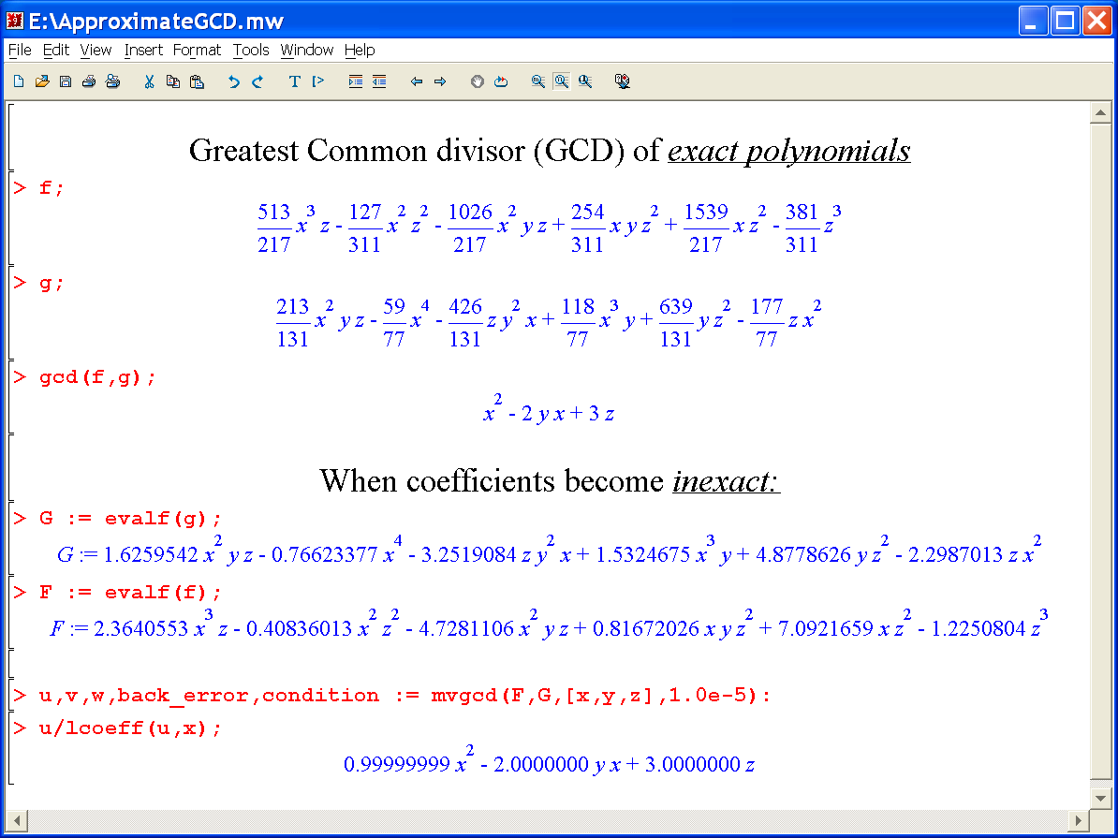

Slide 5
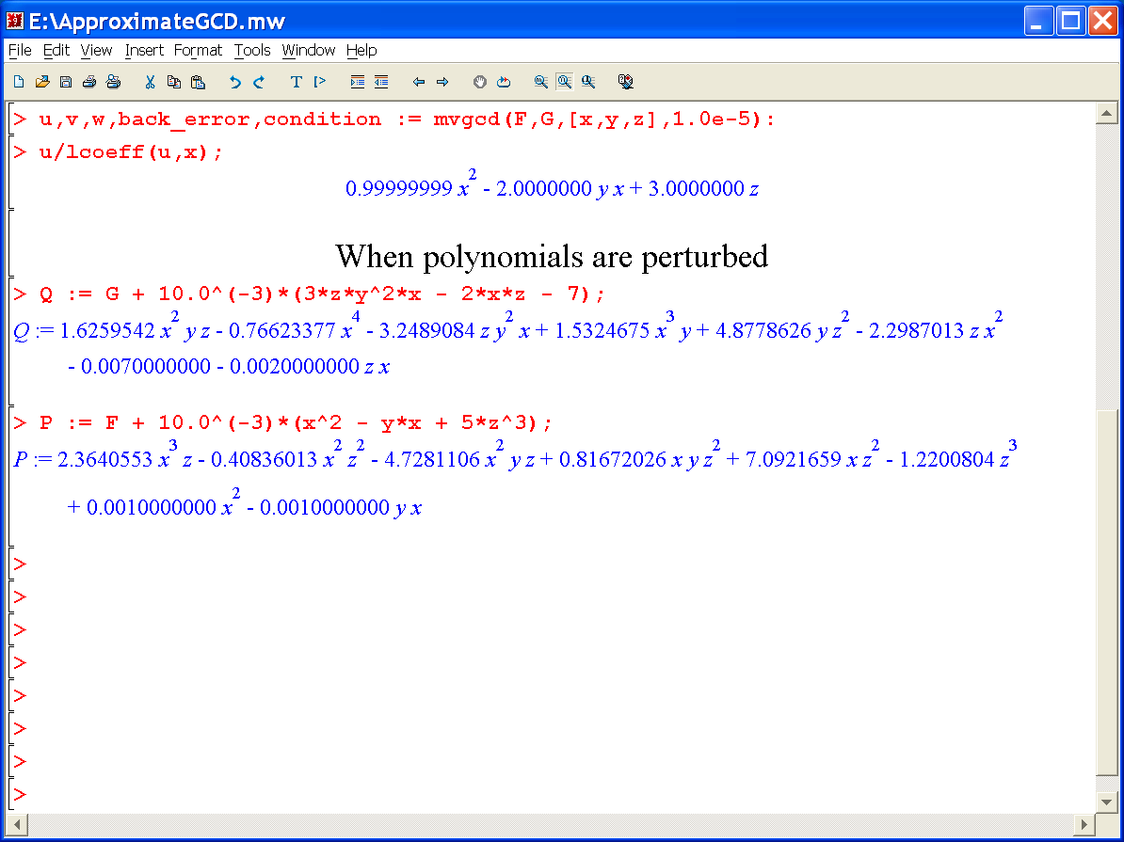
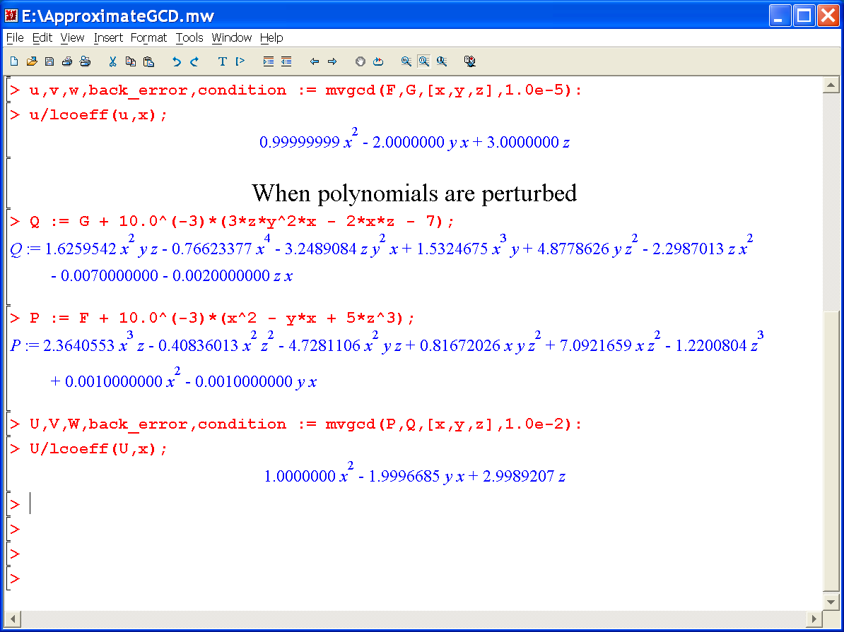
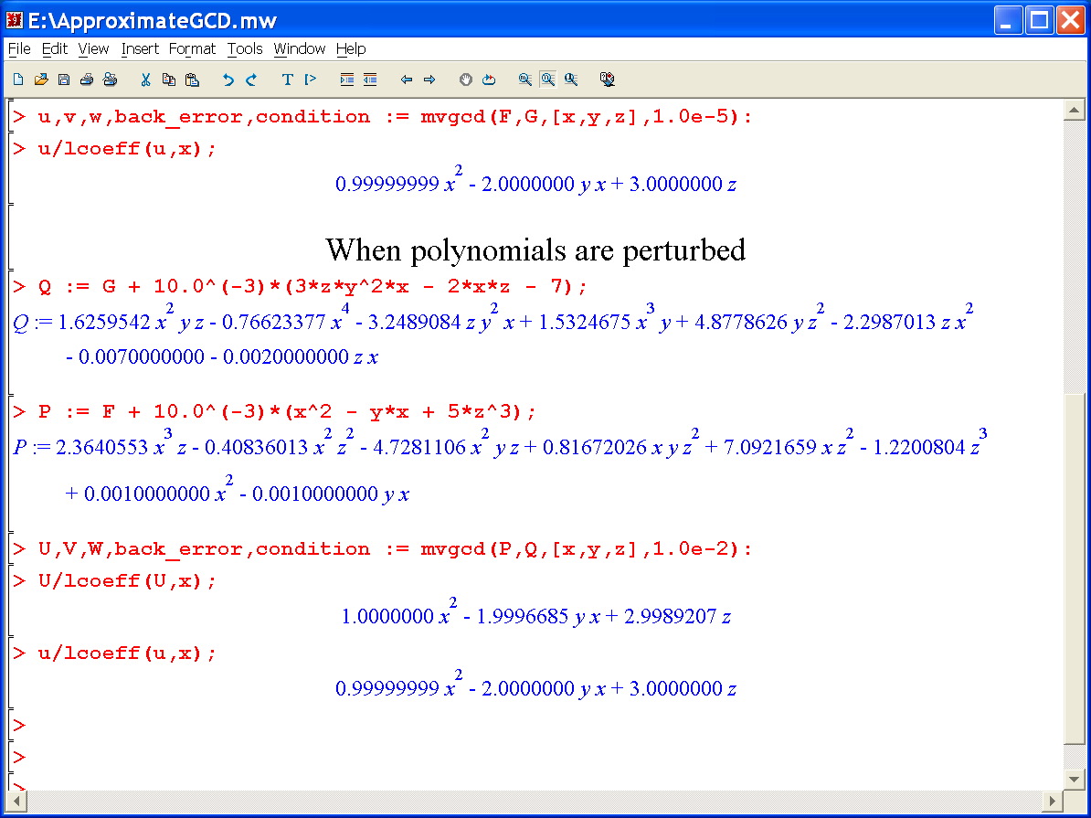


Slide 6
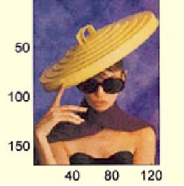
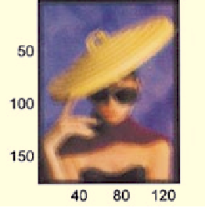
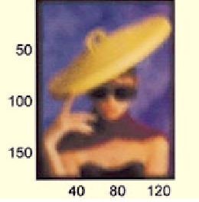



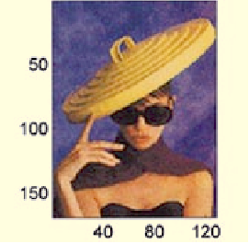


Application: Image restoration (Pillai & Liang)
true image
blurred image
blurred image
restored image
6/29

Slide 7
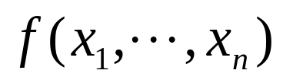
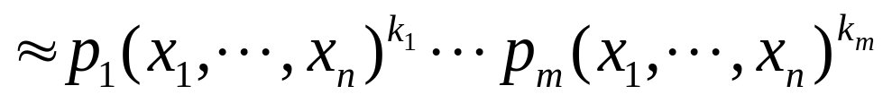
Application: Approximate polynomial factorization
(Gao, Kaltofen, May, Yang, Zhi)
Open challenge #1 in symbolic computation (Kaltofen)
irreducible
Approximate irreducible factorization
A prerequisite: an approximate squarefree factorization (ASFF)
(Gao-Kaltofen-May-Yang-Zhi, Corless-Giesbrecht-Hoeij-Kotsireas-Watt, et al)
--- A typical application of AGCD
The finishing step: Calculating AGCD (Gao-Kaltofen-May-Yang-Zhi)
Gao-Kaltofen-May-Yang-Zhi developed their own AGCD algorithm
7/29

Slide 8

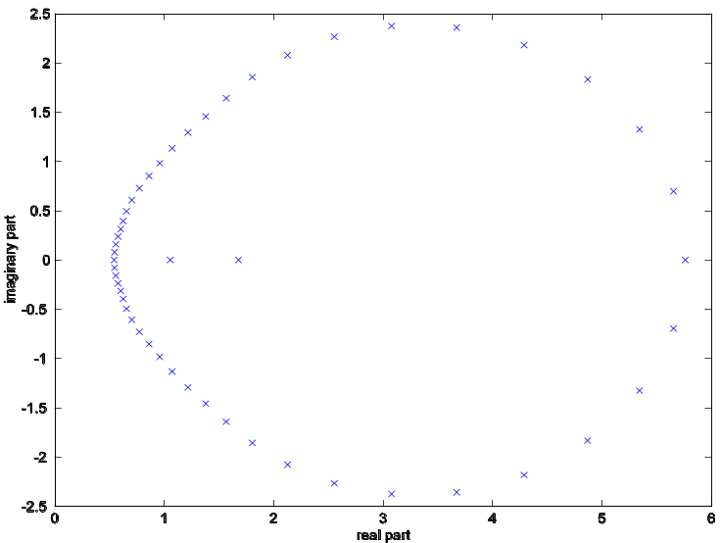
Application: Finding polynomial roots and multiplicity
(Z. Zeng)
MultRoot results:
The backward error: 6.16 x 10⁻¹⁶
Computed roots multiplicities
1.000000000000000 20
2.999999999999997 15
3.000000000000011 10
3.999999999999985 5
ACM TOMS, 2004
AGCD is the key :
“Computing multiple roots of inexact polynomials”,
Z. Zeng, ISSAC 2003
8/29

Slide 9
Wilkinson’s Turing Award (1970):
However:
A numerical algorithm
seeks the exact solution
of a nearby problem
Ill-posed problems
are infinitely sensitive
to data perturbation
Conclusion: Numerical computation is incompatible
with ill-posed problems.
Solution: Ask the right question.
9/29

Slide 10




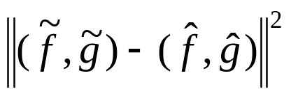
-- space of polynomial pairs
perturbed polynomial pair
original polynomial pair
computed polynomial pair
manifold
Minimize
--- a least squares problem
10/29

Slide 11
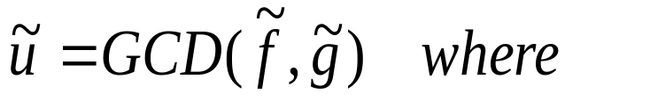
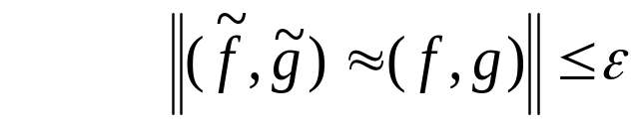

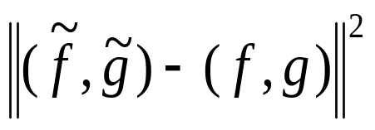
AGCD-finding in principle:
- nearness: find
- max-degree:
is maximal
- min-distance:
is minimal
11/29

Slide 12
Recent history of univariate AGCD:
Methods:
- Euclid : Beckermann-Labahn, Hribernig-Stetter …
Resultant: Corless-Gianni-Trager-Watt, Emiris-Galligo,
(SVD, QR) Rupprecht, Corless-Watt-Zhi, …
Optimization: Corless-Gianni-Trager-Watt, Chin-Corless-Corless,
Karmarkar-Lakshman, …
Root-matching: Pan, Verschelde-Wang, …
Software:
EpsilonGCD: Beckermann-Labahn
QuasiGCD: Beckermann-Labahn
QRGCD: Corless-Watt-Zhi
(Maple SNAP Package)
12/29

Slide 13
Recent History of multivariate AGCD
Methods:
PRS Sasaki-Sasaki, …
Hansel-Lifting Zhi-Li-Noda, …
- Resultant Pillai-Liang, Ochi-Noda-Sasaki
Software:
????
We propose blackbox AGCD methods/software
for both univariate and multivariate polynomials
13/29

Slide 14
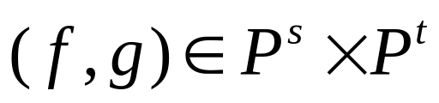

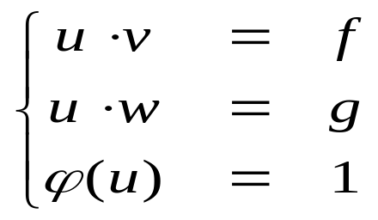
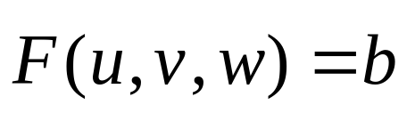
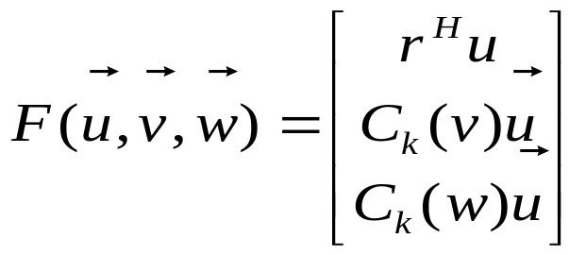
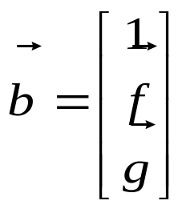
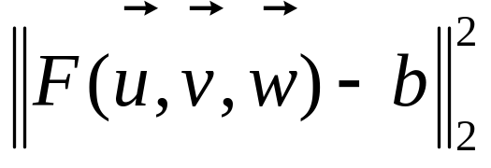
Our strategy:
Reformulate a well-posed problem
Given
and the GCD degree k
Set up a system for
Or, in vector form
where
and
minimize
14/29

Slide 15
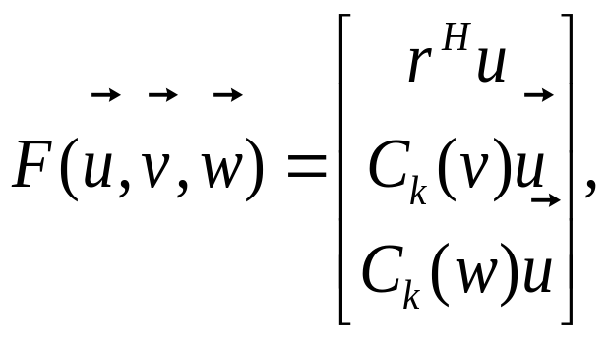
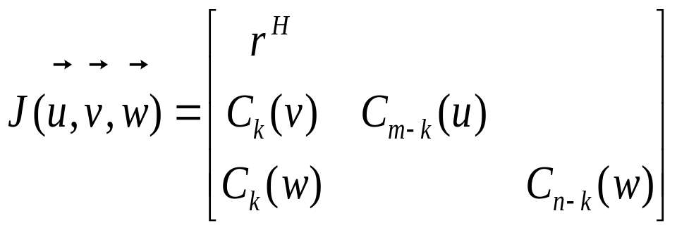
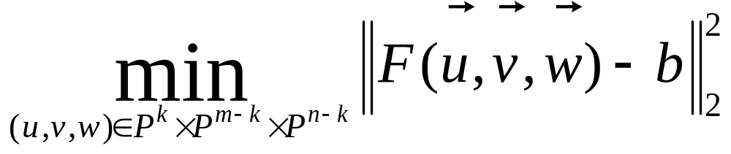
Its Jacobian:
Theorem: The Jacobian is of full rank
if v and w are co-prime
In other words: if the AGCD degree k is correct, then
is a regular, well-posed problem!
15/29

Slide 16
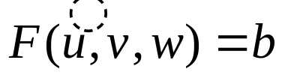

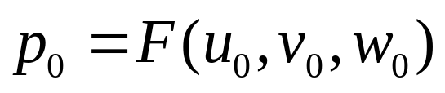

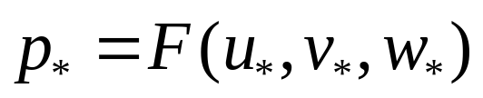
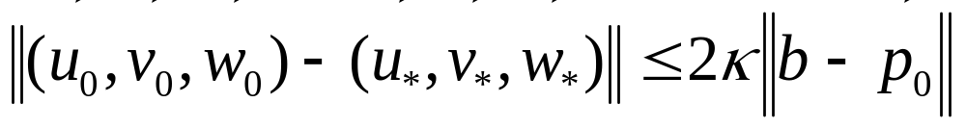
Illustration of the reformulated problem:
pejorative manifold
perturbed polynomial pair
perturbed polynomial pair
original polynomial pair (f,g)
projected polynomials with computed GCD
The problem becomes well-posed, and often well-conditioned!
16/29

Slide 17
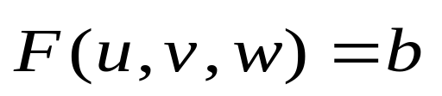

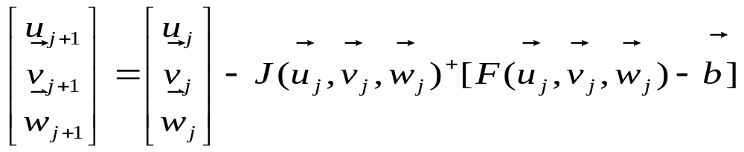

Reformulated problem:
Find a pair (p, q) = (uv, uw) that is nearest to ( f, g )
s.t. degree constraint on u = GCD( p, q )
Or, solve
in least squares sense
is full-ranked
Condition number is finite
The Gauss-Newton iteration locally converges
17/29

Slide 18
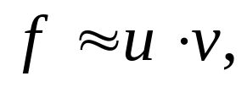

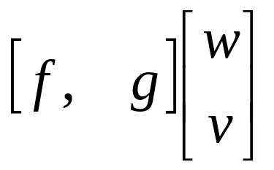
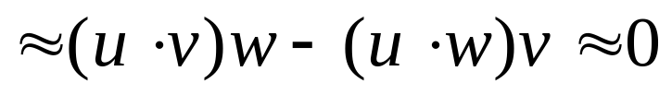
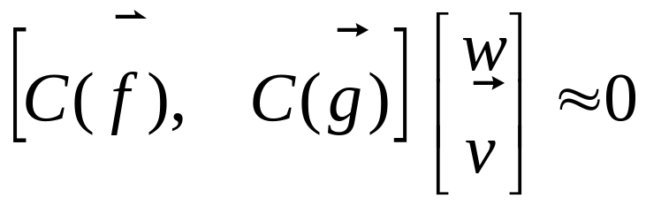
The question: How to determine the GCD structure
If
then
The Sylvester Resultant matrix
is approximately rank-deficient
The GCD structure is determined by computing
the approximate rank of Sylvester matrices
A rank-revealing method and its applications, T. Y. Li and Z. Zeng, to appear: SIMAX

Slide 19
For univariate polynomials :
Stage I: determine the GCD degree
QR
S₂(f,g)
QR
S₁(f,g) =
until finding the first rank-deficient Sylvester submatrix
Stage II: determine the GCD factors ( u, v, w )
by formulating
and the Gauss-Newton iteration
19/29

Slide 20
Start: k = n
Max-degree
k := k-1
k := k-1
Is GCD of degree k
possible?
no
no
probably
Refine with
G-N Iteration
Successful?
yes
Min-distance
nearness
Output GCD
Univariate AGCD algorithm
20/29

Slide 21
Multivariate AGCD:
f( x, y, z ) = u( x, y, z ) v( x, y, z )
g( x, y, z ) = u( x, y, z ) w( x, y, z )
GCD
?
?
f( x, y, z ) = u( x, y, z ) v( x, y, z )
g( x, y, z ) = u( x, y, z ) w( x, y, z )
randomly fixed
Theorem: With probability 1, a multivariate AGCD is a univariate AGCD
in every variable, if other variables are randomly fixed.
21/29

Slide 22
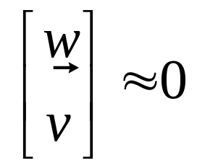
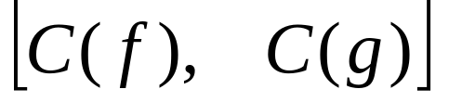
The univariate AGCD algorithm leads to
u₁(x) = u( x, y₀, z₀ )
u₂(y) = u( x₀, y, z₀ )
if u(x,y,z) = AGCD( f, g )
u₃(z) = u( x₀, y₀, z )
The degree structure of u(x,y,z)
Sylvester-like matrix
Theorem: [C(f), C(g)] is rank-deficient by one.
v and w are uniquely determined
22/29

Slide 23
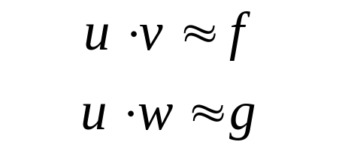
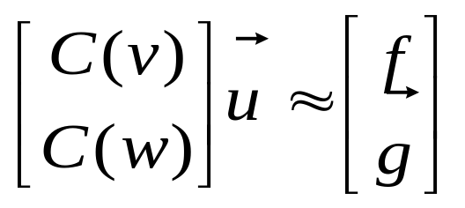

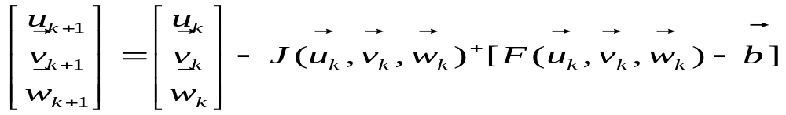

After finding co-factors v and w
We obtain
(Gao-Kaltofen-May-Yang-Zhi method follows a similar approach up to here)
- The G-N iteration ensures the “min-distance”
- And varifies the “nearness”
Result: A robust AGCD algorithm
and a blackbox software mvgcd.
23/29

Slide 24
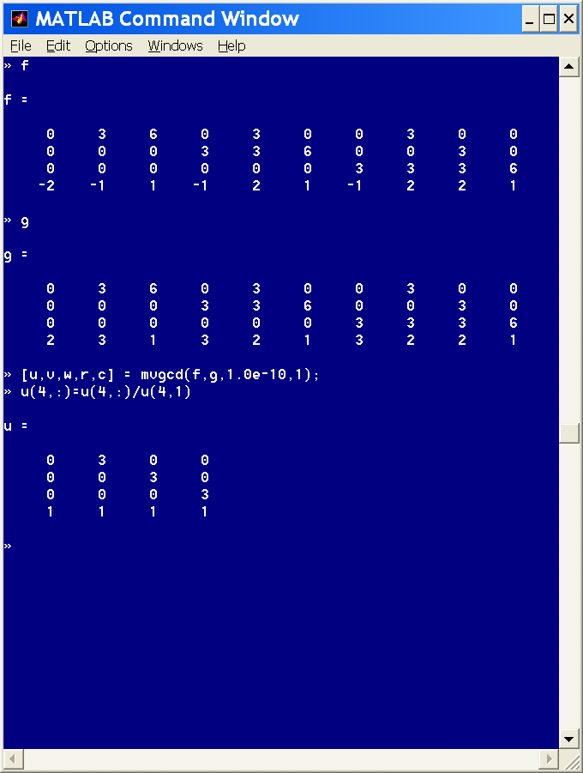
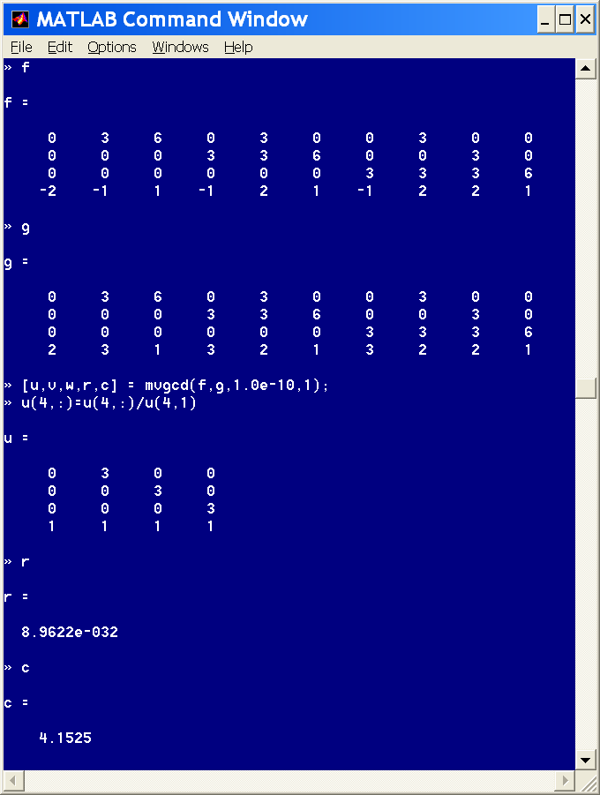
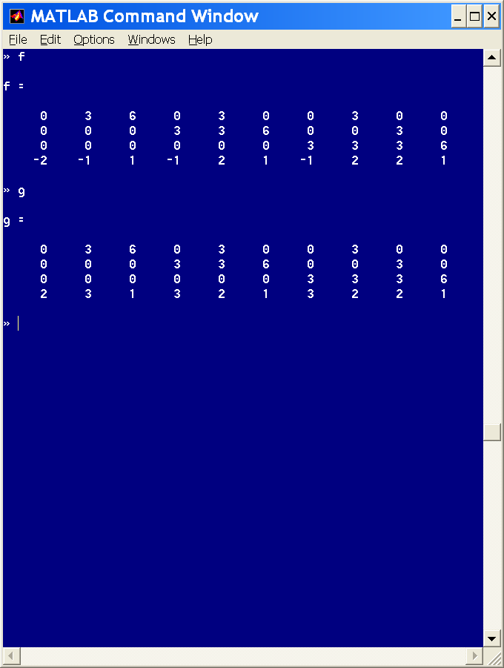


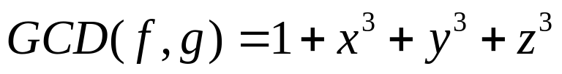

Matlab demo:
backward error =
condition number = 4.1525
24/29

Slide 25






backward error = 0.0031
condition number = 4.1530
25/29

Slide 26
Approximate Squarefree Factorization (ASFF)
Input: polynomial p, tolerance ε, random vector a
ASFF Algorithm I:
u₀ = p
for k = 1, 2, … do
- [u_{k,},v_{k},w_{k}]= AGCD_{ε}(u_{k-1},D_{a}u_{k-1})
- if D_{a}u_{k} = 0, break, end if
end do
output: ASFF v₁v₂…v_{k}
ASFF Algorithm II:
[u_{0,},v₀,w₀]= AGCD(p,D_{a}p)
for k = 1, 2, … do
- [h_{k},v_{k},w_{k}]= AGCD_{ε}(v_{k-1},w_{k-1}-D_{a}v_{k-1})
- if D_{a}w_{k} = 0, break, end if
end do
output ASFF (h₁)¹(h₂)²…(h_{k})^{k}
Example: p = (p₁)⁵(p₂)³(p₃)³(p₄)¹
ASFF Algorithm I: [p₁p₂p₃p₄] [p₁p₂p₃] [p₁p₂p₃] [p₁] [p₁]
ASFF Algorithm II: [p₄]¹ [1]² [p₂p₃]³ [1]⁴ [p₁]⁵
26/29

Slide 27
Ill-posed problems are common in applications
  image restoration - deconvolution
  IVP for stiction damped oscillator - inverse heat conduction
  some optimal control problems - electromagnetic inverse scatering
  air-sea heat fluxes estimation - the Cauchy prob. for Laplace eq.
  … …
Ill-posed problems in computational mathematics
matrix rank-revealing - overdetermined system
- polynomial factoring - polynomial GCD
Jordan Canonical Form - multiple zeros and eigenvalues
- nonisolated zeros … …
27/29

Slide 28



A two-stage strategy for removing ill-posedness:
For a problem
(data ----> solution)
with data D₀
Stage I: determine the structure Σ of the desired solution
this structure determines a pejorative manifold of data
Π = P⁻¹(Σ) = { D | P(D) = S fits the structure }
Stage II: formulate and solve a least squares problem
minimize
28/29

Slide 29
The two-stage approach leads to
blackbox algorithms and software
rank-revealing algorithm
A rank-revealing method and its applications, T. Y. Li and Z. Zeng
multiple root algorithm
Computing multiple roots of inexact polynomials, Z. Zeng
univariate GCD algorithm
The approximate GCD of inexact polynomials. Part I: a univariate algorithm,
Z. Zeng
multivariate GCD algorithm
The approximate GCD of inexact polynomials. Part II: a multivariate algorithm,
Z. Zeng and B. H. Dayton
multivariate ASFF algorithms
(in progress)
Jordan Canonical form algorithm
(in progress)
29/29

