Slide 1
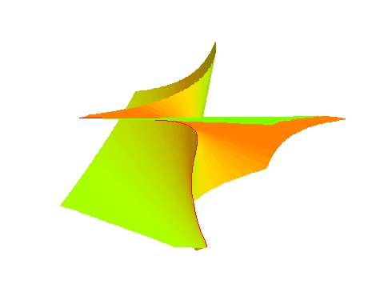
The Tale of Polynomials
Zhonggang Zeng
Nov. 11, 2003 --- Northeastern Illinois University

Slide 2
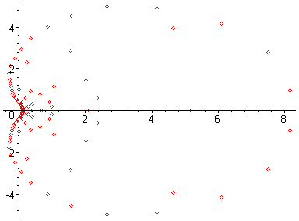
Can you solve (x-1.0 )¹⁰⁰ = 0
Can you solve
x¹⁰⁰-100 x⁹⁹ +4950 x⁹⁸ - 161700 x⁹⁷+3921225x⁹⁶ - ... - 100 x +1 = 0

Slide 3
Exact coefficients
2372413541474339676910695241133745439996376
-21727618192764014977087878553429208549790220
83017972998760481224804578100165918125988254
-175233447692680232287736669617034667590560789
228740383018936986749432151287201460989730173
-194824889329268365617381244488160676107856145
110500081573983216042103084234600451650439725
-41455438401474709440879035174998852213892159
9890516368573661313659709437834514939863439
-1359954781944210276988875203332838814941903
82074319378143992298461706302713313023249
Exact roots
1.072753787571903102973345215911852872073…
0.422344648788787166815198898160900915499…
0.422344648788787166815198898160900915499…
2.603418941910394555618569229522806448999…
2.603418941910394555618569229522806448999 …
2.603418941910394555618569229522806448999 …
1.710524183747873288503605282346269140403…
1.710524183747873288503605282346269140403…
1.710524183747873288503605282346269140403…
1.710524183747873288503605282346269140403…
Inexact coefficients
2372413541474339676910695241133745439996376
-21727618192764014977087878553429208549790220
83017972998760481224804578100165918125988254
-175233447692680232287736669617034667590560780
228740383018936986749432151287201460989730170
-194824889329268365617381244488160676107856140
110500081573983216042103084234600451650439720
-41455438401474709440879035174998852213892159
9890516368573661313659709437834514939863439
-1359954781944210276988875203332838814941903
82074319378143992298461706302713313023249
“attainable” roots
1.072753787571903102973345215911852872073…
0.422344648788787166815198898160900915499…
0.422344648788787166815198898160900915499…
2.603418941910394555618569229522806448999…
2.603418941910394555618569229522806448999 …
2.603418941910394555618569229522806448999 …
1.710524183747873288503605282346269140403…
1.710524183747873288503605282346269140403…
1.710524183747873288503605282346269140403…
1.710524183747873288503605282346269140403…
9
3
5
5

Slide 4
Coeff. in hardware precision
2372413541474339676910695241133745439996376
-21727618192764014977087878553429208549790220
83017972998760481224804578100165918125988254
-175233447692680232287736669617034667590560789
228740383018936986749432151287201460989730173
-194824889329268365617381244488160676107856145
110500081573983216042103084234600451650439725
-41455438401474709440879035174998852213892159
9890516368573661313659709437834514939863439
-1359954781944210276988875203332838814941903
82074319378143992298461706302713313023249
“attainable” roots
1.072753787571903102973345215911852872073…
0.422344648788787166815198898160900915499…
0.422344648788787166815198898160900915499…
2.603418941910394555618569229522806448999…
2.603418941910394555618569229522806448999 …
2.603418941910394555618569229522806448999 …
1.710524183747873288503605282346269140403…
1.710524183747873288503605282346269140403…
1.710524183747873288503605282346269140403…
1.710524183747873288503605282346269140403…
The highest multiplicity is only 4!

Slide 5

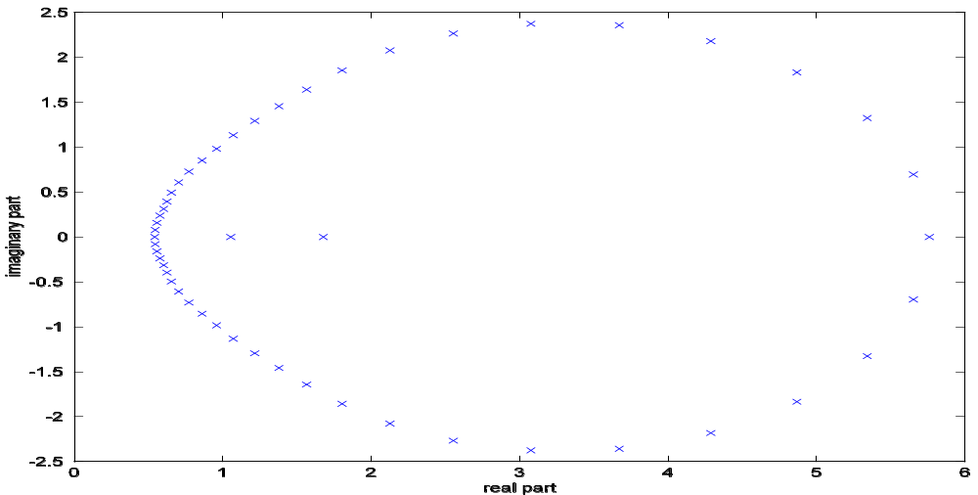
For polynomial
with coefficients in hardware precision:
The computed roots:
+
+
+
+

Slide 6
Polynomial root-finding
x^{n} + a₁ x^{n-1} + a₂ x^{n-2} + ... + a_{n-1}x + a₀ = 0
has played a key role in the history of mathematics
It is one of the
  oldest, and
  most thoroughly studied
mathematical problems

Slide 7
  2000 BC: Babylonians solves quadratics
  300 BC: Euclid solves quadratics with geometrical construction
  1539: Cardan gives complete solution to cubics
  1699: Newton introduced numerical iteration for root-finding
  1700’s Euler repeatedly tries to solve general root-finding, but fails
  1770: Lagrange shows that polynomial of degree 5 or more cannot
  be solved by the methods used for quadratics, cubics, quartics.
  1799: Gauss proves the Fundamental Theorem of Algebra
  (Girard Conjecture, 1629)

Slide 8

Weierstrass (1815-1897) Approximation Theorem:
f(x)
p(x)
a
b
Every continuous function on [a,b] can be approximated
by a polynomial with any accuracy

Slide 9

  1826: Abel proves the impossibility of generally solving
  equations of degree higher than 4-th
General root-finding must be
iterative, and
can only be done approximately
even if round-off errors can be avoided

Slide 10
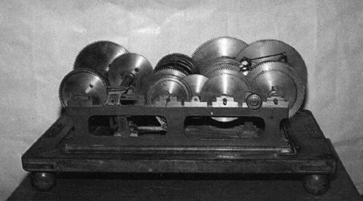
1895: Leonardo Torres Quevedo’s Algebraic Machine
for trinomial equations

Slide 11

1937: Bell Labs build the Isograph
for polynomials of degree up to 15

Slide 12
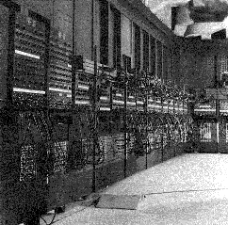

1946: The first electronic digital computer ENIAC
by John Mauchly and
J. Presper Eckert
sponsored by U.S.
military for WWII

Slide 13
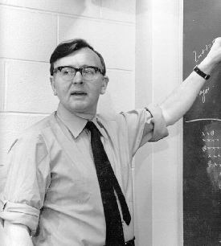

James H. Wilkinson (1919-1986)
Start of project: 1948
Completed: 1950
Add time: 1.8 microseconds
Input/output: cards
Memory size: 352 32-digit words
Memory type: delay lines
Technology: 800 vacuum tubes
Floor space: 12 square feet
Project leader: J. H. Wilkinson
Britain’s Pilot Ace

Slide 14
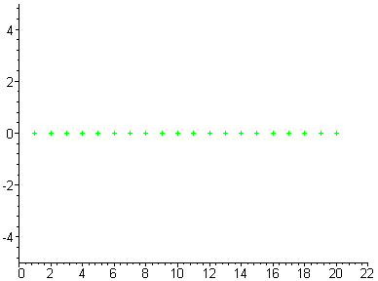
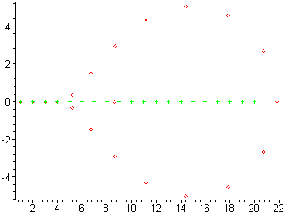
The Wilkinson polynomial
p(x) = (x-1)(x-2)...(x-20)
= x²⁰ - 210 x¹⁹ + 20615 x¹⁸ + ...
Wilkinson wrote in 1984:
Speaking for myself I regard it as the most traumatic
experience in my career as a numerical analyst.

Slide 15

The fundamental question: what should a numerical algorithm really do?
Conventional wisdom: Compute solutions
Wilkinson’s discovery: Not exactly!
A numerical algorithm generates
the exact solution of a nearby problem
To calculate
we actually calculate the exact value of
a nearby polynomial

Slide 16
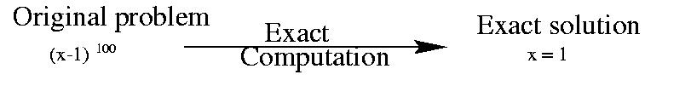
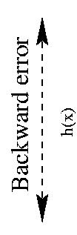
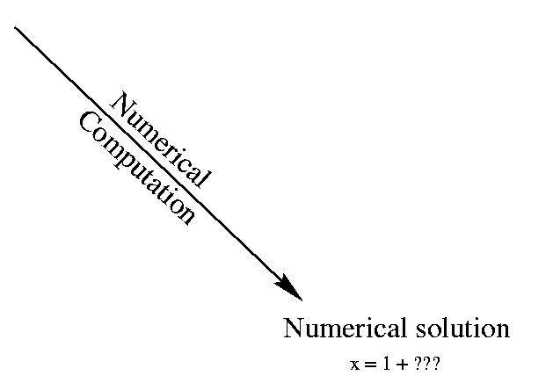

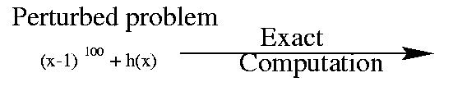
Backward and forward error

Slide 17








To solve
with 8 digits precision:
exact solution
approximate solution
using 8-digits precision
axact solution
backward error: 0.00000001 -- method is good
forward error: 0.0001 -- problem is bad

Slide 18
The condition number
[Forward error] ~ [Condition number] [Backward error]
From problem
From computational method
A large condition number
<=> The problem is sensitive
or, ill-conditioned

Slide 19
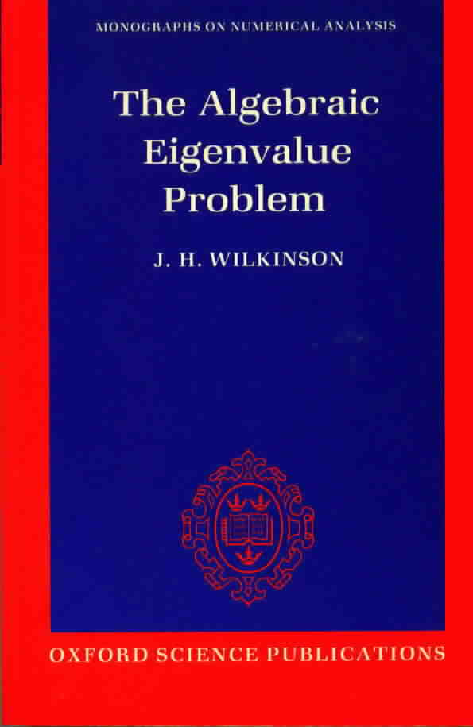
A numerical algorithm is judged by its backward accuracy.
Well-conditioned problem + backward accurate algorithm
→ → accurate solutions
1965: J. H. Wilkinson published his monumental book
1970: Wilkinson won
Turing Award
and
Von Neumann Award

Slide 20


J.H. Wilkinson
Citation
  For his research in numerical analysis to facilitiate the use
  of the high-speed digital computer, having received special
  recognition for his work in computations in linear algebra
  and "backward" error analysis.

Slide 21
Classical textook results on multiple roots
Newton’s iteration converges to a multiple root
locally with a linear rate.
The modified Newton’s iteration
x_{j+1} = x_{j} - mf(x_{j})/f’(x_{j}), j=0,1,2,...
converges to a m-fold root locally with a quadratic rate.
Newton’s iteration applied to
g(x) = f(x)/f’(x)
converges locally and quadratically to a root of f(x) regardliss of its multiplicity.
None of them work!

Slide 22
Example: f(x) = (x-2)⁷(x-3)(x-4) in expanded form.
Modified Newton’s iteration with m = 7
intended for root x = 2:
x₁ = 1.9981
x₂ = 1.7481
x₃ = 1.9892
x₄ = 0.4726
x₅ = 1.8029
x₆ = 1.9931
x₇ = 4.2681
x₈ = 3.3476
... ...

Slide 23


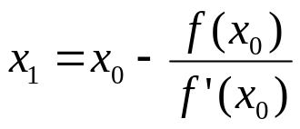
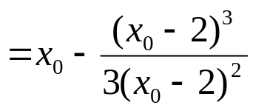
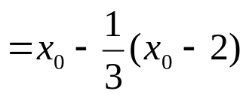

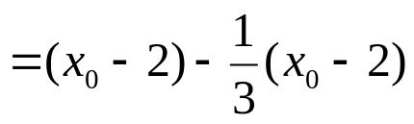

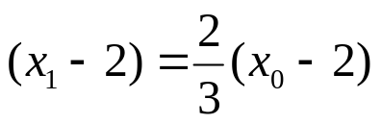

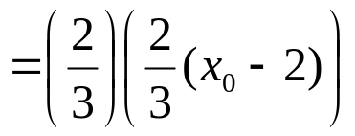
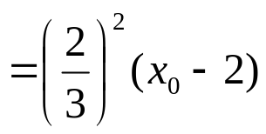
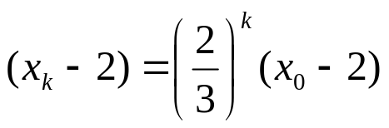


Let
Starting from any initial iterate
Therefore, we proved
Or, did we???

Slide 24

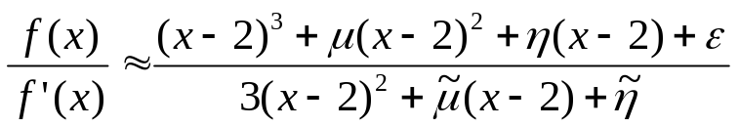
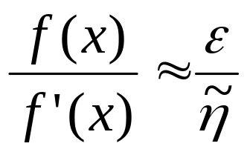
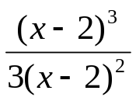
For
When x is near 2
not
is indeed a random number generator!

Slide 25
Conclusion:
Multiple roots are highly sensitive to perturbation
In other words,
computing multiple roots is an ill-conditioned problem

Slide 26
If the answer is highly sensitive to perturbations, you have probably asked the wrong question.
Maxims about numerical mathematics, computers,
science and life, L. N. Trefethen. SIAM News
A: “Customer”
B: Numerical analyst
Who is asking a wrong question?
A: The polynomial
B: The computing objective
What is the wrong question?

Slide 27
The question we used to ask:
(Fundamental Theorem of Algebra)
Given a polynomial
p(x) = x^{n} + a₁ x^{n-1}+...+a_{n-1} x + a_{n}
find z = ( z₁, ..., z_{n} ) such that
p(x) = ( x - z₁ )( x - z₂ ) ... ( x - z_{n} )
This is a singular problem when multiple roots exist

Slide 28

Are multiple roots really sensitive to perturbations?
William Kahan:
This is a misconception
Kahan’s discovery in 1972:
multiple roots are sensitive to arbitrary perturbation,
but insensitive to multiplicity preserving perturbation.

Slide 29
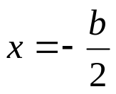



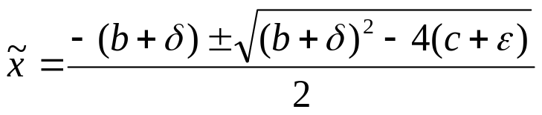
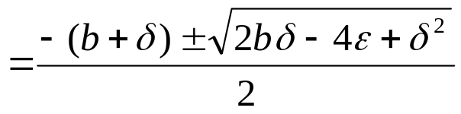

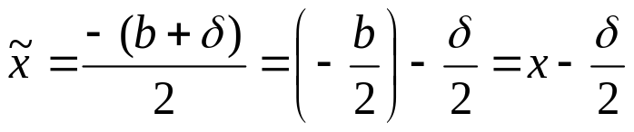
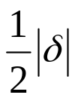

For
a double root
exists if
Arbitrary perturbation:
The square-root magnifies the error.
Multiplicity preserving perturbation:
Forward error:
[Forward error] < 0.5*[backward error]
Backward error:
How can we preserve the multiplicity?

Slide 30
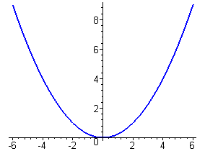
Kahan’s pejorative manifolds
All n-polynomials having certain multiplicity
structure form a pejorative manifold
x^{n} + a₁ x^{n-1}+...+a_{n-1} x + a_{n} <=> (a₁ , ..., a_{n-1} , a_{n} )
Example: ( x-t )² = x² + (-2t) x + t²
Pejorative manifold:
a₁= -2t
a₂= t²

Slide 31
Pejorative manifolds of 3rd-degree polynomials
( x - s )( x - t )² = x³ + (-s-2t) x² + (2st+t²) x + (-st²)
a₁= -s-2t
a₂= 2st+t²
a₃= -st²
Pejorative manifold of
multiplicity structure [1,2]
( x - s )³ = x³ + (-3s) x² + (3s²) x + (-s³)
a₁ = -3s
a₂ = 3s²
a₃ = -s³
Pejorative manifold of
multiplicity structure [ 3 ]

Slide 32
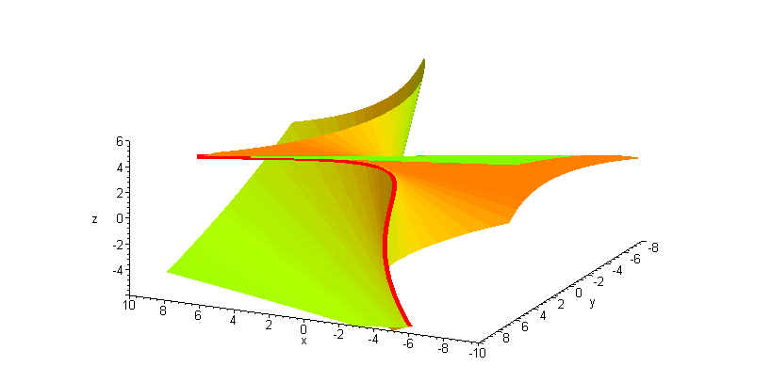
Pejorative manifolds of degree 3 polynomials
The wings:
a₁= -s-2t
a₂= 2st+t²
a₃= -st²
The edge:
a₁ = -3s
a₂ = 3s²
a₃ = -s³
General form of
pejorative manifolds
u = G(z)

Slide 33
W. Kahan, Conserving confluence curbs ill-condition, 1972
Ill-condition occurs when a polynomial is near a pejorative manifold.
Roots are not necessarily sensitive when the polynomial stay
on that pejorative manifold
Ill-condition is caused by solving a polynomial
equation on a wrong manifold
Kahan won 1989 Turing Award, not because of this discovery
which has never been formally published.

Slide 34
Given a polynomial p(x) = x³ + a₁ x²+a₂ x + a₃
/ / / / / / / / / / / / / / / / / /
/ / / / / / / / / / / / / / / / / /
Find ( z₁,z₂, z₃ ) such that
p(x) = ( x - z₁ )( x - z₂ )( x – z₃ )
The wrong question:
because you are asking for simple roots!
Find distinct s, t such that
( x - s ) ( x - t )² = p(x)
The right question:
do it on the pejorative manifold!

Slide 35


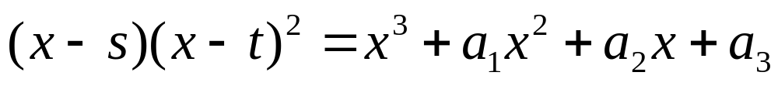
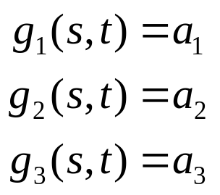
How to solve
Conventional wisdom: from
, hoping
---- wrong question
Reverse the direction: use roots to generate matching coefficients:
Find s and t such that
x³ + (-s-2t) x² + (2st+t²) x + (-st²) = x³ + a₁ x² + a₂ x + a₃
-s-2t = a₁
2st+t² = a₂
-st² = a₃

Slide 36

To solve
x
A
=
b
b
A linear least squares problem

Slide 37
To solve G(z)=a
a
u = G(z)
A nonlinear least squares problem

Slide 38
To calculate roots of p(x)= x^{n} + a₁ x^{n-1}+...+a_{n-1} x + a_{n}
Let ( x - z₁ ) ^{l1}( x - z₂ ) ^{l2} ... ( x - z_{m} ) ^{lm} =
x^{n} + g₁ ( z₁, ..., z_{m} ) x^{n-1}+...+g_{n-1} ( z₁, ..., z_{m} ) x + g_{n} ( z₁, ..., z_{m} )
Then, p(x) = ( x - z₁ ) ^{l1}( x - z₂ ) ^{l2} ... ( x - z_{m} ) ^{lm} <==>
g₁ ( z₁, ..., z_{m} ) =a₁
g₂( z₁, ..., z_{m} ) =a₂
... ... ...
g_{n} ( z₁, ..., z_{m} ) =a_{n}
(degree) n
(m<n)
m (number of distinct roots)
I.e. An over determined polynomial system
G(z) = a

Slide 39
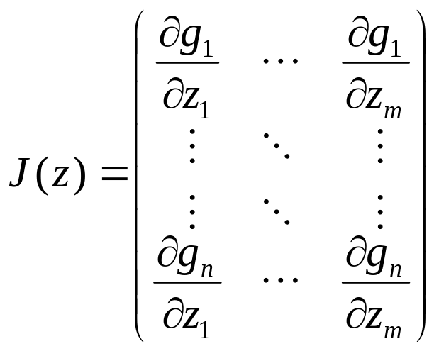
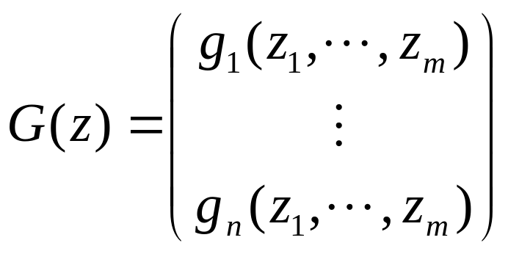
The coefficient operator:
Its Jacobian:
,
Theorem: J(z) is of full rank <=> z₁,…,z_{m} are distinct.
Or the decomposition ( x - z₁ ) ^{l1}( x - z₂ ) ^{l2} ... ( x - z_{m} ) ^{lm} is unreducible

Slide 40
The polynomial
a
Project to tangent plane
u₁ = G(z₀)+J(z₀)(z₁- z₀)
tangent plane P₀ :
u = G(z₀)+J(z₀)(z- z₀)
~
new iterate
u₁=G(z₁)
pejorative root
u*=G(z* )
initial iterate
u₀=G(z₀)
Pejorative manifold
u = G( z )
Solve
G(z₀)+J(z₀)( z - z₀ ) = a
for linear least squares solution z = z₁
Solve
G( z ) = a
for nonlinear least squares solution z=z*
G(z₀)+J(z₀)( z - z₀ ) = a
J(z₀)( z - z₀ ) = - [G(z₀) - a ]
z₁ = z₀ - [J(z₀)⁺] [G(z₀) - a]

Slide 41
The Gauss-Newton iteration
z ^{(i+1)} =z^{(i)} - J(z ^{(i)} )⁺[ G(z ^{(i)} ) - a ], i=0,1,2 ...
where J(.)⁺ is the pseudo-inverse of J(.)
Theorem: The Gauss-Newton iteration locally converges
        at quadratic rate if the polynomial is exact
        at linear rate if the polynomial is inexact but close

Slide 42




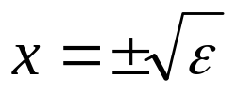

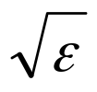

Conventional sensitivity measurement:
At multiple roots, condition number =
For example:
root:
perturbed polynomial
root:
backward error:
forward error:
[forward error] < [condition number] x [backward error]
< [???]
??? =

Slide 43

pejorative manifold
perturbed polynomial
p
original polynomial
q
projected polynomial with computed roots
q(x) has the same multiplicity structure as p(x)
roots of q(x) are accurate approximation to those of p(x)

Slide 44
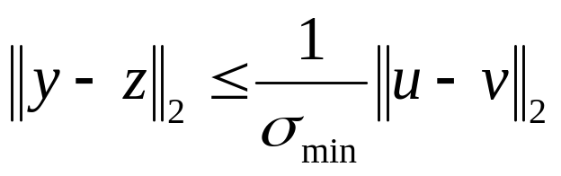
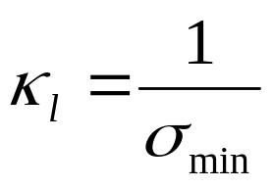
The structure-preserving condition number
v = G(z)
u = G(y)
|| u - v ||₂ = backward error
|| y - z ||₂ = forward error
Definition: The condition number:

Slide 45


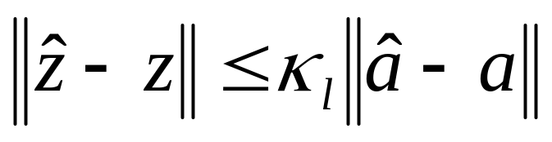
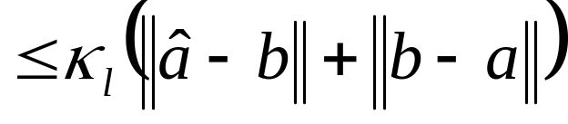
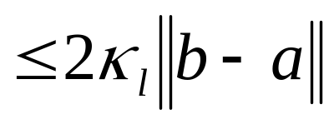
given polynomial b ~ q(x)
a
original polynomial G_{l}(z) = a ~ p(x)
b
computed polynomial

Slide 46

Structure preserving sensitivity measurement:
Multiplicities l₁ l₂ l₃ | Pejorative condition number
1 1 1 1 2 3 10 20 30 100 200 300 | 3.1499 2.0323 0.0733 0.0146
Example:
Multiple roots may not be sensitive after all!

Slide 47
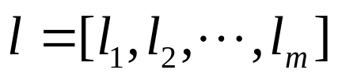

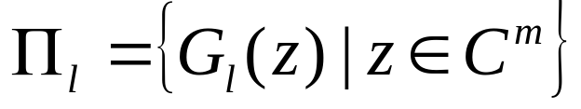
Algorithm I: Given
multiplicity structure
initial iterate
Apply the Gauss-Newton iteration
z ^{(i+1)} =z^{(i)} - J(z ^{(i)} )⁺[ G_{l}(z ^{(i)} ) - a ], i=0,1,2 ...
on

Slide 48
Example 1 (x-1.0 )¹⁰⁰ = 0
To make the problem interesting:
round the coefficients to 5 digits
Step iterates
... ... ... ...
43 1.007
44 1.001
45 1.0001
46 1.0000003
47 .999999998
conventional condition: infinity
structure-preserving condition: 0.0017
Is it ill-conditioned?

Slide 49
Example 2 (x-0.9)¹⁸(x-1.0)¹⁰(x-1.1)¹⁶ = 0
Step z₁ z₂ z₃
--------------------------------------------------------------------
0 .92 .95 1.12
1 .87 1.05 1.10
2 .92 .95 1.11
3 .88 1.01 1.10
4 .90 .97 1.12
5 .901 .992 1.101
6 .89993 .9998 1.1002
7 .9000003 .999998 1.1000007
8 .899999999997 .999999999991 1.100000000009
9 .900000000000006 .99999999999997 1.10000000000001
forward error: 6 x 10⁻¹⁵
backward error: 8 x 10⁻¹⁶
condition number: 58
Even clustered multiple roots are well conditioned

Slide 50
Example 3: The Wilkinson polynomial
p(x) = (x-1)(x-2)...(x-20) = x²⁰ - 210 x¹⁹ + 20615 x¹⁸ + ...
There are 605 manifolds in total.
It is near some manifolds, but which ones?
Multiplicity backward error condition Estimated
structure number error
------------------------------------------------------------------------
[1,1,1,1,1,1,1,1,1...,1] .000000000000003 550195997640164 1.6
[1,1,1,1,2,2,2,4,2,2,2] .000000003 29269411 .09
[1,1,1,2,3,4,5,3] .0000001 33563 .003
[1,1,2,3,4,6,3] .000001 6546 .007
[1,1,2,5,7,4] .000005 812 .004
[1,2,5,7,5] .00004 198 .008
[1,3,8,8] .0002 25 .005
[2,8,10] .003 6 .02
[5,15] .04 1 .04
[20] .9 .2 .2
What are the roots of the Wilkinson polynomial?
Choose your poison!

Slide 51
Question: How do you know the multiplicities?
Algorithm I requires
(i) the multiplicity structure
(ii) the initial iterate
Therefore, we need Algorithm II to calculate these two items

Slide 52
Identifying the multiplicity structure
p(x) = (x-1)⁵(x-2)³ = [(x-1)⁴(x-2) ²] [(x-1)(x-2)]
p’(x)= 5(x-1)⁴ (x-2)³ + 3(x-1)⁵ (x-2)² = [(x-1)⁴(x-2) ²] [5(x-2) + 3(x -1)]
GCD(p,p’) = [(x-1)⁴(x-2) ²]
distinct roots:
u₀(x) = [(x-1)⁴(x-2) ²] [(x-1)(x-2)]
* *
u₁(x) = [(x-1)³(x-2) ] [(x-1)(x-2)]
* *
u₂(x) = [(x-1)²] [(x-1)(x-2)]
* *
u₃(x) = [(x-1)] [(x-1)]
*
u₄(x) = [1] [(x-1)]
*
-----------------------------------------
u₀ = p
u_{m} =GCD(u_{m-1}, u_{m-1}’)
multiplicities 5 3

Slide 53
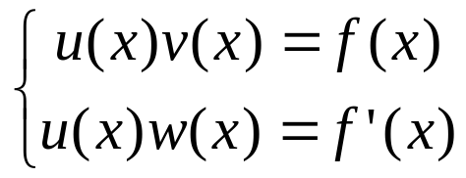

For a polynomial f(x), find a GCD triple (u,v,w) such that
Can this be done numerically and efficiently?
Sub-problems:
  determine the degrees of u,v,w ;
  determine the coefficients of u,v,w.

Slide 54
GCD computation
is
the key to calculating the multiplicities structure
also an important application problem in its own right
a problem in numerical computation
perceived as ill-conditioned or ill-post
As a by-product of this study,
a robust numerical GCD-finder is developed
(Matlab and Maple package available)

Slide 55

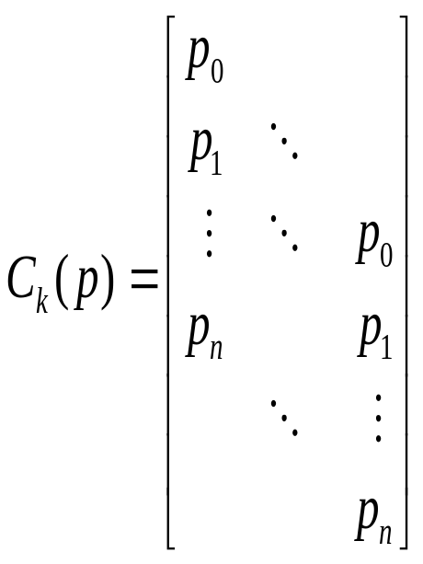

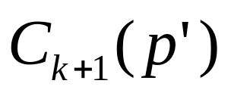
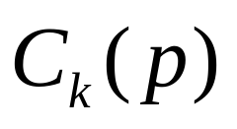
Let
k
k+1
k
k-th convolution matrix
k-th Sylvester’s discriminant matrix
Lemma:
p(x) has k distinct roots <=> k=min{ j | S_{j}(p) is rank deficient }

Slide 56
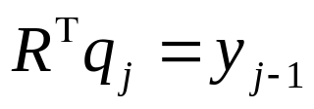
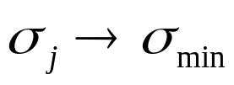




The degrees of u = GCD(p,p’), v=p/u, w=p’/u:
calculate/update the smallest singular value of
S₁(p), S₂(p), …,
QR
S₂(p)
QR
S₁(p) =
Singular pair
,

Slide 57


Let σ_{min}, y be the right singular pair of S_{k}(p). Then
v
y =
w
where
u(x)v(x) = p(x)
Least squares division
to get u
u
=
p
u,v,w, obtained here are
initial approximations

Slide 58






Further refinement of
Let
=
Theorem: J(u,v,w) is full rank <=> u = GCD( p , p’ )

Slide 59

The Gauss-Newton iteration
j=0,1, …
converges locally and quadratically to the GCD triplet u,v,w
u = GCD( p, p’ )

Slide 60
Computing roots of p(x):
1. u₀ = p
2. For k = 1, 2, … do
find u_{m} =GCD(u_{m-1}, u_{m-1}’)
v_{m}= u_{m-1} / u_{m}
Algorithm II
3. From degrees of v_{m} ‘s, identify multiplicities
4. Roots of v_{m} ‘s form initial iterates
Algorithm I
5. The G-N iteration on the pejorative manifold

Slide 61

For polynomial
with (inexact ) coefficients in machine precision
Algorithm II results:
The backward error: 6.05 x 10⁻¹⁰
Computed roots multiplicities
1.000000000000353 20
2.000000000030904 15
3.000000000176196 10
4.000000000109542 5
Algorithm I results:
The backward error: 6.16 x 10⁻¹⁶
Computed roots multiplicities
1.000000000000000 20
1.999999999999997 15
3.000000000000011 10
3.999999999999985 5

Slide 62
Conclusion
1. Ill-condition is cause by a wrong “identity”
2. Multiple roots can be well conditioned pejoratively,
thereby can be accurately calculated
3. multiprecision is not needed, a change in computing objective is.
Question:
Can we calculate multiple zeros of polynomial system?
Can we calculate the Jordan Canonical Form?

