Slide 1
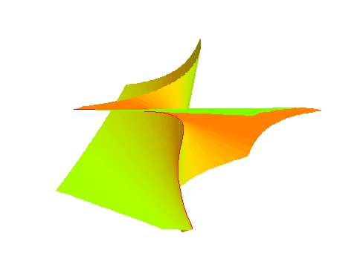
Removing Ill-posedness
in Numerical Computation ---- GCD, JCF and Multiple Roots
Zhonggang Zeng
April 20, 2004, University of Notre Dame

Slide 2
A well-posed problem: (Hadamard)
the solution satisfies
    existence
    uniqueness
    continuity w.r.t data
Ill-posed problems are common in applications
  image restoration - deconvolution
  IVP for stiction damped oscillator - inverse heat conduction
  some optimal control problems - electromagnetic inverse scatering
  air-sea heat fluxes estimation - the Cauchy prob. for Laplace eq.
  … …
1
Notes:
Hadamard introduced the notion of ill-posedness in the context of PDE.

Slide 3
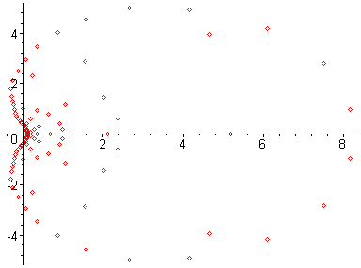
Ill-posed problems in numerical analysis
matrix rank-revealing - overdetermined system
- multivariate polynomial factoring - polynomial GCD
Jordan Canonical Form - multiple zeros and eigenvalues
- nonisolated zeros … …
Can you solve (x-1.0 )¹⁰⁰ = 0
x¹⁰⁰-100 x⁹⁹ +4950 x⁹⁸ - 161700 x⁹⁷+3921225x⁹⁶ - ... - 100 x +1 = 0
-2-

Slide 4
Exact coefficients
2372413541474339676910695241133745439996376
-21727618192764014977087878553429208549790220
83017972998760481224804578100165918125988254
-175233447692680232287736669617034667590560789
228740383018936986749432151287201460989730173
-194824889329268365617381244488160676107856145
110500081573983216042103084234600451650439725
-41455438401474709440879035174998852213892159
9890516368573661313659709437834514939863439
-1359954781944210276988875203332838814941903
82074319378143992298461706302713313023249
Exact roots
1.072753787571903102973345215911852872073…
0.422344648788787166815198898160900915499…
0.422344648788787166815198898160900915499…
2.603418941910394555618569229522806448999…
2.603418941910394555618569229522806448999 …
2.603418941910394555618569229522806448999 …
1.710524183747873288503605282346269140403…
1.710524183747873288503605282346269140403…
1.710524183747873288503605282346269140403…
1.710524183747873288503605282346269140403…
Inexact coefficients
2372413541474339676910695241133745439996376
-21727618192764014977087878553429208549790220
83017972998760481224804578100165918125988254
-175233447692680232287736669617034667590560780
228740383018936986749432151287201460989730170
-194824889329268365617381244488160676107856140
110500081573983216042103084234600451650439720
-41455438401474709440879035174998852213892159
9890516368573661313659709437834514939863439
-1359954781944210276988875203332838814941903
82074319378143992298461706302713313023249
“attainable” roots
1.072753787571903102973345215911852872073…
0.422344648788787166815198898160900915499…
0.422344648788787166815198898160900915499…
2.603418941910394555618569229522806448999…
2.603418941910394555618569229522806448999 …
2.603418941910394555618569229522806448999 …
1.710524183747873288503605282346269140403…
1.710524183747873288503605282346269140403…
1.710524183747873288503605282346269140403…
1.710524183747873288503605282346269140403…
9
3
5
5
-3-

Slide 5
Coeff. in hardware precision
2372413541474339676910695241133745439996376
-21727618192764014977087878553429208549790220
83017972998760481224804578100165918125988254
-175233447692680232287736669617034667590560789
228740383018936986749432151287201460989730173
-194824889329268365617381244488160676107856145
110500081573983216042103084234600451650439725
-41455438401474709440879035174998852213892159
9890516368573661313659709437834514939863439
-1359954781944210276988875203332838814941903
82074319378143992298461706302713313023249
“attainable” roots
1.072753787571903102973345215911852872073…
0.422344648788787166815198898160900915499…
0.422344648788787166815198898160900915499…
2.603418941910394555618569229522806448999…
2.603418941910394555618569229522806448999 …
2.603418941910394555618569229522806448999 …
1.710524183747873288503605282346269140403…
1.710524183747873288503605282346269140403…
1.710524183747873288503605282346269140403…
1.710524183747873288503605282346269140403…
The multiplicity structure [1,2,3,4]
becomes [1,1,1,1,1,1,1,1,1,1]
----- typical ill-posedness
The highest multiplicity is only 4!
-4-

Slide 6

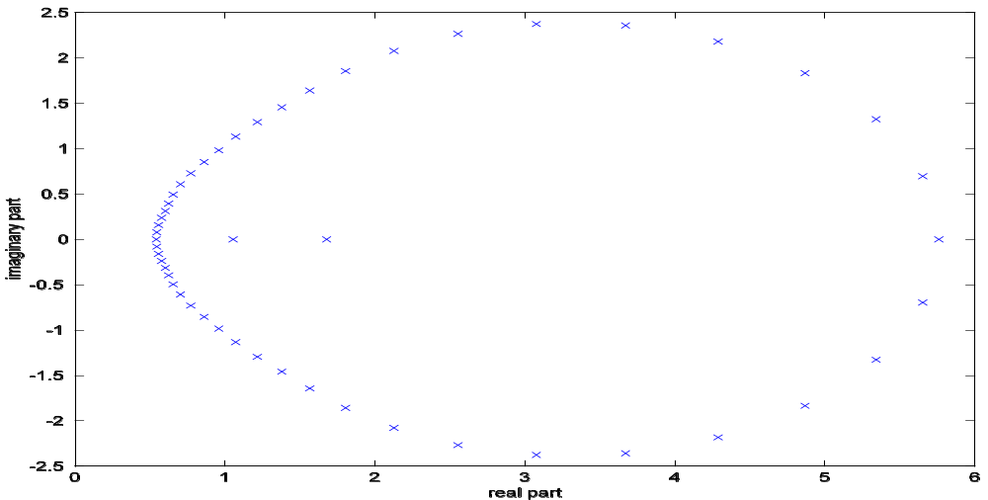
For polynomial
with coefficients in hardware precision:
The computed roots:
+
+
+
+
-5-

Slide 7
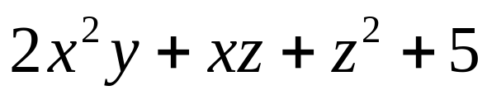
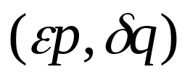
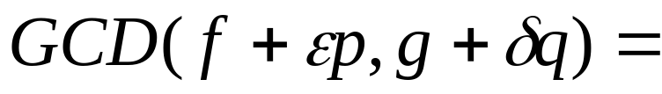

GCD( f, g )=
Under tiny perturbation:
-6-

Slide 8

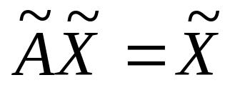
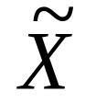
Jordan Canonical Form (JCF)
Every eigenvalue corresponds to a Jordan structure
λ 1
λ 1
λ
λ₃
AX = X
λ 1
λ
λ₃
λ 1
λ
λ₄
λ₂
λ
λ₅
λ
λ₁
Under arbitrary perturbation
λ₈
λ₆
λ₇
λ₁
λ₂
λ₃
λ₄
-- nearly
rank deficient
λ₅
λ₆
λ₇
λ₈
-7-

Slide 9
The challenge:
Ill-posed problem
in
numerical computation
- data error is common in application
- round-off error is inevitable
- Ill-posedness ➔ ill-condition to the extreme
-8-

Slide 10
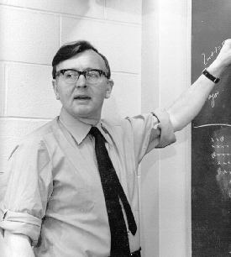
Backward error and condition number
James H. Wilkinson (1919-1986)
won 1970 Turing Award
for
backward error analysis
Numerical Computation
seeks
The exact solution of a nearby problem
-9-

Slide 11
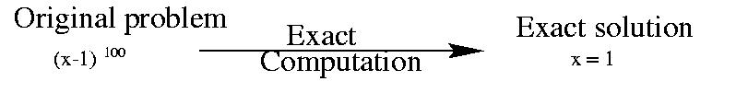
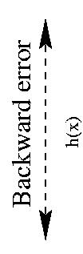
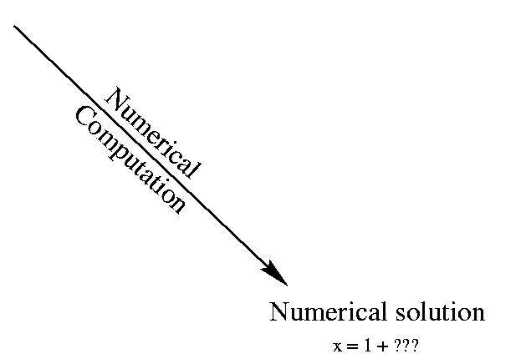

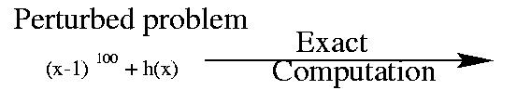
Backward and forward error
Ill-posedness is incompatible with numerical compuation
-10-

Slide 12
The condition number
[Forward error] < [Condition number] [Backward error]
From problem
From computational method
A large condition number
<=> The problem is sensitive or, ill-conditioned
An ill-posed problem
==> condition number is infinity
-11-

Slide 13
If the answer is highly sensitive to perturbations, you have probably asked the wrong question.
Maxims about numerical mathematics, computers,
science and life, L. N. Trefethen. SIAM News
A: “Customer”
B: Numerical analyst
Who is asking a wrong question?
A: The polynomial, matrix
B: The computing objective
What is the wrong question?
-12-

Slide 14
The question we used to ask: (in root-finding)
(Fundamental Theorem of Algebra)
Given a polynomial
p(x) = x^{n} + a₁ x^{n-1}+...+a_{n-1} x + a_{n}
find z = ( z₁, ..., z_{n} ) such that
p(x) = ( x - z₁ )( x - z₂ ) ... ( x - z_{n} )
This problem is ill-posed when multiple roots exist
-13-

Slide 15

Are multiple roots really sensitive to perturbations?
William Kahan:
This is a misconception
Kahan’s discovery in 1972:
multiple roots are sensitive to arbitrary perturbation,
but insensitive to multiplicity preserving perturbation.
-14-

Slide 16
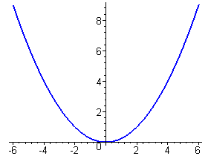
Kahan’s pejorative manifolds
All n-polynomials having certain multiplicity
structure form a pejorative manifold
x^{n} + a₁ x^{n-1}+...+a_{n-1} x + a_{n} <=> (a₁ , ..., a_{n-1} , a_{n} )
Example: ( x-t )² = x² + (-2t) x + t²
Pejorative manifold:
a₁= -2t
a₂= t²
-15-

Slide 17
Pejorative manifolds of 3rd-degree polynomials
( x - s )( x - t )² = x³ + (-s-2t) x² + (2st+t²) x + (-st²)
a₁= -s-2t
a₂= 2st+t²
a₃= -st²
Pejorative manifold of
multiplicity structure [1,2]
( x - s )³ = x³ + (-3s) x² + (3s²) x + (-s³)
a₁ = -3s
a₂ = 3s²
a₃ = -s³
Pejorative manifold of
multiplicity structure [ 3 ]
-16-

Slide 18
Pejorative manifolds of degree 3 polynomials
The wings:
a₁= -s-2t
a₂= 2st+t²
a₃= -st²
The edge:
a₁ = -3s
a₂ = 3s²
a₃ = -s³
General form of
pejorative manifolds
u = G(z)
-17-

Slide 19
W. Kahan, Conserving confluence curbs ill-condition, 1972
Ill-condition occurs when a polynomial is near a pejorative manifold.
Roots are not necessarily sensitive when the polynomial stay
on that pejorative manifold
Ill-condition is caused by solving a polynomial
equation on a wrong manifold
Although Kahan did not propose a practical algorithm, this unpublished
work provides a valuable insight on ill-condition and ill-posedness
-18-

Slide 20
For the ill-posed multiple root problem with inexact data
The key:
Remove the ill-posedness by reformulating the problem
Original problem: calculating the roots
Reformulated problem: finding the nearest
polynomial on a proper pejorative manifold
-- A constraint minimization
Z. Zeng, Computing multiple roots of inexact polynomials,
to appear, Math Comp
-19-

Slide 21

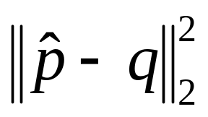

Illustration of the reformulated problem:
Π
pejorative manifold
perturbed polynomial
p
original polynomial
q
projected polynomial with computed roots
Minimize
q has the same multiplicity structure as p
roots of q are accurate approximation to those of p
-20-

Slide 22
To calculate roots of p(x)= x^{n} + a₁ x^{n-1}+...+a_{n-1} x + a_{n}
Let ( x - z₁ ) ^{l1}( x - z₂ ) ^{l2} ... ( x - z_{m} ) ^{lm} =
x^{n} + g₁ ( z₁, ..., z_{m} ) x^{n-1}+...+g_{n-1} ( z₁, ..., z_{m} ) x + g_{n} ( z₁, ..., z_{m} )
Then, p(x) = ( x - z₁ ) ^{l1}( x - z₂ ) ^{l2} ... ( x - z_{m} ) ^{lm} <==>
g₁ ( z₁, ..., z_{m} ) =a₁
g₂( z₁, ..., z_{m} ) =a₂
... ... ...
g_{n} ( z₁, ..., z_{m} ) =a_{n}
(degree) n
(m<n)
m (number of distinct roots)
I.e. An over determined polynomial system
G(z) = a
-21-

Slide 23
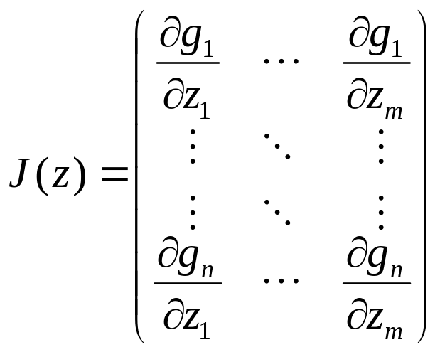
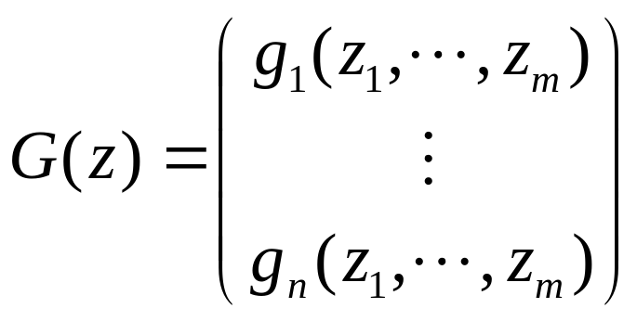
The coefficient operator:
Its Jacobian:
,
Theorem: J(z) is of full rank <=> z₁,…,z_{m} are distinct.
Or the decomposition ( x - z₁ ) ^{l1}( x - z₂ ) ^{l2} ... ( x - z_{m} ) ^{lm} is unreducible
-22-

Slide 24
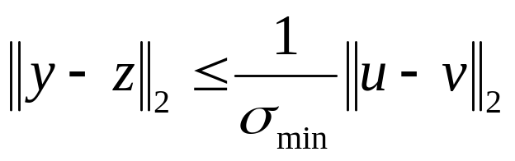
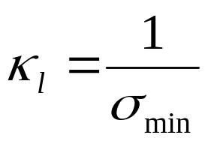
The structure-preserving condition number
v = G(z)
u = G(y)
forward error
(on roots)
backward error
(on data)
condition number
Definition: The structure-preserving condition number:

Slide 25

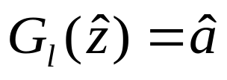
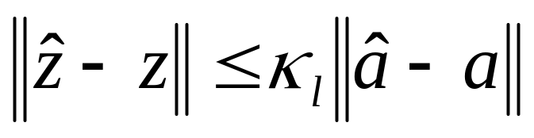
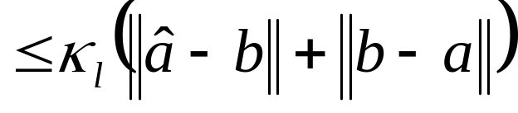
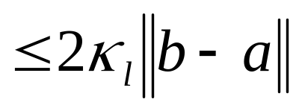
given polynomial b ~ q(x)
a
original polynomial G_{l}(z) = a ~ p
b
computed polynomial
It is now a well-posed problem!
-24-

Slide 26
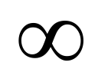

Conventional sensitivity measurement:
At multiple roots, condition number =
Structure preserving sensitivity measurement:
Example:
Multiplicities
l₁ l₂ l₃
Structure preserving condition number
1 1 1
1 2 3
10 20 30
100 200 300
3.1499
2.0323
0.0733
0.0146
Multiple roots may not be sensitive after all!
After removing ill-posedness, we also removed ill-condition
-25-

Slide 27
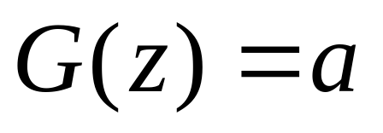

Question: How to solve the reformulated problem:
An overdetermined system
for its
least squares solution
pejorative manifold
a
Minimize || G(z)=a ||²
u=G(z)
-26-

Slide 28
The polynomial
a
Project to tangent plane
u₁ = G(z₀)+J(z₀)(z₁- z₀)
tangent plane P₀ :
u = G(z₀)+J(z₀)(z- z₀)
~
new iterate
u₁=G(z₁)
pejorative root
u*=G(z* )
initial iterate
u₀=G(z₀)
Pejorative manifold
u = G( z )
Solve
G(z₀)+J(z₀)( z - z₀ ) = a
for linear least squares solution z = z₁
Solve
G( z ) = a
for nonlinear least squares solution z=z*
G(z₀)+J(z₀)( z - z₀ ) = a
J(z₀)( z - z₀ ) = - [G(z₀) - a ]
z₁ = z₀ - [J(z₀)⁺] [G(z₀) - a]
-27-

Slide 29
The Gauss-Newton iteration
z ^{(i+1)} =z^{(i)} - J(z ^{(i)} )⁺[ G(z ^{(i)} ) - a ], i=0,1,2 ...
where J(.)⁺ is the pseudo-inverse of J(.)
Theorem: The Gauss-Newton iteration locally converges
        at quadratic rate if the polynomial is exact
        at linear rate if the polynomial is inexact but close
-28-

Slide 30
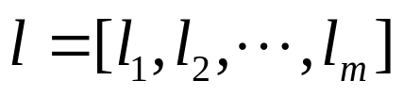

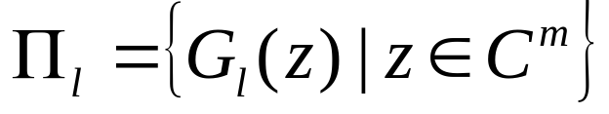
Algorithm: Given
multiplicity structure
initial iterate
Apply the Gauss-Newton iteration
z ^{(i+1)} =z^{(i)} - J(z ^{(i)} )⁺[ G_{l}(z ^{(i)} ) - a ], i=0,1,2 ...
on
As a well-posed and well conditioned problem,
multiple roots can be calculated accurately
-29-

Slide 31
Identifying the multiplicity structure
p(x)= (x-1)⁵(x-2) ³(x-3) = [(x-1)⁴(x-2) ²] [(x-1)(x-2)(x-3)]
p’(x)= [(x-1)⁴(x-2) ²] [ (x-1)(x-2)+5(x -2)(x -3)+3(x -1)(x -3) ]
GCD(p,p’) = [(x-1)⁴(x-2) ²]
distinct roots:
u₀(x) = [(x-1)⁴(x-2) ²] [(x-1)(x-2)(x-3)]
* * *
u₁(x) = [(x-1)³(x-2) ] [(x-1)(x-2)]
* *
u₂(x) = [(x-1)²] [(x-1)(x-2)]
* *
u₃(x) = [(x-1)] [(x-1)]
*
u₄(x) = [1] [(x-1)]
*
-----------------------------------------
u₀ = p
u_{m} =GCD(u_{m-1}, u_{m-1}’)
multiplicities 5 3 1
-30-

Slide 32



A squarefree factorization of f:
u₀ = f
for j = 0, 1, … while deg(u_{j}) > 0 do
u_{j+1} = GCD(u_{j}, u_{j}’)
v_{j+1} = u_{j}/u_{j+1}
end do
the key
Output : f = v₁ v₂ … v_{k}
with v_{j}’s being squarefree
- The number of distinct roots: m = deg(v₁)
- The multiplicity structure
- Roots of v_{j}’s are initial approximation to the roots of f
-31-

Slide 33
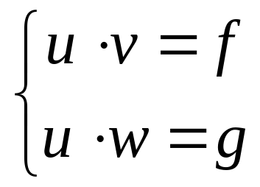
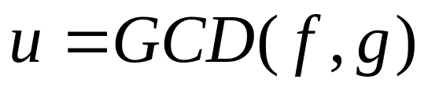
Root-finding leads to another ill-posed problem:
For given polynomials f and g, find u, v, w such that
which is an important application problem in its own right.
Applications: Robotics, computer vision, image restoration,
control theory, system identification, canonical
transformation, mechanical geometry theorem proving,
hybrid rational function approximation … …
The Approximate GCD of inexact polynomials. Part I: a univariate algorithm,
Z. Zeng
The Approximate GCD of inexact polynomials. Part II: a multivariate algorithm,
Z. Zeng and B. Dayton
-32-

Slide 34
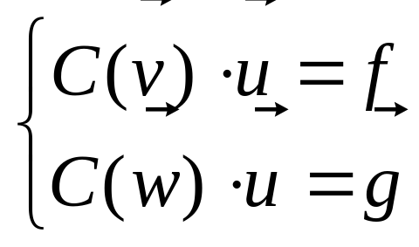
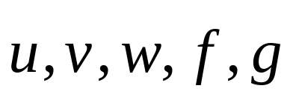
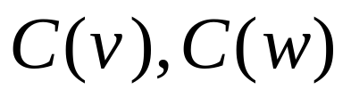
Again, the key:
Remove ill-posedness by reformulating the problem
If the degree of u = GCD(f,g) is known:
Where
: coefficient vectors
: convolution matrices
-33-

Slide 35
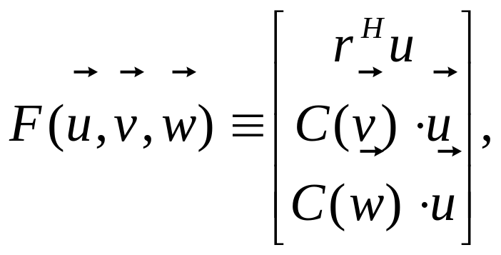
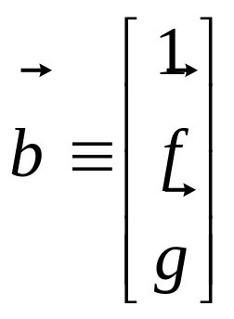
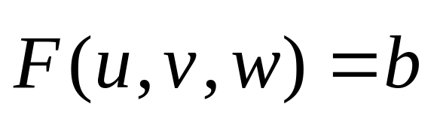
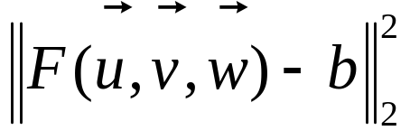
Define
GCD-finding
overdetermined system
Reformulated problem:
(a least squares problem)
Minimize
-34-

Slide 36
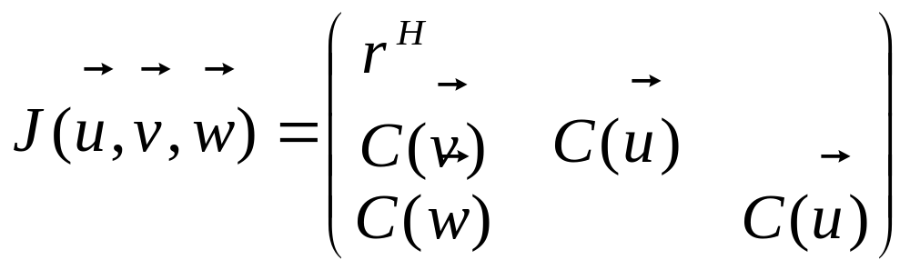

Minimize
For the problem
with
The Jacobian
Theorem: The Jacobian is of full rank if v and w are co-prime
--- ill posedness is removed!
-35-

Slide 37
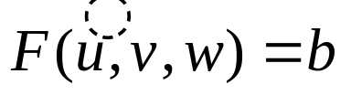

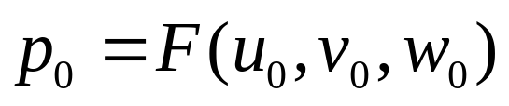

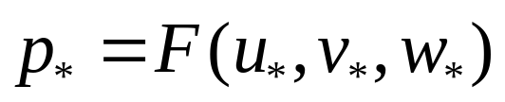
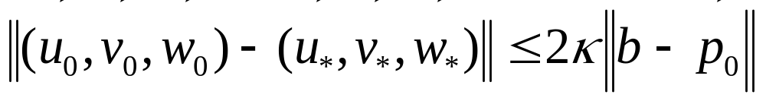
Illustration of the reformulated problem:
pejorative manifold
perturbed polynomial pair
perturbed polynomial pair
original polynomial pair (f,g)
projected polynomials with computed GCD
Again, the problem becomes well-posed, and often well-conditioned!
-36-

Slide 38

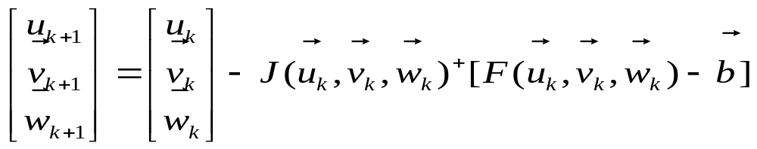

Given a polynomial pair ( f, g )
Problem: Find u = GCD( f, g ).
--- ill-posed
Reformulated problem:
Find a pair (p, q) = (uv, uw) that is nearest to ( f, g )
s.t. a constraint on the degree of u = GCD( p, q )
Or, solve
in least squares sense
is full-ranked
Condition number is finite
The Gauss-Newton iteration locally converges
-37-

Slide 39
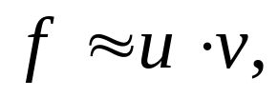

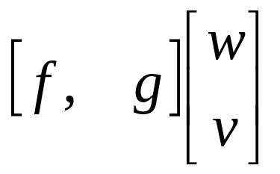
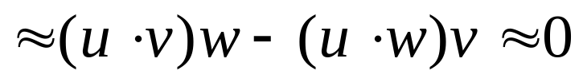
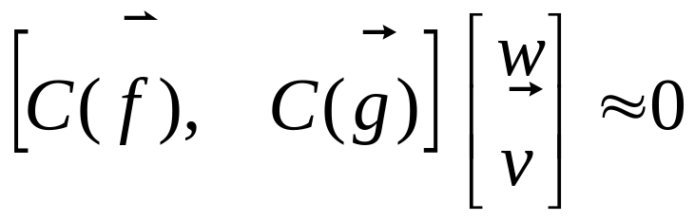
The question: How to determine the GCD structure
If
then
The Sylvester Resultant matrix
is approximately rank-deficient
The GCD structure is determined by computing
the approximate rank of Sylvester matrices
A rank-revealing method and its applications, T. Y. Li and Z. Zeng, to appear: SIMAX

Slide 40
For univariate polynomials :
Stage I: determine the GCD degree
QR
S₂(f,g)
QR
S₁(f,g) =
until finding the first rank-deficient Sylvester submatrix
Stage II: determine the GCD factors ( u, v, w )
by formulating
and the Gauss-Newton iteration
-39-

Slide 41
For multivariate polynomials ( f, g ):
Stage I: determine the GCD degrees
by applying the univariate GCD on each variable,
with other variable randomly fixed.
Stage II: determine the GCD factors ( u, v, w )
by formulating
and the Gauss-Newton iteration
-40-

Slide 42

Back to multiple root computation:
Stage I: determine the multiplicity structure
by squarefree factorization of f
via recursive GCD-finding
Stage II: determine multiple roots
by formulating
and the Gauss-Newton iteration
-41-

Slide 43

For polynomial
with (inexact ) coefficients in machine precision
Stage I results:
The backward error: 6.05 x 10⁻¹⁰
Computed roots multiplicities
1.000000000000353 20
2.000000000030904 15
3.000000000176196 10
4.000000000109542 5
Stage II results:
The backward error: 6.16 x 10⁻¹⁶
Computed roots multiplicities
1.000000000000000 20
2.999999999999997 15
3.000000000000011 10
3.999999999999985 5
-42-

Slide 44
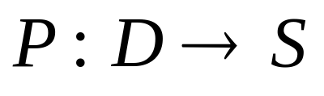
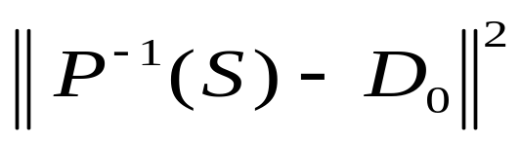

A two-stage strategy for removing ill-posedness:
For a problem
(data ----> solution)
with data D₀
Stage I: determine the structure Σ of the desired solution
this structure determines a pejorative manifold of data
Π = P⁻¹(Σ) = { D | P(D) = S fits the structure }
Stage II: formulate and solve a least squares problem
minimize
by the Gauss-Newton iteration
-43-

Slide 45
The two-stage approach leads to
Blackbox-type algorithms and software
rank-revealing algorithm
A rank-revealing method and its applications, T. Y. Li and Z. Zeng
univariate GCD algorithm
The approximate GCD of inexact polynomials. Part I: a univariate algorithm,
Z. Zeng
multivariate GCD algorithm
The approximate GCD of inexact polynomials. Part II: a multivariate algorithm,
Z. Zeng and B. H. Dayton
multiple root algorithm
Computing multiple roots of inexact polynomials, Z. Zeng
(Distinguished Paper Award, ISSAC 2003)
-44-

Slide 46
Computing the approximate JCF (joint work with T. Y. Li)
λ 1
λ 1
λ
Given A, find X, J:
AX = XJ
λ 1
λ
J =
JCF structure:
[3,2,2,1]
λ 1
λ
λ
Given A, find U, S
AU = US
staircase structure:
[4,3,1]
λ
λ
λ
λ
+ + +
+ + +
+ + +
+ + +
+
+
+
+
S=
λ
λ
λ
+
+
+
λ
-45-

Slide 47
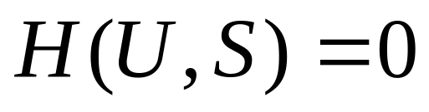
Reformulated problem:
Find U and S that
minimize || AU-US ||_{F}
subject to U^{T}U = I, E U = O
S has a staircase structure
(constraint minimization)
Or, solve an overdetermined system
in least squares sense
Theorem: If A is near a matrix that has an eigenvalue
exactly corresponds to staircase block S, then
the Jacobian of H(U,S) is of full rank.
--- ill-posedness is removed!
--- the Gauss-Newton iteration locally converges!
-46-

Slide 48
A two-stage strategy for computing JCF:
Stage I: determine the Jordan structure and
initial approximation to the eigenvalues
Stage II: Solve the reformulated minimization problem
at each eigenvalue, subject to the structural
constraint, using the Gauss-Newtion iteration.
-47-

Slide 49
Conclusion:
- Ill-posed problems may be reformulated
as well-posed and well conditioned ones
- A two stage approach may help solving
the problem accurately:
-- determine the structure
-- solve a constraint minimization
-48-

