Slide 1

Athlyze
An Agentic RAG Approach for Personalized Fitness and Nutrition
Nishchay Patel

Slide 2

Table of contents
(01)
Application Overview
(02)
Core Architecture
(03)
Data Flow & Chunking
(04)
Agentic Prompt Chain & Langflow
(05)
Performance & Evaluation
(06)
Conclusion & Future Scope

Slide 3
01
Application Overview
Athylze

Slide 4

Application Overview
Problem with Rigid rule-based models
Poor scientific integration
Static recommendations with low personalization
High user drop-off due to frustration caused by generic suggestions
What Athlyze Solves
Dynamically tailors advice using research paper through vector embeddings
Improves engagement via personalized, accurate outputs
Real-time adaptation using Google language models
Reasoning the response for the user against the research database

Slide 5

Athlyze is an intelligent platform that revolutionizes fitness and nutrition guidance by leveraging Agentic Retrieval-Augmented Generation (RAG). Designed to overcome the limitations of static, rule-based applications, it integrates cutting-edge AI techniques with scientific research to deliver hyper-personalized, adaptive plans tailored to each individual’s goals, physiology, and lifestyle.
Key Features
Research-Enriched Vector Repository
Agentic Chunking & Prompt Engineering
Multi-Agent LangFlow Architecture
Schema-Constrained Output Generation

Slide 6
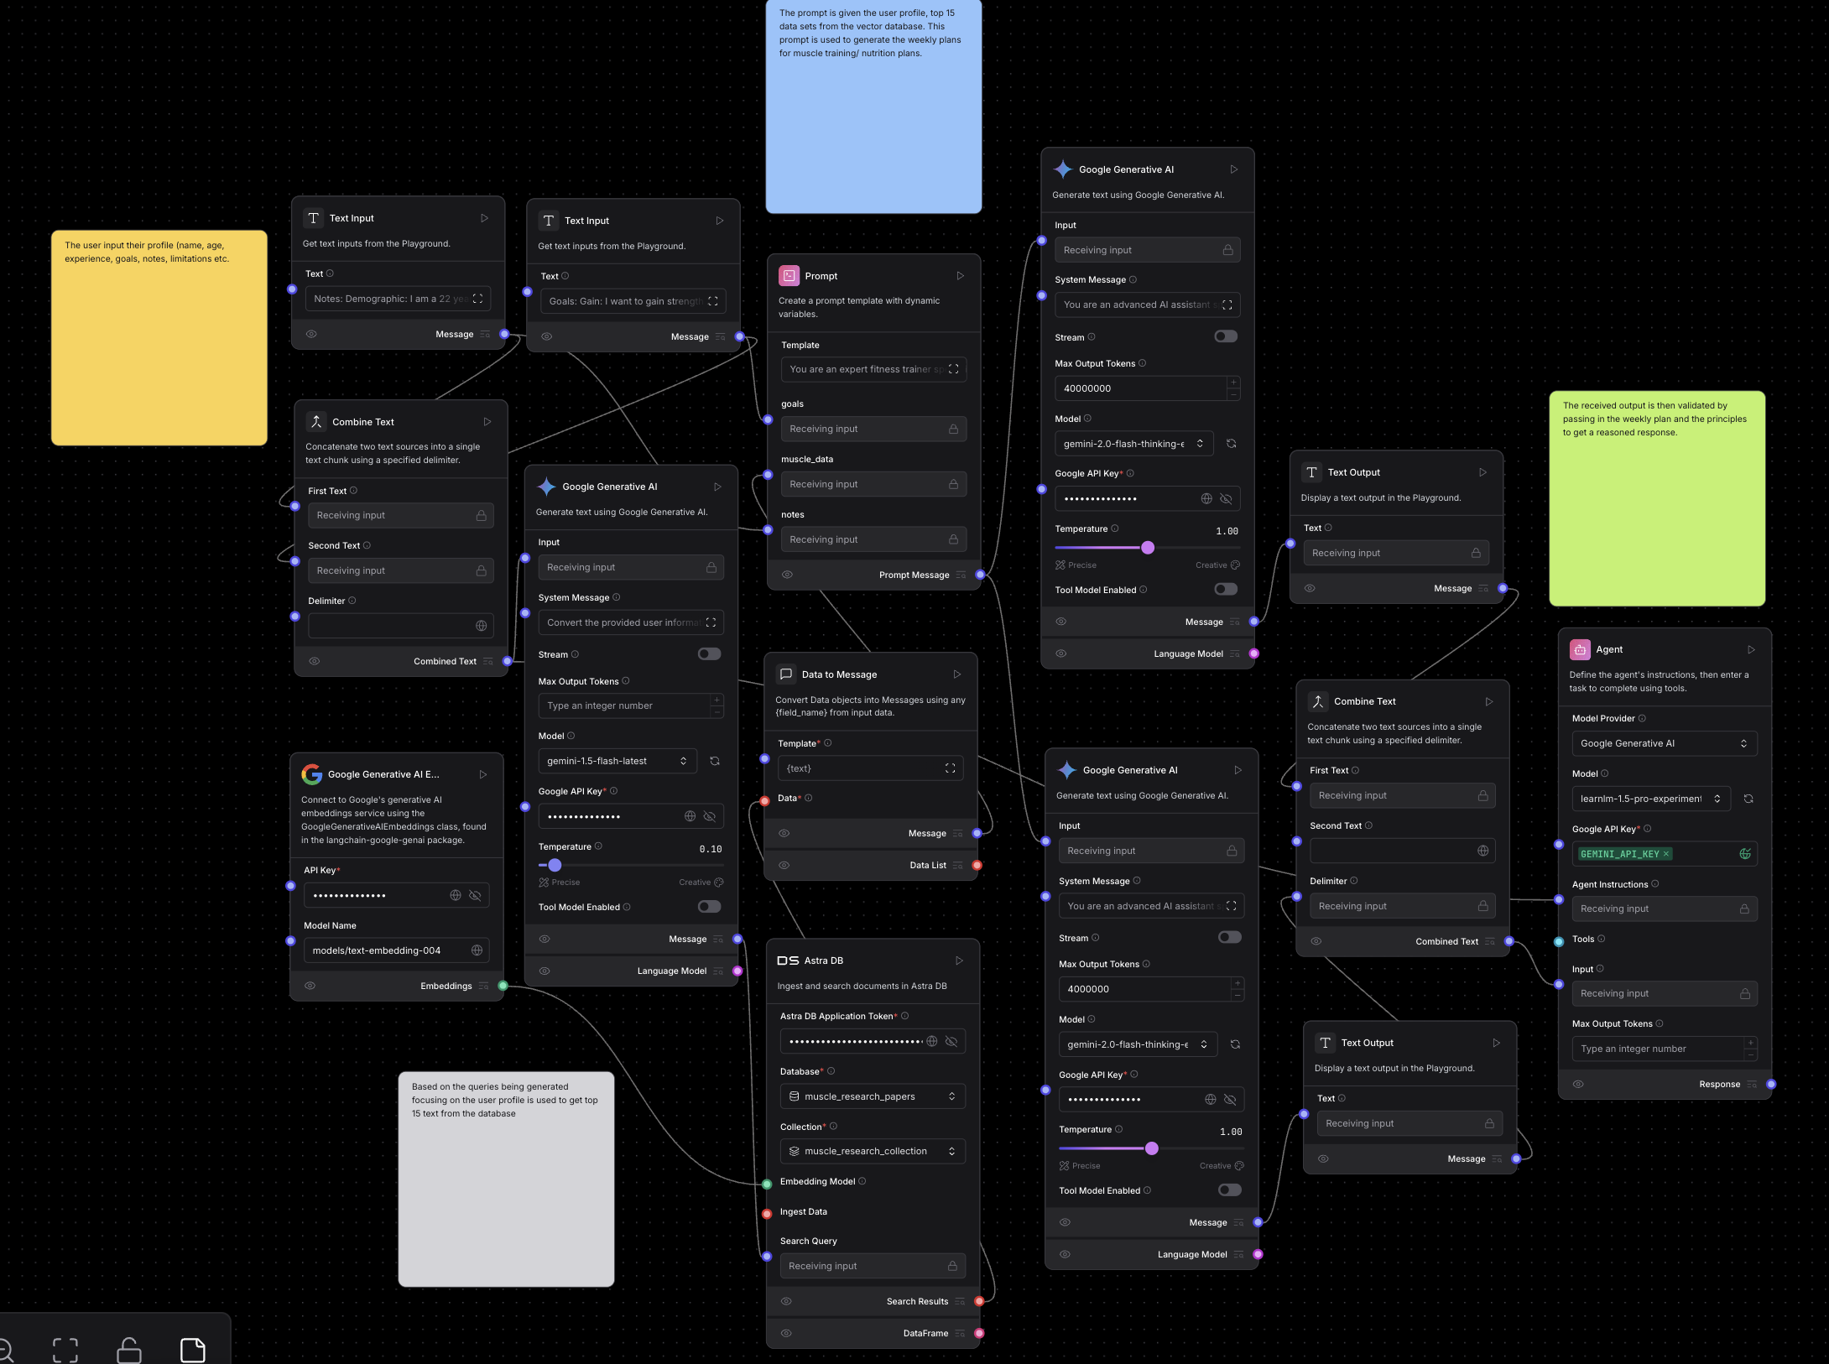

Slide 7
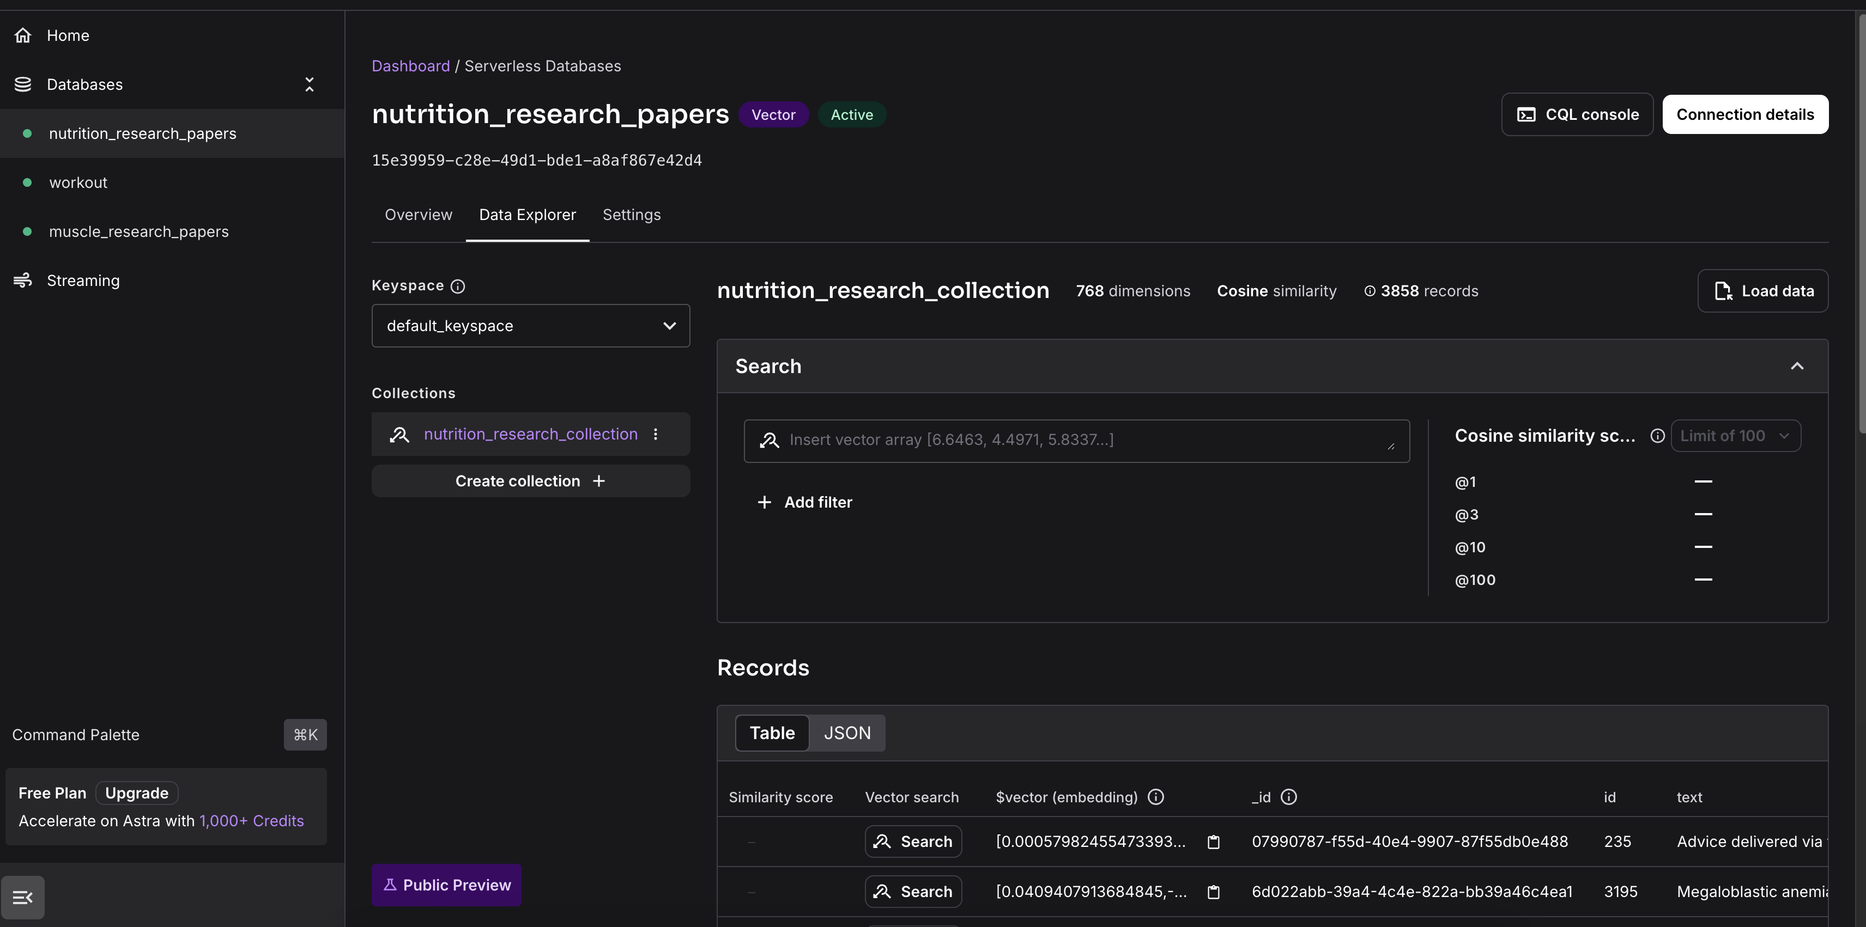

Slide 8
02
Core Architecture
Athylze

Slide 9

Core Architecture
Athlyze integrates multiple components across a parallel multi-agent RAG pipeline:
Key Technologies
Component Technology
LLM Gemini 2.0 Flash
Vector DB AstraDB
Orchestration via LangFlow
Embedding text-embedding-004
Infrastructure GCP Cloud Services
Functional Layers
• Data Collection (Research PDFs)
• Text Preprocessing & Chunking
• Embedding & Storage
• Query Understanding
• Personalized Plan Generation
• Response Structuring & Schema Enforcement

Slide 10
03
Data Flow & Chunking
Athylze

Slide 11
Data Flow & Chunking
Adaptive Chunking Process
Traditional fixed chunking = ❌ loss of semantic context
Athlyze’s Agentic Chunking = ✅ preserves propositions & relevance
Dynamically adjusts boundaries per semantic unit
Integrates metadata (source, topic, hierarchy)
Merges similar fragments recursively using α = 0.63
Result
Reduces context fragmentation
Boosts comprehension & generative fluency
Enables high-quality scientific grounding

Slide 12

Embedding and Retrieval
Vector Embedding Strategy
Uses Google’s text-embedding-004 to convert chunks into 768-dimension vectors
Embeds ~5,561 research excerpts (1,703 training, 3,858 nutrition) (in rows)
Each row includes: vector, ID, metadata, and raw text
Stored in AstraDB
Fast, scalable vector lookup
Filters results using cosine similarity ≥ 0.7
Enables accurate and relevant scientific retrieval

Slide 13
04
Agentic Prompt Chain & Langflow
Athylze

Slide 14
Agentic Prompt Chain & Langflow
Multi-Agent Workflow (via LangFlow)
User Profiling Agent: Collects goals, dietary needs, constraints
Query Generator Agent: Dynamically creates research queries (Qₘ, Qₙ)
Retriever Agent: Filters high-similarity vectors
Plan Generator Agent: Crafts detailed weekly schedules
Summarizer Agent: Extracts top-level guidelines
Validator Agent: Uses JSON schema to ensure structured, valid output
Each agent runs a Gemini model instance with role-specific prompts and temperature tuning.

Slide 15
Hierarchical Prompt Chain
3-Tier Gemini Agents
Stage | Model Function | Temp | Output
M1 | Query Generator | 0.1 | Qm , Qn (6 queries each)
M2 | Plan Synthesizer | 0.7 | Sm, Sn (weekly plan)
M3 | Guideline Summarizer | 0.4 | Gm , Gn (structured best practices)
Schema Enforcement
Every prompt is constrained via a JSON schema J to ensure:
Structural consistency
Accurate data types
Reusability in user interfaces

Slide 16
05
Performance & Evaluation
Athylze

Slide 17
Performance & Evaluation
Key Metrics
✅ Plan Accuracy: 90% over 20 diverse user profiles
🧠 Context Preservation: 89%
⚡ Avg. Response Time: 24–41 seconds
🔄 API Efficiency: < 5 calls per recommendation
🔍 Embedding Similarity: 0.8–0.9 for related clusters
🧯 Hallucination Rate: <4%
User Feedback
Users found the system scientifically grounded and easy to follow
Retention improved due to actionable, personalized advice

Slide 18
06
Conclusion & Future Scope
Athylze

Slide 19
Conclusion
Athlyze transforms static fitness platforms by fusing:
• Agentic RAG
• Multi-agent reasoning
• Research-grounded guidance
• Schema-enforced personalization
It’s a scalable, intelligent system

Slide 20
Future Works
Planned Upgrades
🔁 Real-time PubMed ingestion
🧠 Causal modeling (do-calculus for nutrition/training correlation)
🖼️ Visual embeddings (exercise diagrams, training videos)
🤖 Expanding LangFlow agents to new domains like physical therapy

Slide 21
Demo
Athylze

Slide 22
Thank You
Athylze

