Slide 1
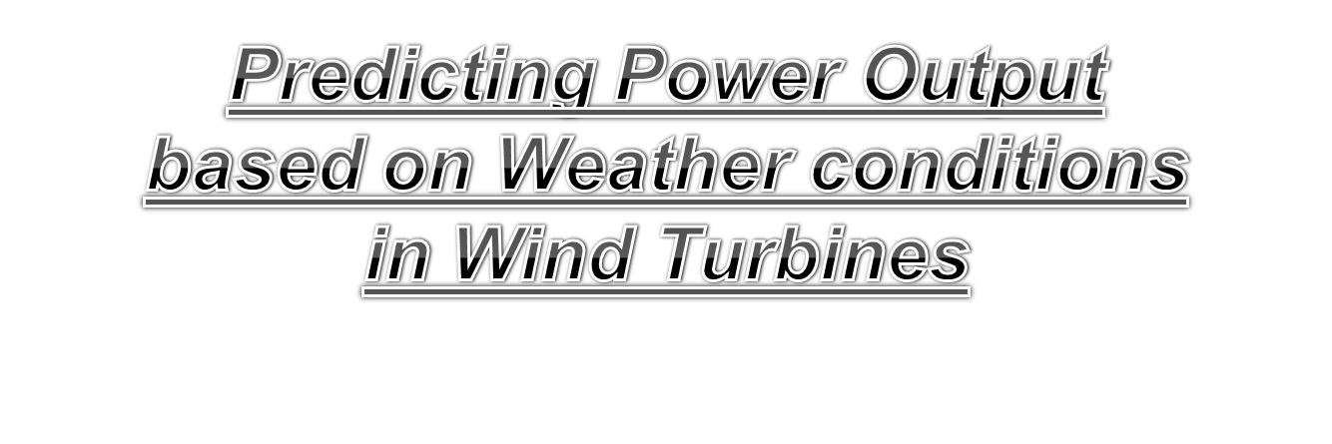
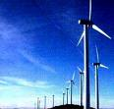
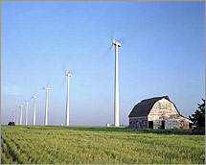



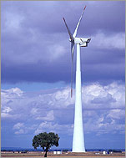



Slide 2

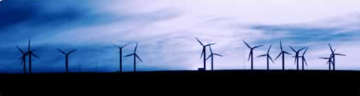
Wind Turbine Energy
Engineering 10, SJSU
Ken Youssefi

Slide 3
Wind Turbine
Wind energy is created when the atmosphere is heated unevenly by the Sun, some patches of air become warmer than others. These warm patches of air rise, other air rushes in to replace them – thus, wind blows.
A wind turbine extracts energy from moving air by slowing the wind down, and transferring this energy into a spinning shaft, which usually turns a generator to produce electricity. The power in the wind that’s available for harvest depends on both the wind speed and the area that’s swept by the turbine blades.

Slide 4
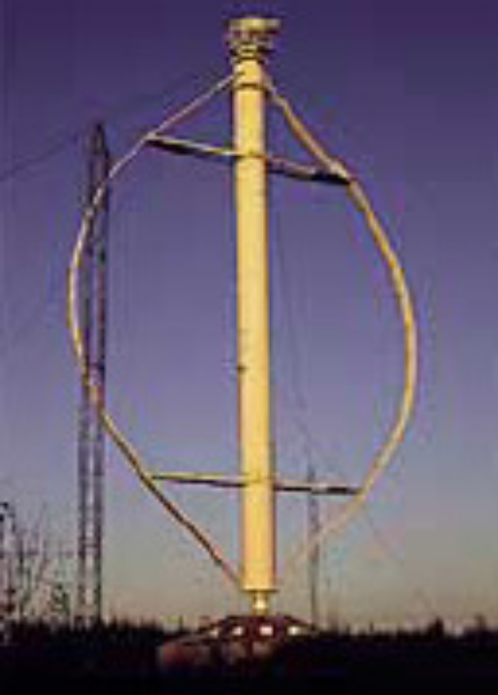
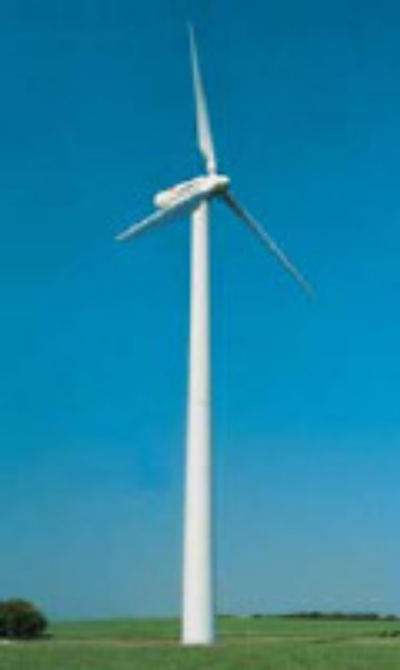
Wind Turbine Design
Two types of turbine design are possible – Horizontal axis and Vertical axis. In horizontal axis turbine, it is possible to catch more wind and so the power output can be higher than that of vertical axis. But in horizontal axis design, the tower is higher and more blade design parameters have to be defined. In vertical axis turbine, no such system is required and there is no cyclic load on the blade, thus it is easier to design. Maintenance is easier in vertical axis turbine whereas horizontal axis turbine offers better performance.
Vertical axis Turbine
Horizontal axis Turbine

Slide 5
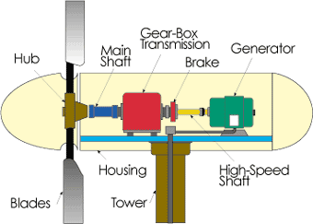
Main components of a Horizontal Axis Wind Turbine
Blades and rotor: Converts the wind power to a rotational mechanical power.
Generator: Converts the rotational mechanical power to electrical power.
Gear box: Wind turbines rotate typically between 40 rpm and 400 rpm. Generators typically rotates at 1,200 to 1,800 rpm. Most wind turbines require a step-up gear-box for efficient generator operation (electricity production).

Slide 6
Main components of a Wind Turbine
Rotor
Rotor
The portion of the wind turbine that collects energy from the wind is called the rotor. The rotor usually consists of two or more wooden, fiberglass or metal blades (new design) which rotate about an axis (horizontal or vertical) at a rate determined by the wind speed and the shape of the blades. The blades are attached to the hub, which in turn is attached to the main shaft.

Slide 7
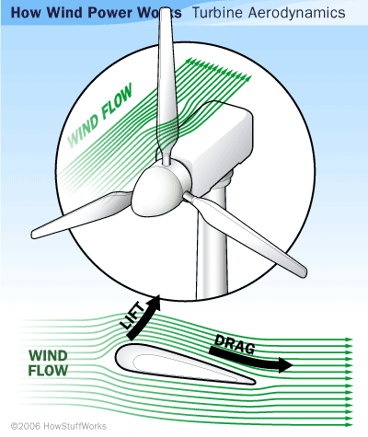
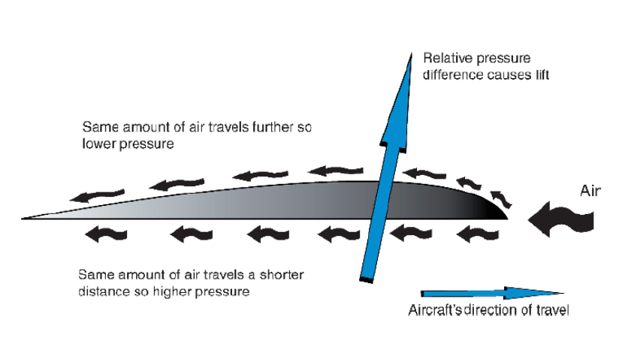
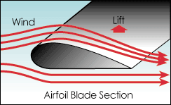
Wind Turbine
Lift Design
The lift blade design employs the same principle that enables airplanes, kites and birds to fly. The blade is essentially an airfoil, or wing. When air flows past the blade, a wind speed and pressure differential is created between the upper and lower blade surfaces. The pressure at the lower surface is greater and thus acts to "lift" the blade. When blades are attached to a central axis, like a wind turbine rotor, the lift is translated into rotational motion. Lift-powered wind turbines have much higher rotational speeds than drag types and therefore are well suited for electricity generation.

Slide 8
Typical Wind Turbine Operation
0 ~ 10 mph --- Wind speed is too low for generating power. Turbine is not operational. Rotor is locked.
10 ~ 25 mph --- 10 mph is the minimum operational speed. It is called “Cut-in speed”. In 10 ~ 25 mph wind, generated power increases with the wind speed.
25 ~ 50 mph --- Typical wind turbines reach the rated power (maximum operating power) at wind speed of 25mph (called Rated wind speed). Further increase in wind speed will not result in substantially higher generated power by design. This is accomplished by, for example, pitching the blade angle to reduce the turbine efficiency.
> 50 mph --- Turbine is shut down when wind speed is higher than 50mph (called “Cut-out” speed) to prevent structure failure.

Slide 9
Theoretical Power Generated by Wind Turbine
Power = ½ (ρ)(A)(V)³
ρ = Density of air = 1.2 kg/m³ (.0745 lb/ft³), at sea level, 20 ºC and dry air
A = swept area = π(radius)², m²
V = Wind Velocity, m/sec.
ρ = 1.16 kg/m³, at 1000 feet elevation
ρ = 1.00 kg/m³, at 5000 feet elevation
ρ = 1.203 kg/m³ at San Jose, at 85 feet elevation. The average wind velocity is 5 mph at 50m tower height
ρ = 1.16 kg/m³ at Altamont pass, at 1010 feet elevation and average wind velocity of 7m/s (15.6 mph) at 50m tower height (turbines need a minimum of 14 mph, 6.25 m/s, wind velocity to generate power).
Notes:
Start

Slide 10
Power Generated by Wind Turbine
How much power a wind turbine with 50 meters long blade can generate with a wind speed of 12 m/s? The site of the installation is about 1000 feet above sea level. Assume 40% efficiency (η).
Air density is lower at higher elevation. For 1000 feet above sea level, ρ is about 1.16 kg/m³
Power = ½ (ρ)(A)(V)³ (η)
= 0.5(1.16)(π50²)(12)³(0.4)
= 3.15 x 10⁶ Watt
= 3.15 MW
where we assumed the turbine efficiency is 40%.

Slide 11
Wind Turbine
The Generator
The generator converts the mechanical energy of the turbine to electrical energy (electricity).
Inside this component, coils of wire are rotated in a magnetic field to produce electricity. Different generator designs produce either alternating current (AC) or direct current (DC), available in a large range of output power ratings.
Most home and office appliances operate on 120 volt (or 240 volt), 60 cycle AC. Some appliances can operate on either AC or DC, such as light bulbs and resistance heaters, and many others can be adapted to run on DC. Storage systems using batteries store DC and usually are configured at voltages of between 12 volts and 120 volts.
Generators that produce AC are generally equipped with features to produce the correct voltage (120 or 240 V) and constant frequency (60 cycles) of electricity, even when the wind speed is fluctuating.

Slide 12
Wind Turbine
Transmission
Most wind turbines require a gear-box transmission to increase the rotation of the generator to the speeds necessary for efficient electricity production.
The number of revolutions per minute (rpm) of a wind turbine rotor can range between 40 rpm and 400 rpm, depending on the model and the wind speed. Generators typically require rpm's of 1,200 to 1,800. As a result, Some DC-type wind turbines do not use transmissions. Instead, they have a direct link between the rotor and generator. These are known as direct drive systems. Without a transmission, wind turbine complexity and maintenance requirements are reduced, but a much larger generator is required to deliver the same power output as the AC-type wind turbines.

Slide 13
Problem Statement
Fossil fuels have been used extensively all over the world to satisfy energy demands. However, their availability is limited and their negative impact on the environment undeniable.
Due to this, the need to develop alternative energy resources was recognized a few decades ago.
Among different alternatives that have been developed, wind energy appears as a promising option to be implemented in many parts of the world.
In order to make wind energy more competitive and attractive to investors, new energy systems are desired. Specifically, it is desired to have a higher energy output.
It is also important to take into consideration all the factors that affect the wind power i.e, wind speed, direction, weather conditions like temperature, season, date/time.
The main moto of this project is to predict power output based on weather conditions which affects the wind power.

Slide 14
Data Collection
Context
In Wind Turbines, This Systems measure and save data's like wind speed, wind direction, generated power etc. for 10 minutes intervals. This file was taken from a wind turbine's system that is working and generating power in Turkey.
Attribute Information
The data's in the file are:
Date/Time (for 10 minutes intervals)
LV ActivePower (kW): The power generated by the turbine for that moment
Wind Speed (m/s): The wind speed at the hub height of the turbine (the wind speed that turbine use for electricity generation)
Theoretical_Power_Curve (KWh): The theoretical power values that the turbine generates with that wind speed which is given by the turbine manufacturer
Wind Direction (°): The wind direction at the hub height of the turbine (wind turbines turn to this direction automatically)

Slide 15
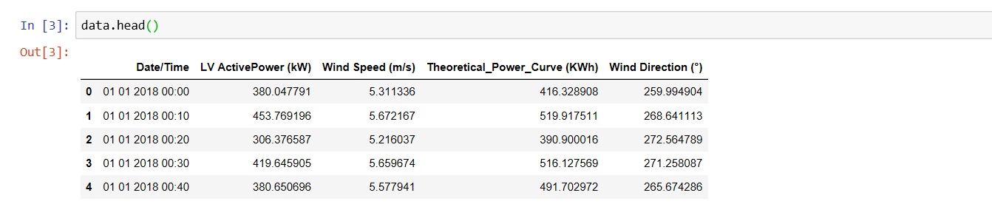
Data Table

Slide 16
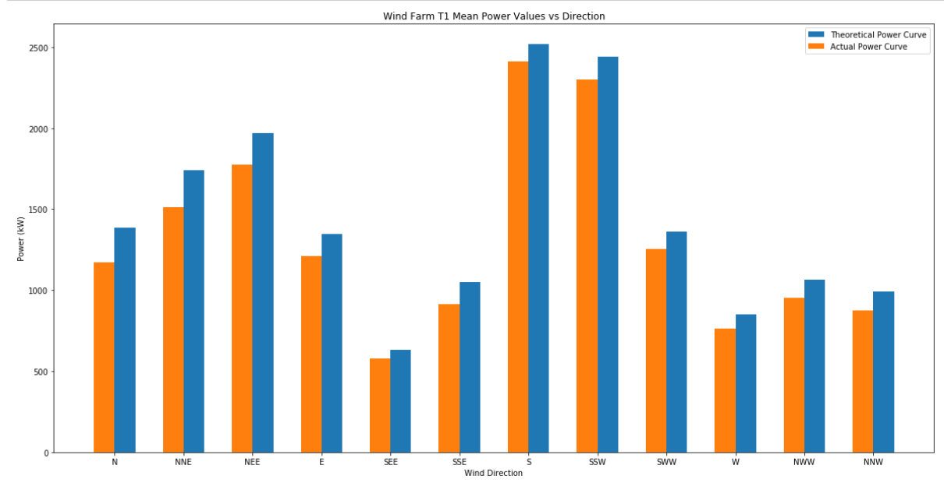
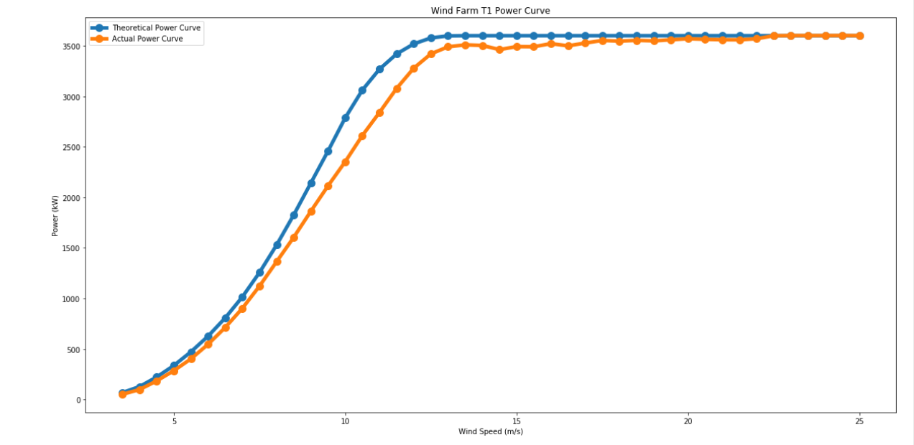
Data Graph

Slide 17
Data Modelling
The data model that we have used in our project is “Multiple Linear Regression” model.
What is Multiple Linear Regression” model???
Multiple Linear Regression is a simple and common way to analyse linear regression. The model is often used for predictive analysis since it defines the relationship between two or more variables
Here:
Y=b0+b1*x1+b2*x2+b3*x3+……bn*xn
Y = Dependent variable and x1, x2, x3, …… xn = multiple independent variables

Slide 18
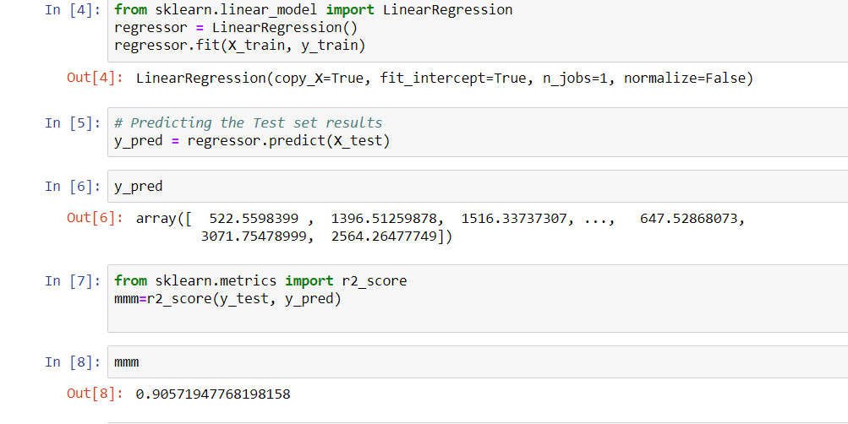
Accuracy:

Slide 19
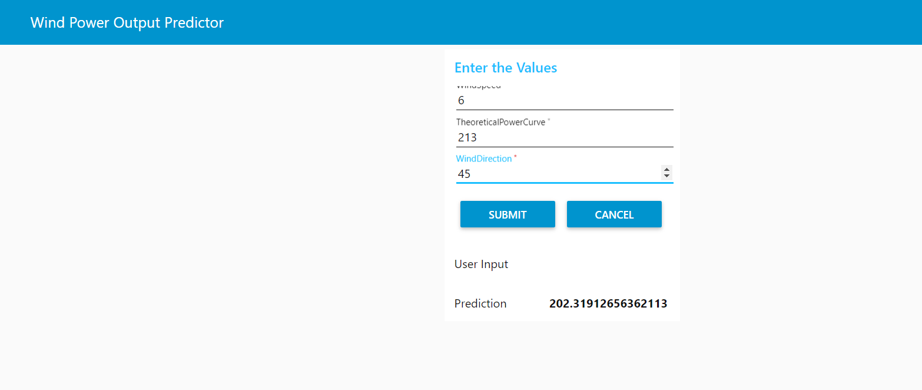
OUTPUT

Slide 20


