Slide 1
Introduction
Lesson Learning outcomes.
After understating this lesson, a student should be able to
  Explain the need of programing languages.
  Explain why natural languages cannot be used for programing.
  List the main features of any programing language.
  Describe the basic components of any language.
  Describe with examples the terms “syntax” and “semantic” with respect to programing languages.
Programming Languages
Introduction - <number>

Slide 2
Introduction
Programming language theory (commonly known as PLT) is a branch of computer science that deals with the design, implementation, analysis, characterization, and classification of programming languages and programming language features.
Wikipedia
Programming Languages
Introduction - <number>

Slide 3
Introduction ….
Objectives :
To understand the important concepts of language theory.
To understand language design concepts and their effect on language design and implementation.
To look at language features, independent of any particular language.
Programming Languages
Introduction - <number>

Slide 4
Benefits
Improve the ability to develop effective algorithm.
  What is the cost (time,space,development time) in using a particular language feature in an algorithm?
Improve the use of existing languages.
  Knowledge on implementation mechanism may improve the efficient use of a feature.
Increase the vocabulary of useful programming constructs.
Allow a better choice of programming language.
Make it easier to learn new languages.
C -> C++ -> Java
Make it easier to design new languages.
Programming Languages
Introduction - <number>

Slide 5
Classification of languages
Natural Languages : Languages used by humans to communicate with humans.
Artificial languages : Languages built by humans for specific purposes.
Programming Languages
Introduction - <number>

Slide 6
Natural Languages
What are the inherent problems in natural languages?
Programming Languages
Introduction - <number>

Slide 7
Natural Languages
What are the inherent problems in natural languages.
  Ambiguous.
  Sometimes meanings depends on the context
  Complex
  Evolve with the time
Programming Languages
Introduction - <number>

Slide 8
Natural Languages
Ambiguity - the presence of multiple possible interpretations for the same sentence.
Lexical ambiguity : is the presence of two or more possible meanings within a single word
“The fisherman went to the bank.”
Syntactic ambiguity: is the presence of two or more possible meanings within a single sentence or sequence of words
  “The professor said on Monday he would give an exam.”
Programming Languages
Introduction - <number>

Slide 9
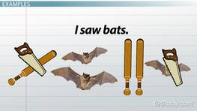
Example(Lexical Ambiguity)
Extracted from the web
Programming Languages
Introduction - <number>

Slide 10

Example (Syntactic ambiguity)
https://examples.yourdictionary.com/reference/examples/examples-of-ambiguity.html
Programming Languages
Introduction - <number>

Slide 11
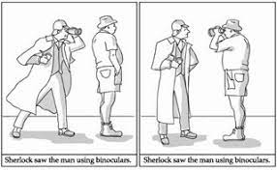
Example
Extracted from the web
Programming Languages
Introduction - <number>

Slide 12
Example
The following judgment is received by the prison about a convict in the prison.
මරන්න එපා ‍බේරන්න.
If you are in-charge of the prison, what do you do?
Programming Languages
Introduction - <number>

Slide 13
Quiz
Why we need programming languages?
Programming Languages
Introduction - <number>

Slide 14
Why Programming Languages?
A computer cannot understand the natural languages used by us. This necessitate the need of artificial languages, which can instruct machines to carry out functions we desire.
Programming Languages
Introduction - <number>

Slide 15
“To put it quite bluntly: as long as there were no machines, programming was no problem at all; when we had a few weak computers, programming became a mild problem, and now we have gigantic computers, programming had become an equally gigantic problem.”
E. W. Dijkstra ACM Turing Lecture 1972
Programming Languages
Introduction - <number>

Slide 16
Quiz
What should be the main properties of a any programming language?
Programming Languages
Introduction - <number>

Slide 17
What is a Programming Language ?
No universally agreed definition.
Any notational system for describing algorithms and data structures in both machine readable and human readable form and which can be implemented on a computer.
An artificial language that can be used to control the behavior of a machine, particularly a computer.
  Wikipedia
Programming Languages
Introduction - <number>

Slide 18
Programming languages allow
  Humans to communicate instructions to machines
  One device to communicate with another device.
Programming Languages
Introduction - <number>

Slide 19
Different Types of Programming Languages
What are the main differences between the following languages.
  HTML
  Python
  C
  PostScript
Programming Languages
Introduction - <number>

Slide 20
  Typically, markup languages like HTML are referred to as non-computational languages and generally not considered as programming languages.
Programming Languages
Introduction - <number>

Slide 21
Programming ?
Writing programs ?
Using an application package like spreadsheet or a word processor ?
  We issue commands for the computer by using some form of notation to carry out some tasks for us.
The term programming has a border meaning.
The traditional forms of programming are useful for a small group of people.
Programming Languages
Introduction - <number>

Slide 22
Programmer ?
Programmer is very much like an architect, a composer or a writer.
Tasks of a programmer
  Form an outline
  Translate the outline into a design
  Iteratively refine the design till it achieves the intended objectives
Programming Languages
Introduction - <number>

Slide 23
Programmer ? …..
When writing an application program, the programmer may have to choose from among several possibilities.
  Each choice may end up with a different organization of the program components.
  Improper understanding of the consequents of using choices typically results in a bad design – ad hoc design
Programming Languages
Introduction - <number>

Slide 24
Evolution of Programming Languages
Size of the problems to be solved by using computers grew from simple applications to complex systems
Languages used in the 1950s and '60s assumed that a single programmer could understand the entire problem and could write program(s) to solve the problem.
Programmers today are unable to understand all of the programs and data.
  Need for programming by using concepts and terms that are familiar, without having to transform the problem to unfamiliar structures.
Programming Languages
Introduction - <number>

Slide 25
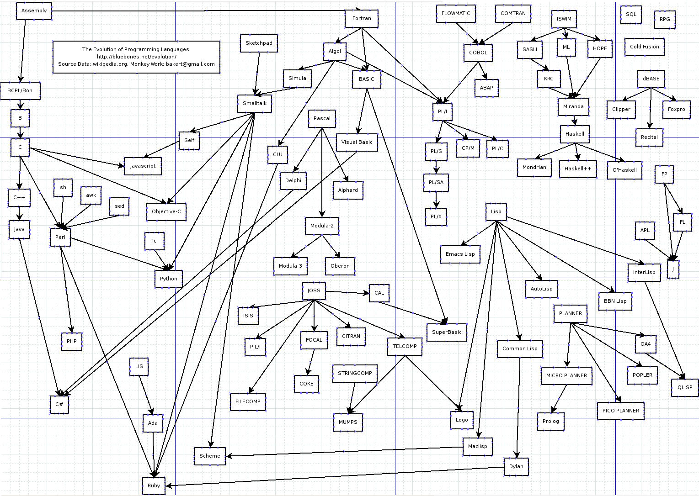
Programming Languages
Introduction - <number>

Slide 26
Evolution of Programming Languages
50s and early 60s: Simple applications; main concern is on machine efficiency.
Late 60s: efficiency of programmers became important; readability, better control structures. maintainability
Late 70s: Data abstraction
Middle 80s: Object-oriented programming
95-today: distributed programs, the web
Programming Languages
Introduction - <number>

Slide 27
Computers do exactly what they are told to do. Therefore, computers can not understand the program the programmer “intend” to write.
The behavior of a program is fully specified by the
  Program
  The language definition
  The input given
Programming Languages
Introduction - <number>

Slide 28
Quiz
Why there are so many programming languages?
Programming Languages
Introduction - <number>

Slide 29
Hundreds of different programming languages are in existence today and new ones are created every year.
Professional programmer is likely to use many different languages during his career.
Mastering a programming language represents a considerable investment.
Each language typically constrains the user to a certain way of thinking, which may be hard to change once the language is mastered.
Programming Languages
Introduction - <number>

Slide 30
Different languages over the years have build communities of users, with different needs, different skills, and different goals.
All of the currently popular languages are “good” for certain communities, for certain purposes.
There is no such thing as a “best” language.
Programming Languages
Introduction - <number>

Slide 31
Why there are so many programming languages.
Features and requirements in different application domains are different and some may be conflicting – difficulty in integrating all requirements.
Programming Languages
Introduction - <number>

Slide 32
Why there are so many programming languages…….
Scientific domain :
  Large volume of complex computations typically on floating point numbers.
  Ability to handle large (multidimensional) arrays.
  Need for parallel computations
Programming Languages
Introduction - <number>

Slide 33
Why there are so many programming languages…….
Business applications:
  Work with persistence data.
  Ability to produce many different types of reports.
  Data analysis
Programming Languages
Introduction - <number>

Slide 34
Why there are so many programming languages…….
Systems programming:
  Ability to control various type of resources(devices)
  Work within time constraints.
Programming Languages
Introduction - <number>

Slide 35
Why new programming languages?
Widely used languages evolve very slowly.
  There is a large community of users and large program base. The cost of educating the large user community and adapting to new changes are very high.
Thus, new languages can evolve vary fast.
  If users can learn a language vary fast and build applications with ease or can be used to build applications that cannot be build by existing languages there is a tendency to move for the new language.
Programming Languages
Introduction - <number>

Slide 36
Some of the reasons for not been able to develop a successful universal language
  Types of Program rage from tiny scripts to perform a very simple task to collections of hundreds of programs to accomplish many tasks.
  Programmers range from novices to experts.
  Programs may run on systems rage from micro controllers to supercomputers.
  Some programs may undergo changes constantly whereas others may subjected to changes very rarely.
Programming Languages
Introduction - <number>

Slide 37
Components of Programming Languages
A programming language can be thought of as a collection of formal specifications concerning its
  Vocabulary (Alphabet),
  Syntax
  Semantic
Programming Languages
Introduction - <number>

Slide 38
Different Layers used in Programming
Application Systems
Programming Language
Compiler/Interpreter
Operating System
Machine language
Programming Languages
Introduction - <number>

Slide 39
General types of programming languages
  Machine level languages
    Consists of binary numbers that can be directly interpreted by a computer’s processor.
    The only notation that the computer can understand and respond to directly.
    The CPU usually has a small program called a micro code, embedded directly in the chip which translates machine instructions directly into hardware signals.
Programming Languages
Introduction - <number>

Slide 40
  Low-level languages
    Instructions are symbolic representation of the machine level languages. Typically, most instructions generate single machine instructions.
  High-level languages
Programming Languages
Introduction - <number>

