Slide 1
White spaces
White space characters are used to improve the readability of a program and as necessary to separate tokens from each other.
Token : indivisible lexical unit.
Characters designated as white space characters and the rules on their usage vary widely between languages.
A Language may designate any combination of the characters “space, newline, tab, page break” etc as white space characters.

Slide 2
Example : In Fortran
DO 5 I = 1.25
DO 5 I = 1, 25
Till the compiler comes to this position, it is not possible to identify the lexical units in the statement

Slide 3
Noise words
Optional words provided by a language only to improve readability of programs are called noise words.
Example : in COBOL there are about 400 reserved words and many of them are noise words.
For example, goto is a noise word for to.

Slide 4
Delimiters : Delimiters are predefined characters or character sequences defined by a language to identify boundary between separate syntactic units.
Example : Python
x=[12,23,True]

Slide 5
Free and fixed formats
A language is a free format language if a program statement can be encoded starting from anywhere on a line, and possible spanning over multiple lines without considering breaks between lines. Ex – C, Java
A fixed format language imposes restrictions on the format of statement such as starting point and line lengths.
Ex RPG2, Fortran 4

Slide 6
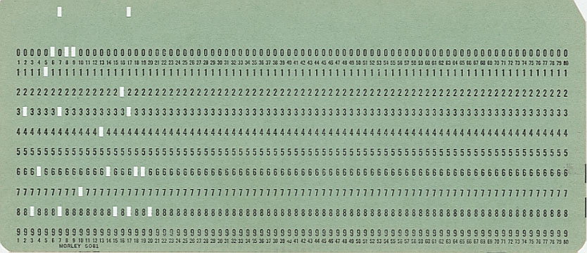
Fortran IV Programming Language
The original FORTRAN programs were prepared on a keypunch machine which punched holes into paper cards which had 80 characters maximum. For this reason, lines in a FORTRAN program are often referred to as "cards." Each card is either a "data" card, a "comment" card or a "statement" card.

