Slide 1





Music
Store Sales
Analysis

Slide 2

Introduction
The Music Store Analysis project aims to explore and analyze the operational and sales data of a digital music store using SQL. This project utilizes a relational database schema that includes detailed information about artists, albums, tracks, genres, customers, employees, invoices, and playlists. Through structured queries, the project provides valuable insights into customer behavior, sales trends, popular genres, and the relationships between employees and customers.
The analysis is conducted using SQL (Structured Query Language), which is an essential tool for managing and querying relational databases. By leveraging SQL’s capabilities, this project demonstrates how data can be efficiently retrieved, manipulated, and visualized to support decision-making processes in a music retail environment.

Slide 3




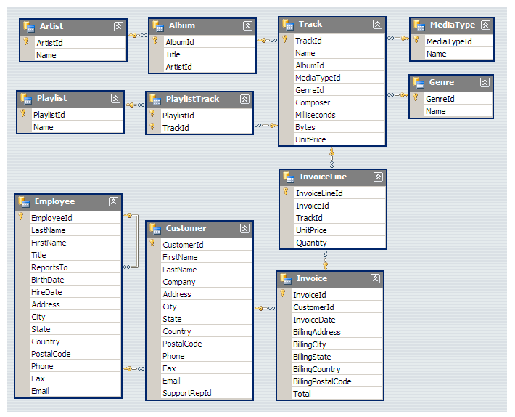
Data schema

Slide 4

Easy Problems
Who is the senior most employee based on job title?
Which countries have the most Invoices?
What are the top 3 values of the total invoice?
Which city has the best customers? We would like to throw a promotional Music Festival in the city we made the most money. Write a query that returns one city that has the highest sum of invoice totals. Return both the city name & sum of all invoice totals
Who is the best customer? The customer who has spent the most money will be declared the best customer. Write a query that returns the person who has spent the most money

Slide 5


Total Revenue generated from all sales
SELECT SUM(total) AS Total_Sales,
COUNT(*) AS Transactions
FROM invoice;

Slide 6

Country with most customers
SELECT billing_country,
COUNT(DISTINCT customer_id) AS customer_count
FROM invoice
GROUP BY billing_country
ORDER BY customer_count DESC
LIMIT 1;

Slide 7

Senior most employee based on job title
SELECT Title,
CONCAT(first_name, ' ', last_name)
AS Employee_Name
FROM employee
ORDER BY levels DESC
LIMIT 1;

Slide 8
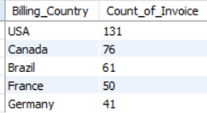
Which countries have the most Invoices?
SELECT Billing_Country,
COUNT(*) AS Count_of_Invoice
FROM invoice
GROUP BY Billing_Country
ORDER BY Count_of_Invoice DESC
LIMIT 5;

Slide 9
What are top 3 values of a total invoice?
SELECT total
FROM invoice
ORDER BY total DESC
LIMIT 3;

Slide 10
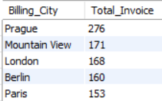
Which city has the best customers?
SELECT Billing_City,
SUM(total) AS Total_Invoice
FROM invoice
GROUP BY Billing_City
ORDER BY Total_Invoice DESC
LIMIT 5;

Slide 11
Moderate Problems
Write query to return the email, first name, last name, & Genre of all Rock Music listeners. Return your list ordered alphabetically by email starting with A.
Let's invite the artists who have written the most rock music in our dataset. Write a query that returns the Artist name and total track count of the top 10 rock bands
Return all the track names that have a song length longer than the average song length. Return the Name and Milliseconds for each track. Order by the song length with the longest songs listed first

Slide 12

Who is the best customer?
SELECT c.customer_id,
c.first_name,
c.last_name,
SUM(total) AS Total_Spent
FROM invoice AS i
JOIN customer AS c ON i.customer_id = c.customer_id
GROUP BY c.customer_id
ORDER BY Total_spent DESC
LIMIT 1;

Slide 13
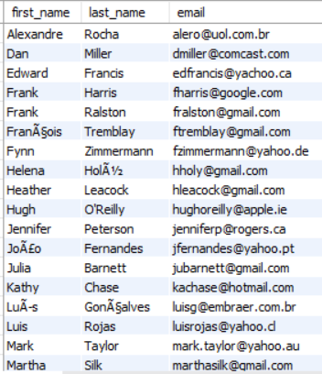
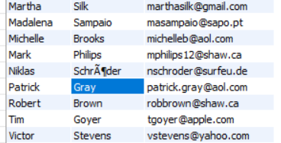
Customers with Rock Music Listeners
SELECT DISTINCT first_name,
last_name,
Email
FROM customer AS c
JOIN invoice AS i ON c.customer_id = i.customer_id JOIN invoice_line AS il ON il.invoice_id = i.invoice_id
WHERE
track_id IN (SELECT track_id
FROM track AS t
JOIN genre AS g ON t.genre_id = g.genre_id
WHERE name = 'Rock’)
ORDER BY email;

Slide 14
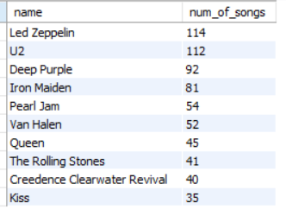
Top Rock Music Artists
SELECT artist.name,
COUNT(artist.artist_id) AS num_of_songs
FROM artist
JOIN album ON artist.artist_id = album.artist_id
JOIN track ON album.album_id = track.album_id
JOIN genre ON track.genre_id = genre.genre_id
WHERE genre.name = 'Rock’
GROUP BY artist.artist_id
ORDER BY num_of_songs DESC
LIMIT 10;

Slide 15
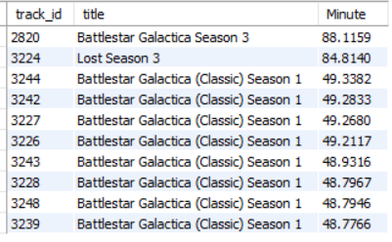
Top Tracks that have song length greater than average song length
SELECT track_id,
a.title,
(milliseconds / 60000) AS Minute
FROM track
JOIN album AS a ON track.album_id = a.album_id
WHERE milliseconds / 60000 > (SELECT AVG(milliseconds / 60000) FROM track)
ORDER BY milliseconds DESC
LIMIT 10;

Slide 16
Advance Problems
Find how much amount spent by each customer on artists? Write a query to return customer name, artist name, and total spent
We want to find out the most popular music Genre for each country. We determine the most popular genre as the genre with the highest number of purchases. Write a query that returns each country along with the top Genre. For countries where the maximum number of purchases is shared, return all Genres
.Write a query that determines the customer that has spent the most on music for each country. Write a query that returns the country along with the top customer and how much they spent. For countries where the top amount spent is shared, provide all customers who spent this amount

Slide 17
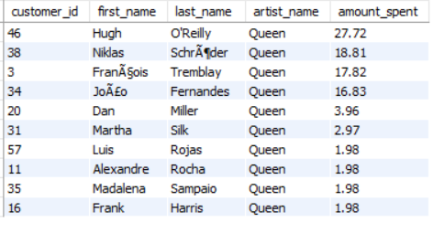
Amount Spent by each customer on most popular artist
WITH best_selling_artist AS
( SELECT artist.artist_id, artist.name AS artist_name, SUM(invoice_line.unit_price * invoice_line.quantity) AS total_sales FROM invoice_line
JOIN track ON invoice_line.track_id = track.track_id
JOIN album ON track.album_id = album.album_id
JOIN artist ON artist.artist_id = album.artist_id
GROUP by 1
ORDER by 3 DESC LIMIT 1 )
SELECT c.customer_id, c.first_name, c.last_name , bsa.artist_name, ROUND(SUM(invoice_line.unit_price * invoice_line.quantity),2)
AS amount_SPENT
FROM invoice
JOIN customer AS c ON invoice.customer_id = c.customer_id
JOIN invoice_line ON invoice_line.invoice_id = invoice.invoice_id JOIN track ON invoice_line.track_id = track.track_id
JOIN album ON album.album_id = track.album_id
JOIN best_selling_artist AS bsa ON bsa.artist_id = album.artist_id GROUP BY 1,2,3,4
ORDER BY 5 DESC;

Slide 18
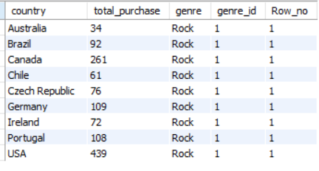
Most popular genre for each country
WITH popular_genre AS (
SELECT c.country,
Count(il.quantity) AS total_purchase,
g.name AS genre, g.genre_id,
ROW_NUMBER()
OVER(PARTITION BY c.country
ORDER BY COUNT(il.quantity) desc) AS Row_no
FROM customer AS c
JOIN invoice AS i ON c.customer_id = i.customer_id
JOIN invoice_line AS il ON i.invoice_id = il.invoice_id
JOIN track ON il.track_id = track.track_id
JOIN genre AS g ON g.genre_id = track.genre_id
GROUP BY c.country, g.name,4
ORDER BY c.country,
total_purchase DESC
)
SELECT * FROM popular_genre WHERE Row_no <=1;

Slide 19
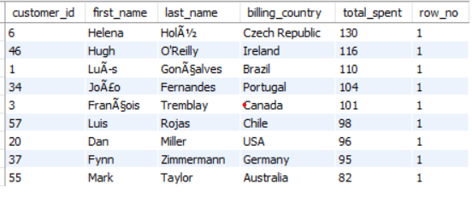
Customers that have spent the most for each country
WITH customer_w_country AS (
SELECT c.customer_id,
c.first_name,
c.last_name,
i.billing_country,
SUM(i.total) AS total_spent,
ROW_NUMBER()
OVER(PARTITION BY i.billing_country
ORDER BY SUM(i.total)desc) AS row_no
FROM customer AS c
JOIN invoice AS i ON c.customer_id = i.customer_id
GROUP BY 1, c.first_name, c.last_name, i.billing_country
ORDER BY total_spent DESC, 5
)
SELECT * FROM customer_w_country WHERE row_no <= 1;

Slide 20

Insight Report
Total sales amount to $4757 across 614 transactions.
USA has the largest customer base and generates the highest number of invoices.
Canada and Brazil also contribute significantly to the total invoice count.
Prague stands out as the top-performing city, with the highest total customer spending, making it an ideal candidate for hosting a promotional music festival.
Helena is the best customer, having spent a total of $130 — a valuable profile for VIP treatment or loyalty rewards.
Each country has at least one top customer based on total spend — these individuals can be targeted for exclusive offers.
Rock is the most popular genre across most countries, highlighting a strong global appeal.
Led Zeppelin has produced the highest number of Rock tracks — ideal for Rock playlists or promotional partnerships.
Customers have collectively spent a notable amount on music by the artist Queen, which shows strong brand power and fan loyalty.

Slide 21


Thank You

