Slide 1
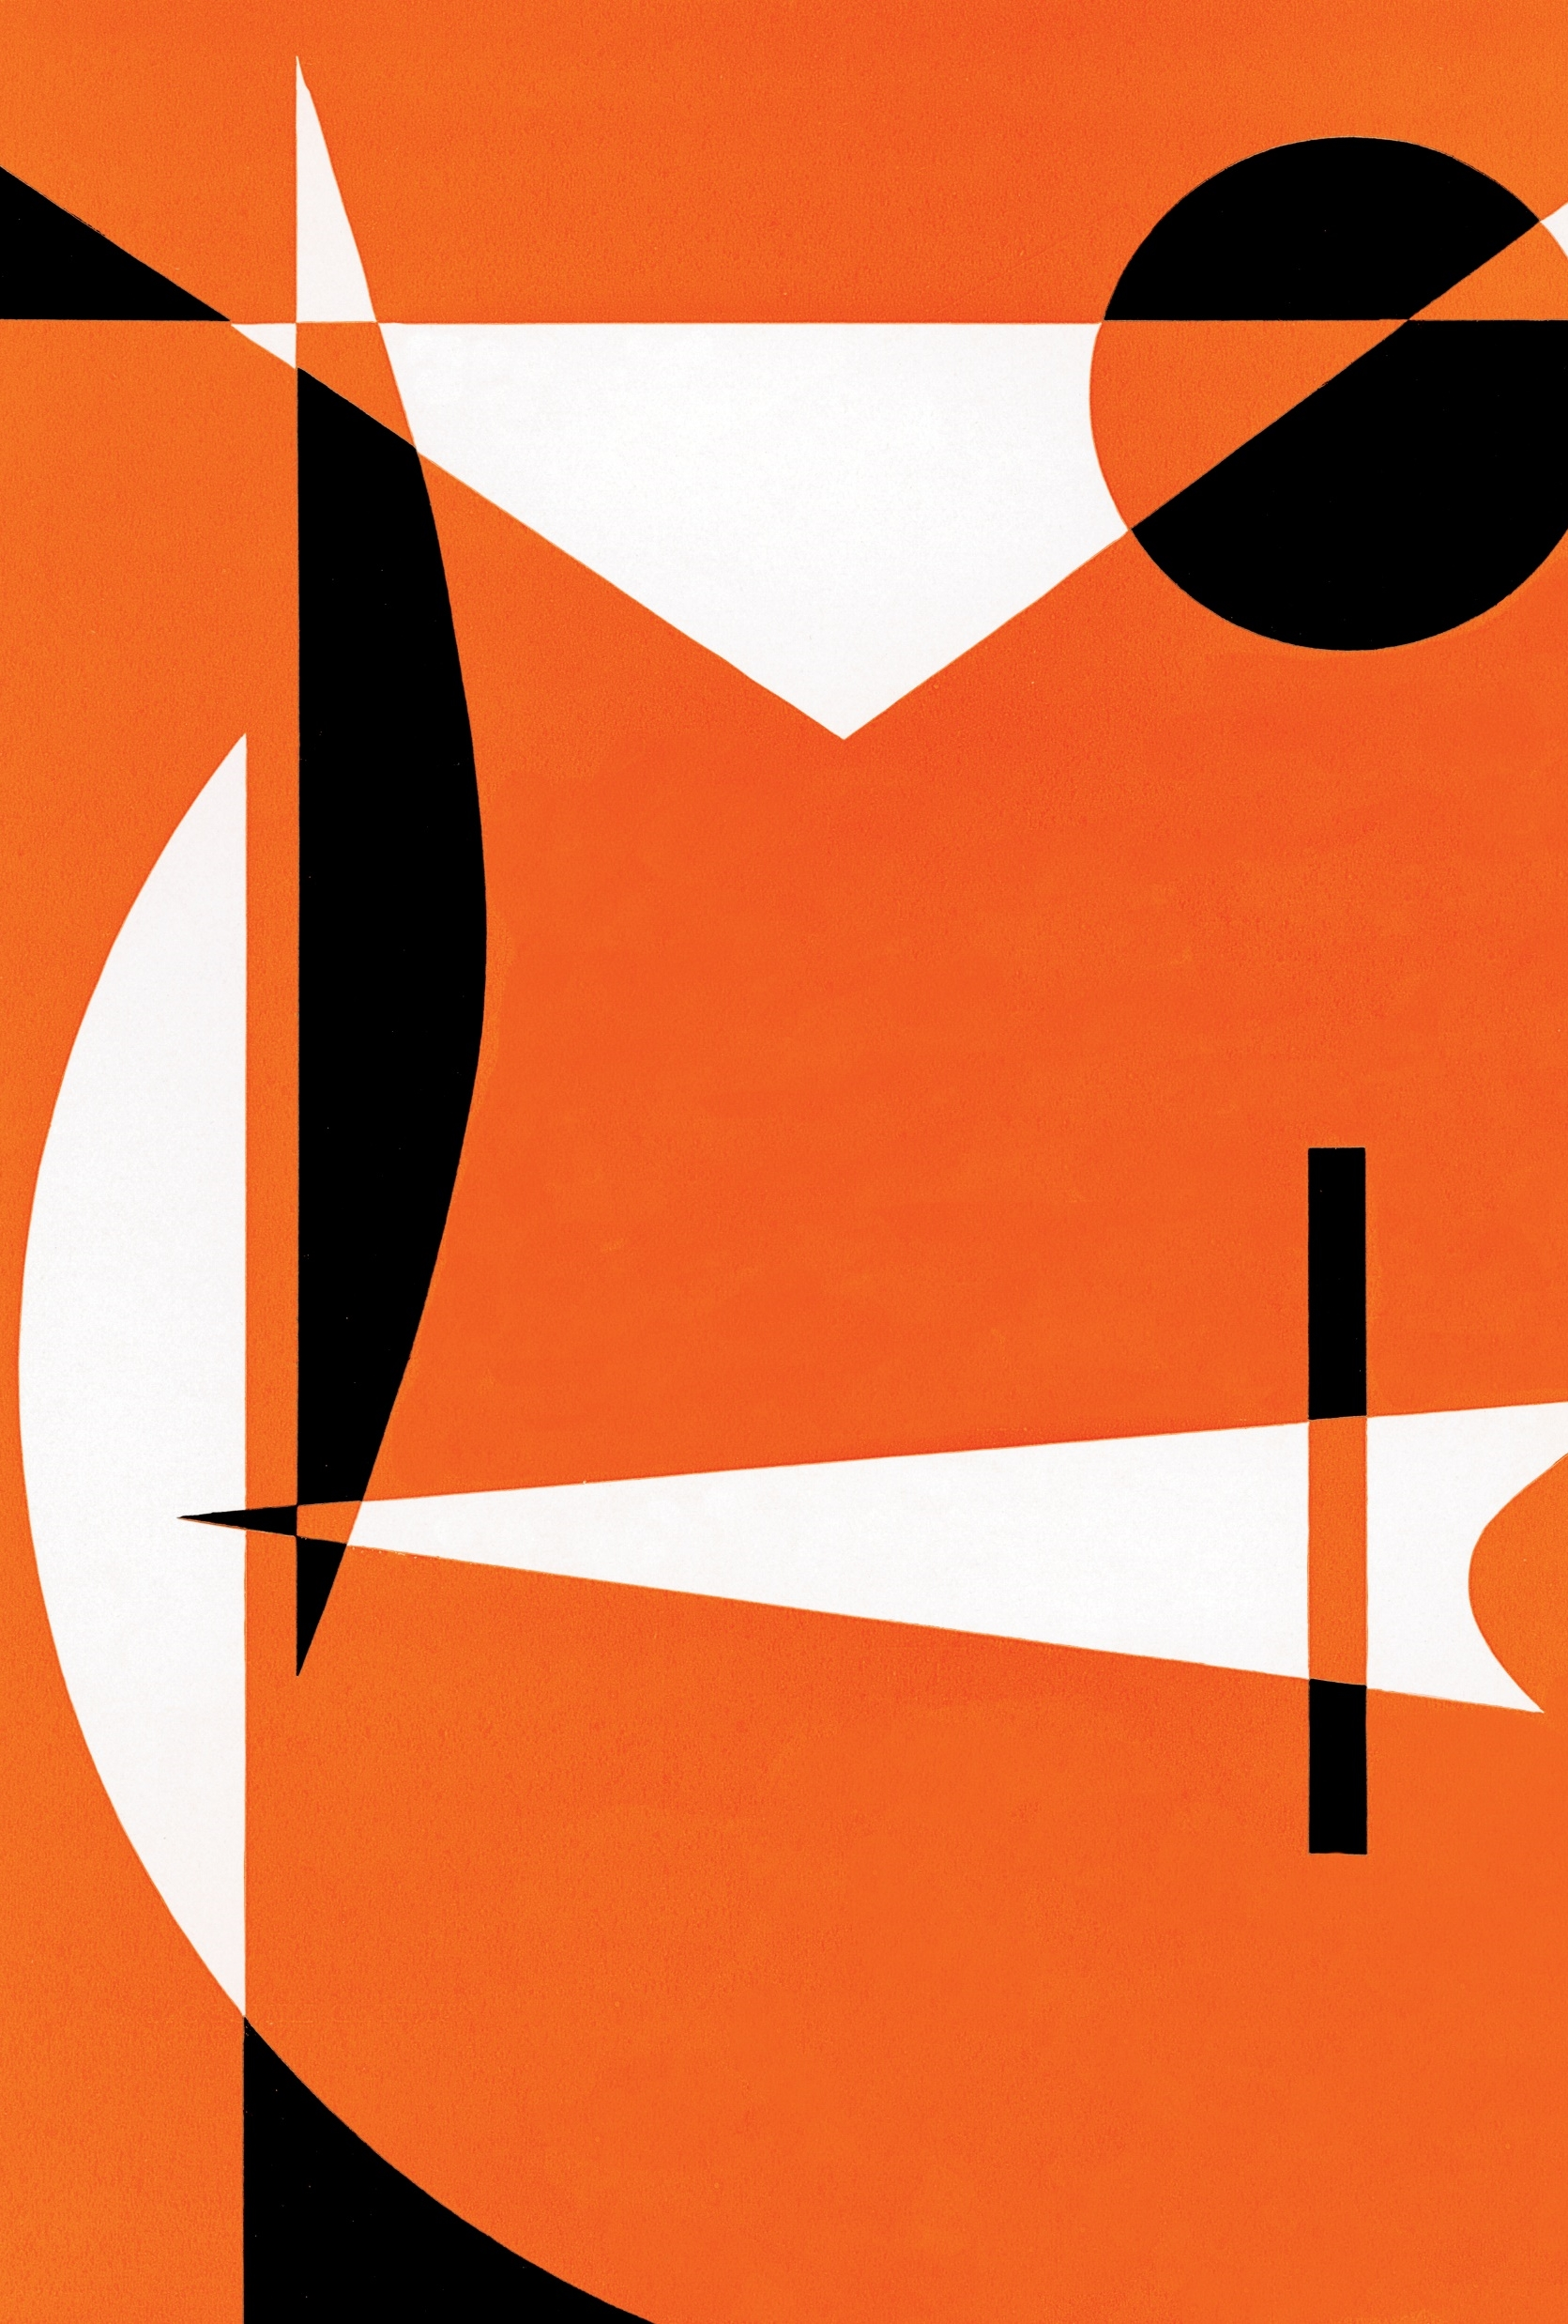
FINGER TARP
Marker on your point
NISHITA MATLANI-1902096
HARSH MEHTA-1902098
ISHA MEHTA-1902099
SHANVI MEHTA-1902100
GUIDE NAME:Dr. JAYANT GADGE

Slide 2
INTRODUCTION
Finger Tarp is a hands-free digital drawing canvas . It helps to draw on screen just by waving your finger fitted with a colorful point or a simple cap. We will be using computer vision techniques of OpenCV to build this project.
The preferred language is python due to its exhaustive libraries and easy to use syntax by understanding the basics it can be implemented easily .

Slide 3
OBJECTIVE
The basic objective is to depict the co-ordinates of the user’s finger on the screen.
This project is hands-free digital drawing board and the brush used can be modified by color with the help of color buttons.
The direction and mapping is completely controlled with the help of OpenCV software.
User can draw on the screen without any Hussle

Slide 4

PROBLEM STATEMENT
Finger tarp is designed to avoid the need of drawing tablets, stylus and expensive devices which are required today for online education especially during this pandemic.
As education is taking a huge turn various expensive devices can be replaced by this project.
Aim is to create a simple prototype for a tarp( drawing board ) that uses hand gestures to paint on a screen.

Slide 5
HARDWARE AND SOFTWARE REQUIREMENTS
Hardware: 8gb/512gb
i5 10th gen
Software: Python OpenCV
NumPy

Slide 6
TECHNOLOGY USED
Python : Python is an interpreted high-level general-purpose programming language. Its design philosophy emphasizes code readability with its use of significant indentation. Its language constructs as well as its object-oriented approach aim to help programmers write clear, logical code for small and large-scale projects.
OpenCV: OpenCV is a Python open-source library, which is used for computer vision in Artificial intelligence, Machine Learning, face recognition, etc. CV is an abbreviation form of a computer vision, which is defined as a field of study that helps computers to understand the content of the digital images such as photographs and videos.
NumPy: NumPy is a library for the Python programming language, adding support for large, multi-dimensional arrays and matrices, along with a large collection of high-level mathematical functions to operate on these arrays.

Slide 7
HOW DOES THIS EXACTLY HAPPEN?
The working of the entire procedure is explained in 4 simple steps
1
COLOUR TRACKING
2
DETECTION OF THE COLOURED POINT AT
THE FINGER TIP
3
TRACKING THE TIP
4
DRAWING THE POINTS

Slide 8
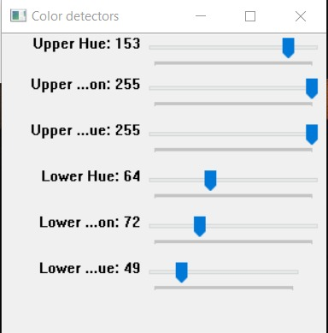
PROJECT WORKING IN STEPS
COLOR DETECTOR SCREEN
Here we set the saturation value of the bead
The saturation will be same as the color of the bead.

Slide 9
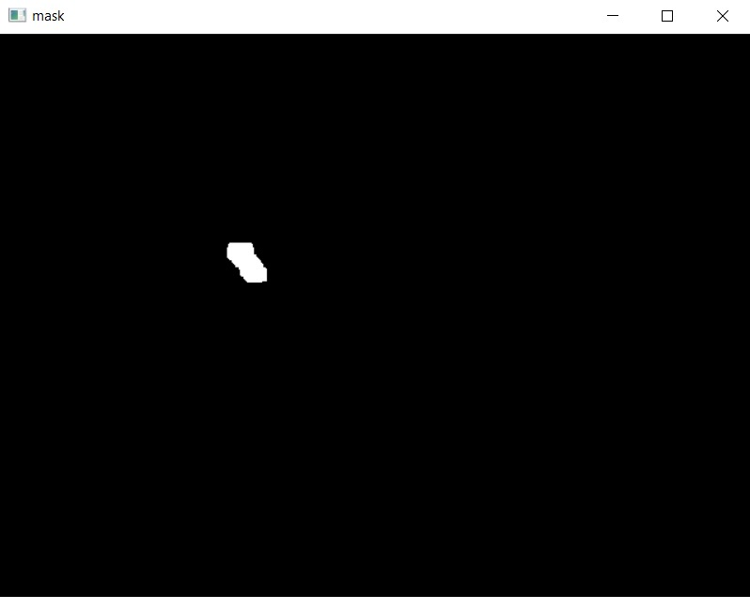
MASK SCREEN
Now the bead is tracked on the mask screen and this is called Color tracking
Mask screen will trace the path of the bead.
This screen is created using cv.inrange() function.
The screen tracks the center of the bead and this gives us the co-ordinates of the center and location of the bead. This is called Detection of the colored point at The finger tip.
With the help of these co-ordinates we can change the color and write on the screen.
MAIN TASK : Tracking of the bead

Slide 10
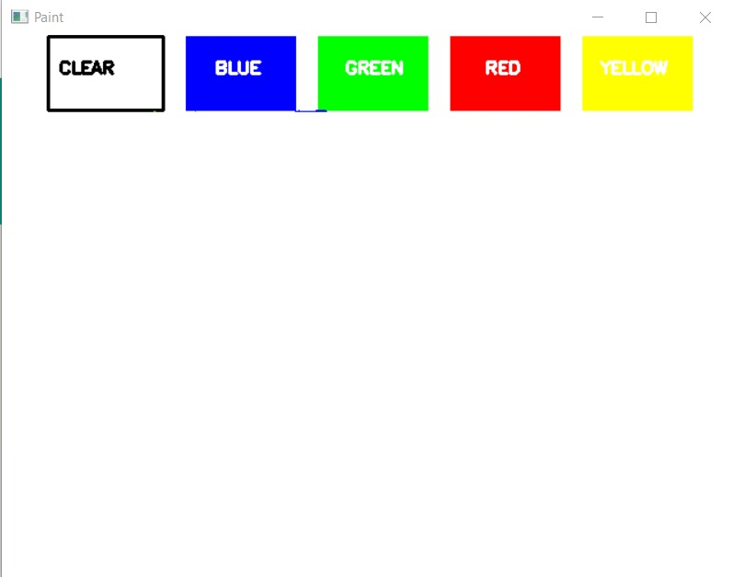
Color change & tracking
1. Mask Screen
Bead is traced and with the help of these co-ordinates we can change the colours and draw
2. Now for example if the Co-ordinates of the bead are from 10-40 (which is assigned for blue color)
3. So when we take our bead in those
co-ordinates the color with change to blue and we can draw the with the help of it.

Slide 11
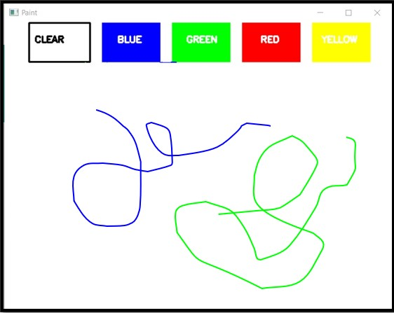
After the center of the bead is detected and the co-ordinates are found these co-ordinates are then stored in DEQUES. DEQUE – A data structure also known as a double-ended queue. Why do we store co-ordinates in deque ? What makes a deque different is the unrestrictive nature of adding and removing items. New items can be added at either the front or the rear. In Every successive frame we will store the pixels of that co-ordinates and the stored points will be filled with their respective color.
Where ever the bead is going the co-ordinates of that point are stored in deque
Red co-ordinates are stored in red deque and same for every color
If the bead is taken to clear the deques are then cleared and screen is clean

Slide 12
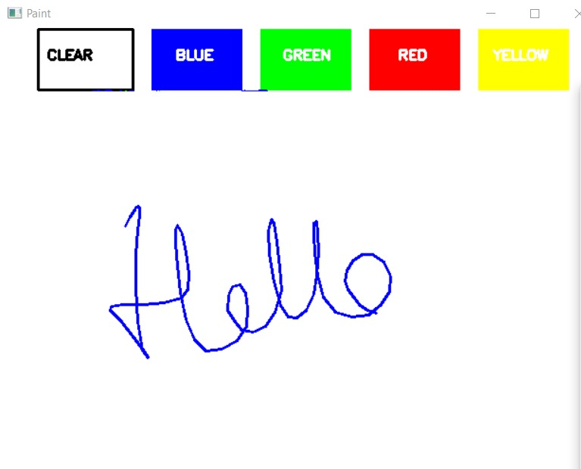
AND THE OUTPUT ON THE PAINT SCREEN WILL BE

Slide 13
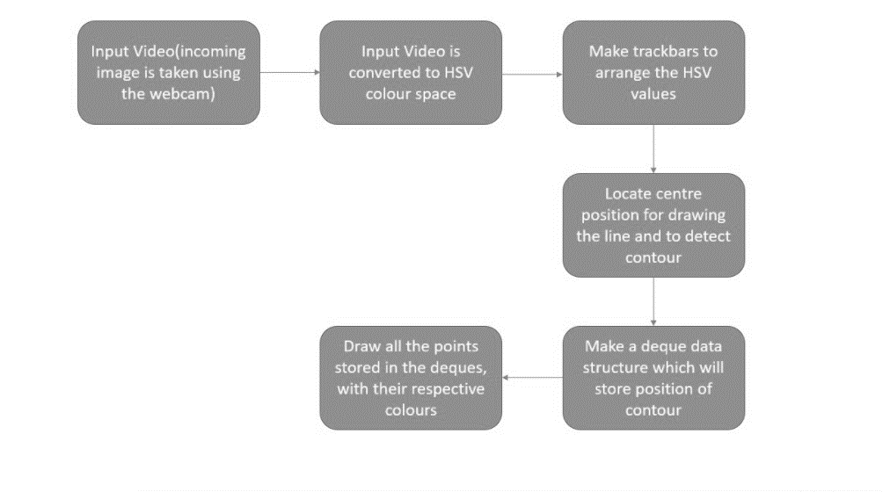
Block Diagram

Slide 14
CONCLUSION AND FUTURE SCOPE
Colorful lines can be drawn wherever the user desires .Its truly like drawing in the air.
It can be run authentically in real time in future.
We can enhance the hand gesture tracking and detecting the color contour more precisely .In future it can replace the white board as we can see online studies has become more common these days. It can be used in classrooms to making more interesting to learn things and easier for teachers to explain.
We can enhance this project by adding features in features like more colors, brushes, textures and option to save that work to

