Slide 1
Handwritten Text Recognition using Machine Learning Techniques
Presented by: Nishita Matlani
Shanvi Mehta
Isha Mehta

Slide 2
INTRODUCTION
Handwriting detection is a technique or capability of a Computer to receive and interpret intelligible handwritten data out of the source such as paper documents, touch screen, photo graphs etc.
Handwritten Text recognition is one of area pattern recognition. The goal of pattern recognition is to categorise or classify data or objects into one of several classes or categories.
Each script has a set of icons, which are known as characters or letters, which have certain basic shapes.

Slide 3
OBJECTIVE
The goal is to identify input characters or image correctly then analyzed to many automated process systems.
We further explore the task of classifying handwritten text and to convert handwritten text into the digital format.
In this project ,we took on the challenge of classifying the image of any handwritten word,which might be in the form of cursive or block writing.

Slide 4
PROBLEM STATEMENT
It’s difficult to store, access physical data and process the data in efficient manner.
Manually it is needed to update, and labor is required in order to maintain proper organization of the data.
Since for long time we have encountered a severe loss of data because of the traditional method of storing data.

Slide 5
BLOCK DIAGRAM
Real World Object
Image Acquisition
Digitization
Output
Image Information Extraction
Preprocessing

Slide 6
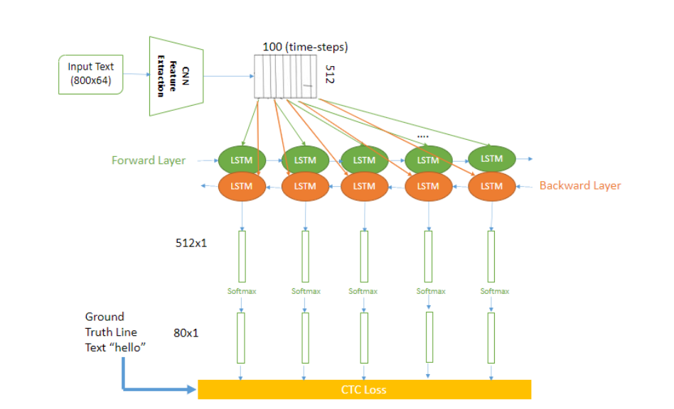
How it works ??

Slide 7
Operations
CNN: the input image is fed into the CNN layers. These layers are trained to extract relevant features from the image. Each layer consists of three operation. Then, the non-linear RELU function is applied. Finally, a pooling layer summarizes image regions and outputs a downsized version of the input.
RNN: the feature sequence contains 256 features per time-step, the RNN propagates relevant information through this sequence. The popular Long Short-Term Memory (LSTM) implementation of RNNs is used, as it is able to propagate information through longer distances and provides more robust training-characteristics than vanilla RNN.

Slide 8
CTC: while training the NN, the CTC is given the RNN output matrix and the ground truth text and it computes the loss value. While inferring, the CTC is only given the matrix and it decodes it into the final text. Both the ground truth text and the recognized text

Slide 9
Altogether there are 3 steps:
Multi-scale feature Extraction → Convolutional Neural Network 5 Layers
Sequence Labeling (BLSTM-CTC) → Recurrent Neural Network (2 layers of LSTM) with CTC
Transcription → Decoding the output of the RNN (CTC decode)

Slide 10
Technology Used
Tensorflow
Python
Numpy
OpenCV

Slide 11
THANK YOU

