Slide 1

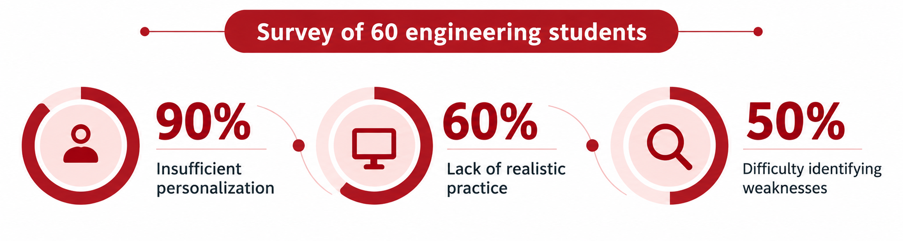
INTERVISTA
An AI-Powered Closed-Loop Framework for Adaptive Interview Preparation and Performance Improvement
Computer Engineering Department
Usha Mittal Institute of Technology,
S.N.D.T. Women’s University
Presented by:
1. Nishigandha Patil
2. Shipra Rode
Abstract
Implementation / Simulation Result
Results
Problem: Interview preparation is scattered across question banks, coding sites and mock interviews, so candidates rarely knows what to practise next.
Solution: INTERVISTA connects assessment, weakness identification, targeted practice, learning resources, and reassessment.
Technology: LLMs, RAG, Whisper speech recognition, persistent skill profiles and a contextual bandit.
Modules: Online assessment, coding, technical and HR interviews, placement simulation, group discussion.
Results: 17.6% average score gain, 81.6% grounded follow-ups, 95.2% weakness-focused retries, 76.6% relevant resources.
Profiling: resume, job description, company name and target role give context.
Interview engine: LLM (gpt-oss-120b on Groq) + RAG (FAISS) generate and validate questions; rules pick follow-ups.
Evaluation: text or voice answers, Whisper transcription, pace, fillers, clarity.
Skill tracking: profile updated after every session.
Adaptive learning: Learning Resources ranked from YouTube.
Frontend & Backend: HTML, CSS, JavaScript, Python, FastAPI
LLM & AI Services: Groq API (openai/gpt-oss-120b), OpenRouter API
RAG & Vector Search: Sentence Transformers (all-MiniLM-L6-v2), FAISS
Database & ORM: PostgreSQL, SQLAlchemy (SQLite fallback)
Speech Processing: Whisper (whisper-large-v3-turbo), FFmpeg
Coding Environment: Monaco Editor, OpenCompiler API
Score gain: +17.6% on average (Frontend 21.8%, Backend 20.7%, Data Analyst 10.4%).
Adaptive behaviour: 81.6% of follow-ups grounded in answers; 95.2% of retries targeted past weaknesses.
Resources: 76.6% matched the identified weaknesses.
Interpretation
Earlier answers shaped follow-ups; recorded weaknesses shaped retries and resources.
One persistent profile ties assessment feedback to progress tracking.
Observations & limitations
Scores plateaued around 66–70 after early gains; harder, more varied practice is needed.
One candidate profile per role: results do not prove causation or generalize. Needs larger studies and expert validation.
Introduction
Challenge: Technical knowledge, coding, problem-solving and communication are practised on separate platforms, with no link between feedback and next steps.
System architecture
User
Login / Sign up
Request flow
LLM · Technical/HR
Groq · gpt-oss-120b
LLM · GD
OpenRouter
SCREENSHOT
Evaluation report / results screen
score, strengths, weaknesses, areas to improve
Replace with your image
Data / results
Web Interface
Frontend
Interview & Practice Modules
Online Assessment (OA)
Individual Practice
Coding Practice
Group Discussion (GD)
FastAPI Orchestrator
Backend
Question bank (system dataset)
Technical Interview (LLM + RAG)
Monaco IDE (external)
AI Personas (OpenRouter)
Proposed Approach: INTERVISTA integrates assessment, weakness identification, targeted learning resources, and repeated practice in one AI-powered platform.
Objective: Help candidates identify what to improve and determine what to practise next.
HR Interview (LLM + RAG)
Open Compiler API
Conclusion
RAG Pipeline
Evaluation & Analysis Services
Unified preparation: assessment, coding, interviews, placement simulation and GD in one platform.
Closed-loop learning: assessment drives weakness diagnosis, targeted resources and the next practice.
Promising results: 17.6% average score gain with adaptive questioning and targeted learning.
Future scope: validate against human experts; larger controlled studies.
Resume / JD
Content Evaluation
Speech Analysis
Answer Analysis
Skill Update
Only OA, Individual Practice & Full Simulation
INTERVISTA closed loop
Context Retrieval
Assess
Diagnose
Adapt
Learn
Reassess
Relevant Questions
Adaptive Learning (Contextual Bandit)
Weaknesses persist in the candidate profile and steer every next attempt
State
Score + weak topics
Action Selection
Revision / Easy / Mixed / Advanced
Resource Recommendation
YouTube + ranking
Literature Survey
PostgreSQL
(SQLAlchemy)
Reports
Research Papers | Contribution | Limitation
MACH [1], TARDIS [2] | Conversational interview coaching | Focus on conversational skills
ERICA [3], EZInterviewer [4] | Automated mock interviews and follow-ups | Focus on interview simulation
MockLLM [5], Conversate [6] | Multi-agent practice and feedback | Focus on interactive practice
Naim et al. [7], HireNet [8], PolyInterview [9] | Automated interview assessment | Focus on performance evaluation
Knowledge Tracing [11], Contextual Bandits [12] | Learner modelling and adaptive learning | General learning approaches
User & Profile
Interview History
Session Reports
Skill State
Saved Resources
Placement Reports
Placement Report
after full simulation only
Module Reports
individual
References
OA Result
Technical Result
HR Result
Placement Report
OA
Technical
HR
Coding
GD
[1] M. E. Hoque et al., “MACH: My automated conversation coach,” UbiComp, 2013.
[2] K. Anderson et al., “The TARDIS framework: Intelligent virtual agents for social coaching in job interviews,” ACE, 2013.
[3] K. Inoue et al., “Job interviewer android with elaborate follow-up question generation,” ACM ICMI, 2020.
[4] M. Li et al., “EZInterviewer: To improve job interview performance with mock interview generator,” ACM WSDM, 2023.
[5] H. Sun et al., “MockLLM: A multi-agent behavior collaboration framework for online job seeking and recruiting,” ACM SIGKDD, 2025.
[6] T. Daryanto et al., “Conversate: Supporting reflective learning in interview practice through interactive simulation and dialogic feedback,” PACM HCI, 2025.
[7] I. Naim et al., “Automated analysis and prediction of job interview performance,” IEEE Trans. Affective Computing, 2018.
[8] L. Hemamou et al., “HireNet: A hierarchical attention model for the automatic analysis of asynchronous video job interviews,” AAAI, 2019.
[9] Z. Wen et al., “PolyInterview: An LLM-based platform for immersive mock interview practice with comprehensive multimodal assessment,” arXiv:2607.10310, 2026.
[10] S. Reddy et al., “Latent skill embedding for personalized lesson sequence recommendation,” ACM KDD, 2016.
[11] A. T. Corbett and J. R. Anderson, “Knowledge tracing: Modeling the acquisition of procedural knowledge,” UMUAI, 1994.
[12] B. Lin et al., “Contextual bandit with adaptive feature extraction,” arXiv:1802.00981, 2018.
Score progression (overall score)
Adaptive-behaviour metrics (%)
Research Gap: Existing approaches address interview simulation, assessment and adaptive learning separately. INTERVISTA integrates performance diagnosis, targeted resources and repeated practice into one framework.

