Slide 1

FemAI: An Intelligent PCOS Screening and Lifestyle Guidance Platform
Nishigandha Sawant (23107047)
Shaily Gupta (23107085)
Vaishnavi Jadhav (23107051)
Project Guide
Ms. Ujwala Pagare

Slide 2
Outline
Introduction -> Motivation
Literature Review
Research Gaps
Objectives
Problem Definition
Methodology/ Workflow/ Architecture Diagram
Performance Evaluation/ Results & Discussions
Conclusion
References

Slide 3

Sustainable Development Goals (SDG) mapped
SDG 3 : Good Health and Well-being
FemAI promotes proactive healthcare by providing an accessible, early screening tool for PCOS. By bridging the gap between diagnosis and management through personalized lifestyle and dietary guidance, it directly improves health outcomes and well-being for women.
SDG 5: Gender Equality, SDG 9: Industry, Innovation and Infrastructure

Slide 4
Introduction
Context: Polycystic Ovary Syndrome (PCOS) affects approximately 1 in 10 women globally, yet remains highly underdiagnosed due to complex clinical symptoms.
Current Reality: Initial screening often relies on expensive, time-consuming clinical lab tests or subjective symptom tracking.
Motivation: To bridge the gap between clinical data and accessible early detection by leveraging Machine Learning.
Vision: Empower women with a proactive, privacy-centric screening tool that not only flags risks but provides immediate, actionable lifestyle interventions.

Slide 5
Literature Review
Traditional ML Diagnostic Models: Existing studies predominantly use standard classifiers (SVM, KNN) but suffer from severe class imbalance, leading to high false-negative rates.
Commercial Health Tracking Apps: Platforms like Flo or Clue focus on cycle tracking but lack predictive clinical intelligence for hormonal disorders.
"Black-Box" AI in Healthcare: Most academic projects output a binary "Positive/Negative" result without providing the physiological reasoning required for medical trust.
Post-Diagnosis Gap: Existing systems stop at risk prediction, leaving users without immediate guidance on symptom management.

Slide 6
Research Gaps
Data Bias: Failure of existing models to mathematically address the minority class (PCOS positive cases) in medical datasets.
Lack of Explainability: Absence of transparent AI mechanisms that can tell a patient or doctor why a specific prediction was made.
Fragmented Ecosystems: The disconnect between predictive diagnosis and personalized therapeutic action (diet and exercise).

Slide 7
Objectives
Algorithm Comparative Analysis: To evaluate and compare the performance of multiple ML classifiers (Logistic Regression, Random Forest, XGBoost) on high-dimensional clinical data.
Model Explainability & Optimization: To implement SMOTE for handling data imbalance and SHAP (SHapley Additive exPlanations) for transparent feature importance.
Automated Lifestyle Guidance: To map ML-flagged risk factors to a personalized recommendation engine for hormonal health management.
Responsive System Integration: To deploy a full-stack, real-time web application (React + FastAPI) for seamless user interaction.

Slide 8
Problem Definition
Statement: To design, optimize, and deploy an intelligent, end-to-end machine learning platform that accurately screens for PCOS using clinical and physical markers.
Core Requirement: The system must overcome standard medical data imbalances, provide transparent reasoning for its predictions, and automatically generate tailored lifestyle and nutritional guidance based on the user's specific risk profile.

Slide 9
Technologies and methodologies
Phase 1: Data Preprocessing & Balancing:
  Dataset: 2000-row expanded clinical dataset.
  Technique: Applied SMOTE (Synthetic Minority Over-sampling Technique) to eliminate predictive bias.
Phase 2: Model Training & Selection:
  Trained Random Forest, XGBoost, and Logistic Regression models using 5-Fold Cross Validation.
Phase 3: Explainability Engine:
  Integrated SHAP to extract the mathematical weight of individual symptoms.
Phase 4: System Architecture (Diagram Placeholder):
  Frontend: React.js (Vite) / Tailwind CSS (Client UI).
  Backend: Python FastAPI (REST API & Model Serving).
  Core: Pickled Scikit-Learn/XGBoost models..

Slide 10
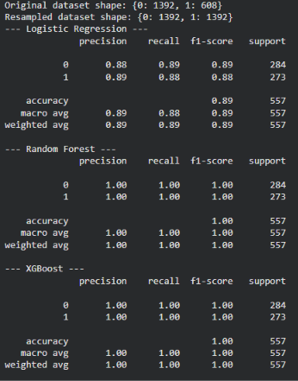
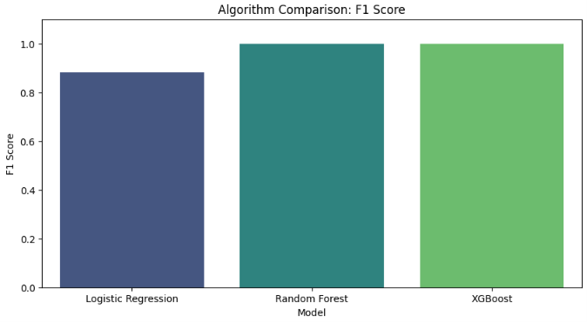
Performance Evaluation

Slide 11
Performance Evaluation
Comparative Metrics:
  Accuracy: Evaluated overall correctness across all algorithms.
  F1-Score: Prioritized over accuracy to penalize false negatives (missing a sick patient) and false positives. [Insert winning model's F1-Score here].
SHAP Feature Importance (Insert SHAP summary plot here):
  The model successfully identified Follicle No. (R/L), Cycle Length, and AMH (ng/mL) as the top physiological drivers for PCOS detection.
Discussion: Implementing SMOTE drastically improved the recall rate for positive cases compared to baseline models.

Slide 12
Conclusion
Achievement: Successfully engineered a highly accurate, non-invasive PCOS screening tool that outperforms standard "black-box" approaches.
Clinical Transparency: Proved that utilizing SHAP builds necessary trust by linking predictions to actual medical markers.
Holistic Approach: Bridged the gap between diagnosis and management by seamlessly integrating personalized lifestyle guidance.
Future Scope: Integration of Convolutional Neural Networks (CNNs) for automated ultrasound image analysis (Phase 2).

Slide 13
Implementation

Slide 14
References
Chawla, N. V., et al. (2002). "SMOTE: Synthetic Minority Over-sampling Technique." Journal of Artificial Intelligence Research, 16, 321-357.
Lundberg, S. M., & Lee, S.-I. (2017). "A Unified Approach to Interpreting Model Predictions (SHAP)." Advances in Neural Information Processing Systems, 30.
Kaggle Open Datasets (2024). Polycystic Ovary Syndrome (PCOS) Clinical Dataset.

Slide 15
Thank You...!!

