Slide 1

FemAI: An Intelligent PCOS Screening and Lifestyle Guidance Platform
Nishigandha Sawant (23107047)
Shaily Gupta (23107085)
Vaishnavi Jadhav (23107051)
Project Guide
Ms. Ujwala Pagare

Slide 2
Outline
Introduction -> Motivation
Literature Review
Research Gaps
Objectives
Problem Definition
Methodology/ Workflow/ Architecture Diagram
Performance Evaluation/ Results & Discussions
Conclusion
References

Slide 3

Sustainable Development Goals (SDG) mapped
SDG 3 : Good Health and Well-being
FemAI promotes proactive healthcare by providing an accessible, early screening tool for PCOS. By bridging the gap between diagnosis and management through personalized lifestyle and dietary guidance, it directly improves health outcomes and well-being for women.
SDG 5: Gender Equality, SDG 9: Industry, Innovation and Infrastructure

Slide 4
Introduction
Context: Polycystic Ovary Syndrome (PCOS) affects approximately 1 in 10 women globally, yet remains highly underdiagnosed due to complex clinical symptoms.
Current Reality: Initial screening often relies on expensive, time-consuming clinical lab tests or subjective symptom tracking.
Motivation: To bridge the gap between clinical data and accessible early detection by leveraging Machine Learning.
Vision: Empower women with a proactive, privacy-centric screening tool that not only flags risks but provides immediate, actionable lifestyle interventions.

Slide 5
Literature Review
Traditional ML Diagnostic Models: Existing studies predominantly use standard classifiers (SVM, KNN) but suffer from severe class imbalance, leading to high false-negative rates.
Commercial Health Tracking Apps: Platforms like Flo or Clue focus on cycle tracking but lack predictive clinical intelligence for hormonal disorders.
"Black-Box" AI in Healthcare: Most academic projects output a binary "Positive/Negative" result without providing the physiological reasoning required for medical trust.
Post-Diagnosis Gap: Existing systems stop at risk prediction, leaving users without immediate guidance on symptom management.

Slide 6
Research Gaps
Research Gap | Description
Data Bias | Failure of existing models to mathematically address the minority class (PCOS positive cases) in medical datasets.
Lack of Explainability | Absence of transparent AI mechanisms that can tell a patient or doctor why a specific prediction was made.
Fragmented Ecosystems | The disconnect between predictive diagnosis and personalized therapeutic action (diet and exercise).

Slide 7
Objectives
Early Risk Screening: Develop an ML-based prototype to identify patterns associated with PCOS using available health and lifestyle information.
Personalized Insights: Provide users with understandable information based on their reported symptoms and lifestyle factors.
Lifestyle Guidance: Suggest general wellness recommendations related to physical activity, nutrition and stress management.
Symptom Awareness: Help users understand common PCOS-associated symptoms and recognize when professional medical advice may be appropriate.
Accessible Healthcare Awareness: Create a user-friendly platform that encourages informed health decisions and consultation with qualified healthcare professionals.

Slide 8
Problem Definition
Statement: To design, optimize, and deploy an intelligent, end-to-end machine learning platform that accurately screens for PCOS using clinical and physical markers.
Core Requirement: The system must overcome standard medical data imbalances, provide transparent reasoning for its predictions, and automatically generate tailored lifestyle and nutritional guidance based on the user's specific risk profile.

Slide 9
Technologies and methodologies
Phase 1: Data Preprocessing & Feature Selection
Dataset: PCOS-related dataset containing clinical and lifestyle features.
Technique: Exploratory Data Analysis (EDA), missing-value analysis, categorical encoding, and selection of 10 relevant input features.
Phase 2: Model Training & Evaluation*
Model: Trained a Linear Support Vector Machine (SVM) using Scikit-learn.
Technique: Train-test split and evaluation using accuracy, precision, recall, F1-score, and confusion matrix.
Phase 3: Risk Prediction & Personalized Wellness*
Prediction: Uses user-provided health and lifestyle inputs to generate a predicted PCOS risk category.
Personalization: Provides relevant lifestyle recommendations based on menstrual regularity, stress levels, BMI, and other assessment responses.
Phase 4: System Architecture*
Frontend: React.js (Vite) / Tailwind CSS (User Interface).
Backend: Python FastAPI (REST API and Model Serving).
Core: Scikit-learn LinearSVC model saved using Pickle/Joblib.
Integration: Connects the assessment form, prediction results, and personalized wellness dashboard.

Slide 10
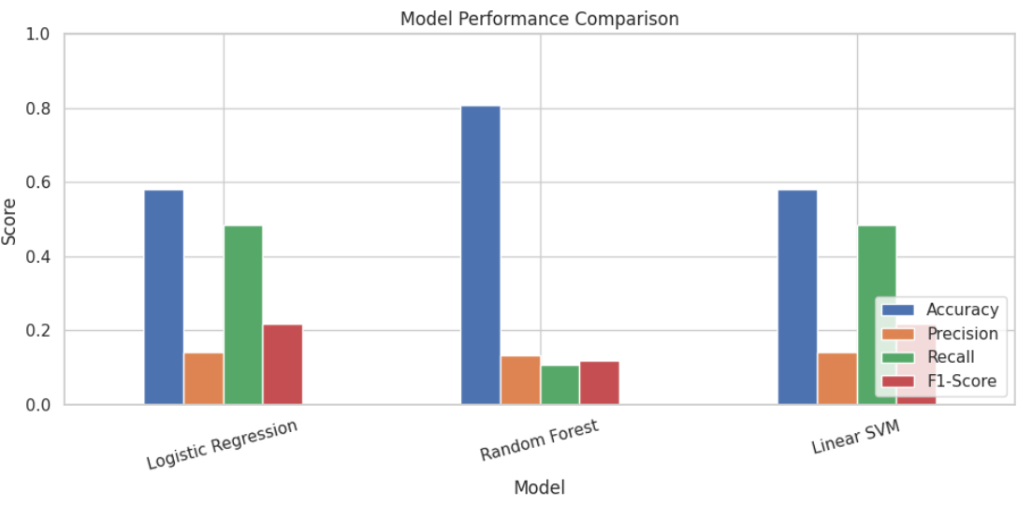
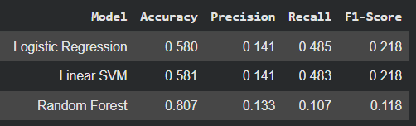
Performance Evaluation

Slide 11
Performance Evaluation
Comparative Metrics:
  Accuracy: Evaluated overall correctness across all algorithms.
  F1-Score: Prioritized over accuracy to penalize false negatives (missing a sick patient) and false positives. [Insert winning model's F1-Score here].
SHAP Feature Importance (Insert SHAP summary plot here):
  The model successfully identified Follicle No. (R/L), Cycle Length, and AMH (ng/mL) as the top physiological drivers for PCOS detection.
Discussion: Implementing SMOTE drastically improved the recall rate for positive cases compared to baseline models.

Slide 12
Conclusion
Achievement: Successfully engineered a highly accurate, non-invasive PCOS screening tool that outperforms standard "black-box" approaches.
Clinical Transparency: Proved that utilizing SHAP builds necessary trust by linking predictions to actual medical markers.
Holistic Approach: Bridged the gap between diagnosis and management by seamlessly integrating personalized lifestyle guidance.
Future Scope: Integration of Convolutional Neural Networks (CNNs) for automated ultrasound image analysis (Phase 2).

Slide 13
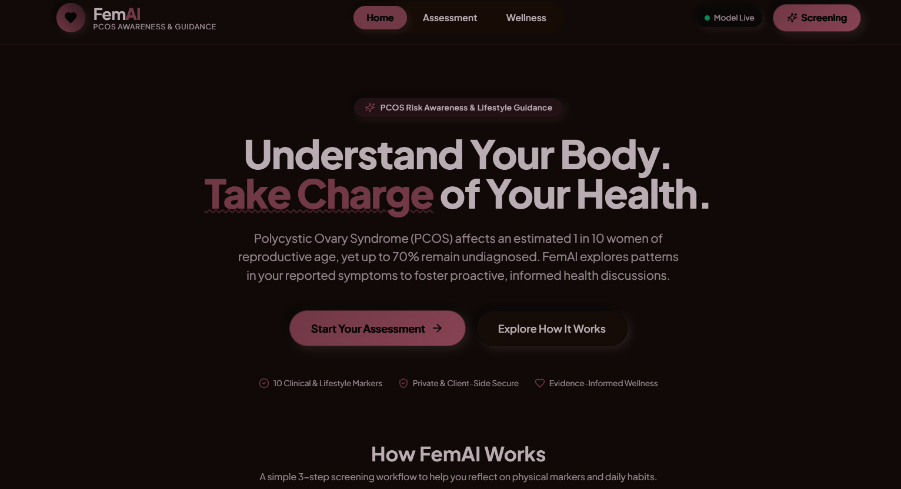
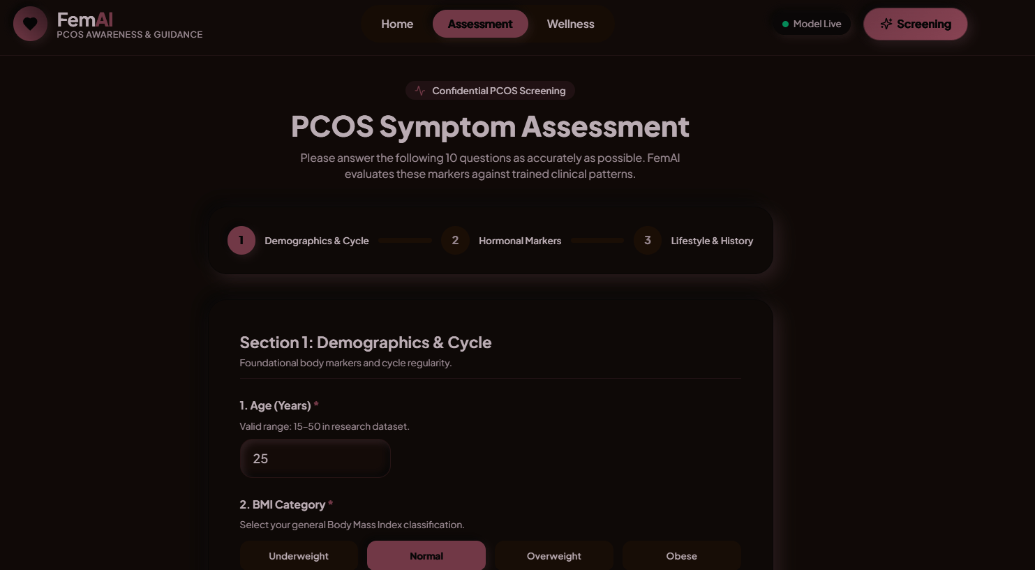
Implementation
Fig 1 : landing page
Fig 2 : Assessment page

Slide 14
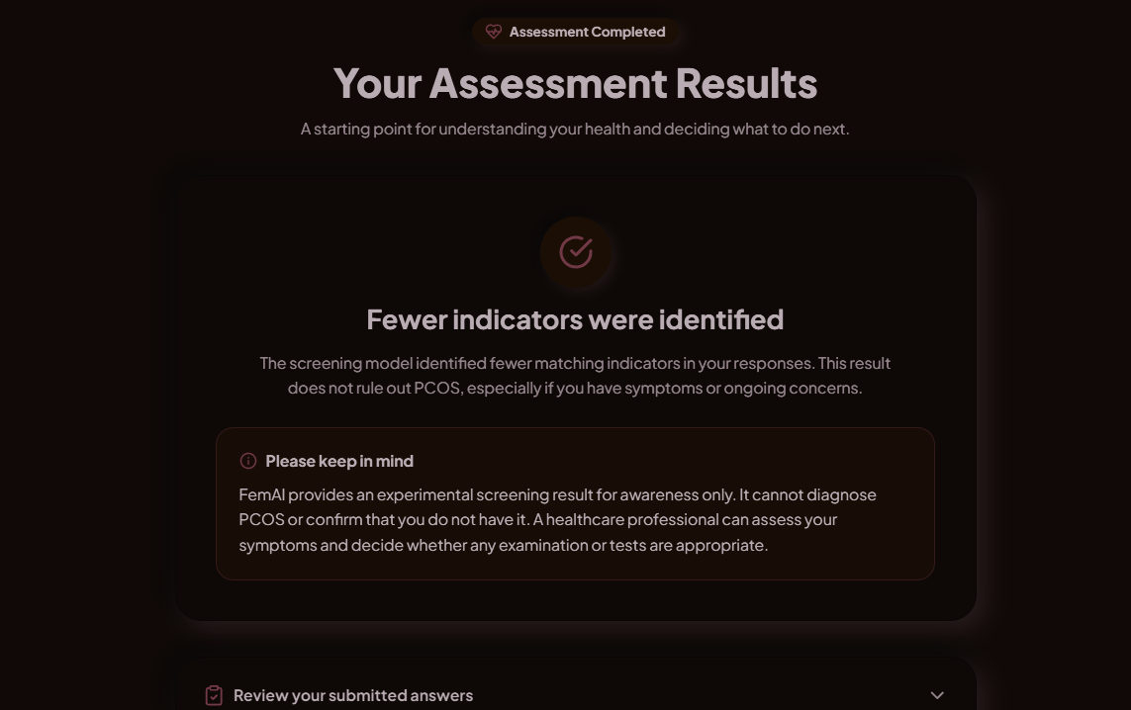
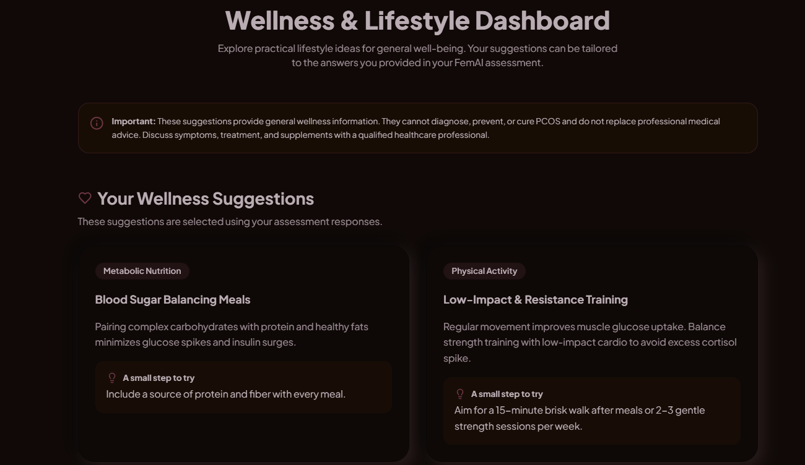
Fig 3: result
Fig4:wellness

Slide 15
References
Chawla, N. V., et al. (2002). "SMOTE: Synthetic Minority Over-sampling Technique." Journal of Artificial Intelligence Research, 16, 321-357.
Lundberg, S. M., & Lee, S.-I. (2017). "A Unified Approach to Interpreting Model Predictions (SHAP)." Advances in Neural Information Processing Systems, 30.
Kaggle Open Datasets (2024). Polycystic Ovary Syndrome (PCOS) Clinical Dataset.

Slide 16
Thank You...!!

