Slide 1

sahayak
Made by :- j coders
Sk. Arshad akhtar
Sumeet nayak
Nishikanta ray

Slide 2
Requirements
Network
Css, html , js , php
People's participation

Slide 3
Covid 19 problem
India, with a population of over 1.3 billion, has seen troublesome growth in covid 19 cases in the past two months . When people are quarantined , they need to be taken care of, and feeding them and keeping them healthy is the most important .The problem arises with tackling the situation accordingly as It is unable to provide access to food to a large number of people . This is where Sahayak lends its helping hand .

Slide 4
What it is :-
Sahayak is basically a webapp that brings useless food to use of welfare . It is built on js, css, html as a website for anyone to access to donate food . It works by collecting food from people or ngos and distributes to covid19 struck areas .
It works 24*7 , and is totally easy to access for a comman man. Just searh where the centres are where food is available and access it .

Slide 5
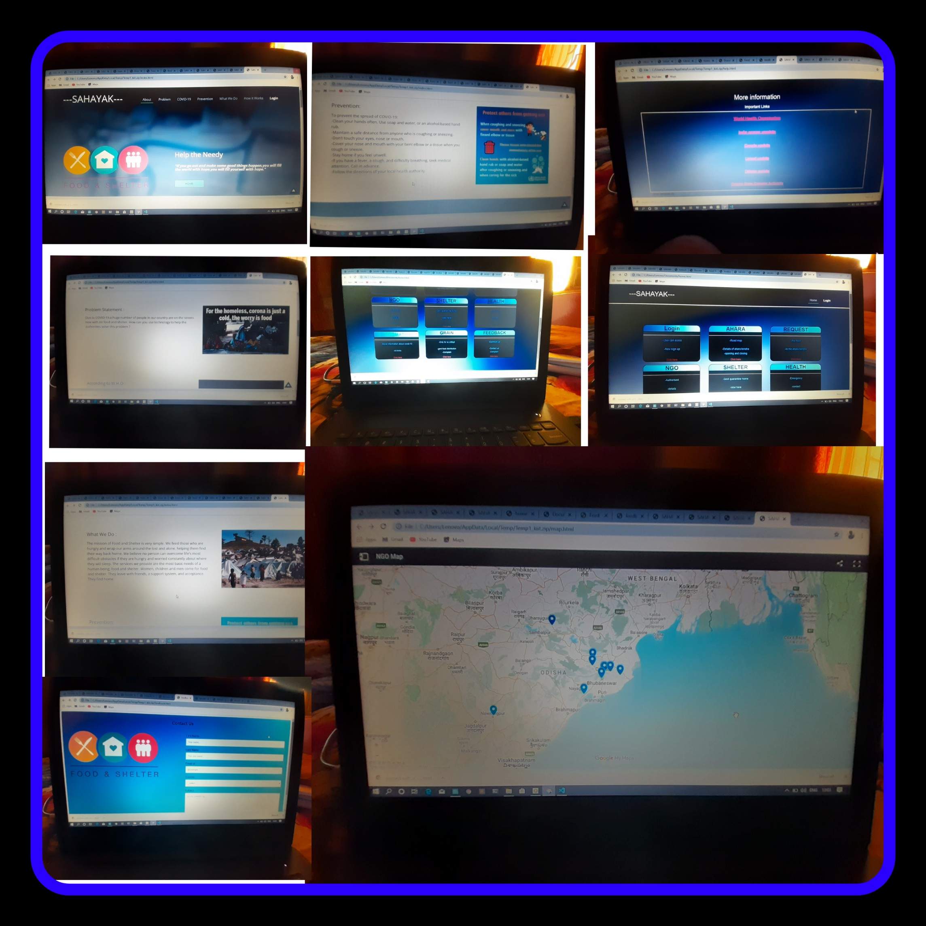
Sahayak website

Slide 6
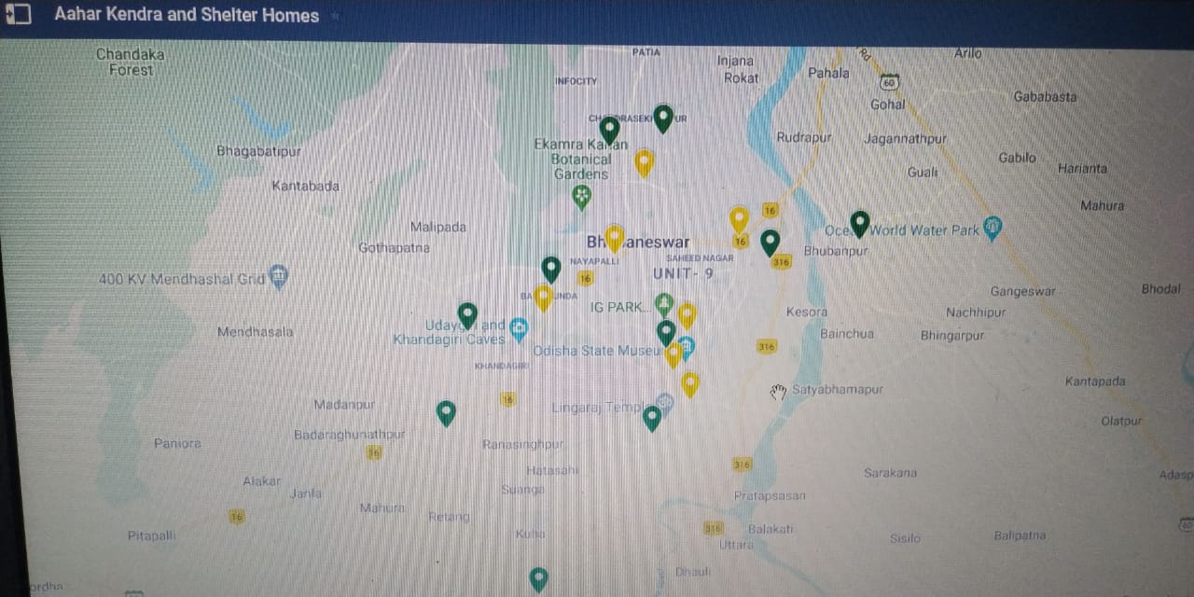
Maps showing ngos and centres where food is available

Slide 7
Buisness model
Target audience are poor persons living on footpath or people having small income or daily wages . Due to covid19 these persons cant work and unable to get even 2 meals per day.
Plan is to provide this website to public , where the govt and ngos can directly locate and help the needy persons .
People can easily locate areas through the provided maps . Govt and people directly interact , which eases distribution of help .

Slide 8

Digital Communications
Access Sahayak
Call @123456
Donate personally

Slide 9

Thank You
NISHIKANTARAY1@GMAIL.COM
Akhtarskarshad2@gmail.com
Sumeetnaikcs@gmail.com

