Slide 1

Object-Oriented Programming in C++
Department of Computer Science &
Engineering
OOP/basic Concepts/1
Notes:
OOP/basic Concepts/SI/

Slide 2
About the Course
Two Goals for this course(OO-P)
  Understand OO
    Thinking in Objects
  Familiar with C++ (P)
    Programming in C++
OOP/basic Concepts/2

Slide 3
How to get the goals
Read and remember
  Read the books, remember the language
Think
  Think in objects, think in classes
and Practice
Do as many coding with C++ as possible and make them running
Ask questions
  Write down the questions on a piece of paper and hand it in
OOP/basic Concepts/3

Slide 4
Concepts of Object-Oriented Programming
UNIT-I
OOP/basic Concepts/4

Slide 5
Decomposition
Algorithmic Decomposition
Divide the system to some modules
Each module should denote a major step in overall process.
Object Oriented Decomposition
1. View the world as a set of autonomous agents that collaborate to perform some higher level behaviour.
OOP/basic Concepts/5

Slide 6
Functional decomposition
The System
Function1
Function2
Function3
. . . . . .
. . . . . .
Function11
Function12
. . . . . .
OOP/basic Concepts/6

Slide 7
Functional decomposition
Example: No. of words in a file
Main
Count
Sorted Words
Count
Sorted Words
getSortedWordList
countDiffWords
printResult
Words Sorted Words
Words(prev,curr)
Word List Flag
getWordList
sortword
checkWord
Word
Words
Word
getWordFromFile
addToWordList
OOP/basic Concepts/7

Slide 8
OO Decomposition
Agent2
Agent1
msg2
msg4
msg1
msg3
Agent3
Agent4
Autonomous Agents(Objects)
OOP/basic Concepts/8

Slide 9
OO Decomposition
Example: No. of words in a file
File
getWord
WordList
Autonomous Agents(Objects)
OOP/basic Concepts/9

Slide 10
Object-Orientation
It is a kind of thinking methodology
  Everything in the world is an object;
  Any system is composed of objects (certainly a system is also an object);
  The evolution and development of a system is caused by the interactions among the objects inside or outside the system
OOP/basic Concepts/9

Slide 11
The development of a system is caused by the interactions
SILICON is developed by the interactions among:
  students
professors
staffs
officers of State Govt.
Some entrepreneurs
… ...
Inside SILICON
Outside SILICON
OOP/basic Concepts/11

Slide 12
Programming Techniques
Unstructured Programming
Structured Programming
Structural Programming is again modified as
Procedural Programming
Object-Oriented Programming
OOP/basic Concepts/12

Slide 13
Unstructured Programming
Usually, people start learning programming by writing small
and simple programs consisting only of one main program. Here ``main program'' stands for a sequence of commands or statements which modify data which is global throughout the whole program.
Main Program
Data
OOP/basic Concepts/13

Slide 14
Drawbacks
This programming technique can only be used in a very small program.
For example, if the same statement sequence is needed at different locations within the program, the sequence must be copied. If an error needed to be modified, every copy needs to be modified.
This has lead to the idea to extract these sequences(procedure), name them and offering a technique to call and return from these procedures.
OOP/basic Concepts/14

Slide 15
Procedure Program view
Main Program Data
Procedure₁
Procedure₂
Procedure₃
Procedural Programming uses Algorithms as the Basic building block.
OOP/basic Concepts/15

Slide 16

Main Program(Also a module)
Data
Module₁
+
Module₂
+
Data
Data₁
Data
Data₂
Data Data₁
Procedure₁
Procedure₂ Procedure₃
The main program coordinates calls to procedures in separate modules and hands over appropriate data as parameters.
OOP/basic Concepts/16

Slide 17
Object Oriented Programming Characteristics of OOP
Abstraction
Encapsulation
Inheritance
Polymorphism
OOP/basic Concepts/17

Slide 18
Abstraction(contd.)
An Abstraction denotes the Essential characteristics of an object that distinguishes it from all other kinds of objects and thus defines sharply defined conceptual boundaries, relative to the perspective of the viewer.
OOP/basic Concepts/18

Slide 19
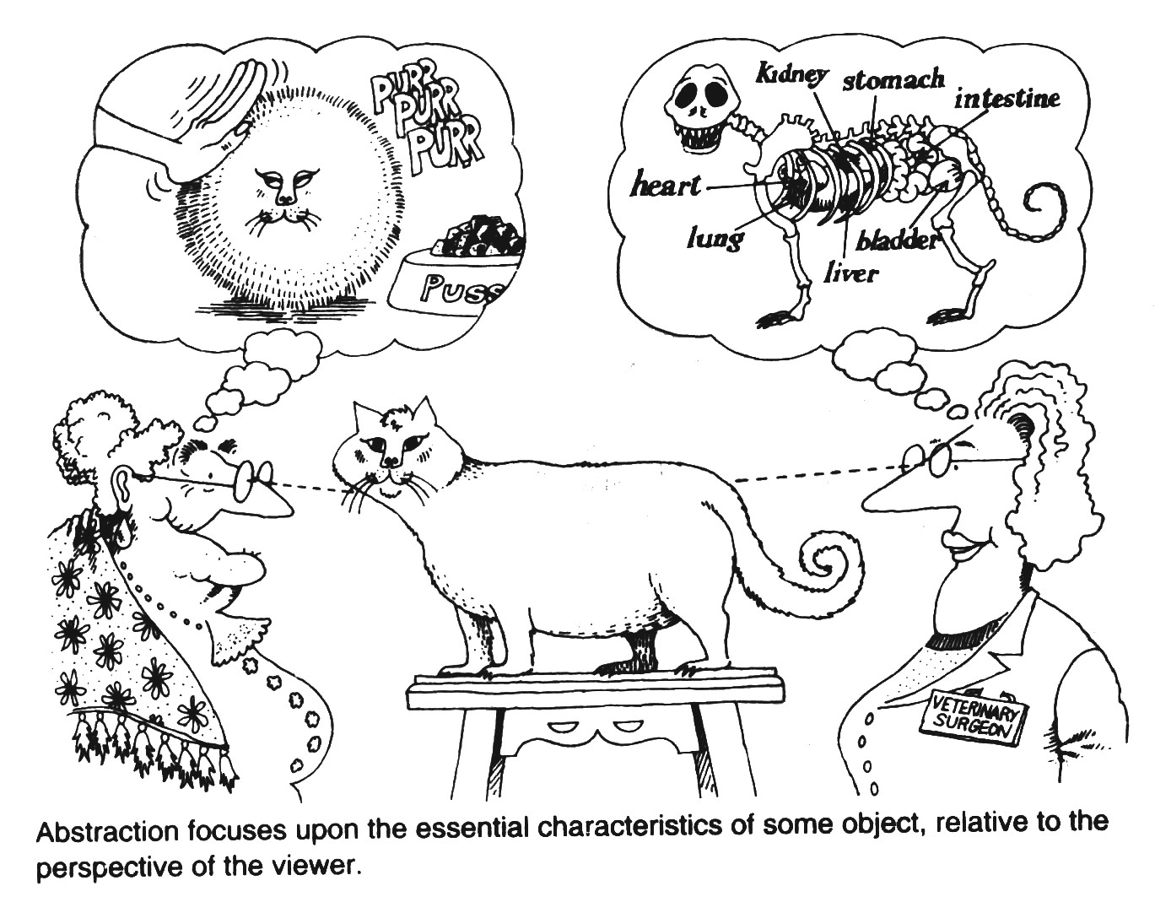
Abstraction
OOP/basic Concepts/najit/33

Slide 20
Abstraction(contd.)
It focuses on the outside view(interface) of an object. Therefore, it serves to separate an objects essential behaviour from its implementation.
It is used to reduce complexity by ignoring some aspect of a subject that are not relevant to the current purpose.
Example : A MAP (is not an exact picture)
Only the essential features of an area are shown
Unimportant features are ignored.
OOP/basic Concepts/20

Slide 21
Abstraction(contd.)
All Abstractions have static as well as dynamic properties.
Example: A FILE
Static : Name, Space, Content Dynamic: the value contained in static
properties.
It is dynamic because a file may grow or shrink in size
Its name and content may change
OOP/basic Concepts/21

Slide 22
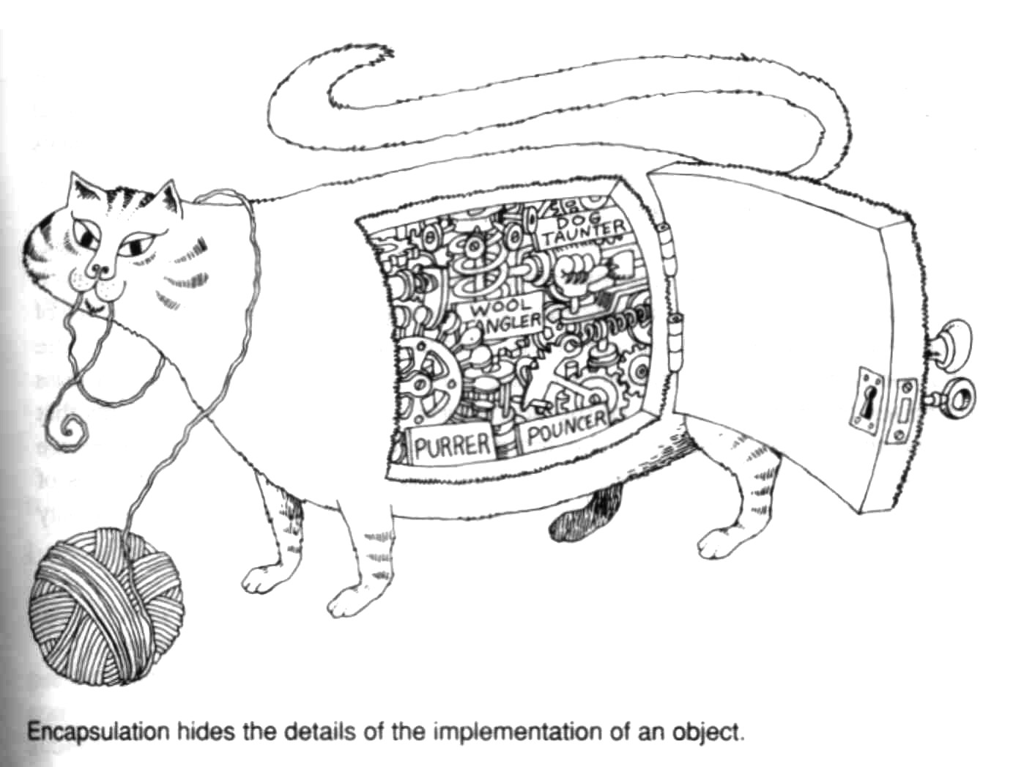
Encapsulation
OOP/basic Concepts/22

Slide 23
Encapsulation(contd.)
It is the process of compartmentalising the elements of an abstraction that constitute its structure and behaviour.
In this process we keep the properties (or structure or states) and behaviour of an object in one place bundeled together.
It supports information hiding
i.e. hiding all the information that is unnecessary to the outside world.
OOP/basic Concepts/23

Slide 24
Encapsulation(contd)
Encapsulation helps to achieve abstraction by hiding the implementation of behaviours
It provides explicit barriers among different abstractions
Example: Riding a Bike
Most of the riders are ignorant about the detail structure of an IC Engine.
Changing gears on your bike need not require to know “how the gear mechanism works” just need to know which lever to move.
OOP/basic Concepts/24

Slide 25
Encapsulation
Each abstraction have two parts : an interface and an implementation.
Encapsulated elements may be termed as the secrets of abstraction
Benefits:
Helps to achieve Abstraction by hiding some information
Helps avoiding mishandling of information that is private to the abstraction from out side
Complexity is managed by keeping related information in one place (Modularity)
Increases understandability
…
OOP/basic Concepts/25

Slide 26
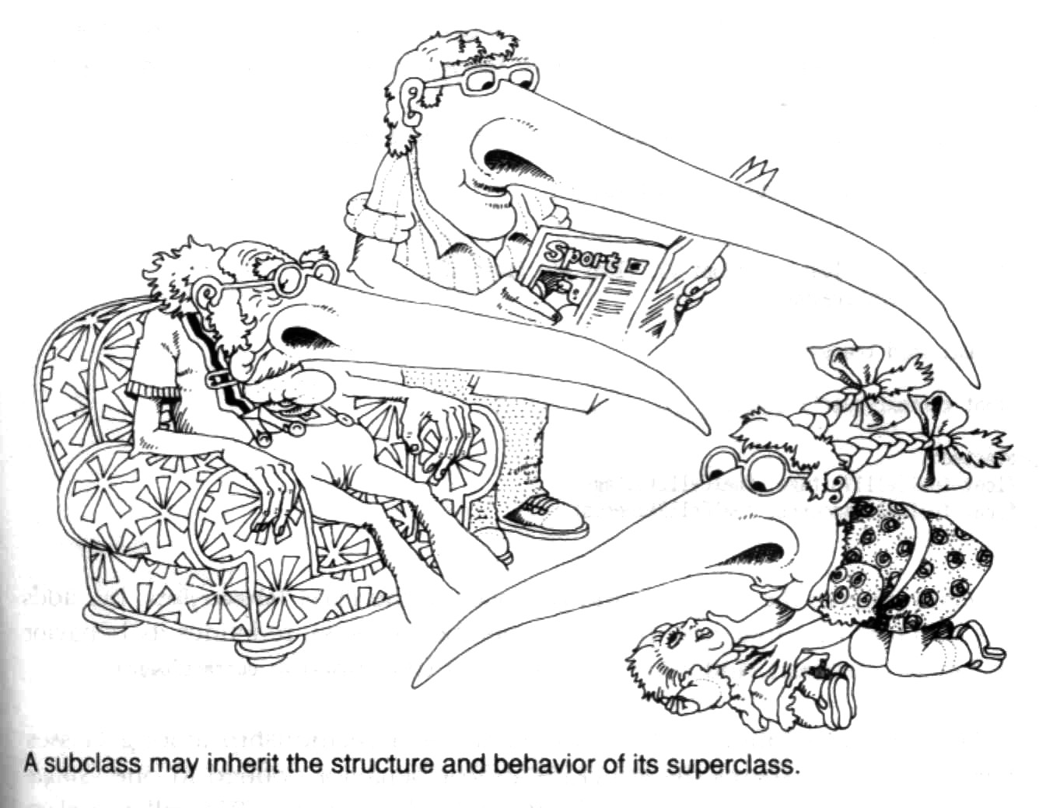
Inheritance(is a)
OOP/basic Concepts/26

Slide 27
Examples (Inheritance)
Mammal is a kind of Animal
Tiger is a kind of Mammal
Cheetah is a kind of Tiger
House is a kind of tangible Asset
Quick sort is a kind of Sorting algo
  Sub class?
  Super Class?
OOP/basic Concepts/27

Slide 28
Examples (contd.)
Vehicle
LandVehicle
WaterVehicle
Car
AmphibiousVehicle
Boat
OOP/basic Concepts/28

Slide 29
Inheritance(contd.)
It implies a Generalization/Specialization hierarchy
i.e subclass specializes its superclass and superclass generalizes its subclass
Its benefits are Extensibility,Maintainability,Reusability, Understandability,Abstraction, and
Substitutability
OOP/basic Concepts/29

Slide 30
Polymorphism
It is the property that allows to exhibit different behaviours at different situations
Different objects respond differently to a same message
Example: message draw
Circle responds with drawing a circle Polygon responds with drawing a polygon
…
OOP/basic Concepts/30

Slide 31
Dynamic Binding
(Also called as Late binding) Code associated with a given message will be decided at run time
Helps achieving polymorphism
OOP/basic Concepts/31

Slide 32
Object₁
Data₁+Procedures₁
Object₂
Data Procedures
Data₂ + Data₁₂
Object₃
Data₃ + Procedures₃
Object₄
Data₄ + Procedures₄
OOP/basic Concepts/32

Slide 33
Object-Oriented Programming
In object-oriented programming , instead of calling a procedure which we must provide with the correct handle, we would directly send a message to the object in questions.
Roughly speaking, each object implements its own module.
OOP/basic Concepts/33

Slide 34
C++
C++ is an object-oriented version of C. It is compatible with C (it is actually a superset), so that existing C code can be incorporated into C++ programs.
C++ programs are fast and efficient.
These qualities helped make C++ an extremely popular programming language.
OOP/basic Concepts/34

Slide 35
C++ My View
I love it! Because
…With it, you can program the best program in the world.
I hate it! Because
…Also with it, you can program the worst
program in the world.
So, be attention to the OO and the non OO properties of C++ when learning and using it.
OOP/basic Concepts/35

Slide 36
This Course
When you make a large software/product, you will know that object-orientation is really useful.
C++ will be used in your first real software.
So, this course is for both your first career and your last career, i.e. for your whole career.
Not Just A COURSE!!! Beginning of YOUR Career…
OOP/basic Concepts/36

Slide 37

OOP/basic Concepts/37

