Slide 1
Environmental Science

Slide 2
Course Objective
This course introduces the students to the environmental consequences of industries, development actions etc. and the methods of minimizing their impact through technology and legal systems.

Slide 3
Modules
This Course is divided into 6 Modules
Ecology, biogeochemical cycles
Environmental Gradients
Water and wastewater treatment
Atmospheric Chemistry and noise pollution
Solids waste management
Health impacts of waste and e-waste

Slide 4

Swachh Bharat Abhiyaan (Clean India Mission)

Slide 5

A ‘Green’ Planet....

Slide 6

....But a ‘fragile’ planet, handle with care !

Slide 7
Origin
The word “Environment” has come from an old French word environ or environner to be exact which literally means “to encircle” or “to surround”.

Slide 8
Definition
The word “environment” can be defined as “our life support system which includes air, water, land/soil & all other natural resources present around us”.

Slide 9
Definition
According to ISO:14001( International Organization for Standardization), environment can be defined as, “Surroundings in which an organization operates, including air, water, land, natural resources, flora(plants), fauna(animals), human beings and interrelations”.

Slide 10
Related Terms
Environmental Science
Environmental Engineering
Environmental Management
Environmental Laws

Slide 11
Environmental Science
It is the study of human beings impact on the environment and the physical, chemical and biological changes occurring in nature which focuses on pollution.
It is highly interdisciplinary & it collects information from various fields such as biology, chemistry, geography, agriculture, geology etc.

Slide 12
Environmental Engineering
It is defined as that branch of engineering which is concerned with protecting the environment from the potentially deleterious or harmful effects of human activities, protecting the human population from the effects of environmental pollution and improving the environmental quality for better human health & well being.

Slide 13
Environmental Management
It consist of auditing of EIA (Environmental Impact Assessment), Planning, Preparing EIS (Environmental Impact Statement) & pollution management.

Slide 14
Environmental Laws
It involves the body of statuaries, policies those are made in order to protect the nature from being misused by human beings.
Some laws are regulative or controlling in nature while some are for preventive measure & some are binding on us.

Slide 15
Sustainable Development (SD)
It can be defined as “the ability to meet the needs of present generation without compromising the ability of future generation to meet their needs” i.e. the balance or proper use of resources, so that our future generation will not face any problem for their survival, after taking care of our own survival needs.

Slide 16
Pillars or Components of SD
There are three pillars or components of Sustainable Development (SD)
a) Economical Development
b) Society or community Development
c) Environmental Protection

Slide 17
Human Dimension in Env. Engg.
It is also known as Three factor model for assessing environmental degradation.
To estimate or assess the extent of environmental degradation John Holdern (a physicist) and Paul Ehrlich (a biologist) have given a three factor model.

Slide 18
Human Dimension in Env. Engg.
According to this model, total environmental Impact (I) of degradation and pollution due to population in a given area depends on three factors i.e. P, A, T.
P represents Size of population
A represents Affluence or Per capita Consumption or per person consumption
T represents Technology used.

Slide 19
Human Dimension in Env. Engg.
The relationship is, I = PAT
In the developing countries, P³ syndrome i.e.(Population, Pollution, Poverty) and in the rich developed countries overuse of natural resources are the key or important factors leading to environmental degradation.

Slide 20
Building Blocks of Env. Engg.
Env. Engg. consists of Basic Engg. and Basic Sciences.
Basic Engg. consists of Civil Engg. and Chemical Engg.
Basic Science consists of Chemistry, Physics, Biology, Economics.

Slide 21
Building Blocks of Env. Engg.(Basic Engg.)
Civil Engg. consists of -
a) Infrastructure,
b) Water Resources,
c) Water Quality,
d) Sanitary Services,
e) Hydroinformatics and
f) Waste Engg.

Slide 22
Building Blocks of Env. Engg. (Basic Engg.)
Chemical Engg. consists of –
a) Chemical Hazardous Waste process Engg.
b) Transport of chemicals
c) Air Quality

Slide 23
Building Blocks of Env. Engg. (Basic Science)
Chemistry consists of –
a) Water Chemistry
b) Air Chemistry
c) Soil Chemistry

Slide 24
Building Blocks of Env. Engg.(Basic Science)
Physics consists of –
a) Hydrology & Hydrogeology
b) Meteorology & Atmospheric Science
c) Fluid Mechanics
d) Heat & Mass Transfer
e) Sound & Noise
f) Soil Physics

Slide 25
Building Blocks of Env. Engg. .(Basic Science)
Biology consists of –
a) Microbiology
b) Ecology
c) Agronomy

Slide 26
Building Blocks of Env. Engg. .(Basic Science)
Economics consists of –
a) Economics management
b) Environmental Laws
c) Politics
d) Social Sciences

Slide 27
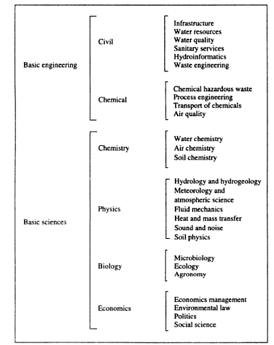
Building Block of Env. Engg.

Slide 28
Environmental Problems
The major environmental problems that we are facing are –
a) Water Pollution
b) Air Pollution
c) Biodiversity Depletion
d) Large amount of Waste Production
e) Food Supply Problems

Slide 29
Causes of Environmental Problems
Many Environmental Problems presently we are facing are mainly due to –
a) Over Population
b) Wasteful use of Resources
c) Destruction & Degradation of Wildlife Habitats
d) Depletion & Contamination of Surface Water & Ground Water

Slide 30
Causes of Environmental Problems
e)Depletion of Non-Renewable resources or minerals
f) Deforestation
g) Soil Erosion
h) Loss of Biodiversity

Slide 31
Definition of Pollution
It is an undesirable change in physical, chemical or biological characteristics of air, water & soil, that may harmfully affect human beings, animals, the plant life, industrial progress, living conditions & cultural assets.

Slide 32
Definition of Pollutant
It is an undesirable harmful solid, liquid or gaseous substance present in such a concentration in the environment which tends to be injurious for the whole living organisms.

Slide 33
Ecological Concepts
The word ecology was coined by Ernst Haeckel from two Greek words, Oikos & Logos.
Oikos means House or Living Space & Logos means Study
Ecology is the branch of Biology concerned with the relations of various species to one another & to their physical surroundings

Slide 34
Ecological Perspective
Ecological perspective demands a greater understanding of the functioning of living systems & their interactions with the environment.
It gives a qualitative emphasis on ecological concepts.

Slide 35
Principles of ecology
Living organisms can’t exist with total disregard to their environment.
All living organisms & their physical environment are interdependent upon each other & also affect each other.

Slide 36
Principles of ecology
Every living organisms has certain limits of tolerance towards the various factors of environment & only within these limits the organisms can survive.
The existence of life depends upon flow of energy through food chains & the cycling of nutrients.

Slide 37
Aspects of ecology
The two important aspects of ecology are –
a) Autecology or species ecology
b) Synecology or community ecology

Slide 38
a) Autecology
It is concerned with the ecology of an individual species & it’s population.

Slide 39
b) Synecology
It is the study of communities, their composition, their behaviour & the relation to the environment.
Synecology is further subdivided into three categories –
i) Population Ecology
ii) Genetic Ecology
iii) Taxonomic Ecology

Slide 40
i) Population Ecology
It relates with individual organisms with different groups of organisms within the ecosystem of different levels & the interrelationship among themselves

Slide 41
ii) Genetic Ecology
It is also known as Gene Ecology.
Different organisms have different genes & chromosomes, hence they live in different places.
The relationship due to the variation in genes among biotic components with their surroundings non-biotic environment is known as Genetic Ecology.

Slide 42
iii) Taxonomic Ecology
It includes ecology of taxonomic groups such as microbes, vertebrates (with backbone), invertebrates (without backbone) & insects etc.

Slide 43
Ecosystem
An ecosystem is defined as a natural functional ecological unit comprising of living organisms (i.e. biotic community) & their non-living (i.e. abiotic) environment that interact to form a stable self-supporting system.
Example: Pond ecosystem, Forest ecosystem etc.

Slide 44
Ecosystem
The ecosystems are characterized by a diversity of species, but in an ecosystem there must be representatives from the three functional or metabolic groups such as Primary Producers, Consumers & Decomposers.
The ecosystems can vary in sizes.

Slide 45
Properties of Ecosystem
An Ecosystem exists independent of specific components i.e. an individual tree may die, but a forest persist.
The components of an ecosystem are interdependent.
The nature of ecosystem depends on the species biodiversity of the ecosystem.

Slide 46
Properties of Ecosystem
The function of ecosystem depends on the energy flow & cycling of chemical elements within the ecosystems.
The ecosystem can be disturbed by human activities & the most adverse effect of disturbance is the loss of biodiversity.

Slide 47
Types of Ecosystem
Natural Ecosystem
Artificial or Man-made or Man-engineered Ecosystem

Slide 48
1. Natural Ecosystem
These ecosystems operate by themselves under natural conditions.
Depending on the type of habitats, these are further sub-divided into –
I) Terrestrial Ecosystem
II) Aquatic Ecosystem

Slide 49
I) Terrestrial Ecosystem
It includes forest, grassland, desert ecosystems.

Slide 50
II) Aquatic Ecosystem
These ecosystems found in the aquatic environment.
It can be divided into two categories –
a) Fresh water ecosystem
b) Marine water ecosystem

Slide 51
a) Fresh water ecosystem
The Fresh water ecosystem can be
i) Lotic &
ii) Lentic
Lotic means (moving or running water)
e.g. River or Stream ecosystem
Lentic means (Still or Standing water)
e.g. Pond, Lake ecosystem

Slide 52
b) Marine water ecosystem
These include salt water bodies which may be Ocean ecosystem, Sea ecosystem.

Slide 53
2. Artificial ecosystem
These are maintained artificially by human beings.
e.g. garden, park.

Slide 54
Incomplete ecosystem
Abysmal depth of oceans where no light penetrates represent incomplete ecosystem.
There are no green plants & hence there are no primary production.

Slide 55
Structure or components of ecosystem
Ecosystem has two major components.
1. Abiotic & 2. Biotic
Abiotic can be classified into hydrosphere, atmosphere & lithosphere
Biotic can be classified into producer, consumer & decomposer.
Consumer can be primary, secondary, tertiary consumers.

Slide 56
Functions of ecosystem
Energy flow : It regulates the flow of energy from one level to the other.
Nutrient cycling : It regulates cycling of nutrients.
Environmental gradients : The ecosystem fix the limit of tolerance for each organism towards various factors of environment.

Slide 57
Functions of ecosystem
Food Chain & Food Web : The energy produced by green plants are passed to next levels by a chain of consumers leading to formation of food chain &
interlinking of food chain will lead to formation of food web.
Biodiversity : The ecosystem regulates the species diversity to acquire a stable system.

Slide 58
Natural Resources
The materials those occur in the environment or those are created by the environment & useful for supporting life or promoting the well-being of human beings are termed as natural resources

Slide 59
Natural Resources
Natural Resources are the naturally occurring substances those are considered valuable in their natural form & their value rest in the amount of material available & the demand for it.

Slide 60
Types of Natural Resources
There are three types of natural resources –
1) Renewable or Inexhaustible
i.e. available in unlimited quantity.
Ex – Solar energy, wind power etc.
2) Non-renewable or exhaustible
i.e. available in limited quantity
Ex – coal, petrol, diesel etc.

Slide 61
Types of Natural Resources
3) Abstract Natural Resources :
It includes animals, plants & natural landscapes as part of countryside used for recreation & tourism activities.
Ex – Bird watching, sight-seeing

Slide 62
2.Biodiversity
It doesn’t imply just a collection of species, but is a basic resource which acts as a human life support system.
Biodiversity plays an important role in biogeochemical cycles.

Slide 63
2.Biodiversity
Biodiversity has three hierarchical levels i.e.
i) Genetic Biodiversity
ii) Species Biodiversity
iii) Ecosystem Biodiversity

Slide 64
2.Biodiversity
There can be three kinds of losses of biological resources.
i) Depletion of a once common species
ii) Local or global extinction
iii) Ecosystem disruption.

Slide 65
Levels of organization in Biotic Components
There are six major levels of ecological organization are recognized in the biotic components of the environment.
1) Individual
2) Population
3) Community
4) Ecosystem
5) Biomes &
6) Biosphere

Slide 66
1) Individual
These are single species.
Individuals have physiological functions & respond to environmental conditions

Slide 67
2) Population
Population consists of a group of individuals of the same species living in a particular area at the same time.
Birth rate, death rate plays an important role in the size of population.

Slide 68
3) Community
Population of different species living together interact with each other to form a community.
Niche :-
A suitable or comfortable position in the ecological hierarchy for a species.
Ex- Phytoplankton Zooplankton Fish Whale
Niche of fish in the above ecological hierarchy is three or 3rd position.

Slide 69
4) Ecosystem
It includes both biotic & abiotic components of an area.
The major or important feature of this ecological level is the strong interaction between the various biotic & abiotic components present.
Nutrient cycling & energy flow occur in this ecological level.

Slide 70
5) Biomes
When environmental conditions are similar in different parts of the country or around the globe, the habitats & communities are also often similar, giving rise to a higher level of biotic organization known as biomes.
Ex- a)Tropical Rainforest(High temp.& High rainfall)
b) Desert Scrub(High temp. & low rainfall)

Slide 71
6) Biosphere
The highest organizational level is the biosphere & it extends from bottom of the sea to the top of the sky where life exists.
Biogeochemical cycles occur at this ecological level.

Slide 72
Interaction of Biotic and Abiotic components of an ecosystem
Biotic
Hydrosphere(Water)
Living Organisms (Biotic)
Lithosphere (Soil)
Atmosphere(Air)
Abiotic

Slide 73
Interaction Processes….
The previous diagram represents dynamic nature of ecosystem due to interactions and interdependence of the various components present.

Slide 74
Ecosystem Process
In the ecosystem process, the following processes are essential for the survival & maintenance of biotic components.
1. Energy flow &
2. Nutrient cycling

Slide 75
1. Energy flow
On the earth, the ultimate source of energy of life is
solar radiation.
There are two sources of energy –
a) Autotrophic
b) Heterotrophic

Slide 76
1.(a) Autotrophic
Autotrophic production of energy is carried out within the ecosystem by green plants in the presence of sunlight using photosynthesis process.

Slide 77
1.(b) Heterotrophic
Heterotrophic energy source is the one, where the chemical energy is imported as organic matter which is originated from primary production in some other ecosystem.
This imported organic matter is called allochthonous.

Slide 78
Photosynthesis
12H₂O + 6CO₂ + 709kcal(from sunlight)
C₆H₁₂O₆+ 6O₂ + 6H₂O
(Carbohydrate)
Out of total amount of solar radiation available,
only 1 to 5% is used in the photosynthesis process.
Chlorophyll

Slide 79
Photosynthesis
The organic matter produced by green plants in the Photosynthesis process is called
Primary Production or (PP)
PP is affected by various environmental factors like water, light, temperature & soil nutrients.
PP is of 2 types.
1) GPP (Gross Primary Production)
2) NPP (Net Primary Production)

Slide 80
Photosynthesis
GPP – R(Respiration) = NPP
GPP is the total amount of chemical energy or biomass stored by plants per unit area per unit time.
Since plant requires energy for synthesis of organic matter & functioning of plant itself, some of GPP is used in the process of respiration.

Slide 81
Photosynthesis
NPP is used for plant growth & reproduction.
NPP is normally 80 to 90% of GPP.
As various environmental factors affect PP, hence GPP & NPP vary over the globe.
NPP can be classified into four broad groups each with a characteristic productivity range.

Slide 82
Photosynthesis
1. Low range – 0 to 250 gm/m² – year
Ex- Desert, semi-desert
2. Middle range – 250 to 1000 gm/m² – year
Ex- Non-forest communities like shrubland, grassland
3. Normal range – 1000 to 2000 gm/m² – year
Ex- Forest
4. High range – 2000 to 3000 gm/m² – year
Ex- Rainforest

Slide 83
Respiration
When any organism requires energy, the reverse chemical reaction of photosynthesis occurs, known as respiration, where the glucose molecule is broken down in the presence of oxygen to produce CO₂, H₂O & energy for work done & maintenance. The reaction is –
C₆H₁₂O₆+6O₂ 6CO₂+6H₂0+ energy for work done & maintenance
Metabolic enzymes

Slide 84
2. Nutrient cycling
During decomposition, the complex organic molecules in the original detritus or waste are gradually broken down to much simpler constituents & inorganic molecules like nitrates & phosphates, as the material moves through the decomposer or detritus food chain.

Slide 85
2. Nutrient cycling
These are then, enter into the soil or sediment or dissolved in water, where they become the nutrients available for reuse by green plants.
This whole process of recycling of nutrients within the ecosystem is known as nutrient cycling.

Slide 86
Detritus chain energy flow
(D1 to D4 are different levels in the detritus chain & size of circles indicate the relative amount of energy present in the level.)
Organic Waste
D1
D2
D3
D4
R
(Respiration)

Slide 87
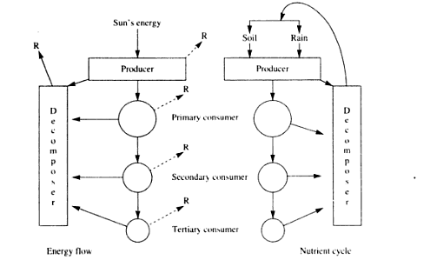
Overview of 2 major ecosystem process of energy flow, nutrient cycling

Slide 88
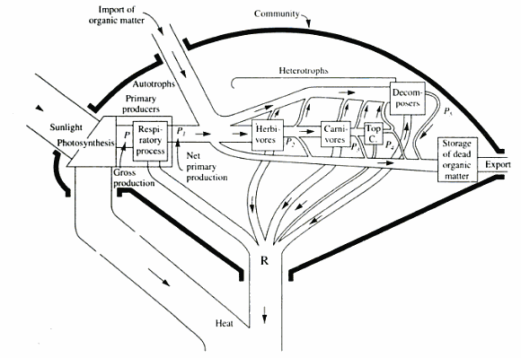

Slide 89
This diagram represents the hydraulic analogy of energy flow through an ecosystem.
(Pg.- 39, G.Kiely)
The energy is imagined as being channelled through pipes whose thickness is proportional to the rate of energy flow.
R = Respiration &
Top C = Top carnivore

Slide 90
Food Chain
Chemical energy produced by primary producers & the nutrients used by plants to build plant tissues, are passed up by a chain of consumers leading to formation of food chain, where each link in the chain is provided with energy & nutrients.

Slide 91
Food Chain
Each consumer population uses the food energy for living & respiration & the remaining energy can then be used to produce new biomass by growth & reproduction, which is called secondary production &
become a potential food & energy source for another species, further up in the food chain.

Slide 92
Food Chain
Depending on the types of foods, there are
three types of food chain available.
a) Predator or Grazing Food Chain
b) Saprophytic or Detritus Food Chain
c) Parasitic Food Chain

Slide 93
a) Predator or Grazing Food Chain
Predator means an animal that naturally preys on others.
Ex:-
Sunlight Grass Grasshopper Frog Snake Hawk

Slide 94
b) Saprophytic or Detritus Food Chain
It starts from DOM
(Dead Organic Matter) & goes to detritus feeding organisms i.e.
detrivores i.e.
bacteria, worms etc. & on to their predators.
Ex:-
Dead leaves Soil mites Insects Lizard

Slide 95
c) Parasitic Food Chain
It is a food chain in which parasites live on the host body or within the host body to get energy.
This food chain also starts from the green plants & animals to parasitic microbes.

Slide 96
Food Web
In most ecosystems, food chains interlink with each other to produce food web.
Food web shows the food pattern of energy flow in the ecosystem.
Grasshopper Frog
Grass Rabbit Hawk
Mouse Snake
(Terrestrial Food Web)

Slide 97
Trophic Level
Trophic level or nutritional level or tier gives the feeding status of an organism in an ecosystem.
It is based on the concept who feeds on whom.
It is the position an organism occupies in the food chain

Slide 98
Trophic Level
i)First trophic level or primary producer level
Ex: - Green plants
ii)Second trophic level or primary consumer level
Ex: - Herbivores
iii)Third trophic level or secondary consumer level
Ex: - Carnivores

Slide 99
Ecological pyramid
The graphical representation of tropic levels is called the ecological pyramid.
The arrangement of organisms in a food chain according to trophic levels forms a pyramid.
Generally, pyramids are of
three types.

Slide 100
Ecological pyramid
1. Pyramid of energy
2. Pyramid of biomass
3. Pyramid of numbers.

Slide 101
1. Pyramid of energy
Generally, 10% energy is transferred between adjacent tropic levels & rest 90% of energy is used up in that tropic level giving rise to energy pyramid. This is called 10% rule of ecosystem.
It is based on rate of energy flow & productivity at each successive trophic level.
It decreases from autotrophs to higher tropic level.

Slide 102
1. Pyramid of energy
3⁰ consumers
10 KCal
2⁰ consumers
100 KCal
1⁰ consumers
1,000 KCal
Autotrophs
10,000 KCal

Slide 103
2. Pyramid of biomass
It shows the total mass of the organisms in each tropic level.
It is based on total dry weight present in the level.
It decreases from autotrophs to higher trophic level.

Slide 104
2. Pyramid of biomass
3⁰ consumers
10 Kg (Large Fish)
2⁰ consumers
100 Kg (Small Fish)
1⁰ consumers
1,000 Kg (Fish Larvae)
10,000 Kg (Green Plants)
Autotrophs

Slide 105
3.Pyramid of Numbers
It shows the number of organisms in each trophic level.
There may be gradual decrease or increase in the number of individuals.

Slide 106
3.Pyramid of Numbers
(Grassland Ecosystem)
10,000 (Grass)
10 (Lions)
50 (Wolves)
100 (Deer)

Slide 107
3.Pyramid of Numbers (Inverted Pyramid)
(Parasitic Ecosystem)
Hyperparasite
(1,00,000)
Parasite (1,000)
Fruit Eating Birds(10)
Plant
(1)

Slide 108
Ecological Succession
In an ecosystem, new species may succeed older species.
The process of gradual change in the conditions of physical environment, leading to the change in the species structure of an ecological community (i.e. replacement of one species by the other) over space & time, is called Ecological Succession or Ecological Development.

Slide 109
Biogeochemical Cycles
Bio means living beings
Geo means earth extended to air & water, where life exists.
Chemical means chemical elements which continuously move in the cycles.
The cyclic pathways through which chemical elements move from environment to the organisms & back to the environment are called bio-geochemical cycles.

Slide 110
Biogeochemical Cycles
All parts or components of different ecological systems, on a local or global scale are linked with the Biogeochemical Cycles.
Biogeochemical Cycles can have a number of phases & reservoirs.
1) Organic Phase
2) Inorganic Phase

Slide 111
Biogeochemical Cycles
1) Organic Phase :-
In this phase, nutrients pass rapidly through biotic communities using food chain.
2) Inorganic Phase :-
It contains all nutrient elements & are external to food chain.

Slide 112
Biogeochemical Cycles
The various sub-phases of the inorganic phase are –
a) Sedimentary Phase
b) Atmospheric Phase
c) Aquatic Phase or Aquatic Reservoir

Slide 113
Biogeochemical Cycles
a) Sedimentary Phase :-
It involves interactions with the solid earth or rocks & results of geological activities such as weathering.
b) Atmospheric Phase :-
It forms major part of some cycles like ‘N’ cycle & ‘C’ cycle & minor parts of some cycles like ‘P’ Cycle.

Slide 114
Biogeochemical Cycles
c) Aquatic Phase or Aquatic Reservoir :-
It involves plant nutrients.
Types of biological cycles:-
There are two types of biological cycles.
I) Water or Hydrological Cycle
II) Air or Atmospheric Cycle.

Slide 115
Biogeochemical Cycles
II) Air or Atmospheric Cycle :-
It can be classified into –
i) C – Carbon
ii) N – Nitrogen
iii) O – Oxygen
iv) P – Phosphorous
v) S – Sulphur

Slide 116
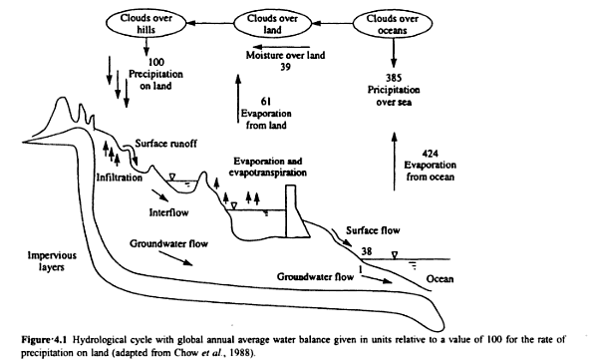
Hydrological Cycle

Slide 117
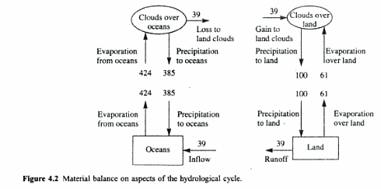
Hydrological Cycle

Slide 118
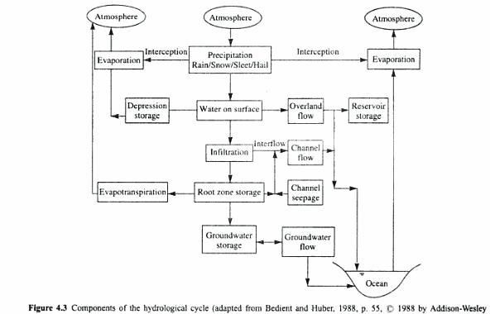
Hydrological Cycle

Slide 119
Hydrological Cycle
Interception:-
It is the evaporation of water from the outer surface of leaves during & after rainfall.
Transpiration:-
It is the evaporation of water through foliage.
Evapotranspiration:-
It is the combination of Evaporation from water bodies & transpiration from leaves.

Slide 120
Hydrological/Water Equilibrium
Surface inflow + Sub-surface inflow + Precipitation + Imported water + Decrease in ground water storage = Surface outflow + Sub-surface outflow + Consumptive use + Exported water + Increase in ground water storage
It has an important impact on agriculture, forestry, irrigation, water supply & hydropower.

Slide 121
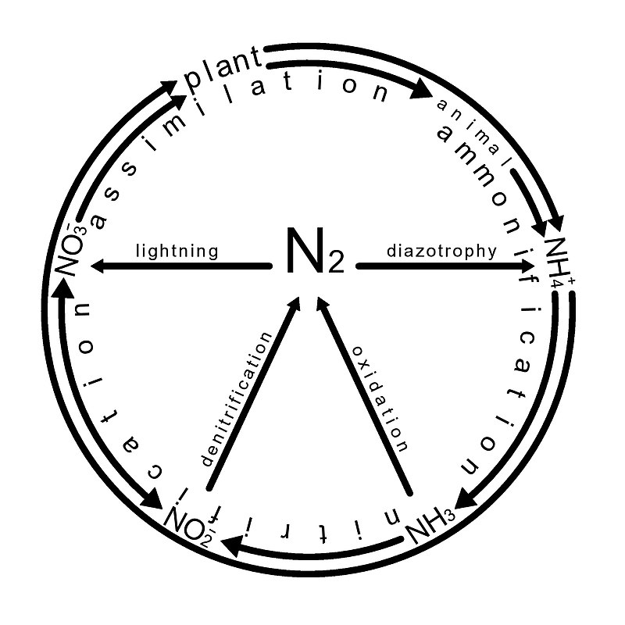
The Nitrogen Cycle

Slide 122
Environmental Gradients
The environment or environmental factors are not similar over the globe or around the earth, giving rise to Environmental Gradients & due to which different species live in different places.

Slide 123
Environmental Gradients
The physical, chemical factors like light, temperature & P^{H} are known as conditions & the factors the organism actually uses like food, water, shelter are known as resources.
There is a global gradient change from the equator towards north or south.

Slide 124
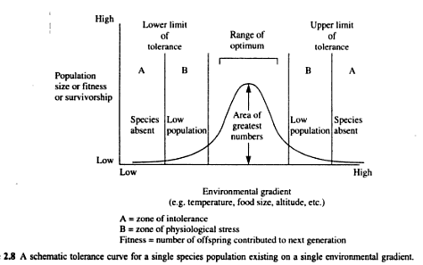
Environmental Gradients

Slide 125
Environmental Gradients
This is a normally distributed bell-shaped curve, as the change in environmental conditions are gradual from equator towards north or south.
But, pollution can make it skew-shaped
i.e. sharp decrease of curve towards left or right from range of optimum.

Slide 126
Environmental Gradients
Limiting Factors:-
The resources in shortage of supply or the conditions over which the species has the smallest range of optimum will limit the species function & is called the limiting factor.

Slide 127
Environmental Gradients
Ex:- Plant growth is strongly correlated with rain, but in arid region sufficient light is available, but water scarcity is there which is the limiting factor.
The tolerance of species to different environmental conditions or resources level vary from each other.

Slide 128
Environmental Gradients
The favourable environmental factors to a species provide wide tolerance curve & broad range of optimum known as Eurytopic factors.
The unfavourable environmental factors to a species provide narrow tolerance curve & narrow range of optimum known as Stenotopic factors.

Slide 129
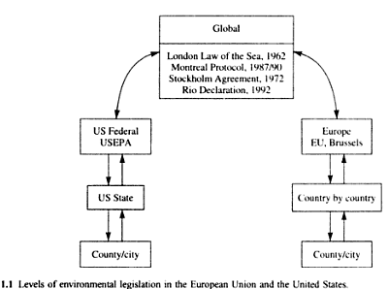
EU & US Env. Laws or Directives

Slide 130
EU & US Env. Laws or Directives
London Law of the sea is for prevention of sea pollution by oil.
Stockholm Agreement has imposed ban on the ocean dumping wastes.
Montreal Protocol is for reducing CFCs & other ozone depleting chemicals.
Rio Declaration has objectives of sustainable development.

Slide 131
Regulatory Structure of Indian Env. Laws
MOEF – Ministry of Environment & Forest,
Government of India
CPCB – Central Pollution Control Board
SPCB – State Pollution Control Board

Slide 132
Indian Env. Laws
Water Laws
Air Laws
Wildlife & Forest Laws
General Env. Laws

Slide 133
Water Laws
The various env. Laws on water are –
1) The Water(Prevention & Control of Pollution) Act – 1974
2) The Water(Prevention & Control of Pollution) Act rules – 1975
3) The Water(Prevention & Control of Pollution) Cess Act – 1977
4) The Water(Prevention & Control of Pollution) Act, rules & amendments – 1992

Slide 134
Objectives of Water Law
The objectives are –
a) Prevention & control of water pollution
b) Maintaining good quality of water
c) Establishment of boards for the prevention & control of water pollution.

Slide 135
Air Laws
The various env. Laws on air are –
1) The air(Prevention & Control of Pollution) Act – 1981
2)The air(Prevention & Control of Pollution) Act rules – 1982
3) Atomic Energy Act – 1982
4) Motor Vehicles Act – 1988

Slide 136
Objectives of Air Law
The objectives are –
a) Prevention & control of air pollution
b) Maintaining good quality of air
c) Establishment of boards for the prevention & control of air pollution

Slide 137
Wildlife & Forest Laws
The various env. Laws for wildlife & forest are-
1) The wildlife protection act – 1972
2) The wildlife protection act and amendments – 1991
3) The forest conservation act – 1980
4) The national forest policy – 1988

Slide 138
Objectives of Wildlife & Forest Laws
The Objectives are –
a) Protection & conservation of wildlife
b) To preserve biodiversity
c) To maintain essential ecological processes & life supporting systems.

Slide 139
General Env. Laws
The various laws in this category are –
1) The environmental protection act (EPA) – 1986 or Umbrella act
2) Hazardous waste (management & handling) rules – 1989
3) Biomedical waste(management & handling) rules – 1998

Slide 140
Objectives of Umbrella act
Protection & improvement of environment & prevention of hazards to all living creatures.
Maintenance of harmonious relationship between human beings & their environment.

Slide 141
Soil Chemistry
The order of 10 most abundant elements in soil & crustal rocks are –
In soil :
O > Si > Al > Fe > C > Ca > K > Na > Mg > Ti
In Crystal rock :
O > Si > Al > Fe > Ca > Mg = Na > K > Ti > P

Slide 142
Soil Chemistry
The most common soil minerals are –
Quartz - SiO₂
Calcite - CaCO₃
Gypsum - CaSO₄.2H₂O
Gibbsite - Al(OH)₃

Slide 143
Soil Chemistry
Soil Salinity :-
A soil solution is considered saline, if the electrical conductivity (EC) is greater than 4000 micro-siemens/cm or µs/cm.
This condition occurs, when evaporation exceeds precipitation.
If this condition continues then, saltpan will occur.

Slide 144
Soil Chemistry
General Composition of soil :-
1)Inorganic or Mineral matter–45% (Ca,Mg etc.)
2) Organic matter – 5% (Humus)
3) Soil water – 25%
4) Soil air – 25%

Slide 145
Soil Chemistry
Types of soil in India :-
1. Red soil
2. Black soil
3. Mountainous soil
4. Desert soil
5. Alluvial soil
(fine grained fertile soil present in river bed)

Slide 146
Soil Chemistry
The elemental properties of soil in relation to infiltration are –
1. Bulk Density or Dry Density
2. Particle Density
3. Porosity
4. Water content
5. Degree of saturation

Slide 147
Soil Chemistry
Bulk Density(ρ_{b})=M_{d}/V_{t}
= Dry mass of soil/Total volume of soil
2. Particle Density(ρ_{m})=M_{d}/V_{d}
= Dry mass of soil/Dry volume of soil
3. Porosity(φ)= (V_{a}+V_{w})/V_{s}
= (Volume of air + Volume of water)/Volume of soil
4. The water content (ϴ) = V_{w}/V_{s}
= Volume of water/ Volume of soil

Slide 148
Soil Chemistry
5. Degree of saturation(s):-
It is a measure of wetness.
So, S =V_{w}/(V_{a}+V_{w})
=(V_{w}/V_{s})/[(V_{a}+V_{w})]/V_{s}
= ϴ/ φ

Slide 149
Soil Chemistry
Soil Moisture Deficit (SMD) :-
The Soil Moisture Deficit is the term used when soil moisture is below the Field Capacity (FC) of soil.
Field Capacity (FC) :-
It is the maximum % of volumetric soil moisture that a soil sample will hold freely against earth gravity. It varies from 5% for sandy soil to 30% for dry soil.

Slide 150
Atmospheric Chemistry
Primary Pollutant :-
The Primary Pollutants are those which are emitted by identifiable manmade sources.
Ex:- SO_{X}, NO_{X},CO

Slide 151
Atmospheric Chemistry
Secondary Pollutant :-
The secondary pollutants are those formed in the atmosphere by chemical or photochemical reactions of primary pollutants.
Ex:- Acid rain, Photochemical Smog
Photochemical smog :-
It is basically the product of HC(Hydrocarbon)+NO_{x}+Sunlight------> SMOG

Slide 152
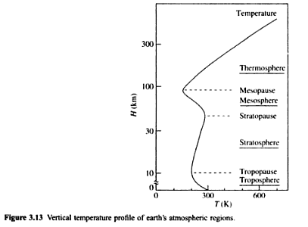
Atmospheric Chemistry

Slide 153
Atmospheric Chemistry
Troposphere – 0-12 km
Stratosphere – 12-50 km
Mesosphere – 50-80 km
Thermosphere – 80-700 km

Slide 154
Atmospheric Chemistry
The Troposphere is mostly heated by transfer of energy from the earth surface and temperature decreases with altitude or height.
In Stratosphere temperature increases with height due to increased absorption of UV radiation by Ozone Layer.

Slide 155
Atmospheric Chemistry
In Mesosphere temperature decreases with height due to decreasing solar heating.
In Thermosphere temperature increases with height due to absorption of highly energetic solar radiation which causes atmosphere particles in this layer to become electrically charged.

Slide 156
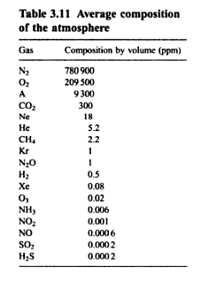
Atmospheric Chemistry

Slide 157
Chemical & Biochemical Reactions
The relationship between rate of reaction(r), concentration of reactants(c) & reaction order (n) is given by,
r=c^{n} => log (r) = n log (c)
Reactions can be -
Zero order
First order
Second order

Slide 158
Zero Order
In this case, rate of reaction(r) is independent of concentration of reactants(c).
Half life period (t_{1/2})= C₀/2k₀,
where C₀ is concentration of reactants at t=0 & k₀ is reaction rate constant
Ex:- Photochemical reaction between H₂ & Cl₂
H₂(g) + Cl₂(g) 2HCl(g)

Slide 159
First Order
In this case, rate of reaction(r) is directly proportional to concentration of reactants(c)
Half life period (t_{1/2}) = ln2/k₁
=0.69/k₁
Ex:- Dissociation of hydrogen peroxide
H₂O₂(l) H₂O(l)+1/2 O₂(g)

Slide 160
Second Order
In this case, rate of reaction(r) is directly proportional to square of concentration of reactants(c)
Half life period (t_{1/2}) = 1/k₂C₀
Ex:- Dissociation of NO₂ to NO (Nitric Oxide)
2NO₂(g) 2NO(g)+O₂(g)

Slide 161
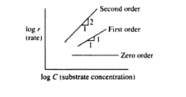
Orders of reaction

Slide 162
Material Balance
Input – output = accumulation
If there is no accumulation within the process, then input = output

Slide 163
Material Balance
A comprehensive formulation of the principle of material balance is as follows –
Accumulation within the system = input throughout the system boundaries + generation within the system - output through the system boundaries- consumption within the system

Slide 164
Methodology of Material Balance
Sketch a figure defining boundary of the process.
Label the flow of each stream & their composition with symbols.
Show all know flows & composition on the figure

Slide 165
Methodology of Material Balance
Select the basis or units for calculation
Write the material balances which include total balance & component balance
Solve the equations & check the solutions.

Slide 166
Problem-1
A wastewater treatment plant with an output of 38,400 m³/day discharges the liquid effluent with a BOD of 20 mg/L into a river. If the BOD of the river upstream of the discharge point is 0.2 mg/L, at a minimum flow of 20m³/s, calculate the BOD of the river downstream of the discharge, assuming complete mixing.

Slide 167
Problem-2
PSS(Primary Sewage Sludge) & SSS(Secondary Sewage Sludge) are thickened(or mixed) together. If the PSS is produced at 100kg/hr at 1% DS(Dry Solid) & SSS is produced at 150kg/hr at 3% DS, determine the DS percentage of the end product.

Slide 168
Problem-3
Everyday 3780m³ of wastewater is treated at a municipal wastewater treatment plant. The influent contains 220mg/L of suspended solids. The treated water has a suspended solid concentration of 5 mg/L. Determine the mass of sludge produced daily from the treatment plant.

Slide 169
Problem-4
A slurry containing 20% by weight of limestone(CaCO₃) is processed to separate pure dry limestone from water. If the feed rate is 2000kg/hr, how much CaCO₃ is produced per hour.

Slide 170
Reactor Configuration
In environmental engineering, particularly in water & waste water treatment reactors used are of 3 types –
i) Batch Reactor(BR)
ii) Continuously Stirred Tank Reactor(CSTR)
iii) Plug Flow Reactor(PFR)

Slide 171
i) Batch Reactor(BR)
In this case, the reactants or inputs enter into the reactor, remain for desired time & then discharged.
Ex:- BOD test

Slide 172
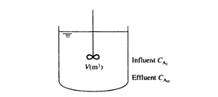
Diagram of BR

Slide 173
ii) Continuously Stirred Tank Reactor(CSTR)
In this case, reactants continuously enter into the reactor & the products are continuously discharged from a well-mixed vessel.
Ex:- Waste water treatment

Slide 174
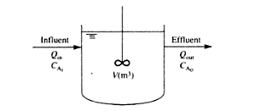
Diagram of CSTR

Slide 175
iii) Plug Flow Reactor(PFR)
In this case, the reactants or inputs are entered at one end & products are discharged at the other end, after spending a minimum retention time in the system.
Ex:- mixing of pollutant in river flow

Slide 176

Diagram of PFR

Slide 177
Noise Pollution
Sounds are mechanical waves of pressure which allow us to hear & listen.
Sounds can be transmitted through solid, liquid & gas.
Generally human beings can perceive sound frequencies between 20 Hz & 20 KHz.

Slide 178
Noise Pollution
Noise is a sound, that is loud, unpleasant, unexpected or undesired.
Sounds, particularly loud ones, that disturb people or make it difficult to hear wanted sounds, are called noise.
Noise is a subset of sound.

Slide 179
Sources of Noise Pollution
Sources can be classified into outside & inside.
Outside include construction sites, road traffic, airport, factories etc.
Inside include phones, TV, radio, home appliances etc.
Main source is urbanization & increasing population.

Slide 180
Sources of Noise Pollution
Source Sound in dB
Normal conversation 60
Alarm Clock 80
Car horn 120
Jet 130
Gunshot 140
Rocket Launching 180

Slide 181
Effects of Noise Pollution
Sleep disturbance
Lack of productivity
Causes stress & depression
Hormone imbalance
Higher heart rate

Slide 182
Noise Control or Attenuation
Noise has following medium.
Source→Transmission Path →Receiver
The acoustic treatment of above three can help in attenuation.

Slide 183
Ways to reduce Noise Pollution
Wear ear plugs
Avoid using multiple appliances at a time
Keep vehicles & machines in proper condition
Buildings can be designed with suitable noise absorbing material for the walls, windows, and ceilings.
Social awareness programs should be taken up to educate the public about the causes and effects of noise pollution.

Slide 184
Physical Properties of Sound
The various physical properties of sound are –
Amplitude(A)
Wavelength(λ)
Time Period(T or P)
Frequency(f)
Speed of sound(c)

Slide 185
Physical Properties of Sound
Amplitude is maximum or minimum pressure
Wavelength is the distance between successive crest or trough
Time period is the time gap between successive crest or trough
Frequency is the number of complete pressure variations or cycles per second.
Speed of sound in air is 340m/sec.

Slide 186
Noise Criteria
The various noise criteria can be –
L_{Aeq} ( Equivalent Continuous Level)
L_{AE} (Sound Exposure Level)
L_{AN} (Sound Level Exceeded for N% of time)

Slide 187
Indian Standard for ambient noise level
Area code Area Daytime Night time
A Industrial Area 75dB 70dB
B Commercial Area 65dB 55dB
C Residential Area 55dB 45dB
D Silence Zone 50dB 40dB
The above values are of L_{Aeq}.

Slide 188
Inverse Square Law of sound Propagation
It states that, the sound intensity(I) is inversely proportional to the square of the distance (r) it propagates.
I= W/4πr² i.e.
Iα1/r²,
where, W is Sound power of noise source in watt.

Slide 189
Formula
The sound power level is measured in decibel(dB) i.e.
L_{W}=10 log(W/10⁻¹²)
where, L_{W} is sound power level in dB for 10⁻¹² watt & W is sound power of noise source in watt.

Slide 190
Formula
The sound pressure level is measured in decibel(dB) & is directly proportional to the square of sound pressure i.e.
L_{P}=10log{P²/(P₀)²}
= 20 log (P/P₀)
where L_{P} is sound pressure level in dB,
P is measured pressure in Pascal &
P₀ is reference pressure = 20μPa

Slide 191
Problems
Q.1. The sound from a voice shouting source is 0.001W. What is the sound power level?
Q.2.If a sound source has a pressure of 2000μPa at 10mtr distance, calculate
a) Sound Pressure Level in dB
b) Sound Intensity in Watt/m²
c) Sound Power in Watt.

Slide 192
Problems
Q.3.If two sound sources have equal pressure of 2000μPa, then determine the sound pressure in dB.
Q.4. An air conditioner generates a noise level of 75dB for five minutes in every hour. If the background noise level is 55dB, then calculate the L_{Aeq}.

Slide 193
Physical Properties of Water
The various physical properties of water that shows wide variation in magnitude includes –
Colour
Turbidity
Taste & odour
Temperature
Solids

Slide 194
Physical Properties of Water
Colour:-
It is measured in Hazen’s Scale.
The permissible limit of colour for drinking water is 5mg/L or ppm.

Slide 195
Physical Properties of Water
Turbidity:-
It is the measure of cloudiness in water & caused by presence of suspended matter which scatters & absorbs light.
It is measured in NTU
(Nephelometric Turbidity Unit)
The Permissible limit of turbidity for drinking water is 1NTU.

Slide 196
Physical Properties of Water
Taste & Odour :-
This may be due to presence of micro-organisms, algae, dissolved minerals, salts etc.
It is measured in TON
(Threshold Odour Number)
The permissible limit of TON for drinking water is 1 to 3.

Slide 197
Physical Properties of Water
Taste & Odour:-
TON = (A + B)/ A A - Volume of Sample with odour B -Volume of Pure Water with no odour Added
If A was a 100 ml sample and 100 ml of water had to be added to not detect the odour - the TON would be 2. TON = (100 + 100)/ 100=200/100=2.

Slide 198
Physical Properties of Water
Temperature:-
The temperature of water varies with atmospheric temperature & it is a significant parameter regarding characteristics of water.
For drinking water the temperature should be 10-25⁰C.

Slide 199
Physical Properties of Water
Solids:-
Solids content of water represents the characteristics of water.
Solids present in water can be studied as follows-
a) Total Solids(TS)
b) Suspended Solids(SS)

Slide 200
Physical Properties of Water
c) Total Dissolved Solids(TDS)
= TS – SS
d) Total Volatile Solids(TVS)
e) Volatile Suspended Solids(VSS)
f) Filterable Solids(FS) & Non-Filterable Solids (NFS)

Slide 201
Physical Properties of Water
NFS = SS
(Particle Size Range is 10⁰ to 10⁻³ mm)
FS can be Colloidal
(Particle Size Range is 10⁻³ to 10⁻⁶ mm) &
Dissolved
(Particle Size Range is 10⁻⁶ to 10⁻⁹ mm)

Slide 202
Chemical Properties of Water
It can be
Inorganic &
Organic

Slide 203
Chemical Properties of Water
Inorganic Chemical properties of water includes –
^{. pH}
Alkalinity & Acidity
Hardness
Conductivity

Slide 204
Chemical Properties of Water
Organic Chemical properties of water includes-
BOD
(Bio-Chemical Oxygen Demand)
COD
(Chemical Oxygen Demand)
TOC
(Total Organic Carbon)
TOD
(Total Oxygen Demand)

Slide 205
Inorganic Chemical Properties of Water
pH is
Potential of Hydrogen or Power of Hydrogen
pH = - log [H⁺] or
= - log [H₃O⁺]
pH range for public water supplies is 6.5 to 8.5.

Slide 206
Problem
In a water treatment plant, the pH values of incoming & outgoing water are 7.2 & 8.4 respectively. Assuming a linear variation of pH with time, determine the average pH value of water.

Slide 207
Inorganic Chemical Properties of Water
Alkalinity & Acidity :-
Alkalinity is also known as ANC or
(Acid Neutralizing Capacity) &
Acidity is also known as BNC or
(Base Neutralizing Capacity)

Slide 208
Inorganic Chemical Properties of Water
Alkalinity can be of
three types.
a) Carbonate Alkalinity
b) Bicarbonate Alkalinity &
c) Hydroxide Alkalinity

Slide 209
Inorganic Chemical Properties of Water
a) Carbonate Alkalinity in
mg/L as CaCO₃ or ppm CaCO₃ can be expressed as

Slide 210
Problem
The Supernatant from anaerobic co-digestion of the MSW food fraction & PSS(Primary Sewage Sludge) has an alkalinity of 4427 mg/L as CaCO₃. The P^{H} is 7.27 at a temperature of 25⁰C.Determine the individual alkalinity contribution.

Slide 211
Inorganic Chemical Properties of Water
Hardness:-
Hard water has high mineral content.
Hardness of water are of two types:-
a) Temporary Hardness or
Carbonate Hardness
b) Permanent Hardness or
Non-Carbonate Hardness

Slide 212
Inorganic Chemical Properties of Water
a)Temporary Hardness:-
It is due to carbonate & bicarbonate of Ca⁺² & Mg⁺².
b)Permanent Hardness:-
It is due to Chloride & Sulphate of Ca⁺² & Mg⁺².

Slide 213
Inorganic Chemical Properties of Water
Hardness of water is expressed in mg/L as CaCO₃.
The permissible limit of hardness of drinking water is
200 mg/L as CaCO₃.

Slide 214
Inorganic Chemical Properties of Water
Hardness in mg/L as CaCO₃
= [M⁺²(concentration in mg/L) X 50]/ [equivalent weight of M⁺²]
= M⁺²(Concentration in meq/L) X 50

Slide 215
Problem
Determine the various hardness of the following water sample.
Constituent Concentration (in mg/L)
Ca⁺² 60
Mg⁺² 29.3
HCO₃⁻ 366

Slide 216
Inorganic Chemical Properties of Water
Conductivity or Electrical Conductivity:-
It is the measure of the ability of an aqueous solution to carry an electric current.

Slide 217
Inorganic Chemical Properties of Water
where,
ec is electrical conductivity in μs(siemens)/cm,
C_{i} is concentration of ionic species in solution in mg/L &
f_{i} is conductivity factor for ionic species.

Slide 218
Organic Chemical Properties of Water
BOD₅ = 0.6 COD
CBOD or
Carbonaceous BOD = 0.92 COD

Slide 219
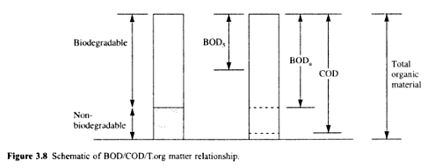
Organic Chemical Properties of Water

Slide 220
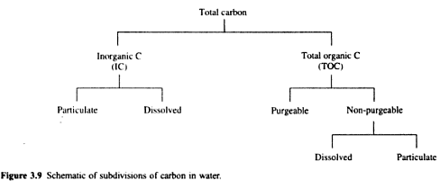
Organic Chemical Properties of Water

Slide 221
Problems
Q.1. Determine COD & TOC for glucose(C₆H₁₂O₆)?
Q.2. If bacteria cells are represented by the chemical formula C₅H₇O₂N, then determine the potential carbonaceous BOD, when bacteria cell concentration is 1000mg/L.

Slide 222
Problems
Q.3. A wastewater is analysed & is shown to contain 100 mg/L of ethylene glycol (C₂H₆O₂) & 120 mg/L of phenol(C₆H₆O). Determine COD & TOC.

Slide 223
Problem
Q. Determine the time required for benzene (C₆H₆) & DDT(C₁₄H₉Cl₅) to vapourize to half of their original concentration from a wastewater treatment plant holding tank of depth 2mtr. The mass transfer co-efficient (k) for benzene is 0.144mtr/hr & for DDT is 9.34x10⁻³ mtr/hr.

Slide 224
Solubility of gases in water
The solubility of gases in water is related to the partial pressure of the gas in the atmosphere above the water & is given by Henry’s Law, which can be expressed as follows:-

Slide 225
Solubility of gases in water
P_{g}= (K_{h})(X_{g})
where,
P_{g}= Partial pressure of the gas,
K_{h}= Henry’s Law Constant
Xg= Equilibrium mole fraction of the dissolved gas in the liquid phase

Slide 226
Concept of Hydrology
i)Water Balance or Water Budget
ii)Energy Balance or Energy Budget
iii)Bowen Ratio
iv)Hyetograph & Hydrograph
V)Rainfall-Runoff Relationship or
Rational formula for determining runoff

Slide 227
Concepts of Hydrology
i)Water Balance or Water Budget:-
It gives the quantitative account of hydrological cycle.
The equation for water balance is based on conservation of mass.

Slide 228
Concept of Hydrology
The water balance equation is
P= R+E+∆S+∆G
Where, P is Precipitation
R is Runoff
E is Evaporation
∆S is change in soil moisture status
∆G is change in ground water status

Slide 229
Concepts of Hydrology
ii) Energy Balance or Energy Budget :-
The equation for Energy Balance or Energy Budget is –
R_{n}= LE+H+G+PS+M
Where,
R_{n} is specific flux of net incoming radiation,
L is Latent Heat of Vapourization

Slide 230
Concepts of Hydrology
E is Evaporation
H is Specific flux of heat into the atmosphere
G is Specific flux of heat into the ground
PS is Photosynthetic energy fixed by plants
M is energy for respiration & heat storage

Slide 231
Concepts of Hydrology
iii) Bowen Ratio :-
It is an useful parameter for energy budget & represents ratio between heat flux & evaporation rate.
It can be expressed by –
B_{O}=H/LE

Slide 232
Concepts of Hydrology
iv) Hyetograph & Hydrograph :-
Hyetograph represents rainfall intensity vs time.
Hydrograph represents runoff or stream discharge vs time.
If time is unit i.e. 1hr., then hydrograph will be unit hydrograph.

Slide 233
Concepts of Hydrology
V)Rainfall-Runoff Relationship or
Rational formula for determining runoff :-
Q=CIA
Where,Q is runoff in m³/sec
C is locality coefficient
I is Rainfall Intensity in mm/hr
A is Catchment Area in square Km

Slide 234
Concepts of Hydrology
Peak Discharge (Q_{P})or Peak Run-off can be expressed as follows:-
Q_{P}=0.278 CIA
Modified Rational Formula given by Wallingford is :-
Q_{P}=0.278C_{V}C_{R}IA
Where, C_{V} is volumetric runoff coefficient &
C_{R} is Routing Coefficient

Slide 235
Organic content parameter
When an organic waste is discharged to a stream, the organic content of the effluent or discharge undergoes a biochemical reaction with the help of micro-organisms.
The BOD = P(DO_{I}-DO_{F})
Where, P is Dilution Ratio,
DO_{I} & DO_{F} are initial & final DO(Dissolved Oxygen) concentration

Slide 236
Organic content parameter
The Corrected BOD = P[(DO_{I}-DO_{F})-f(B_{I}-B_{F})]
Where, f is the correction factor or seeding factor=1-(1/P),
B_{I} & B_{F} are initial & final DO(Dissolved Oxygen) concentration of seeded diluted water or Blank

Slide 237
Problem
Q. The results from a BOD test diluted by 100 are given below. Calculate the BOD_{S}.
Time (in days) DO(in mg/L)
0 7.95
1 3.75
2 3.45
3 2.75
4 2.15
5 1.80

Slide 238
Problem
Q. The results from a BOD test diluted by 100 are given below. Calculate the Corrected BOD_{S}.
Time (in days) DO(in mg/L) Blank DO(in mg/L)
0 7.95 8.15
1 3.75 8.10
2 3.45 8.05
3 2.75 8.00
4 2.15 7.95
5 1.80 7.90

Slide 239
Organic matter
The rate of decomposition of organic matter is directly proportional to the amount of organic matter available & it is a first order reaction.
i.e. d/dt(L_{t})α L_{t}
=> d/dt(L_{t}) = -k₁xL_{t}
Where, L_{t} is BOD remaining in mg/L=BOD_{r} &
K₁ is deoxygenation rate coefficient

Slide 240
Problem
Q. If K₁ or deoxygenation rate coefficient is 0.15 per day, then determine the ultimate BOD or BOD_{u} or L₀.

Slide 241
Temperature effect on K₁
Temperature has an effect on K₁ & is given by,
K_{T} = (K₂₀)x(θ)^{(T-20)}
Where,
K_{T}= The deoxygenation rate coefficient at T⁰C
K₂₀=The deoxygenation rate coefficient at 20⁰C
θ= Coefficient= 1.047 for 20⁰C< T < 30⁰C &
= 1.35 for 4⁰C < T < 20⁰C

Slide 242
NBOD
The Oxygen demand associated with the oxidation of ammonia(NH₃) to nitrate (NO₃⁻) is called Nitrogenous BOD or NBOD.

Slide 243
Problem
Q. Determine the TOD(Total Oxygen Demand) if the sample contains 25 mg/L of N.

Slide 244
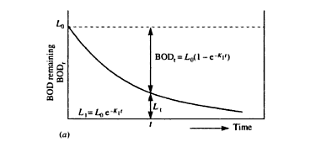
BOD remaining(BOD_{r}) graph

Slide 245
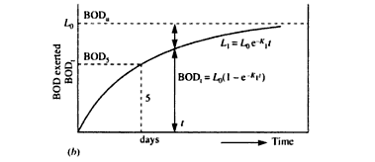
BOD exerted(BOD_{t}) graph

Slide 246
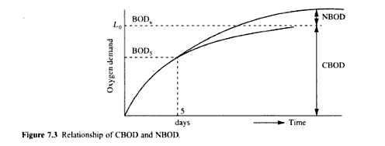
CBOD & NBOD relationship

Slide 247
Problem
Q. 15ml of sample was diluted in 300ml bottle. Initial DO was 8.9 mg/L & final DO after 5days was 4.4mg/L. The corresponding initial & final DO of diluted water was 9.1mg/L & 9.05 mg/L. Find out 5 days BOD at 20⁰C.

Slide 248
Problem
Q. BOD of an sample incubated for one day at 30⁰C was found to be 100mg/L. What would be the 5 day BOD at 20⁰C. The deoxygenation rate coefficient (K₁) is 0.12 at 20⁰C.

Slide 249
Problem
Determine the two day BOD for a wastewater at 20⁰C, while BOD₅ at 20⁰C is 250mg/L. The deoxygenation rate coefficient(K₁) value at 20⁰C is 0.2 per day. What shall be the BOD after the end of seven days at 25⁰C .

Slide 250
Problem
A BOD test was conducted taking 5% wastewater mixed with 95% aerated water for dilution & the following observations were found out:
i) DO of the aerated water used for dilution is 3.6 mg/L
ii) DO of the original wastewater sample is 0.8 mg/L

Slide 251
iii) DO of the diluted wastewater after incubation at 20⁰C for 5 days is 0.7 mg/L
Calculate the 5 days BOD of the above wastewater sample if the deoxygenation constant is 0.11.

Slide 252
Aquatic Pollution
The aquatic Pollution can be classified into three broad groups.
a) Fresh water pollution or
Surface water pollution
b) Estuarine pollution
c) Marine pollution

Slide 253
a)Fresh water pollution
The pollution of fresh water can be caused by:-
Wastes from municipality & industries
Oil from industry wastes & cleaning of vehicles
Thermal waste from industries & power stations
Heavy metals etc.

Slide 254
b) Estuarine pollution
Estuarine means tidal mouth of river or where river mixes with the sea.

Slide 255
c) Marine pollution
The main pollutants for Marine pollution are:-
i) Manmade organic poisons like
Pesticides & herbicides
ii) Radioactivity due to radioactive substances.

Slide 256
Oxygen Sag Curve
The longitudinal profile of Oxygen concentration is Known as Oxygen sag curve.

Slide 257
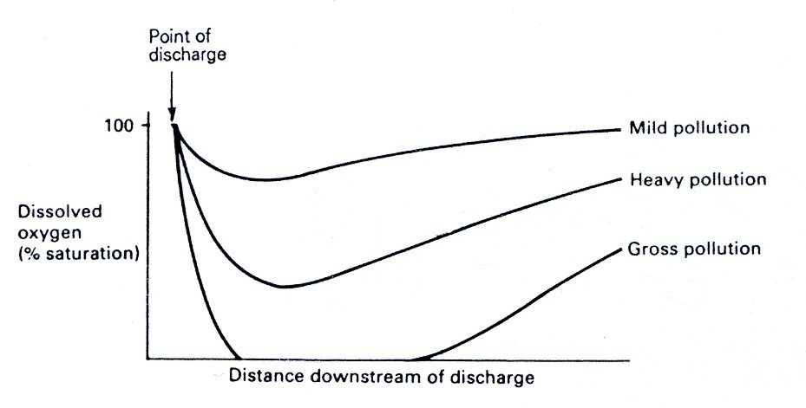
Oxygen Sag Curve

Slide 258
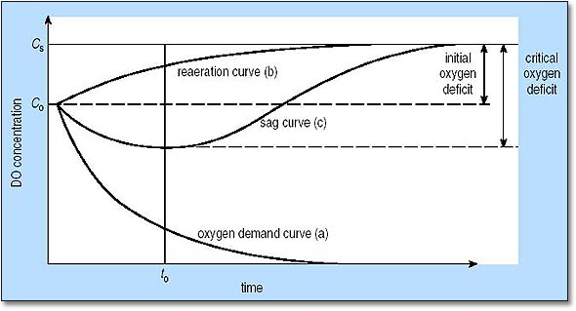
Oxygen Sag Curve

Slide 259
Eutrophication
It can be defined as the enrichment of water by inorganic plant nutrients like N & P, which results in increase in primary productivity.
Artificial eutrophication is known as cultural eutrophication which can be achieved by adding fertilizers.

Slide 260
Eutrophication
The problems arising due to Eutrophication are:-
Water quality may have unacceptable taste & odour
Water may be injurious to health
The household usefulness of water may decrease.

Slide 261
Point & Non-Point Sources of Pollution
Point Sources are those, which discharge pollutants from specific locations such as chimney, drainpipe of factories etc.
Point Sources are easier to monitor & regulate.

Slide 262
Point & Non-Point Sources of Pollution
Non-point sources of pollution are those, which don’t have any specific location of discharge.
As a result, these are difficult to monitor & regulate.
Ex:- Run-off from paddy fields, Lawns & Gardens.

Slide 263
Oxygen transfer in water bodies
The oxygen transfer in water bodies is given by Orlob equation i.e.

Slide 264
Oxygen transfer in water bodies
Where,
C_{g} = Saturation Concentration of oxygen
C₀ = Initial Concentration of oxygen
C_{t} = Concentration of oxygen after time ‘t’
K₂ = reaeration rate constant

Slide 265
Problem
If saturation concentration of oxygen in water is 9.2mg/L & the initial concentration of oxygen is 2.1mg/L, then determine the time it takes to become 7.5mg/L , having K₂ value 0.25 per day. What is the time required for C_{t} to be 5,6,7,8,9 mg/L.

Slide 266
Ground water Quality/Contamination
The most simple model of decay of a contaminant is to assume the decay to be a first order reaction i.e.
r = - Kc &
C_{t} = C₀e^{-Kt}

Slide 267
Ground water Quality/Contamination
Where,
C_{t} = Concentration at time ‘t’ in mg/L
C₀ = Initial Concentration in mg/L
t = time in days
K = first order decay coefficient

Slide 268
Problem
Determine the concentration of a contaminant at the downstream well, if the upstream concentration is 80mg/L. Assume decay constant (k) to be 10⁻⁴ per day & time (t) = 274 years.

Slide 269
Ground Water Recharge
It is also known as deep percolation
It is a hydrologic process, where water moves downward from surface to ground.
Recharge can occur both naturally & artificially.
Natural way of recharge is occurred through hydrological cycle.

Slide 270
Ground Water Recharge
Recharge occurs artificially, when rainwater, reclaimed water or recycled water is injected or routed to the subsurface.
Recharge can help move excess salts that accumulate in the root zone to deeper soil layers or into the deep groundwater system.

Slide 271
Ground Water Flow
The ground water flow is governed by Darcy’s law which can be expressed as follows:-
Q = KiA
= KA(dh/dL)
= KA{(h₂-h₁)/(L₂-L₁)}

Slide 272
Ground Water Flow
Where,
Q = horizontal flow in m³/sec
K = hydraulic conductivity in m/sec
i = dh/dL= hydraulic gradient
A = cross sectional area in square mtr

Slide 273
Ground Water Flow
h₂- h₁= water head drop
L₂-L₁ = Length difference over which water head drop occurs
q = Q/A
= Specific discharge or
discharge per unit area

Slide 274
Problem
Determine the daily flow capacity and transmissivity of an aquifer, if it’s height, width, length are 15mtr, 800mtr & 2km respectively. The water head change over the length 2km is 3mtr. The hydraulic conductivity(K) value is 6x10⁻⁷ m/sec.

Slide 275
Problem
Determine the hydraulic conductivity(K) for an unconfined aquifer which is 10mtr thick, if a well delivers 360m³/day. Observation well(1) is situated at 20mtr from pumping well & record a draw down of 6mtr. Observation well(2) is situated at 600mtr from pumping well & draw down is 3mtr. The original water table is recorded at 12mtr.

Slide 276
Water Table
A water table is the underground depth, at which point the ground is totally saturated by water.
The water table may vary due to seasonal changes in precipitation, evapotranspiration & topography etc.

Slide 277
Aquifer
An aquifer is a body of saturated rock through which water can easily move.
An aquifer is an underground layer of water bearing permeable rock from which ground water can be extracted using a water well.
Aquifer can be of two types:-
a) Unconfined aquifer
b) Confined aquifer

Slide 278
Unconfined aquifer
An unconfined aquifer is the one which is open to receive water from the ground surface & whose water table surface is free to fluctuate up & down, depending on the recharge & discharge rate.
These are extremely susceptible to contamination.

Slide 279
Confined aquifer
These type of aquifers have rock layer with less permeability or confining bed of rock above them due to which water can’t enter freely into these type of aquifers from the ground surface.
These are less susceptible to contamination.

Slide 280
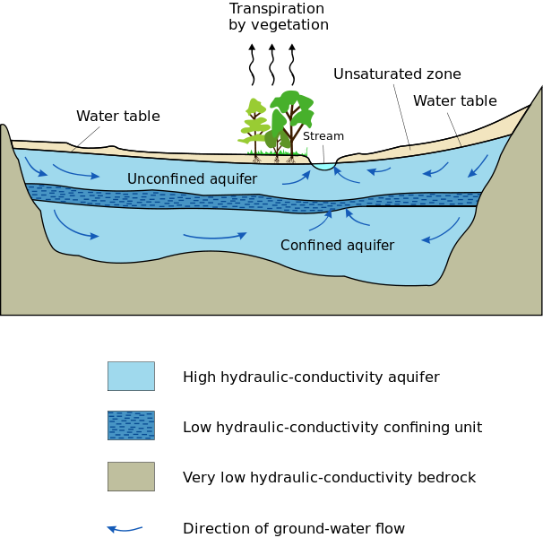
Figure

Slide 281
Water Treatment
The objectives of water treatment are :-
A) To produce Water which is safe for human consumption
B) To produce Water at a reasonable cost
C) To reduce water impurities to acceptable levels

Slide 282
Organoleptic Parameters
Organoleptic Parameters are those parameters which can be sensed or felt by human organs.
Ex:- Colour, Taste & Odour etc.

Slide 283
Classes of Water treatment
Class Description Source
A No Treatment Borehole water
B Disinfection only Borehole water
C Standard water Treatment River,Reservoir
D Advanced/Special water Industrial water Treatment

Slide 284
Monitoring Frequency
The water quality parameters are required to be monitored depending on the source & quality of raw water.
The three categories are:-
A) Minimum monitoring(C1)
B) Current monitoring(C2)
C) Periodic Monitoring(C3)

Slide 285
Water Treatment Processes
The treatment processes of water can be classified into three stages :-
A) Pretreatment processes
B) Standard or Conventional processes
C) Special or Advanced processes

Slide 286
A) Pretreatment processes
Some treatment processes are required prior to standard water treatment processes which may include :-
i) Screening
ii) Storage
iii) Aeration
iv) Chemical pre-treatment

Slide 287
A) Pretreatment processes
i) Screening:-
Different types of screens are used in this process. Those are can be :-
a)Coarse Screen
b)Fine Screen
c)Micro Screen

Slide 288
A) Pretreatment processes
a) Coarse Screen:-
These screens contain typically inclined bars of 25mm dia & 100mm spacing, preventing large floating matters from entering the treatment plant

Slide 289
A) Pretreatment processes
b) Fine Screen:-
If storage is not provided, then fine screens are fitted after the coarse screens.
If there is storage, then fine screens are placed at the outlet of the storage tanks.
Fine screens are typically mesh with openings about 6mm dia or square

Slide 290
A) Pretreatment processes
C) Micro Screen:-
In micro screens, mesh openings range from 20 to 40 µm.
These type of screens are used only for relatively uncontaminated water.

Slide 291
A) Pretreatment processes
ii) Storage:-
Storage tanks balance the flows going to the treatment plant.
Storage capacity should be equivalent to 7 to 10 days of the average water demand.
The period of storage shouldn’t be long, so as not to encourage the growth of unwanted organisms

Slide 292
A) Pretreatment processes
iii) Aeration:-
Aeration is the supply of oxygen from the atmosphere to water to effect beneficial changes in the quality of water.
It is a common treatment process for groundwater

Slide 293
A) Pretreatment processes
Aeration is generally used for the following:-
a) To release excess H₂S gas which may cause undesirable taste & odour.
b) To release excess CO₂ which may have corrosive properties
c) To increase oxygen content of water.

Slide 294
A) Pretreatment processes
iv) Chemical pre-treatment:-
The chemical pre-treatment to remove undesirable properties of water like algae or excess colour is a more expensive process than chemical post-treatment.
In pre-treatment, greater amount of chemicals are required to effect the same result as some of the chemicals are absorbed by turbidity of water.

Slide 295
A) Pretreatment processes
The two Chemical pre-treatment processes which are generally used are:-
a) Pre-Chlorination
b) Activated Carbon

Slide 296
A) Pretreatment processes
a) Pre-chlorination:-
It is used on low turbidity water with a high coliform count. The chlorine is injected into the water stream & it oxidizes & precipitates iron & manganese. It also kill pathogens & reduces colour. The chlorine dose used is 5mg/L. Pre-chlorination also reduces NH₃ in both surface water & ground water supplies.

Slide 297
A) Pretreatment processes
b) Activated Carbon:-
The activated Carbon is used for:-
i) Removal of Photosynthetic Algae
ii) Improvement of colour & odour
iii) Removal of organic compounds

Slide 298
A) Pretreatment processes
Activated Carbon can be used either as PAC (Powdered Activated Carbon) or as GAC (Granular Activated Carbon).
Generally for water treatment PAC is used, but GAC is used where taste & odour of water have an industrial base.
PAC has lower cost & efficiency than GAC.
Doses may vary from 3 to 20 mg/L.

Slide 299
B) Standard or Conventional processes
It includes:-
i) Sedimentation
ii) Coagulation
iii) Flocculation
iv) Filtration &
V) Disinfection

Slide 300
B) Standard or Conventional processes
i) Sedimentation:-
The heavier large particles settle down by the force of gravity at the bottom of the sedimentation tank, which is called Sedimentation.
Stoke’s law for settling velocity is the deciding equation for sedimentation.

Slide 301
B) Standard or Conventional processes
Stoke’s law can be represented by:-
V_{S}=(g/18µ)(ρ_{s}- ρ_{w})d²
Where, V_{S} is settling velocity
g is acceleration due to gravity
µ is dynamic viscosity
d is diameter of settling particle
ρ_{s} is density of particle settling
ρ_{w} is density of water

Slide 302
B) Standard or Conventional processes
ii) Coagulation:-
The lighter smaller particles don’t settle down by the force of gravity.
To make them settle down, some amount of coagulants are added to the water, which is called Coagulation.

Slide 303
B) Standard or Conventional processes
Some examples of coagulants are:-
Alum i.e. aluminium sulphate
Ferric Chloride
Ferric Sulphate
Ferrous Sulphate

Slide 304
B) Standard or Conventional processes
iii) Flocculation:-
When coagulants are added to the water, the lighter smaller particles coagulate or combine with each other forming bigger particles, known as floc & the process is called flocculation.

Slide 305
B) Standard or Conventional processes
iv) Filtration:-
It is the process of passing water through a porous medium, with the expectation that the filtrate water has better quality than the incoming water.

Slide 306
B) Standard or Conventional processes
Generally, two types of filters are used
a)Rapid gravity filter:-
Here rate of filtration is high i.e. 5 to 20m/hr.
b) Slow sand filter:-
Here rate of filtration is slow i.e. 0.1 to 0.2m/hr.

Slide 307
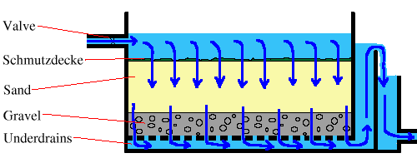
Slow Sand Filter

Slide 308
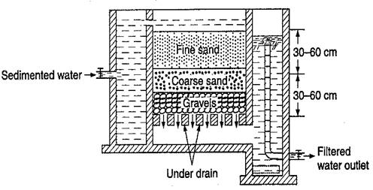
Rapid Gravity Filter

Slide 309
Terminology
Sand particles range in diameter from 0.0625 mm to 2 mm. An individual particle in this range size is termed a sand grain. Sand grains are between gravel (with particles ranging from 2 mm up to 64 mm) and silt (particles smaller than 0.0625 mm down to 0.004 mm)

Slide 310
Terminology
ISO (International Organization for Standardization)14688 grades sands as fine, medium and coarse with ranges 0.063 mm to 0.2 mm, 0.2 mm to 0.63 mm, 0.63 mm to 2.0 mm respectively.

Slide 311
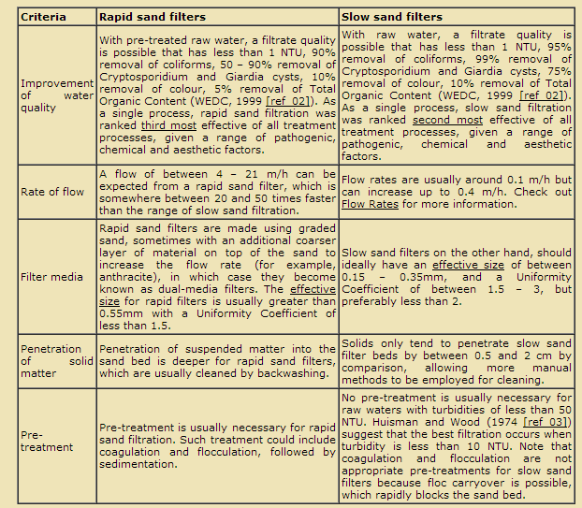
Comparision

Slide 312
Terminology
In order to select the correct grain size it is necessary to measure the Effective Size (or D10) and Uniformity Coefficient (or K). Both are used in defining filter media, in this case to know whether a type of media is or is not suitable for slow sand filtration.

Slide 313
Terminology
The effective size of a given sample of sand is the particle size (in millimetres) where 10% of the particles in that sample (by weight) are smaller, while 90% are larger. Usually this is denoted as the D10.

Slide 314
Terminology
The size distribution is represented by the Uniformity Coefficient, which enables you to see how well graded your sand sample is (that is, whether there is a whole different range of sizes, or whether most of the sample is only one size). This is done by taking the D60 and dividing by the D10.

Slide 315
B) Standard or Conventional processes
V) Disinfection:-
By disinfection, pathogens & micro-organisms are killed, thereby making water more pure.
The requirements of a good disinfectant are-
a) It should be toxic to micro-organisms.
b) It should have a fast rate of kill.

Slide 316
B) Standard or Conventional processes
c) It should be persistent enough to prevent regrowth of organisms in the distribution system.
d) It shouldn’t produce undesirable compounds.
e) It should be safe to handle.
f) It should be of reasonable cost.

Slide 317
B) Standard or Conventional processes
Chick’s law:-
The rate of destruction of micro-organisms is often a first order chemical reaction as given by Chick’s law i.e.

Slide 318
B) Standard or Conventional processes
Where,
N_{t} = Number of organisms at time ‘t’
N₀ = Number of organisms at time ‘t’= 0
K = Rate constant depends on types of micro-organisms present & types of disinfectants used

Slide 319
B) Standard or Conventional processes
The various examples of disinfectants are:-
a) Chlorine dioxide
b) Chlorine
c) Chloramines
d) UV radiation

Slide 320
Chlorine demand & Breakpoint Chlorination
When chlorine is added to water, the chlorine at first oxidizes inorganic compounds & some amount of chlorine will be consumed by organic matter present in water. Then some amount of chlorine will be used for formation & subsequent destruction of chloramines.

Slide 321
Chlorine demand & Breakpoint Chlorination
The amount of chlorine required to fulfill the above consumption requirements are called chlorine demand.
The point at which the chlorine demand is satisfied is called the breakpoint chlorination.

Slide 322
Chlorine demand & Breakpoint Chlorination
The excess dose of chlorine after breakpoint, is available for disinfection which appears as residual chlorine.
A residual chlorine of minimum 0.5mg/L is maintained in disinfection practices.

Slide 323
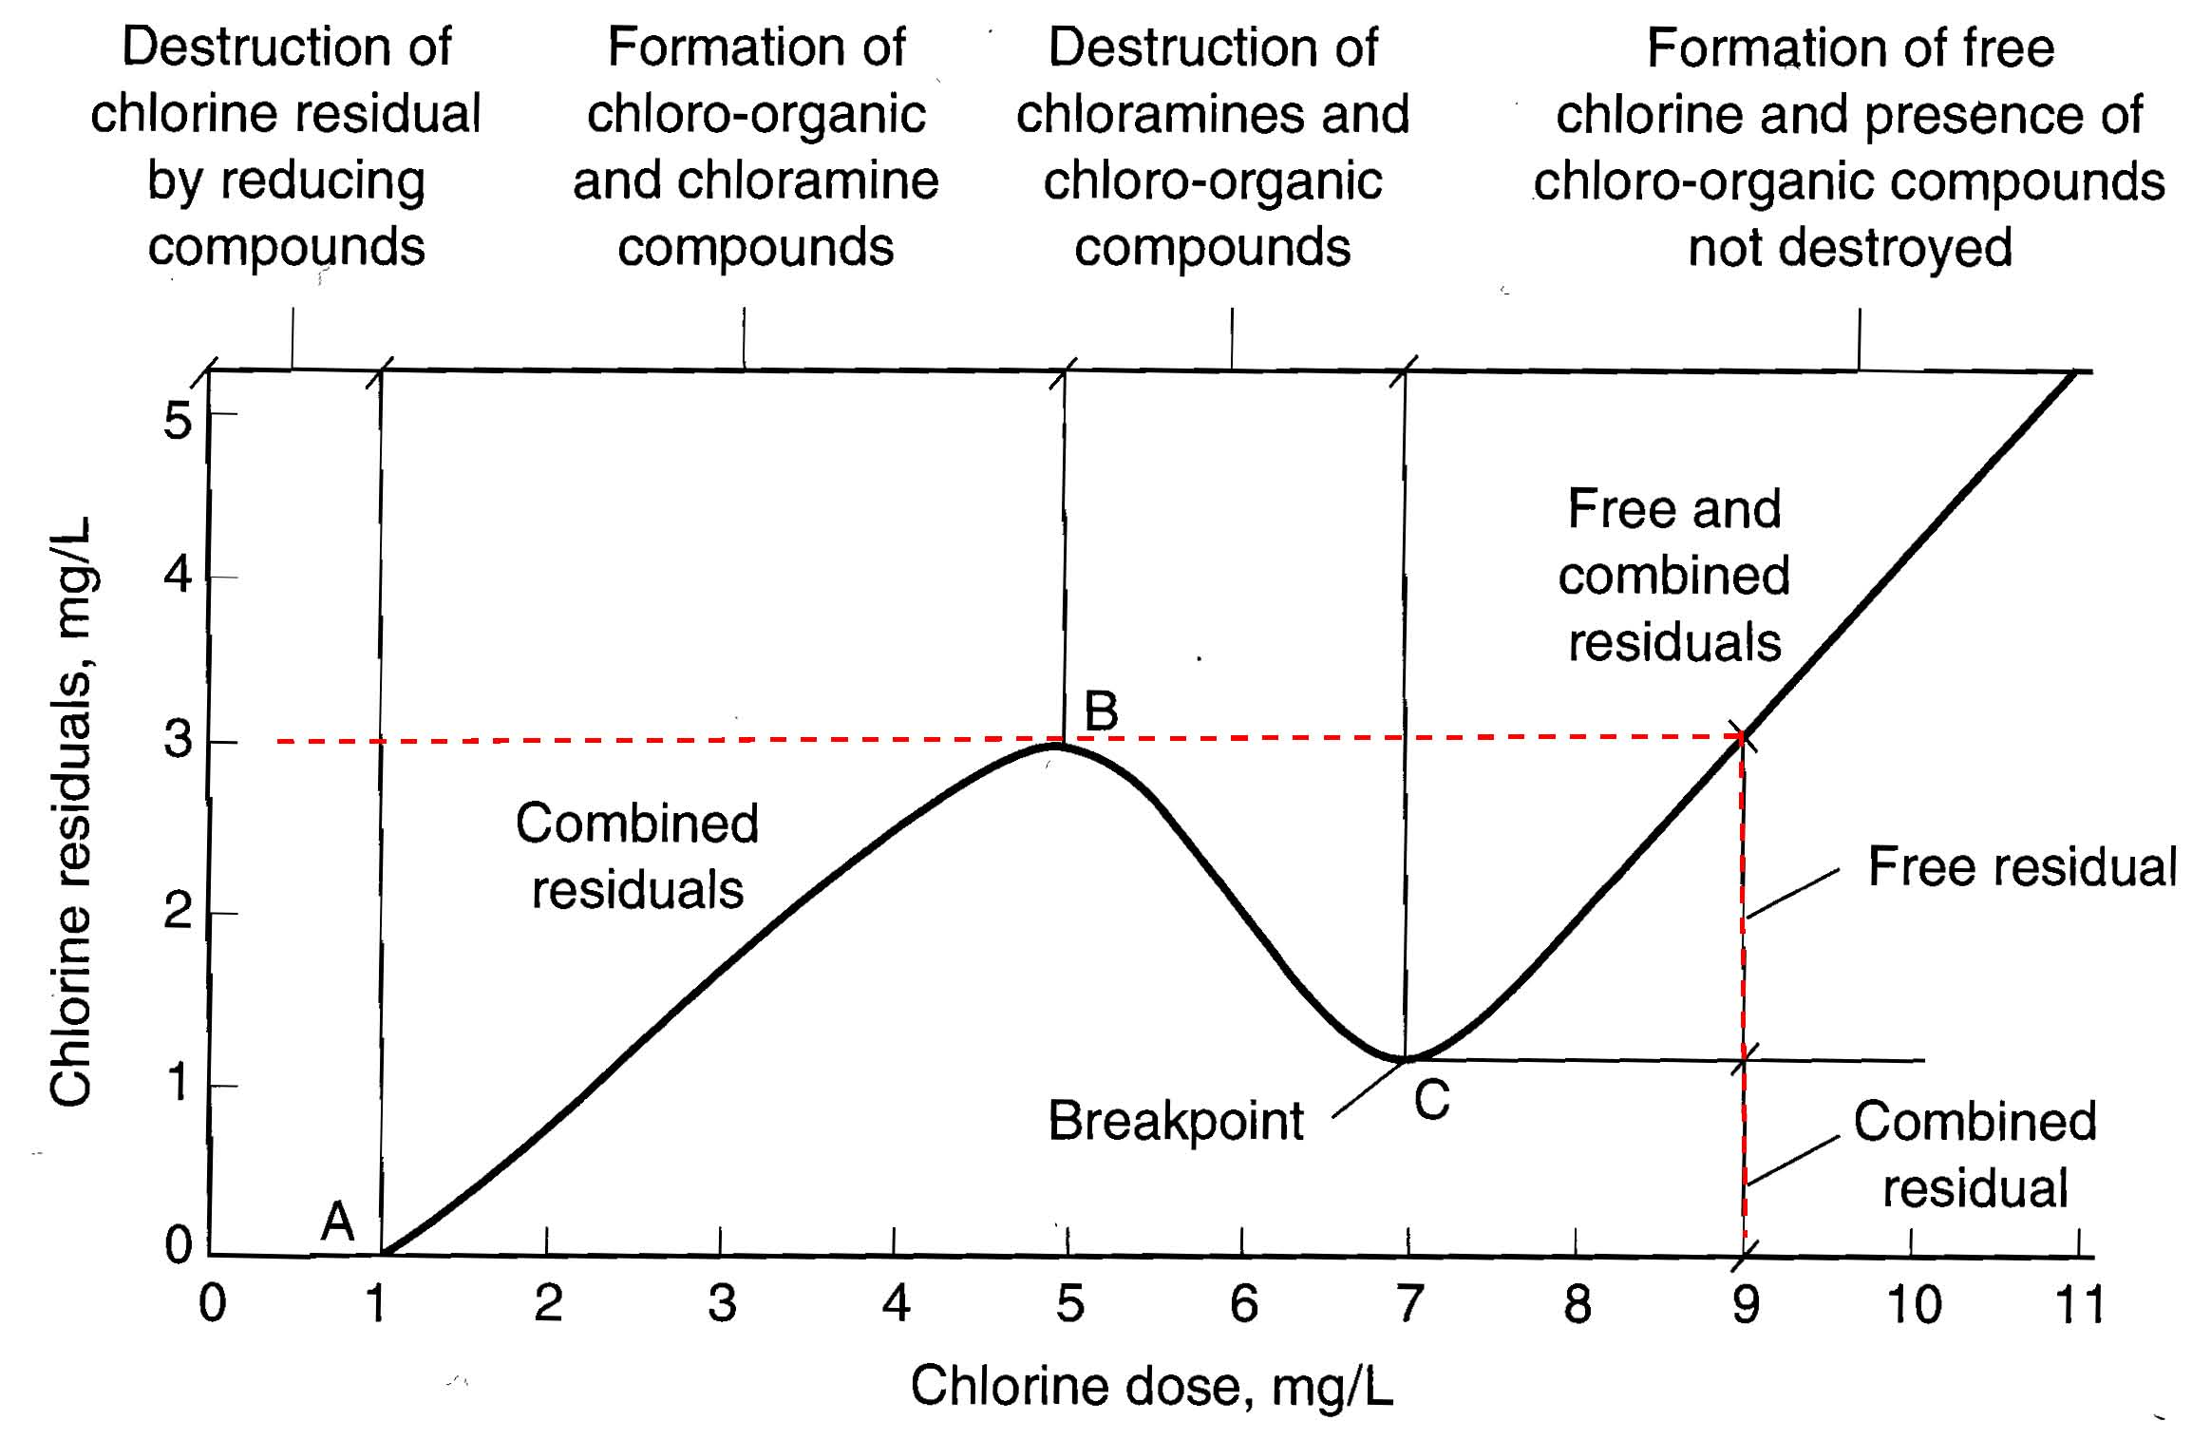
Chlorine demand & Breakpoint Chlorination

Slide 324
C) Special or Advanced processes
The purposes of advanced water treatment processes are:-
i) To take water treated by standard water treatment processes & to improve it to an exceptionally high quality water as often required by particular industries like food industry & pharmaceuticals etc.

Slide 325
C) Special or Advanced processes
ii) To treat water containing specific chemical or microbiological contaminants, so that they can be brought to an acceptable standard.

Slide 326
C) Special or Advanced processes
The various advanced water treatment processes are:-
i) Iron(Fe) & Manganese(Mn) removal
ii) Ion exchange
iii) Chemical Oxidation
iv) Membrane processes like Reverse Osmosis & electrodialysis.

Slide 327
C) Special or Advanced processes
i) Iron(Fe) & Manganese(Mn) removal:-
The acceptable limit of Iron as Fe and Manganese as Mn in drinking water are 0.3 & 0.1 mg/L respectively.
By aeration the Fe⁺² ions are oxidized to Fe⁺³ & precipitates out as Fe(OH)₃, which can be removed by filtration.

Slide 328
C) Special or Advanced processes
Mn⁺² can be removed by oxidizing Mn⁺² to Mn⁺⁴ & then precipitating out.

Slide 329
C) Special or Advanced processes
ii) Ion Exchange:- Ion exchange processes are reversible & the direction of reaction in this case depends on the concentration & levels of the saturation of the sodium resin.
Ex:-Water softening process

Slide 330
C) Special or Advanced processes
The reactions can be -

Slide 331
C) Special or Advanced processes
Na₂R is Exchangeable Na Resin &
R is complex base like Zeolite.
Zeolites are the aluminosilicate members.
Ex. of Zeolite is Na₂Al₂Si₃O₁₀·2H₂O, the formula for natrolite.

Slide 332
C) Special or Advanced processes
iii) Chemical Oxidation:-
It is the resultant reaction when two or more chemical species are added with each other with the purpose of increasing the oxidation state of one by reducing the other.
Ex:- Fe⁺² is oxidised by HOCl (Hypochlorous acid)

Slide 333
C) Special or Advanced processes
The ferrous ion increased in oxidation state from +2 to +3 & chlorine reduced from Cl⁺ to Cl⁻.
The reaction can be –
2Fe⁺² + HOCl + 5H₂O 2Fe(OH)₃+Cl⁻ + 5H⁺

Slide 334
C) Special or Advanced processes
iv) Membrane processes like Reverse Osmosis & electrodialysis:-
Reverse Osmosis(RO):- It is a solubilization diffusion technique, that makes use of a semipermeable membrane which acts as a barrier to dissolved salts & inorganic molecules.

Slide 335
C) Special or Advanced processes
Reverse osmosis (RO) is a water purification technology that uses a semipermeable membrane. This membrane technology is not properly a filtration method.
In reverse osmosis, an applied pressure is used to overcome osmotic pressure, which is the minimum pressure which needs to be applied to a solution to prevent the inward flow of water across a semipermeable membrane

Slide 336
C) Special or Advanced processes
Reverse osmosis can remove many types of molecules and ions from solutions, and is used in both industrial processes and the production of potable water. The result is that the solute is retained on the pressurized side of the membrane and the pure solvent is allowed to pass to the other side.

Slide 337
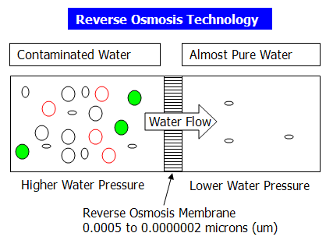
Diagram

Slide 338
C) Special or Advanced processes
Electrodialysis(ED):- It is an electrically charged membrane process, where the ions are transferred through a membrane from a less concentrated solution to a more concentrated solution.

Slide 339
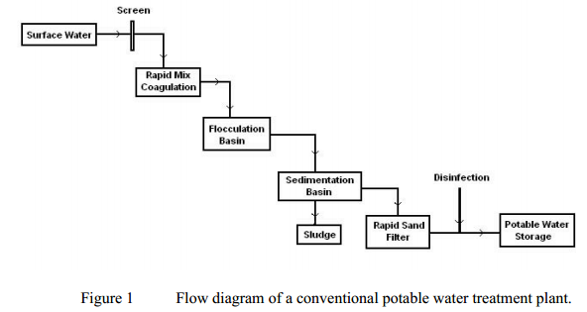
Flow Diagram

Slide 340
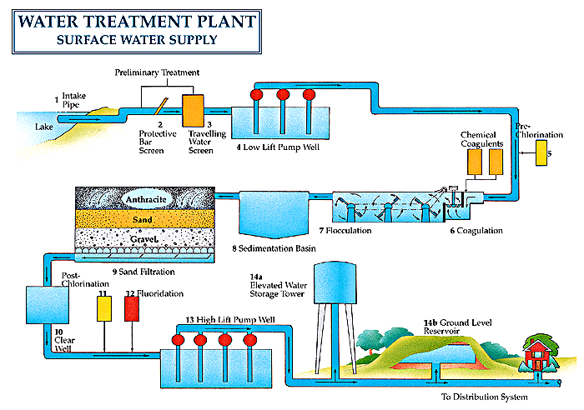
Water treatment plant

Slide 341
Air Pollution
Criteria Pollutants:-
The criteria pollutants as defined by USA, EC(European Community) & WHO includes CO,NO₂,SO₂,Pb,PM-10(Particulate Matter of dia less than 10µm)
These are generally found in urban environment.

Slide 342
Air Pollution
Non-Criteria Pollutants:-
The non-criteria air pollutants are those for which emission limits from industry are set or fixed.
These are more poisonous & hazardous w.r.t. criteria pollutants
Ex:- Benzene(C₆H₆),Carbon disulphide(CS₂), Arsenic, Asbestos

Slide 343
Air Pollution
Acid Deposition:-
Rainwater has pH approximately 5.7 & rainwater having pH less than this will be treated as acid rain, which will be a reason for acid deposition on the earth.
Hydrocarbon(HC),SO_{X},NO_{X} emitted from industries & vehicles are the main source of acid deposition.

Slide 344
Air Pollution
GHG(Green House Gases):-
A GHG absorbs & emits radiation within the thermal infrared range having wavelength between 700nm to 1mm i.e.
700x10⁻⁹ m to 10⁻³m
The major GHGs in order of their contribution are CO₂>CFCs>CH₄>N₂O(Nitrous Oxide)

Slide 345
Air Pollution
Air Pollution Meteorology:-
The meteorological factors are –
Wind speed & direction
Temperature & humidity
Turbulence
Atmospheric Stability
Topographic effects on meteorology

Slide 346
Air Pollution
Scales:-
Air pollution emission can be measured in 3 scales-
a) Microscale
b) Mesoscale
c) Macroscale

Slide 347
Air Pollution
a) Microscale:-
It is of the order of 1km & duration is minutes to hours.
Ex:- Chimney gases

Slide 348
Air Pollution
b) Mesoscale:-
It is of the order of 100km & duration is hours to days.
Ex:- Mountain valley wind

Slide 349
Air Pollution
c) Macroscale:-
It is of the order of 1000km & duration is days to weeks.
Ex:- wind over oceans & continents

Slide 350
Air Pollution
Wind Speed:-
Wind speed at any height(z) can be determined using power law relationship i.e.
U_{Z}=U₁₀(Z/Z₁₀)^{P}

Slide 351
Air Pollution
Where,
U_{Z} is wind speed at height Z mtr
U₁₀ is wind speed at 10mtr height
Z is height in mtr
Z₁₀ is 10 mtr height
P is exponent, depends on terrain & stability class

Slide 352
Air Pollution
Q. Use power law velocity profile equation to determine U₂₀,U₅₀,U₁₀₀,U₂₀₀ if U₁₀ is 5m/sec & p is 0.2.

Slide 353
Air Pollution
Lapse Rate:-
In the lower troposphere, the temperature usually decreases with altitude.
The rate of temperature change or gradient is known as the lapse rate.
Lapse rate can be ambient or adiabatic.

Slide 354
Air Pollution
Ambient Lapse Rate (ALR) or
Environmental Lapse Rate(ELR):-
The temperature change or gradient with respect to rising altitude is known as ambient lapse rate & it varies from day to day & day to night.
This is the actual change of temperature with altitude for the stationary atmosphere.

Slide 355
Air Pollution
Adiabatic Lapse Rate:-
The temperature change of a parcel of air against rising altitude under adiabatic condition (i.e. occurring without the addition or loss of heat) is called the adiabatic lapse rate.

Slide 356
Air Pollution
Adiabatic Lapse Rate can be of two types-
i) Dry Adiabatic Lapse Rate(DALR)
ii) Moist adiabatic lapse rate (MALR) or
Saturated adiabatic lapse rate(SALR)

Slide 357
Air Pollution
For dry air i.e. DALR value is 0.98⁰C per 100mtr or approximately 1⁰C per 100mtr or 10⁰C per KM height
For moist air i.e. MALR value is 0.55⁰C per 100mtr or approximately 0.6⁰C per 100mtr or 6⁰C per KM height.

Slide 358
Air Pollution
A neutrally stable atmosphere occurs when ALR(Ambient)=DALR i.e. rate of cooling with rising altitude is nearly 1⁰C per 100mtr.
A stable atmosphere occurs when ALR < DALR i.e. rate of cooling with rising altitude is less than 1⁰C per 100mtr.

Slide 359
Air Pollution
An unstable atmosphere occurs when ALR > DALR i.e. rate of cooling with rising altitude is greater than 1⁰C per 100mtr.
A stable inversion condition occurs, when the temperature increases with altitude.

Slide 360
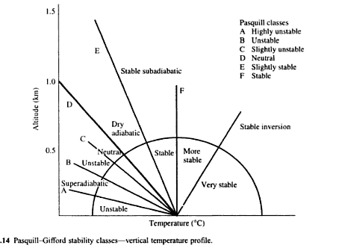
Stability Classes

Slide 361
Stability Classes
The previous figure represents the relationship of the variety of possible ambient lapse rate(ALR) to the dry adiabatic lapse rate(DALR) as corresponding to the Pasquill-Gifford stability classes.

Slide 362
Air Pollution
Atmospheric Dispersion:-
For determining atmospheric dispersion, generally 5 models are used like –
Gaussian model
Numerical model
Statistical model
Empirical model
Physical model

Slide 363
Air Pollution
Out of the above models, Gaussian model is generally used.
The various assumptions of Gaussian model are –
i) There is no variation in wind speed & direction between the source & receptor.

Slide 364
Air Pollution
ii) All discharges remain in the atmosphere.
iii) Dispersion doesn’t occur in the downward direction.
iv) Emission rates are assumed constant & continuous.

Slide 365
Industrial Air Emission Control
There are three general options in air emission control:-
i) Waste minimization
ii) Recovery & Recycling
iii) Destruction or Disposal

Slide 366
Industrial Air Emission Control
Special Methods:-
There are three special methods of air emission control:-
i) FGD(Flue Gas Desulphurization)
ii) NO_{X} removal
iii) Fugitive emission

Slide 367
Industrial Air Emission Control
i) FGD:-
FGD systems are of two types.
a) It generates a residue which must be disposed off.
b) It converts SO₂ & SO₃ to a marketable product.

Slide 368
Industrial Air Emission Control
The chemistry of FGD systems are –
SO₂ + CaO → CaSO₃
2CaSO₃ + O₂ → 2CaSO₄
CaCO₃ + SO₂ → CaSO₃ + CO₂

Slide 369
Industrial Air Emission Control
ii) NO_{X} removal:-
The term NO_{X} implies two major oxides of nitrogen i.e.
NO(Nitric Oxide) &
NO₂(Nitrogen Dioxide)

Slide 370
Industrial Air Emission Control
The simplest, most widely used model of NO_{X} formation is the Zeldovich mechanism, which may be expressed as follows –
N₂ + O = NO + N
O₂ + N = NO + O
OH + N = NO + H

Slide 371
Industrial Air Emission Control
Methods of NO_{X} reduction:- (T-16.5,P-777,G.kiely)
Methods:-
a)Flue gas recirculation
b)Low NO_{X} burner
c)Staged burners
d)Selective catalytic reduction(SCR)
e)Selective non-catalytic reduction(SNCR)

Slide 372
Industrial Air Emission Control
iii) Fugitive Emission:-
Fugitive emissions are industrial emissions from both point & non-point sources. These sources may be considered the equipments & methods associated with the transferring, conveying, loading, unloading, storage, packaging & processing of materials.

Slide 373
Industrial Air Emission Control
Control of fugitive emissions depend on compounds involved, quantities involved & the equipment being used.

Slide 374
Equipment Selection & Design
The Equipment Selection & Design is made on the basis of the types of compounds which are required to be removed.
Generally, compounds can be of three types –
a) Volatile Organic Compounds(VOCs)
b) Inorganic Compounds
c) Particulate matter

Slide 375
Equipment Selection & Design
The major types of equipments which are used are –
i) Incinerators
ii) Absorbers
iii) Adsorbers
iv) Condensers
v) Filters

Slide 376
Equipment Selection & Design
vi) Scrubbers or wet collectors:-
It is an apparatus using water or solution for purifying gases or vapours
vii) Various particle collection devices like ESP(Electrostatic Precipitator)
viii) Impingement separators:-
By density difference, it separates solids from gases

Slide 377
Equipment Selection & Design
ESP:- An electrostatic precipitator (ESP) is a highly efficient filtration device that removes fine particles, like dust and smoke, from a flowing gas using the force of an induced electrostatic charge minimally impeding the flow of gases through the unit.

Slide 378
Equipment Selection & Design
Basic Working Principle of ESP:-
In high- voltage electrostatic field, affected by the electric field force, gas ionization takes place. There are tremendous amount of electrons and ions existing in the ionized gas. After the dust particles are combined with these electrons and ions, they will be polarized, most of them are negatively polarized. Under the action of the field force, negatively charged particles migrates towards the positive electrode and in turn release electrons and attach to the positive electrode.

Slide 379
Equipment Selection & Design
When the particles agglomerate and the layers reaches a certain thickness on the plate, rapping system will start to work and the particles will be dislodged from the collecting plate by vibration and falling into the hopper. That ends the collection process.

Slide 380
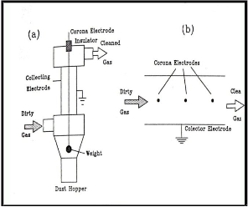
Diagram

Slide 381
Equipment Selection & Design
The efficiency of an ESP with plate collector is given by Anderson-Deutsch equation which can be expressed as follows:-
Efficiency = 1- e^{(-AW/Q)}
where, A = area of the plates in square mtr
W= particle sedimentation velocity in an electric field in mtr/sec
Q= Gas flow rate in m³/sec

Slide 382
Problem
A quantity of 50 m³/sec of air flows from a cement manufacturing facility. It contains cement particles whose settling velocity is 0.12 mtr/sec. If 99% removal efficiency is required, calculate the surface area of the ESP or design an ESP.

Slide 383
Problem
Calculate the percentage increase in area of the ESP plates, if the efficiency of the ESP unit is to be increased from 99% to 99.7%. Given the flow rate is 50m³/sec & particulate velocity is 0.15mtr/sec.

Slide 384
Problem
The drift velocity of fly ash particle is given by the empirical equation w= 1.5X10⁵ d_{p}, where d_{p} is particle size. Determine the plate area required to remove particles of dia 0.7µm with removal efficiency 95%. Flow to ESP is 5m³/sec.

Slide 385
Waste Minimization
Waste minimization is necessary :-
i) To control pollution
ii) To decrease the depletion rate of resources
ii) To increase efficiency & hence profitability

Slide 386
Waste Minimization
Elements of a waste minimization strategy:-
It includes –
i) Reduction at source
ii) Recycle/ Reuse
iii) Treatment
iv) Disposal

Slide 387
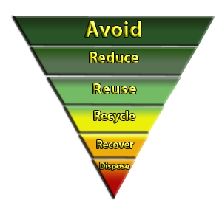
Waste Minimization Hierarchy

Slide 388
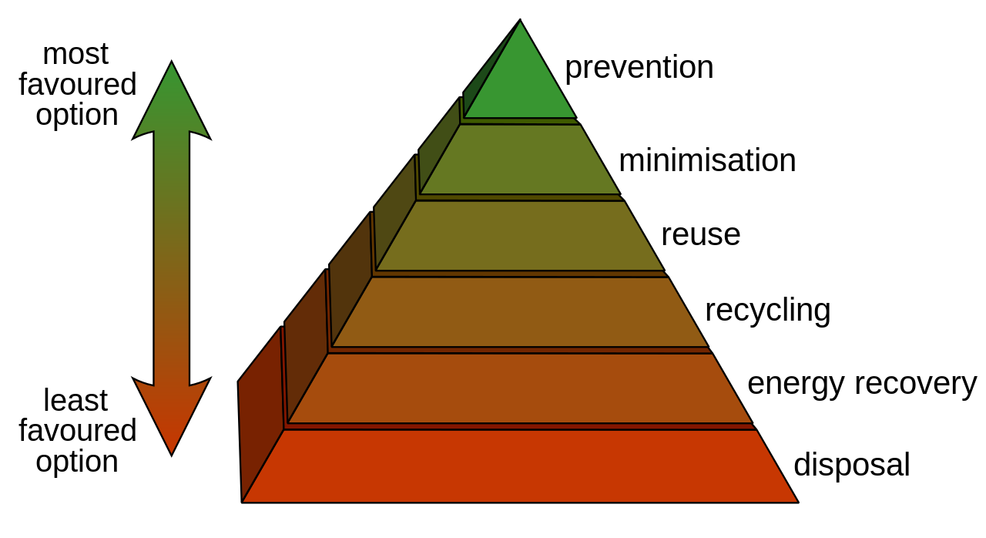
Waste Minimization Hierarchy

Slide 389
Waste Reduction Techniques
It has four major categories:-
i) Inventory Management
ii) Production Process Modification
iii) Volume Reduction
iv) Recovery

Slide 390
Waste Reduction Techniques
i) Inventory Management:-
Inventory means a detailed list of articles, goods, property.
Inventory management includes –
a) Inventory Control
b) Materials Control

Slide 391
Waste Reduction Techniques
ii) Production Process Modification:-
It includes –
a) Operational & maintenance procedures
b) Materials Change
c) Process equipment modification

Slide 392
Waste Reduction Techniques
iii) Volume Reduction:-
It includes –
a) Source Segregation
b) Concentration

Slide 393
Waste Reduction Techniques
iv) Recovery:-
It includes –
a) on-site
b) off-site

Slide 394
Life Cycle Assessment(LCA)
LCA is an useful environmental management tool.
Any product may have the following stages in it’s lifecycle –
i) Raw material acquisition
ii) Bulk material processing

Slide 395
Life Cycle Assessment(LCA)
iii) Engineered & specialty materials production
iv) Manufacturing & assembly
v) Uses & services
vi) Retirement or expired
vii) Disposal

Slide 396
Life Cycle Assessment(LCA)
LCA has the following phases –
i) Planning
ii) Screening
iii) Data Collection
iv) Data treatment
v) Evaluation

Slide 397
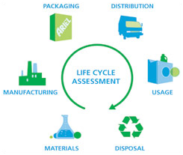
Diagram

Slide 398
Environmental Impact Assessment
Environmental Impact Assessment (EIA) is a process that requires consideration of the environment & public participation in the decision making process of project development.
Environmental Impact Assessment (EIA) is an important management tool for ensuring optimal use of natural resources for sustainable development.

Slide 399
Environmental Impact Assessment
The stages of EIA include –
i) Screening
ii) Scoping
iii) EIS preparation
iv) Review

Slide 400
Environmental Impact Assessment
i) Screening:-
By screening, it is to be decided which projects should be subject to environmental assessment.
ii) Scoping:-
It is the process which defines the key or important issues that should be included in the environmental assessment.

Slide 401
Environmental Impact Assessment
iii) EIS preparation:-
It is the scientific & objective analysis of the scale, significance & importance of impacts identified.
iv) Review:-
The review panel guides the study & then advises the decision makers.

Slide 402
Environmental Impact Assessment
Origin of EIA:-
All ecosystems including human beings have threshold of tolerance for pollution & disturbances, beyond which the system may suffer anything from temporary upsets to complete destruction. After second world war industrial & agricultural practices began to cause environmental damage which crossed the thresholds & lead to origin of EIA.

Slide 403
Environmental Impact Assessment
EIA Procedure:-
There are generally three options for establishing EIA procedures.
i) Legislative Option i.e. Legal approach
ii) Middle Ground Option i.e. within accepted planning & Procedures
iii) Policy Option i.e. within the administrative policy of government

Slide 404
Environmental Impact Assessment
Project Screening for EIA:-
The success of EIA depends on effective coverage & application of projects. The various methods commonly used to select projects for EIA are –
i) The use of positive (EIA required) & negative (EIA not required) list

Slide 405
Environmental Impact Assessment
ii) The use of project criteria
iii) The sensitive area criteria
iv) Matrices
v) Initial Environmental Evaluation(IEE)

Slide 406
Environmental Impact Assessment
Initial Environmental Evaluation(IEE):-
IEE is a mini EIA.
It requires a description of the environment & the development & the identification of environmental impacts those are anticipated.

Slide 407
Environmental Impact Statement(EIS)
EIS is a review document prepared for assessment in the EIA process.
Scope Studies of EIS:-
Scoping is the procedure for establishing the TOR(Terms Of Reference) for the EIS.

Slide 408
Environmental Impact Statement(EIS)
In general, the objectives would be to identify the concerns & issues those need attention, necessary for public involvement & to prepare a detailed report for the investigation of specific issues associated with the development.

Slide 409
Environmental Impact Statement(EIS)
Preparation of an EIS:-
One of the important elements of any project is the preparation of documentation to communicate the findings & conclusions of the study.

Slide 410
Environmental Impact Statement(EIS)
The value of the project is sharply diminished, if it’s findings don’t reach it’s requisite results or intended audiences.
The important points to be considered are –
i) Planning
ii) Purpose
iii) Audience
iv) Structure

Slide 411
Environmental Impact Statement(EIS)
Review of an EIS:-
The functions of the review authority includes-
i) The scope of the assessment i.e. which projects should be subjected to a full or partial EIS.
ii) General or specific guidelines & advice on the methods of EIS.

Slide 412
Environmental Impact Statement(EIS)
iii) Formulate the TOR(Terms Of Reference) & initiate a detailed EIS.
iv) Ensure that, the EIS had been adequately completed within the TOR.

Slide 413
Solid Waste Management
Solid waste is the unwanted or useless solid materials generated from combined residential, industrial and commercial activities in a given area.
Management of solid waste reduces or eliminates adverse impacts on the environment and human health and supports economic development and improved quality of life.

Slide 414
Solid Waste Management
It may be categorised according to its origin (domestic, industrial, commercial, construction or institutional); according to its contents (organic materials like plastics, rubber, food items & inorganic materials like glass, metal etc); or according to hazard potential (toxic, non-toxic, flammable, radioactive, infectious etc).

Slide 415
Solid Waste Management
A number of processes are involved in effectively managing waste for a municipality.
These include monitoring, collection, transport, processing, recycling and disposal.

Slide 416
Solid Waste Management
The order or hierarchy of solid waste management includes –
i) Waste prevention & minimization
ii) Reuse & Recycling
iii) Transformation
iv) Landfill

Slide 417
Solid Waste Management
Reuse:-
A newly purchased product is put to another use after the first use is completed.
Recycling:-
It is the processing of used materials or waste into new products to prevent waste of potentially useful materials.

Slide 418
Solid Waste Management
Properties of MSW(Municipal Solid Waste):-
The various properties of MSW includes –
i) Physical Properties of MSW
ii) Biological Properties of MSW
iii) Chemical & Energy Properties of MSW

Slide 419
Solid Waste Management
i) Physical Properties of MSW:-
The various Physical Properties of MSW are –
a) Particle Size Distribution
b) Density & Moisture Content
c) Field Capacity
d) Shear Strength
e) Hydraulic Conductivity

Slide 420
Solid Waste Management
a) Particle Size Distribution:-
Particle size is measured in terms of size of screens in mm through which wastes are passing.
This distribution will provide the information of various materials present.

Slide 421
Solid Waste Management
b) Density & Moisture Content:-
Density is mass per unit volume, which is a useful physical parameter used for separating various wastes from each other before treatment.

Slide 422
Solid Waste Management
The moisture content is expressed as mass of water vapour per unit mass of substance.
Moisture Content(%) = {(a-b)/a}X100
Where,
‘a’ is initial mass of sample &
‘b’ is mass of sample after drying

Slide 423
Solid Waste Management
c) Field Capacity (FC):-
It is the maximum percentage of volumetric soil moisture that a MSW sample will hold freely against earth’s gravity.
FC can be calculated by –
FC = 0.6 – 0.55(W/4500+W)
Where, W is overburden weight in Kg.

Slide 424
Solid Waste Management
d) Shear Strength:-
Solid wastes when compacted usually have high shearing strength & hence don’t flow on standing, but sludge has poor shearing strength & therefore very often sludge is co-disposed with MSW.

Slide 425
Solid Waste Management
e) Hydraulic Conductivity:-
Sludge in landfills tend to resist the movement of water through them due to low hydraulic conductivity, as sludge has high moisture content.

Slide 426
Solid Waste Management
ii) Biological Properties of MSW:-
Organic or biological matter in MSW is significant for the energy recovery by biodegradation.
Biodegradation can be accomplished either by aerobic or anaerobic process.

Slide 427
Solid Waste Management
The biodegradability of the organic fraction of MSW is given by –
BF = 0.83 - 0.028LC
Where,
BF is Biodegradable Fraction
LC is Lignin(organic) Content in % of dry weight
High LC will give low biodegradability.

Slide 428
Solid Waste Management
iii) Chemical & Energy Properties of MSW:-
The various steps involved in this are –
a) Proximate Analysis
b) Ultimate Analysis
c) Energy Content

Slide 429
Solid Waste Management
a) Proximate Analysis:-
It deals with the determination of moisture content(W%), volatile matter(VM%), non-combustible fraction (i.e. ash%) & Fixed Carbon(FC).
FC can be found out by –
FC=100 - W(%) - VM(%) - ash(%)

Slide 430
Solid Waste Management
FC is the solid combustible residue that remains after the material is heated & the volatile matter is ejected.

Slide 431
Solid Waste Management
b) Ultimate Analysis:-
It is the elemental analysis of essential major elements like C,H,O,N,P,S in percentage mass.

Slide 432
Solid Waste Management
c) Energy Content:-
Heating value or calorific value of MSW may be defined as the amount of heat liberated in calorie, when a gram of MSW is burnt.
It gives the amount of organic matter present in the MSW.
Generally, terms like E, H_{u}, H_{wf}, H_{awf} are used to express energy content.

Slide 433
Solid Waste Management
E is Energy Content
H_{u} is LHV(Lower Heat Value) i.e. energy received from waste as collected from site
H_{wf} is NHV(Normal Heat Value) i.e. energy received from water-free waste
H_{awf} is HHV(Higher Heat Value) i.e. energy received from ash-water-free waste

Slide 434
Solid Waste Management
H_{u} = H_{awf} x B – 2.445 x W
Where,
B is flammable fraction or combustible component
W is moisture content fraction or water content

Slide 435
Solid Waste Management
The energy content of MSW can be determined from following equations –
i) Dulong Equation
ii) Khan Equation

Slide 436
Solid Waste Management
i) Dulong Equation:-
H_{awf} = 337(C )+1419{(H)- 0.125(O)} + 93(S) +
23(N)
Where, C, H, O, S, N are the % by weight of each element present in the material.

Slide 437
Solid Waste Management
ii) Khan Equation:-
E= 0.051{F + 3.6(CP)} + 0.352(PLR)
Where, E = Energy content,
F = % of food material by weight
CP = % of Cardboard & Paper by weight
PLR = % of Plastic & Rubber by weight

Slide 438
Solid Waste Management
Q. Calculate the heat value of domestic MSW, if the chemical composition is C₄₅₀H₂₀₅₀O₉₅₀N₁₂S.
Q. Calculate the lower heat value of the above MSW if water content(w) = 21% & ash content(A) = 20%

Slide 439
Solid Waste Management
Separation of MSW:-
The different major components of MSW must be separated from one & the other in order to have suitable management of MSW.
The component separation can be done at the household or at the industry i.e. at the source or at the transfer station or at the final destination, where mechanical sorting or separation is possible.

Slide 440
Solid Waste Management
Storage & Transport of MSW:-
It depends on types of collection facility available & materials present, which can be –
i) Door Step Collection
ii) Regular Roadside Collection
iii) Dustbins at market places
iv) Community Recycle bin

Slide 441
Solid Waste Management
Integrated Waste Management:-
The ideal integrated waste management plan might have following priorities –
i) Minimize all components of waste fraction.
ii) Recycle, what is possible of paper, cardboard, non-ferrous metals.
iii) Reuse plastics, ferrous metals, glass.

Slide 442
Solid Waste Management
iv) Compost food fraction of MSW.
v) Incinerate the remaining food waste.
vi) Landfill the remaining after proper treatment.

Slide 443
Solid Waste Management
Leachate in Landfills:-
Leachate is the contaminated water in landfills which arrive at the landfill site through external precipitation.
The amount of leachate produced in a landfill depends on it’s water balance, which can be expressed as follows –
LC = PR + SRT – SRO – EP – ST

Slide 444
Solid Waste Management
Where,
LC is Leachate,
PR is Precipitation
SRT is Surface Run To i.e. water outside the site entering the landfill
SRO is Surface Run-off
EP is Evapotranspiraton
ST is Change in water storage

Slide 445
Solid Waste Management
Q. Calculate the Landfill area requirement for 20 years for a city of population of about 5 lakhs. Assume MSW generation as 500gm per capita per day & density of MSW is 500kg/m³.

Slide 446
Hazardous Waste Management
Hazardous waste is defined as, any waste which because of it’s physical, chemical quality, quantity and infectious characteristics can cause significant hazards to human health or the environment, when improperly treated, stored, transported or disposed.

Slide 447
Hazardous Waste Management
A substance is hazardous, if it exhibits one or more of the following characteristics.
i) Ignitable:- The substance causes or enhances fire.
ii) Reactive:- The substance reacts with other materials & may explode.

Slide 448
Hazardous Waste Management
iii) Corrosive:- The substance destroys tissues or metals.
iv) Toxic:- The substance is a danger to health, water, food & air.

Slide 449
Hazardous Waste Management
Hazardous Category Nature of Waste
H1 Explosive
H2 Oxidiser
H3A Highly Flammable
H3B Flammable
H4 Irritant
H5 Harmful

Slide 450
Hazardous Waste Management
Generation of Hazardous Waste:-
Industry Type Hazardous Substances
Battery Cd, Pb, Ag, Zn
Electroplating Co,Cr,Cu,Zn
Printing As,Cr, Cu,Pb,Se
Textiles Cr, Cu, Organics

Slide 451
Hazardous Waste Management
Medical Hazardous Wastes :-
These are the wastes generated from hospitals, medical colleges, nursing homes, clinical laboratories & operation theatres etc.

Slide 452
Hazardous Waste Management
Medical hazardous wastes include –
i) Expired or Obsolete medicines
ii) Infectious dressing materials
iii) Pathological wastes from medical laboratories & operation theatres
iv) Wastes from dental clinics etc.

Slide 453
Hazardous Waste Management
Household Hazardous Waste:-
The household hazardous wastes come from kitchen, bathroom, garage, garden etc.
It may include –
i)Used or Exhausted batteries
ii)Chemicals like dyes, perfumes
iii)Pesticides, herbicides, used oils, lubricants etc.

Slide 454
Hazardous Waste Management
Transportation of Hazardous Waste :-
The data or information required for Transportation of Hazardous Waste are –
i) Waste Generator
ii) Composition of Waste
iii) Physical Appearance
iv) Method of Packaging

Slide 455
Hazardous Waste Management
v) ADR/RID classification
ADR means transport of dangerous goods by road
RID means transport of dangerous goods by rail
vi) UN Number(United Nation Number)

Slide 456
Hazardous Waste Management
ADR/RID classification:-
Class Item Description
1a Explosive Items
1b Items loaded with explosives
1c Detonators & similar types of goods
2 Gases, Compressed, Condensed or
dissolved under pressure
3 Flammable Liquids

Slide 457
Hazardous Waste Management
The UN numbers range from UN0001 to about UN3500 and are assigned by the United Nations Committee of Experts on the Transport of Dangerous Goods.

Slide 458
Hazardous Waste Management
UN Number Hazardous Item
1001 Acetylene Dissolved
1002 Compressed Air
1003 Liquefied air, refrigerated
1005 NH₃, dry, liquefied

Slide 459
Hazardous Waste Management
For Hazardous Waste transport, special numbers are also used.
1759 – Corrosive Solid Compounds
1760 – Corrosive Liquid
1906 – Waste Acids
1992 – Flammable Liquid, toxic
1993 – Flammable Liquid

Slide 460
Hazardous Waste Management
Treatment of Hazardous waste:-
i) Thermal Treatment (Incineration)
ii) Chemical Treatment (Neutralization)
iii) Physical Treatment (Filtration, Flocculation)
iv) Disposal (Secure Landfill)

Slide 461
Hazardous Waste Management
Incineration:-
Incineration can be defined as controlled high temperature oxidation of primarily organic compounds to produce CO₂ & H₂O with non-objectionable by-products.

Slide 462
Hazardous Waste Management
3 T’s of Incineration:-
i) Time
ii) Temperature
iii) Turbulence

Slide 463
Hazardous Waste Management
i) Time:-
Adequate residence time for solids for complete destruction or breaking of bonds.
It depends on feed rate, incinerator dimension & rotation speed.

Slide 464
Hazardous Waste Management
ii) Temperature:-
High enough temperature is required for destruction of hazardous waste.
iii) Turbulence:-
Sufficient turbulence with adequate air or oxygen for mixing of waste with oxygen.
This depends on rotation speed & incinerator types.

Slide 465
Hazardous Waste Management
Types of Incinerator:- (P-724-731,G.kiely)
i) Rotary Kiln
ii) Liquid injection
iii) Plasma Arc Destruction
iv) Wet Air Oxidation
V) Fluidized Bed Combustion

Slide 466
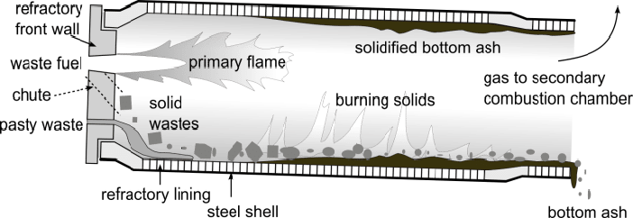
A rotary kiln incinerator

Slide 467
Hazardous Waste Management
i) Rotary Kiln:-
This is most common type of incinerator.
Here Chemical destruction of waste occurs.
ii) Liquid injection:-
This is for treating liquid organic waste.

Slide 468
Hazardous Waste Management
iii) Plasma Arc Destruction:-
In this case, electric arc of very high temperature is used.
iv) Wet Air Oxidation:-
It is an aqueous phase oxidation where materials are exposed to gaseous source of oxygen.

Slide 469
Hazardous Waste Management
V) Fluidized Bed Combustion:-
This is suitable for uniform types of waste.
In this case, heat transfer is very fast & uniform.

Slide 470
Hazardous Waste Management
DRE(Destruction & Removal Efficiency):-
Destruction and removal efficiency (DRE) is the efficiency of the unit (kiln) in destruction and removal of a particular targeted organic compound.
In incineration DRE of above 99% is required.

Slide 471
Hazardous Waste Management
DRE can be calculated by using the following formula –
DRE= {(W_{in} – W_{out})/W_{in}} x 100
Where,
W_{in} is mass feed rate of specific organic component to the incinerator
W_{out} is mass emission rate of same organic component from the incinerator

Slide 472
Hazardous Waste Management
CE(Combustion Efficiency):-
Combustion efficiency is a measurement of how well the fuel being burned or is being utilized in the combustion process.

Slide 473
Hazardous Waste Management
CE can be calculated by using the following formula –
CE = {(C_{CO2} – C_{CO})/C_{CO2}} x 100
Where,
C_{CO2} is concentration of CO₂ in the emitted gas
C_{CO} is concentration of CO in the emitted gas

Slide 474
Hazardous Waste Management
Q. Find out CE(Combustion Efficiency) & DRE(Destruction & Removal Efficiency) of an incinerator from the following data –
i) Input of phenolic waste is 18.2% & outlet phenol is 0.04%
ii) Outlet gas concentration of CO is 0.1% & CO₂ is 25.7%

