Slide 1
RoboSUST
Presentation for Young Bangla Division Meet - Sylhet

Slide 2
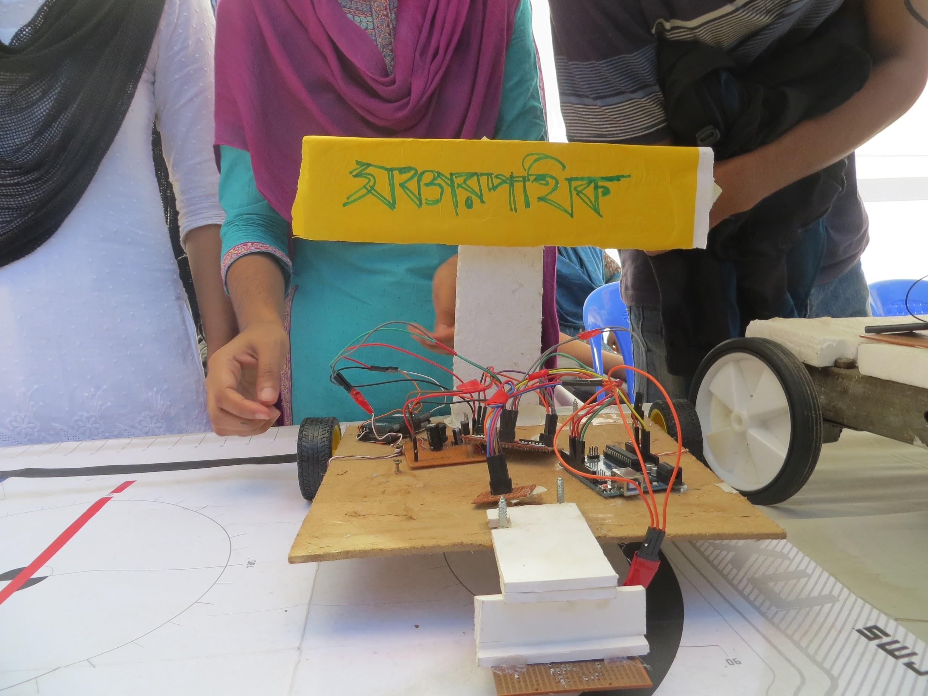
Project Showcasing
Soncharpothik (সঞ্চারপথিক) v1
Line Follower Bot
First exposed in Kaizen-SUST Project Fair ‘13

Slide 3
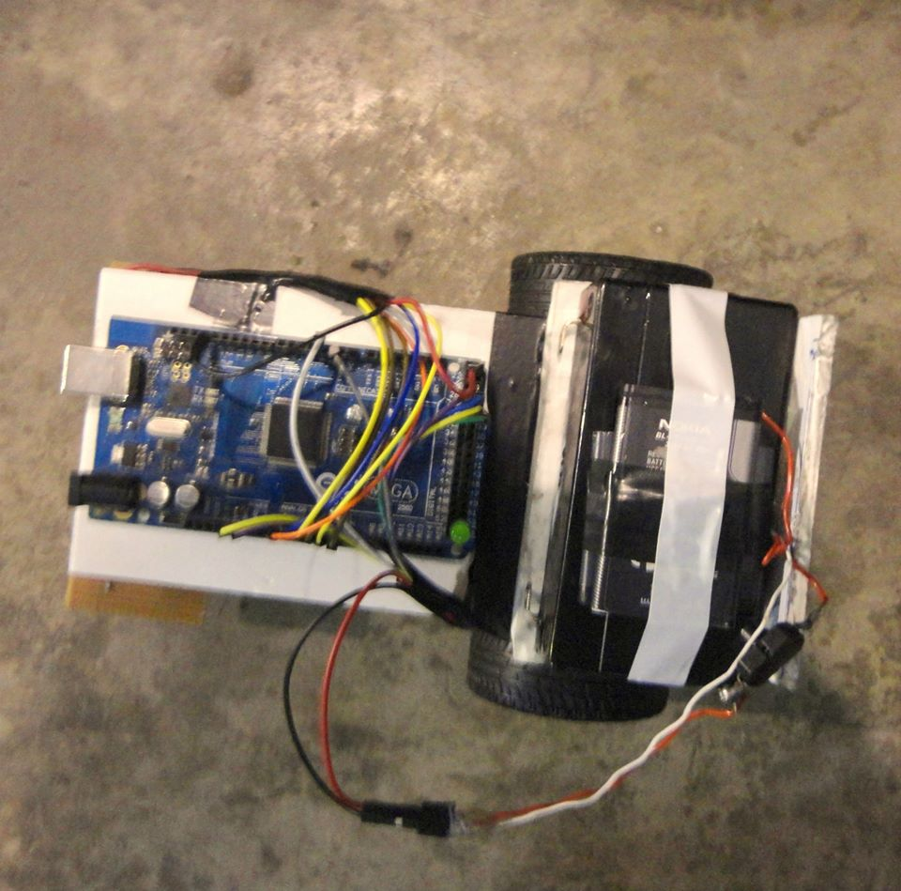
Soncharpothik (সঞ্চারপথিক) v2
Line Follower Bot
First Exposed in National Robotics Festival ‘13

Slide 4
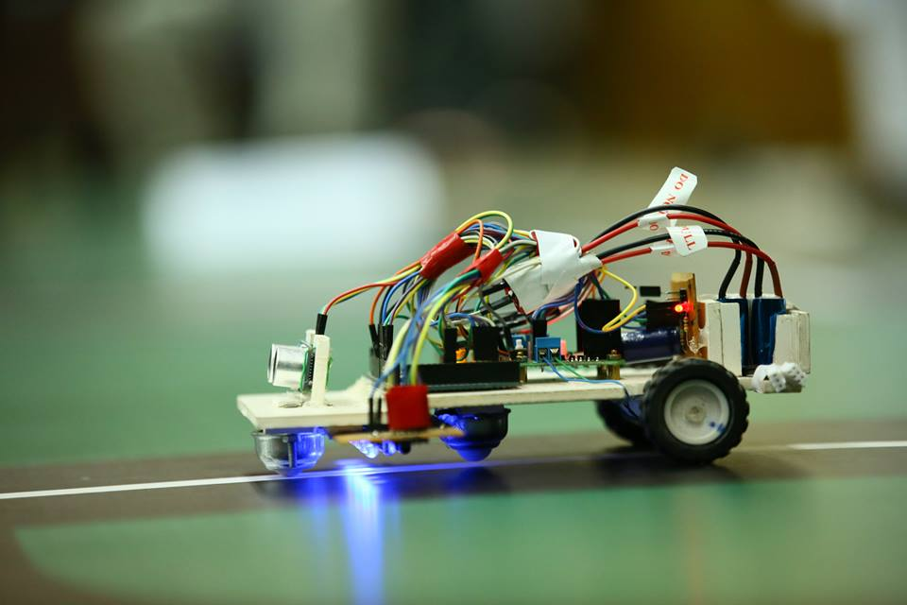
Soncharpothik (সঞ্চারপথিক) v3
Line Follower & Obstacle Detector Bot
First Exposed in IUT Esonance ‘14 Became Champion

Slide 5
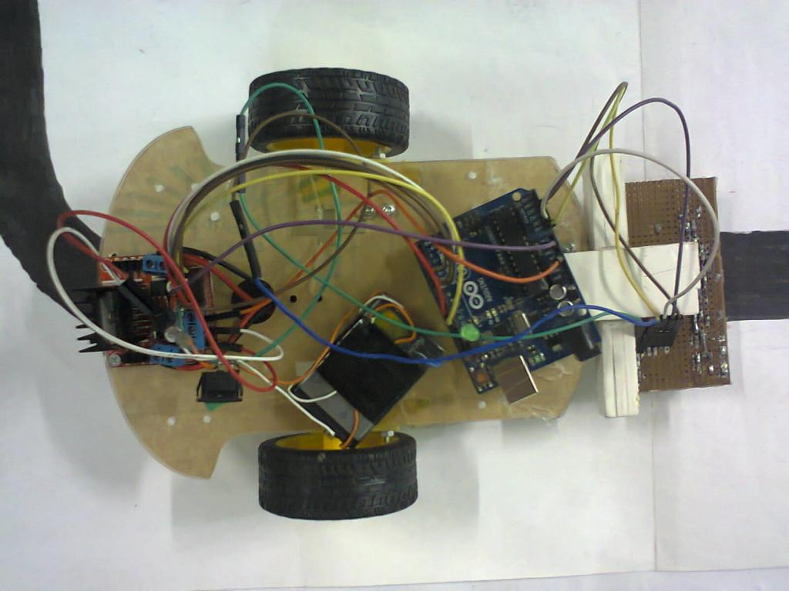
Hijibiji (হিজিবিজি)
Line Follower Bot
Build as an Academic Project

Slide 6
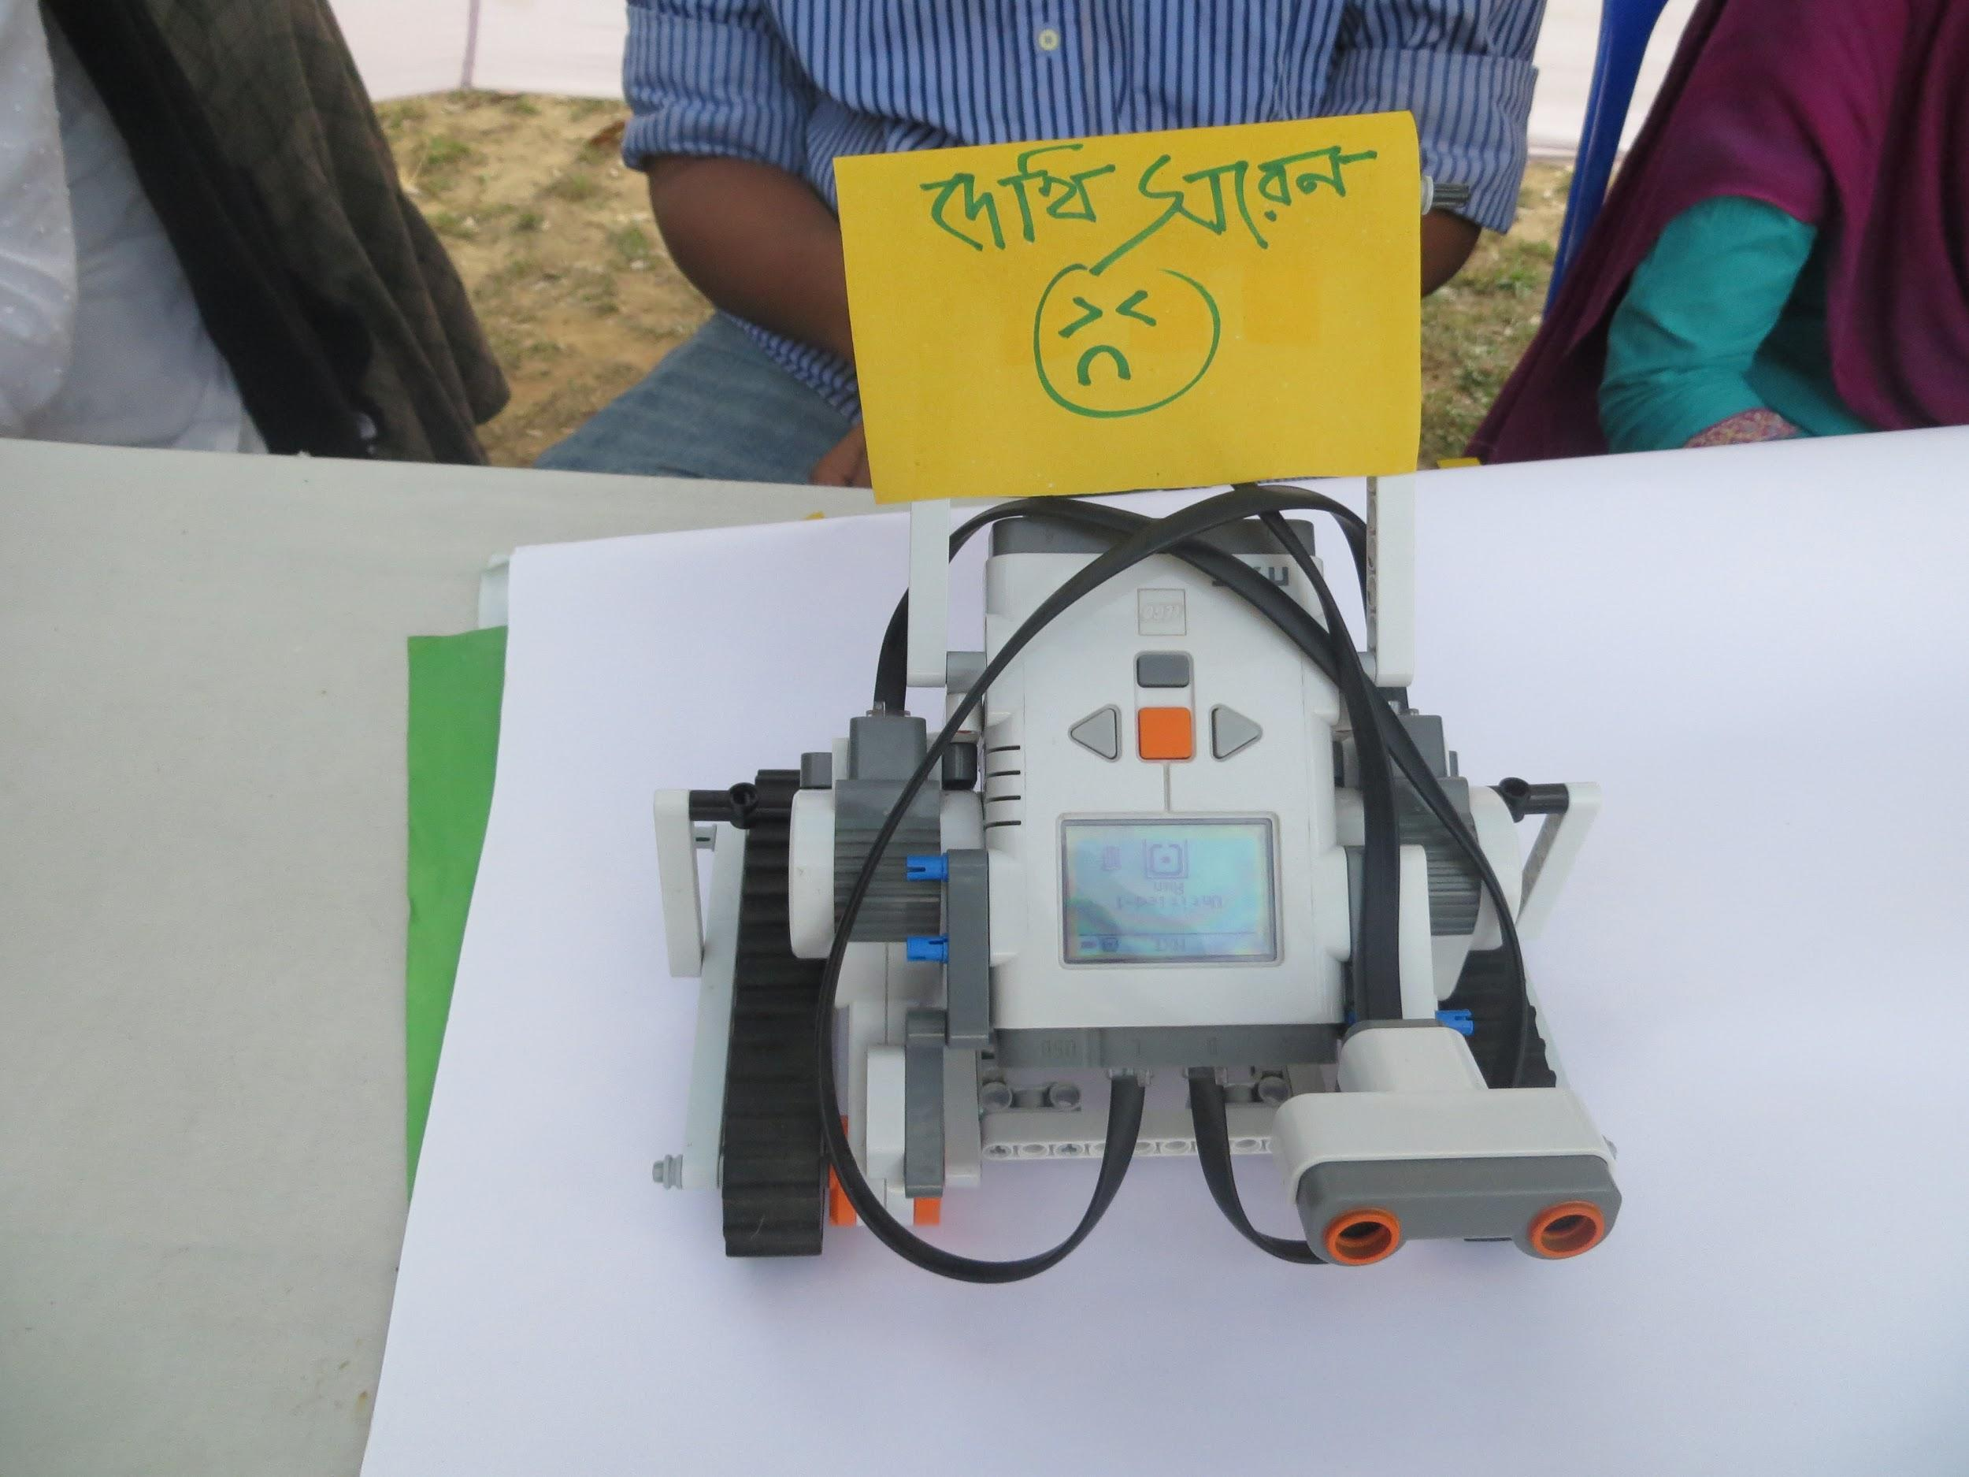
Dekhi Shoren (দেখি সরেন)
Obstacle Detector & Avoider Robot
First Exposed in Kaizen SUST Project Fair ‘13

Slide 7
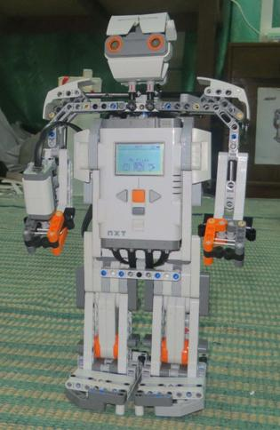
Duronto Chele (দুরন্ত ছেলে)
Walking Humanoid Robot with Touch & Color Sensing Capability

Slide 8
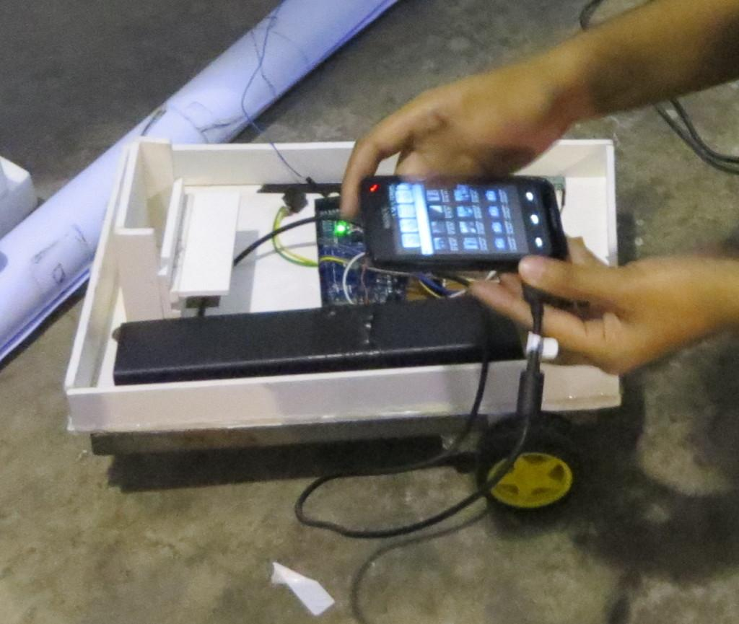
Spy
Phone controlled robot that can capture photos & videos from dangerous locations.
First Exposed in National Robotic Festival ‘14
Build as an academic project.

Slide 9
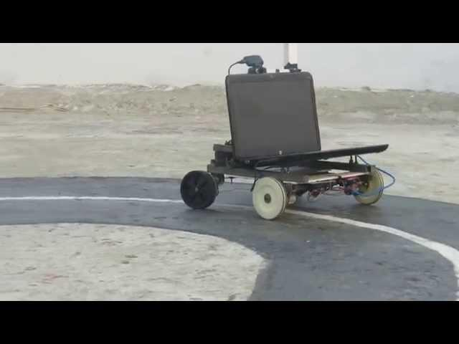
Sustusoras Rex
Line Follower & Object Grabber Robot
Built for CUET RMA Roborace ‘14

Slide 10
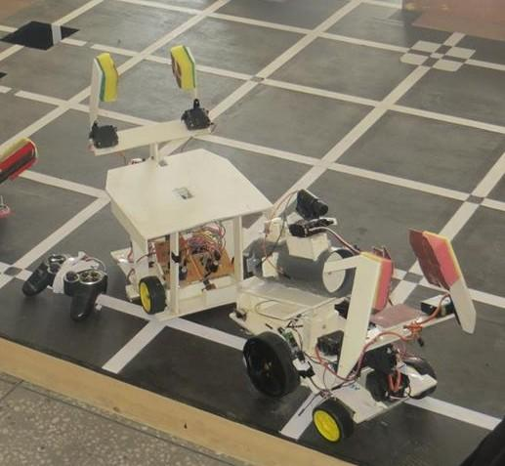
IRC Robots
The IRC Manual & Autonomous Bot
Became 2nd Runner-up in Techfest IIT, Bombay

Slide 11
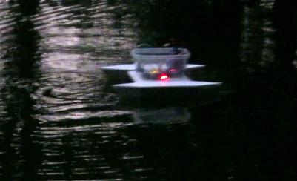
Water Bot
Android Controlled Water Surface Craft.

Slide 12
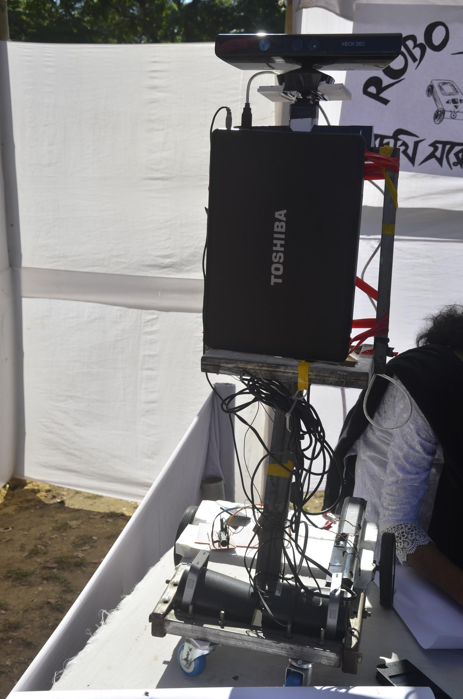
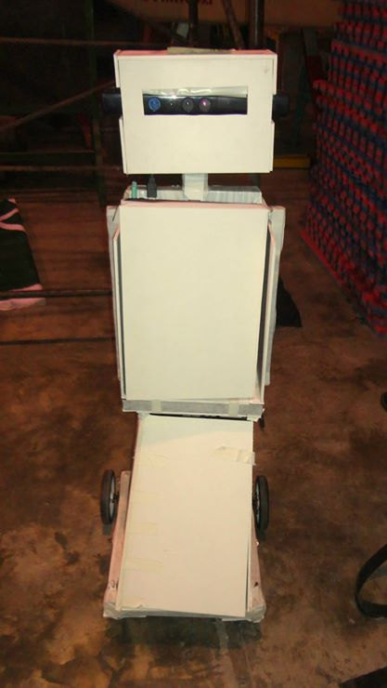
SUSTU-v1
Humanoid Robot with Bangla Talking Capability & Hand gesture following Capability
First Exposed in Kaizen-SUST Project Fair ‘13
Secondly on NRF ‘14

Slide 13
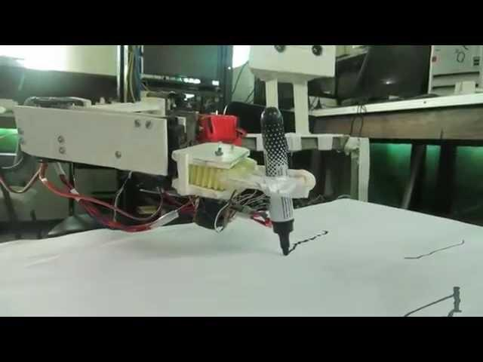
SUSTU - v2
Can grab object with the arm and write on the paper.

Slide 14
Thank You.

