Slide 1
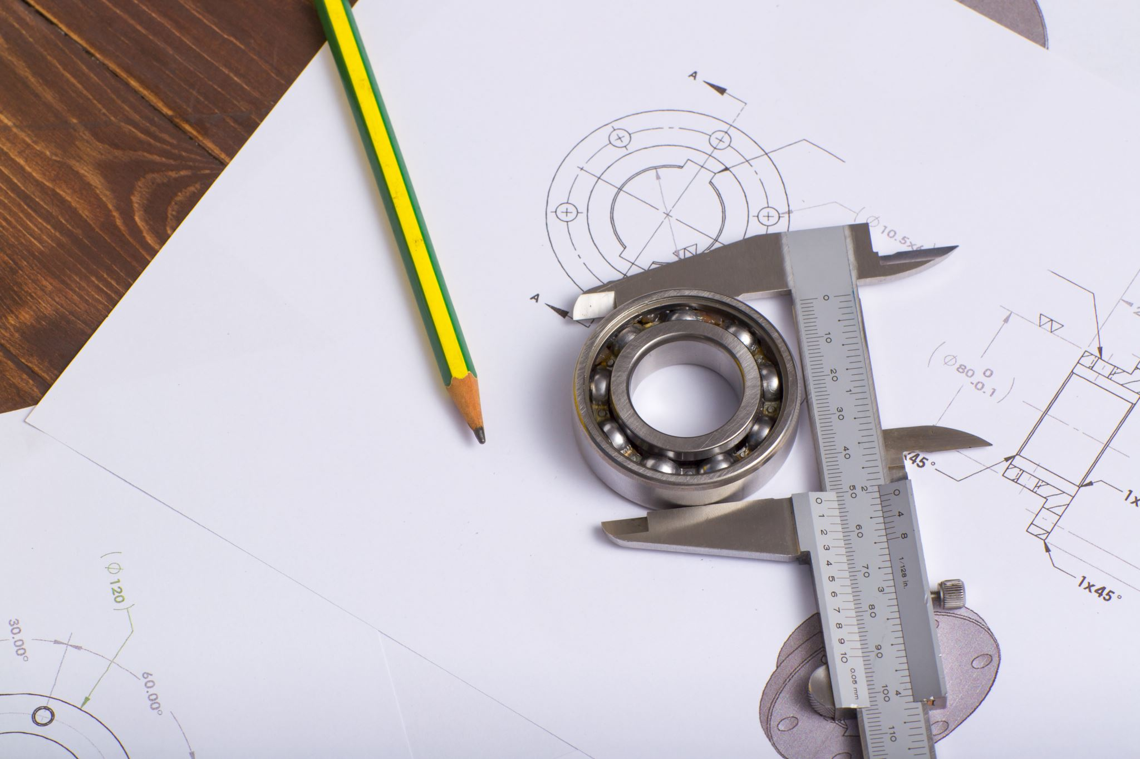
Damage Detection on Bearings
Condition Monitoring Project
By Nishilkumar Balar
Matr. No. - 1638936

Slide 2
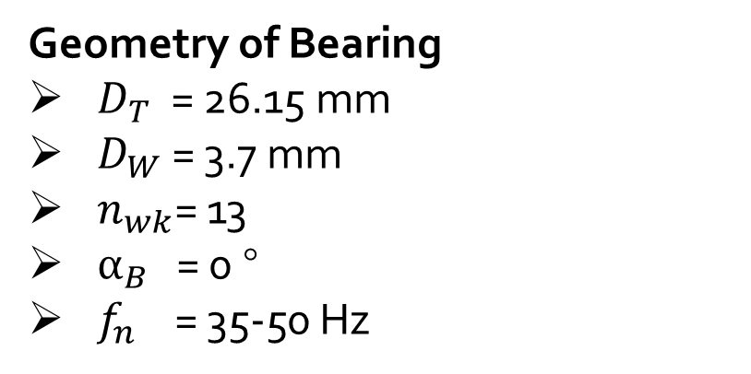
Experimental Setup
Accelerometer sensor (vibration sensor)
Sensor type: PCB 353B15
Bearing (SKF - 61804)
Coupler type: Kistler 5134A
Measurement device: dSPACE MicroLabBox (16 Bit A/D Converter)
Sampling Frequency: 40kHz
FOCUS!
Geometry of Bearing
$D_{T}$ = 26.15 mm
$D_{W}$= 3.7 mm
$n_{wk}$= 13
$α_{B}$ = 0 °
$f_{n}$ = 35-50 Hz

Slide 3
Objective
Data Archive: WS2223_16 (data of signal for 3 different bearings)
The project's goal is to analyze three provided signals that are composed of information from a bearing. We must determine which signal is the damaged signal in order to identify the data that the signals convey about the damaged bearing.
Proposed steps
Time Domain Signal Analysis
Frequency Domain Signal Analysis
Envelope Spectra Analysis

Slide 4
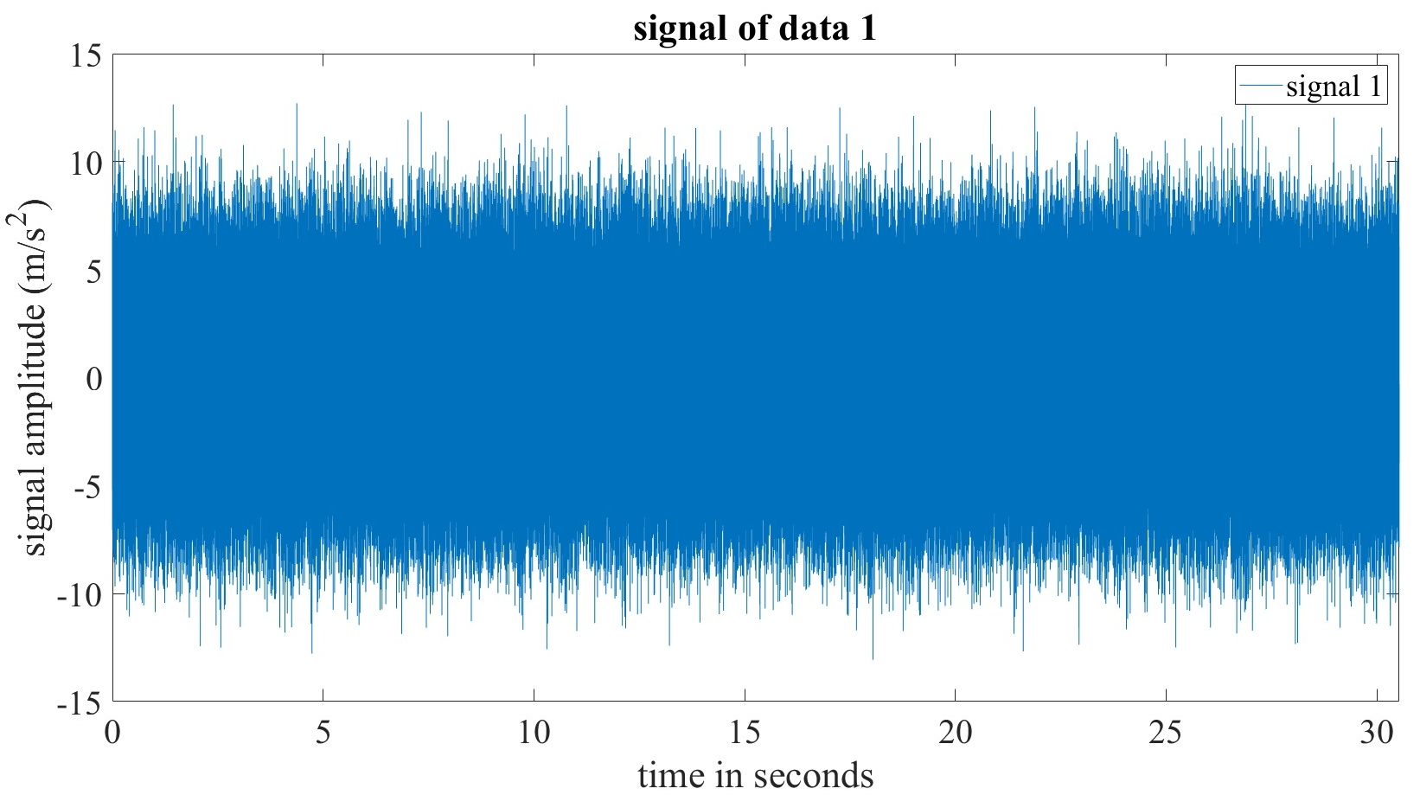
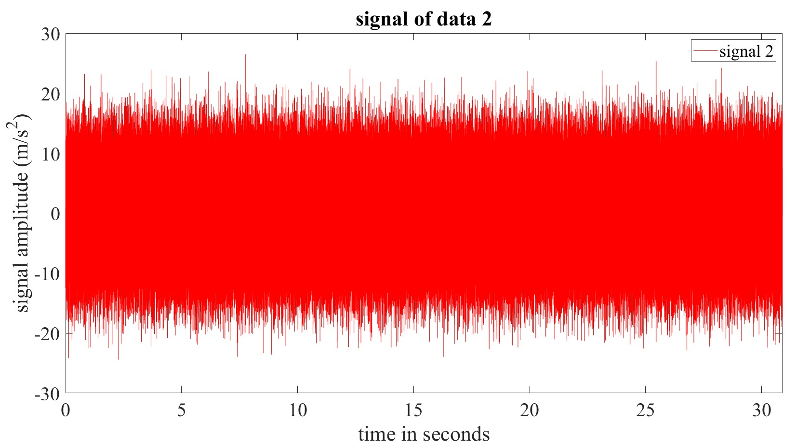
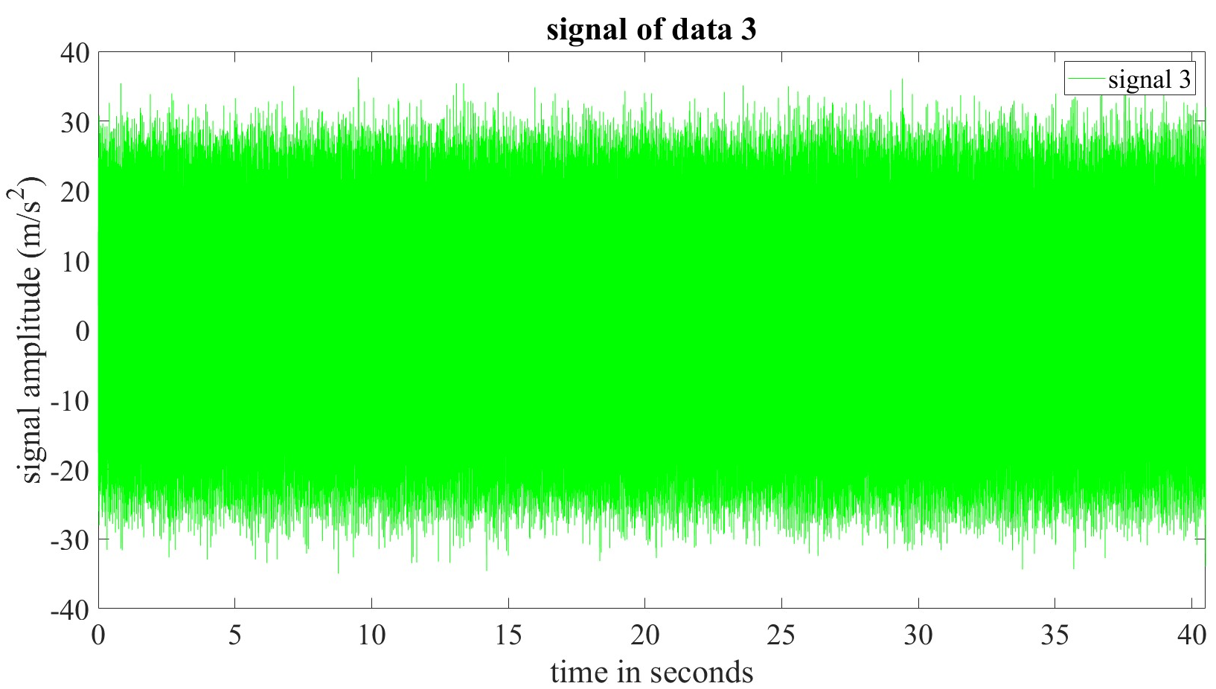
Time Domain Analysis

Slide 5
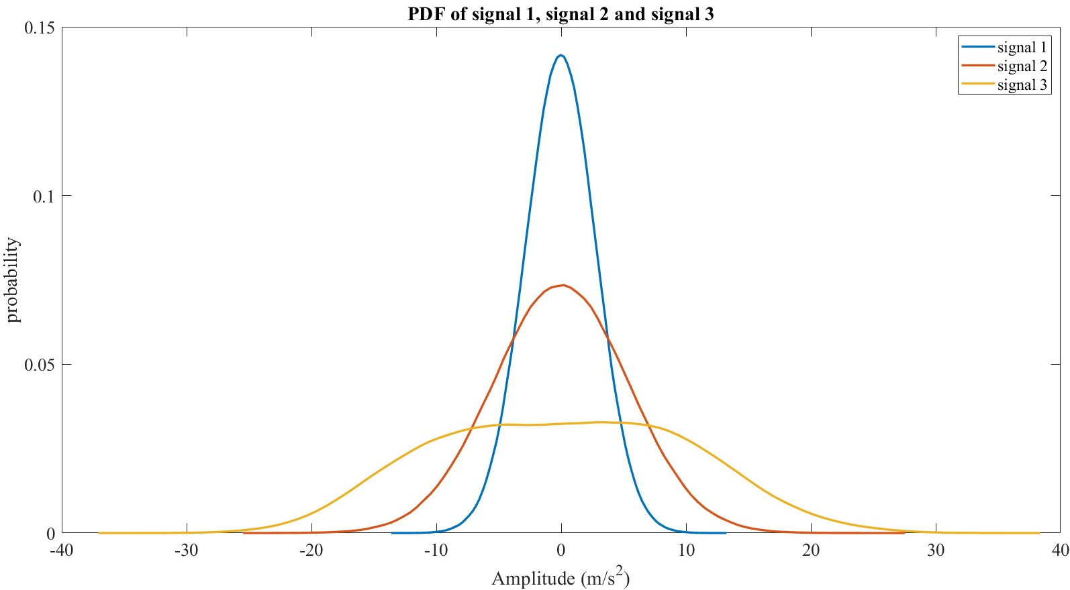
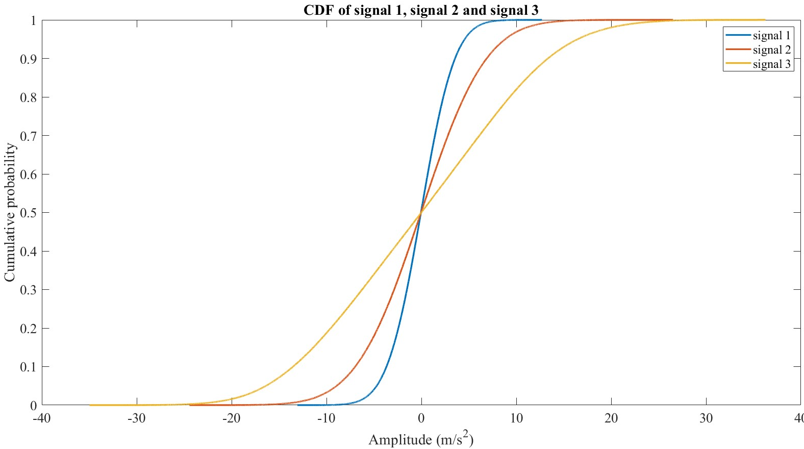
Time Domain Analysis
Probability Density Function (PDF) and Cumulative Distribution Function (CDF)
Observations:
No detection of Statistical based change
Features from time domain analysis are not informative

Slide 6
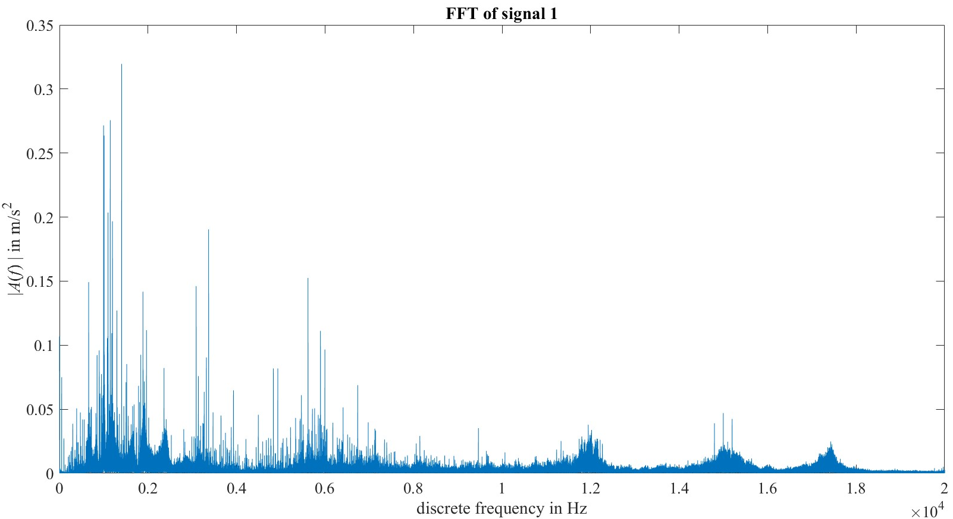
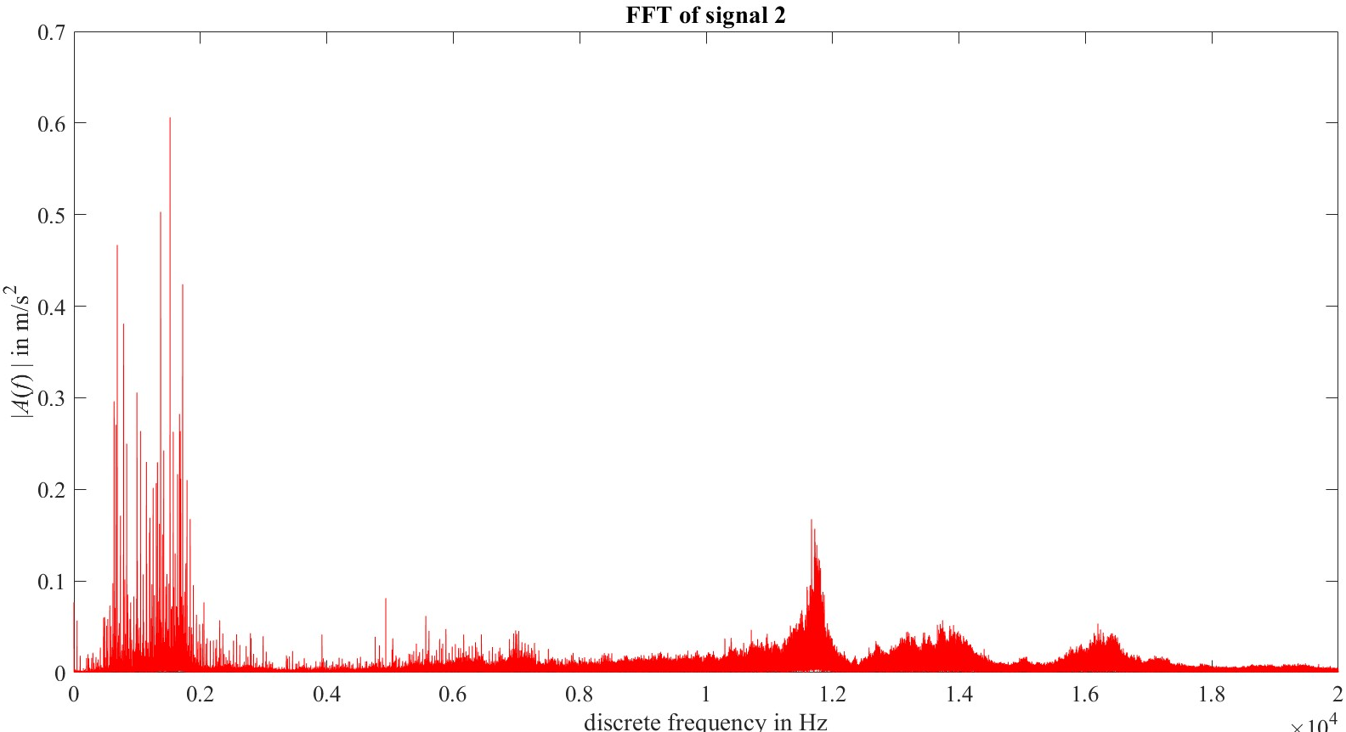
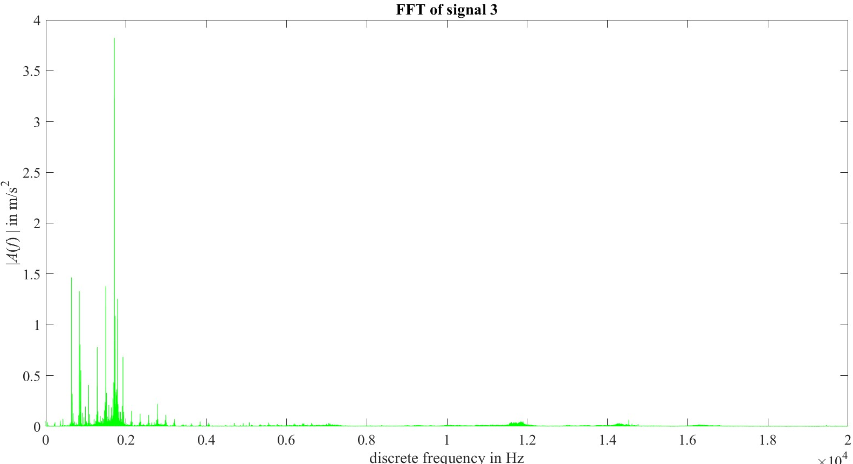
Frequency Domain Analysis
Fast Fourier Transform (FFT) of the measured signal data
Resonance because of shock shaped impulse
Damage frequency modulation with high frequency

Slide 7
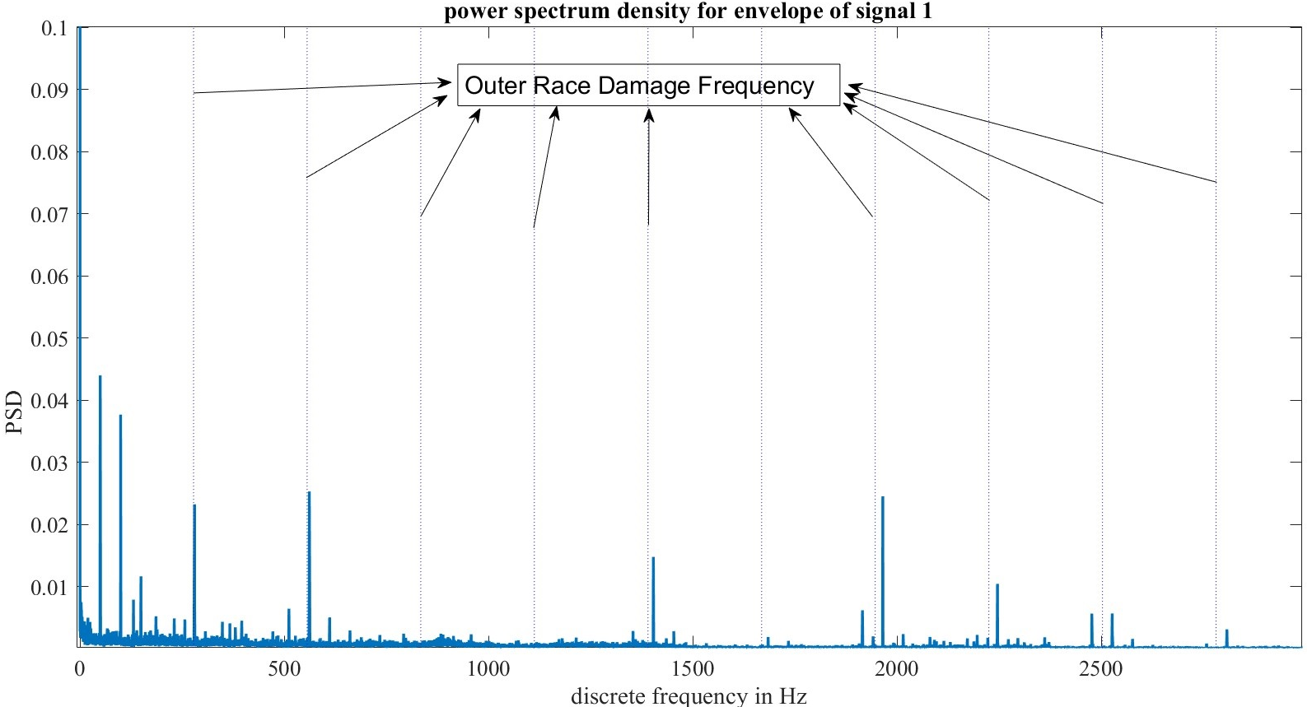
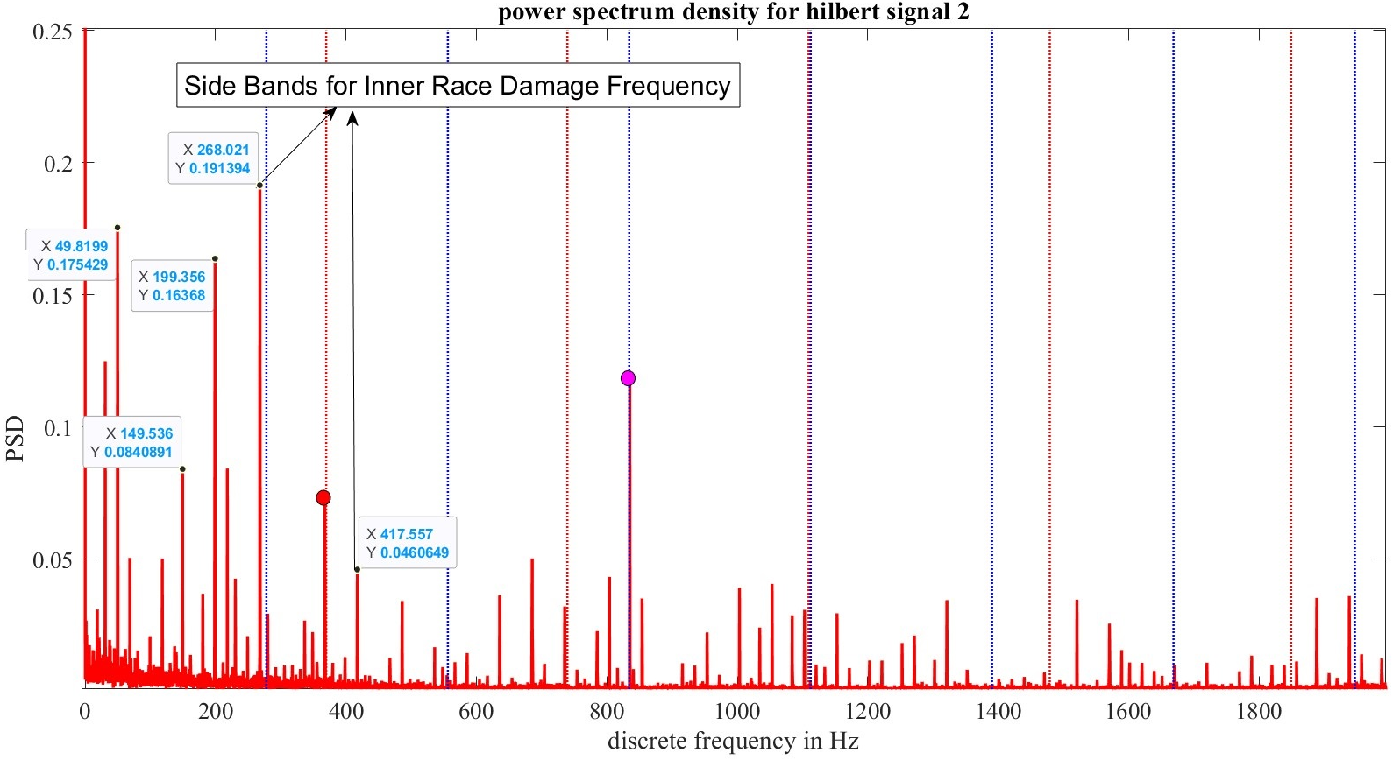
Frequency Domain Analysis
Envelope Formation for demodulation of damaged signal from high frequency
Power Spectrum Density of Envelope signal
Peak Energy in dB/Hz for Bearing 1
Outer Race Frequency and its harmonics
278.2 Hz (1x, 2x, 3x,..)
Bearing Roll Over Frequency and its harmonics
49.84 Hz (1x, 2x, 3x,..)
Peak Energy in dB/Hz for Bearing 2
Inner Race Frequency and its harmonics
369.81 Hz (1x, 2x, 3x,..)
Side Bands of ±49.84 Hz (1x, 2x,..) w.r.t. Inner race damage frequency because of modulation.

Slide 8
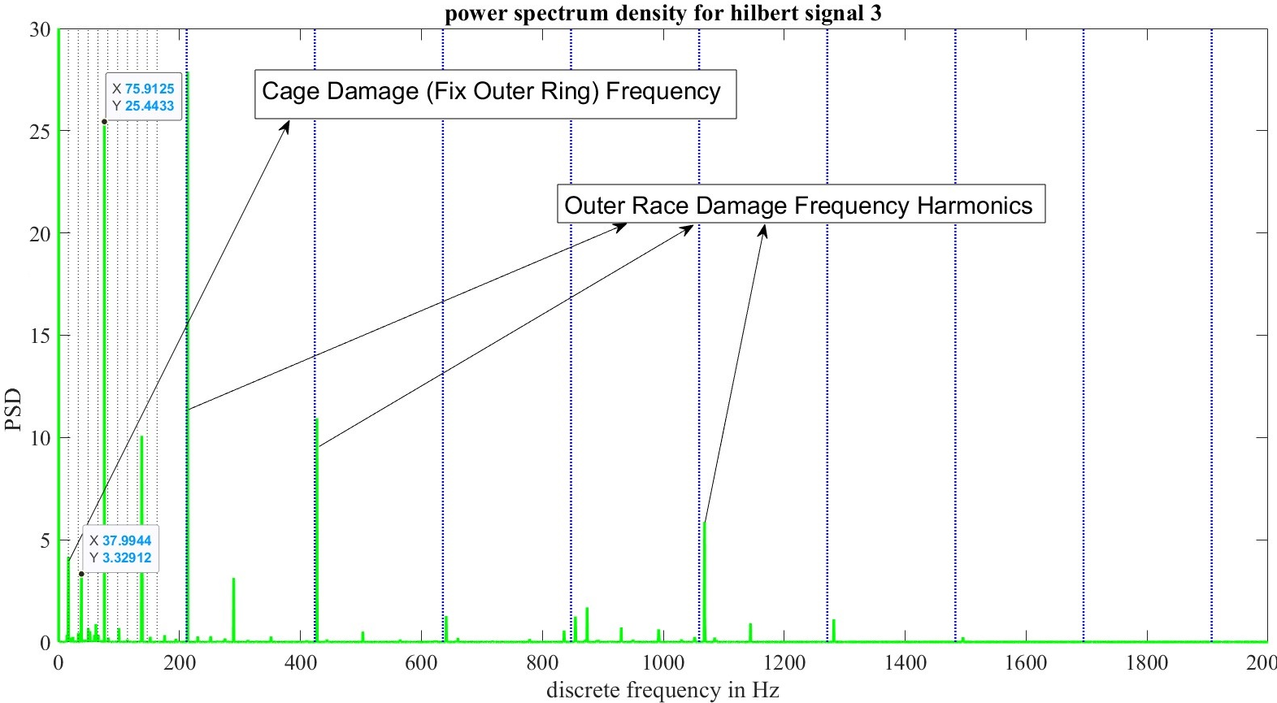
Frequency Domain Analysis
Note:
Envelope Spectrum of each bearing shows peak at Roll Over Frequency and its harmonics which indicates vibration signal measurement due to shaft’s rotation speed.
Peak Energy in dB/Hz for Bearing 3
Outer Race Frequency and its harmonics
211.856 Hz (1x, 2x, 3x,..)
Cage damage Frequency for Fix Outer Ring and its harmonics
16.30 Hz (1x, 2x, 3x,..)

Slide 9
Concluded Result
Bearing No. | File No. (WS2023_16) | Detected Damage
1 | file_004_23192223 | Damage on Outer Ring
2 | file_009_23192223 | Damage on Inner Ring
3 | file_023_23192223 | Damage on Outer Ring Damage on Cage with Fixed Outer Ring

Slide 10
Thank You!

