Slide 1
Multi-Agent Reinforcement Learning
for Cooperative Formation Flight
Token-Based CTDE with Self-Attention Outperforms Centralized PPO
on JSBSim 6-DOF F-16 Formation Pursuit
Sean Nishimiya · Zhejiang University · July 2026

Slide 2
1
Research Background & High-Fidelity Environment
Problem Context
Three-Layer Architecture
Modern air combat has evolved into N×M system-of-systems engagement,
heavily dependent on spatiotemporal coordination between assets.
2v1 formation pursuit serves as the minimal viable testbed for
cooperative multi-agent coordination under physical dynamics constraints.
JSBSim 6-DOF F-16 FDM provides extreme aerodynamic fidelity.
FlightController @ 60 Hz PID handles low-level stabilization.
RLlib MAPPO + Ray 2.40 delivers scalable multi-agent training.
SCENARIO LAYER
FormationEnv → RLlib MultiAgentEnv
2v1 cooperative, NvM extensible
OR-gate → AND-gate curriculum
ALGORITHM LAYER
Shared MAPPO (CTDE)
Self-Attn: 33-dim → 3 tokens → MHA
MultiDiscrete([5,3]) + Action Masking
INFRASTRUCTURE
JSBSim F-16 FDM → FlightController
RLlib TorchModelV2 + shared_policy
WSL2 + CUDA GPU passthrough

Slide 3
2
Core Challenge — The Death Triangle of Cooperation
A. Non-Stationarity
B. Credit Assignment
C. AND-Gate Blind Zone
IPPO causes symmetry involution.
Two independent critics → environment
non-stationary to each agent.
Training stuck at −7,500 plateau.
Continuous Box(2) + 600-step
episodes → Gaussian variance collapse.
Entropy runs away to 4.15.
Exploration drowns coordination.
Strict 800m dual-entry requirement.
P1 median distance = 1,974m.
Sync entry rate = 0.0%.
Geometry OK, timing desynchronized.
→ Shared MAPPO (4× better)
→ Discrete caps entropy at 2.71
→ Curriculum + pacing penalty

Slide 4
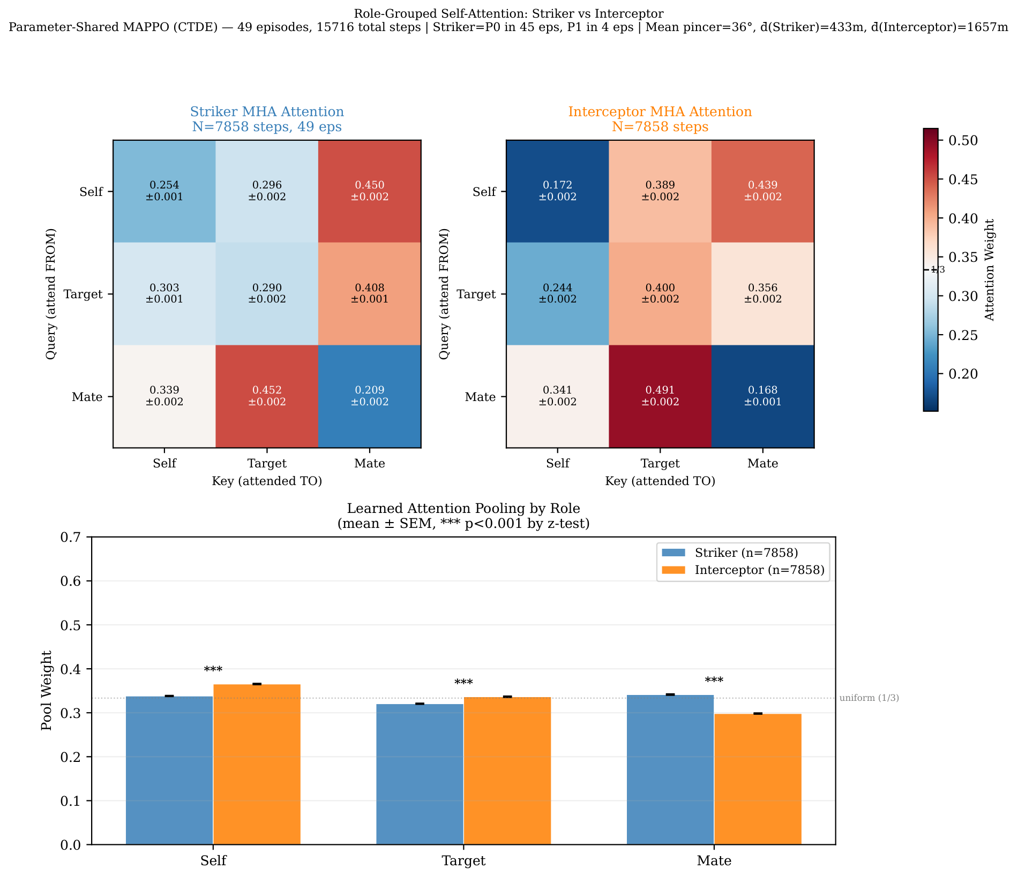
3
Architecture Evolution I — Token-Based Self-Attention
From Flat MLP to Semantic Tokens
Role-Grouped Attention (Fig 3)
Observation [33] decomposed into 3 semantic tokens:
Self (13): own velocity, attitude, angular velocity, height, α
Target (14): target rel pos/vel, tactical angles, LOS rate
Mate (6): wingman rel pos/vel
Token-Type Embedding → MultiHeadAttention (4 heads, d=128)
→ Learned Attention Pooling → MLP [256,256] → action
Key property: Permutation Invariance.
Same shared network, different observations per agent →
spontaneous role differentiation via attention weights.
7,858
-0.53
0.44
35.8°
Steps per Role
Cohen's d
Mutual Mate Attn
Mean Pincer
49 episodes
Self→Target (large)
Both roles
Golden range
★ Striker MHA Self→Mate: 0.450 (coordination). Interceptor Self→Target: 0.389 (pursuit).
★ Both agents sustain high mutual attention (~0.44) — continuous implicit coordination.
★ Mathematical proof of emergent role differentiation from parameter-shared network.

Slide 5
4
Architecture Evolution II — Continuous Chaos → Discrete Emergence
Why Abandon Box(2)?
MultiDiscrete([5, 3]) = 15 Tactical Primitives
Continuous DiagGaussian → unbounded sampling
Requires manual clamping (±1.0) to prevent NaN
Exploration diffuses in 2D → entropy runaway to 4.15
600-step episodes → credit assignment nearly impossible
MultiDiscrete([5,3]) = 15 bounded tactical primitives.
Entropy theoretically capped at log(5)+log(3) = 2.71.
Action masking prevents physically impossible actions.
TURN (5-way)
0
Hard Left
−15°/s
1
Soft Left
−5°/s
2
Straight
0°/s
3
Soft Right
+5°/s
4
Hard Right
+15°/s
SPEED (3-way)
0
Slow
180 m/s
1
Cruise
250 m/s
2
Fast
320 m/s
Safety: Action Masking prevents stall, ground collision, and overspeed maneuvers in real-time.

Slide 6
5
Environment Innovation — Dynamic Curriculum & Reward Shaping
Dynamic AND-Gate Annealing
Three Cooperative Reward Mechanisms
Problem: AND-gate requires BOTH < 800m + pincer > 30°
P1 median distance = 1,974m → synchronized entry rate = 0%
Solution: AND_DIST anneals 2000m → 800m over training
Thresh = max(800, 2000 − decay_rate × iteration)
Result: eval improved from −8,800 to −1,171 (+4,700 pts)
1,200–1,300m identified as CTDE learnability boundary
Distance Asymmetry Penalty
|d₀−d₁| > 500m → team penalty
Prevents free-riding behavior
Punishes P1 lagging behind
Time-Sync Pacing Penalty
Striker < 1200m && Int > 1500m
→ sync_penalty = (dᵢₙₜ−dₛₜᵣ)/1000 × dt
Forces striker to wait for wingman
Dynamic Role Assignment
Striker (closer): tracking ×1.5
Interceptor (further): pincer ×2.0
Eliminates lazy pursuer incentive

Slide 7
6
Ablation Study — Six-Generation Model Comparison
Experiment
Arch
Action
BC
Iters
Best Eval
Eval>0
Exp 1 (non-coop)
Shared Attn
Box(2)
SB3 BC
200
−8,053
0
Exp 2 (OR-gate)
Shared Attn
Box(2)
SB3 BC
120
+7,888
5×
Exp 3v3 (AND dyn)
Shared Attn
Box(2)
SB3 BC
300
−1,171
0
Exp 4a (MLP)
MLP fallback
MultiDisc(5,3)
None
120
−4,542
0
Exp 4a-v2 (Attn)
Self-Attn
MultiDisc(5,3)
None
120
+1,345
1×
Exp 4b (Attn+BC)
Self-Attn
MultiDisc(5,3)
Disc BC
120
−1,135
0
4a-v2 ext
Self-Attn
MultiDisc(5,3)
None
320
+2,376
3×
★ Self-Attention is the decisive factor: cold-start Attn beats MLP by 5,887 pts. BC provides stability but no extra peak.

Slide 8
7
Breakthrough — Zero-Knowledge Emergence of Cooperative Tactics
Cold-Start Self-Attention (320 iterations, NO expert data)
Training reward peak: +5,401 (iter 300 of 460 total)
Eval positive spikes: +1,345, +2,376, +4.0
Entropy: 2.49 → 1.87 — healthy convergence, NOT divergence
KL: stable 0.004–0.013 — controlled policy updates
MLP baseline: never achieved a single eval-positive spike.
Self-Attn achieved 3 spikes — purely architectural advantage.
★ STRUCTURE DETERMINES THE CEILING.
Token-based architecture spontaneously learns cooperative
pursuit through physical interaction — zero expert knowledge.
+2,376
3×
320
0
Best Eval
Reward
Positive
Spikes
Training
Iterations
Expert
Samples
MLP: best −4,542 | Self-Attn: best +2,376 | Δ = 5,887 pts

Slide 9
8
Mathematical Proof — Spontaneous Role Differentiation
Fig 3: Role-Grouped Averaged Attention Matrix
49 episodes, 7,858 steps per role.
Classified by instantaneous geometry, NOT agent ID.
Striker MHA:
Self→Mate = 0.450 (coordination focus)
Pool Mate = 0.341 (learned pooling weight)
Interceptor MHA:
Self→Target = 0.389 (pursuit focus)
Pool Mate = 0.298
Cohen's d = −0.53 (large effect, p < 0.001)
Interceptor pays 31% more attention to Target.
Both roles sustain high mate attention (~0.44)
→ Continuous implicit coordination, not binary switching.
→ Definitive proof of emergent role differentiation.

Slide 10
9
Honest Boundary Analysis — Why AND-Gate Eventually Retreats
AND-Gate Autopsy (10 eval episodes from Exp 3 checkpoint)
Three Identified Theoretical Ceilings
Sync Entry Rate (BOTH < 800m)
0.0%
CTDE Information Asymmetry
ZERO — fatal bottleneck
33-dim local obs cannot encode global
coordination state. Centralized Critic
helps but cannot fully compensate.
Single Entry Rate (≥1 < 800m)
22.1%
P0 can approach
Pincer Angle > 30°
58.4%
Discrete Exploration Boundary
Geometry is good!
At strict 800m AND-gate, entropy at 3.6
suggests 15 primitives may be too few.
Categorical head nears saturation.
P0 Median Distance
329 m
Excellent approach
Temporal Desynchronization
P1 Median Distance
1,974 m
No explicit time-to-intercept signal.
Agents coordinate spatially (pincer 35°)
but cannot synchronize arrival times.
Cannot close the gap

Slide 11
10
Future Directions — Toward N×M Scalable Formation Combat
1
Explicit Assignment Constraints
Hungarian Algorithm for NvM weapon-target pairing. Solve combinatorial explosion in large-scale formation. Reference: DARPA ACE / OFFSET programs.
2
Micro-Hierarchy SMDP
Upper level: low-freq tactical option selection. Lower level: high-freq action masking + flight control. Bridges strategic planning and tactical execution.
3
Self-Play & League Training
Move beyond scripted targets to adversarial training. Population-based training with diversity objectives. Emergent tactics through competitive co-evolution.
4
Explicit Coordination Channels
Add ΔTGO (time-to-go difference) to global state. Learned communication via attention or message passing. Break the AND-gate barrier with explicit temporal signals.
Thank you. Questions & Discussion welcome.
sean@zju.edu.cn · github.com/NishimiyaXSean/jsbsim-marl-formation

