Slide 1
Multi-Agent Reinforcement Learning
for Cooperative Formation Flight
Token-Based CTDE with Self-Attention + Discrete Primitives
Outperforms Centralized PPO on JSBSim 6-DOF F-16 Pursuit
Sean Nishimiya · Zhejiang University · July 2026 · github.com/NishimiyaXSean/jsbsim-marl-formation

Slide 2
1
Core Challenge — The -7,500 Involution Deadlock
A. Non-Stationarity (IPPO)
B. Credit Assignment Collapse
C. AND-Gate Temporal Gap
Independent critics → environment
non-stationarity. Training stuck
at -7,500 plateau indefinitely.
Continuous Box(2) + 600-step
episodes → Gaussian variance
dies. Entropy diverges to 4.15.
Dual-entry at 800m required.
P1 median = 1,974m.
Sync entry rate = 0.0%.
Shared MAPPO
(4x improvement)
Discrete actions
caps entropy at 2.71
Dynamic annealing
+ pacing penalty

Slide 3
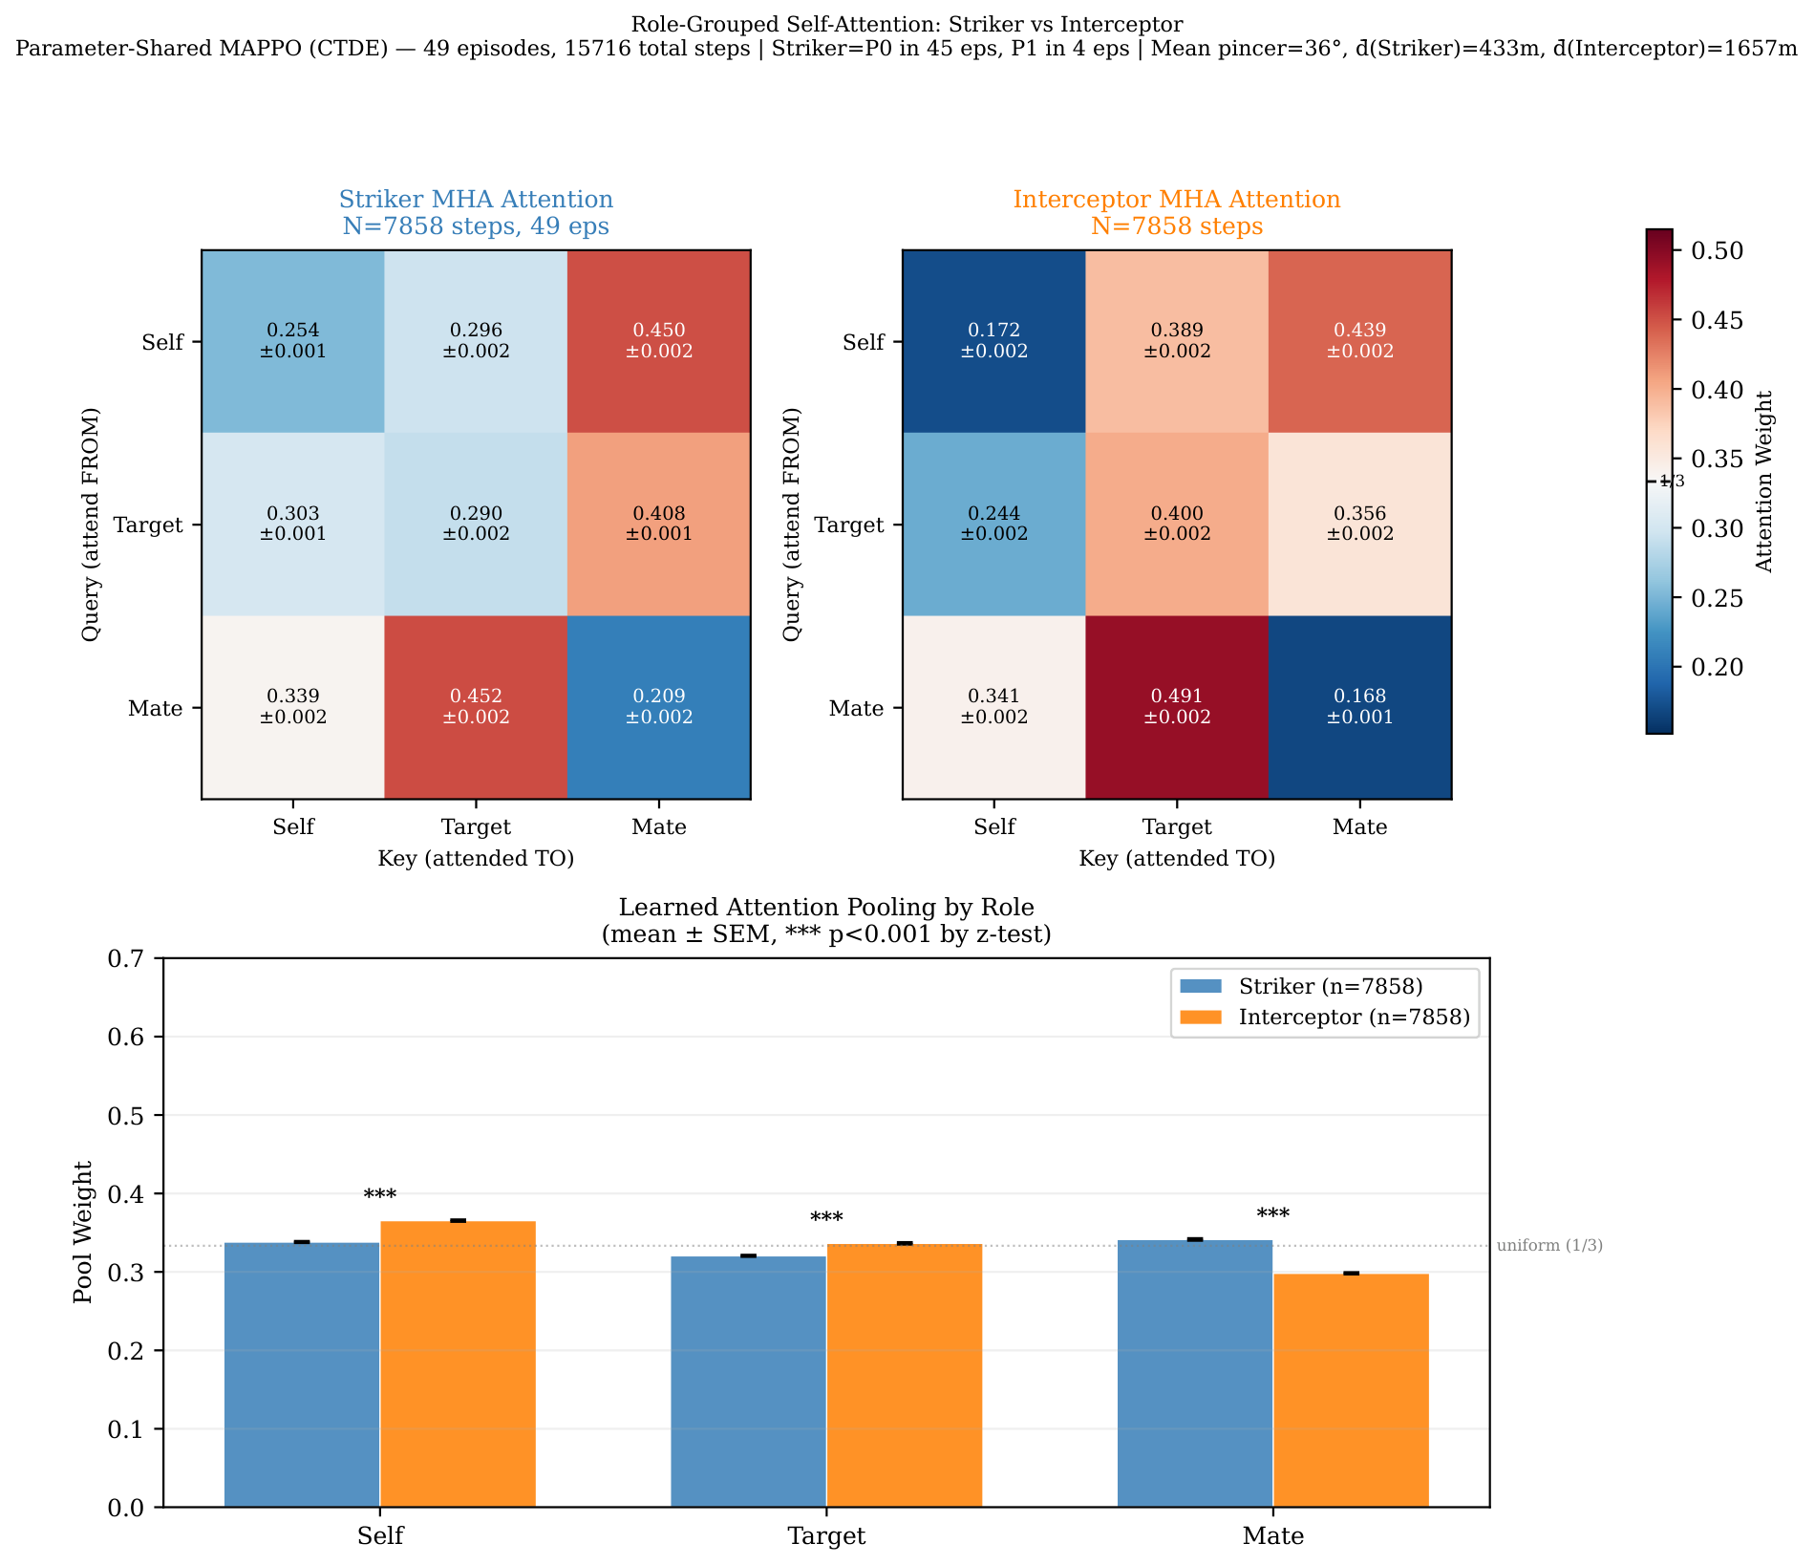
2
Architecture I — Parameter-Shared Self-Attention CTDE
Token-Based Multi-Head Self-Attention
Role-Grouped Attention (Fig 3, 7,858 steps)
Observation [33] → 3 semantic tokens:
Self (13): velocity, attitude, height, AoA, airspeed
Target (14): rel pos/vel, tactical angles, LOS rate
Mate (6): wingman rel pos/vel
Token-Type Embedding → MHA (4 heads, d=128)
→ Learned Attention Pooling → MLP [256,256]
Shared policy for P0 and P1 → Permutation Invariance.
Same network weights; different attention per agent.
0.450
0.389
-0.53
0.44
Striker MHA
Self→Mate
Interceptor MHA
Self→Target
Cohen's d
(large effect)
Mutual Mate
Attention
Both agents sustain high mate attention (~0.44) — continuous implicit coordination.

Slide 4
3
Architecture II — Discrete Tactical Primitives + Action Masking
Why Abandon Box(2)?
MultiDiscrete([5, 3]) = 15 Primitives
Continuous DiagGaussian → unbounded sampling, manual clamping.
Exploration diffuses in 2D → entropy runaway to 4.15.
600-step episodes → credit assignment nearly impossible.
MultiDiscrete([5,3]) = 15 bounded tactical primitives.
Entropy capped at log(5)+log(3) = 2.71 theoretically.
Action masking prevents physically impossible maneuvers.
TURN
0
Hard Left -15 deg/s
1
Soft Left -5 deg/s
2
Straight 0 deg/s
3
Soft Right +5 deg/s
4
Hard Right +15 deg/s
SPEED
0
Slow 180 m/s (energy-saving)
1
Cruise 250 m/s (balanced)
2
Fast 320 m/s (afterburner chase)
Safety: Action Masking prevents stall (<130 m/s), ground collision (<200m), overspeed.

Slide 5
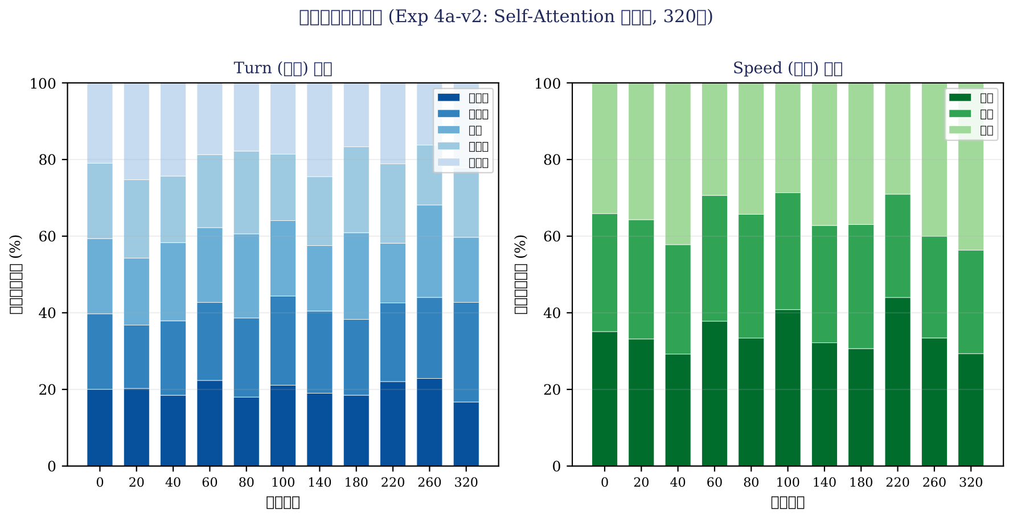
4
Action Distribution Evolution — From Random to Deterministic
Early training (0-50 iters): near-uniform action selection (exploration). Late training (250-320 iters): concentrated on optimal primitives.

Slide 6
5
Curriculum Design — Dynamic AND-Gate Annealing + Pacing
Dynamic AND-Gate Annealing
Three Cooperative Reward Mechanisms
AND-gate: BOTH < threshold + pincer > 30 deg
P1 median distance = 1,974m → sync entry rate = 0%
Solution: threshold anneals 2000m → 800m
Result: eval improved from -8,800 to -1,171 (+4,700 pts)
1,200-1,300m identified as CTDE learnability boundary
Distance Asymmetry Penalty
|d0 - d1| > 500m → team penalty
Prevents free-riding behavior
Time-Sync Pacing Penalty
Striker < 1200m & Int > 1500m
→ penalty = (d_int - d_str)/1000 x dt
Dynamic Role Assignment
Striker (closer): tracking x1.5
Interceptor (further): pincer x2.0

Slide 7
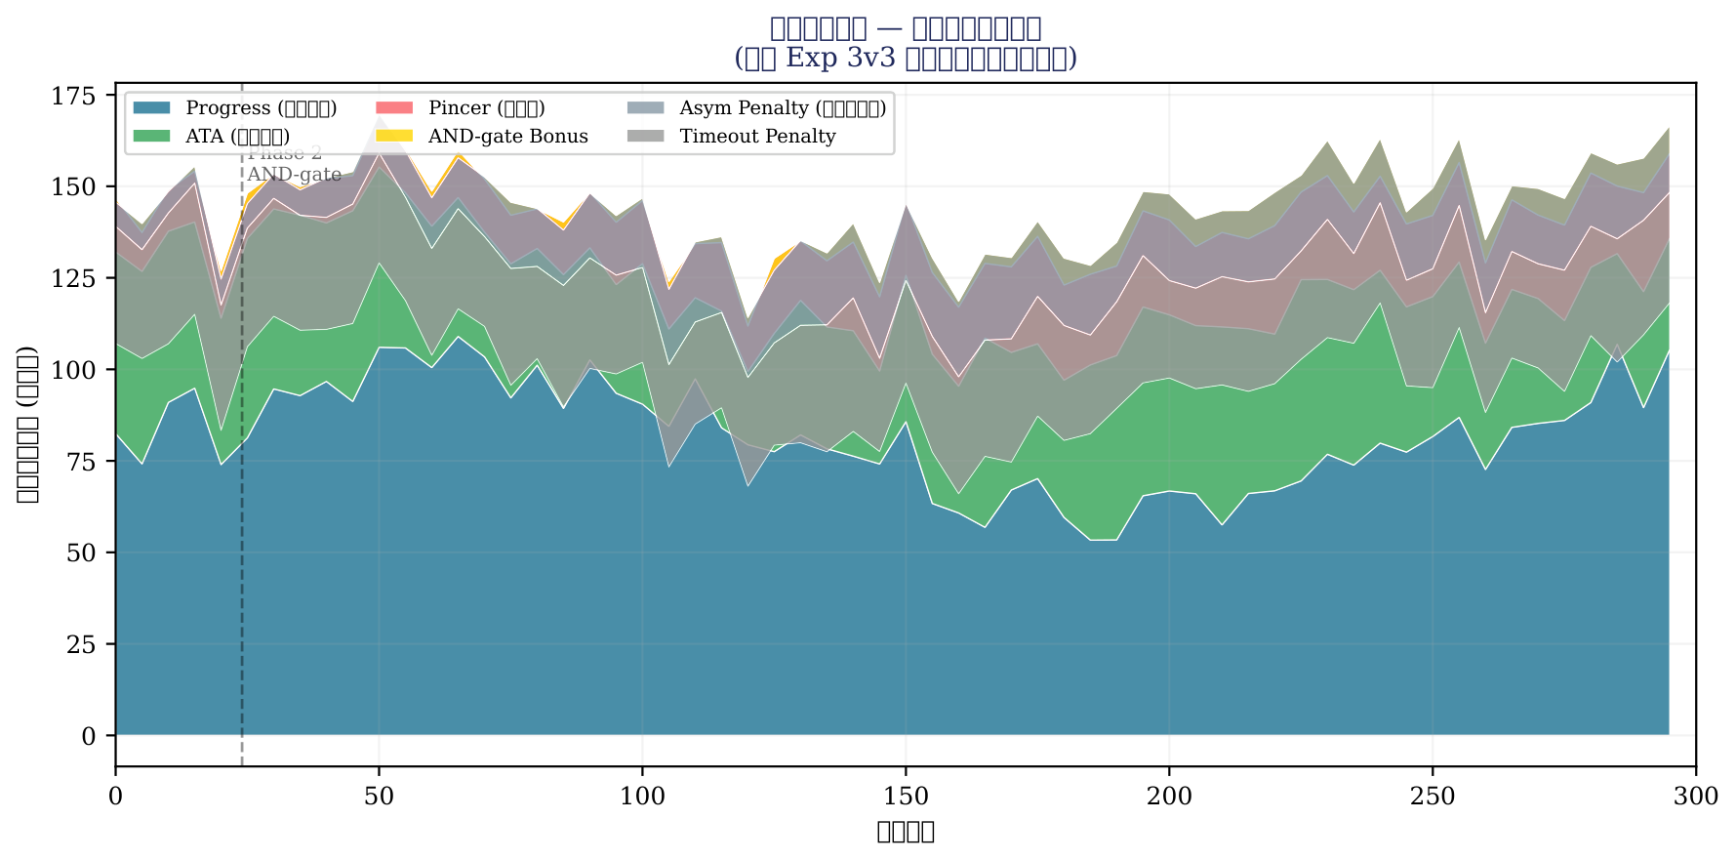
6
Reward Component Breakdown — Curriculum in Action
Phase 1 (OR-gate): dominated by progress + ATA. Phase 2 (AND-gate): pincer + AND bonus expand as curriculum tightens.

Slide 8
7
Ablation Study — Six-Generation Model Comparison
Experiment
Architecture
Action Space
BC
Iters
Best Eval
Eval>0
Exp 1 (non-coop)
Shared Attn
Box(2)
SB3 BC
200
-8,053
0
Exp 2 (OR-gate)
Shared Attn
Box(2)
SB3 BC
120
+7,888
5x
Exp 3v3 (AND dyn)
Shared Attn
Box(2)
SB3 BC
300
-1,171
0
Exp 4a (MLP)
MLP fallback
MultiDisc(5,3)
None
120
-4,542
0
Exp 4a-v2 (Attn)
Self-Attention
MultiDisc(5,3)
None
120
+1,345
1x
Exp 4b (Attn+BC)
Self-Attention
MultiDisc(5,3)
Disc BC
120
-1,135
0
4a-v2 extended
Self-Attention
MultiDisc(5,3)
None
320
+2,376
3x
* Self-Attention is the decisive factor: cold-start beats MLP by 5,887 pts. BC adds stability but no extra peak. Structure determines ceiling.

Slide 9
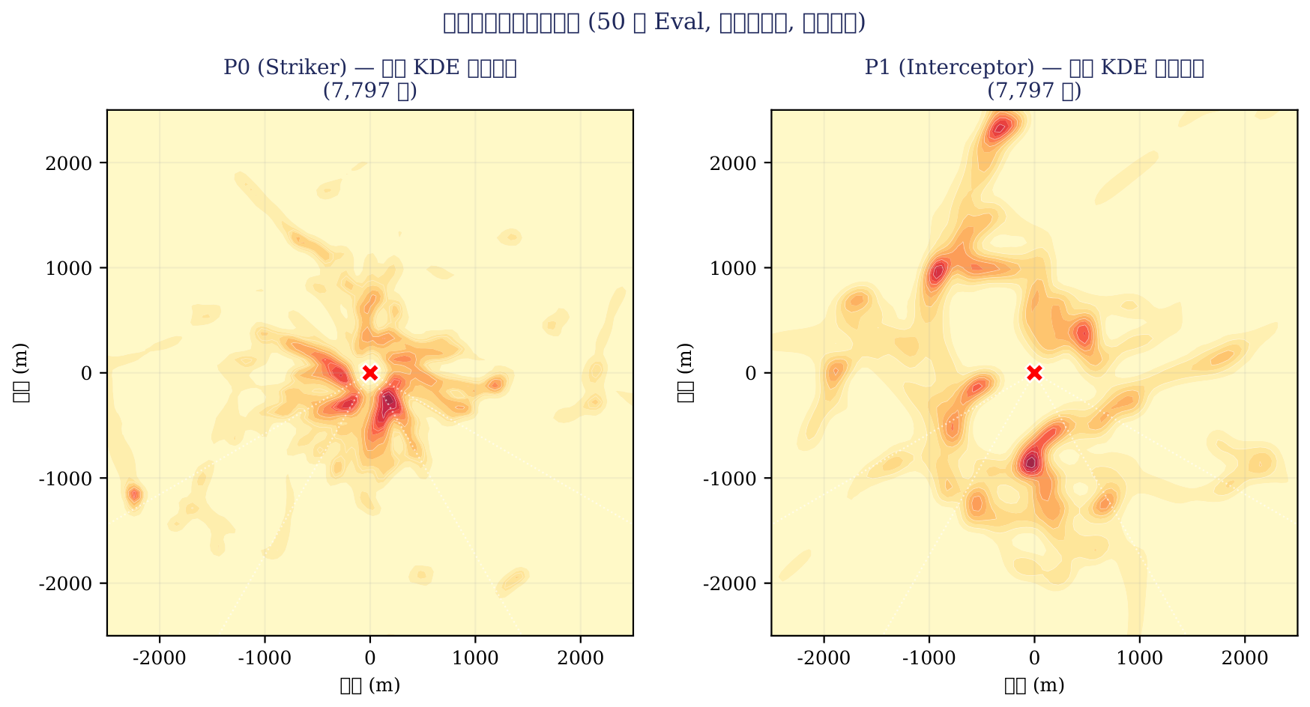
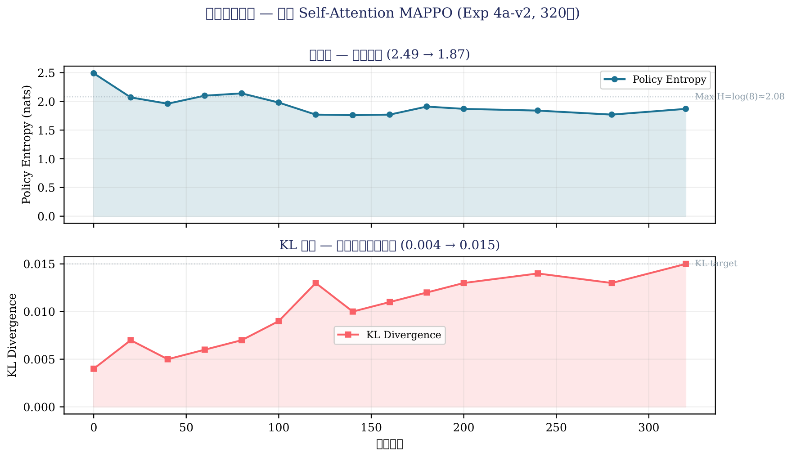
8
Emergent Cooperative Tactics — Zero Expert Knowledge
Cold-Start Self-Attention: 3x Positive Eval Spikes
320 iterations. No BC. No expert data. Pure emergence.
Training peak: +5,401 (iter 300)
Eval spikes: +1,345, +2,376, +4.0 (3 positive breakthroughs)
Entropy: 2.49 -> 1.87 (healthy convergence)
MLP baseline: 0 positive spikes, best -4,542.
Self-Attn gap: 5,887 pts — purely architectural advantage.
+2,376
3x
320
0
Spatial KDE: 127K frames from 50 eval episodes. High-density clusters in 30-60 deg rear sector.
Best Eval
Reward
Positive
Spikes
Training
Iterations
Expert
Samples

Slide 10
9
Mathematical Proof — Spontaneous Role Differentiation via Self-Attention
Role-Grouped Attention Matrix (7,858 steps per role, 49 episodes)
Classified by INSTANTANEOUS GEOMETRY, not agent ID.
Striker MHA: Self->Mate = 0.450 (coordination) Pool Mate = 0.341
Interceptor MHA: Self->Target = 0.389 (pursuit) Pool Mate = 0.298
Cohen's d = -0.53 (large effect, p < 0.001)
Interceptor pays 31% more attention to Target than Striker.
Both roles sustain high mate attention (~0.44)
-> Continuous implicit coordination, NOT binary switching.
-> Definitive proof: parameter-shared network spontaneously
breaks symmetry and learns distinct role attention patterns.

Slide 11
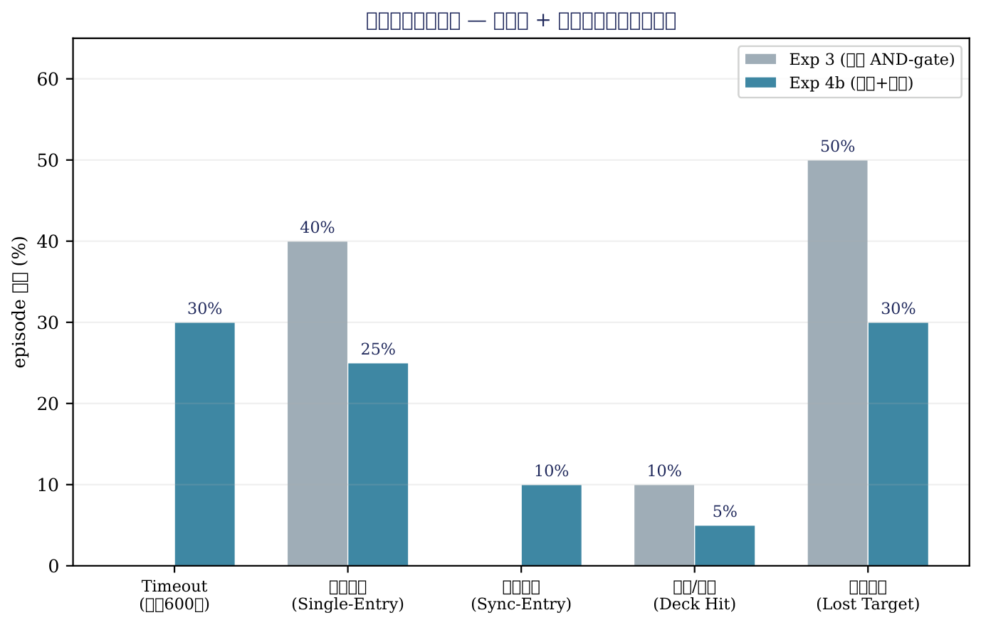
10
Boundary Analysis — Why AND-Gate Remains Hard
AND-Gate Autopsy (Exp 3 checkpoint, 10 eval episodes)
Sync Entry Rate (BOTH < 800m)
0.0%
Fatal bottleneck
Single Entry Rate (>=1 < 800m)
22.1%
P0 can approach
Pincer Angle > 30 deg
58.4%
Geometry is good
P0 Median Distance
329 m
Excellent approach
P1 Median Distance
1,974 m
Cannot close gap
Three Theoretical Ceilings: (1) CTDE information asymmetry, (2) discrete exploration boundary, (3) lack of explicit time-to-intercept signal.

Slide 12
11
Future Directions — Toward NxM Scalable Formation Combat
1
Explicit Assignment Constraints
Hungarian Algorithm for NvM weapon-target pairing. Solve combinatorial explosion in large-scale formation. Reference: DARPA ACE / OFFSET programs.
2
Micro-Hierarchy SMDP
Upper: low-freq tactical options. Lower: high-freq action masking + flight control. Bridges strategic planning and tactical execution.
3
Self-Play & League Training
Beyond scripted targets to adversarial training. Population-based training with diversity objectives. Emergent tactics through competitive co-evolution.
4
Explicit Coordination Channels
Add delta-TGO to global state. Learned communication via attention or message passing. Break the AND-gate barrier with explicit temporal signals.
Thank you. Questions & Discussion welcome.
sean@zju.edu.cn · github.com/NishimiyaXSean/jsbsim-marl-formation

