Slide 1
RAID (Redundant Arrays of Independent Disks)

Slide 2
Redundant Arrays of Independent Disks
RAID, or “Redundant Arrays of Independent Disks” is a technique which makes use of a combination of multiple disks instead of using a single disk for increased performance, data redundancy or both.
RAID is very transparent to the underlying system.
This means, to the host system, it appears as a single big disk presenting itself as a linear array of blocks.
This allows older technologies to be replaced by RAID without making too many changes in the existing code.
Why data redundancy?
Data redundancy, although taking up extra space, adds to disk reliability.
This means, in case of disk failure, if the same data is also backed up onto another disk, we can retrieve the data and go on with the operation.
On the other hand, if the data is spread across just multiple disks without the RAID technique, the loss of a single disk can affect the entire data.

Slide 3
Key evaluation points for a RAID System
Reliability: How many disk faults can the system tolerate?
Availability: What fraction of the total session time is a system in uptime mode, i.e. how available is the system for actual use?
Performance: How good is the response time? How high is the throughput (rate of processing work)? Note that performance contains a lot of parameters and not just the two.
Capacity: Given a set of N disks each with B blocks, how much useful capacity is available to the user?

Slide 4
Different RAID levels

Slide 5
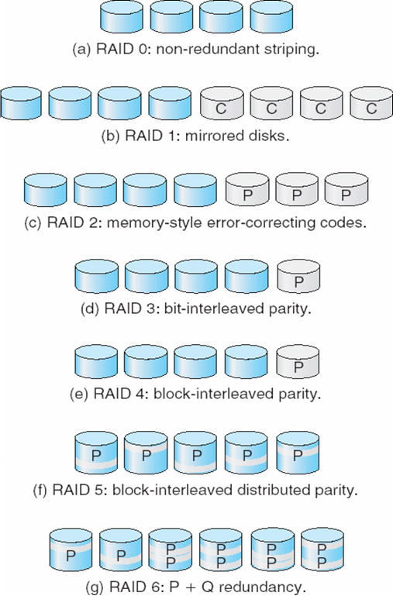
RAID Levels

Slide 6
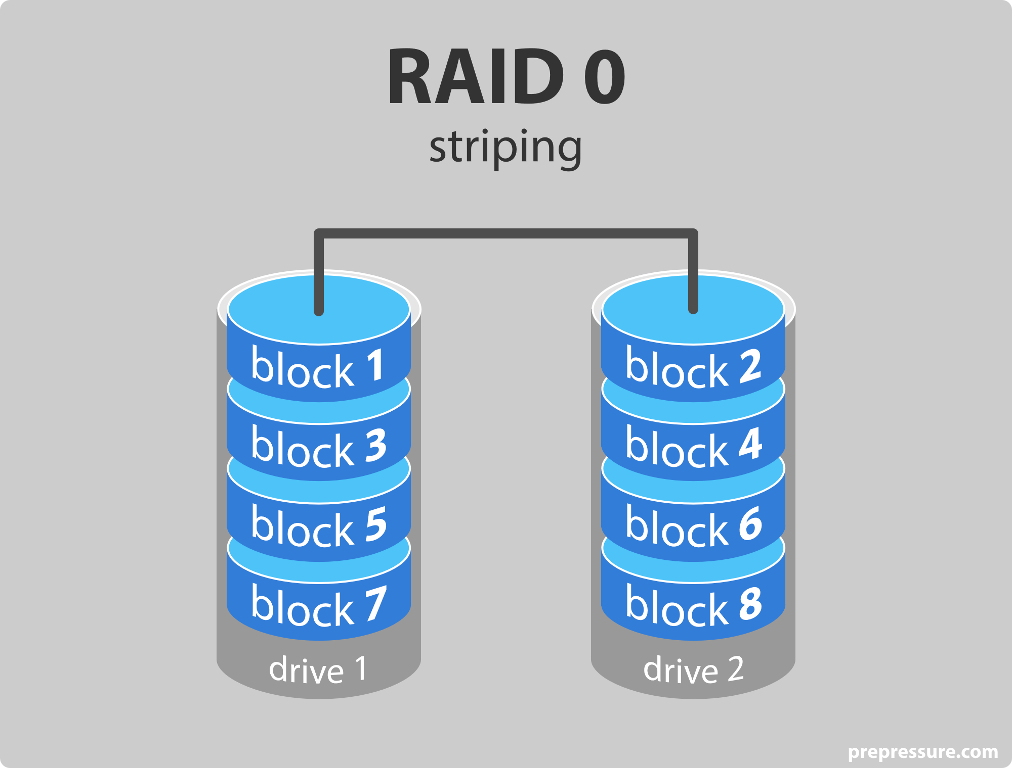
RAID-0 (Striping)
Blocks are “striped” across disks
Evaluation:
Reliability: 0 There is no duplication of data. Hence, a block once lost cannot be recovered.
Capacity: N*B The entire space is being used to store data. Since there is no duplication, N disks each having B blocks are fully utilized.

Slide 7
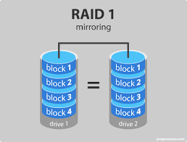
RAID-1 (Mirroring)
More than one copy of each block is stored in a separate disk. Thus, every block has two (or more) copies, lying on different disks.
RAID 0 was unable to tolerate any disk failure. But RAID 1 is capable of reliability.
Evaluation:
Assume a RAID system with mirroring level 2.
Reliability: 1 to N/2 1 disk failure can be handled for certain, because blocks of that disk would have duplicates on some other disk. If we are lucky enough and disks 0 and 2 fail, then again this can be handled as the blocks of these disks have duplicates on disks 1 and 3. So, in the best case, N/2 disk failures can be handled.
Capacity: N*B/2 Only half the space is being used to store data. The other half is just a mirror to the already stored data.

Slide 8
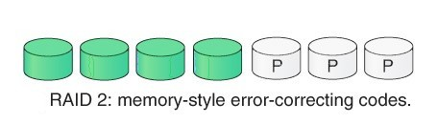
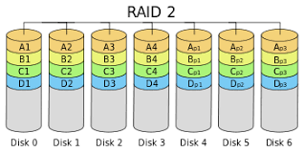
RAID 2:
It consist of Bit-level Striping. RAID 2 records Error Correction Code (ECC) using hamming code parity. In this level each data bit in a word is recorded on a separate disk and ECC codes of the data words are stored on a different set of disk.
Advantage –
In case of Error Correction it uses hamming code.
It Uses one designated drive to store parity.
Disadvantage –
It has complex structure and high cost due to extra drive.
It require extra drive for error detection.

Slide 9
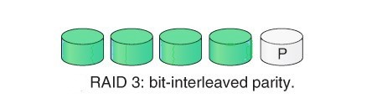
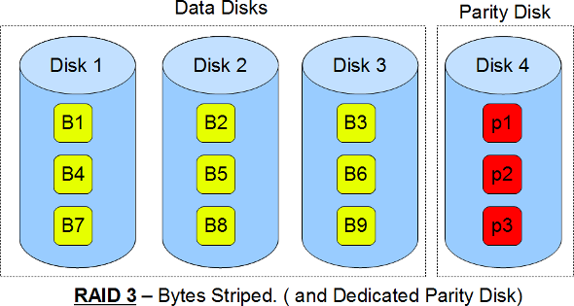
RAID 3:
RAID 3 consists of Byte-level Striping. It stripes the data onto multiple disk. The parity bit generated for each disk section and stored on a different dedicated disk. This level overcome the single disk failure.
Advantages –
Data can be transferred in bulk.
Data can be accessed in parallel.
Disadvantages –
It require an additional drive for parity.
In case of small size files it performs slowly.

Slide 10
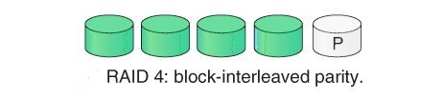
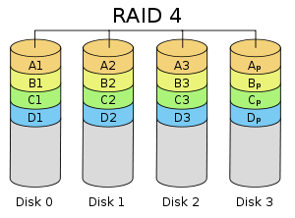
RAID 4:
RAID 4 consist of Block-level Striping. In this level entire set or block of data written onto the data disk and then the parity is generated and stored on a different set of disk. This level overcome at most one disk failure. If more than one disk failure occur then there is no way to recover the data. Both RAID 3 and RAID 4 require at least three disk to implement RAID.
Advantages –
It facilitates simultaneous I/O request because of Block striping.
Storage overhead is low.
Disadvantages –
Parity disk may lead to bottleneck.
Slow random writes because of separate block parity.

Slide 11
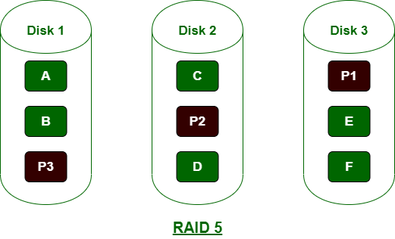
RAID 5 :
In RAID 5, data is equally divided in all disks and minimum number of physical disks needed is 3. The main advantages of RAID 5 over RAID 1 are no need of large space, supports data accessing at the time of recovery and high security of data. RAID 5 is generally suited for medium level of applications.
Advantage –
RAID 5 was introduced to make the random write performance better.
Disadvantage –
RAID 5 allows recovery of at most 1 disk failure (because of the way parity works). If more than one disk fails, there is no way to recover the data.

Slide 12
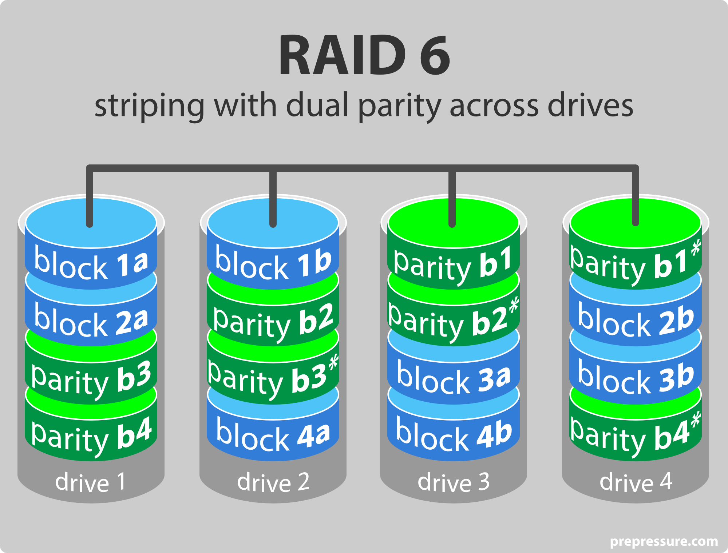
Raid 6
RAID 6 extends RAID 5 by adding another parity block; thus, it uses block-level striping with two parity blocks distributed across all member disks

Slide 13
Thankyou

