Slide 1

CONVERSION CATALYST
Smart Lead Matching for Better Sales
Team Data Dynamos | Hackathon Prototype 2026

Slide 2

THE PROBLEM
The Current Issue: Blind Assignment
!
Random, Round-Robin Routing
THE METRIC IMPACT
50
Infinity Learn gets thousands of leads daily, handled by over 600 sales managers. Right now, leads are handed out randomly or in a round-robin format.
leads / day
hard cap per manager
The result: high-quality, high-intent leads are often handed to managers who are a poor fit for that specific customer.
That fixed capacity is being wasted on mismatched leads — directly reducing the conversion rate of High (H) intent leads.

Slide 3
THE SOLUTION
Smart Matchmaking
We built an automated system that acts as a smart matchmaker, not a random dealer — using past data to predict exactly which manager has the highest chance of closing a specific lead.
01
02
The Logic
Fairness
The system looks at historical conversion rates, language matches, and geographic fit to score the best pairing between lead and manager.
No manager gets overloaded. Each manager can only handle 50 leads a day. If the best-fit manager for a lead has already hit that limit, the system automatically looks for the next best manager who still has room.

Slide 4
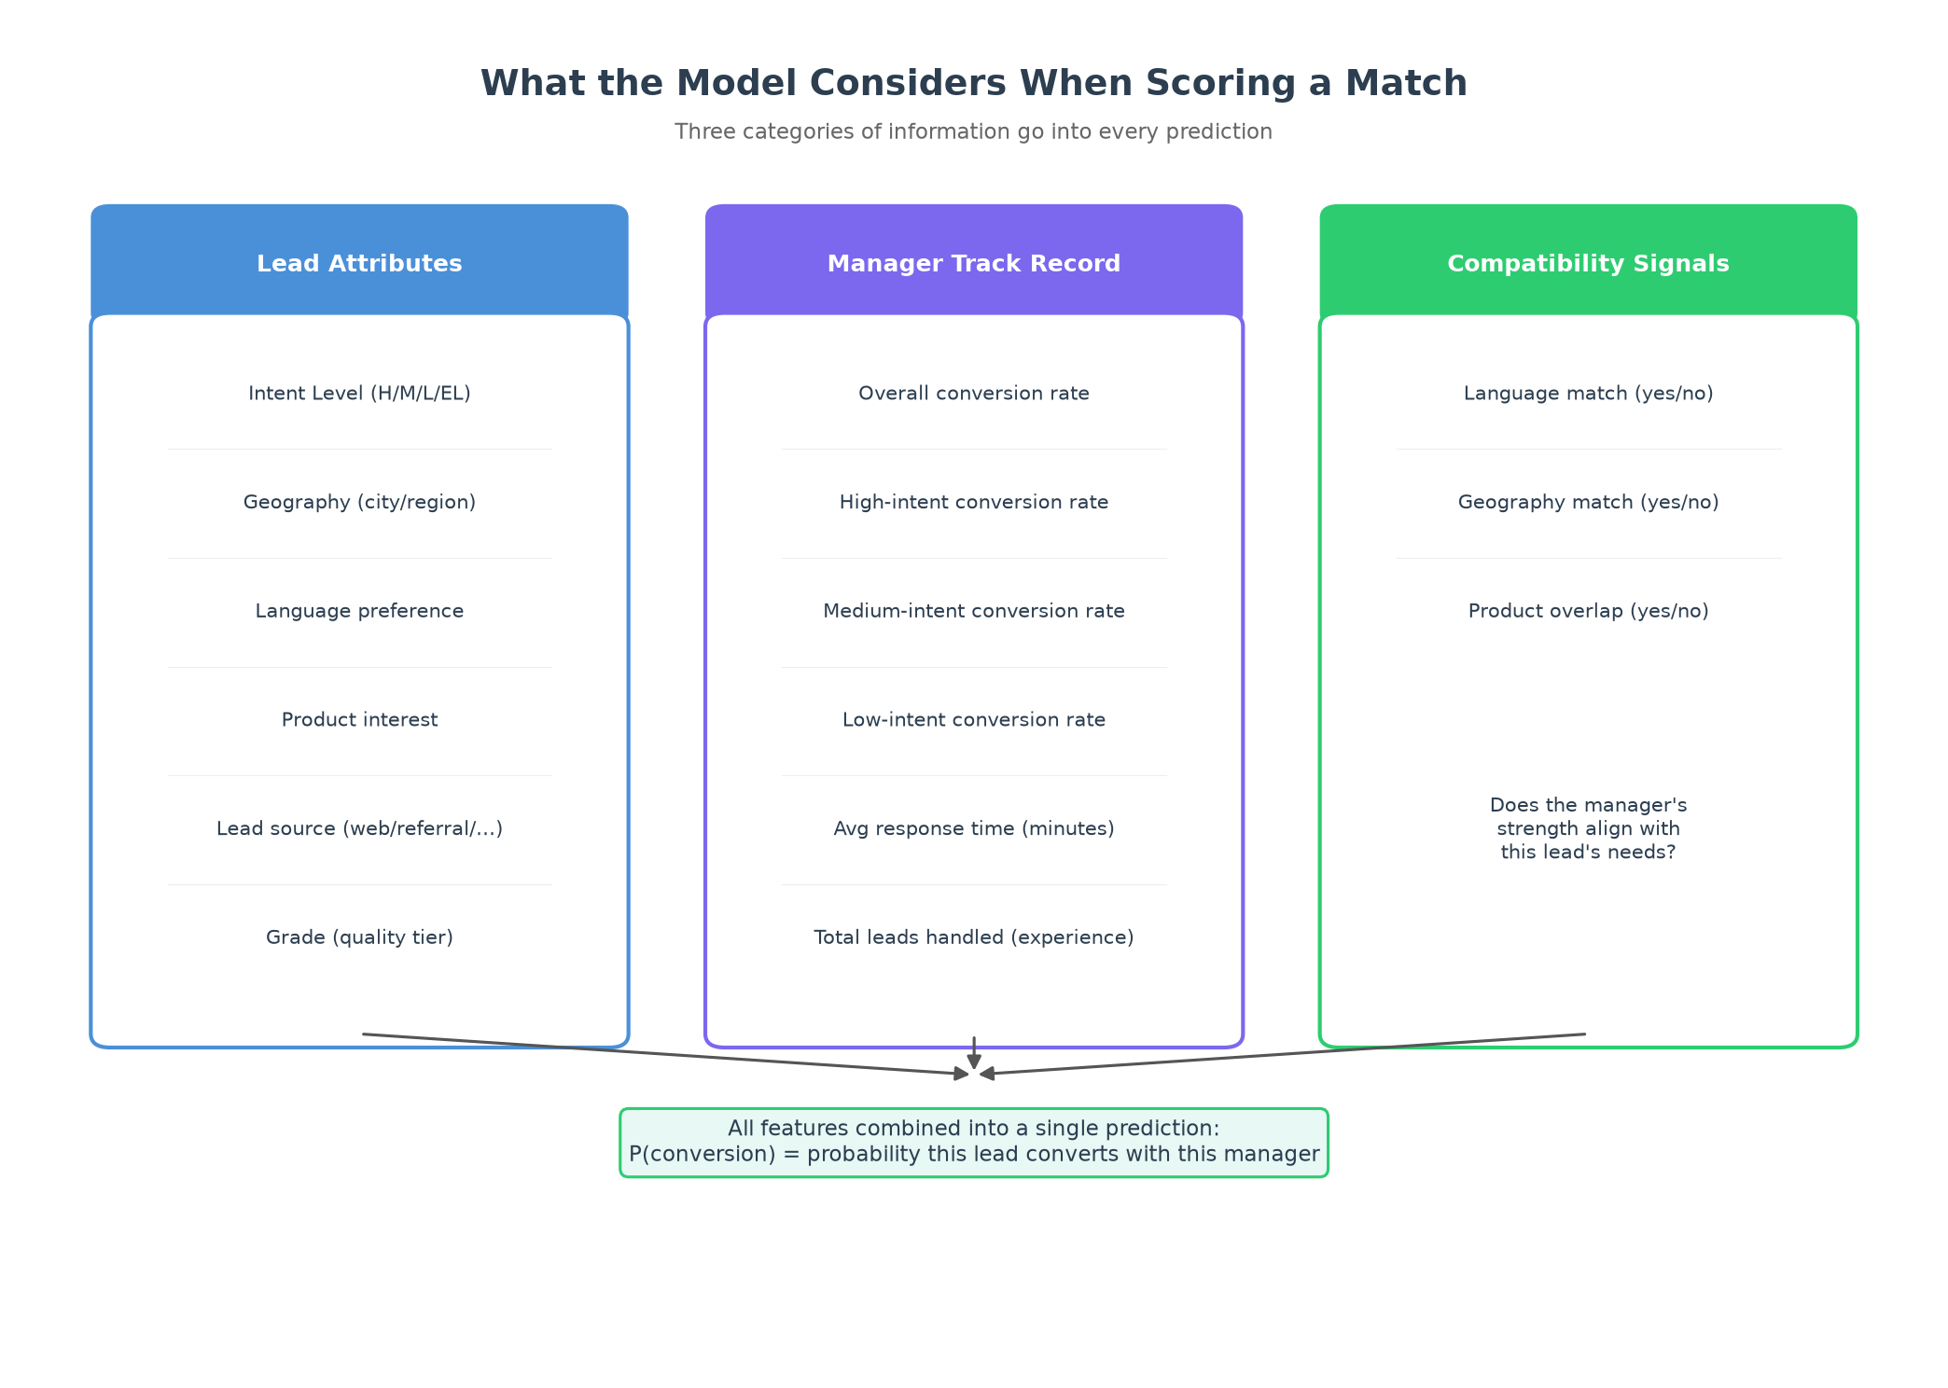
THE MODEL

Slide 5
THE ARCHITECTURE
Under the Hood
The Setup
A fully automated pipeline built on AWS that runs every night at 4 AM.
1
The Engine
A machine learning model trained weekly on past sales data. It scores every new lead against every available manager.
2
The Integration
Once matches are made, the system automatically pushes assignments into the LeadSquared CRM. Managers log in to find their best leads waiting.
3
The Failsafe
Any leftover leads are placed in a ranked pool where managers can manually claim them, ensuring zero leads are dropped.
4

Slide 6
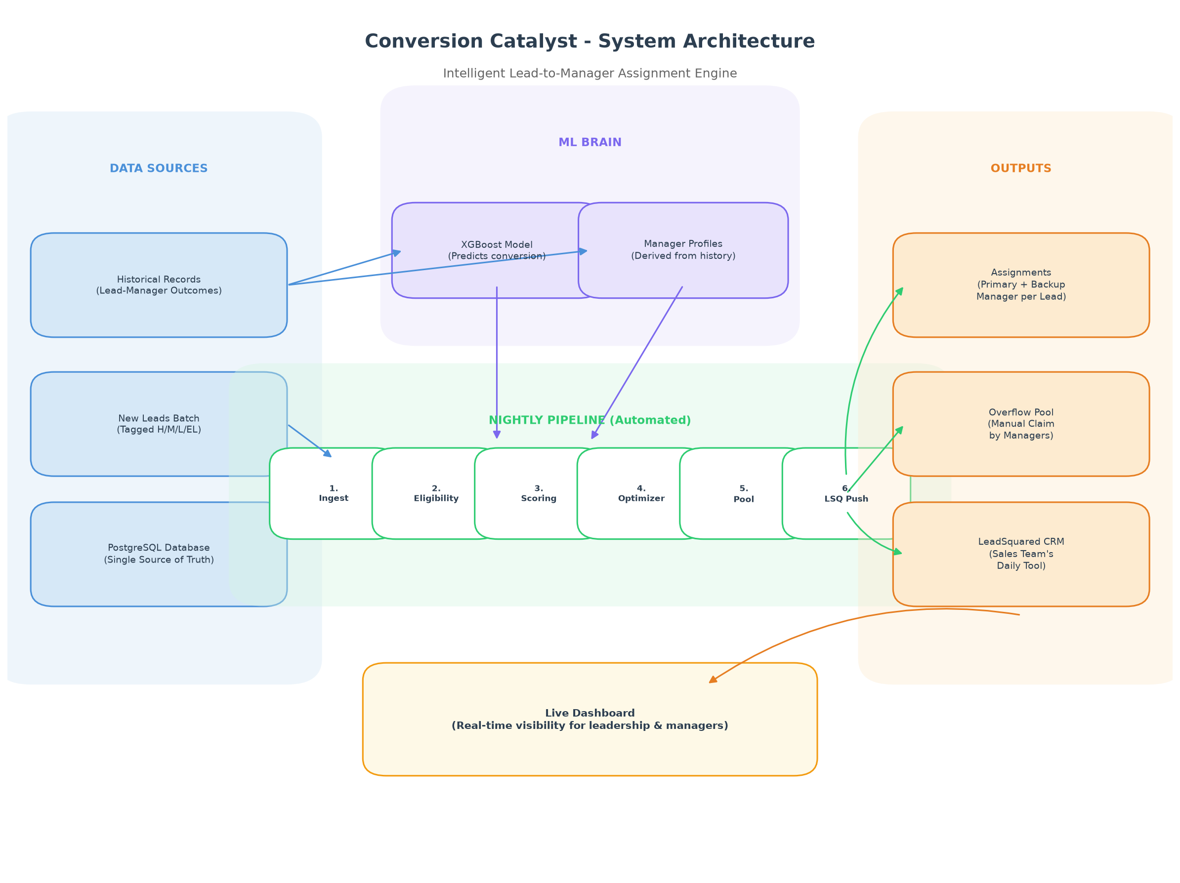
THE ARCHITECTURE

Slide 7
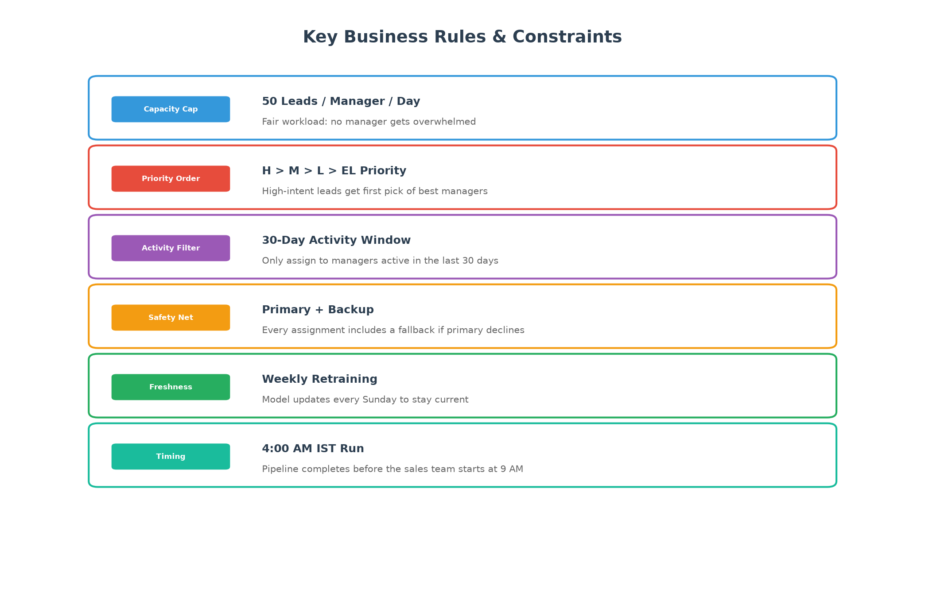
THE GUARDRAILS

Slide 8
WHY IT MATTERS
Measurable Business Impact
PROVEN TREND
PROTOTYPE-TESTED
BUILT-IN
BY DESIGN
Conversion Already Improved Once
Fast & Automated
Fully Explainable
Zero Manual Routing
When Infinity Learn moved from unstructured assignment to HML-based allocation, conversion on these leads roughly tripled from ~1% to 2–3%.
The full pipeline runs end-to-end in under a minute on sample data, ingest, score, assign, and push, with no manual steps.
Every assignment comes with a reason. No black-box decisions — leadership and managers can see exactly why a lead went where it did.
No one has to sit and hand-assign leads. The system does it automatically, every night, before the sales day starts.
BUILDING ON A PROVEN TREND
This isn't a first attempt, it's the next step. Infinity Learn has already seen conversion move from ~1% to 2–3% once, simply by introducing HML-based lead categorization. Our model goes a layer deeper: instead of just categorizing leads, it matches each one to the specific manager most likely to convert it. We're not Better matching has already moved conversion once, and there's no reason to think it stops here.
Beyond conversion: this also means fairer workloads, better language/geography fit for customers, and a fully auditable process outcomes we can already demonstrate in the prototype, not just project.

Slide 9
LIVE DEMO
See It In Action
Let’s walk through the live prototype demonstration of the Conversion Catalyst.
1
2
3
4
INGEST
SCORE
REVIEW
PUSH
›
›
›
We will ingest a batch of new leads into our system.
Run the matching engine to filter unavailable managers and score the rest.
Display the final output, showing exactly why a lead was assigned.
Demonstrate the CRM assignment push using our mock API.

Slide 10

Thank You
Conversion Catalyst
Tushar Sharma
Nishit Singh
Yash Chopra
Shubham Parikh
Team Data Dynamos | Hackathon Prototype 2026

