Slide 1

DIALOGFLOW - API
(CHAT BOT)
NISHITA DASH
CB.EN.U4CSE18037

Slide 2
OBJECTIVE
The main objective of the case study is to train a chat bot to interact with the user, that is to take in voice or text input from the user and respond accordingly with a speech output. This is done using dialogflow-api and bucket. The bucket is used to extract images of various tourist places in India by their names. Dialogflow is used to train the bot to chat with the user with appropriate response. The chat bot is named as agus, this is a user friendly chat bot which drives away the boredom.

Slide 3
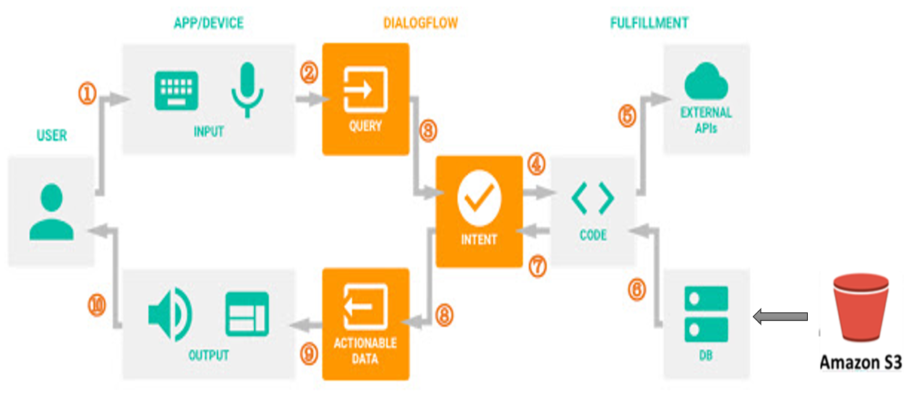
ARCHITECTURE

Slide 4
ARCHITECTURE (cont.)
First in S3 bucket if there is a request to display an image it extracts the images from the bucket by their names.
Next in dialogflow api we create a new agent.
To train this chat bot we are going to use 2 things intents and entities.
We are going to create intents that is used for training the chat bot.
It has set of questions that can be posed by the user in the ‘training phrases’ and in the ‘text response’ it has the set of responses that it should give in return.
Some intents can also have a follow up intent. A follow-up intent is a child of its associated parent intent. A follow-up intent is only matched when the parent intent is matched in the previous conversations. You can also create multiple levels of nested follow-up intents.

Slide 5
ARCHITECTURE (cont.)
Entities are a mechanism in Dialogflow for identifying and extracting useful data from natural-language inputs. Entities are used to pick out specific pieces of information that your users mention. Any important data that you want to get from a user's request will have a corresponding entity.
To enable the dialogflow api, I have used a key from the GCP in the json format.
I have designed a web page of the chat bot that takes in either audio or text input from the user, and according to the intents that are designed it responses back to the user. Then we use the concepts of speech synthesis, speech to text and interpret the request made user and according to the intents designed in dialogflow it generates the corresponding output. After the output is generated, by using ServerMessage, text to speech concept the chat bot responds back with a voice reading out the message.

Slide 6

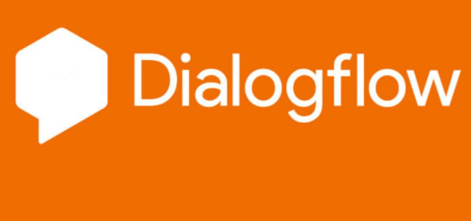
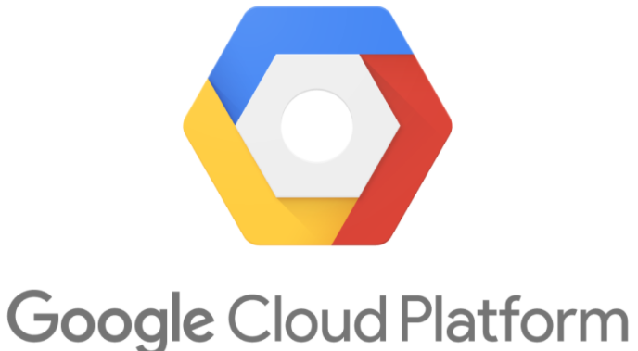
CLOUD FEATURES
Dialogflow api (Table of contents: Agents, Intents, Entities, Contexts, Follow-up intents, Dialogflow console)
S3 bucket
GCP

Slide 7
THANK YOU

