Slide 1
Task 3 - Dashboard Design
Data Analytics Internship
Sales Performance Dashboard

Slide 2
Dataset Overview
Dataset: Sales Data Sample
Tool: Power BI
Focus: Sales performance and business insights

Slide 3
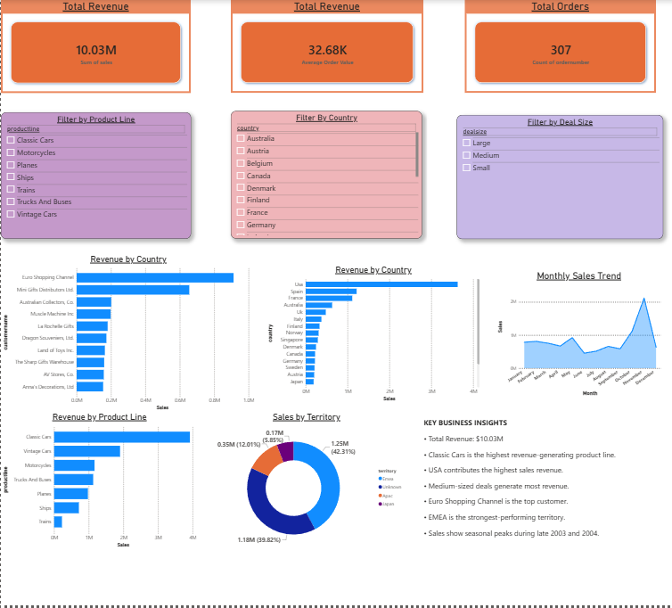
Dashboard Features
KPI Cards
Interactive Slicers
Monthly Sales Trend
Product Line Analysis
Country Analysis
Customer Analysis
Territory Analysis

Slide 4
Key Findings
Total Revenue: $10.03M
Total Orders: 307
Classic Cars is the top product line
USA is the highest revenue-generating country
Medium-sized deals contribute the most revenue
EMEA is the strongest territory

Slide 5
Conclusion
The dashboard helps stakeholders monitor sales performance and supports data-driven decision making through interactive visualizations.

