Slide 1
TEAM PROJECT GROUP 4 MACHINE LEARNING USING SVM
By: Adil Khan, Deepthi Vishwanath, Nishita Narvekar, Nitisha Raut

Slide 2
AGENDA
DATA ANALYSIS
FEATURE SELECTION
OPTIMIZATION
PREDICTION RESULTS
TEXT NORMALIZATION
TF-IDF
PROPOSAL FOR DaysInLife DATA

Slide 3

DATA ANALYSIS
Calculated mean values for each feature in case of Success ( Status = 1)
Calculated mean values for each feature in case of Failure ( Status = 0 )

Slide 4

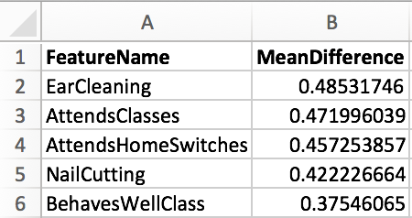
DATA ANALYSIS
Calculated Mean differences between these two groups
Sorted these mean differences in ascending order for feature ranking

Slide 5
DATA ANALYSIS
Dataset 1
Features Selected:
Age
Sex
Breed
EarCleaning
AttendsClasses
AttendsHomeSwitches
NailCutting
BehavesWellClass

Slide 6
FEATURE SELECTION
The features we use to train the model has a huge impact on the accuracy with which the model predicts.
Correct features help in reducing overfitting, improving accuracy and reducing training time.
We used some of the automatic feature selection techniques to choose the features for our model.
Univariate Selection
Recursive Feature Elimination
Feature Importance using Random Forest

Slide 7
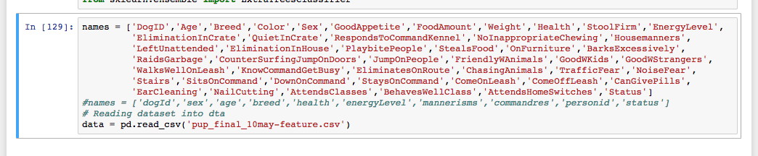
FEATURE SELECTION
FEATURES USED
The above features were provided to each technique

Slide 8
FEATURE SELECTION
Univariate Selection
This technique uses statistical tests to select features that have the strongest relationship with the output variable.
SelectKBest class: Allows to select specific number of features, along with different tests of statistical functions.
10 best features that got selected:
Sex,Weight,Age,Color,AttendsHomeSwitches,StaysOnCommand,LeftUnattended,EarCleaning,BhavesWellClass,HouseManners,NailCutting,CounterSurfingJumpOnDoors, TrafficFear

Slide 9
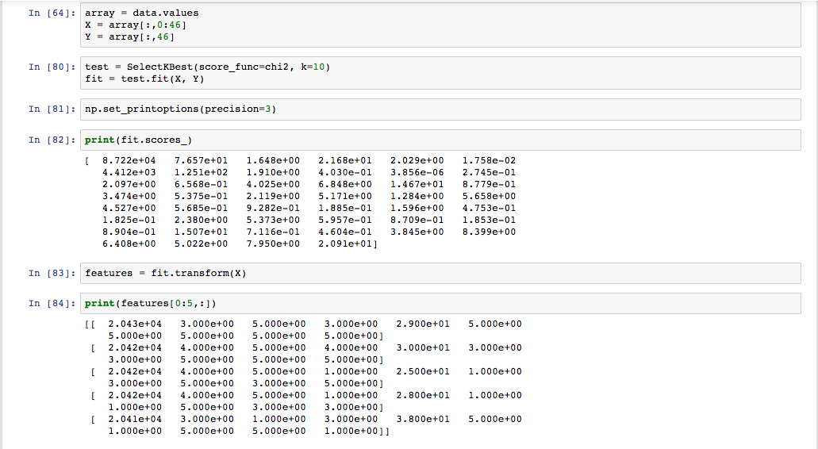
FEATURE SELECTION
UNIVARIATE FUNCTION

Slide 10
FEATURE SELECTION
Recursive Feature Elimination
Recursively removes attributes and builds a model on those that remain.
This model is used to predict which attribute contributes the most in determining the target value.
6 best features that got selected:
Breed,GoodAppetite,EnergyLevel,HouseManners,TrafficFear,StayOnCommand

Slide 11
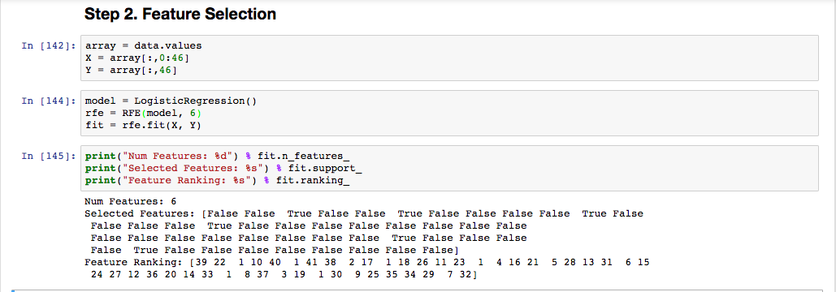
FEATURE SELECTION
Recursive Feature Elimination

Slide 12
FEATURE SELECTION
Feature Importance using Random Forest
Decision Trees like Random Forest and Extra Trees can be used to determine the importance of features.
An importance score is assigned to each attribute - Larger the score, more important the attribute.
10 best features that got selected:
DogID,Age,Weight,BehavesWellClass,NailCutting,StealsFood,Sex,ComeoffLeash, StaysOnCommand,ChasingAnimals

Slide 13
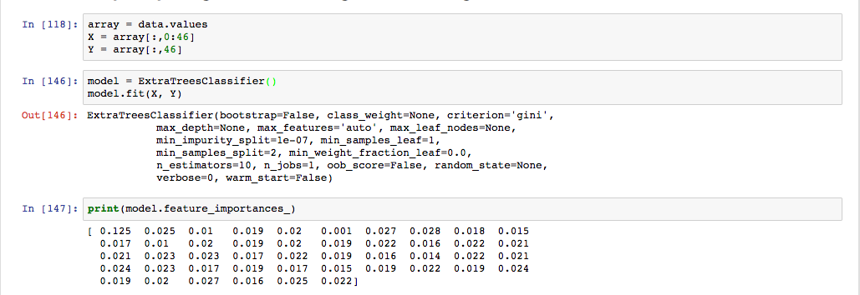
FEATURE SELECTION
Feature Importance using Random Forest

Slide 14
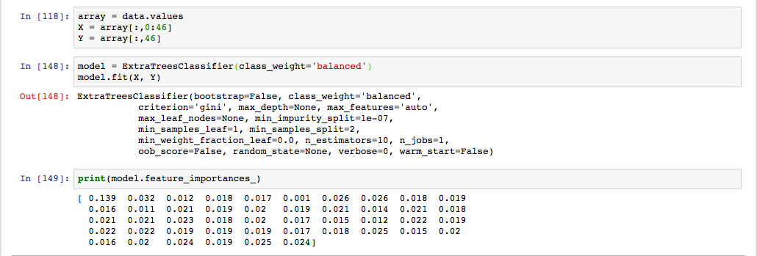
FEATURE SELECTION
Feature Importance using Random Forest with Tuning

Slide 15
OPTIMIZATION
stepSize is a scalar value denoting the initial step size for gradient descent.
numIterations is the number of iterations to run.
regParam is the regularization parameter when using L1 or L2 regularization.
miniBatchFraction is the fraction of the total data that is sampled in each iteration, to compute the gradient direction.

Slide 16
PREDICTION RESULTS
Prediction rates for all the selected datasets:
 | Milestone1 (8 features) | Custom DS1 (8 features) | Univariate DS (10 features) | RFE DS (6 features) | RF DS (9 features)
Prediction Rate for Training Set | 62.61% | 61.56% | 62.87% | 63.11% | 62.21%
Prediction Rate for Testing set | 62.88% | 65.42% | 60.32% | 59.1% | 63.45%

Slide 17
TEXT NORMALIZATION
DaysInLife data cleaning
Removed full stops, commas, extra spaces, parenthesis, integers, colons, semicolons, inverted commas
Converted the entire text to lowercase
Stop words removal
Used the spark feature transformation library to remove stop words : StopWordsRemover
StopWordsRemover takes the following parameters:
caseSensitive
inputCol
outputCol
stopWords

Slide 18
TEXT NORMALIZATION
Raw Data
i, am, a, full, time, hospice, nurse, who, visits, patients, on, a, flexible, schedule, start, time, in, the, morning, varies, and, arrival, home, varies, however, i, make, my, schedule, so, i, am, able, to, come, home, between, patients, if, necessary, evenings, are, usually, spent, doing, tasks, around, the, house, or, running, errands, i, attend, a, quilt, bee, every, two, weeks, and, look, forward, to, increasing, my, outings, in, the, evening, to, enrich, my, pup, in, training, weekends, are, as, calm, or, busy, as, necessary, with, trips, to, the, beach, at, times, the, pup, will, share, the, house, with, my, senior,
Processed Data
full, time, hospice, nurse, visits, patients, flexible, schedule, start, time, morning, varies, arrival, home, varies, however, make, schedule, able, come, home, patients, necessary, evenings, usually, spent, tasks, around, house, running, errands, attend, quilt, bee, every, two, weeks, look, forward, increasing, outings, evening, enrich, pup, training, weekends, calm, busy, necessary, trips, beach, times, pup, share, house, senior

Slide 19
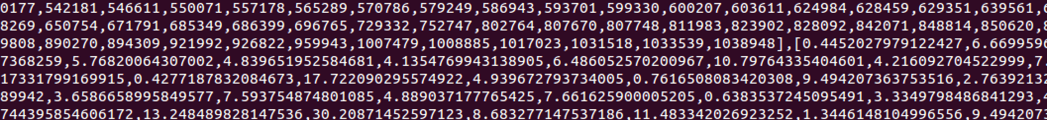
TF-IDF
We loaded data in the form of sequence, each line was a separate document
val documents: RDD[Seq[String]] = sc.textFile("dayinlife").map(_.split(" ").toSeq)
First transform data using the using TF
Second use the output of first step to transform data using IDF

Slide 20
PROPOSAL FOR DaysInLife DATA
Words like walk, beach, play will positively affect the prediction
Words like busy, work, away should negatively impact the prediction
Although, this data won't greatly affect the prediction results as compared to the other data.

Slide 21
References
https://spark.apache.org/docs/2.1.0/mllib-linear-methods.html
https://github.com/zygmuntz/phraug/blob/master/csv2libsvm.py
http://scikit-learn.org/stable/modules/model_evaluation.html#classification-metrics
https://spark.apache.org/docs/2.1.0/api/scala/index.html#org.apache.spark.ml.feature.StopWordsRemover
https://spark.apache.org/docs/2.1.0/ml-features.html#stopwordsremover
https://spark.apache.org/docs/2.1.0/ml-features.html
http://www.sunlab.org/teaching/cse8803/fall2016/lab/spark-mllib/

