Slide 1
Team name: UNSTOPPABLES
Members: 1. Pratham Jain (PGDM)
2. Nishita Thakkar(PGDM)
3. Neha Badkas(PGDM)
4. Shreyash Deshmukh(PGDM-RBA)
5. Raima Banerjee(PGDM-RURAL)
6. Yash Yeole (PGDM-EBIZ)

Slide 2
Analyzing Restaurants in Bengaluru Using Zomato data
Q1. Is the rating of a restaurant affected by it providing Online order facility or not ?
Q2. Is the rating dependent on the approx. cost for 2?
Q3 Which are the top 10 areas that have the cheapest but highly rated restaurants ?
Q4 If someone is planning on opening a restaurant in Bangalore and wants to provide online delivery service where should he open his restaurant to make a profitable online business?

Slide 3
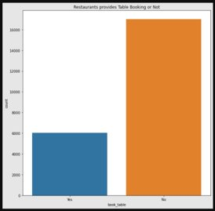
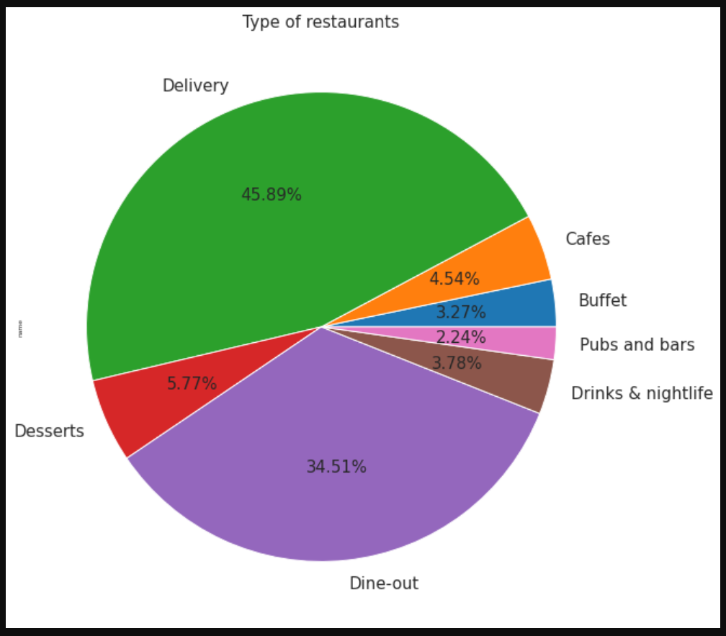
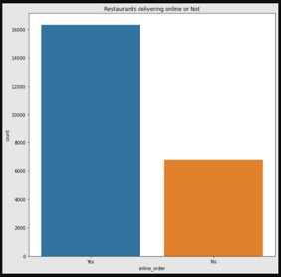
SOLUTION OVERVIEW

Slide 4
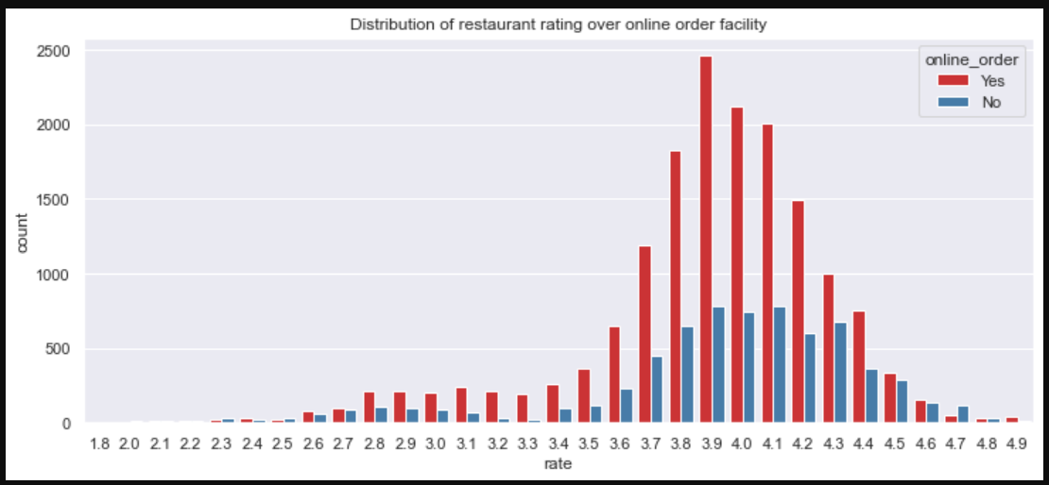
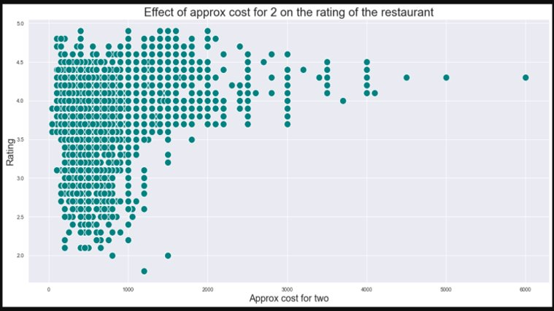
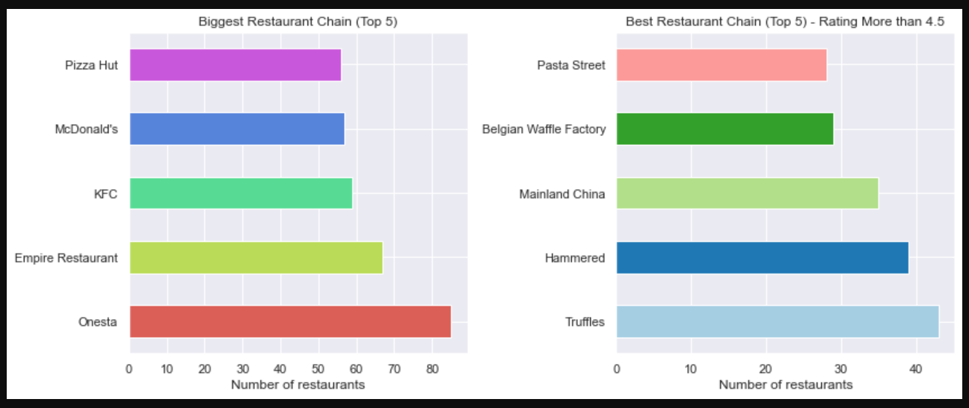
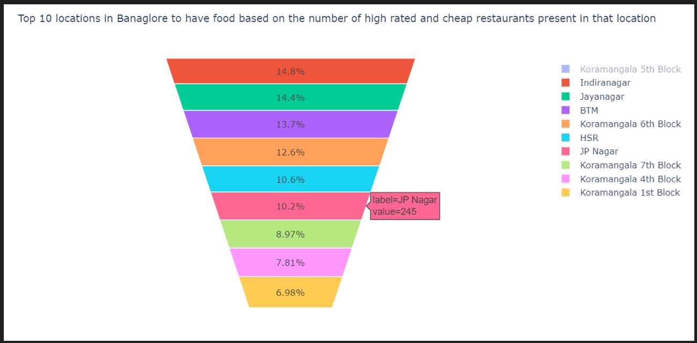
Distribution of restaurants rating over online order facility
Effect of approx. cost of 2 on the rating of the restaurant
Biggest and best restaurant chains of the city
Top 10 location with cost effective & highly rated restaurants

Slide 5
Detailed Working
IMPORTING LIBRARIES - For data visualisation, we need to import the libraries in code file such as Pandas, numpy, Seaborn, Matplotlib, Sklearn, Plotly, Dexplot and Tqdm.
DOWNLOADING THE DATASET- The next step is to unpack the dataset and read it.
BASIC DATA UNDERSTANDING- Furthermore to understand the data by checking data types of the columns which we are interested to work with. While checking we must change the variables of the columns from object to integer if we have to perform analysis on them.
DATA CLEANING AND DATA MANIPULATION- It is important to clean unwanted data from the data set so that the analysis can be performed smoothly. For which we need to ensure that there are no duplicate values in the data set and remove unwanted data columns like URL, address , phone no., remove duplicate rows and convert NaN values to float.
EXPLORATRY ANALYSIS AND VISUALISATION- The next step is to use the data set for the analysis by using the code to create charts to analyse various parameters which will help restaurants and Zomato in decision making

Slide 6
Key Insights
•In the city of Bangalore there are total 7 types of restaurant.
•74 % restaurants don’t provide table bookings.
•30% Restaurant are beyond the rich of digitization and are not having online order facility.
•Koramangala 5th Block has the most number of listed restaurants and is the top place to visit if someone wants to have food from high rated restaurants but at low price..
•BTM has the maximum number of hotels providing online services.
•Onesta is the most famous restaurant in the city.
•Truffles is the best restaurant chain with a rating of more than 4.5 .
•The average rating is between 3.7 to 3.9.
•The average cost for 2 is approx Rs.500 .
•Delivery is the most preferred type of restaurant.
•The rating of restaurants providing online order services have a slightly good rating.

Slide 7
Uniqueness of the solution
This analysis provides stakeholders with an insight to make business decisions regarding where to locate restaurants or how to choose menu items based on locational scarcity, among other things. It includes a detailed overview of restaurants in Bangalore that includes area-wise density of various restaurant types offering different services like dine-in, delivery, and takeaways.
Additionally, this analysis offers a comprehensive viewpoint to diners or foodies spread throughout Bangalore, allowing them to enjoy their meal by providing an understanding of the ratings provided by various customers and additional knowledge of the average cost per person required in the restaurant so that they can make an informed choice.
Finally, the entire analysis includes a variety of pictorial representations of data in the form of graphs that address a wide range of stakeholder questions, making this study a unique solution for giving both business owners and food enthusiasts an overview of restaurant chains located among the entire demography of Bangalore.

