Slide 1

DA 675 Fuzzy Systems and Applications
Nishi Chaudhary(246150001)
Under the guidance of
Dr. Teena Sharma

Slide 2
TABLE OF CONTENT
INTRODUCTION
CNN ARCHITECTURE
WHY TO USE POOLING LAYERS
FUZZY POOLING
DATASET
MODEL EVALUATION
CONCLUSION
REFERENCES

Slide 3
INTRODUCTION
CNNs utilize convolution and pooling for feature extraction and dimension reduction in image classification.
Traditional pooling methods overlook uncertainty that can propagate through layers.
A novel fuzzy pooling approach, based on type-1 fuzzy sets, addresses local imprecision in feature maps.
Fuzzy pooling includes fuzzification, aggregation, and defuzzification steps, acting as a drop-in replacement for standard pooling layers.

Slide 4
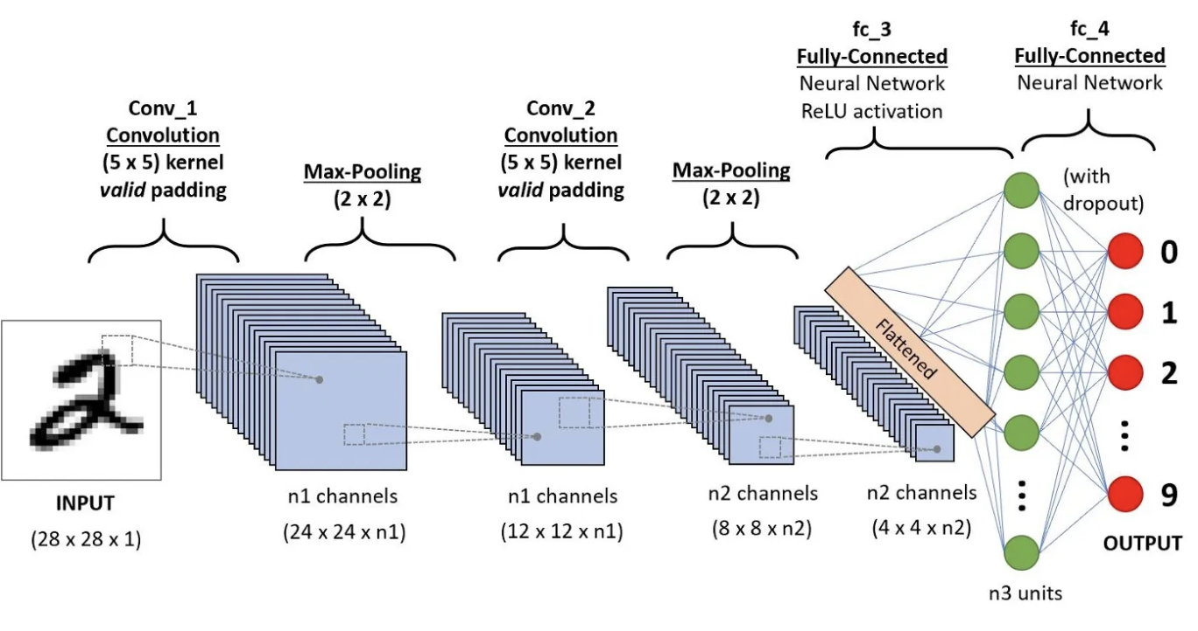
CNN ARCHITECTURE

Slide 5
Why to use Pooling Layers?
Pooling layers are used to reduce the dimensions of the feature maps. It reduces the number of parameters to learn, and the amount of computation performed in the network.
The pooling layer summarizes the features present in a region of the feature map generated by a convolution layer.

Slide 6
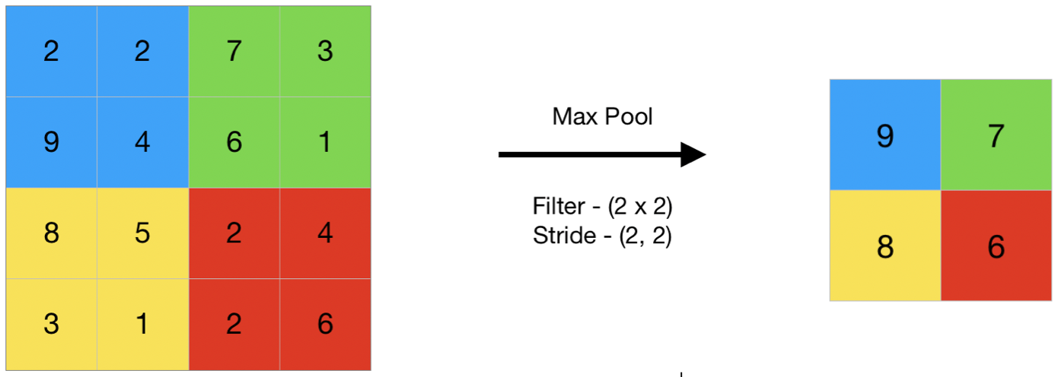
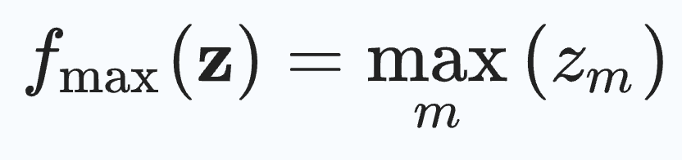
Max Pooling
Max pooling is a pooling operation that selects the maximum element from the region of the feature map covered by the filter.

Slide 7
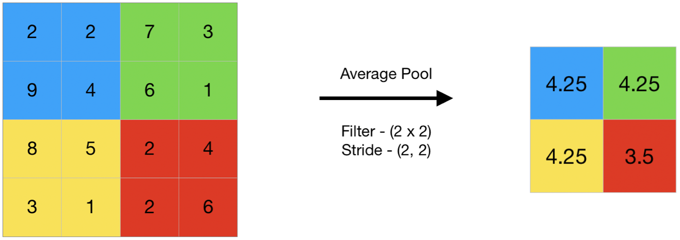
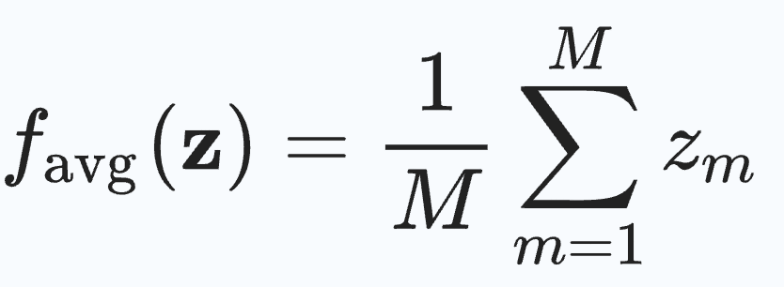
Average Pooling
Average pooling computes the average of the elements present in the region of feature map covered by the filter.

Slide 8
Fuzzy Pooling
Fuzzification: Converts numerical values in a pooling region into fuzzy values based on defined membership functions.
Aggregation: Combines the fuzzy values in each pooling window, often using a mathematical operation like a fuzzy algebraic sum.
Defuzzification: Produces a single representative value for the pooling region, based on the aggregated fuzzy values.

Slide 9
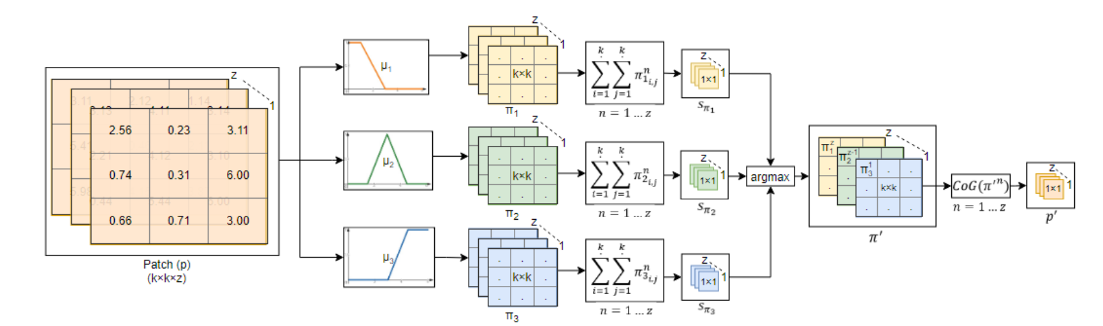
Fuzzy Pooling

Slide 10
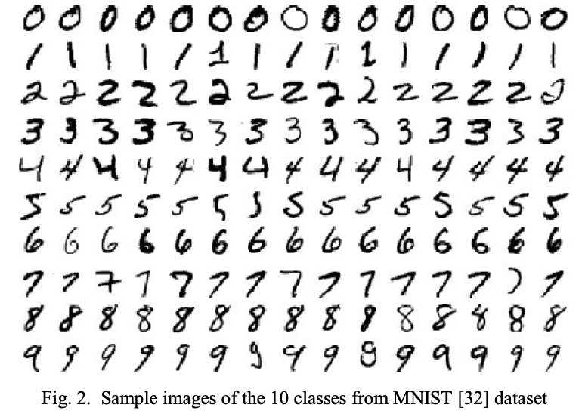
MNIST DATASET
MNIST dataset consists of 70.000 grayscale 28×28 pixels in size images of handwritten digits.
It is split into two subsets from which 60.000 are used for training and 10.000 for testing.

Slide 11
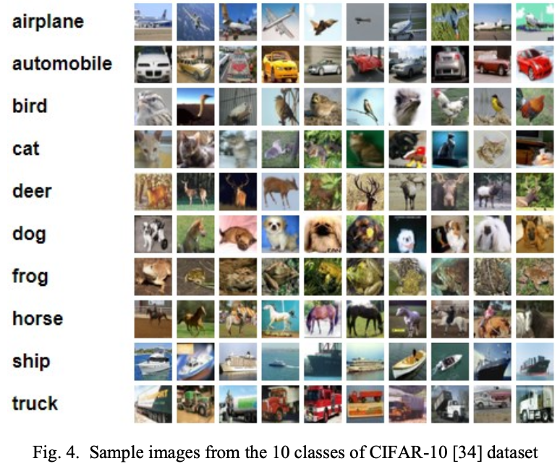
CIFAR- 10 DATASET
CIFAR- 10 dataset is consisting of 60.000 natural RGB images of 32×32 pixels in size from 10 different classes.
It is split into two subsets from which, 50.000 are used for training and 10.000 for testing.
The dataset contains 6.000 images per class.

Slide 12
MODEL EVALUATION
COMPARATIVE ACCURACY RESULTS OF THE PROPOSED TYPE-1 FUZZY POOLING METHODOLOGY ON MNIST DATASET
Methodology | Loss | Accuracy
Max Pooling | 0.0430 | 98.12%
Average Pooling | 0.0521 | 98.26%
RegP | 0.0700 | 97.96%
Proposed | 0.0681 | 98.85%

Slide 13
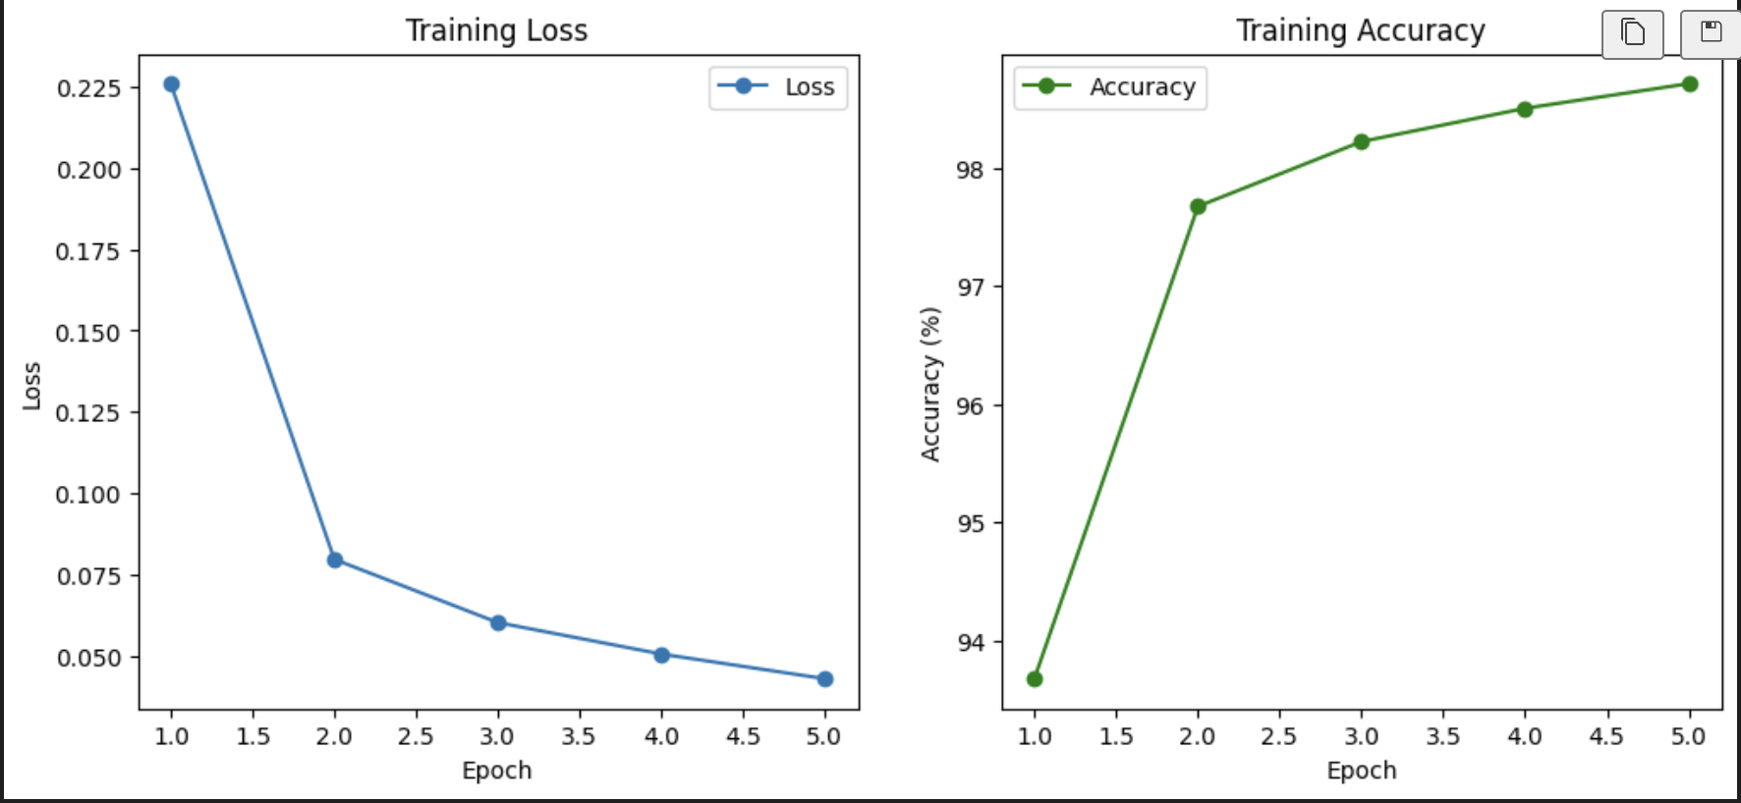
Max Pooling

Slide 14
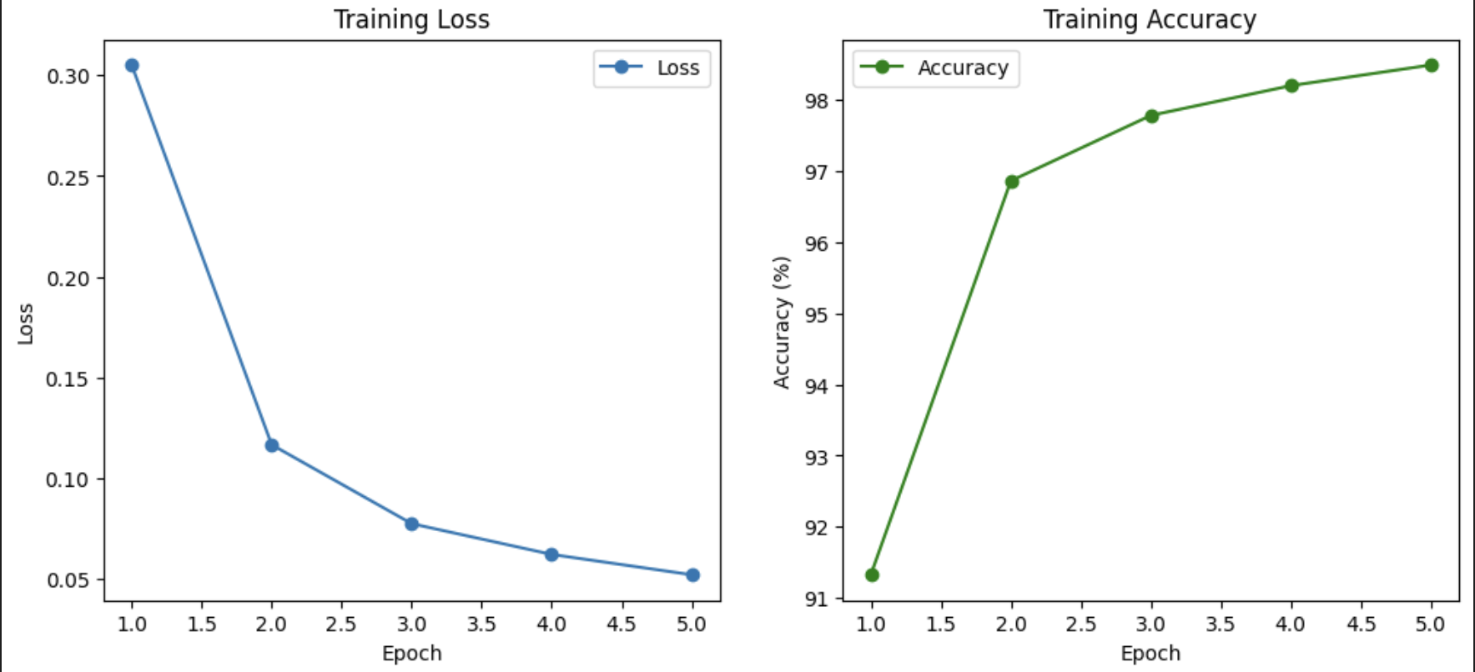
Average pooling

Slide 15
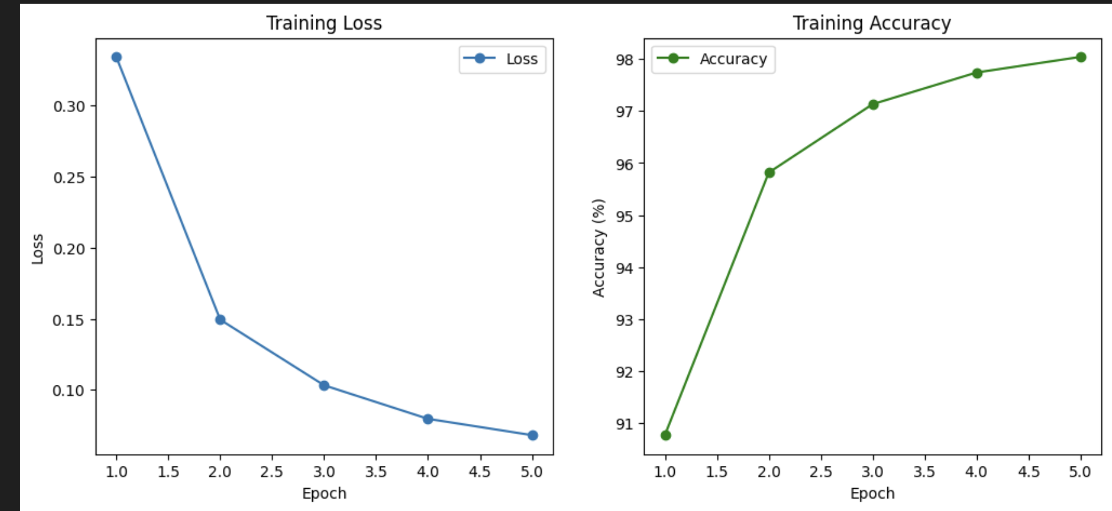
Fuzzy Pooling

Slide 16
MODEL EVALUATION
COMPARATIVE ACCURACY RESULTS OF THE PROPOSED TYPE-1 FUZZY POOLING METHODOLOGY ON CIFAR-10 DATASET
Methodology | Loss | Accuracy
Max Pooling | 0.0530 | 75.03%
Average Pooling | 0.0621 | 62.94%
RegP | 0.0534 | 58.52%
Proposed | 0.0581 | 78.14%

Slide 17
CONCLUSION
A novel fuzzy pooling operation for CNNs is introduced, addressing feature uncertainty.
Experiments demonstrate significant improvements in CNN classification performance over traditional pooling methods.
Fuzzy pooling can replace standard pooling layers, enhancing generalization and retaining important features.
Visual and statistical validation confirm improved feature preservation.

Slide 18
REFERENCES
H.-J. Zimmermann, Fuzzy set theory—and its applications. Springer Science & Business Media, 2011.
K. He, X. Zhang, S. Ren, and J. Sun, “Deep residual learning for image recognition,” in Proceedings of the IEEE conference on computer vision and pattern recognition, 2016, pp. 770–778.
Mixed fuzzy pooling in convolutional neural networks for image classification.
Fuzzy based Pooling in Convolutional Neural Network for Image Classification.

Slide 19
THANK YOU

