Slide 1

Efficient Suitcase Packing Using Backtracking Algorithm
Design and Analysis of Algorithms Project
NAME: Nishitha Penagaluru
ROLL NO.: ch.sc.u4cse24031

Slide 2

Problem Statement
Packing items efficiently into a suitcase is a common optimization problem in logistics and daily life.
Objective:
Maximize the number of items packed
Constraints
Applications:
Items must not overlap
It must stay within suitcase boundaries
Items may be rotated in different orientations
Travel luggage packing
Warehouse storage optimization
Shipping and logistics
Given
A suitcase with fixed width, breadth, and height
A set of items with different dimensions

Slide 3


Input and Output Specifications
Input Format
Output Format
Suitcase dimensions:
W × B × H
Number of items: N
Item dimensions:
Each item can be rotated into 6 different orientations.
Maximum number of items packed
Placement coordinates for each item
→ Coordinates represent:
Bottom-front-left corner
Top-back-right corner
relative to the suitcase origin (0,0,0).

Slide 4
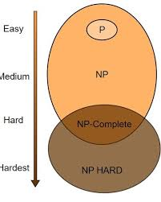



Problem Classification: NP- Hard Complexity
1
2
3D Bin Packing Problem
NP-Hard Classification
No known polynomial-time algorithm exists for solving
all instances optimally.
Classified as an
NP-Hard problem
3
Characteristics:
Items must be arranged in three-dimensional space
Objective is optimal space utilization
Therefore, intelligent search methods such as Backtracking are used.
For N items, there are 6ᴺ possible orientation combinations, making
brute-force approaches infeasible for large N.

Slide 5
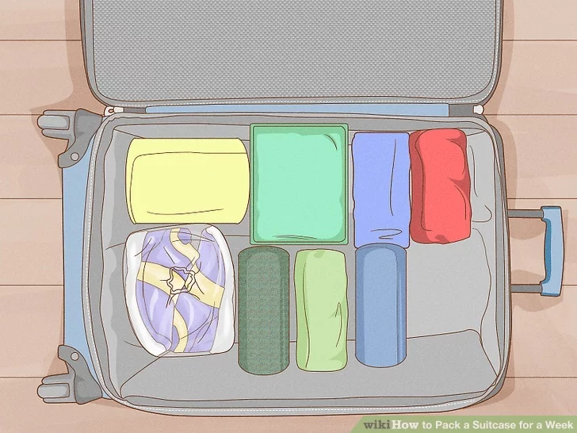
Algorithm Overview: Backtracking Approach
Select an item
Generate all possible rotations
Try placing the item in all valid positions
Check:
boundary constraints
overlap with other items
If valid → place item and continue recursively
If not valid → try another configuration
Track the best solution found
Backtracking ensures that all feasible arrangements are explored.

Slide 6



Key Techniques
Item Rotation
Eachitem can be rotated in 6 different orientations (permutations of
Each item can be rotated into 6 orientations:
(W,B,H)
(W,H,B)
(B,W,H)
(B,H,W)
(H,W,B)
(H,B,W)
dimensions). The algorithm explores all valid rotations to find optimal placement configurations.
Boundary Checking
Ensures items remain within suitcase boundaries by verifying that all item
corners lie within the suitcase dimensions in each dimension.
Condition:
x + width ≤ suitcase width
y + breadth ≤ suitcase breadth
z + height ≤ suitcase height
Overlap Detection
Checks if two items occupy the same space.Two boxes overlap if their 3D ranges intersect in all dimensions.This prevents items from colliding.

Slide 7

Optimization: Pruning Technique
Backtracking can explore many configurations.
To improve efficiency, pruning is used.
Pruning Rule:
currentPackedItems + remainingItems ≤ bestPackedItems
if this condition is satisfied then this branch cannot produce a better solution.
So the algorithm stops exploring that branch.
Benefits:
Reduces unnecessary computations
Speeds up the search process
Maintains optimal solution guarantee

Slide 8
Time Complexity
Space Complexity
O((6×P)N)
O(N)
items × rotations × positions
O(N) due to recursion and placement tracking.
6- number of rotations
P - Positions
N- number of items
Since the suitcase packing problem is NP-Hard, the backtracking algorithm explores multiple placement combinations, leading to exponential worst-case complexity.

Slide 9

Example Input and Output Demonstration
Input Example
Sample Output
Suitcase: 5 × 5 × 5
units Items:
Items Packed: all three
Positions:
Item 1: 3 × 2 × 1
Item 2: 2 × 2 × 2
Item 3: 1 × 1 × 1
Item 1 → (0,0,0)
Item 2 → (0,0,1)
Item 3 → (0,0,3)
All items satisfy:
boundary constraints
non-overlapping condition

Slide 10

Conclusion & Future Improvements
Advantages
Limitations
Guarantees optimal packing
Handles 3D spatial constraints
Supports item rotation
Uses pruning to improve efficiency
Exponential time complexity
Not ideal for very large numbers of items
Future Improvements
Possible enhancements include:
Branch and Bound optimization
Heuristic packing algorithms
Parallel computation for faster search
These improvements could significantly reduce computation time for large datasets.

Slide 11


