Slide 1

TEAM-A3 Online Payment Fraud Detection
Jawaharlal Nehru Technological University Hyderabad University College of Engineering, Science & Technology
Submitted by Guided by
B.Srivathsav (22011A6603) Mr Naresh kumar A
N.Ananya Sri(22011A6619) Assistant Professor
K.Nishitha(22011A6620)
G.Shivani Aaradhya(22011A6624)

Slide 2
TABLE OF CONTENTS
1.Introduction
2.Problem statement
3.Objectives
4.Scope
5.Tools and technologies used
6.Project Workflow
7.Proposed methods
8.Implementation
9.Result
10.Conclusion

Slide 3
Introduction
Online payment fraud involves unauthorized transactions using stolen or fake info.
India saw digital fraud rise to ₹14.57B by March 2024 (RBI).
Detecting fraud ensures data security and trust in digital payments.

Slide 4
Problem Statement
Rapid growth in online transactions led to increase in fraud.
Manual or rule-based systems are ineffective.
Need for intelligent systems to flag suspicious behavior early.

Slide 5
Project Objectives
Detect fraudulent transactions using ML.
Preprocess and analyze data.
Develop a user interface for real-time fraud detection.
Strengthen digital payment security.

Slide 6
Scope of the Project
Fraud Detection Using Historical Data
Real-Time Prediction
Multi-Model Evaluation
Web Application Integration
Scalable for Large Datasets
Educational Value
Foundation for Advanced Systems

Slide 7
Tools & Technologies Used
Python
Pandas, NumPy for data manipulation
Scikit-learn for machine learning
Matplotlib for visualization
Flask for deployment

Slide 8
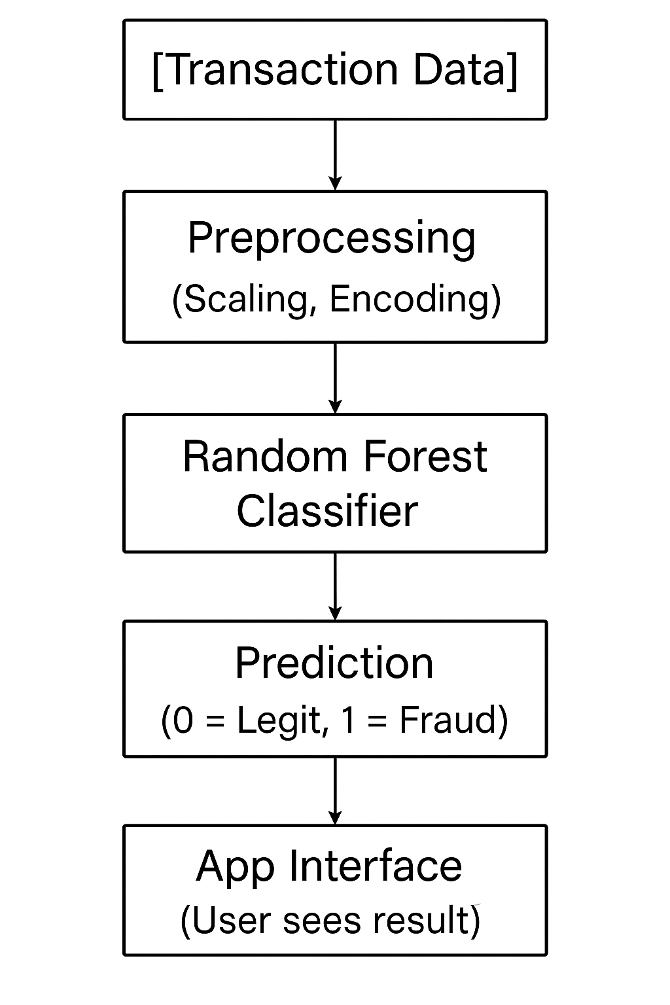
Project Workflow

Slide 9
Proposed Methods
Data Collection and Exploration
Data Preprocessing and Feature Selection
Train-Test Split
Machine Learning Model Implementation
Model Evaluation and Comparison
Integration with Flask Web Application
User Input and Real-Time Prediction

Slide 10
Dataset Overview
Data Collected from Kaggle datasets
Data includes columns: type, amount, balances,name, etc.
Target label: isFraud (0 = legit, 1 = fraud)
Handled class imbalance using SMOTE
(SMOTE generates synthetic samples for the minority class (fraud) This balances the class distribution)

Slide 11
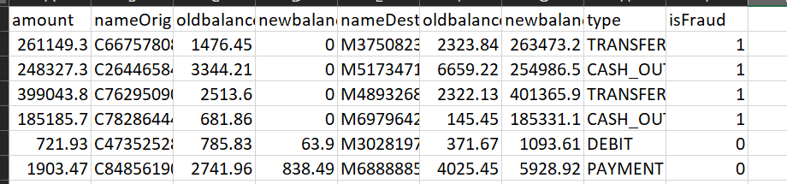
Understanding Transaction Types
TRANSFER: Money sent to another user.
CASH_OUT: Withdrawal from account.
DEBIT: Internal deduction (charges).
PAYMENT: To merchants.
Filtered for relevant transaction types so Focus on TRANSFER & CASH_OUT (high fraud risk).

Slide 12
Feature Engineering
Selected: amount, balances, type(key features that impact fraud prediction, removing irrelevant ones.)
Handled missing or inconsistent values.
Encoded 'type' using label encoding
Normalized values with MinMaxScaler

Slide 13
Training & Testing
80-20 train-test split
Model trained with balanced class weights
Applied multiple machine learning algorithms on the dataset.
Evaluation on unseen test data
Evaluation Metrics: Accuracy, Precision, Recall, and F1-score were used.

Slide 14
Model Selection
Implemented both Random Forest and Logistic Regression models.
Random Forest Classifier selected for deployment due to higher accuracy and better handling of fraud detection.
 | Random Forest | Logistic Regression
Accuracy | Very High | Good
Fraud Recall | High (~85%) | Low (~60%)
Handles Imbalance | Excellent | Needs balancing tricks
Training Time | Slower | Faster
Interpretability | Low | High

Slide 15
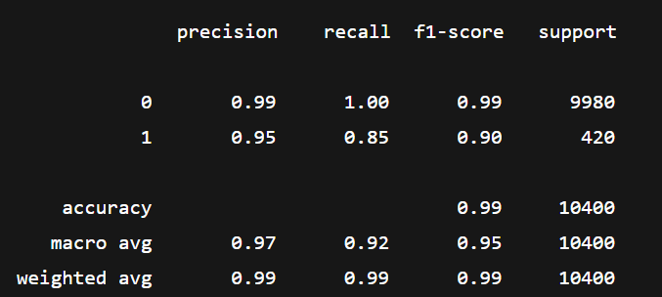
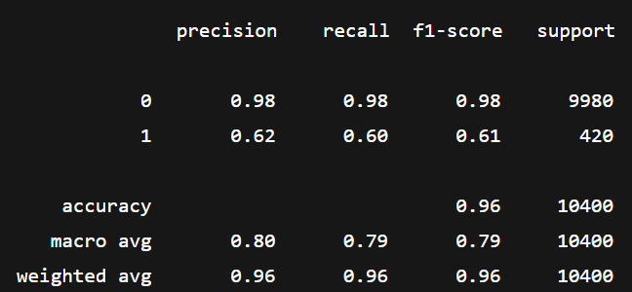
Model Evaluation
Random
Forest
classifier
Logistic regression

Slide 16
Web Interface
Built using Flask framework
Simple form to enter transaction details
Provides real-time fraud prediction
Shows result as Fraud or Genuine
Loads model using pickle
Clean and user-friendly design

Slide 17
Challenges Faced
Severe class imbalance
Many zero-value features
Variability in transaction types
Simplifying user input

Slide 18
Solutions Implemented
Used class_weight='balanced' in RandomForest
Focused on meaningful transaction types
Preprocessed data using normalization and encoding

Slide 19
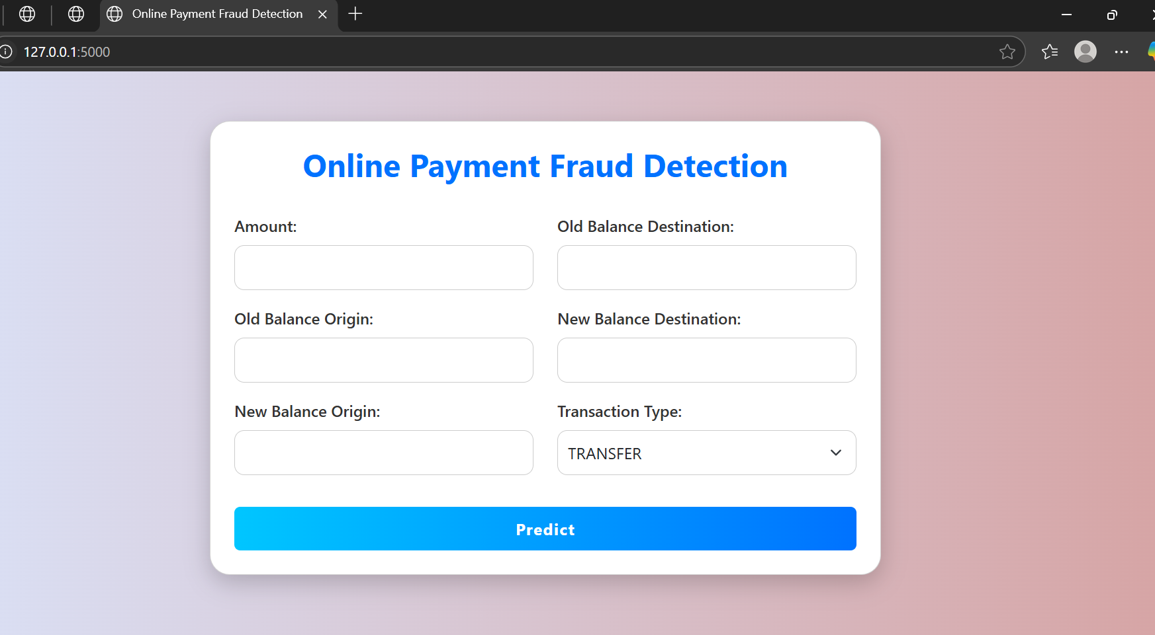
Results
Our Project User Interface After Deploying:

Slide 20
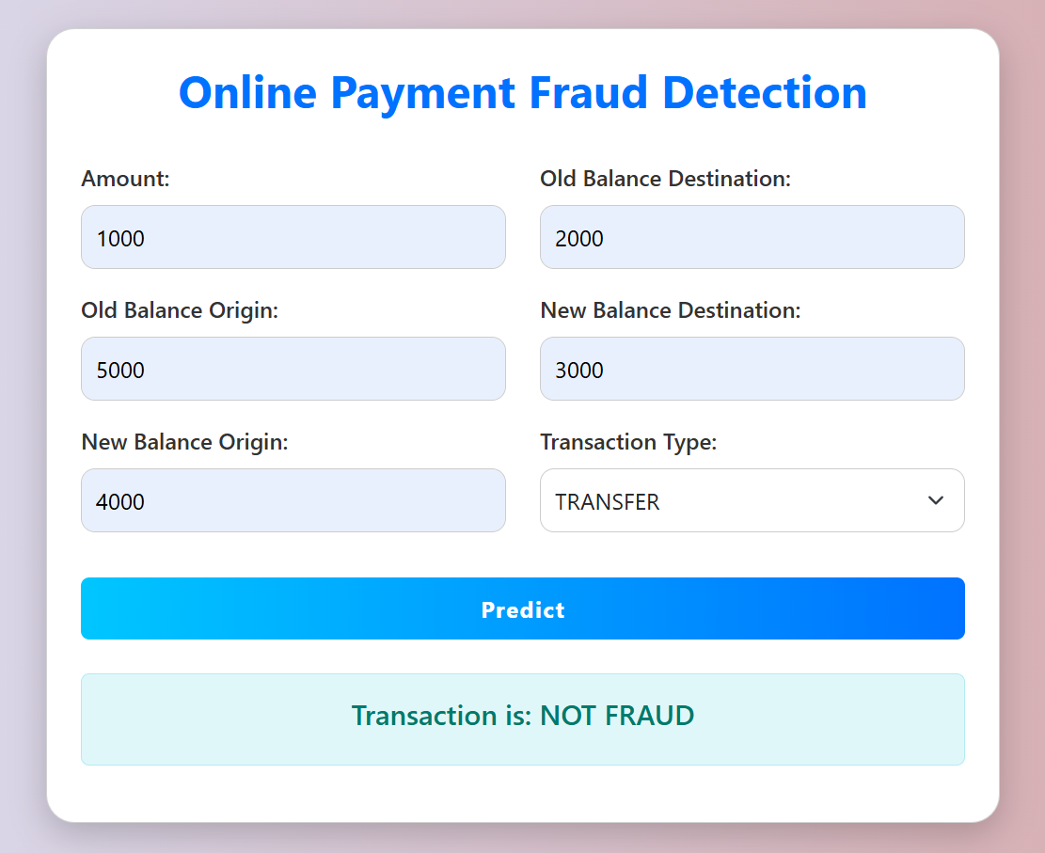

Slide 21
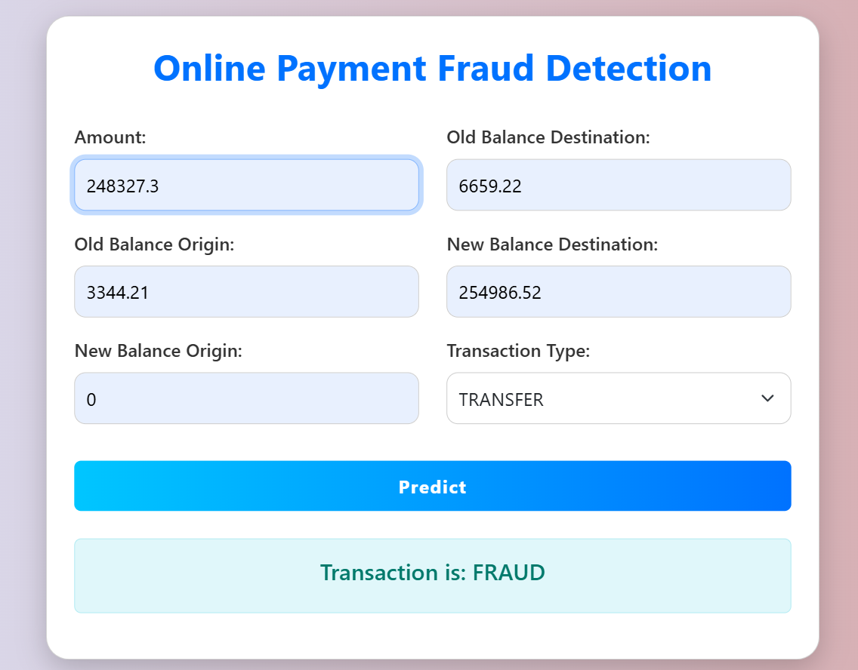

Slide 22
Benefits of Our Model
Early fraud detection
No dependency on sensitive user credentials
Enhanced user trust
Can be integrated with e-commerce, banking, wallets

Slide 23
Application Areas
Online Banking Systems
Digital Wallet Providers
E-commerce Payment Platforms
Mobile Banking Apps

Slide 24
Conclusion
Built a robust fraud detection system
Integrated ML model into a web application
Improved digital payment security
Thank you for your attention!

