Slide 1
Fake Social Media Accounts and Their Detection
PIP2001 Capstone Project
Review-2
Batch Number: CCS-G09
Roll Number | Student Name
20211CCS0017 | M Sonali
20211CCS0026 | Bhavana MM
20211CCS0034 | Jakku Nishithaa
20211CCS0153 | Hiranmayi R
20211CCS0009 | Satharla Mohammed Maaz
Under the Supervision of,
Dr.Sharmasth Vali Y
Professor / Associate Professor / Assistant Professor
School of Computer Science and Engineering
Presidency University
Name of the Program: Computer Science and Engineering Spl. Cyber Security
Name of the HoD: Dr. S P Anandaraj
Name of the Program Project Coordinator: Dr. Sharmast Vali Y
Name of the School Project Coordinators: Dr. Sampath A K / Dr. Abdul Khadar A / Mr. Md Ziaur Rahman

Slide 2
Contents
Problem Statement
Introduction
Literature review
Research gap in existing model
Proposed method
Requirements
Architecture
Objectives
Outcomes
Timeline of project
Conclusion
Mapping with SDG

Slide 3
Problem Statement
Detecting fake social media accounts is crucial due to the rise of bots and fraudulent profiles, which erode trust and security. Innovative algorithms and machine learning models are being created to analyze user behavior, profile data, and posting habits. These tools quickly identify and deactivate fake accounts, ensuring online interactions are authentic and reliable. This protects users from misinformation, manipulation, and cyber threats.

Slide 4
Introduction
The rapid growth of social media has been accompanied by a surge in fake accounts, which are often used for spreading misinformation, conducting fraudulent activities, and manipulating public opinion. Detecting these accounts accurately has become a significant challenge, as traditional rule-based systems and basic machine learning models frequently fail to keep pace with the sophisticated tactics employed by malicious actors.
To tackle this issue, we are using SVM, XG Boost, Naive Bayes model. In this model, SVM is utilized for feature selection, effectively identifying and extracting the most relevant features from a wide range of user data, such as text patterns, behavioural characteristics, and network metrics. By reducing data dimensionality and filtering out noise, the SVM ensures that only significant features are passed on for further analysis.

Slide 5
Subsequently, the XG Boost takes these refined features and performs classification to distinguish between fake and real accounts and it is known for its high accuracy in classification tasks. We can achieve accuracy rates of up to 91% in identifying fake profiles, significantly outperforming other algorithms. The other approach is Naive Bayes, speed in both training and prediction makes it ideal for real-time classification tasks, which is crucial for detecting fake profiles as they are created. As a result, it holds significant potential for bolstering the security and trustworthiness of social media platforms.

Slide 6
Literature Review
Author Name | Research paper name | Published date and platform | Challenges | Solutions
Naman Singh; Tushar Sharma; Abha Thakral; Tanupriya Choudhury | Detection of Fake Profile in Online Social Networks Using Machine Learning. | 23 August 2018, Institute of Electrical and Electronics Engineers | 1. Difficulty in identifying fake profiles due to their evolving nature. | Using bot detection systems with real-time AI analysis and automatic bot prevention technology.
K. Harish, R.Naveen Kumar, Dr. J. Briso Becky Bell | Fake Profile Detection Using Machine Learning | 29 April 2023, International Journal of Scientific Research in Science, Engineering and Technology | Addressing challenges associated with false profiling, mass following, commercial misuse | Training, testing, and analyzing models to determine profile authenticity, and continuous monitoring to ensure the model's continued effectiveness.
Nitika Kadam, Sanjeev Kumar Sharma | Social Media Fake Profile Detection Using Data Mining Technique. | 5 October 2022, Journal of Advances in Information Technology. | The search results note the difficulty in identifying and reporting bogus accounts, indicating that manual methods are inefficient | Identifying key features indicative of fake profiles, such as profile completeness, activity patterns, and linguistic characteristics.
Kotra Shreya; Amith Kothapelly; Deepika V; Hariharan Shanmugasundaram | Identification of Fake accounts in social media using machine learning | 15 March 2023, Institute of Electrical and Electronics Engineers. | Ensuring that the chosen machine learning models perform well across various metrics such as accuracy, precision, recall, and F1 score can be difficult. | Once the best-performing model is identified, it will be deployed in a production environment to facilitate real-time identification of fake accounts.
Pegah Azami, Kalpdrum Passi | Detecting Fake Accounts on Instagram Using Machine Learning and Hybrid Optimization Algorithms. | 24 September 2024, Multidisciplinary Digital Publishing Institute. | Spam accounts have become a major problem on social media platforms | Building and training deep neural network models to detect fake or spam Instagram accounts.
Gaurav Vijay Barde and Dr. Nilesh R. Wankhade | Social Media Fake Account Identification Using Machine Learning | December 2023, International Journal of Advanced Research in Science, Communication and Technology. | Social media platforms are flooded with false information and advertisements spread by fake accounts | Using machine learning algorithms like Random Forest and Support Vector Machines (SVM) for classifying data to detect profile cloning.

Slide 7
Research gap in existing models
Evasion Techniques by Bots (Adversarial Gaps): The evolution of bots, mimicking human behavior and employing adversarial attacks, poses significant challenges to detection. Addressing these requires robust models capable of countering these tactics and adapting to evolving threats, ensuring the integrity of online platforms.
Detection of Deepfakes and Synthetic Identities: The emergence of deepfake technology for profile media introduces a critical challenge as current detection models struggle to distinguish it from genuine content. Addressing this requires efficient and accurate deepfake detection algorithms, potentially leveraging Generative Adversarial Networks (GANs) and Convolutional Neural Networks (CNNs), alongside the creation of substantial, labeled datasets despite the high computational demands.
Privacy-Preserving Detection Methods: Current bot detection methods often necessitate access to sensitive user data, raising privacy concerns under regulations like GDPR. Balancing detection accuracy with user privacy presents a significant challenge. Research is needed to develop privacy-preserving machine learning (PPML) techniques, such as federated learning and differential privacy, to enable effective detection while safeguarding user information.

Slide 8
Proposed Method
The proposed project aims to develop an advanced application for detecting fake social media profiles, addressing the limitations of traditional methods.
It leverages cutting-edge technologies like machine learning and behavioral analytics to analyze diverse features such as linguistic patterns, network connections, and activity data.
The primary objective is to create a swift and highly accurate method for distinguishing genuine from fake accounts using powerful algorithms within a Python-based environment.
The system utilizes Python's libraries to rapidly process and analyze features like profile information, user behavior, and content characteristics, employing algorithms like Random Forest, XGBoost, and Decision Trees.
The integration of advanced algorithms enables the detection of subtle patterns and anomalies often missed by conventional methods, ensuring higher accuracy.

Slide 9
The system is designed to be dynamic and forward-looking, continuously learning from new data to improve its detection capabilities as fraudulent behaviors evolve.
Ultimately, the application aims to significantly enhance the effectiveness of fake profile detection, contributing to a safer, more trustworthy, and secure online social media environment, fostering user trust and reducing misinformation.

Slide 10
Requirments
Software Requirments:
i. Operating System – Windows 7/8/10
ii. Server side script – HTML, CSS & JS
iii. IDE – Visual Studio
iv. Technology – Python 3.6+
Hardware Requirments:
i. Processor – I3/ Intel Processor
ii. RAM - 4GB
iii. Hard disk – 160GB

Slide 11
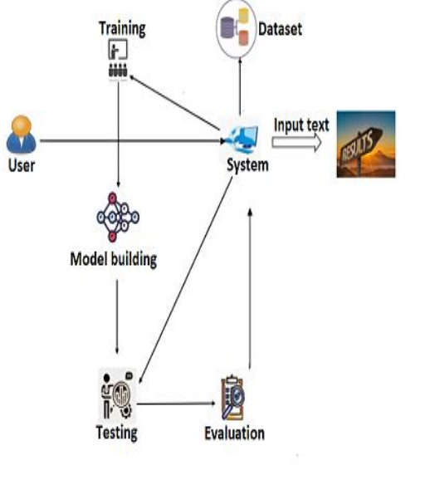
Architecture
User: An individual who interacts with the system.
System: The core application or process being described.
Dataset: A collection of data used for training and testing the model.
Input text: Textual data provided to the system for processing.
Training: The process of teaching the model using the dataset.
Model building: The creation or development of the machine learning model.
Testing: Evaluating the model's performance on unseen data.
Evaluation: Assessing the model's results and effectiveness.
Results: The output or outcome produced by the system.

Slide 12
Objectives
Identify and Classify Fake Accounts – Develop a machine learning model to differentiate between genuine and fake social media accounts based on behavioral patterns, account attributes, and content analysis.
Enhance Detection Accuracy – Improve the accuracy of fake account detection by leveraging supervised and unsupervised learning techniques, incorporating feature engineering, and optimizing model performance.
Develop a Scalable Detection System – Create an automated and scalable system that can analyze large datasets in real-time, helping social media platforms detect and mitigate fake accounts efficiently.

Slide 13
Expected Outcomes
Improved Fake Account Detection – A well-trained machine learning model capable of accurately identifying fake social media accounts based on various features such as profile information, activity patterns, and engagement behavior.
Enhanced Cybersecurity and Trust – Strengthened security measures for social media platforms, reducing misinformation, scams, and fraudulent activities, thereby improving user trust and platform integrity.
Automated and Scalable Solution – A deployable detection system that can analyze large datasets in real time, making it easier for social media companies to proactively detect and remove fake accounts.
Insights into Fake Account Behaviors – A comprehensive analysis of the characteristics and strategies used by fake accounts, helping researchers and developers refine detection techniques further.

Slide 14
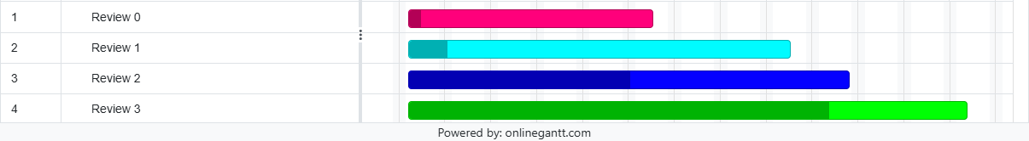
Time Line of project
Review 0 starts around February 3rd and concludes by february 8th.
Review 1 begins later in February, around the 17th, and extends till february 22nd.
Review 2 commences in march, around the 17th, and continues 22nd march, showing progress in two distinct phases.
Review 3 starting in late april 21st and stretching well April 27th, with a noticeable shift in intensity.

Slide 15
Conclusion
This project proposes and implemented an XGBoost-based machine learning model for detecting fake Instagram profiles, achieving a notable accuracy of 91%. The integration of SVM, Naive Bayes, and effective feature selection/reduction techniques significantly enhanced detection accuracy and efficiency. Compared to complex, less accurate traditional methods reliant on expert intervention, the proposed Python-based system offers a simplified, efficient, and scalable solution leveraging libraries like Pandas, NumPy, and Sklearn. The reduced feature set minimizes computational costs, crucial for large platforms.
While demonstrating a significant advancement, the study acknowledges limitations such as potential feature selection bias and the reliance on training data quality. Future research should focus on enhancing feature sets, exploring deep learning methodologies, and expanding the model's applicability across various social media platforms. Continuous model updates and the incorporation of ensemble methods are recommended to further bolster the system's robustness and adaptability against evolving fake account tactics, ultimately contributing to a more secure and authentic online environment.

Slide 16
References
[1] Pagan Azania; Kalpdrum Passi, Detecting Fake Accounts on Instagram Using Machine Learning and Hybrid Optimization, 24 September 2024, Multidisciplinary Digital Publishing Institute.
[2] Kotra Shreya; Amith Kothapelly; Deepika V; Hariharan Shanmugasundaram, Identification of Fake accounts in social media using machine learning, 15 March 2023, Institute of Electrical and Electronics Engineers.
[3] K. Harish; R.Naveen Kumar; Dr. J. Briso Becky Bell, Fake Profile Detection Using Machine Learning, 29 April 2023, International Journal of Scientific Research in Science, Engineering and Technology.
4] Nitika Kadam; Sanjeev Kumar Sharma, Social Media Fake Profile Detection Using Data Mining Technique, 5 October 2022, Journal of Advances in Information Technology.
[5]T. Om Prathyusha; N. Sai Kumar; E. Vishnu Priya; T. Vijaykanth Reddy, Fake account detection using machine learning, 6 June 2021, International journal of creative research thoughts.
[6] Naman Singh; Tushar Sharma; Abha Thakral; Tanupriya Choudhury, Detection of Fake Profile in Online Social Networks Using Machine Learning, 23 August 2018, Institute of Electrical and Electronics Engineers.
[7] Gaurav Vijay Barde; Dr. Nilesh R. Wankhade, Social Media Fake Account Identification Using Machine Learning, December 2023, International Journal of Advanced Research in Science, Communication and Technology

Slide 17

Project work mapping with SDG
SDG 9-Industry, Innovation and Infrastructure: The project involves tech innovation for detection and relates to securing the digital space, contributing to a trustworthy infrastructure.
SDG 16-Peace, Justice and Strong Institutions: Fake social media accounts spread misinformation and undermine institutions. Detection promotes a just online environment.
SDG 17-Partnerships for the Goals: Collaboration is key.

Slide 18
Thank You

