Slide 1
Fake Social Media Accounts and Their Detection
PIP2001 Capstone Project
Review-3
Batch Number: CCS-G09
Roll Number | Student Name
20211CCS0017 | M Sonali
20211CCS0026 | Bhavana MM
20211CCS0034 | Jakku Nishithaa
20211CCS0153 | Hiranmayi R
20211CCS0009 | Satharla Mohammed Maaz
Under the Supervision of,
Dr.Sharmasth Vali Y
Professor / Associate Professor / Assistant Professor
School of Computer Science and Engineering
Presidency University
Name of the Program: Computer Science and Engineering Spl. Cyber Security
Name of the HoD: Dr. S P Anandaraj
Name of the Program Project Coordinator: Dr. Sharmast Vali Y
Name of the School Project Coordinators: Dr. Sampath A K / Dr. Abdul Khadar A / Mr. Md Ziaur Rahman

Slide 2
Contents
Problem Statement
Introduction
Literature review
Research gap in existing model
Proposed method
Architecture
Objectives
Outcomes
Timeline of project
Results
Conclusion
Github-link
Mapping with SDG

Slide 3
Problem Statement
Fake social media accounts are a big problem because they spread lies, trick people, and pose risks, so experts are creating smart tools that analyze user behavior, profile details, and posting habits (like strange names, fake photos, or spammy posts) to quickly detect and shut down these fake accounts, making online interactions safer and more trustworthy by preventing scams, false information, and cyber threats.

Slide 4
Introduction
The project aims to predict the authenticity of social media accounts using machine learning.
Online Social Networks (OSNs) have grown in popularity and are used for various activities, attracting malicious actors.
Researchers are developing techniques to detect fake accounts, but current methods have limitations.
The system utilizes machine learning algorithms like AdaBoost, CatBoost, and Extra Tree Classifier for better accuracy.

Slide 5
Python and libraries like Pandas, NumPy, and Sklearn are used for implementation.
The goal is to provide a fast and reliable method to accurately detect fake accounts, enhancing online security and user trust.

Slide 6
Literature Review
Author Name | Research paper name | Published date and platform | Challenges | Solutions
Naman Singh; Tushar Sharma; Abha Thakral; Tanupriya Choudhury | Detection of Fake Profile in Online Social Networks Using Machine Learning. | 23 August 2018, Institute of Electrical and Electronics Engineers | 1. Difficulty in identifying fake profiles due to their evolving nature. | Using bot detection systems with real-time AI analysis and automatic bot prevention technology.
K. Harish, R.Naveen Kumar, Dr. J. Briso Becky Bell | Fake Profile Detection Using Machine Learning | 29 April 2023, International Journal of Scientific Research in Science, Engineering and Technology | Addressing challenges associated with false profiling, mass following, commercial misuse | Training, testing, and analyzing models to determine profile authenticity, and continuous monitoring to ensure the model's continued effectiveness.
Nitika Kadam, Sanjeev Kumar Sharma | Social Media Fake Profile Detection Using Data Mining Technique. | 5 October 2022, Journal of Advances in Information Technology. | The search results note the difficulty in identifying and reporting bogus accounts, indicating that manual methods are inefficient | Identifying key features indicative of fake profiles, such as profile completeness, activity patterns, and linguistic characteristics.
Kotra Shreya; Amith Kothapelly; Deepika V; Hariharan Shanmugasundaram | Identification of Fake accounts in social media using machine learning | 15 March 2023, Institute of Electrical and Electronics Engineers. | Ensuring that the chosen machine learning models perform well across various metrics such as accuracy, precision, recall, and F1 score can be difficult. | Once the best-performing model is identified, it will be deployed in a production environment to facilitate real-time identification of fake accounts.
Pegah Azami, Kalpdrum Passi | Detecting Fake Accounts on Instagram Using Machine Learning and Hybrid Optimization Algorithms. | 24 September 2024, Multidisciplinary Digital Publishing Institute. | Spam accounts have become a major problem on social media platforms | Building and training deep neural network models to detect fake or spam Instagram accounts.
Gaurav Vijay Barde and Dr. Nilesh R. Wankhade | Social Media Fake Account Identification Using Machine Learning | December 2023, International Journal of Advanced Research in Science, Communication and Technology. | Social media platforms are flooded with false information and advertisements spread by fake accounts | Using machine learning algorithms like Random Forest and Support Vector Machines (SVM) for classifying data to detect profile cloning.

Slide 7
Research gap in existing models
Evasion Techniques by Bots (Adversarial Gaps): The evolution of bots, mimicking human behavior and employing adversarial attacks, poses significant challenges to detection. Addressing these requires robust models capable of countering these tactics and adapting to evolving threats, ensuring the integrity of online platforms.
Detection of Deepfakes and Synthetic Identities: The emergence of deepfake technology for profile media introduces a critical challenge as current detection models struggle to distinguish it from genuine content. Addressing this requires efficient and accurate deepfake detection algorithms, potentially leveraging Generative Adversarial Networks (GANs) and Convolutional Neural Networks (CNNs), alongside the creation of substantial, labeled datasets despite the high computational demands.
Privacy-Preserving Detection Methods: Current bot detection methods often necessitate access to sensitive user data, raising privacy concerns under regulations like GDPR. Balancing detection accuracy with user privacy presents a significant challenge. Research is needed to develop privacy-preserving machine learning (PPML) techniques, such as federated learning and differential privacy, to enable effective detection while safeguarding user information.

Slide 8
Proposed Method
The proposed project aims to develop an advanced application for detecting fake social media profiles, addressing the limitations of traditional methods.
It leverages cutting-edge technologies like machine learning and behavioral analytics to analyze diverse features such as linguistic patterns, network connections, and activity data.
The primary objective is to create a swift and highly accurate method for distinguishing genuine from fake accounts using powerful algorithms within a Python-based environment.
The system utilizes Python's libraries to rapidly process and analyze features like profile information, user behavior, and content characteristics, employing algorithms like Random Forest, XGBoost, and Decision Trees.

Slide 9
The integration of advanced algorithms enables the detection of subtle patterns and anomalies often missed by conventional methods, ensuring higher accuracy.
The system is designed to be dynamic and forward-looking, continuously learning from new data to improve its detection capabilities as fraudulent behaviors evolve.
Ultimately, the application aims to significantly enhance the effectiveness of fake profile detection, contributing to a safer, more trustworthy, and secure online social media environment, fostering user trust and reducing misinformation.

Slide 10
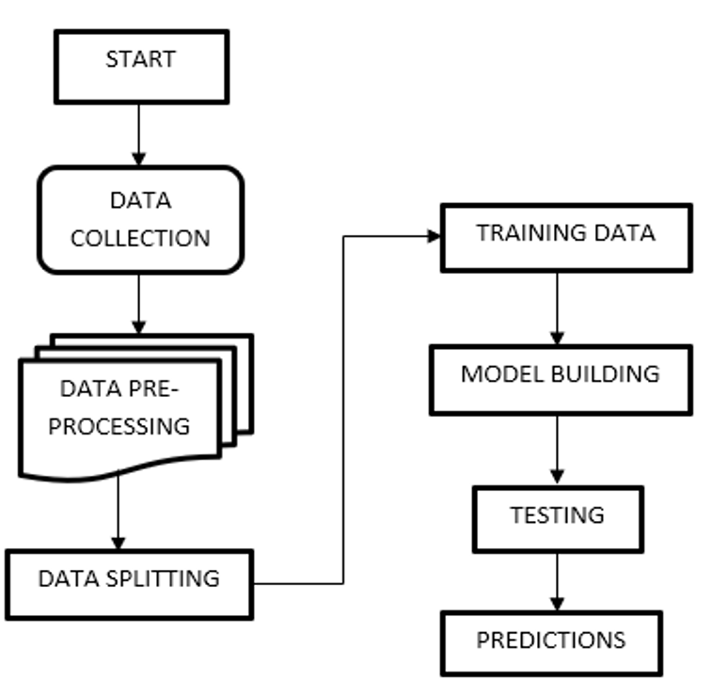
Architecture
START: The initiation point of the fake account detection process.
DATA COLLECTION: Gathering the necessary information about social media accounts.
DATA PRE-PROCESSING: Cleaning and preparing the collected data for analysis.
DATA SPLITTING: Dividing the pre-processed data into training and testing sets.
TRAINING DATA: The portion of the data used to teach the machine learning model.
MODEL BUILDING: Selecting and developing the machine learning model for detection.
TESTING: Evaluating the trained model's performance on unseen data.
PREDICTIONS: The model's output, indicating whether an account is fake or not.

Slide 11
Objectives
Identify and Classify Fake Accounts – Develop a machine learning model to differentiate between genuine and fake social media accounts based on behavioral patterns, account attributes, and content analysis.
Enhance Detection Accuracy – Improve the accuracy of fake account detection by leveraging supervised and unsupervised learning techniques, incorporating feature engineering, and optimizing model performance.
Develop a Scalable Detection System – Create an automated and scalable system that can analyze large datasets in real-time, helping social media platforms detect and mitigate fake accounts efficiently.

Slide 12
Expected Outcomes
Improved Fake Account Detection – A well-trained machine learning model capable of accurately identifying fake social media accounts based on various features such as profile information, activity patterns, and engagement behavior.
Enhanced Cybersecurity and Trust – Strengthened security measures for social media platforms, reducing misinformation, scams, and fraudulent activities, thereby improving user trust and platform integrity.
Automated and Scalable Solution – A deployable detection system that can analyze large datasets in real time, making it easier for social media companies to proactively detect and remove fake accounts.
Insights into Fake Account Behaviors – A comprehensive analysis of the characteristics and strategies used by fake accounts, helping researchers and developers refine detection techniques further.

Slide 13
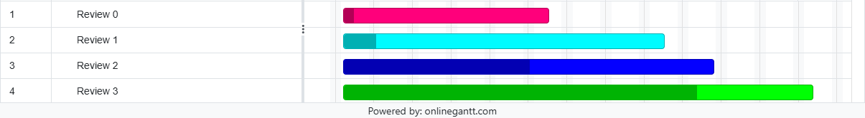
Time Line of project
Review 0 starts around February 3rd and concludes by february 8th.
Review 1 begins later in February, around the 17th, and extends till february 26nd.
Review 2 commences in march, around the 21th, and continues 22nd march, showing progress in two distinct phases.
Review 3 starting in late april 21st and stretching well April 27th, with a noticeable shift in intensity.

Slide 14

Results

Slide 15
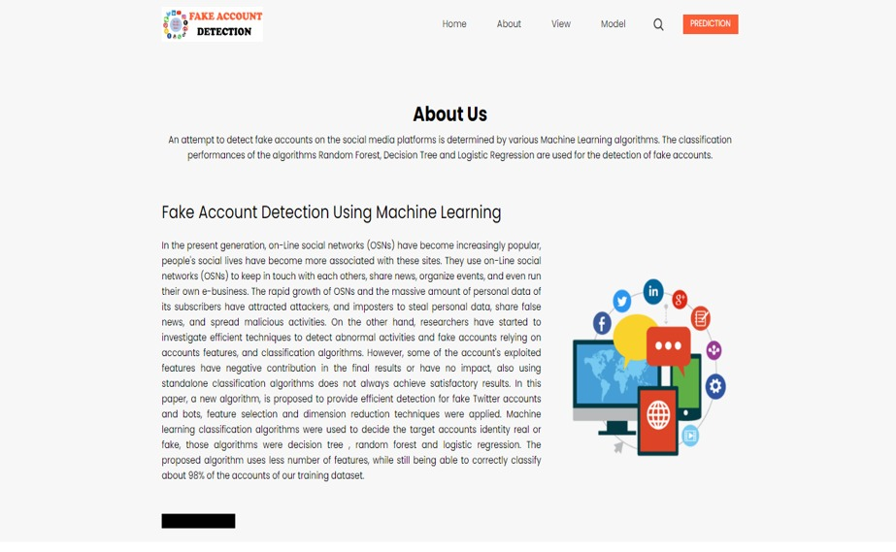

Slide 16
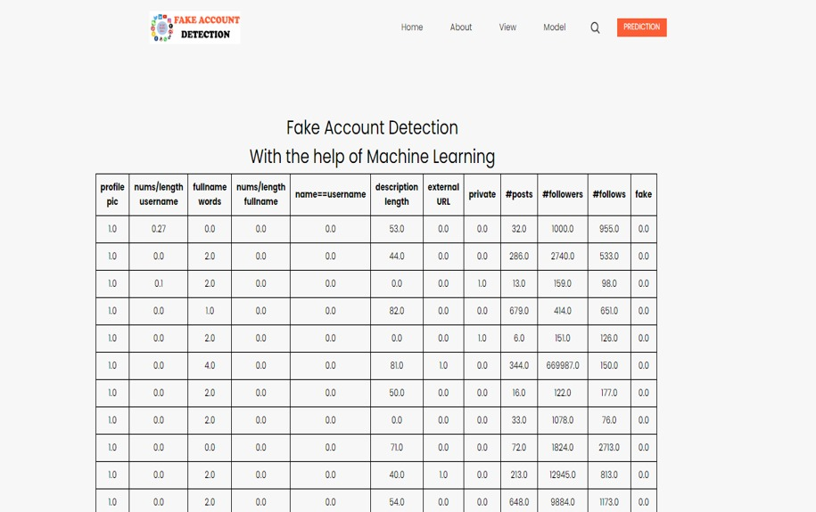

Slide 17
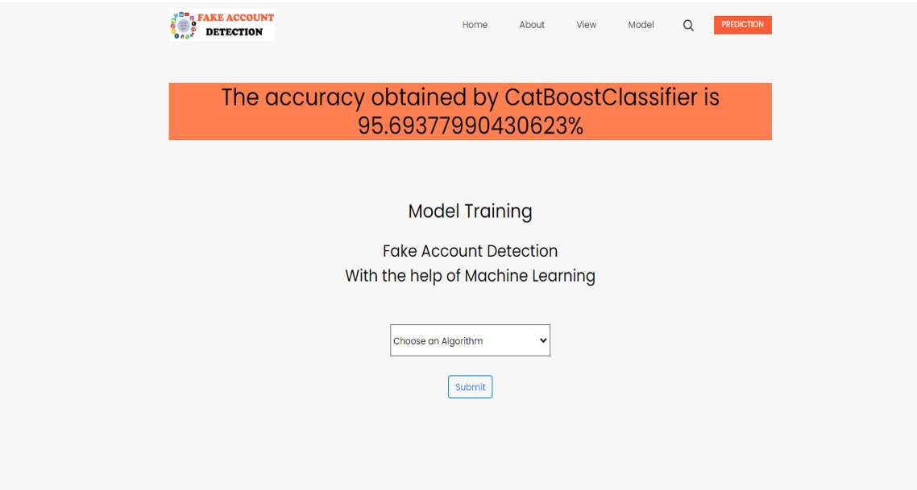

Slide 18
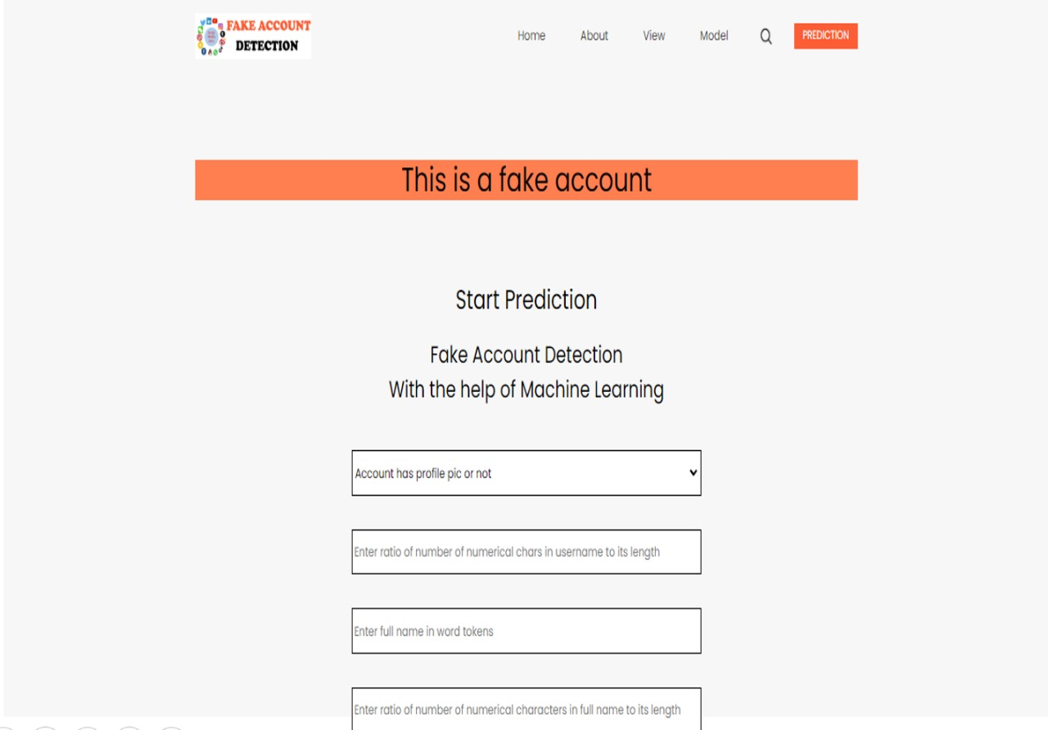

Slide 19
Conclusion
In conclusion, The primary objective of this project is to predict the authenticity of social media accounts through data analysis and machine learning models. This holds true in an area clearly recognized through the research that fake accounts have become increasingly prevalent in Online Social Networks (OSNs), causing various problems that include but are not limited to the dissemination of misinformation and lack of trust in user metrics. Because of all these, this project will apply AdaBoost, Catboost, and the Extra Tree Classifier using a Python environment to come up with a faster and most reliable method of authenticating fake accounts efficiently.

Slide 20
References
[1] Pagan Azania; Kalpdrum Passi, Detecting Fake Accounts on Instagram Using Machine Learning and Hybrid Optimization, 24 September 2024, Multidisciplinary Digital Publishing Institute.
[2] Kotra Shreya; Amith Kothapelly; Deepika V; Hariharan Shanmugasundaram, Identification of Fake accounts in social media using machine learning, 15 March 2023, Institute of Electrical and Electronics Engineers.
[3] K. Harish; R.Naveen Kumar; Dr. J. Briso Becky Bell, Fake Profile Detection Using Machine Learning, 29 April 2023, International Journal of Scientific Research in Science, Engineering and Technology.
4] Nitika Kadam; Sanjeev Kumar Sharma, Social Media Fake Profile Detection Using Data Mining Technique, 5 October 2022, Journal of Advances in Information Technology.
[5]T. Om Prathyusha; N. Sai Kumar; E. Vishnu Priya; T. Vijaykanth Reddy, Fake account detection using machine learning, 6 June 2021, International journal of creative research thoughts.
[6] Naman Singh; Tushar Sharma; Abha Thakral; Tanupriya Choudhury, Detection of Fake Profile in Online Social Networks Using Machine Learning, 23 August 2018, Institute of Electrical and Electronics Engineers.
[7] Gaurav Vijay Barde; Dr. Nilesh R. Wankhade, Social Media Fake Account Identification Using Machine Learning, December 2023, International Journal of Advanced Research in Science, Communication and Technology

Slide 21
Github-link
https://github.com/Nishithaa-2411/Fake-Account-Detection-On-Instagram-Using-Machine-Learning

Slide 22

Project work mapping with SDG
SDG 9-Industry, Innovation and Infrastructure: The project involves tech innovation for detection and relates to securing the digital space, contributing to a trustworthy infrastructure.
SDG 16-Peace, Justice and Strong Institutions: Fake social media accounts spread misinformation and undermine institutions. Detection promotes a just online environment.
SDG 17-Partnerships for the Goals: Collaboration is key.

Slide 23
Thank You

