Slide 1
GROUP - 11
Project Title :
Dynamic Control of RLC Buffer Size for Latency Minimization in Mobile RAN
Team Details :
P V Asish - CS18BTECH11037
Sai Nishith J - CS18BTECH11018
G Vishal Siva Kumar - CS18BTECH11013
Mentor : Ujjwal Pawar

Slide 2
Problem Statement:
Minimization of exogenous delay for an interactive flow that shares a mobile wireless link (radio bearer) with at least one greedy TCP flow.
Exogenous delay is the delay that occurs when packets of the application flow find the link buffer loaded with packets of other applications.
Exogenous delay is particularly harmful to low-bandwidth
interactive applications, as it inflates their latencies despite the
negligible load that they impose on the network.

Slide 3
Scope of Work:
Comparison of latency due to exogenous delay after adding buffers to maintain per flow queues in the PDCP layer and Dynamic Sizing of the RLC-AM Buffer.
Understanding NS-3 module codes related to RLC and PDCP layers.
Understand and make changes to lte-pdcp and lte-rlc files.

Slide 4
Deliverables:
Changes in code of PDCP layer and RLC layer of Data Link Layer.
Comparison of latency to original stack.
Simulation of problem statement in ns3

Slide 5
Problem Replication in ns3
Tried to replicate the problem in ns3.
Would be helpful for end comparison as well.
Created a user with two different traffics.
Delay was increasing as expected.

Slide 6
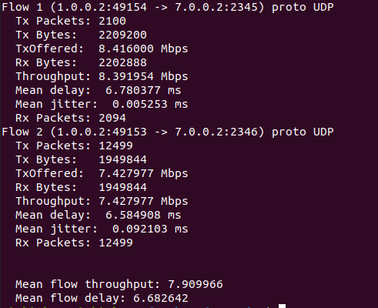
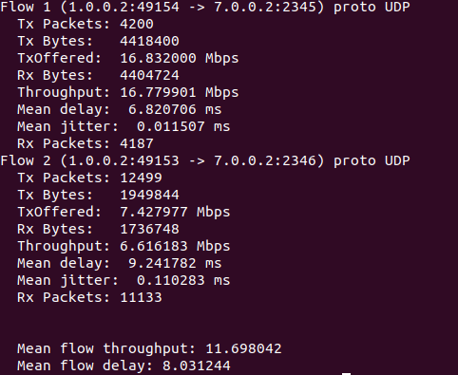
EXOGENOUS DELAY SIMULATION
Flow 1 : eMBB traffic, Flow 2 : URLLC (single user, two kinds of traffic - RLC AM mode)

Slide 7
Work Flow:
Read the documentation lte module of ns3
Studied the lte module codes related to lte-pdcp,lte-rlc.
Had to find out which files need to be edited.

Slide 8
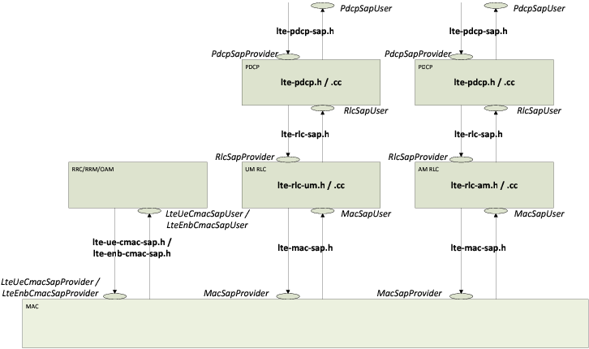
NS3-LTE module:

Slide 9
Implementation Idea:
Had to edit pdcp-lte.cc and pdcp-lte.h.
Added queues at pdcp layer.
Multithreading was required since, original method would be taking packets from upper layer and send to queues. Other thread parallely needs to send packets from queues to RLC layer.

Slide 10
Implementation Problems:
Method which invoked the scheduler thread wasn’t accepting new packets until the scheduler thread joins.
Packets were being sent one by one from one layer to the next and finally being placed in RLC buffer.
Only single packet was received.

Slide 11
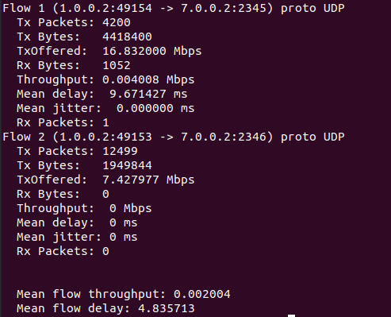
IMPLEMENTATION PROBLEM :

Slide 12
RLC Buffer dynamic sizing:
Second aspect of paper was dynamic sizing of buffer.
Basically size of buffer changes from a threshold minimum to maximum value.
Ns3-lte uses a vector to maintain buffer.

Slide 13
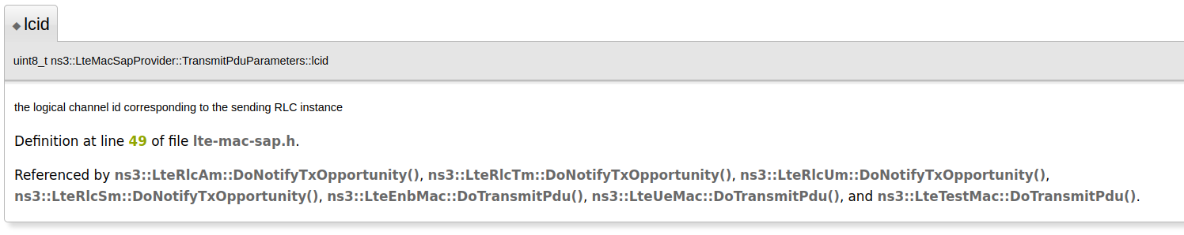
Studied codes on Logical channel id:
Checked all the methods which referenced lcid.

Slide 14
Studied codes on Logical channel id:
None of methods were using lcid in calling some other method or perform any actions
Rnti value was being stored in couple of methods.
Could be because schedulers just focuses on traffic of various users and not scheduling the different traffic types of a single user.

Slide 15
Shuffling packets of RLC buffer:
Tried to measure the changing order of packets in RLC buffer.
No changes in delay of flows were observed.

Slide 16
Conclusion:
Couldn’t get to a final solution which solved our problems.
The sequential nature of ns3 is probably the stopping factor for this implementation.

Slide 17
Learnings:
Got to know about concept exogenous delay and why is it crucial factor in 5g.
Got a good exposure of NS3 and how vast the code base is.
Understood importance of Open source Development
Biggest take away : Implementation could be really hard even though we have clear idea of the problem statement and approach

Slide 18
Work Division:
Sai Nishith : Problem Simulation part and studying ns3-LTE documentation
Asish : Studying Pdcp layer codes and thread implementation at Pdcp
Vishal : Studying RLC layer codes and thread implementation at Pdcp
.

Slide 19
References:
Dynamic Control of RLC Buffer Size for Latency Minimization in Mobile RAN: https://ieeexplore.ieee.org/document/8377190
NS3-LTE:
https://www.nsnam.org/docs/release/3.14/models/html/lte-design.html#fig-lte-rlc-implementation-model

Slide 20
Thank You

