Slide 1

ADTA 5130 DATA ANALYTICS 1
PREDICTING THE PRICE OF THE HOUSES
Nishith Reddy Mannuru: 11467417

Slide 2
INTRODUCTION AND BUSINESS OBJECTIVE
The main aim of this model is to build a predictive model which can predict the price of the houses based on the parameters such as, number of bedrooms, number of bathrooms, number of stories, the square feet of the house, the age of the house and the vacancy of the house.
This can really help the real estate agents to predict the prices of the houses based on their client requirements or even they can give an estimate to their clients on the number of bedrooms, bathrooms, sqft of the house and many more based on their budget to buy a house.

Slide 3
DATA DICTIONARY
Attribute Name | Description
PRICE | The price at which the house is being sold.
SQFT | The total number of square feet of the house.
BEDS | The number of bedrooms in a particular house.
BATH | The number of bathrooms in a particular house.
AGE | Describes how old the house is.
STORIES | Tells us the number of floors or stories the house contains.
VACANT | Tells us if that particular house is vacant or occupied. “0” represents it is vacant. “1” represents it is occupied.
This data set contains a set of 551 records under 7 attributes.
The attributes being as follows:

Slide 4
HYPOTHESIS GENERATION WITH RESPECT TO PROBLEM STATEMENT
NULL HYPOTHESIS (Ho):
The price of the houses cannot be estimated by the parameters such as number of bedrooms, number of bathrooms, the square feet of the house, number of stories in a house and on how old the house is.
ALTERNATE HYPOTHESIS (Ha):
The price of the houses can be estimated by the parameters such as number of bedrooms, number of bathrooms, the square feet of the house, number of stories in a house and on how old the house is.

Slide 5
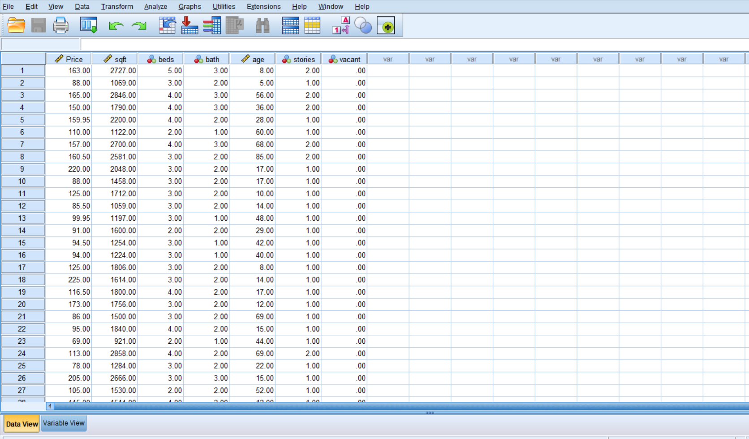
IMPORTING THE DATASET INTO SPSS
DATA VIEW:

Slide 6
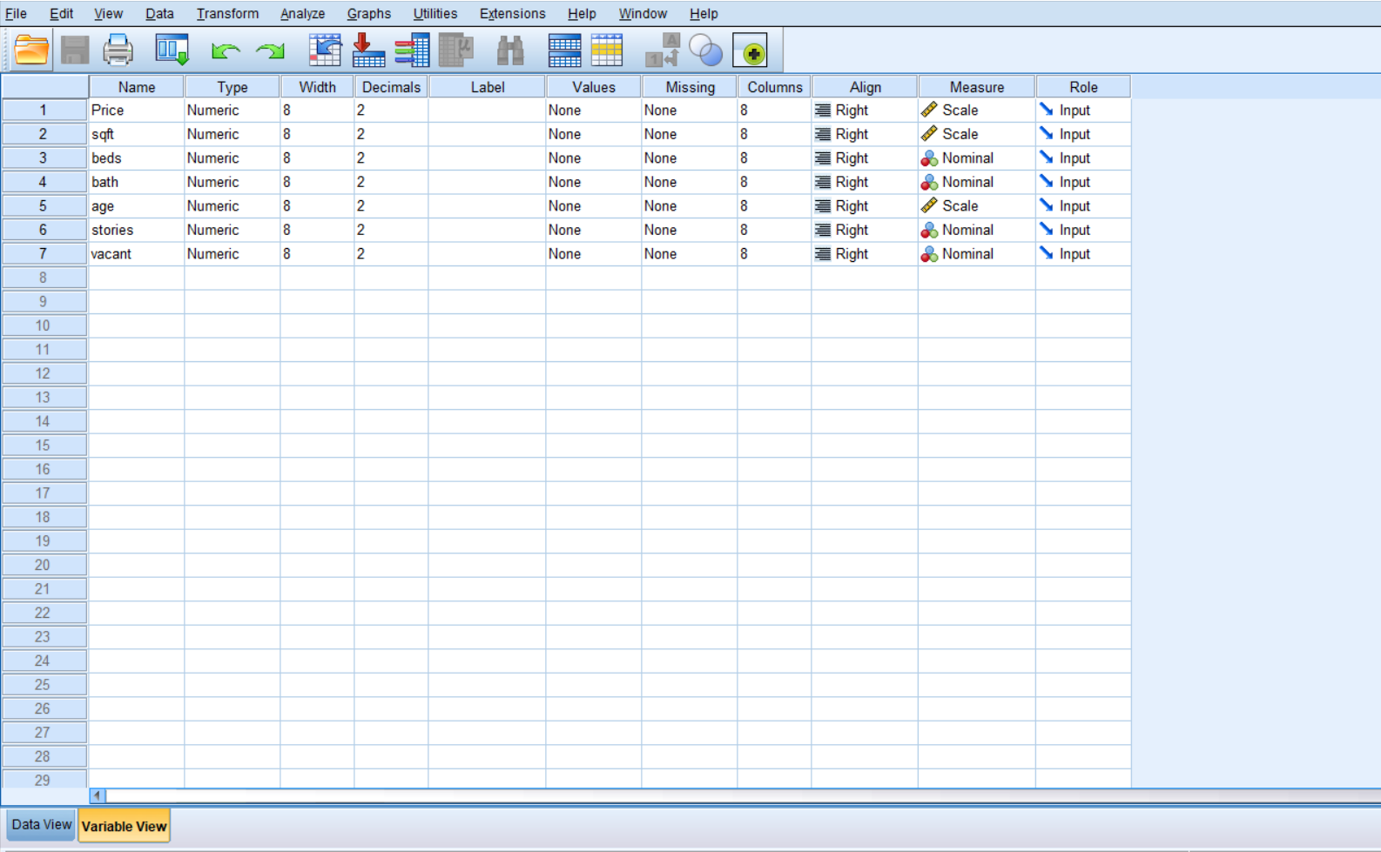
VARIABLE VIEW

Slide 7
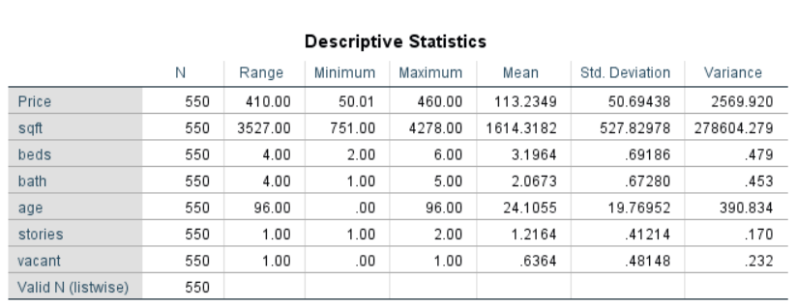
DESCRIPTIVE STATISTICS

Slide 8
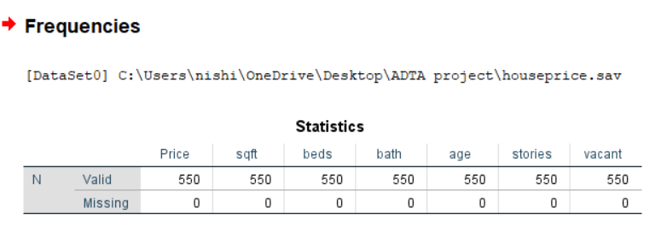
CHECKING THE MISSING VALUES IN THE DATASET
Cleaning is one of the important steps before I run any mode. It is a step of data preparation. The cleaner data I have, the more accurate the model can predict the data. There are many ways to clean the data like making use of mean, median or mode if the missing variable is quantitative. Also, I can predict the missing values sometimes using the existing data points.
All in all, one must understand the domain of the business case and then accordingly perform the missing value imputation.
But luckily, this dataset does not contain any missing values, and is perfect to be used for analysis.

Slide 9
EXPLORATORY DATA ANALYSIS (EDA)
I are conducting exploratory data analysis to figure out in what ways the data sets are similar or different. I used bar graphs to analyze them better.
Attached below are some bar graphs which represents the prices of the property based on number of bedrooms, number of bathrooms, and also number of floors.

Slide 10
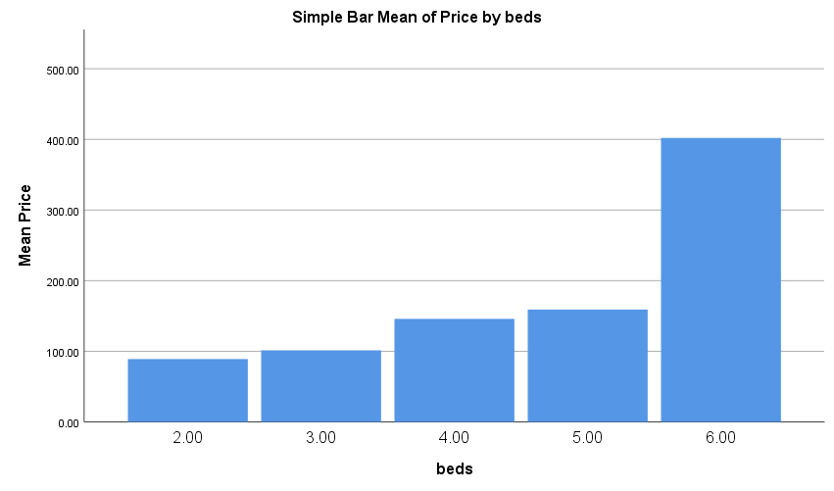
From this bar graph, I could observe, as the number of bedrooms in a house increase, the price of that property also increases

Slide 11
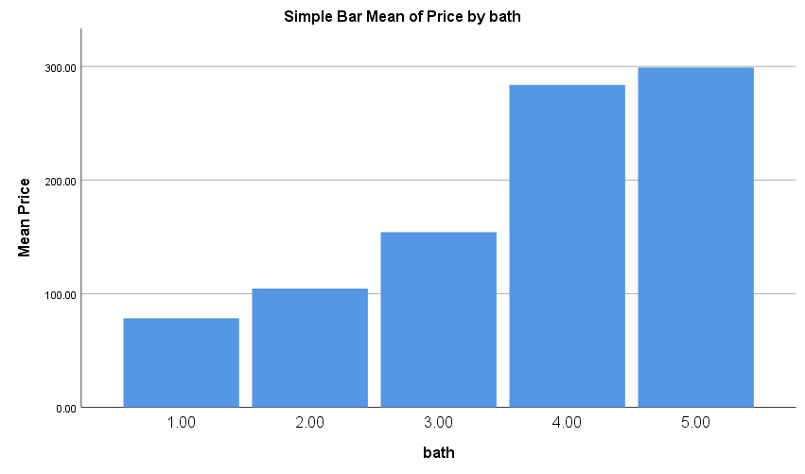
It is the same even in this case, more the number of bathrooms, more is the price of the property.

Slide 12
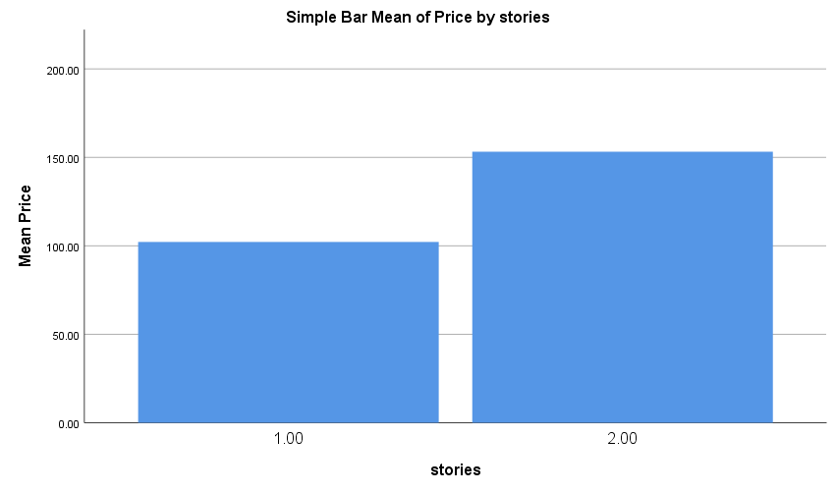
The price of the property also depends on the number of stories it has. As the number of stories increases, so does the price of the property.

Slide 13
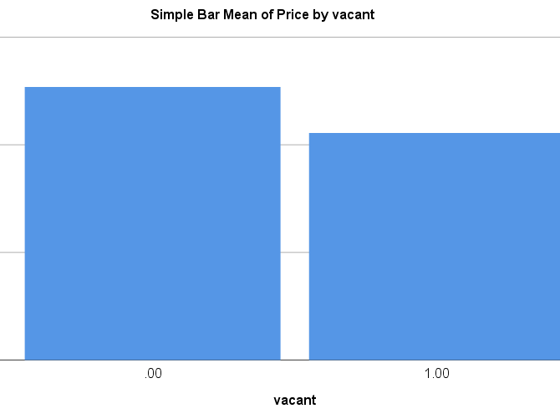
“0” represents the property being vacant.
“1” represents that they are occupied.
I could notice that the vacant properties are costlier when compared to the occupied properties.

Slide 14
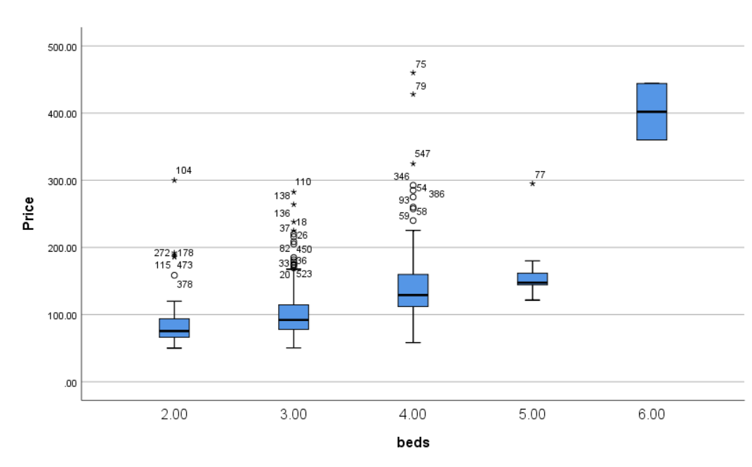
CHECKING FOR OUTLIERS

Slide 15
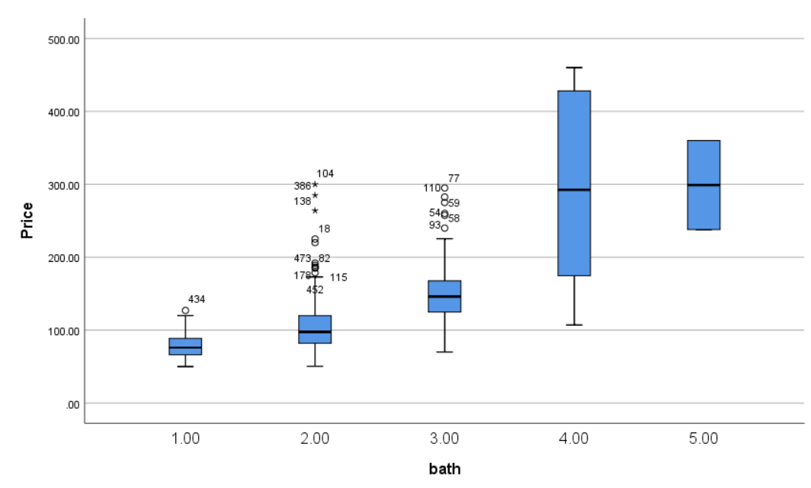

Slide 16
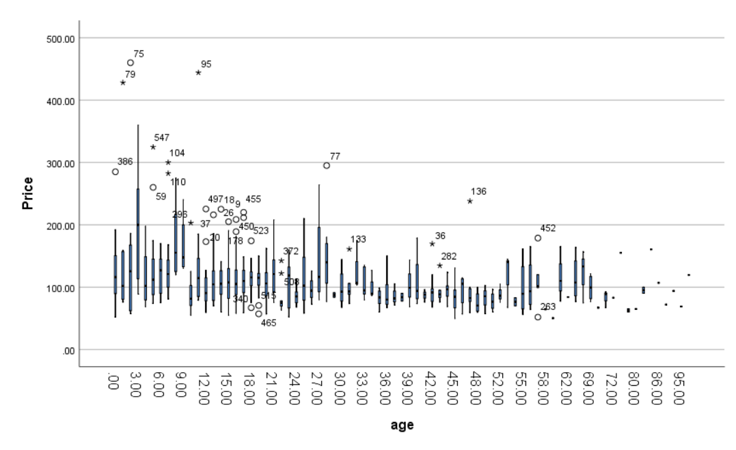

Slide 17
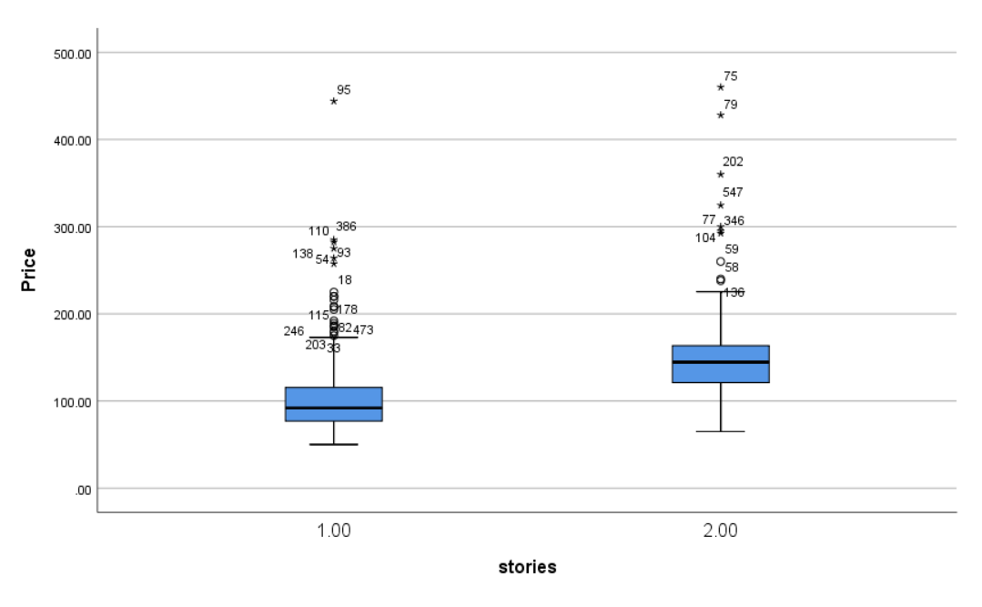

Slide 18
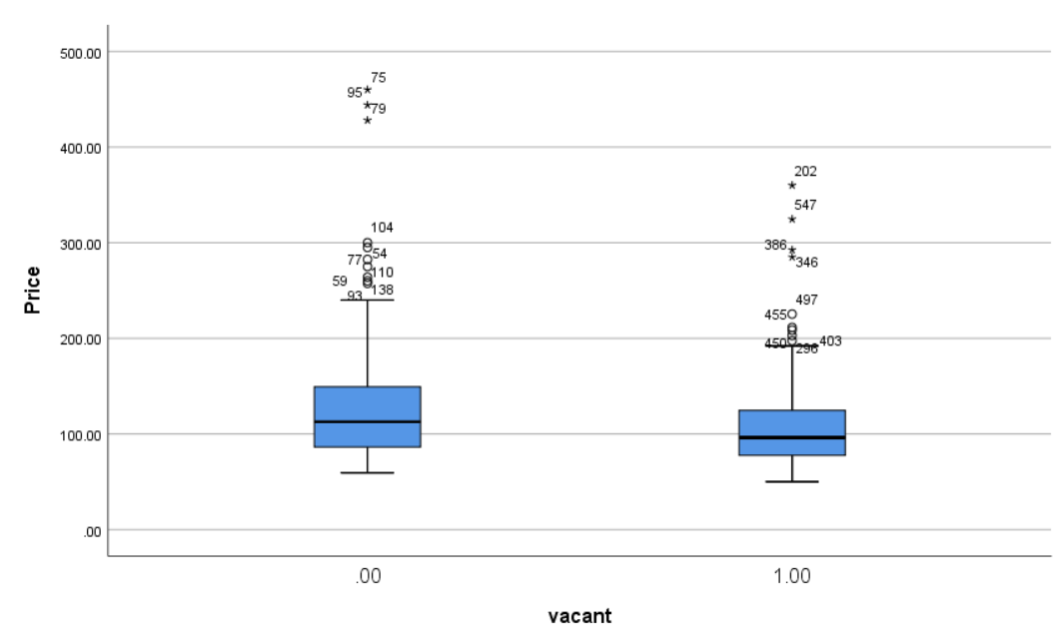

Slide 19
As you can observe there are a lot of outliers being observed in our data.
Therefore, in this case I will be running two regression model.
By removing the outliers.
By considering the outliers.
And the best model to forecast the price of the house, will be based on the two regression models.

Slide 20
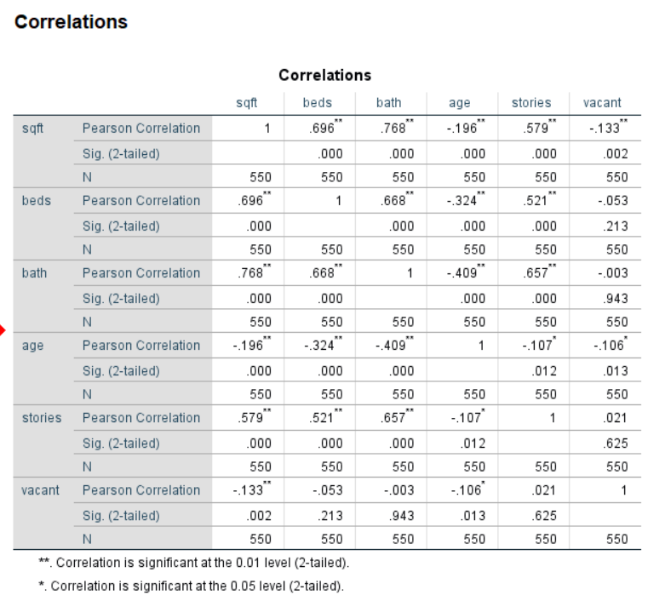
CORRELATION
I would like to see if there are any variables which are highly correlated with each other or not.
Now, I are going to use the correlation to measure the strength of linear relationship between the quantitative variables.
As, can be observed there are no variables being correlated with each other.
So, all the variables can be used in our analysis.

Slide 21
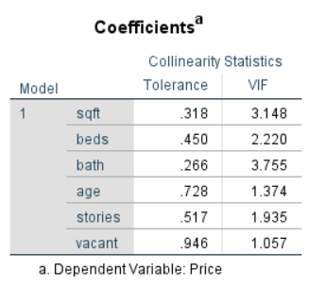
CHECKING FOR MULTI COLLINEARITY
If for any of the independent variable, if the tolerance statistics value is less than 0.1 or if the VIF statistic value is greater than 10, then I can say multi collinearity exits between the variables.
But, in this case the tolerance statistic is greater than 0.1 and the VIF statistic is less than 10 for all the independent variables.
Therefore, I can say that there is no multi correlation between the variables.
Therefore, all the independent variables can be used in our regression model.

Slide 22
REGRESSION ANALYSIS -1(trimming the mean to remove outliers)
In this regression analysis, I are trimming of the mean to eliminate the outliers. I are using the Z score to verify the outliers and any observations with the Z score value more than 3 standard deviations away from the mean is being trimmed off.
After eliminating the outliers, you can notice that the number of observations in the dataset has reduced to 528.
Statistics
 |  | Price | sqft | beds | bath | age | stories | vacant | log_price
N | Valid | 528 | 528 | 528 | 528 | 528 | 528 | 528 | 528
 | Missing | 0 | 0 | 0 | 0 | 0 | 0 | 0 | 0

Slide 23
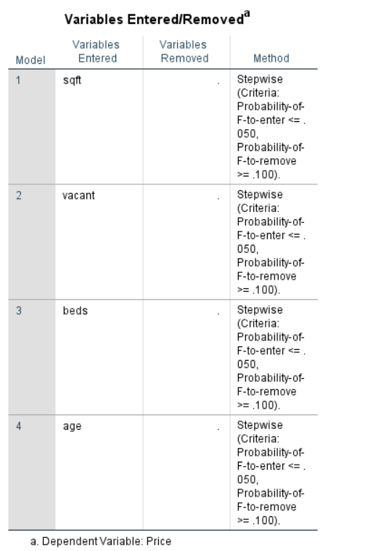
STEPWISE REGRESSION FOR REGRESSION ANALYSIS 1
I are using the stepwise regression to know exactly which independent variables could be significant to produce an analysis on the dependent variable.
You can notice that sqft, vacant, beds and age alone are enough to significantly predict the price of the property.

Slide 24
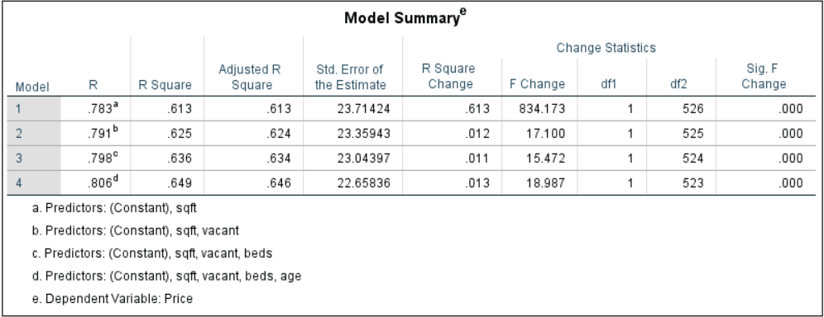
You can notice that the R-Square value to be 0.649 i.e., 64%. Which is not bad.
Therefore, I can say that the variance explained in this model is 64%.

Slide 25
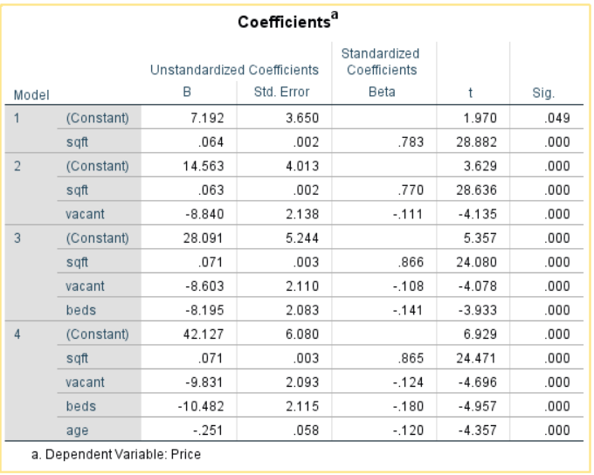
The p-values (sig.) for all my independent variables is less than 0.05.
Therefore, I can say that all my independent variables are significant.

Slide 26
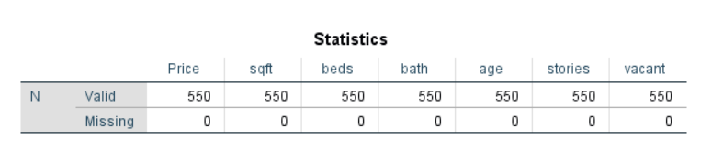
REGRESSION ANALYSIS – 2 (RUNNING THE MODEL WITH OUTLIER CONSIDERED)
In this analysis I will be running a regression model with all the outlier included in the model.
By running this regression model with all outliers, I want to check if the fit of the model is affected or not.
In this case, you can see that I are dealing with all 550 observations in the model.
And no observations are missing.

Slide 27
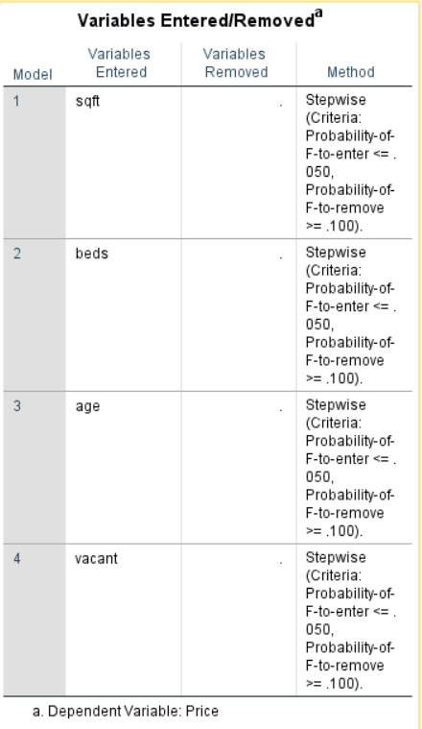
STEPWISE REGRESSION FOR REGRESSION ANALYSIS 2
I are using the stepwise regression to know exactly which independent variables could be significant to produce an analysis on the dependent variable.
You can notice that sqft, vacant, beds and age alone are enough to significantly predict the price of the property in this regression analysis.

Slide 28
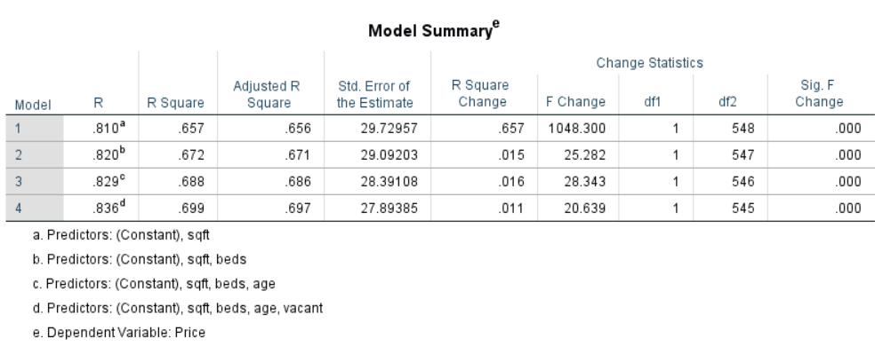
The R-square has significantly increased to 0.699 i.e., 69%, due to the considerations of the outliers.
Therefore, I could say that the variability explained in this model 69%, which is much better than the variability explained by the model 1.

Slide 29
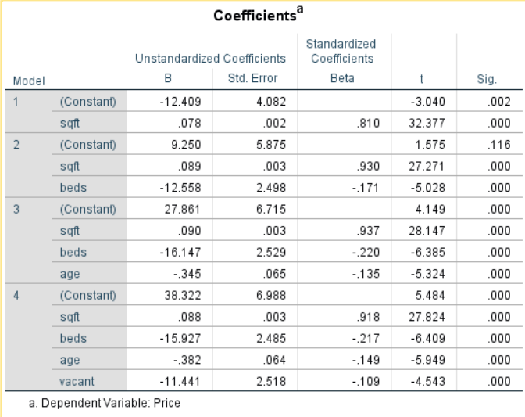
You can notice that the p-values (sig.) for all my independent variables is less than 0.05.
Therefore, I can say that all my independent variables are significant.

Slide 30
WHICH MODEL TO USE OUT OF THE TWO REGRESSION MODELS
Since the R-square value of regression analysis 2 is higher when compared to the regression analysis 1, and since all the variables are significant, I are considering the regression analysis 2 model to make analysis on the price of the house.

Slide 31
RESUDIAL ANALYSIS
The residuals should have a mean of zero, should be normally distributed and should also follow constant variance assumption (Homoscedasticity).

Slide 32
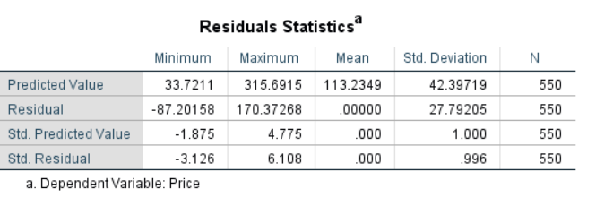
RESIDUAL STATISTICS
As you can see, the mean of my residual is zero.
Therefore, the condition is satisfied.

Slide 33
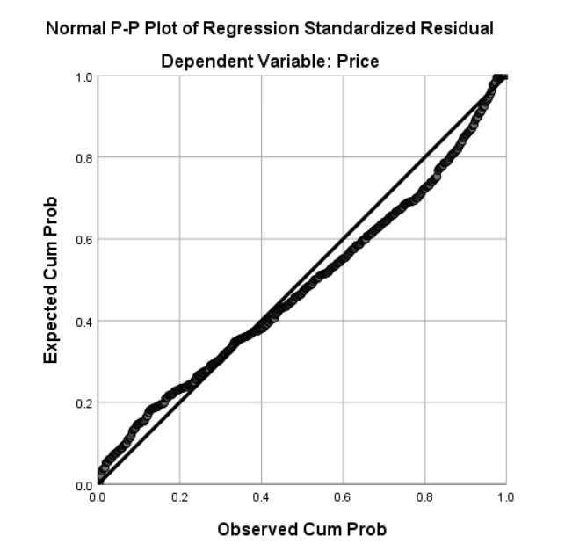
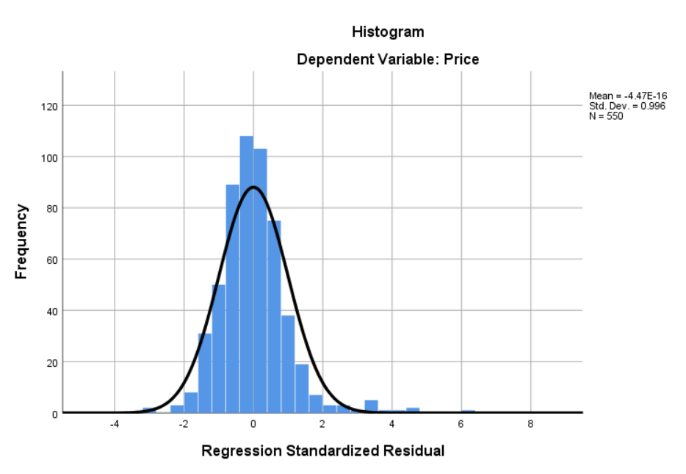
CHECKING THE NORMALLY DISTRIBUTED ASSUMPTION
As can be observed from the histogram and the P-P plot, the residuals are not normally distributed.
Therefore, it violates the assumption.

Slide 34
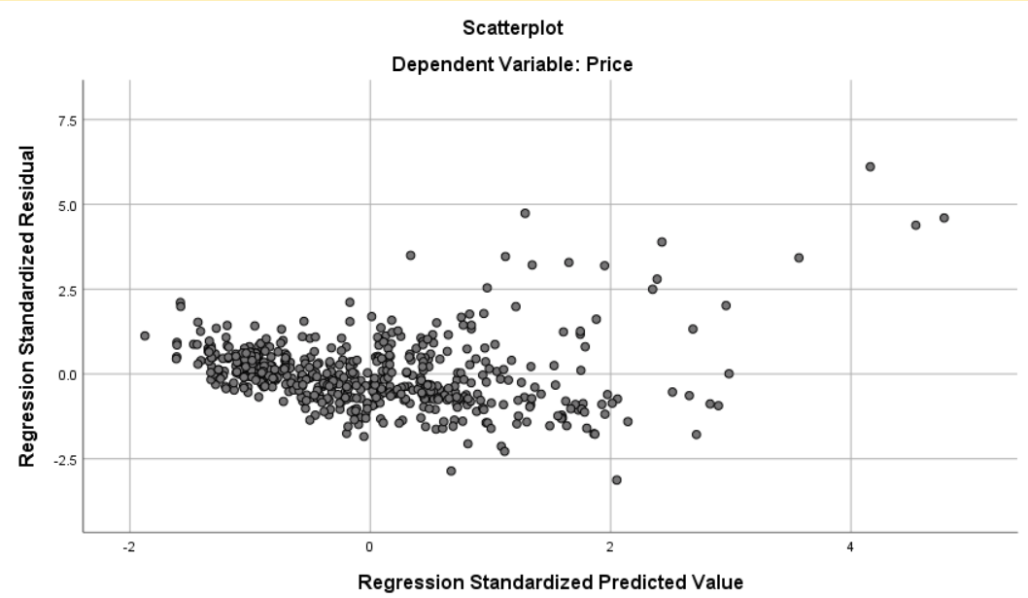
CHECKING FOR CONSTANT VARIANCE (HOMOSCEDASTICITY)
From this scatter plot you can observe that the constant variance assumption is being violated.
Therefore, I are going you transform our target variable (price), to make it satisfy all the residual assumptions.
Therefore, I are going to use LOG transformation.

Slide 35
LOG TRANSFORMING MY TARGET VARIABLE AND RE-RUNNING THE REGRESSION ANALYSIS
My target variable has changed to Log_Price, after log transformation.

Slide 36
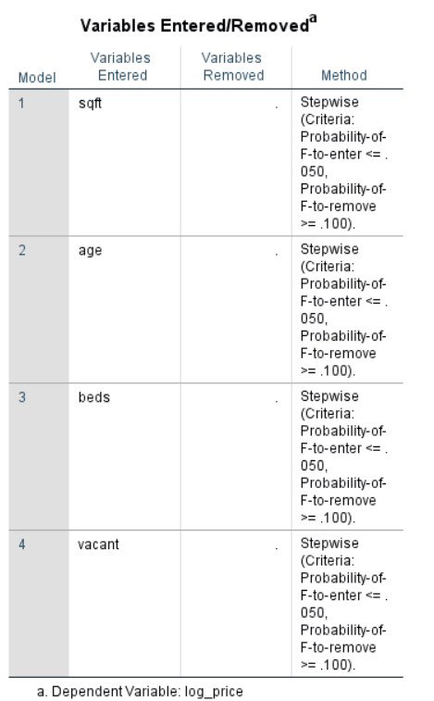
REGRESSION ANALYSIS WITH THE TRANSFORMED VARIABLE
After running the stepwise regression analysis with the transformed target variable, the variables sqft, age, beds, and vacant are said to be significant with respect to the target variable price

Slide 37
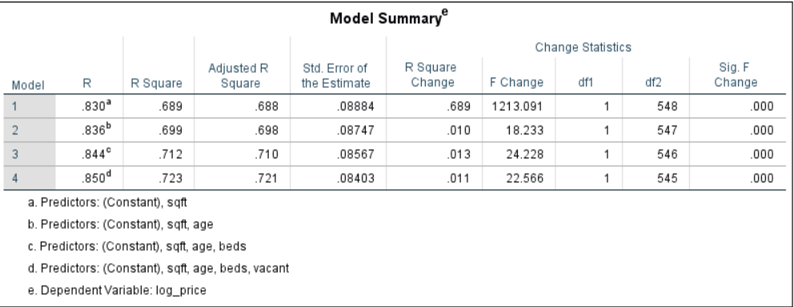
The R-square value has also increased from 0.699 to 0.723 after log transforming the target variable.
Therefore, the amount of variance explained by this model is 0.723 i.e., 72%.

Slide 38
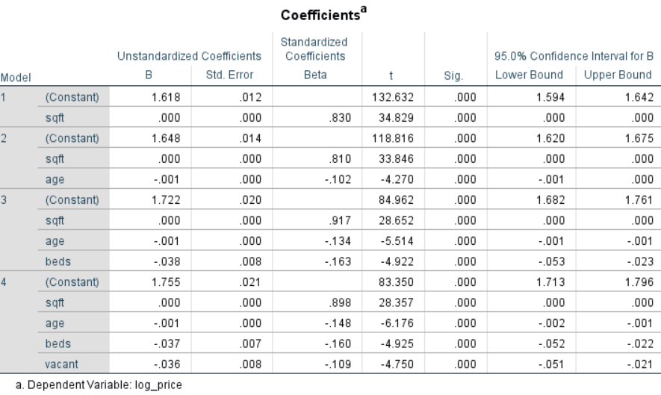
I can even see that the P- values (Sig) for all the independent variables is less than the alp value (0.05).
Therefore, all the independent variables i.e., sqft, age, beds, and vacant are all significant.
Therefore, the regression model is.
Price = sqft – 0.001(age) – 0.037(beds) – 0.036(vacant).

Slide 39
RESIDUAL ANALYSIS WITH THE TRANSFORMED VARIABLE
As I have mentioned before, the residuals should be normally distributed, with a mean of zero and should follow constant variance (Homoscedasticity).

Slide 40
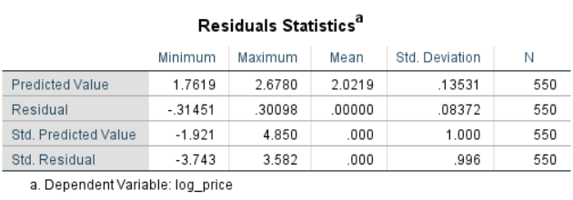
The mean of the residuals is zero. Therefore, the condition is satisfied.

Slide 41
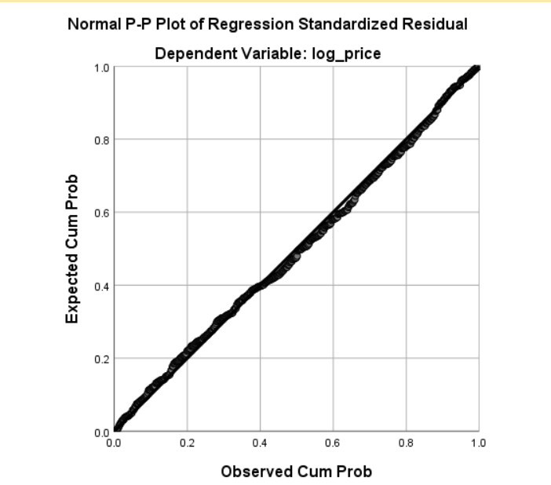
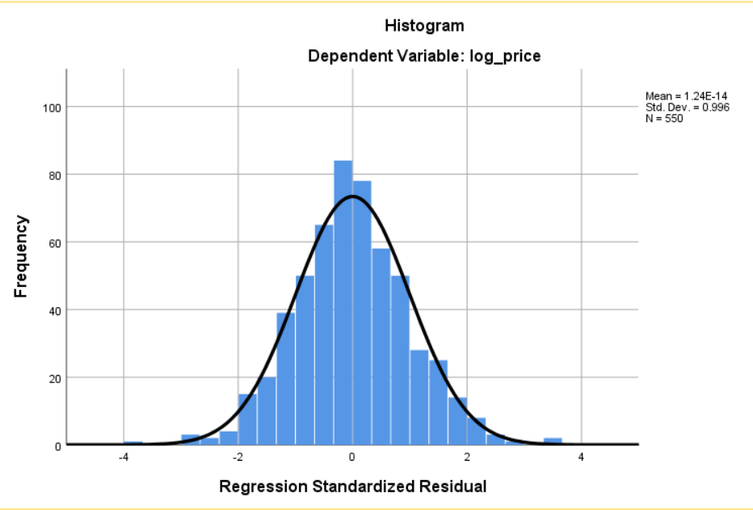
As observed from the histogram and the normal P-P plot, you can observe that, it is normally distributed.
Therefore, the normal distribution assumption is satisfied.

Slide 42
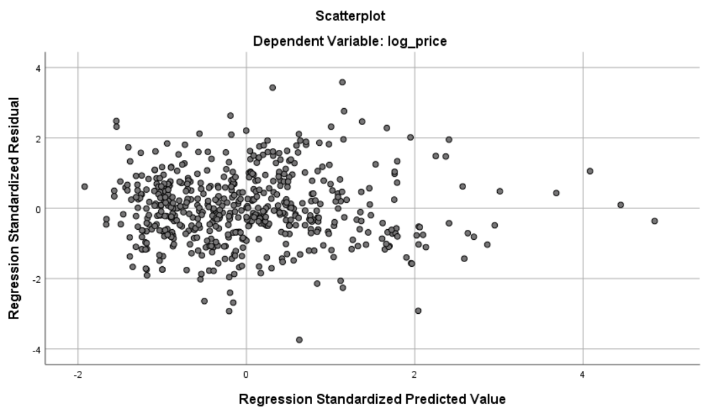
CHECKING FOR CONSTANT VARIANCE(HOMOSCEDASTICITY)
Therefore, from the regression standardized residual vs regression standardized predicted value scatter plot, it is clear that the data is satisfying the constant variance assumption.
Therefore, the homoscedasticity condition is satisfied.
Therefore, all the residual assumptions are satisfied.

Slide 43
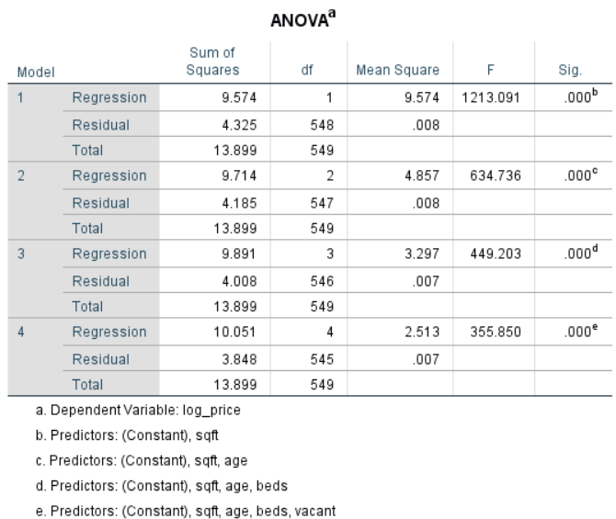
CONCLUSION TO THE PROBLEM STATEMENT
Since the p-value(sig.) is less than alpha (0.05), I reject the null hypothesis.
Therefore, I can conclude saying that the price of the houses can be estimated by the parameters such as number of bedrooms, number of bathrooms, the square feet of the house, number of stories in a house and also on how old the house is.

