Slide 1

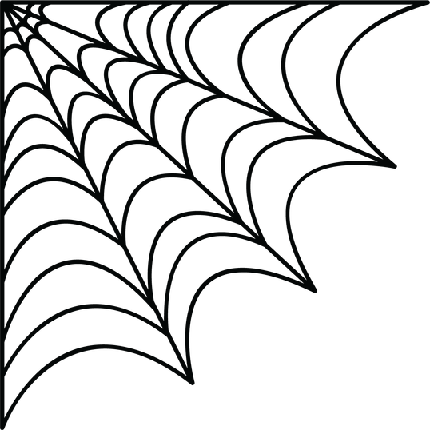





arch presents
2nd edition of
10hr hackathon
POLTERGEIST
Crowd-crush early warning
Notes:
Hi, we're team ___. Our project is Poltergeist, a crowd-crush early-warning system for the Voodoo Vision track.

Slide 2
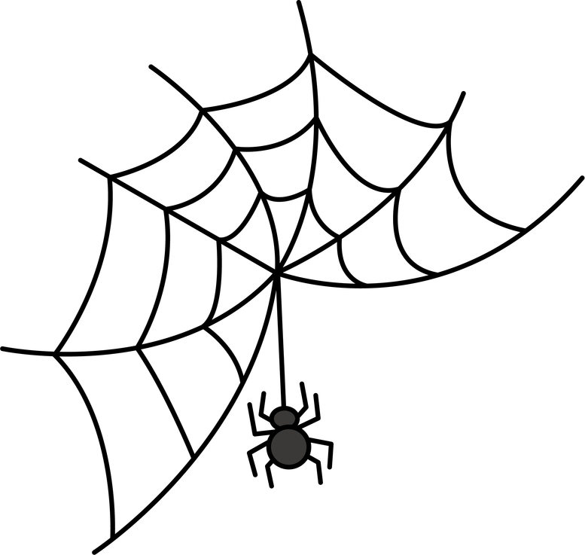

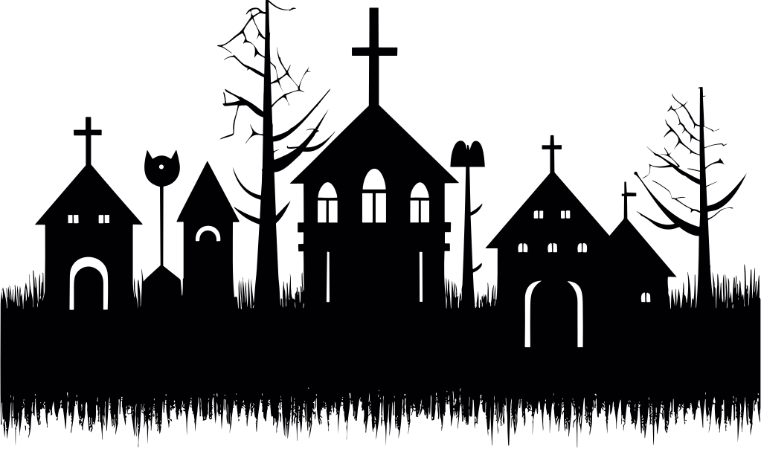

Team Name:
Track Selected: Voodoo Vision (Computer Vision)
Name | SRN/PRN | Email ID | Phone Number
Notes:
Fill in your team name and each member's name, SRN, email and phone in the table.

Slide 3

Problem Statement
11
2–3 lakh
186
deaths in the Chinnaswamy Stadium crush, June 2025
fans at a stadium built for 35,000, per Karnataka's CM
deaths in five Indian crowd crushes in just 12 months
Why it keeps happening
The problem we're solving
No one measures crowd density live
A crush builds in minutes, with no alarm
Crowd size is guessed by eye at the gates
Organisers can't see danger building inside a crowd until it's too late. They need a live, automatic warning from the cameras they already have.
Notes:
Open with Chinnaswamy: 11 people died outside the stadium on 4 June 2025, and the crowd was many times the venue's capacity. It isn't a one-off: Hathras (121, Jul 2024), Tirupati (6, Jan 2025), Maha Kumbh (30, Jan 2025), New Delhi station (18, Feb 2025) and Bengaluru (11, Jun 2025) add up to 186 deaths in 12 months. Sources: PTI, AP and Reuters reports. The gap: cameras are already there, but nobody turns the video into a density number in real time.

Slide 4





Novelty
1 How it's different
2 How it solves the problem
Today: guards watch CCTV and guess crowd size
Warns early
Measures people per m² in every zone, every second
Alerts at Warning level, minutes before density turns critical
Today: people-counters miss heads in packed crowds
Points to the exact spot
Switches to a density-map model when the crowd gets dense
Names the gate or zone, so staff can stop entry or open exits
Today: systems only count heads
No new hardware
Also reads motion: surges and pushing toward one exit
Runs on existing CCTV or a phone, from one laptop
Notes:
Three things set us apart. One: we give a number, people per square metre per zone, instead of a guard's guess. Two: normal person detectors like YOLO undercount packed crowds, exactly when it matters, so we switch to a density-map model (CSRNet) once a zone gets dense. Three: we read motion with optical flow, because a sudden surge is as dangerous as high density.

Slide 5




Brief About the Idea
Poltergeist turns any CCTV or phone camera into a live early-warning system for crowd crushes.
Count
Map
Sense
Warn
Counts every person, even in a packed crowd
Live heatmap of people per m² for each zone
Optical flow spots sudden surges and pushing
Safe, Warning or Critical alerts on organisers' phones
Built for: stadiums · concerts · temples and festivals · railway stations · college fests
Notes:
One line: Poltergeist turns any camera into a crowd-crush early-warning system. It counts, maps density, senses surges and warns, so organisers act before people fall.

Slide 6




Proposed Solution
1 Capture
2 Count
3 Measure
4 Sense
5 Score + alert
Live CCTV or phone video
YOLO if sparse, CSRNet if packed
People ÷ zone area = people per m²
Optical flow flags surges and crowds converging
Dashboard + Telegram alerts
Risk levels per zone
Our 10-hour build, 4 people
SAFE
WARNING
CRITICAL
P1 Video pipeline + YOLO counts
P2 Density model + heatmap
P3 Optical flow + risk engine
P4 Dashboard + Telegram alerts
under 4 /m²
4 to 6 /m²
6+ /m² or a surge
Based on crowd scientist Prof. G. Keith Still's guidance; tunable per venue.
Notes:
Walk the pipeline left to right. The key design choice is step 2: YOLO for sparse areas, a density-map model for packed ones. Zones are drawn once on the camera view with their real area, so counts become people per square metre. Optical flow adds the motion signal. Risk levels: under 4 per m² safe, 4 to 6 warning, above 6 or a sudden surge critical (based on Prof. G. Keith Still's crowd-safety guidance). Everything uses pretrained models, so the 10 hours go into building, not training.

Slide 7





Technologies Used
Vision models
Video and motion
Core
YOLOv8 for people detection
CSRNet for dense crowds
OpenCV for frames and zones
Farneback optical flow
Python, PyTorch, NumPy
Runs on one GPU laptop
Dashboard
Alerts
Data and testing
Streamlit live control room
Plotly heatmaps and trends
Telegram bot, free and instant
Twilio SMS as a backup
ShanghaiTech for accuracy
UMN + our clips for surges
Notes:
Everything is open source and pretrained. YOLOv8 for sparse counting, CSRNet or DM-Count for dense crowds, OpenCV optical flow for motion, Streamlit for the dashboard and a Telegram bot for alerts. We check our counts on ShanghaiTech and test surge detection on the UMN dataset and our own campus footage.

Slide 8
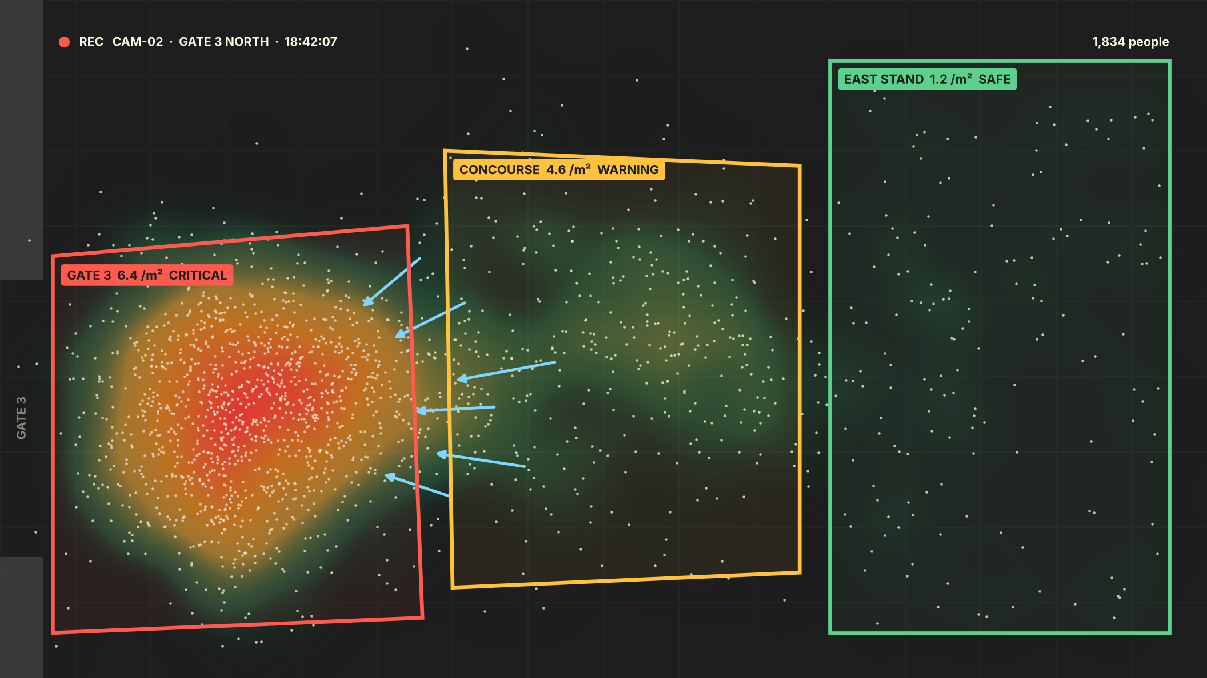

Wireframe: Live Control Room
Poltergeist · Live crowd monitor
3 cameras live · 18:42
ZONES
Gate 3
6.4 /m²
CRITICAL
Concourse
4.6 /m²
WARNING
East Stand
1.2 /m²
SAFE
CRITICAL · Gate 3
6.4 people/m² and surging toward the gate
Do now: pause entry, open Gate 4
Alert security
Acknowledge
Notes:
This is the organiser's screen. Left: the camera view with the density heatmap and each zone outlined in its risk colour; the blue arrows are optical flow showing people pushing toward Gate 3. Right: every zone's live density, and the alert that also goes to security's phones on Telegram, with a suggested action.

Slide 9
Thank You!
Poltergeist · Voodoo Vision
Notes:
Thank the judges and invite questions. Have the demo video ready.

