Slide 1

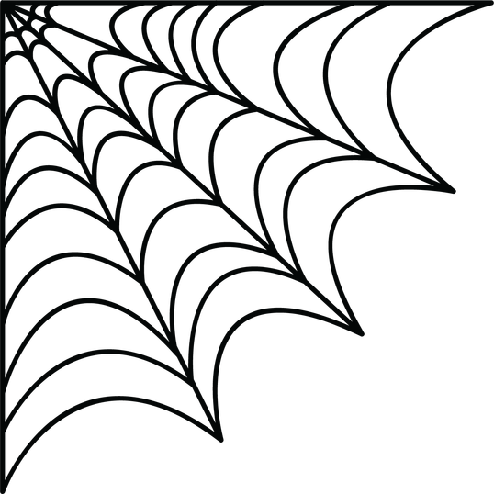





arch presents
2nd edition of
10hr hackathon
Crowd Whisperers
Crowd-crush early warning
Notes:
Hi, we're team ___. Our project is Poltergeist, a crowd-crush early-warning system for the Voodoo Vision track.

Slide 2
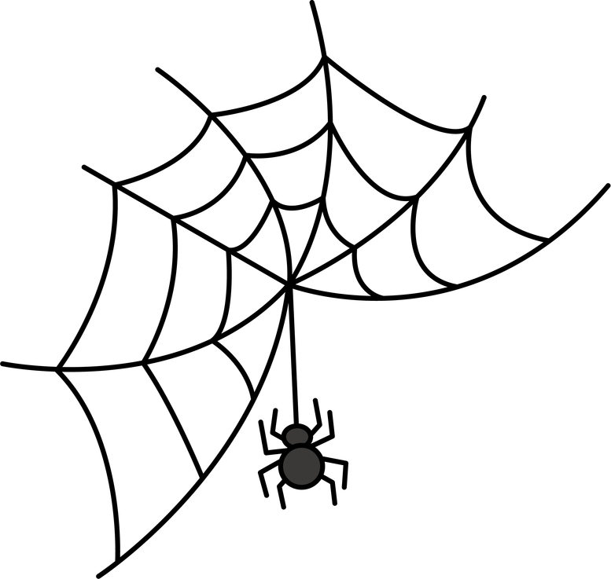



Team Name: Crowd Whisperers
Track Selected: Voodoo Vision (Computer Vision)
Name | SRN/PRN | Email ID | Phone Number
P MANAS SIDDHARDHA | PES1UG24AM186 | pmsiddhardha1@gmail.com | 9392892760
Nishkal M R | PES1UG24AM181 | nishkalmr321@gmail.com | 8123332849
S Bhuvanashree | PES1UG24AM235 | bhuvzzs24@gmail.com | 9591940629
S Chakshu | PES1UG24CS390 | chakshusuresh@gmail.com | 7022680465
Notes:
Fill in your team name and each member's name, SRN, email and phone in the table.

Slide 3
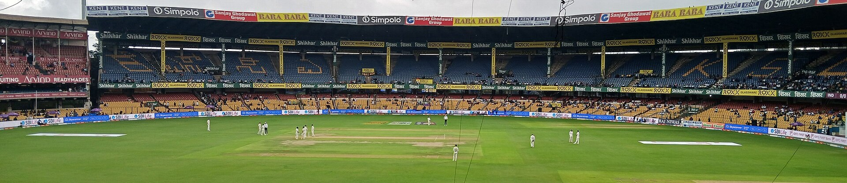

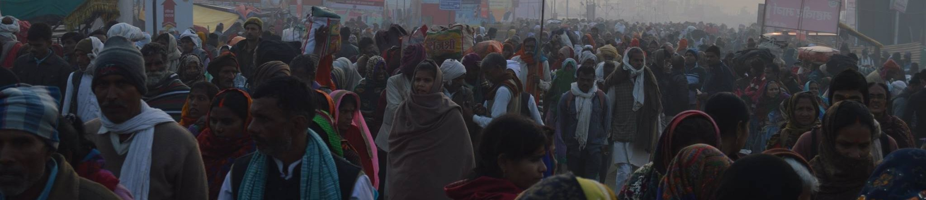
Problem Statement
11
2–3 lakh
186
deaths in the Chinnaswamy Stadium crush, June 2025
fans at a stadium built for 35,000, per Karnataka's CM
deaths in five Indian crowd crushes in just 12 months
The problem we're solving
M. Chinnaswamy Stadium, Bengaluru · Raghavan2010, CC0
Organisers can't see a crush building, and help reaches the wrong spot too late.
No one measures crowd density live
A crush builds in minutes, with no alarm
Help is slow to reach someone who falls
Maha Kumbh crowd, Prayagraj · Michael T. Balonek, CC BY-SA 4.0
Notes:
Open with Chinnaswamy: 11 people died outside the stadium on 4 June 2025, and the crowd was many times the venue's capacity. It isn't a one-off: Hathras (121, Jul 2024), Tirupati (6, Jan 2025), Maha Kumbh (30, Jan 2025), New Delhi station (18, Feb 2025) and Bengaluru (11, Jun 2025) add up to 186 deaths in 12 months. Sources: PTI, AP and Reuters reports. The gap: cameras are already there, but nobody turns the video into a density number in real time. Photos (Wikimedia Commons): Chinnaswamy Stadium by Raghavan2010 (CC0); Kumbh Mela crowd by Michael T. Balonek (CC BY-SA 4.0).

Slide 4





Novelty
1 How it's different
2 How it solves the problem
Today: guards watch CCTV and guess crowd size
Warns early
Predicts when a zone will turn critical, minutes ahead
"Gate 3 critical in 6 min", from live gate inflow
Today: people-counters miss heads in packed crowds
Sends help fast
Switches to a density-map model when the crowd packs in
Nearest medical or police post gets the alert; escalates if no reply
Today: alarms stop at the control room
Moves the crowd
Sends the nearest help station, with location and photo
Suggests which gate to open; PA speaks in Kannada, Hindi, English
Notes:
Three things set us apart. One: we don't just measure density, we predict it. From the rate people enter through each gate we say 'critical in 6 minutes', which is real early warning. Two: normal person detectors like YOLO undercount packed crowds, exactly when it matters, so we switch to a density-map model (CSRNet). Three: most systems stop at a dashboard. We dispatch the nearest medical or police post with a photo, escalate if nobody accepts within 60 seconds, and tell the crowd where to go through PA announcements.

Slide 5





Brief About the Idea
Poltergeist predicts crowd crushes, spots incidents and sends the nearest help, using cameras a venue already has.
Predict
Detect
Dispatch
Redirect
Live heatmap + gate inflow: "critical in 6 min"
Crush risk, a person down, or a panicked scatter
Banshee alerts the nearest help post, escalates after 60 s
Suggests the gate to open; PA announces in 3 languages
Private by design: faces are blurred on screen and only counts are stored, never identities
Built for: stadiums · concerts · temples and festivals · railway stations · college fests
Notes:
Our story in four words: predict, detect, dispatch, redirect. Poltergeist predicts when a zone will turn critical, detects incidents like a person going down, sends the nearest help post (our Banshee alerts, named after the spirit whose wail warns of death), and tells the crowd where to go. Faces are blurred and only counts are stored, so it's private by design.

Slide 6



Proposed Solution
1 Capture
2 Count
3 Predict
4 Detect
5 Respond
Live CCTV or phone video, faces blurred
YOLO if sparse, CSRNet if packed
People per m² + minutes to critical
Surges and scatter (optical flow), falls (pose)
Nearest help post, gate advice, PA
Risk levels per zone
Our 10-hour build, 4 people
SAFE
WARNING
CRITICAL
P1 Video, YOLO + pose, face blur
P2 Density model, heatmap, prediction
P3 Optical flow + risk engine
P4 Dashboard, dispatch, PA voice
under 4 /m²
4 to 6 /m²
6+ /m² or a surge
Based on crowd scientist Prof. G. Keith Still's guidance; tunable per venue.
Notes:
Walk the pipeline left to right. Step 2: YOLO for sparse areas, a density-map model for packed ones. Step 3: zones are drawn once with their real area, so counts become people per square metre, and a line counter at each gate gives the inflow rate, which we project forward to 'minutes until critical'. Step 4: optical flow catches surges and people scattering; YOLOv8-pose catches someone lying still for 5 seconds. Step 5: the nearest help post of the right type gets a Telegram alert with a photo and an Accept button; if nobody accepts in 60 seconds it escalates to the next post. The dashboard suggests which gate to open and plays a PA announcement in Kannada, Hindi and English. Risk levels follow Prof. G. Keith Still's crowd-safety guidance. Everything uses pretrained models, so the 10 hours go into building, not training.

Slide 7




Technologies Used
Vision models
Video and motion
Prediction
YOLOv8 people + pose (falls)
CSRNet for dense crowds
OpenCV: zones, face blur
Farneback optical flow
Python, PyTorch, NumPy
Inflow trend → time to critical
Dashboard
Dispatch + PA
Data and testing
Streamlit live control room
Venue map of help posts
Telegram bot + Accept button
gTTS voice in 3 languages
ShanghaiTech for accuracy
UMN + our clips for surges
Notes:
Everything is open source and pretrained. YOLOv8 counts people and YOLOv8-pose spots falls; CSRNet handles dense crowds. OpenCV gives us zones, face blurring and optical flow. A simple inflow trend predicts time to critical. Streamlit runs the dashboard with a map of help posts, a Telegram bot handles dispatch with an Accept button, and gTTS generates the PA announcements. We check counts on ShanghaiTech and test surges on the UMN dataset and our own campus footage.

Slide 8
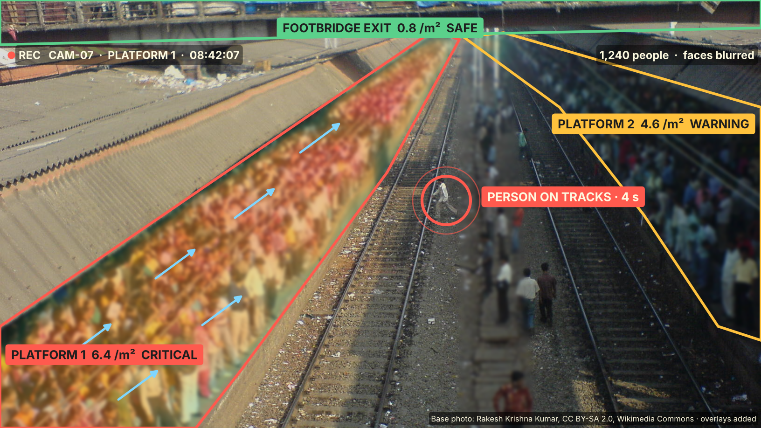

Wireframe: Live Control Room
Poltergeist · Live crowd monitor
3 cameras live · faces blurred · 08:42
ZONES
Platform 1
6.4 /m²
CRITICAL
Platform 2
4.6 /m²
CRITICAL IN 6 MIN
Footbridge
0.8 /m²
SAFE
CRITICAL · Platform 1
6.4 /m², crowd surging, person on tracks
Accepted: RPF Post 2, 60 m away
Do now: route to footbridge; PA is on
Also send medical
Acknowledge
Notes:
This is the control-room screen on a real station photo. Left: the camera view with faces blurred, the density heatmap, each zone outlined in its risk colour, blue optical-flow arrows showing Platform 1 pushing toward the stairs, and a real incident: someone walking across the tracks. Right: each zone's live density, a prediction that Platform 2 will be critical in 6 minutes, and the Banshee alert: RPF Post 2, 60 metres away, has accepted on Telegram, and the PA is routing people to the footbridge. The base photo is real ('Mumbai morning rush' by Rakesh Krishna Kumar, CC BY-SA 2.0); the overlays are our mock-up, not model output.

Slide 9
Thank You!
Crowd Whisperers · Voodoo Vision
Notes:
Thank the judges and invite questions. Have the demo video ready.

