Slide 1
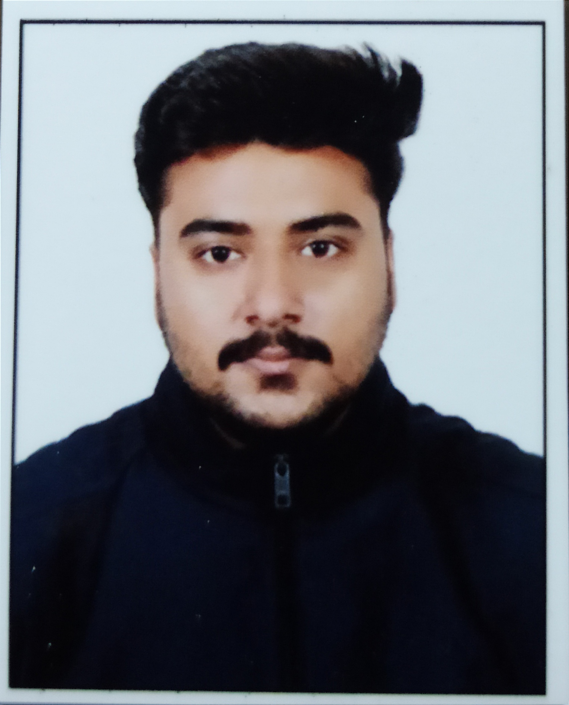

Nishkarsh Tewari
Analyst/Software Engineer
Bachelor of Technology
Mechanical Engineering : 2017 – 2021
Az-900 from Microsoft : 05/05/2022
Skills Dot Net
C#
Backend
REST-API
Database
SQL database – MSSQL
AddOns
Github
Swagger
Postman
Additional Details
Leadership
Quick Learner
Team management
Bangalore
nishkarsh.tewari@capgemini.com
+91 7068923550
A4
Ready to learn new technologies and implement them to further improve my knowledge.
A team player with good communication skill always ready to work for the enrichment of knowledge
Eager to work in a team of dedicated people and serve a key role in the enhancement and development of the project.
Jungle Safari Management System Application
Completed end to end case study of Jungle Safari Management System Application along with JWT authentication, Swagger and postman testing using ASP.NET Core Web API.
Az-900 Certification from Microsoft
Completed this course and having Azure certification.

