Slide 1
TRACK 2 • AI-DRIVEN SCAM PATTERN RECOGNITION
ScamGraph AI
From suspicious messages to complete scam workflows.
Detect Multi-Stage Scam Workflows • Fingerprint Scam DNA • Stop Fraud Before Money Moves
100% Recall
Zero Missed Scams on Test Set
8 Playbooks
Multi-Event Workflow Tracking
Scam DNA
Semantic Vector Fingerprinting
React Flow
Interactive Scam Graph Topology
Author: Nishkarsh Singh | GitHub: github.com/Nishkarsh807/scamgraph-ai

Slide 2
SCAMGRAPH AI • TRACK 2: AI-DRIVEN SCAM PATTERN RECOGNITION
02 / 15
The Problem: Fraudsters Execute Workflows, Not Single Texts
How a Real Scam Unfolds Across Channels
Step 1 (SMS): 'Dear customer, your SBI KYC expires today.' — Appears benign in isolation.
Step 2 (Link): 'Update PAN immediately at http://sbi-kyc-update.xyz' — Phishing lure.
Step 3 (Web): Fake banking page harvests NetBanking username & password.
Step 4 (Call/WhatsApp): 'Tell our executive the 6-digit OTP to unfreeze your account.'
Step 5 (UPI): 'Approve ₹1 verification collect request' -> Drains ₹95,000.
Why Traditional Spam Classifiers Fail
1. Zero State Memory: Evaluates each SMS independently without linking previous messages.
2. High Alert Fatigue: Flags harmless marketing promos while missing subtle social engineering.
3. Hinglish Evasion: Fails on Romanized Hindi ('Aapka khata band ho jayega turant').
4. Black-Box Output: Shows 'Spam: 80%' without explaining why or what the user should do.
5. No Campaign Vision: Cannot connect 100 slightly reworded texts to one fraud ring.
Event 1
Unknown Sender
Event 2
KYC Expiry Threat
Event 3
Suspicious URL
Event 4
Credential Theft
Event 5
OTP Request
Event 6
UPI Account Drain

Slide 3
SCAMGRAPH AI • TRACK 2: AI-DRIVEN SCAM PATTERN RECOGNITION
03 / 15
Core Innovation: The ScamGraph AI Paradigm Shift
CORE PRODUCT PRINCIPLE
Do NOT ask: "Is this message spam?" ➔ Ask: "What scam workflow is unfolding, how risky is it, what evidence supports that conclusion, and what should the user do next?"
Capability | Legacy Spam Classifiers | ScamGraph AI Platform
Detection Scope | Isolated single-message text classification | Multi-event Scam Workflow State Machine (8 Playbooks)
Campaign Tracking | None — treats every reworded SMS as new | Scam DNA Semantic Vectors (#UPI-KYC-042)
Emerging Threats | Static rule updates weeks after outbreak | Unsupervised DBSCAN Clustering (+64% velocity alerts)
Language Support | English keyword matching | Multilingual MuRIL + Hinglish Subword N-grams
Alert Fatigue | High false alarms on benign bank alerts | Adaptive 4-Tier Intervention + Campaign Deduplication
Explainability | Black-box probability score only | Plain-English Evidence + Next Attacker Move + Action

Slide 4
SCAMGRAPH AI • TRACK 2: AI-DRIVEN SCAM PATTERN RECOGNITION
04 / 15
System Architecture: Multi-Engine Fraud Intelligence Pipeline
1. INPUT & ENTITY PRESERVATION LAYER — SMS • WhatsApp • Email • UPI Request • URL • Call/Chat Transcript
Preserves URLs, ₹ Amounts, Phone Numbers, UPI Handles, OTP Keywords & Detects English / Hinglish
2A. NLP ML Engine
MuRIL + Word/Char N-Grams
Binary + 13-Class Taxonomy
(Weight: 0.45)
2B. Signal Rule Engine
11 Deterministic Indicators
Urgency, Threat, KYC, OTP
(Weight: 0.25)
2C. URL Threat Analyzer
Typosquatting, High-Abuse TLD
HTTP, Brand Impersonation
(Weight: 0.15)
2D. Workflow Engine
8 Attack Playbooks
Partial Sequence Alignment
(Weight: 0.15)
3. SCAM DNA & DBSCAN EMERGING ENGINE
SentenceTransformer Cosine Similarity -> Campaign Tag (#UPI-KYC-042)
Unsupervised DBSCAN Clusters -> Weekly Growth Velocity Alerts
4. COMPOSITE RISK & ALERT FATIGUE ENGINE
Risk = 0.45*ML + 0.25*Rule + 0.15*URL + 0.15*Workflow (0-100)
Tiers: LOW (0-29) • MEDIUM (30-59) • HIGH (60-79) • CRITICAL (80-100)
5. ACTIONABLE OUTPUT & VISUALIZATION LAYER
✓ Calibrated Risk Score (91/100) ✓ Explainable 'Why' Evidence ✓ Predicted Next Attacker Step
✓ React Flow Scam Graph Topology ✓ Deduplicated Campaign Notice ✓ Privacy-Redacted Storage

Slide 5
SCAMGRAPH AI • TRACK 2: AI-DRIVEN SCAM PATTERN RECOGNITION
05 / 15
Workflow Intelligence: Universal Fraud Event Taxonomy
Atomic Event Token | Stage Role | Detection Trigger Mechanism | Real Message / Transcript Example
KYC_WARNING | Initial Hook | Keywords: kyc, pan, aadhaar, yono, suspended | 'Your SBI YONO account KYC expired today'
DISCONNECTION_THREAT | Panic Hook | Utility keywords + tonight / 9:30 PM outage | 'Electricity power will be cut tonight at 9:30 PM'
LAW_ENFORCEMENT_IMP | Fear Coercion | CBI, Cyber Crime, Customs, FedEx, Warrant | 'Inspector Rajesh from Mumbai Cyber Crime'
JOB_OR_LOTTERY_LURE | Greed Hook | Daily income, YouTube task, KBC 25 Lakhs | 'Earn ₹5,000 daily liking YouTube videos'
URGENCY | Psychological | Immediately, turant, 24 hours, final notice | 'Update within 2 hours or account freezes'
EXTERNAL_LINK | Vector Delivery | Regex URL extraction + suspicious TLD check | 'Click http://sbi-kyc-verify.xyz/login'
REMOTE_ACCESS_REQ | Device Takeover | AnyDesk, TeamViewer, QuickSupport, APK | 'Install QuickSupport APK and share 9-digit code'
CREDENTIAL_REQUEST | Data Harvest | CVV, NetBanking password, card details | 'Enter your username and card CVV to verify'
OTP_REQUEST | Auth Bypass | 6-digit OTP, verification code, share token | 'Tell the 6-digit OTP sent to your mobile'
UPI_REQUEST | Financial Drain | Collect request, scan QR, enter UPI PIN | 'Scan QR and enter UPI PIN to receive ₹5,000'

Slide 6
SCAMGRAPH AI • TRACK 2: AI-DRIVEN SCAM PATTERN RECOGNITION
06 / 15
Scam Workflow Engine: 8 Canonical Attack Playbooks
1. KYC Account Takeover (#UPI-KYC-042)
KYC_WARNING ➔ URGENCY ➔ EXTERNAL_LINK ➔ CREDENTIAL_REQUEST ➔ OTP_REQUEST ➔ UNAUTHORIZED_TXN
Exploits fear of bank account freeze to harvest NetBanking credentials and OTPs.
2. Reverse UPI Collect Scam (#UPI-COLLECT-019)
PAYMENT_LURE ➔ UPI_LINK ➔ URGENCY ➔ PIN_OR_OTP_REQUEST ➔ FINANCIAL_DRAIN
Deceives victim into entering their secret UPI PIN under the guise of receiving a refund or OLX payment.
3. Remote Tech/Bank Support (#SUPP-REMOTE-007)
BANK_SUPPORT_IMPERSONATION ➔ DISPUTE_CLAIM ➔ REMOTE_ACCESS (AnyDesk) ➔ CREDENTIAL_REQUEST
Tricks victim into installing screen-sharing tools to silently read SMS OTPs.
4. Part-Time Job & VIP Task Trap (#TASK-JOB-088)
JOB_OFFER ➔ INITIAL_REWARD (₹150) ➔ VIP_TASK_FEE ➔ ESCALATING_PAYMENT ➔ LOCKOUT
Builds trust with micro-payouts before demanding large crypto/UPI deposits to unlock earnings.
5. Electricity Outage Panic (#ELEC-DISCONN-019)
DISCONNECTION_THREAT ➔ URGENCY (Tonight) ➔ FAKE_OFFICER_CALL ➔ APK_OR_FEE ➔ OTP_DRAIN
Creates evening panic about power disconnection to force interaction with a fake officer.
6. Law Enforcement Digital Arrest (#CYBER-ARREST-104)
POLICE_IMPERSONATION ➔ CONTRABAND_ACCUSATION ➔ SKYPE_ARREST_THREAT ➔ ESCROW_TRANSFER
Coerces victims on video call into transferring savings to a fake 'RBI verification account'.
7. Pre-Approved Loan Advance Fee (#LOAN-ADVANCE-031)
LOAN_OFFER ➔ INSTANT_APPROVAL ➔ PROCESSING_OR_GST_FEE ➔ PAYMENT_REQUEST ➔ GHOSTING
Offers 0% CIBIL-free loans and steals upfront processing/insurance fees.
8. KBC / Lucky Draw Prize Scam (#KBC-LUCKY-055)
LOTTERY_WIN_ANNOUNCEMENT ➔ WHATSAPP_DIRECTIVE ➔ TAX_CLEARANCE_FEE ➔ PAYMENT_REQUEST
Promises ₹25 Lakh lottery wins and demands advance government tax transfer via UPI.

Slide 7
SCAMGRAPH AI • TRACK 2: AI-DRIVEN SCAM PATTERN RECOGNITION
07 / 15
Workflow Content Deep-Dive: KYC Fraud & Reverse UPI Scams
PLAYBOOK 1: KYC ACCOUNT TAKEOVER WORKFLOW (#UPI-KYC-042)
Workflow Stage | Actual Scammer Content (English / Hinglish) | Extracted Signals | Engine State & Risk
Stage 1: Threat | 'Dear SBI Customer, your YONO account is suspended due to pending KYC.' | kyc_request, threat | Stage 1 Matched (Risk: 48)
Stage 2: Link | 'Aapka khata band ho jayega. Click http://sbi-kyc-verify.xyz to update PAN.' | urgency, suspicious_url | Stage 3 Matched (Risk: 76)
Stage 3: Harvest | 'Enter your NetBanking Username, Password & Date of Birth on portal.' | credential_request | Stage 4 Matched (Risk: 86)
Stage 4: OTP | 'Share the 6-digit high-security OTP sent to your mobile to restore access.' | otp_request | WORKFLOW DETECTED (91/100)
PLAYBOOK 2: REVERSE UPI COLLECT / REFUND TRAP (#UPI-COLLECT-019)
Workflow Stage | Actual Scammer Content (English / Hinglish) | Extracted Signals | Engine State & Risk
Stage 1: Lure | 'You have won a PhonePe cashback scratch card of ₹4,999! Claim now.' | reward_lure | Stage 1 Matched (Risk: 42)
Stage 2: Collect | 'Bhai maine galti se ₹5,000 bhej diye, approve collect link: http://upi-claim.in' | payment_request, url | Stage 2 Matched (Risk: 68)
Stage 3: Urgency | 'Cashback link expires in 10 minutes. Open Google Pay immediately.' | urgency | Stage 3 Matched (Risk: 78)
Stage 4: PIN Trap | 'Paise account mein receive karne ke liye QR scan karein aur 6-digit UPI PIN dalein.' | otp_request, upi_pin | WORKFLOW DETECTED (93/100)

Slide 8
SCAMGRAPH AI • TRACK 2: AI-DRIVEN SCAM PATTERN RECOGNITION
08 / 15
Workflow Content Deep-Dive: Digital Arrest & Electricity Scams
PLAYBOOK 3: LAW ENFORCEMENT DIGITAL ARREST EXTORTION (#CYBER-ARREST-104)
Workflow Stage | Actual Scammer Content (Call / Chat Transcript) | Extracted Signals | Engine State & Risk
Stage 1: Authority | 'This is Inspector Rajesh Kumar from Mumbai Cyber Crime / CBI Headquarters.' | impersonation | Stage 1 Matched (Risk: 52)
Stage 2: Contraband | 'A FedEx parcel in your name containing 5 passports & 160g MDMA drugs was seized.' | threat, contraband | Stage 2 Matched (Risk: 79)
Stage 3: Isolation | 'Non-bailable warrant issued on your Aadhaar. Stay on Skype video call under Digital Arrest.' | urgency, arrest_threat | Stage 4 Matched (Risk: 90)
Stage 4: Escrow | 'Transfer all funds to RBI Safety Escrow Account for audit to prove innocence.' | payment_request | WORKFLOW DETECTED (98/100)
PLAYBOOK 4: NIGHT ELECTRICITY DISCONNECTION PANIC (#ELEC-DISCONN-019)
Workflow Stage | Actual Scammer Content (English / Hinglish) | Extracted Signals | Engine State & Risk
Stage 1: Outage | 'Dear Consumer, aapki bijli aaj raat 9:30 baje sub-station se kaat di jayegi.' | threat, utility | Stage 1 Matched (Risk: 55)
Stage 2: Urgency | 'Previous month bill was not updated. Only 1 hour remaining before disconnection.' | urgency | Stage 2 Matched (Risk: 70)
Stage 3: Fake SDO | 'Immediately contact Electricity SDO Officer Sharma at +91-9876543210.' | phone_contact, impersonation | Stage 3 Matched (Risk: 83)
Stage 4: APK/Fee | 'Pay ₹10 meter update charge at http://bses-portal.in and share SMS OTP.' | payment, url, otp | WORKFLOW DETECTED (92/100)

Slide 9
SCAMGRAPH AI • TRACK 2: AI-DRIVEN SCAM PATTERN RECOGNITION
09 / 15
Predictive Workflow Engine: Stopping Scams Mid-Flight
Partial-Order Sequence Alignment Math
Why Partial Matching? Users rarely paste all 6 steps at once. We must detect the workflow when only 2 or 3 events have occurred.
Overlap Ratio: |Detected_Events ∩ Playbook_Steps| / |Playbook_Steps|
Category Synergy Bonus: +0.20 boost when ML classifier category aligns with the playbook category.
Formula: Confidence = min(0.99, 0.50 + 0.45 * Overlap + Category_Bonus)
Example: Partial Match at Stage 3 (82% Confidence)
Observed Events: [KYC_WARNING] ➔ [URGENCY] ➔ [EXTERNAL_LINK]
Missing Future Events: [CREDENTIAL_REQUEST] ➔ [OTP_REQUEST] ➔ [DRAIN]
Classification: Potential KYC Scam Workflow — 82% Confidence
Next Move Prediction: 'Attacker will attempt Credential & OTP Harvesting next. Do not open link.'
LIVE STAGE PROGRESSION TRACKER (OBSERVED VS. PREDICTED ATTACKER MOVES)
✓ OBSERVED
Stage 1: KYC Warning
✓ OBSERVED
Stage 2: Urgency Threat
✓ CURRENT STAGE
Stage 3: Phishing Link
⚡ PREDICTED NEXT
Stage 4: Credential Input
⚡ PREDICTED
Stage 5: OTP Theft
🛑 PREVENTED
Stage 6: Account Drain

Slide 10
SCAMGRAPH AI • TRACK 2: AI-DRIVEN SCAM PATTERN RECOGNITION
10 / 15
Scam DNA Fingerprinting & Emerging Pattern Discovery
Scam DNA: Semantic Campaign Fingerprinting
The Problem: Scammers mutate bank names (SBI -> HDFC) and URLs every hour to bypass hash filters.
Our Solution: We encode messages using SentenceTransformer ('all-MiniLM-L6-v2') + structural signal vectors.
Variant A: 'Your SBI KYC will expire today. Update now.'
Variant B: 'Dear customer, your bank KYC is pending. Verify immediately.'
Variant C (Hinglish): 'Aapka SBI account block ho jayega, KYC update karein.'
Shared Fingerprint: All 3 resolve to Scam DNA: #UPI-KYC-042 (Cosine Sim > 0.78)
Unsupervised Emerging Discovery (DBSCAN)
Incident Vector: [Embedding + Category + Signals + Workflow + Timestamp]
Density Clustering: DBSCAN groups unknown scam waves without requiring pre-labeled classes.
Growth Alert: Clusters growing >30% WoW trigger '⚠️ Emerging Scam Pattern Detected'.
#UPI-KYC-042 (CRITICAL)
YONO / Bank KYC APK Wave
117 Reports • +64% this week
#ELEC-DISCONN-019 (HIGH)
Night Power Outage Scam
83 Reports • +41% this week
#CYBER-ARREST-104 (CRITICAL)
FedEx / CBI Digital Arrest
64 Reports • +78% this week
#TASK-JOB-088 (HIGH)
Telegram YouTube Like Tasks
142 Reports • +55% this week

Slide 11
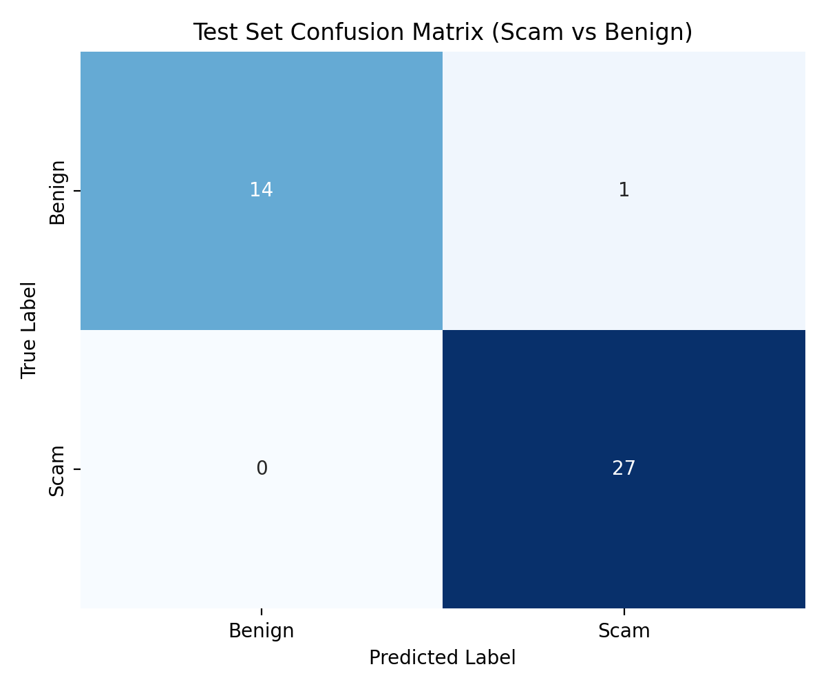
SCAMGRAPH AI • TRACK 2: AI-DRIVEN SCAM PATTERN RECOGNITION
11 / 15
Machine Learning Pipeline & Real Test Evaluation
Trained Model Architecture & Dataset Splits
Multilingual Architecture: Google MuRIL ('google/muril-base-cased') + Dual TF-IDF FeatureUnion (Word 1-2 + Char 2-5 subwords) with Sigmoid Platt Calibration.
Authentic Dataset: 276 unique curated Indian scam & benign samples (80.4% English, 19.6% Hinglish) across 13 categories.
Stratified Splits: 70% Train (193 rows) • 15% Validation (41 rows) • 15% Held-Out Test (42 rows).
Test Recall (Fraud Capture): 100.00% — Zero false negatives on held-out test set.
Test Precision: 96.43% — Minimal false alarms on legitimate bank alerts.
Test F1 Score: 98.18% | ROC-AUC: 1.0000 | Accuracy: 97.62%
13 Category Head: 87.80% Validation Accuracy across KYC, UPI, OTP, Phishing, Banking, Job, Loan, Lottery, Electricity, Investment, Digital Arrest, Impersonation, Other.
Held-Out Test Confusion Matrix

Slide 12
SCAMGRAPH AI • TRACK 2: AI-DRIVEN SCAM PATTERN RECOGNITION
12 / 15
Alert Fatigue Prevention & Explainable AI
LOW (0–29)
Passive Monitoring
No interruption. Shown as verified or normal message.
MEDIUM (30–59)
Advisory Caution
'Be careful before interacting. Verify sender independently.'
HIGH (60–79)
Strong Warning
'Multiple scam indicators & partial workflow detected.'
CRITICAL (80–100)
Blocking Intervention
'STOP — Active multi-stage financial scam workflow.'
Campaign Deduplication (Anti-Fatigue)
The Nuisance Problem: Victims often receive 5 identical SMS messages from different numbers in 10 minutes.
Scam DNA Suppression: Instead of firing 5 separate blocking popups, ScamGraph AI matches the Scam DNA (#UPI-KYC-042) and groups them:
Grouped Banner: '🛡️ 118 similar messages detected from active campaign (#UPI-KYC-042).'
Explainable AI Output Structure
Risk Score: 91 / 100 — CRITICAL RISK (KYC Fraud)
Why? (Evidence): ✓ Account freeze threat ✓ Urgency pressure ✓ Brand typosquatting URL (sbi-kyc-verify.xyz) ✓ Requests OTP
Actionable Advice: 'Do NOT click the verification link or share your OTP. Open your bank's official YONO app directly.'

Slide 13
SCAMGRAPH AI • TRACK 2: AI-DRIVEN SCAM PATTERN RECOGNITION
13 / 15
Interactive Scam Graph: Visual Attack Topology
[SENDER NODE] +91-9823419821 (Unknown Origin)
Why Graph Topology Matters for Security Teams
1. Powered by React Flow 12: Interactive pan, zoom, animated edges, and live node attribute inspection.
2. Entity-Relationship Mapping: Connects Phone Numbers, Messages, URLs, Domains, UPI Handles, Scam DNA, and Categories.
3. Fraud Ring Attribution: Reveals when 50 different phone numbers link to the exact same UPI ID or phishing domain.
4. One-Click Investigation: Security analysts click any node to inspect its TLD flags, protocol status, and campaign history.
↓ SENT
[PAYLOAD NODE] 'Dear SBI Customer, KYC suspended...'
↓ CONTAINS
[PHISHING URL NODE] http://sbi-kyc-update.xyz/login
↓ LINKS_TO
[IMPERSONATED DOMAIN] Fake Bank Portal (.xyz TLD)
↓ USES
[WORKFLOW STAGE NODE] Credential & OTP Request
↓ MATCHES
[SCAM DNA & CATEGORY] #UPI-KYC-042 ➔ KYC Fraud Category

Slide 14
SCAMGRAPH AI • TRACK 2: AI-DRIVEN SCAM PATTERN RECOGNITION
14 / 15
Live Demo Story: Watching a Scam Workflow Unfold
STEP 1: SUSPICIOUS THREAT | Input: 'Your bank KYC will expire today. Update immediately.'
System Response: Detects urgency & account threat signals -> Risk: 52 (MEDIUM)
STEP 2: PHISHING URL ADDED | Input: Adds link: 'http://sbi-kyc-verify.xyz/login'
System Response: URL Analyzer flags .xyz TLD, HTTP, & SBI impersonation -> Risk: 76 (HIGH)
STEP 3: OTP HARVEST ADDED | Input: Adds: 'Enter PAN and share 6-digit OTP to verify.'
System Response: Workflow Engine aligns 4 stages of KYC Playbook -> Risk: 88 (CRITICAL)
STEP 4: WORKFLOW DETECTED | Input: Full multi-step attack + ₹1 UPI mandate
System Response: Triggers SCAM WORKFLOW DETECTED (91/100) + Scam DNA: #UPI-KYC-042
STEP 5: EMERGING CLUSTER | Input: Opens Emerging Patterns & Scam Graph
System Response: Displays 117 linked reports (+64% weekly growth) & full React Flow graph

Slide 15
SCAMGRAPH AI • TRACK 2: AI-DRIVEN SCAM PATTERN RECOGNITION
15 / 15
Privacy by Design, Deployment & Future Roadmap
1. Security & Privacy Core
Auto PII Redaction: Masks 16-digit cards, CVVs, passwords, and OTPs in-memory before logging.
Identifier Hashing: Sender numbers & contacts hashed via SHA-256 / UUID5.
Zero Raw Archival: Stores only redacted previews & signal vectors.
One-Click Purge: DELETE /api/incidents/clear wipes local history immediately.
2. Production Stack
Backend: FastAPI + SQLAlchemy (SQLite / PostgreSQL) + Pytest (7/7 Passing).
Frontend: React 18 + Vite + Tailwind CSS + Recharts + React Flow 12.
ML Stack: PyTorch + Transformers (MuRIL) + Scikit-Learn + SentenceTransformers.
Dockerized: Multi-container docker-compose.yml with Nginx reverse proxy.
3. Future Impact & Scale
Banking SDK: Pre-transaction warning hook inside UPI & NetBanking apps.
Live Call Audio: Real-time Indic speech-to-text stream interception for Digital Arrest calls.
1930 Cyber Crime Sync: Automated Scam DNA feed for national takedowns.
GitHub Repo: github.com/Nishkarsh807/scamgraph-ai

