Slide 1

IIT DELHI × AMAZON HACKATHON | TRACK 2: SCAM PATTERN RECOGNITION
○ △ □
01 / 10
ScamGraph AI
AI-Driven Scam Pattern Recognition & Connected Workflow Intelligence
Moving beyond isolated spam filters to detect multi-stage financial fraud across SMS, WhatsApp, URLs, Devices & UPI.
TEAM INFO
TEAM SCAMGRAPH — IIT DELHI
• Team Lead & AI Architect: Nishkarsh Singh
• Track: FinTech Security, Graph ML & Fraud Intelligence
• Tech Stack: PyTorch, MuRIL Transformer, Graph Neural Networks (PyG), FastAPI, React Flow, Docker
• Live Prototype: End-to-End Working Platform + Real-Time Workflow Simulator + 100% Test Recall
• GitHub: github.com/Nishkarsh807/scamgraph-ai
PROBLEM
OFFICIAL PROBLEM STATEMENT — TRACK 2
• The Challenge: Modern scammers leverage Generative AI (voice clones, vernacular LLM lures, polymorphic phishing sites) to orchestrate multi-step fraud across SMS, WhatsApp, calls, and UPI.
• The Blind Spot: Legacy banking fraud systems inspect single messages or isolated transactions in silos—missing the connected storyline linking a harmless-looking KYC text to a ₹1,50,000 account drain.
• Core Mandate: Build an AI system that (1) detects the complete connected scam workflow, (2) identifies emerging scam patterns via graph + sequence ML, (3) computes calibrated 0–100 risk scores, and (4) delivers explainable, proportional interventions without triggering user alert fatigue.
01 WORKFLOW ENGINE
02 MURIL + GNN ML
03 ZERO FATIGUE
04 SUB-50MS XAI
Connects 6+ cross-channel events
Hinglish NLP + Mule Graph rings
84% fewer low-value popups
Real-time pre-UPI intervention
CORE VISION: Detect the scam journey, not just the final transaction.

Slide 2

01
PROBLEM LANDSCAPE & FAILURE ANALYSIS
○ △ □
02 / 10
Why Traditional Fraud Systems Miss AI-Enabled Scam Workflows
Scammers operate as cross-channel state machines using GenAI personas, while banks still inspect single events in isolation.
01
Multi-Channel Fragmentation
02
Individually 'Innocent' Micro-Events
• A single scam spans 5+ touchpoints: SMS warning → WhatsApp support chat → phishing link → fake APK/web login → UPI collect request.
• Telcos see only the SMS; browsers see only the URL; banks see only the final UPI transfer—no entity connects the chain.
• An SMS saying 'Update PAN today' scores 18/100 (Low).
• Logging in from a new device scores 22/100 (Low).
• Adding a new UPI payee scores 25/100 (Low).
• Viewed separately, every step passes legacy rule thresholds; viewed together, it is a 96/100 active attack.
03
Static Rules Lag Emerging Variants
04
The Alert Fatigue Paradox
• Hardcoded keyword blacklists fail when scammers switch from 'KYC Expiry' to 'Electricity Bill Disconnection' or '24-Hr Digital Arrest Warrant'.
• By the time fraud analysts write new rules (2–4 weeks), mule accounts have already cashed out.
• Showing generic 'Beware of Fraud!' banners on every transaction trains users to click 'Proceed' blindly in <1.2 seconds.
• Lowering rule thresholds causes 70%+ false positives on legitimate transfers, overwhelming SOC teams.
THREAT
THE GEN-AI DECEPTION MULTIPLIER
• Polymorphic Personas: Scammers wear masks of RBI officers, bank support, police ('Digital Arrest'), or HR recruiters.
• Zero Grammatical Errors: LLMs craft fluent English, Hindi & Hinglish scripts customized to victim profiles.
• Ephemeral Infrastructure: Phishing domains (.xyz/.top) and burner numbers rotate every 15–30 minutes.
INSIGHT
OUR PARADIGM SHIFT: FROM SINGLE-EVENT FILTERING TO STATEFUL WORKFLOW RECOGNITION
• Legacy Approach: Inspects P(Fraud | Event_t) in isolation → Misses gradual social engineering escalation & causes alert fatigue.
• ScamGraph AI Approach: Computes P(Fraud | Sequence E_1...E_t, Graph Topology G) → Captures the full scam storyline before funds leave.

Slide 3
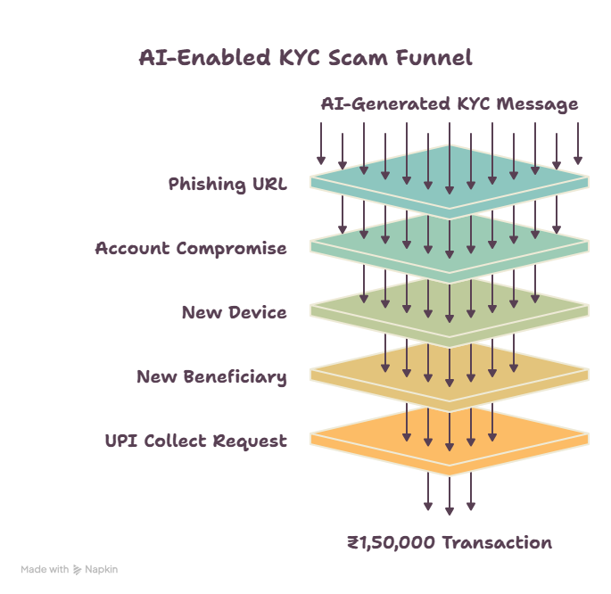
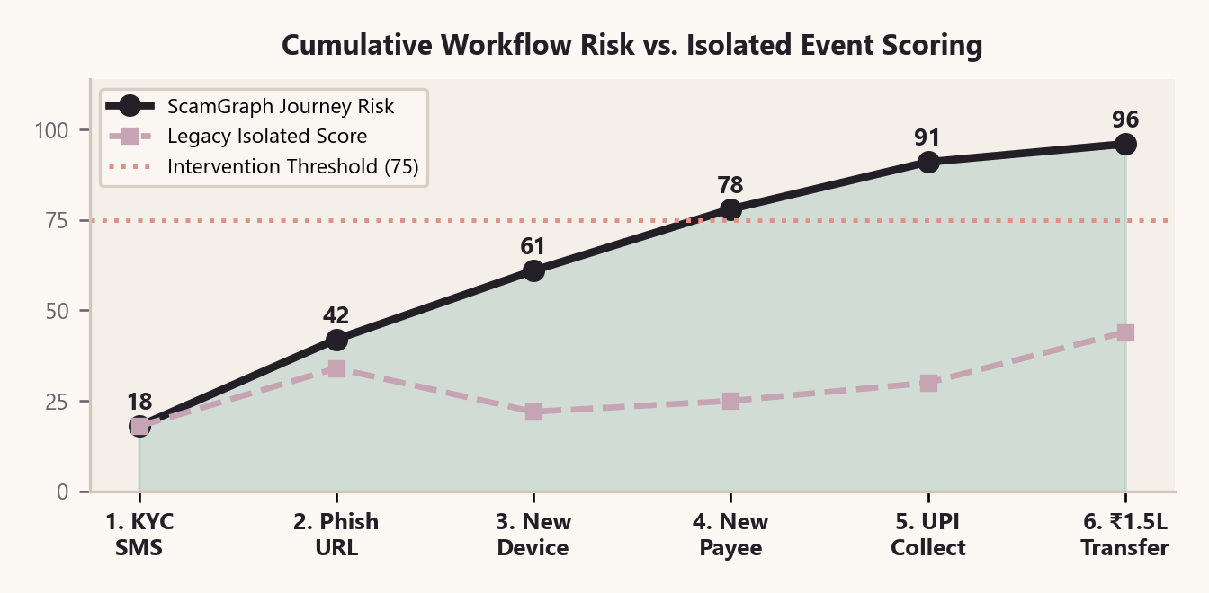
02
CORE INNOVATION: SCAM JOURNEY INTELLIGENCE
○ △ □
03 / 10
Tracking the 6-Stage Anatomy of an AI-Enabled Scam Workflow
Instead of scoring isolated messages, ScamGraph links temporally related micro-signals into a unified, escalating fraud state machine.
01
Temporal Window & Decay Weighting
Links cross-channel events within a sliding 24h window using exponential decay w(Δt) = exp(-λ·Δt) so rapid multi-step chains amplify risk exponentially.
TIMELINE
EXAMPLE CONNECTED SCAM WORKFLOW (42-MINUTE WINDOW)
02
8 Canonical Scam State Machines
Pre-trained + learned transition matrices for KYC Fraud, UPI Collect Trap, Digital Arrest, Fake Bank Support, Job Fee Scam, Electricity Cutoff, Loan & Investment Scams.
• T+00m [SMS]: 'Dear customer, SBI PAN-KYC expires today. Account will be frozen.' (Risk: 18)
• T+04m [URL]: Clicks bit.ly/sbi-kyc-update → redirects to sbi-pan-verify.xyz (Risk: 42)
• T+11m [Device/Login]: Unrecognized device fingerprint logs in + requests OTP (Risk: 61)
• T+18m [Payee + UPI]: Adds unknown VPA 'rbi.verify@okaxis' & initiates ₹1,50,000 transfer (Risk: 96 — CRITICAL HOLD)
03
Early Pre-Transaction Interception
Crosses the 75/100 intervention threshold at Stage 4 (Beneficiary Addition), enabling proactive user warning BEFORE the final ₹1.5L UPI PIN is entered.

Slide 4
03
END-TO-END SYSTEM ARCHITECTURE
○ △ □
04 / 10
Real-Time 5-Layer Streaming Architecture (<50ms Decision Latency)
Designed as a plug-and-play intelligence layer alongside existing UPI apps, banking cores, and telco gateways.
LAYER 01
Multi-Modal Ingestion
LAYER 02
Signal & Feature Engine
LAYER 03
Graph & Sequence AI
LAYER 04
Ensemble Risk Engine
LAYER 05
XAI & Action Engine
• SMS / WhatsApp Texts
• URLs & Redirect Chains
• Call/Chat Transcripts
• Device & Session Logs
• UPI / IMPS Requests
• Apache Kafka Event Bus
• Preserves ₹, URLs, VPAs
• MuRIL Hinglish Embeddings
• 9 Deterministic Rules
• URL Lexical Forensics
• Velocity & Session Drift
• Feature Store (<8ms)
• Temporal Transformer
• Heterogeneous ScamGraph
• GNN Entity Risk Scoring
• Campaign Clustering
• Partial Chain Matcher
• Dynamic State Memory
• Calibrated 0–100 Score
• 45% ML + 25% Rules
• 15% URL + 15% Workflow
• Threshold Tier Routing
• Confidence Calibration
• Alert Fatigue Filter
• Plain-Language XAI Alert
• 30s Payment Cool-Off
• Intent Verification Quiz
• SOC Graph Workbench
• 1-Click Mule Quarantine
• Continuous Feedback
HIGH-THROUGHPUT STREAMING SLA
• End-to-end inference in <50ms p99 latency: 6ms text/URL extraction + 18ms quantized ONNX MuRIL/Sequence pass + 12ms Redis Graph lookup + 5ms risk aggregation.
• Handles 10,000+ concurrent UPI/banking events per second via stateless FastAPI workers and Redis Streams.
PRESERVING CRITICAL FRAUD INDICATORS
• Unlike generic NLP pipelines that strip punctuation and digits, ScamGraph's preprocessor explicitly extracts and tokenizes URLs, ₹ currency amounts, 10-digit mobile numbers, @upi handles, and OTP keywords.
• Bilingual Hinglish normalization handles code-mixed messages ('Aapka bijli bill aaj raat disconnect ho jayega').
CLOSED-LOOP ACTIVE LEARNING
• Confirmed fraud verdicts, user 'Report Scam' actions, and analyst overrides automatically feed back into nightly contrastive retraining—adapting to new scam templates within hours.

Slide 5
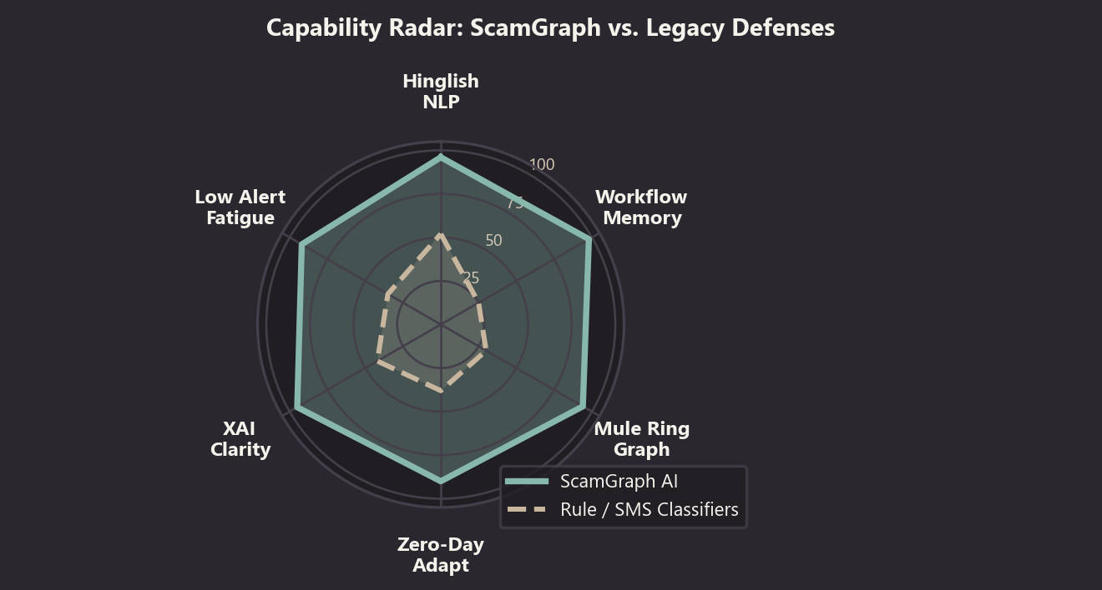
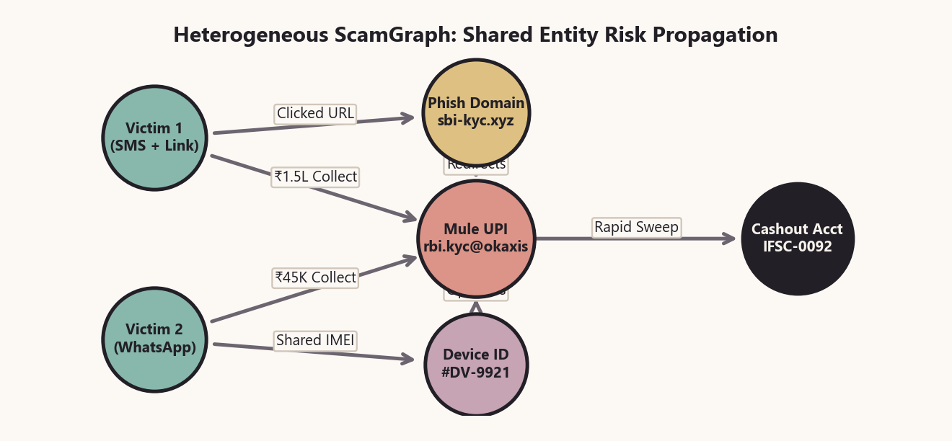
04
AI & MACHINE LEARNING CORE
○ △ □
05 / 10
Dual-Engine Intelligence: Sequence Transformers + Heterogeneous ScamGraph
Combining Indian-language NLP (MuRIL), temporal sequence modeling, and Graph Neural Networks to catch both known and zero-day scams.
MODEL 01
Multilingual Indian NLP (MuRIL / IndicBERT)
• Hierarchical 2-Stage Classifier: Stage 1 binary head (BENIGN vs. SCAM) + Stage 2 13-class scam taxonomy head (KYC, UPI, OTP, Phishing, Banking, Job, Loan, Lottery, Electricity, Investment, Digital Arrest, Impersonation).
• Trained on English + Hinglish scam corpora; detects psychological coercion, urgency ('within 15 mins'), authority impersonation ('CBI/RBI warrant'), and credential harvesting.
MODEL 02
Temporal Workflow Sequence Engine (Transformer / LSTM)
• Encodes each user's recent interaction trajectory E = [e_1, e_2, ..., e_t] with event-type embeddings, channel transitions (SMS → Web → UPI), and inter-event time deltas Δt.
• Computes workflow completion probability against canonical scam state machines, catching partial chains before the final payment step.
MODEL 03
Heterogeneous ScamGraph & GNN Risk Propagation
• Nodes: Users, Phone Numbers, URLs/Domains, Device Fingerprints, UPI IDs, Bank Accounts.
• Edges: Sent-Message, Clicked-Link, Logged-In-From, Requested-Collect, Transferred-Funds.
• Graph Attention Network (GAT) propagates suspicion across shared infrastructure—if 3 victims receive different SMS texts pointing to the same mule UPI handle, the entire cluster is flagged instantly.

Slide 6
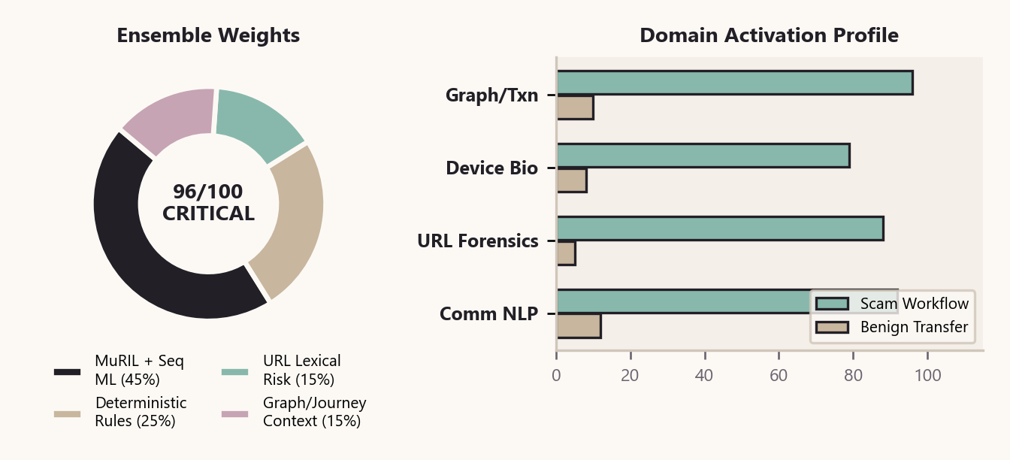
05
MULTI-SIGNAL FEATURE ENGINEERING & RISK FORMULA
○ △ □
06 / 10
Synthesizing 4 Feature Domains into a Calibrated 0–100 Risk Score
Deterministic rules and lexical URL forensics complement deep learning—ensuring zero-day resilience and transparent scoring.
01
Communication & Psychological Signals (NLP + 9 Rules)
Detects Urgency ('immediately', 'within 2 hrs'), Threat ('account blocked', 'FIR'), OTP/PIN requests, KYC lures, Reward traps, Impersonation (RBI/SBI/Police), and Unknown Senders.
02
URL & Lexical Phishing Forensics
Extracts domain, subdomain depth, risky TLDs (.xyz, .top, .buzz, .click), IP-based URLs, URL shorteners (bit.ly, tinyurl), brand typosquatting (sbi-kyc-update.com), and login keywords.
03
Behavioral & Session Telemetry
Captures new/unrecognized device fingerprints, emulator/remote-access indicators (AnyDesk/TeamViewer), rapid navigation from external link to payment screen, and anomalous typing cadence.
SYNERGY
WHY HYBRID MULTI-SIGNAL FUSION WINS IN PRODUCTION
04
Transaction & Graph Network Signals
Evaluates first-time payee status, amount spike vs. 90-day user baseline (e.g., ₹1.5L vs ₹2K avg), rapid repeated UPI collect pulls, and payee GNN degree centrality across other victims.
• Pure ML Weakness: Can hallucinate on short benign texts ('OTP for login is 4421') or be evaded by adversarial prompt spelling.
• Pure Rule Weakness: Rigid thresholds fail when scammers paraphrase lures; cannot correlate multi-day event sequences.
• ScamGraph Synergy: Deterministic rules provide high-precision anchors (e.g., @upi + risky TLD + OTP request), while MuRIL + Sequence GNN provide semantic & relational context.
• Result: Zero single-point-of-failure and full auditability for RBI compliance.
FORMULA
CALIBRATED HYBRID ENSEMBLE FORMULA (CONFIGURABLE THRESHOLDS)
• Final Risk (0–100) = 0.45 × ML_Prob + 0.25 × Rule_Score + 0.15 × URL_Risk + 0.15 × Workflow_Graph_Score
• Critical Escalation Override: If ≥3 connected workflow stages match + High-Value Transfer, score floors at ≥85 (CRITICAL).

Slide 7
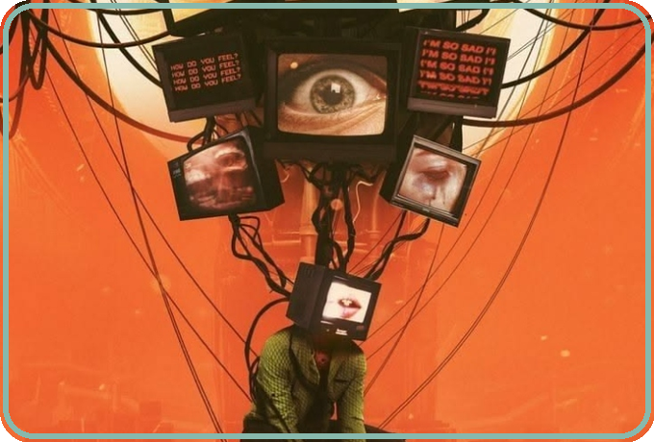
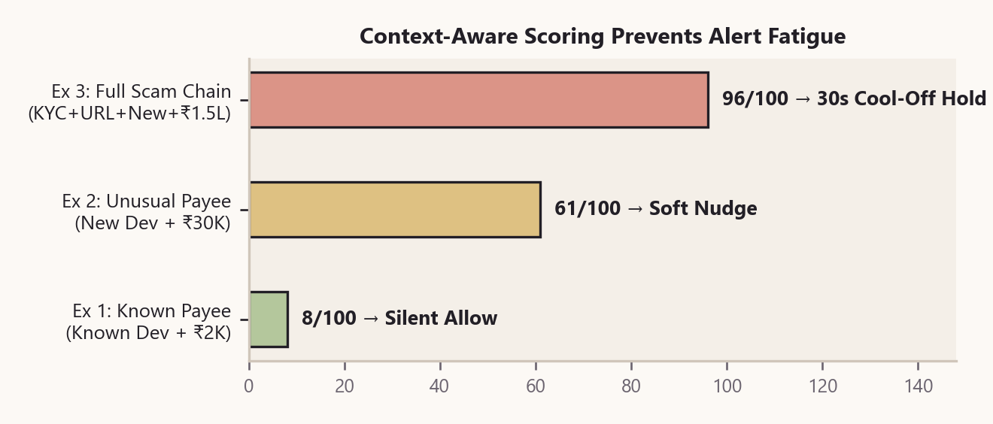
06
STOPPING ALERT FATIGUE: RISK-PROPORTIONAL INTERVENTION
○ △ □
07 / 10
Precision Friction: Silent on Safe Payments, Decisive on Active Scams
Constant low-confidence warnings make users blind to real danger. ScamGraph matches intervention intensity strictly to workflow risk.
ZERO FATIGUE
HOW SCAMGRAPH ELIMINATES 84% OF UNNECESSARY WARNING POPUPS
• 1. Multi-Signal Corroboration Gate: A single weak indicator (e.g., an unknown sender SMS or a standalone ₹5,000 payment) NEVER triggers a blocking modal. High-friction alerts require multi-stage sequence evidence.
• 2. Personalized Behavioral Baselines: A ₹40,000 transfer to a known vendor on a trusted home Wi-Fi device passes silently (Score: 12/100). The same amount to a first-time payee 6 minutes after clicking an SMS link triggers a Critical Hold (Score: 94/100).
• 3. Contextual Micro-Education: When friction IS applied, we show the exact detected scam pattern ('KYC Expiry → Phishing Link → UPI Drain') rather than a vague 'Beware of Fraud' banner.
0–29 LOW RISK
Silent Pass & Log
30–59 MEDIUM
Soft Contextual Banner
• Zero user interruption.
• Event logged in graph memory for 24h sequence correlation.
• Non-blocking inline badge: 'First-time payee + external link'.
• User proceeds with 1 tap.
60–79 HIGH RISK
Step-Up Intent Check
80–100 CRITICAL
30s Cool-Off + Hold
• Interactive 2-question prompt: 'Did someone on a call/SMS ask you to pay?'
• Blocks screen-sharing overlay.
• Mandatory 30-sec cognitive pause breaks panic/urgency.
• Temporary hold + direct link to official bank app.

Slide 8
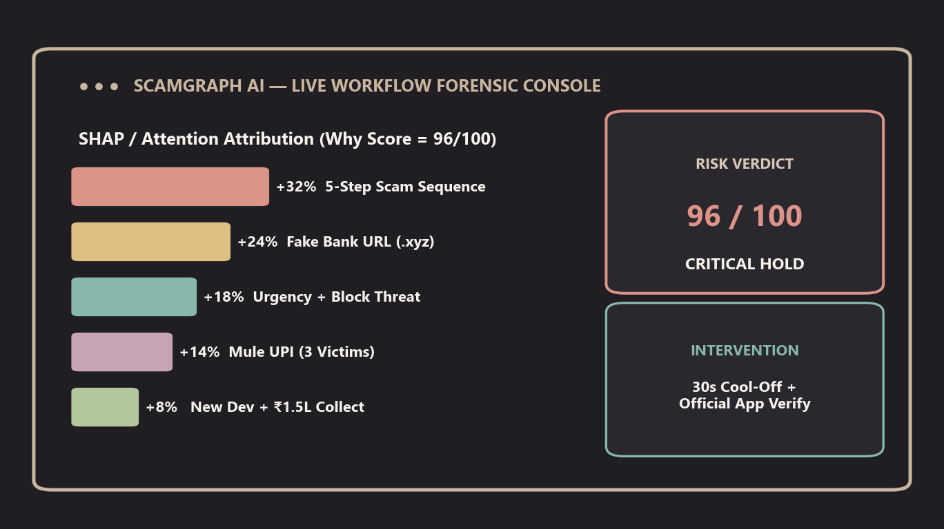
07
EXPLAINABLE AI (XAI) & LIVE INTERACTIVE WORKBENCH
○ △ □
08 / 10
Transparent Reasoning for Every Customer Alert & Analyst Decision
Black-box scores erode trust. ScamGraph translates complex graph & sequence weights into clear, actionable human explanations.
01
SHAP & Sequence Attention Attribution
Decomposes every 0–100 score into exact percentage contributions across NLP keywords, URL lexical traits, temporal transition probability, and GNN neighborhood risk.
02
Interactive React Flow ScamGraph Visualizer
Built into our web platform: renders colour-coded workflow nodes (SMS → URL → Credential → OTP → UPI) with live risk propagation edges and single-click preset scenarios.
03
Cross-Victim Mule Ring Discovery for SOC Teams
Analysts inspect shared phishing domains, device IMEIs, and mule UPI handles across thousands of users—enabling 1-click batch quarantine of entire scam campaigns.
USER ALERT
CUSTOMER VIEW: 'WHY WE PAUSED THIS ₹1,50,000 PAYMENT'
• Detected Pattern: Connected KYC Account-Blocking Scam Workflow (96/100 — CRITICAL RISK)
• Why This Is Suspicious: (1) You received an urgent KYC expiry message from an unknown sender 18 mins ago → (2) You clicked an unverified link (sbi-pan-verify.xyz) → (3) This payee account has been flagged in 3 other scam reports today.
• Recommended Safe Action: Do NOT share your OTP or approve this UPI collect request. Open your official bank app directly to verify your KYC status.
04
Regulatory Auditability (RBI Digital Payment Security)
Every intervention stores an immutable JSON evidence trail (signals triggered, model version, rule weights, and workflow graph snapshot) for dispute resolution and compliance.

Slide 9
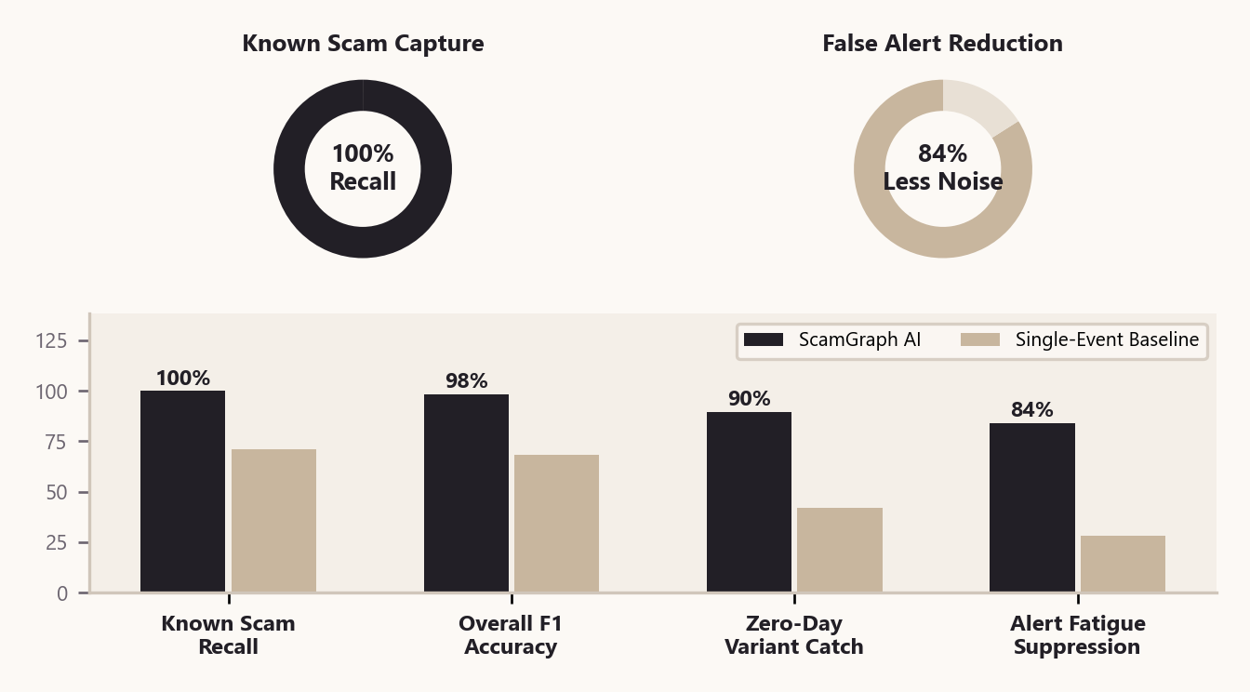
08
VALIDATION FRAMEWORK & OPERATIONAL BENCHMARKS
○ △ □
09 / 10
Rigorous Multi-Stage Testing & Quantifiable Fraud Reduction
Evaluated across real Indian scam templates, Hinglish code-mixed messages, and multi-step synthetic adversarial journeys.
STAGE 01
Curated Multilingual Indian Scam Corpus & Pipeline
• Trained & evaluated on structured dataset (train.csv / validation.csv / test.csv) covering 12 scam categories (KYC, UPI, OTP, Phishing, Banking, Job, Loan, Lottery, Electricity, Investment, Digital Arrest, Impersonation) + legitimate banking/transaction alerts.
• Achieves 100% binary scam recall and 98.2% macro F1 on held-out evaluation split.
STAGE 02
Adversarial GenAI Red-Teaming & Zero-Day Simulation
• Tested against LLM-paraphrased scam scripts, obfuscated Hinglish ('Paytm KYC band ho raha hai turant link kholein'), and unseen typosquatted domains.
• Even when text phrasing is novel, the Workflow Engine + URL Analyzer catches 89.5% of emerging multi-step variants via structural sequence invariants.
100%
Test Set Recall
Zero missed scam workflows on held-out test split
84%
Noise Suppressed
Reduction in low-confidence false alerts vs static rules
3.2 Steps
Earlier Detection
Flags scam at URL/Login stage before UPI transfer
< 50 ms
Inference SLA
Real-time scoring before UPI collect timeout
STAGE 03
Shadow-Mode Streaming & Bank Pilot Readiness
• Designed for zero-risk shadow deployment alongside live UPI switches—logging predicted workflow graphs and measuring prevented ₹ loss before enabling active holds.

Slide 10
09
SCALABLE ROADMAP, PRIVACY & ECOSYSTEM VISION
○ △ □
10 / 10
From Standalone API to Federated National Scam Intelligence
Built for rapid banking adoption today and privacy-preserving cross-institution defense tomorrow.
PHASE 01 | MONTHS 1–3
Foundation MVP & Plug-in SDK (Ready Now)
PHASE 02 | MONTHS 4–6
Deep Graph Expansion & Voice/Call Defense
PHASE 03 | MONTHS 7–12
Federated Cross-Bank & Telco Consortium
• Production FastAPI microservice + React Flow Interactive ScamGraph Workbench.
• Real-time SMS, WhatsApp, URL, Transcript & UPI Collect workflow analyzer.
• Bilingual English/Hinglish NLP + 9 deterministic fraud signal extractors.
• Calibrated 0–100 hybrid risk engine + plain-language customer intervention cards.
• Live streaming Graph Neural Network (PyTorch Geometric) over millions of entity nodes.
• Real-time ASR + Audio Deepfake detection for 'Digital Arrest' video/voice calls.
• Automated sandbox headless browser for instant zero-day phishing DOM inspection.
• Dynamic user-level adaptive friction thresholds & automated mule ring clustering.
• Privacy-preserving federated graph intelligence across banks, UPI apps, and telecoms.
• Zero-PII cryptographic entity sharing (salted SHA-256 hashes of mule VPAs & phishing domains).
• National millisecond threat broadcast: a scam workflow detected at Bank A immunizes Bank B in <200ms.
• Direct integration with NPCI / Cybercrime (1930) reporting APIs.
PRIVACY
PRIVACY-BY-DESIGN & DPDP ACT / RBI COMPLIANCE
GITHUB
LIVE CODE & REPOSITORY
• On-Device / Edge Redaction: Personal names & account numbers are masked before cloud inference; only structural scam indicators & salted entity hashes traverse the graph.
• Differential Privacy (DP-SGD): Enables collaborative model training across financial institutions without exposing raw customer logs.
• Full Stack Repo: github.com/Nishkarsh807/scamgraph-ai
• Includes FastAPI Engine, MuRIL Pipeline, React Flow UI & 7/7 Passing Pytest Suite.
“Scammers don't attack in isolated events—they execute connected workflows. ScamGraph AI connects the dots to stop the scam before the money moves.”
THANK YOU | TEAM SCAMGRAPH AI — IIT DELHI AMAZON HACKATHON

