Slide 1

Amazing Community GitHub Actions
By Nishkarsh Raj @

Slide 2


Nishkarsh Raj
Principal DevOps Evangelist & Consultant
GitHub Star, 2021
Open Source Enthusiast
Avid GitHubber
Notes:
Image used in the preview file : https://unsplash.com/photos/t3zrEm88ehc

Slide 3
Agenda
Community GitHub Actions
01
04
GitHub Actions 101
CI/CD
End-To-End Pipelines setup
02
05
First Steps
Notification Center
Creating the Hello, World! GitHub Actions and hosting it on GitHub Marketplace
Sending GitHub Repository events notification on Discord and Slack
03
06
Maintainer’s Corner
Miscellaneous Amazing Actions

Slide 4






Automation <3
Notes:
Multiple image used in Unsplash collection : https://unsplash.com/collections/4735930/thepres

Slide 5
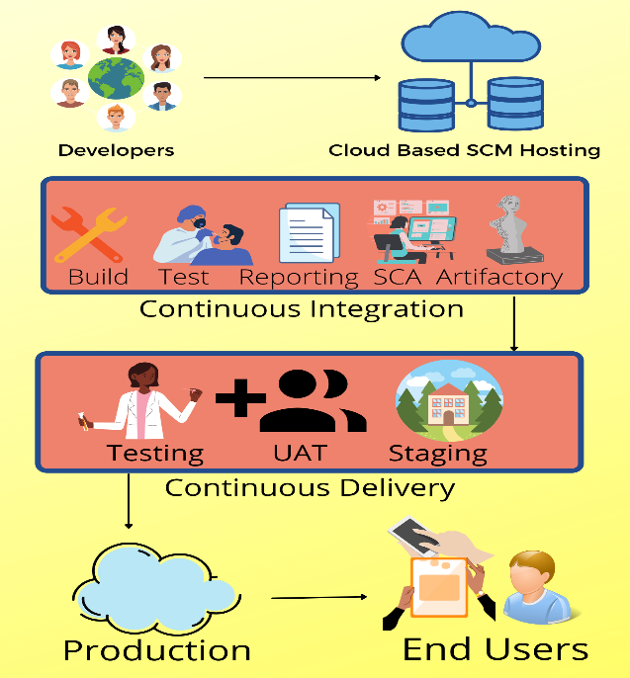

Slide 6

GitHub Actions 101
01
Introduction
Automate, customize, and execute your software development workflows right in your repository with GitHub Actions. You can discover, create, and share actions to perform any job you'd like, including CI/CD, and combine actions in a completely customized workflow.
Notes:
Image used in the preview file : https://unsplash.com/photos/thhFvgLWnms

Slide 7
02
The First Step
Hello, World! GitHub Actions
Notes:
Image used in the preview file : https://unsplash.com/photos/thhFvgLWnms

Slide 8
03
Maintainer’s
Corner
Notes:
Image used in the preview file : https://unsplash.com/photos/thhFvgLWnms

Slide 9
Continuous Integration & Continuous Delivery
04
Notes:
Image used in the preview file : https://unsplash.com/photos/thhFvgLWnms

Slide 10
05
Notification Center
Notes:
Image used in the preview file : https://unsplash.com/photos/thhFvgLWnms

Slide 11
06
Miscellaneous Actions
Notes:
Image used in the preview file : https://unsplash.com/photos/thhFvgLWnms

Slide 12
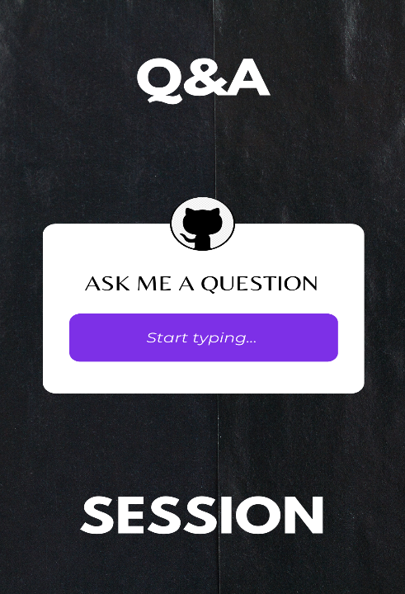

Slide 13


