Slide 1

GitHub Automation
Test-Automation Mid Semester Project using Selenium and TestNG Framework

Slide 2
GitHub Automation
Team Details:
Member 1: Nishkarsh Raj
SAP ID: 500060720
Roll Number: R171217041
Member 2: Lakshika Parihar
SAP ID: 500060110
Roll Number: R171217031
Member 3: Shraddha Saini
SAP ID: 500062194
Roll Number: R171217055

Slide 3
Code
package github;
//Import the required packages ---------
import org.openqa.selenium.By;
import org.openqa.selenium.WebDriver;
import org.openqa.selenium.WebElement;
import org.openqa.selenium.chrome.ChromeDriver;
import org.testng.Assert;
import org.testng.annotations.AfterMethod;
import org.testng.annotations.AfterSuite;
import org.testng.annotations.BeforeMethod;
import org.testng.annotations.BeforeSuite;
import org.testng.annotations.DataProvider;
import org.testng.annotations.Test;
1

Slide 4
public class Main
{
public static String str;
public static WebDriver driver;
public static WebElement element;
@BeforeSuite
public void Setup_Drivers() ---------
{
System.setProperty("webdriver.chrome.driver", "D:\\UPES DevOps\\DevOps Sem 6\\Test Automation\\Softwares\\chromedriver.exe");
}
2

Slide 5
//Before Method because it repeats as many times as the Test Cases
@BeforeMethod ------------
public void Visit_GitHub()
{
driver = new ChromeDriver();
driver.navigate().to("https://github.com/login");
driver.manage().window().maximize();
}
3

Slide 6
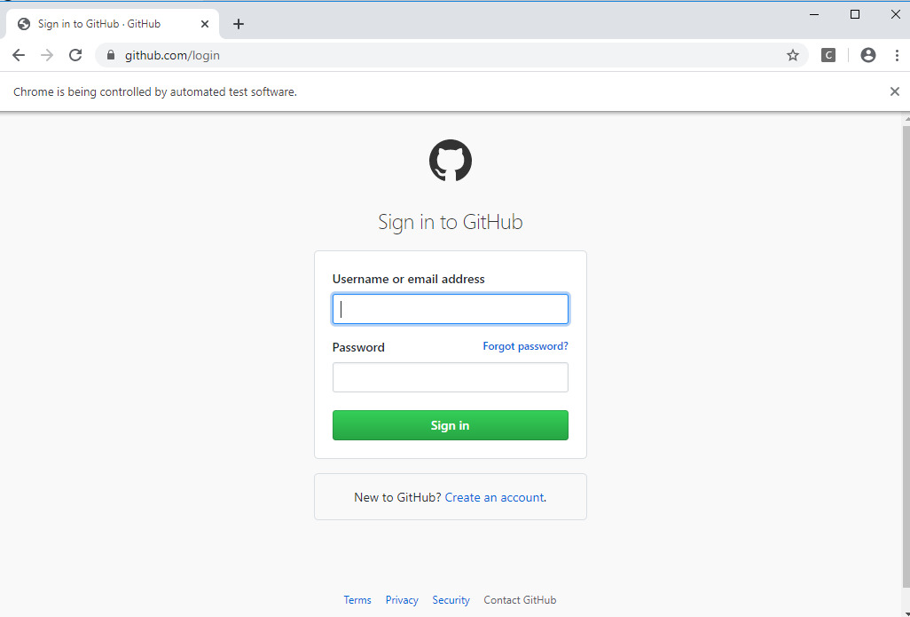

Slide 7
@Test(dataProvider = "getData",priority=1)
public void Login(String username, String password) -------------
{
//Assertions
str = driver.findElement(By.xpath("//*[@id=\"login\"]/form/div[1]/h1")).getText();
Assert.assertTrue(str.contains("Sign"));
str = driver.findElement(By.xpath("//*[@id=\"login\"]/form/div[4]/label[1]")).getText();
Assert.assertTrue(str.contains("Username"));
str = driver.findElement(By.xpath("//*[@id=\"login\"]/form/div[4]/label[2]")).getText();
Assert.assertTrue(str.contains("Password"));
Assert.assertTrue(driver.findElement(By.xpath("//*[@id=\"login\"]/form/div[4]/input[9]")).isEnabled());
//Image check /html/body/div[1]/div[2]/div/a/svg
4

Slide 8
element = driver.findElement(By.name("login"));
element.sendKeys(username);
element = driver.findElement(By.name("password"));
element.sendKeys(password);
driver.findElement(By.name("commit")).click();
}

Slide 9
@DataProvider(name="getData")
public Object[][] getData(){
Object[][] obj = new Object[3][2];
obj[0][0] = "nishkarshraj000@gmail.com";
obj[0][1] = "Nish123!@#";
obj[1][0] = "MeghaRawat3";
obj[1][1] = "Megh4@123";
obj[2][0] = "raj123khare@gmail.com";
obj[2][1] = "Ni$hkar$H3";
return obj;
}

Slide 10
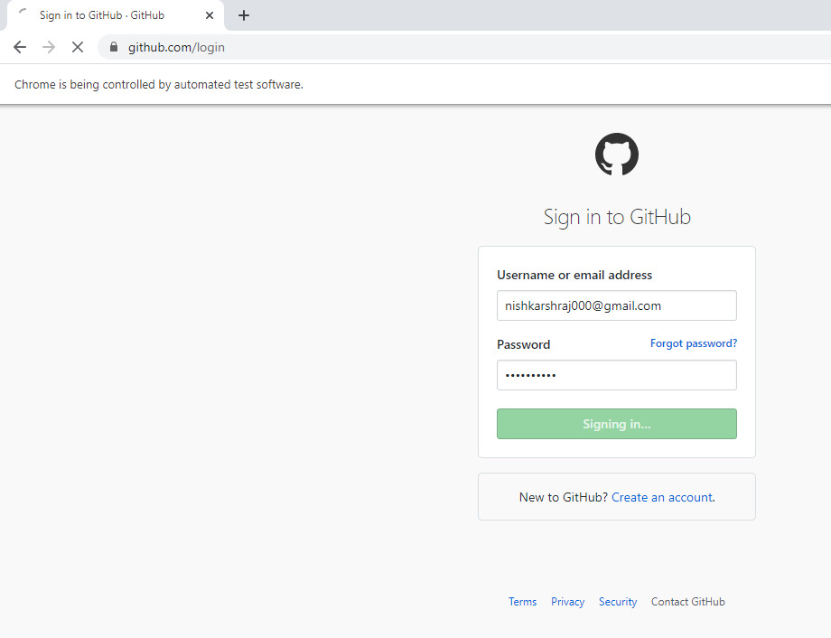
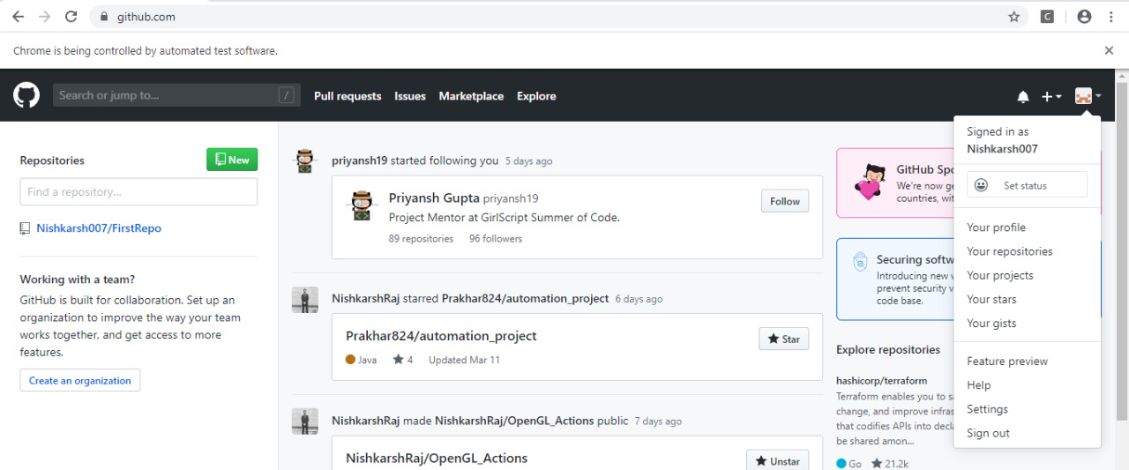

Slide 11
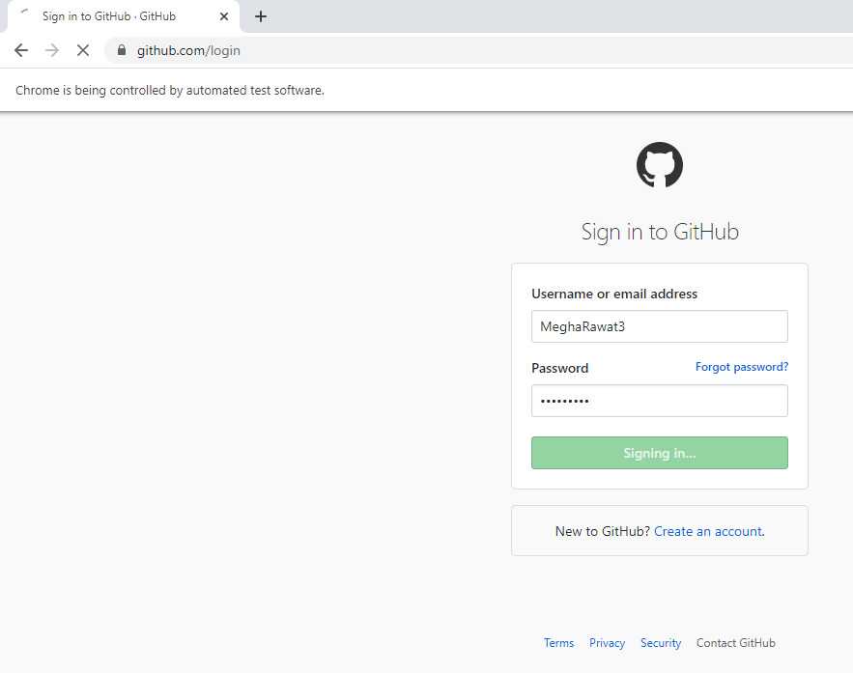
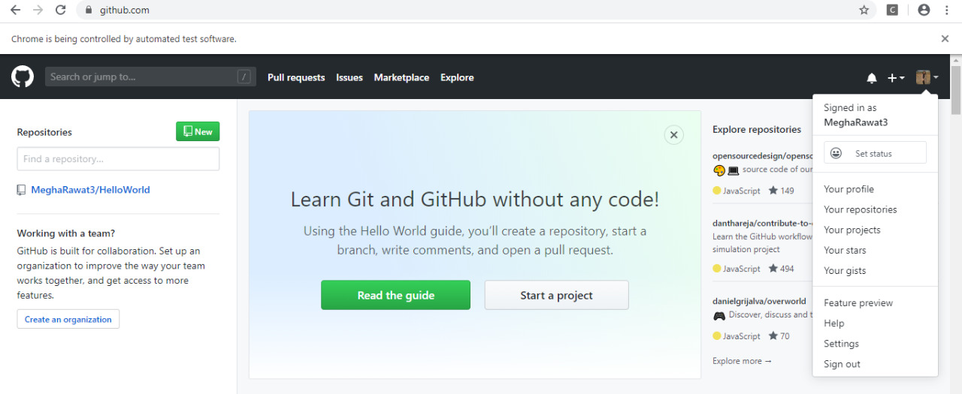

Slide 12
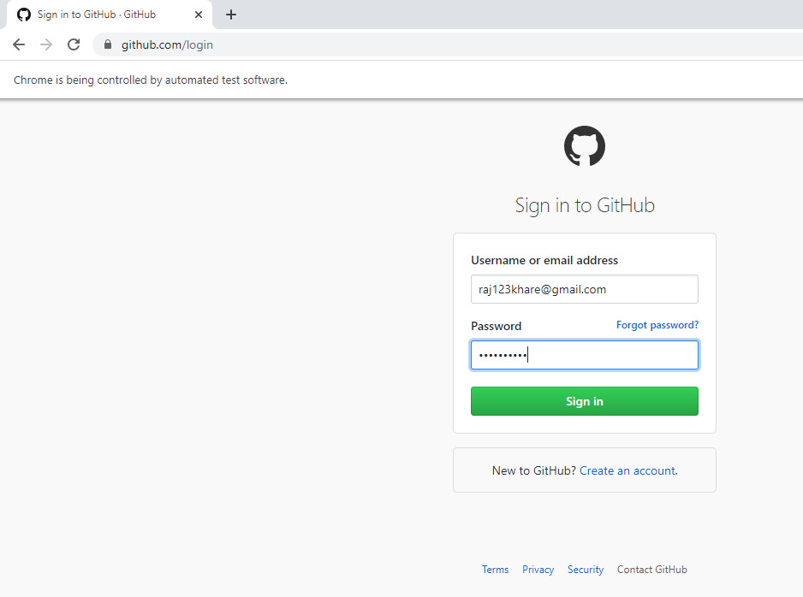
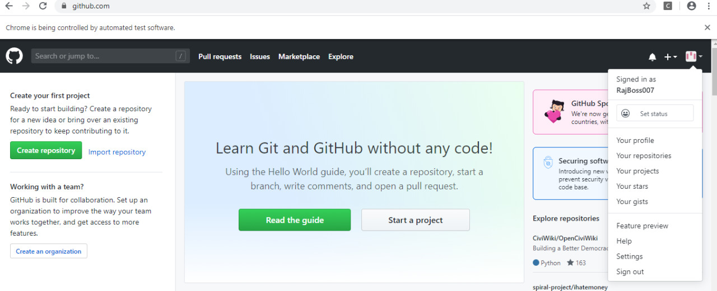

Slide 13
@Test(priority=2)
public void CreateRepository() -------------
{
element = driver.findElement(By.name("login"));
element.sendKeys("nishkarshraj000@gmail.com");
element = driver.findElement(By.name("password"));
element.sendKeys("Nish123!@#");
driver.findElement(By.name("commit")).click();
//Homepage assertions
str = driver.findElement(By.xpath("/html/body/div[4]/div/aside[1]/div[2]/div[1]/div/h2")).getText();
Assert.assertTrue(str.contains("Repositories"));
Assert.assertTrue(driver.findElement(By.xpath("/html/body/div[4]/div/aside[1]/div[2]/div[1]/div/h2/a")).isEnabled());
5

Slide 14
//Create Repository
driver.findElement(By.xpath("/html/body/div[4]/div/aside[1]/div[2]/div[1]/div/h2/a")).click();
element = driver.findElement(By.xpath("//*[@id=\"repository_name\"]"));
element.sendKeys("Test Automation");
//Create Repository Page Assertions
str = driver.findElement(By.xpath("//*[@id=\"new_repository\"]/div[2]/auto-check/dl/dt/label")).getText();
Assert.assertTrue(str.contains("Repository"));
str = driver.findElement(By.xpath("//*[@id=\"repository-owner-label\"]")).getText();
Assert.assertTrue(str.contains("Owner")); driver.findElement(By.xpath("//*[@id=\"new_repository\"]/div[3]/button")).submit();

Slide 15
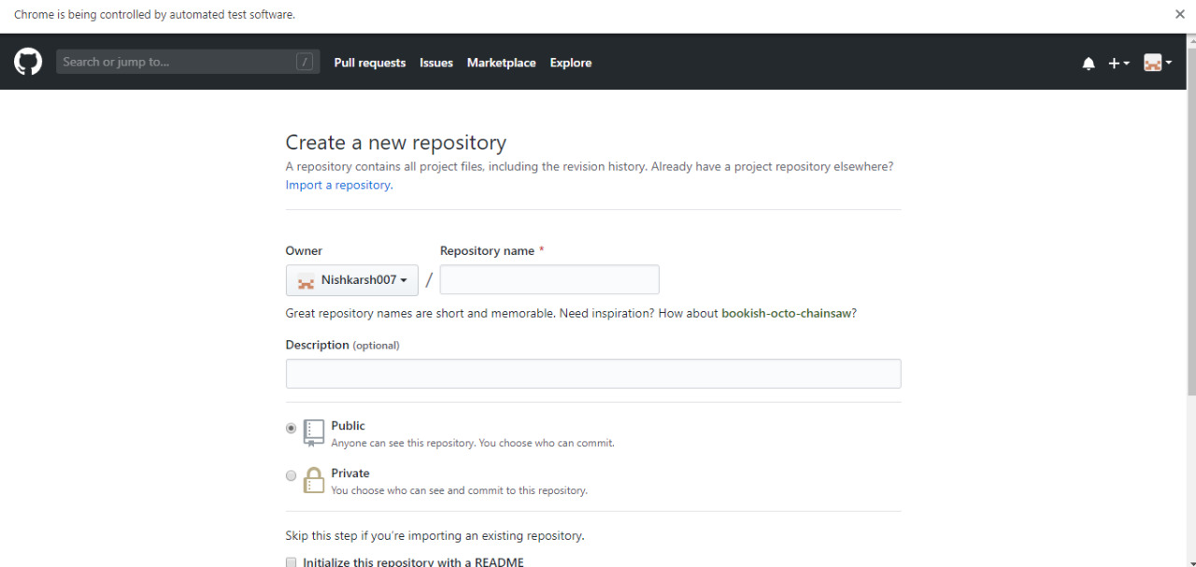

Slide 16
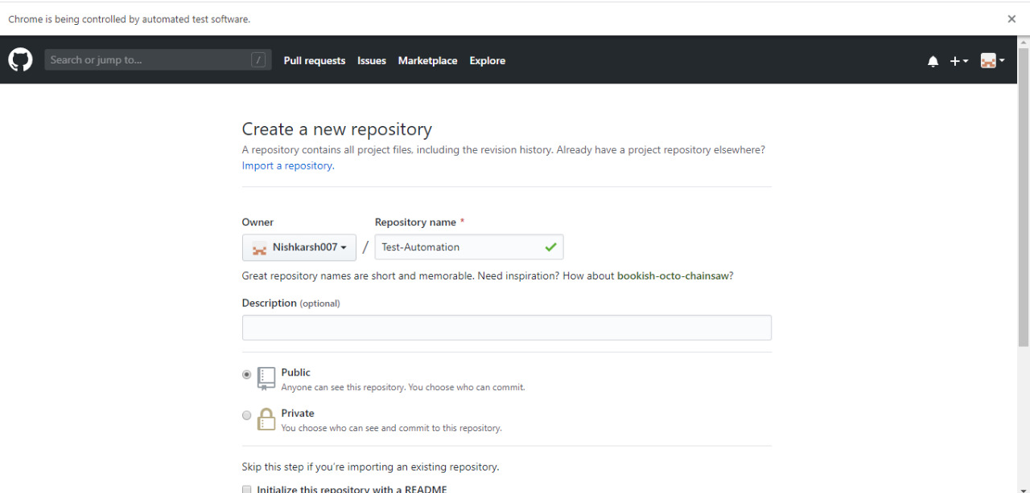

Slide 17
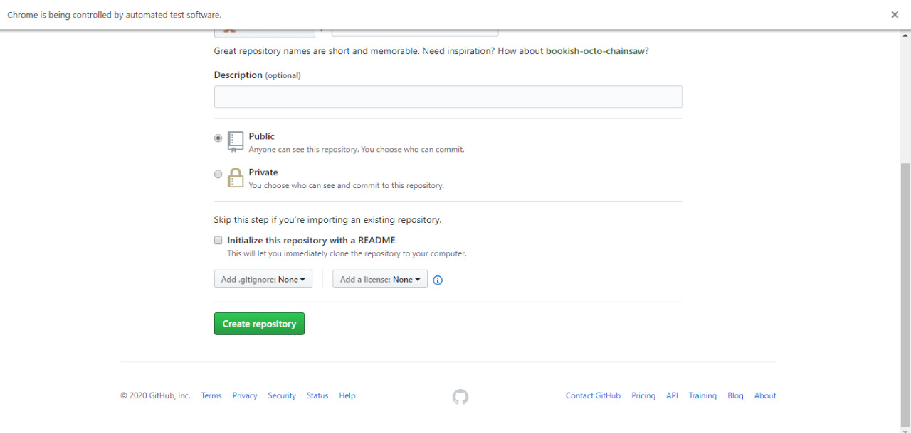

Slide 18
//Repository Homepage Assertions
str = driver.findElement(By.xpath("//*[@id=\"js-repo-pjax-container\"]/div[1]/nav/span[1]/a/span")).getText();
Assert.assertTrue(str.contains("Code"));
str = driver.findElement(By.xpath("//*[@id=\"js-repo-pjax-container\"]/div[1]/nav/span[2]/a/span[1]")).getText();
Assert.assertTrue(str.contains("Issues"));

Slide 19
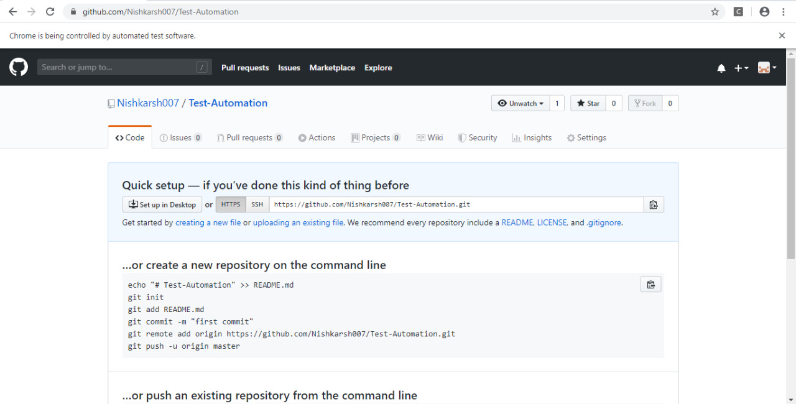

Slide 20
//Add Default file to make the repository forkable because empty repository cannot be forked
driver.findElement(By.xpath("//*[@id=\"js-repo-pjax-container\"]/div[2]/div/div[1]/div[1]/p/a[1]")).click();
//File name
element = driver.findElement(By.name("filename"));
element.sendKeys("README.md");
//Content
element = driver.findElement(By.xpath("//*[@id=\"js-repo-pjax-container\"]/div[2]/div/div/form[2]/div[5]/div[2]/div/div[5]/div[1]/div/div/div/div[5]/div/pre"));
element.sendKeys("Default Content");

Slide 21
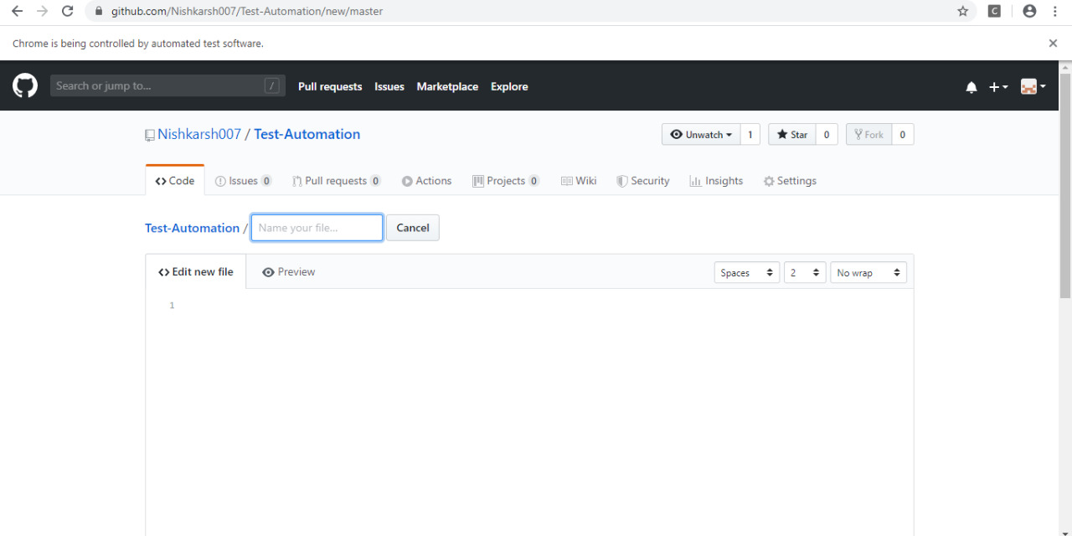

Slide 22
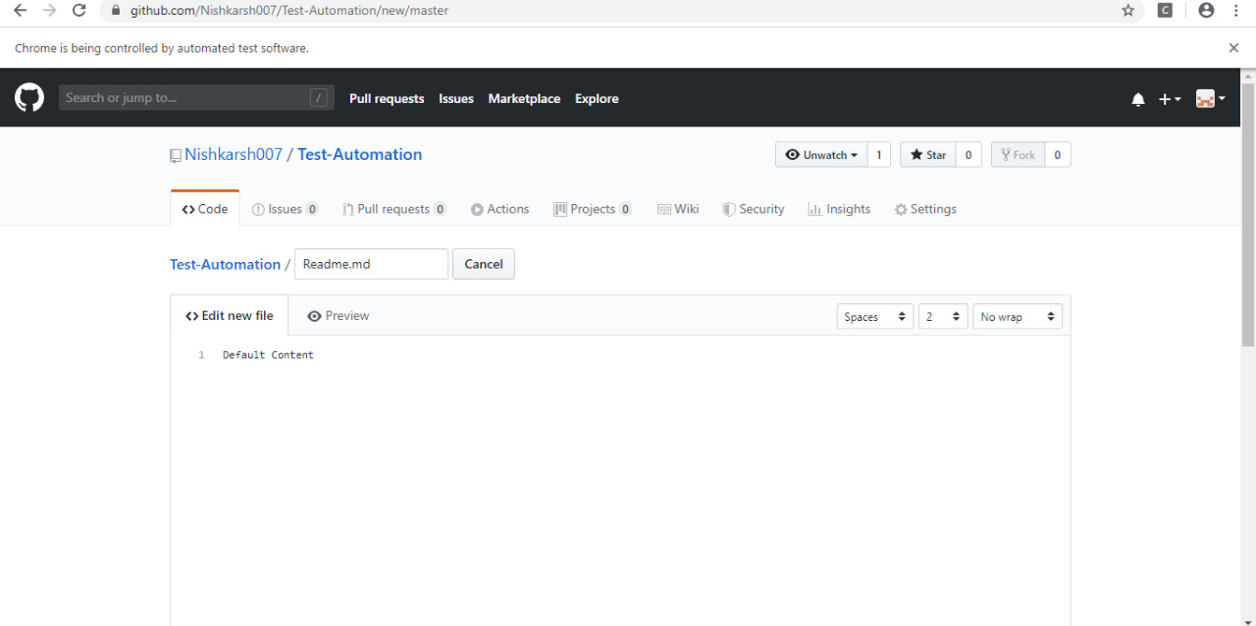

Slide 23
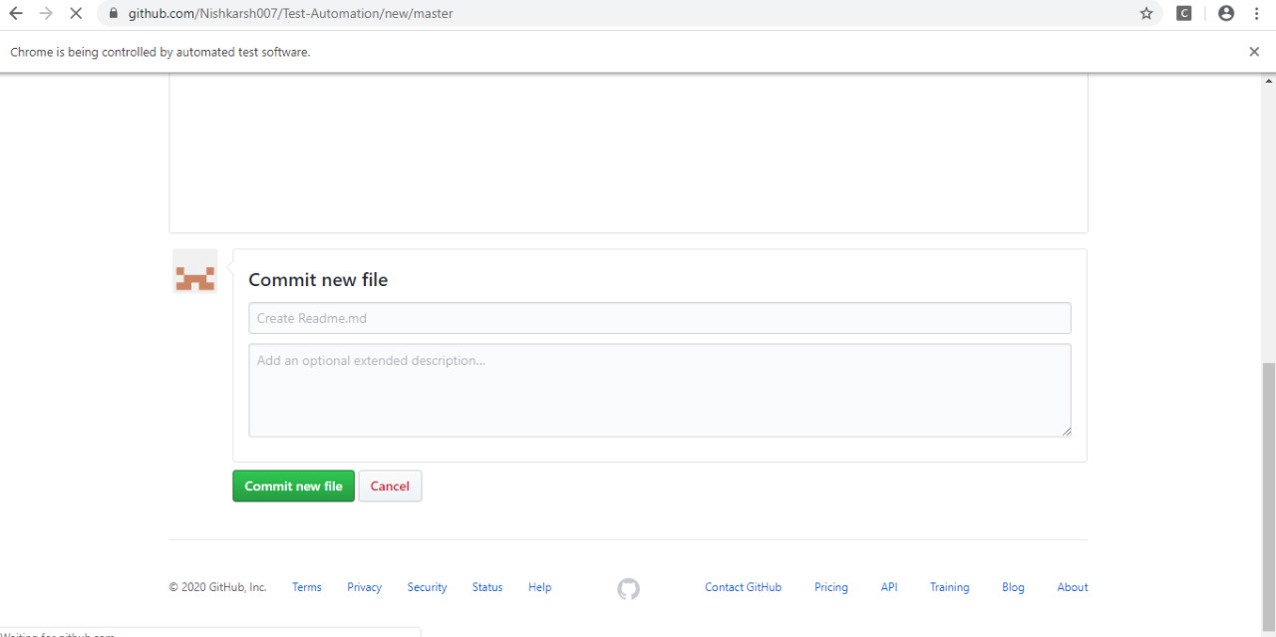

Slide 24
//Create File Assertions
str = driver.findElement(By.xpath("//*[@id=\"js-repo-pjax-container\"]/div[2]/div/div/form[2]/div[5]/div[1]/div[1]/button[1]")).getText();
Assert.assertTrue(str.contains("Edit"));
str = driver.findElement(By.xpath("//*[@id=\"js-repo-pjax-container\"]/div[2]/div/div/form[2]/div[5]/div[1]/div[1]/button[2]")).getText();
Assert.assertTrue(str.contains("Preview"));
driver.findElement(By.id("submit-file")).click();
}

Slide 25
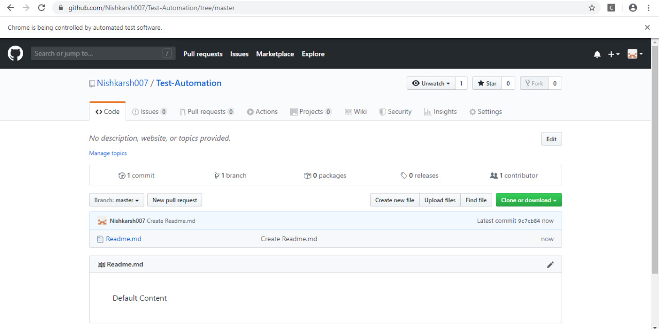

Slide 26
//Fork 1
@Test(priority=3)
public void Fork1() ---------------
{
element = driver.findElement(By.name("login"));
element.sendKeys("raj123khare@gmail.com");
element = driver.findElement(By.name("password"));
element.sendKeys("Ni$hkar$H3");
driver.findElement(By.name("commit")).click();
//Navigate to repository to be forked driver.navigate().to("https://github.com/Nishkarsh007/Test-Automation");
//Fork the repository
//Time Delay to interact
int i;
for(i=0;i<10000;i++)
{ // }
//driver.findElement(By.partialLinkText("Fork")).click(); driver.findElement(By.xpath("/html/body/div[4]/div/main/div[2]/div/ul/li[3]/form/button")).click();
}
6

Slide 27
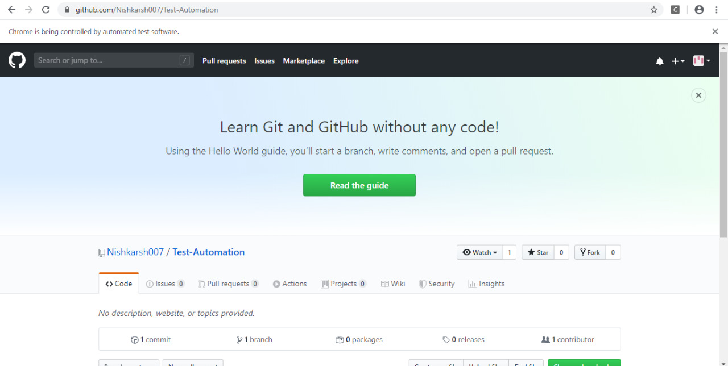

Slide 28
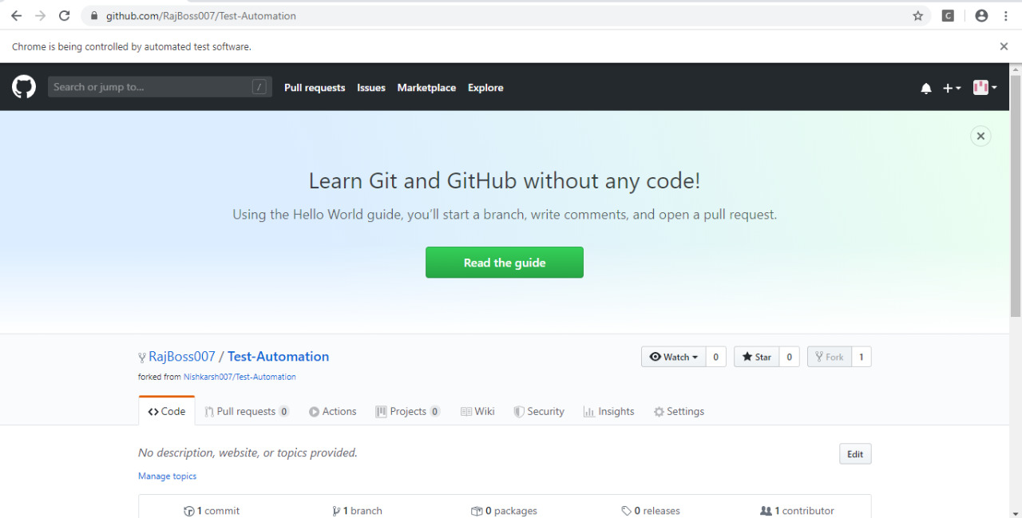

Slide 29
@Test(priority=5)
public void Fork2() ------------------
{
element = driver.findElement(By.name("login"));
element.sendKeys("MeghaRawat3");
element = driver.findElement(By.name("password"));
element.sendKeys("Megh4@123");
driver.findElement(By.name("commit")).click();
//Navigate to repository to be forked
driver.navigate().to("https://github.com/Nishkarsh007/Test-Automation");
//Fork the repository
int i;
for(i=0;i<10000;i++)
{
//
} driver.findElement(By.xpath("/html/body/div[4]/div/main/div[2]/div/ul/li[3]/form/button")).click();
}
7

Slide 30
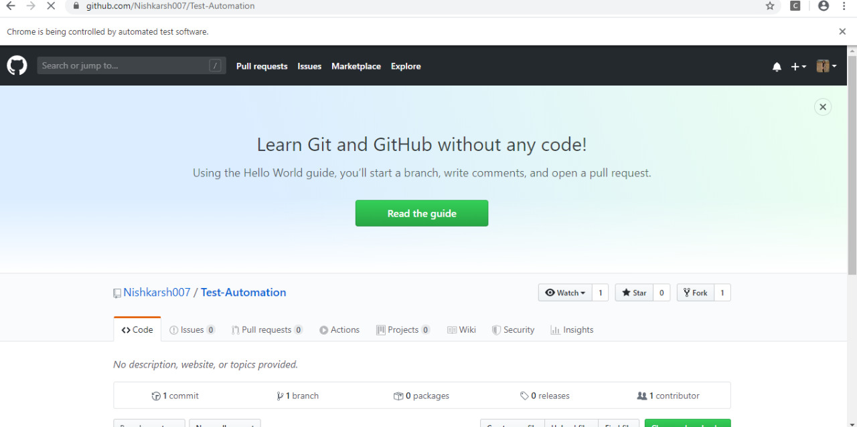

Slide 31
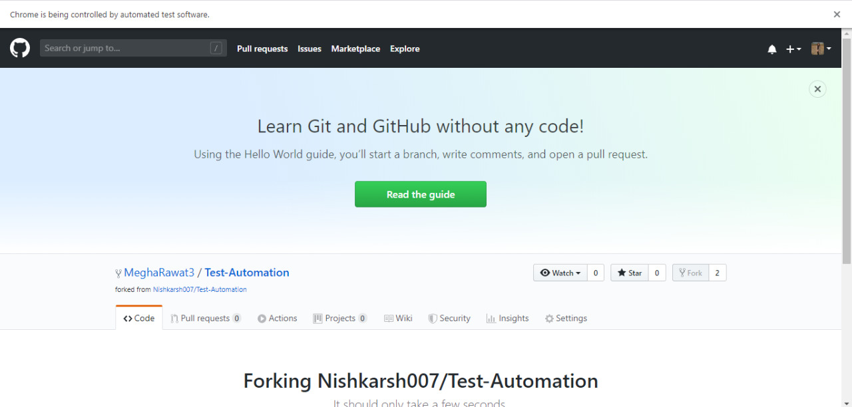

Slide 32
@Test(priority=4)
public void PR1() -------------------
{
element = driver.findElement(By.name("login"));
element.sendKeys("raj123khare@gmail.com");
element = driver.findElement(By.name("password"));
element.sendKeys("Ni$hkar$H3");
driver.findElement(By.name("commit")).click();
//Navigate to repository to be forked but commit to master branch rather than creating new branch
driver.navigate().to("https://github.com/RajBoss007/Test-Automation");
8

Slide 33
// Create new file in the new branch
driver.findElement(By.xpath("//*[@id=\"js-repo-pjax-container\"]/div[3]/div/div[3]/div[2]/form/button")).click();
element = driver.findElement(By.xpath("//*[@id=\"js-repo-pjax-container\"]/div[3]/div/div/form[2]/div[1]/span/input"));
element.sendKeys("Feature.md");
element = driver.findElement(By.xpath("//*[@id=\"js-repo-pjax-container\"]/div[3]/div/div/form[2]/div[5]/div[2]/div/div[5]/div[1]/div/div/div/div[5]/div/pre"));
element.sendKeys("Default Content");
driver.findElement(By.xpath("//*[@id=\"submit-file\"]")).click();
// the new branch with feature.md file is created

Slide 34
// Revisit the homepage of the repository to get access to PR button
//driver.navigate().to("https://github.com/RajBoss007/Test-Automation");
//Note, we assume patch 1 as the default branching mechanism! patch 2 even wont work
//driver.findElement(By.xpath("//*[@id=\"js-repo-pjax-container\"]/div[3]/div/div[1]/ul/li[2]/a")).click(); //Open branches
driver.findElement(By.xpath("//*[@id=\"js-repo-pjax-container\"]/div[3]/div/div[3]/a")).click();
/*
//Pull Request Page Assertions
str = driver.findElement(By.xpath("//*[@id=\"js-repo-pjax-container\"]/div[3]/div/div[1]/div[1]/h1")).getText();
Assert.assertTrue(str.contains("Comparing"));
Assert.assertTrue(driver.findElement(By.xpath("//*[@id=\"js-repo-pjax-container\"]/div[3]/div/div[2]/div/button")).isEnabled());
*/ }

Slide 35
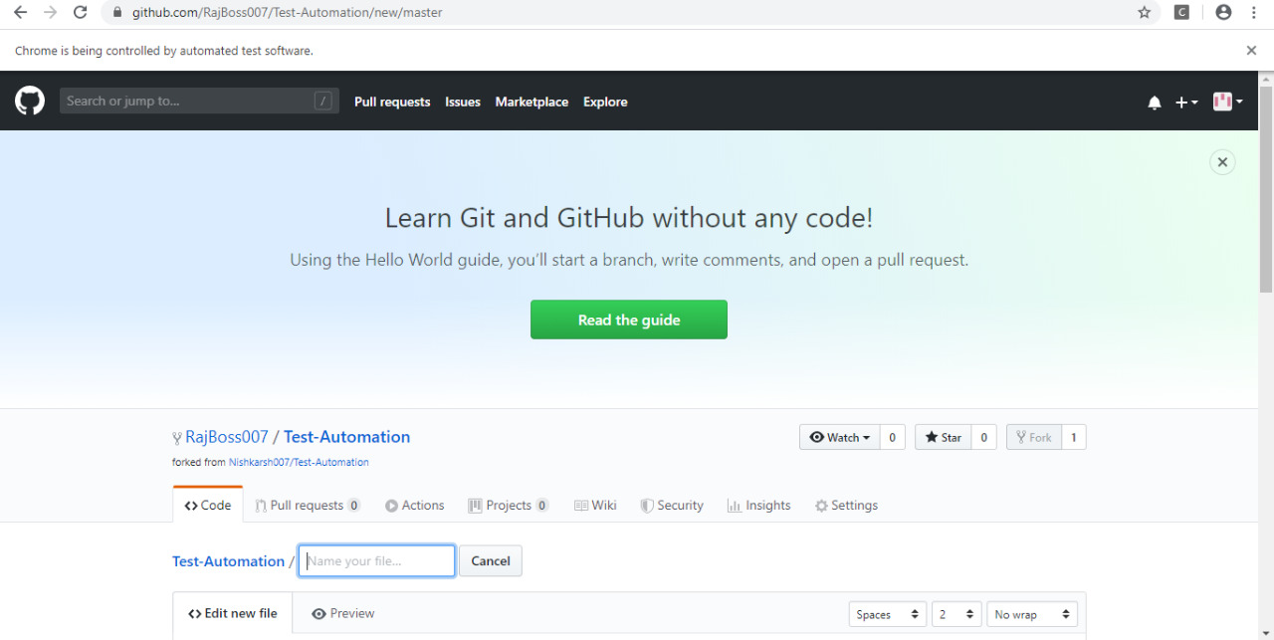

Slide 36
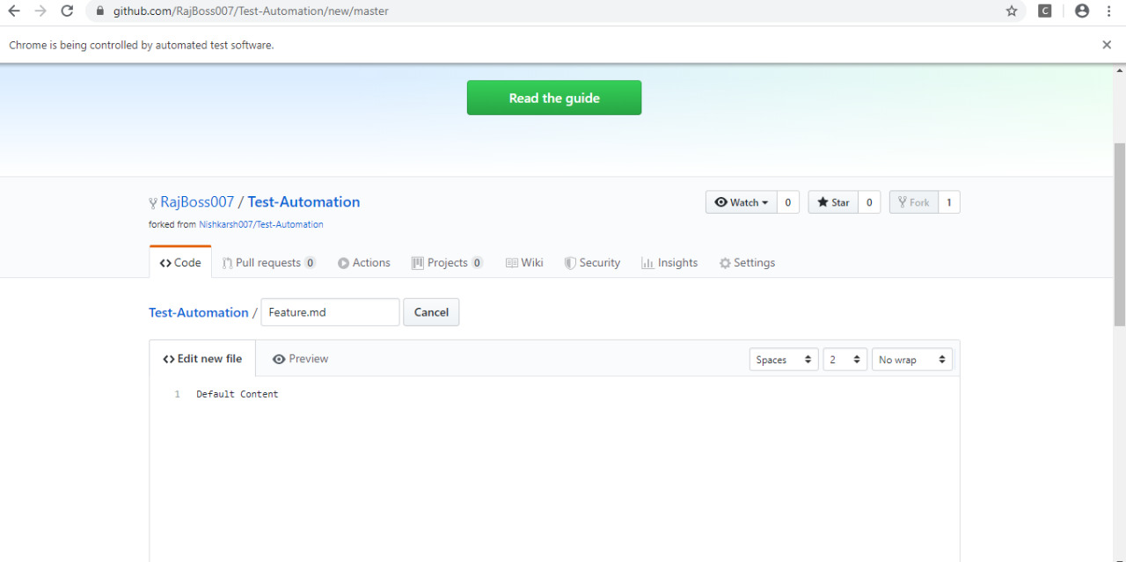

Slide 37
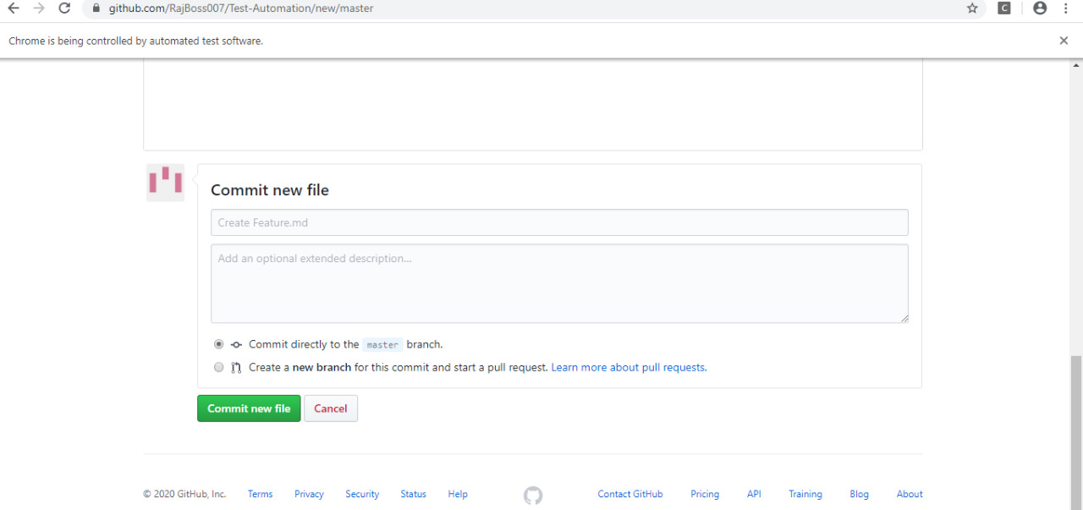

Slide 38
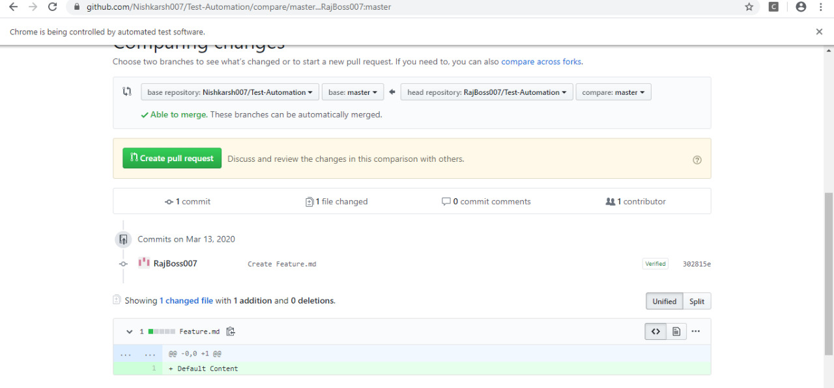

Slide 39
@Test(priority=6)
public void PR2() --------------------
{
element = driver.findElement(By.name("login"));
element.sendKeys("MeghaRawat3");
element = driver.findElement(By.name("password"));
element.sendKeys("Megh4@123");
driver.findElement(By.name("commit")).click();
//Navigate to repository to be forked but commit to master branch rather than creating new branch
driver.navigate().to("https://github.com/MeghaRawat3/Test-Automation");
9

Slide 40
// Create new file in the new branch driver.findElement(By.xpath("//*[@id=\"js-repo-pjax-container\"]/div[3]/div/div[3]/div[2]/form/button")).click();
element = driver.findElement(By.name("filename"));
element.sendKeys("Feature2.md");
element = driver.findElement(By.xpath("//*[@id=\"js-repo-pjax-container\"]/div[3]/div/div/form[2]/div[5]/div[2]/div/div[5]/div[1]/div/div/div/div[5]/div/pre"));
element.sendKeys("Default Content");
driver.findElement(By.xpath("//*[@id=\"submit-file\"]")).click();
// the new branch with feature.md file is created

Slide 41
// Revisit the homepage of the repository to get access to PR button
//driver.navigate().to("https://github.com/RajBoss007/Test-Automation");
//Note, we assume patch 1 as the default branching mechanism! patch 2 even wont work //driver.findElement(By.xpath("//*[@id=\"js-repo-pjax-container\"]/div[3]/div/div[1]/ul/li[2]/a")).click(); //Open branches
driver.findElement(By.xpath("//*[@id=\"js-repo-pjax-container\"]/div[3]/div/div[3]/a")).click();
}

Slide 42
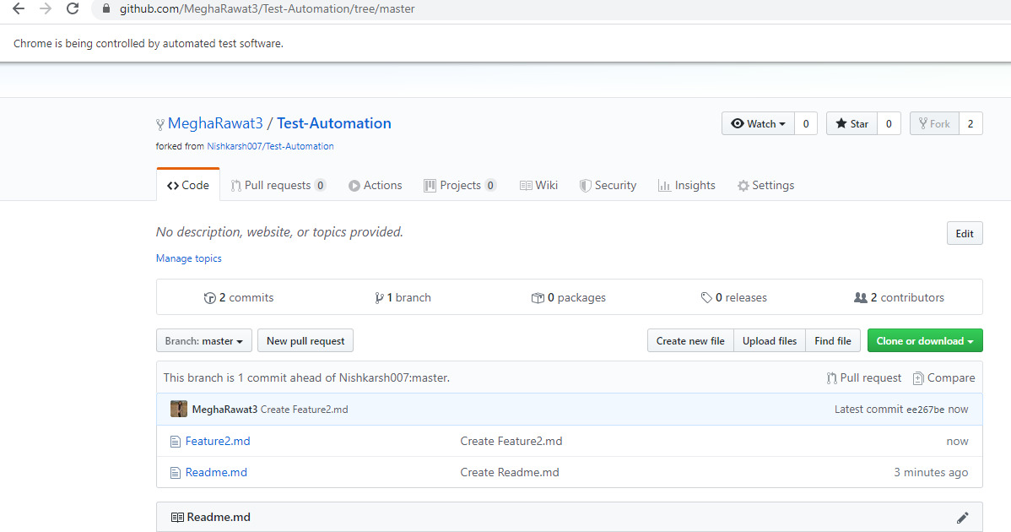

Slide 43


Slide 44
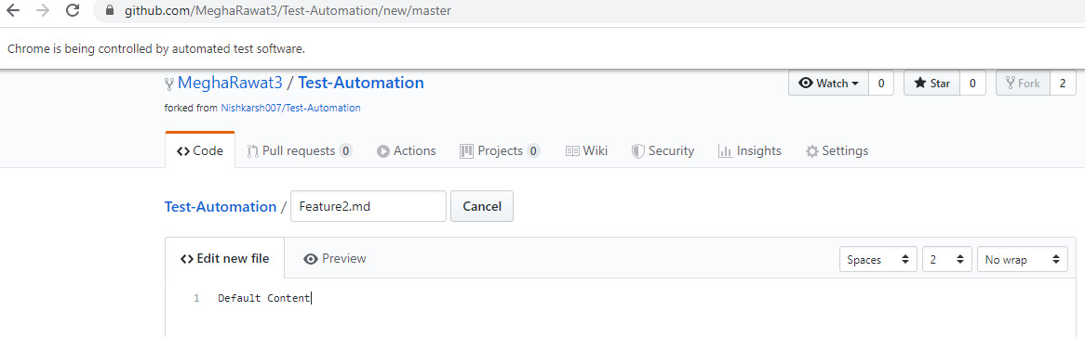

Slide 45
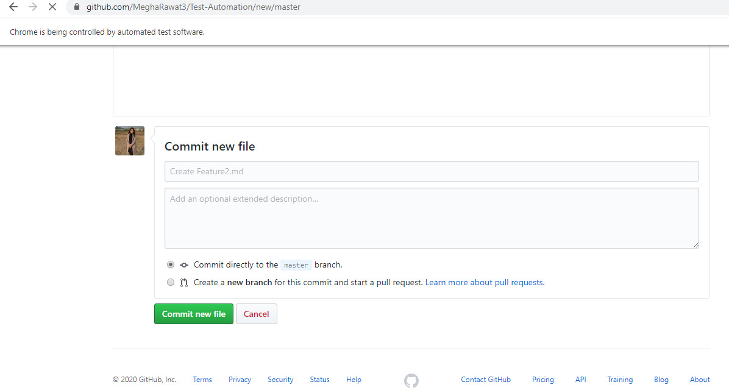

Slide 46
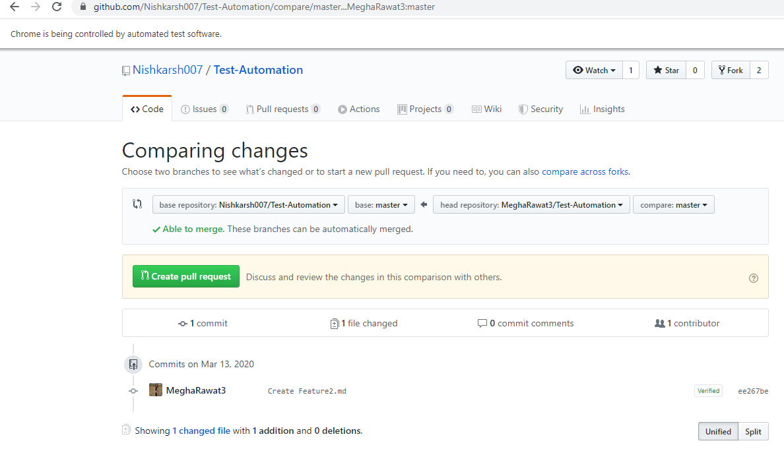

Slide 47
@Test(priority=7)
public void MergePR() --------------
{
element = driver.findElement(By.name("login"));
element.sendKeys("nishkarshraj000@gmail.com");
element = driver.findElement(By.name("password"));
element.sendKeys("Nish123!@#");
driver.findElement(By.name("commit")).click();
driver.navigate().to("https://github.com/Nishkarsh007/Test-Automation");
driver.findElement(By.xpath("//*[@id=\"js-repo-pjax-container\"]/div[1]/nav/span[3]/a/span[1]")).click();
}
10

Slide 48
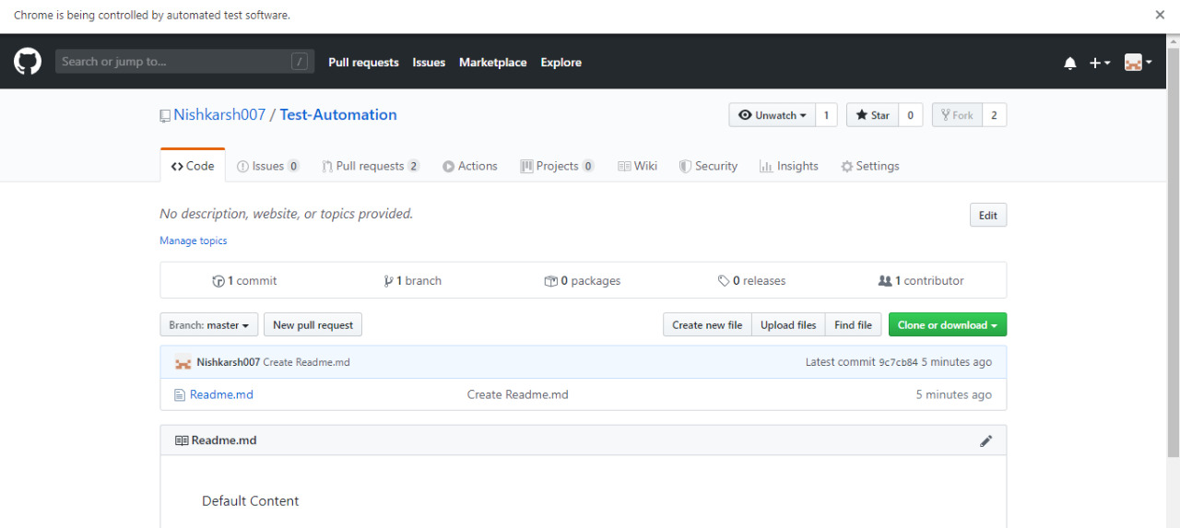

Slide 49
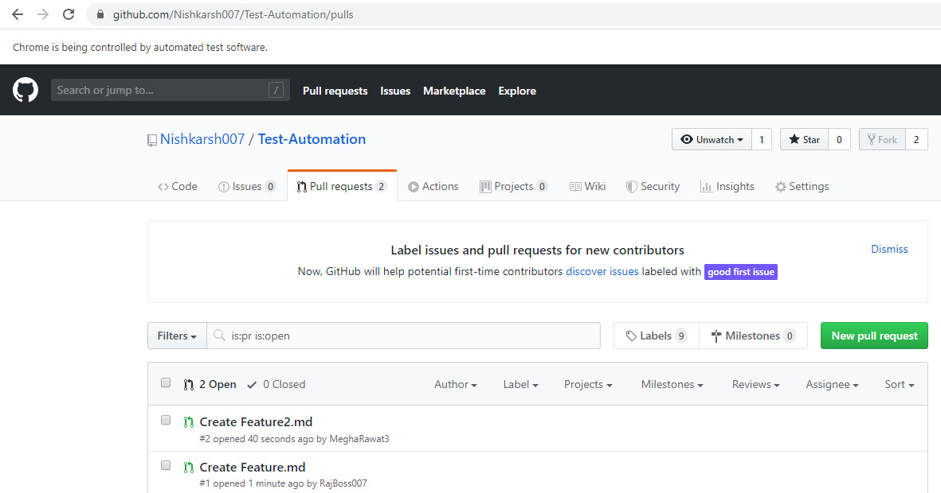

Slide 50
@AfterMethod --------------
public void Destructor()
{
//Delete the current session
//driver.quit();
}
@AfterSuite --------------
public void Completion()
{
System.out.println("All test cases completed");
}
}
11
12

Slide 51
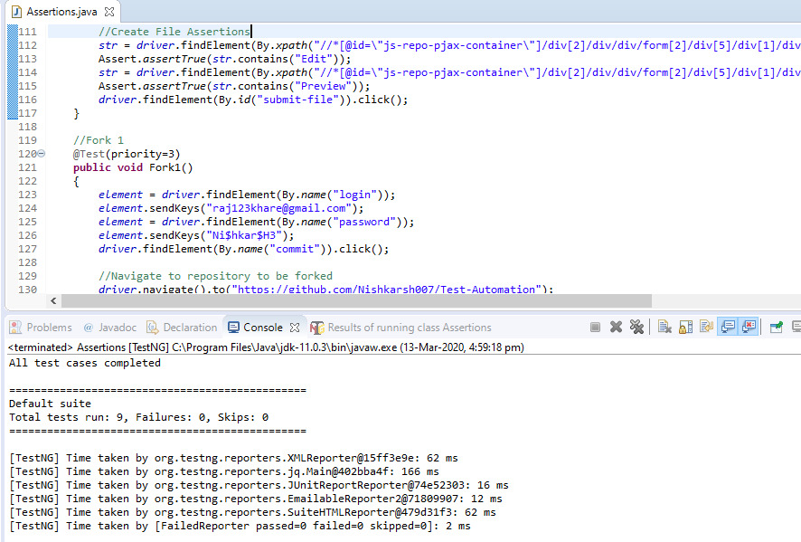

Slide 52
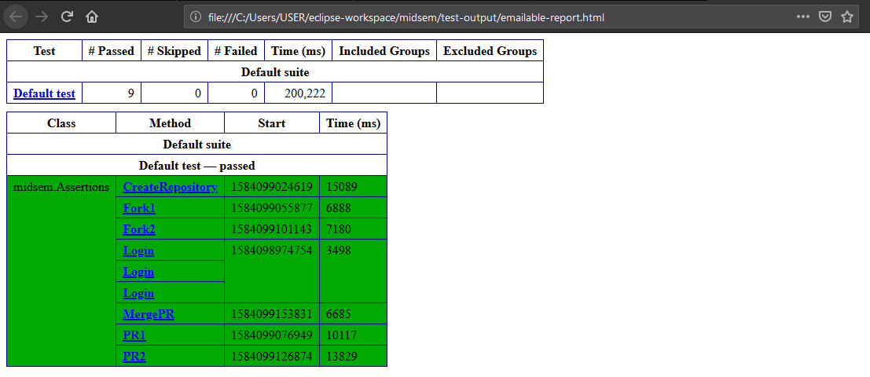

Slide 53
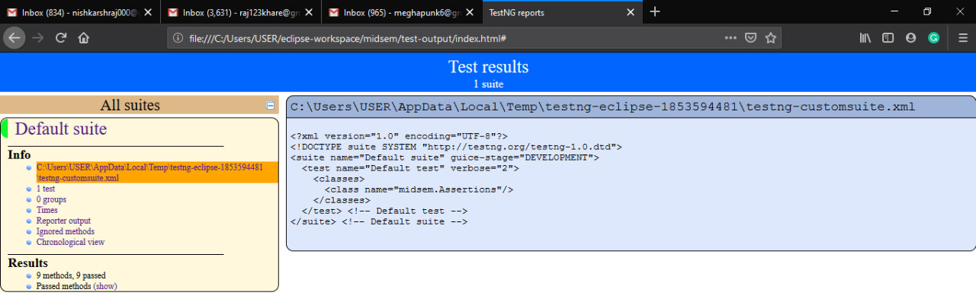

Slide 54
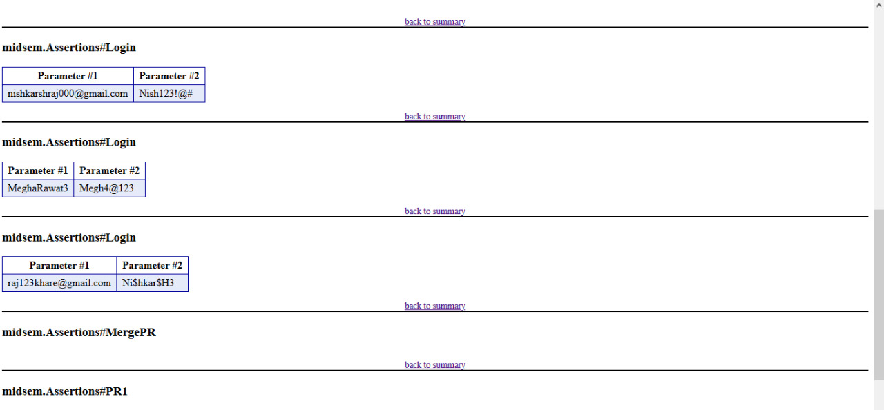

Slide 55
