Slide 1
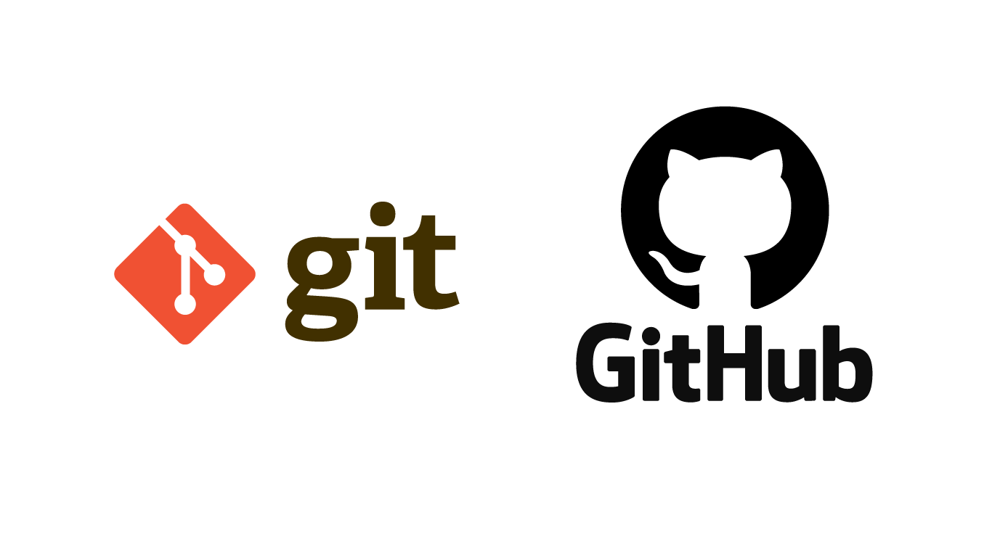
GitHub - introduction

Slide 2

First of all – what is Git?
Git is a distributed version control system for tracking source code changes during software development.
It is designed to coordinate work between programmers, but can also be used to track changes in any file group.
Git was created by Linus Torvalds in 2005 for Linux kernel development, with other kernel developers
contributing to its initial development as well.
Git is open and free software distributed under the terms of the GNU Version 2 General Public License.
Each Git library on each computer is a complete database, with a full history and full version tracking capabilities, with no need of network or central server access.

Slide 3

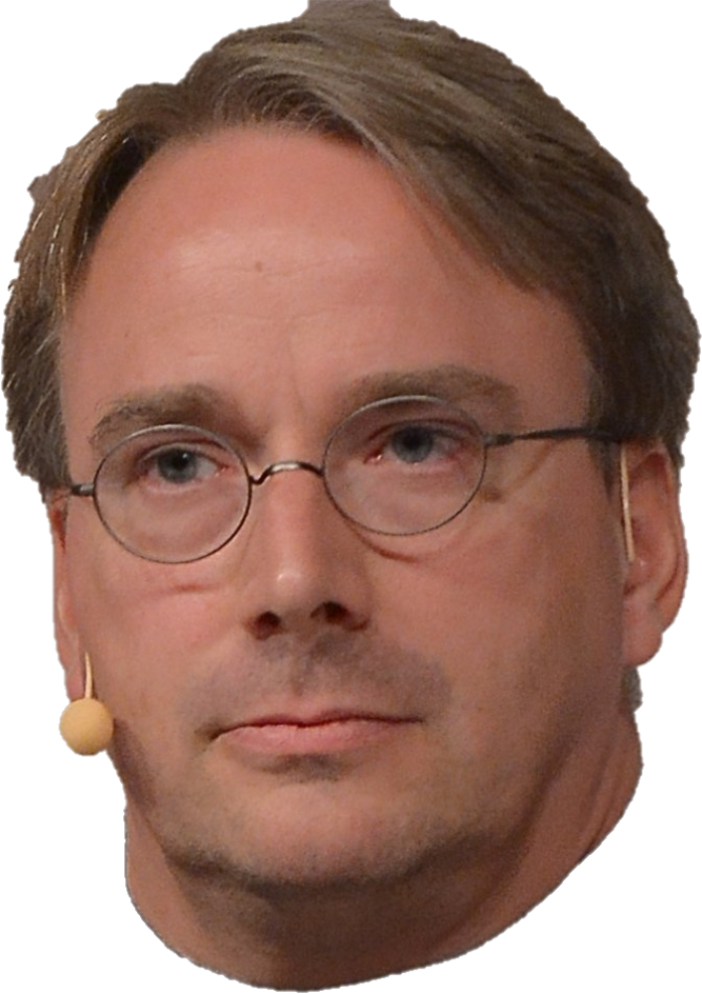
How Git started
In 2005, Andrew Tridgell, an Australian computer programmer, led "BitMover”, the company that founded “BitKeeper”, to stop supporting the Linux development community. That's because in April of that year, Tridgell tried to create a free software (now known as “SourcePulle”) that interoperates with Bitkeeper.
As a result, Linus Torvalds was looking for an alternative system. He wanted a distributed system that he
could use as BitKeeper, but none of the free systems available was answered his needs . That's because none of the
existing systems were suitable For the purposes of Linux kernel development, performing several large
operations simultaneously.
After failing to find a suitable system, Torvalds began writing one of his own.
Git's development began on April 3, 2005.
The first merge of multiple branches took place on 18 April.
Torvalds achieved its performance goals and on June 16 Git managed the kernel 2.6.12 release.
On July 26, 2005 Torvalds turned over maintenance to Junio ​​Hamano who was a major contributor to the Git
project.

Slide 4
The need for Git
Switching from a centralized version control system to Git changes the way your development team creates software. And, if you’re a company that relies on its software for mission-critical applications, altering your development workflow impacts your entire business.

Slide 5
Git features
Branch workflow: One of the biggest advantages of Git is its branching capabilities. Unlike centralized version control systems, Git branches are easy to merge. This facilitates the feature branch workflow popular with many Git users. Feature branches provide an isolated environment for every change to your codebase. When a developer wants to start working on something, no matter how big or small, they create a new branch. This ensures that the master branch always contains production-quality code.
Distributed Development: Git is a distributed version control system. Instead of a copy, each developer gets their own complete local repository, with a full history of commits.
Having a full local history makes Git fast, since it means you don’t need a network connection to create
commits, inspect previous versions of a file, or perform differences between commits.
Pull requests: A pull request is a way to ask another developer to merge one of your branches into their repository. This not only makes it easier for project leads to keep track of changes, but also lets developers to discuss around their work before integrating it with the rest of the codebase.
When a developer gets stuck with a hard problem, they can open a pull request to ask for help from the
rest of the team. Also, junior developers can be confident that they aren’t destroying the entire
project by treating pull requests as a formal code review.

Slide 6
some of Git advantages
Faster release cycle: The ultimate result of feature branches, distributed development, pull requests, and a stable community is a faster release cycle. These capabilities facilitate an fast workflow where developers are encouraged to share smaller changes more frequently.
Pluggable merge strategies: As part of the toolkit design, Git has a well-defined model of incomplete merger, and has multiple algorithms to complete it, culminating in telling the user that it is unable to complete the merge automatically and needs manual editing.
Garbage collection: Aborting operations or backing out changes will leave useless “dangling” objects in the database. Git will automatically perform garbage collection when enough loose objects have been created in the repository.
Popularity: GitHub is not the only option you have. There are many other companies which provide you the same thing, but GitHub is definitely the most popular one.
Programmers use GitHub to show their skills where as many companies are working on their projects, using GitHub.Git.

Slide 7

So, what is GitHub?
GitHub is a code hosting platform for version control and collaboration between programmers.
GitHub was developed by Chris Wanstrath, P. J. Hyett, Tom Preston-Werner and Scott Chacon through the “Ruby on Rails” development tool. The company's offices are located in San Francisco.
The platform provides storage and access control services. It also provides a number of collaboration features such as bug tracking and wiki task management for each project.

Slide 8
About GitHub, Inc.
GitHub, Inc. is an American company that provides software version control, using Git.
This is a Microsoft subsidiary, which acquired it in 2018.
The company's offices are located in San Francisco.
GitHub, Inc. was originally a flat organization with no middle managers. Employees could choose to work on projects that interested them (open allocation), but salaries were set by the chief executive.
In 2014, GitHub, Inc. introduced a layer of middle management.

Slide 9
About GitHub
GitHub is a web-based versioning and storage management software for software development projects.
The software provides access control and a number of collaboration features such as bug tracking, feature requests and wiki task management for each project.
GitHub offers plans for free, professional, and enterprise accounts. Free GitHub accounts are commonly used to host open source projects.
GitHub began offering unlimited private repositories at no cost in January 2019 (limited to three contributors
per project).

Slide 10
GitHub growth timeline
February
2008
February 2009
July
2009
July
2010
April
2011
January
2013
December
2013
Today
Founded
46,000
public
Repositories
Over
100,000
Users
and
90,000
public
Repositories
1,000,000
Repositories
2,000,000
Repositories
3,000,000
Users
and
5,000,000
Repositories
10,000,000
Repositories
37,000,000
Users
and
100,000,000
Repositories

Slide 11
GitHub services
Projects can be accessed and operated on GitHub using the standard Git command line interface that all standard Git commands work with.
GitHub allows registered and unregistered users to browse public repositories on the site. In addition, many Git
extensions were also created by GitHub and other third parties that interoperates with the platform.
The site provides social networking-like functions such as feeds, followers and a social network graph to display how developers work on their versions ("forks") of a repository and what fork is newest.
A user must create an account in order to contribute content to the site, but public repositories can be browsed and downloaded by anyone. With a registered user account, users are able to have discussions, manage repositories, submit contributions to others' repositories, and review changes of the code.

Slide 12
GitHub services
In addition to hosting the source code, GitHub supports several formats and features such as:
Documentation (including README files)
Issue tracking (including feature requests) with labels, milestones, assignees and a search engine.
Wiki: A knowledge-based site that users modify and collaborate content and structures directly from the web browser.
Pull requests
GitHub also runs other services: a pastebin-style site called "Gist" designed to host code snippets (GitHub is suitable for hosting larger projects).
Gist is a simple way to share code snippets with others.
Because each "Gist" has its own Git repository, multiple code snippets can be contained in one "mass" and can be pushed
and pulled using Git.

Slide 13
Glossary
- Repositoryמאגר תוכנה הוא מקום מרכזי לשמירה על משאבים שמשתמשים יכולים למשוך מהם בעת הצורך.
- Mergingמיזוג הוא פרקטיקה נפוצה עבור מפתחים המשתמשים במערכות בקרת גרסאות. בין אם נוצרים סניפים לבדיקה, תיקוני באגים או מסיבות אחרות, מיזוג מחייב שינויים למיקום אחר.
ליתר דיוק, מיזוג לוקח את התוכן של ענף מקור ומשלב אותם עם סניף יעד.
- Branchingסיעוף הוא הנוהג של יצירת עותקים של תכניות בפיתוח לעבודה בגרסאות מקבילות, שמירה על המקור ועבודה על ה"ענף", או ביצוע שינויים שונים לכל אחד.
- Forkבהנדסת תוכנה, פרויקט "ממוזלג" (forked project) הוא כאשר מפתחים לוקחים עותק של קוד המקור מחבילת תוכנה אחת, מתחילים בפיתוח עצמאי, ויוצרים פיסת תוכנה נפרדת.
לצורך דוגמה, תוכנת קוד פתוח וחינמית היא כזו אשר על פי הגדרה ניתן "למזלג" אותה מצוות הפיתוח המקורי
ללא אישור מראש, מבלי להפר את חוק זכויות היוצרים.
ההבדל בין "מזלג" לבין "ענף" הוא שמזלג יוצר עותק מלא של המאגר שלך, ואילו הסתעפות רק מוסיפה "ענף" ל"עץ"
שהוא כמובן, קוד המקור.
- Bitkeeperכלי תוכנה לבקרת גרסאות מבוזרות של קוד המקור למחשב.
- Rubi on rails כלי פיתוח המעניק למפתחי אתרים מסגרת ומספק מבנה לכל הקוד שהם כותבים. מסגרת ה-Rails מסייעת למפתחים לבנות אתרים ואפליקציות, מכיוון שהיא מפשטת ומפשטת משימות חוזרות ונשנות.

Slide 14
Glossary
Pastebin- סוג של יישום web שבו ניתן לאחסן טקסטים לטווח זמן מוגדר. סוג אתר זה הוא בשימוש בעיקר על ידי מתכנתים השומרים או מציגים פיסות קוד מקור, אך בפועל כל אחד יכול לשתף בו טקסט. הרעיון שמאחורי אתרים מעין אלו הוא להפוך לנוח שיתוף של טקסטים ברשת.
Interoperation- יכולת פעולה הדדית היא מאפיין של מוצר או מערכת, שהממשקים שלהם מובנים לחלוטין, לעבוד עם מוצרים או מערכות אחרים, ביישום או בגישה, ללא הגבלות כלשהן.
Git commit- הפקודה “commit”משמשת לשמירת השינויים שלך במאגר המקומי. השימוש בפקודה “Git commit”שומר רק אובייקט commit חדש במאגר ה-Git המקומי. החלפת התחייבויות צריכה להתבצע באופן ידני ומפורש.
- README fileקובץ טקסט המכיל מידע למשתמש אודות התוכנה, תכנית השירות או המשחק. קבצי README לרוב מכילים הוראות ועזרה נוספת, ופרטים על תיקונים או עדכונים.

Slide 15
Basic Git Commands to handle github
We can manage github through the command line in our pc
Basic commands:
git init – create a new git repository
git remote add origin (+URL) – define the selected address remote server of github
git push – upload file from our local project to github
git push -u origin master – upload full repository to github
git pull – download most updated file from github to our git
git clone (+ URL) – copy a selected repository from github to a new directory in our local git
Git branch – creating a new branch from the master

Slide 16
Examples Of Github repositories

Slide 17
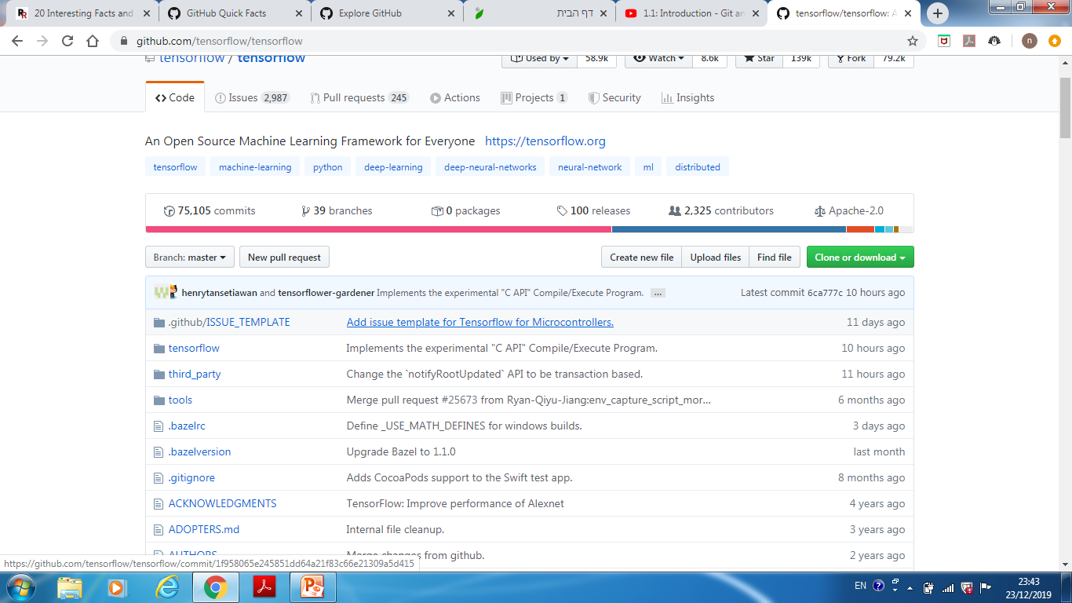
TensorFlow – machine learning

Slide 18
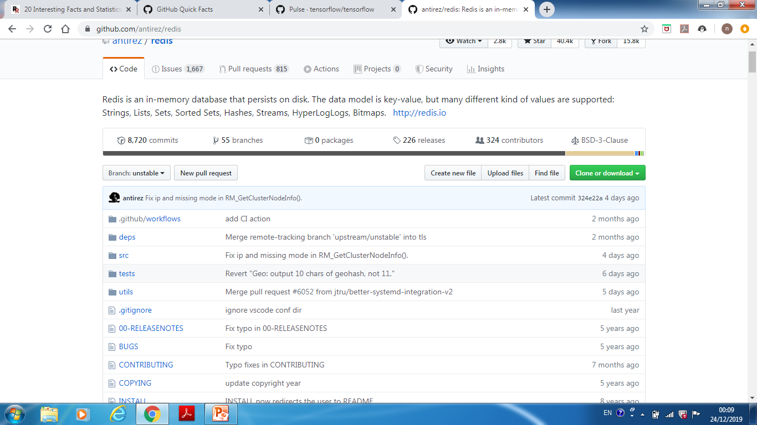
Redis - database

