Slide 1
Shri Madhwa Vadiraja Institute of Technology and Management, Bantakal AUTOMATIC COMPOST BIN PRESENTED BY: Pratiksha :4MW23EC038 Nishmitha:4MW23EC039 Prerana :4MW23EC051 UNDER THE GUIDANCE OF - Mr. Ganesh Shetty UNDER THE EVALUATION OF - Mr. Sachin Prabhu Date :03/12/2025

Slide 2
OUTLINE
• ABSTRACT
• INTRODUCTION
• LITERATURE REVIEW
• PROBLEM STATEMENT
• OBJECTIVES
• PROPOSED METHODOLOGY
• THE EXPECTED OUTCOME
• BUDGET ANALYSIS REPORT / RESOURCES
• CONCLUSION/FUTURE SCOPE
• REFERENCES

Slide 3
ABSTRACT
This project focuses on the development of an "Automatic Compost Bin" designed to streamline organic waste management in small-scale institutional settings. The system integrates mechanical and electronic components to automate compost mixing, aeration and monitoring. Key features include a motorized blade system, sensor-based feedback control and IoT-enabled remote monitoring via the Blynk app. The goal is to reduce composting time, minimize manual effort and produce nutrient-rich compost efficiently.

Slide 4
INTRODUCTION
Organic waste accumulation is a growing concern in urban and semi-urban environments.
Traditional composting methods are time-consuming and require constant human intervention.
The Automatic Compost Bin aims to address these challenges by automating the composting process.
With integrated sensors, motorized mixing and remote monitoring, the system offers a smart, efficient and eco-friendly solution for decentralized waste management.

Slide 5
LITERATURE REVIEW
Sr. No | Author(s) | Year | Title | Source | Method / Findings | Contribution to Present Work
1 | Jay Singh, Shiva Pujan Jaiswal, Vikas Singh Bhadoria, Niharika Varshney, Monika Jain | 2019 | Production of Bio-Gas and Organic Fertilizer Using Canteen and Kitchen Waste | 2019 2nd International Conference on Power Energy, Environment and Intelligent Control (PEEIC), 2019. | This paper presents a method that uses canteen and kitchen waste to produce biogas and organic fertilizer. The process involves collecting food waste and converting it into energy and manure through anaerobic digestion. | It inspired the idea of transforming biodegradable waste into valuable products for a cleaner and more sustainable environment.

Slide 6
LITERATURE REVIEW
Sr. No | Author(s) | Year | Title | Source | Method / Findings | Contribution to Present Work
2 | Rohit Bhoir, Rasika Thakur, Pooja Tambe, Rakesh Borase, Sushant Pawar. | 2020 | Design and Implementation of Smart Compost System Using IOT | 2019 2nd International Conference on Power Energy, Environment and Intelligent Control (PEEIC), 2019. | The research paper introduces a smart composting system that uses IoT-based sensors to monitor temperature, moisture and aeration inside the compost bin. The system automatically controls these parameters to maintain ideal composting conditions and ensure faster decomposition. | contributes to the present work by showing how IoT technology can be used to automate and improve composting efficiency. It inspired the idea of creating an automatic compost bin that provides real-time monitoring.

Slide 7
LITERATURE REVIEW
Sr. No | Author(s) | Year | Title | Source | Method / Findings | Contribution to Present Work
3 | Tahseen Sayara, Rezq Basheer, Fatina Hawamde, Antoni Sánchez | 2020 | Recycling of Organic Wastes through Composting: Process Performance and Compost Application in Agriculture. | Agronomy, Vol. 10, No. 11, Article 1838 ,November 2020 | The paper explores guidelines for applying compost to crops and other agricultural uses, highlighting its effects on soil fertility, disease suppression and potential challenges associated with large-scale compost application. | This work contribute to the present work by emphasizing the importance of compost maturity and stability in producing high-quality compost.

Slide 8
LITERATURE REVIEW
Sr. No | Author(s) | Year | Title | Source | Method / Findings | Contribution to Present Work
4 | Sumit Badotra, Sarvesh Tanwar, AmitSundas, Pankaj Dhiman. | 2021 | Smart Waste Segregation System Using IoT | 2021 IEEE International Conference for Innovation in Technology (INOCON), Bengaluru, India, Nov. 6–8, 2021. | This research focuses on developing a smart compost system using IoT technology. Sensors are used to measure key composting parameters such as temperature, moisture and aeration in real time. | The contribution of this work to the present study is the integration of IoT-based monitoring for maintaining ideal composting conditions.

Slide 9
LITERATURE REVIEW
Sr. No | Author(s) | Year | Title | Source | Method / Findings | Contribution to Present Work
5 | Mrigank Goel Amogh Harsh Goyal Preeti Dhiman, Vikas Deep, Purushottam Sharma, Vinod Kumar Shukla | 2021 | Smart Garbage Segregator and IoT Based Waste Collection system | 2021 International Conference on Advance Computing and Innovative Technologies in Engineering (ICACITE), Greater Noida, India, 2021. | This paper presents an IoT-based waste management system that automatically segregates waste into wet, dry and recyclable categories using sensors. It also uses an ultrasonic sensor to detect the fill level of bins and sends alerts to a central server when bins are full. | This inspired the idea of using smart monitoring and alert systems in the automatic compost bin to improve convenience and management efficiency.

Slide 10
LITERATURE REVIEW
Sr. No | Author(s) | Year | Title | Source | Method / Findings | Contribution to Present Work
6 | Meng Li, Fei Li, Jun Zhou, Qingbin Yuan, Nan Hu | 2022 | Fallen leaves are superior to tree pruning as bulking agents in aerobic composting disposing kitchen waste | IJERT, Bioresource Technol. Vol 16. no.5, 2022. | This research compares fallen leaves and tree pruning as bulking agents in aerobic composting of kitchen waste. Fallen leaves were found to provide better aeration, faster decomposition and higher-quality compost than tree pruning. | The study contributes to the present work by identifying effective bulking materials for composting. This insight helps improve compost quality and efficiency in the automatic compost bin

Slide 11
LITERATURE REVIEW
Sr. No | Author(s) | Year | Title | Source | Method / Findings | Contribution to Present Work
7 | Liu Zheng,Liu Xinyu ,Li Huagang,Li Shuang, pan Rongguang,Ge Lupun | 2023 | Effect of different organic wastes on kitchen waste machine composting secondary fermentation | Proc. 2023 35th Chinese Control and Decision Conference (CCDC), 2023 | This study investigates how various organic wastes influence the secondary fermentation phase in machine-assisted composting of kitchen waste. | research contribute to Understanding the role of different organic additives that can enhance composting efficiency, improve compost quality and reduce processing time.

Slide 12
LITERATURE REVIEW
Sr. No | Author(s) | Year | Title | Source | Method / Findings | Contribution to Present Work
8 | Rahul Adhikary, Vemu Sudham, Swaroop Sualsingh | 2024 | Real-Time Soil Nutrient Monitoring Using NPK Sensors: Enhancing Precision Agriculture . | 2024, 2nd International Conference on Signal Processing, Communication, Power and Embedded System (SCOPES), | This study presents a real-time soil nutrient monitoring system utilizing NPK sensors to enhance fertilizer management and precision agriculture. | This research contributes to the present work by showcasing the application of NPK sensors in real-time soil nutrient monitoring.

Slide 13
LITERATURE REVIEW
Sr. No | Author(s) | Year | Title | Source | Method / Findings | Contribution to Present Work
9 | Dr. G.Rajamuneeswara n, P.Hridhya, B.Sakthivel, N.Gayathri Bai | 2024 | Smart Compost Guardian: An IOT-Based Real-Time Compost Monitoring and Alert System | International Journal of Engineering Research & Technology (IJERT), Vol. 13, Issue 5, June 2024 | This study introduces the "Smart Compost Guardian," an IoT-based system designed to monitor and manage composting conditions in real-time. Utilizing a Raspberry Pi and DHT11 sensor, the system tracks temperature and humidity levels within compost bins. | The research contributes to the present work by providing a practical implementation of IoT technology in compost monitor. It emphasizes the importance of real-time data collection and user notifications.

Slide 14
LITERATURE REVIEW
Sr. No | Author(s) | Year | Title | Source | Method / Findings | Contribution to Present Work
10 | Swapna Raghunath, S.S Nasira Banu, Prathima Talluri, V. Nanditha Reddy, Lakshita Chouhan | 2025 | Sensor Integrated Smart Composting Bin for Household Applications | International Conference on Emerging Trends in Industry 4.0 Technologies (ICETI4T), 2025. | The system utilizes sensors to monitor key parameters such as temperature, moisture, and aeration, ensuring optimal composting conditions. The integration of these sensors allows for real-time data collection and management. | The research contributes to the present work by demonstrating the feasibility and benefits of incorporating sensor technology into household composting systems.

Slide 15
PROBLEM STATEMENT
To design and develop an Automatic Smart Compost bin that efficiently converts organic waste into compost and liquid fertilizer with minimal human intervention, overcoming the limitations of traditional composting methods.

Slide 16
OBJECTIVES
To develop an automatic compost bin that converts organic waste into compost with minimal human effort.
To use sensors for accurate monitoring of moisture, temperature and Bin full level.
To automate chopping, mixing, aeration, and waste transfer using motors and servos.
To enable real-time monitoring through IoT (Blynk) for easy user access.
To speed up composting, reduce manual labor and ensure efficient, eco-friendly waste management.

Slide 17
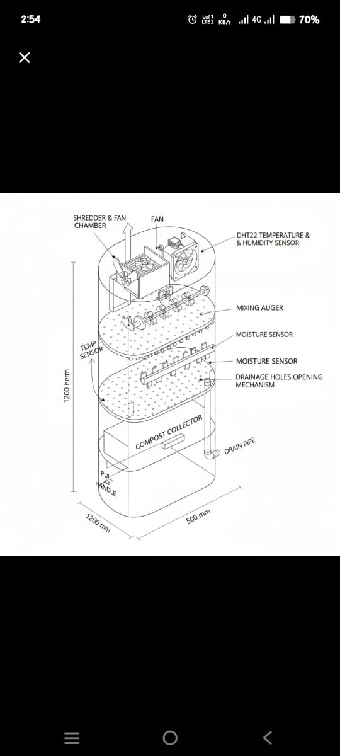
PROPOSED METHODOLOGY
(a)

Slide 18
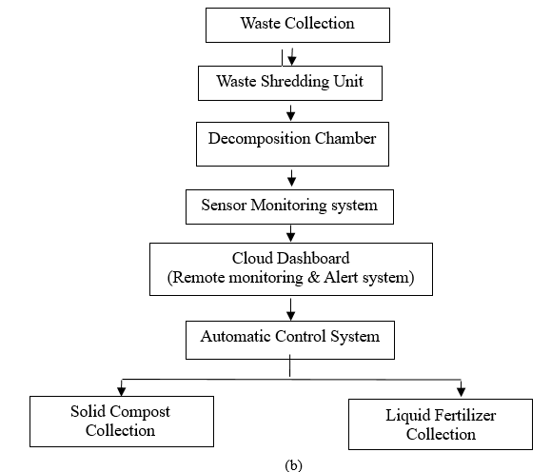
PROPOSED METHODOLOGY

Slide 19
THE EXPECTED OUTCOME
Efficient composting with reduced manual effort.
Compost ready in 15 days.
Real-time monitoring via mobile app.
Compact and scalable design.
Dual output: solid compost and liquid fertilizer.

Slide 20
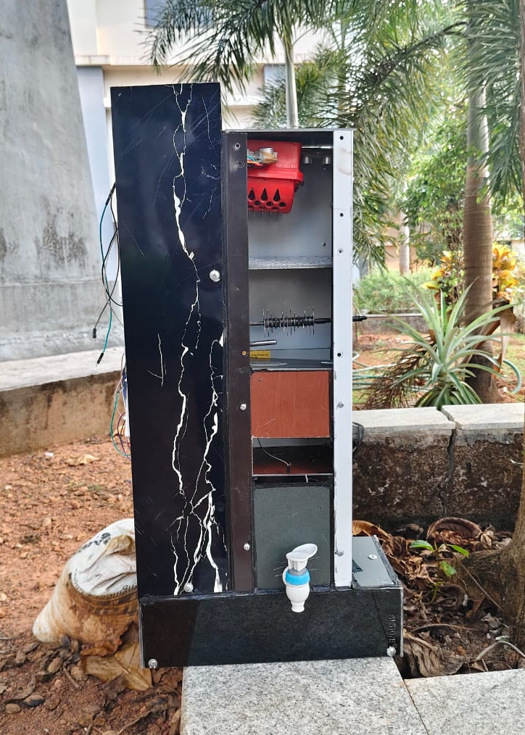
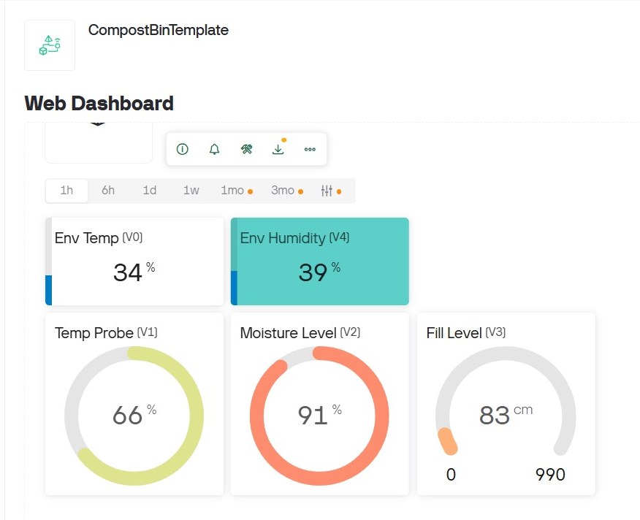
OUTCOMES

Slide 21
BUDGET ANALYSIS REPORT / RESOURCES
Category | Included Items | Cost (₹)
Microcontroller & Sensors | ESP32, Arduino Uno, Ultrasonic ×3, Temperature probe, DHT22, Moisture sensor, Jumper wires, Breadboard | 2,320
Motors & Mechanical Components | DC motors ×2, Servo motors ×2, Chopper blades ×2, Screws/Nuts/Bolts, Latch, Tape | 1,900
Power System | Li-ion battery, Battery holder, Battery charger, Bin holder/structure | 1,390
Motor Driver / Control | L298N H-bridge | 220
Accessories | Silicon, ACP Sheets, small misc items | 840
 | welding | 3,000
Total Cost | — | ₹9,370

Slide 22
CONCLUSION/FUTURE SCOPE
The Automatic Compost Bin offers a practical solution for decentralized organic waste management. Future enhancements may include solar-powered operation, AI-based compost quality prediction, and integration with smart city waste networks. The system promotes sustainability and supports circular economy goals.

Slide 23
REFERENCES
[1] J. Singh, S. P. Jaiswal, V. S. Bhadoria, N. Varshney, and M. Jain, “Production of Bio-Gas and Organic Fertilizer Using Canteen and Kitchen Waste,” in 2019 2nd International Conference on Power Energy, Environment and Intelligent Control (PEEIC), 2019. Available: https://ieeexplore.ieee.org/document/8976623
[2] R. Bhoir, R. Thakur, P. Tambe, R. Borase, and S. Pawar, “Design and Implementation of Smart Compost System Using IOT,” in 2020 IEEE International Conference for Innovation in Technology (INOCON), Bengaluru, India, Nov. 6–8, 2020. Available: https://ieeexplore.ieee.org/document/9298219

Slide 24
REFERENCES
[3] T. Sayara, R. Basheer, F. Hawamde, and A. Sánchez, “Recycling of Organic Wastes through Composting: Process Performance and Compost Application in Agriculture,” Agronomy, vol. 10, no. 11, article 1838, Nov. 2020. doi:10.3390/agronomy10111838 . Available:https://sci-hub.se/10.3390/agronomy10111838
[4] M. Goel, A. H. Goyal, P. Dhiman, V. Deep, P. Sharma, and V. K. Shukla, “Smart Garbage Segregator and IoT Based Waste Collection system,” in 2021 International Conference on Advance Computing and Innovative Technologies in Engineering (ICACITE), Gr. Noida, India, 2021. Available: https://ieeexplore.ieee.org/document/9404692

Slide 25
REFERENCES
[5] S. Badotra, S. Tanwar, A. Sundas, and P. Dhiman, “Smart Waste Segregation System Using IoT,” in 2021 9th International Conference on Reliability, Infocom Technologies and Optimization (Trends and Future Directions) (ICRITO), 2021. Available: https://ieeexplore.ieee.org/document/9596173
[6] M. Li, F. Li, J. Zhou, Q. Yuan, and N. Hu, “Fallen leaves are superior to tree pruning as bulking agents in aerobic composting disposing kitchen waste,” Bioresource Technol. (probable journal), vol. , no. , 2022. Available:https://www.researchgate.net/publication/356372138_Fallen_leaves_are_superior_to_tree_pruning_as_bulking_agents_in_aerobic_composting_disposing_kitchen_waste

Slide 26
REFERENCES
[7] Z. Liu, X. Liu, H. Li, S. Li, R. Pan, and L. Ge, “Effect of different organic wastes on kitchen waste machine composting secondary fermentation,” in Proc. 2023 35th Chinese Control and Decision Conference (CCDC), 2023. doi:10.1109/ccdc58219.2023.10326656. Available : https://ieeexplore.ieee.org/abstract/document/10326656
[8] R. Adhikary, V. Sudham, and S. Sualsingh, “Real-Time Soil Nutrient Monitoring Using NPK Sensors: Enhancing Precision Agriculture,” in 2024 2nd International Conference on Signal Processing, Communication, Power and Embedded System (SCOPES),2024. Available:https://ieeexplore.ieee.org/document/10991026

Slide 27
REFERENCES
[9] S. Raghunath, S. S. N. Banu, P. Talluri, V. N. Reddy, and L. Chouhan, “Sensor Integrated Smart Composting Bin for Household Applications,” in 2025 International Conference on Emerging Trends in Industry 4.0 Technologies (ICETI4T), 2025. Available: https://xplorestaging.ieee.org/document/11132135
[10] G. Rajamuneeswaran, P. Hridhya, B. Sakthivel, and N. G. Bai, “Smart Compost Guardian: An IOT-Based Real-Time Compost Monitoring and Alert System,” IJERT, vol. 13,no.5,2025. Available:https://www.ijert.org/smart-compost-guardian-an-iot-based-real-time-compost-monitoring-and-alert-system

Slide 28
THANK YOU

