Slide 1
MyBank project – deposits module
- nishmitha s shetty

Slide 2
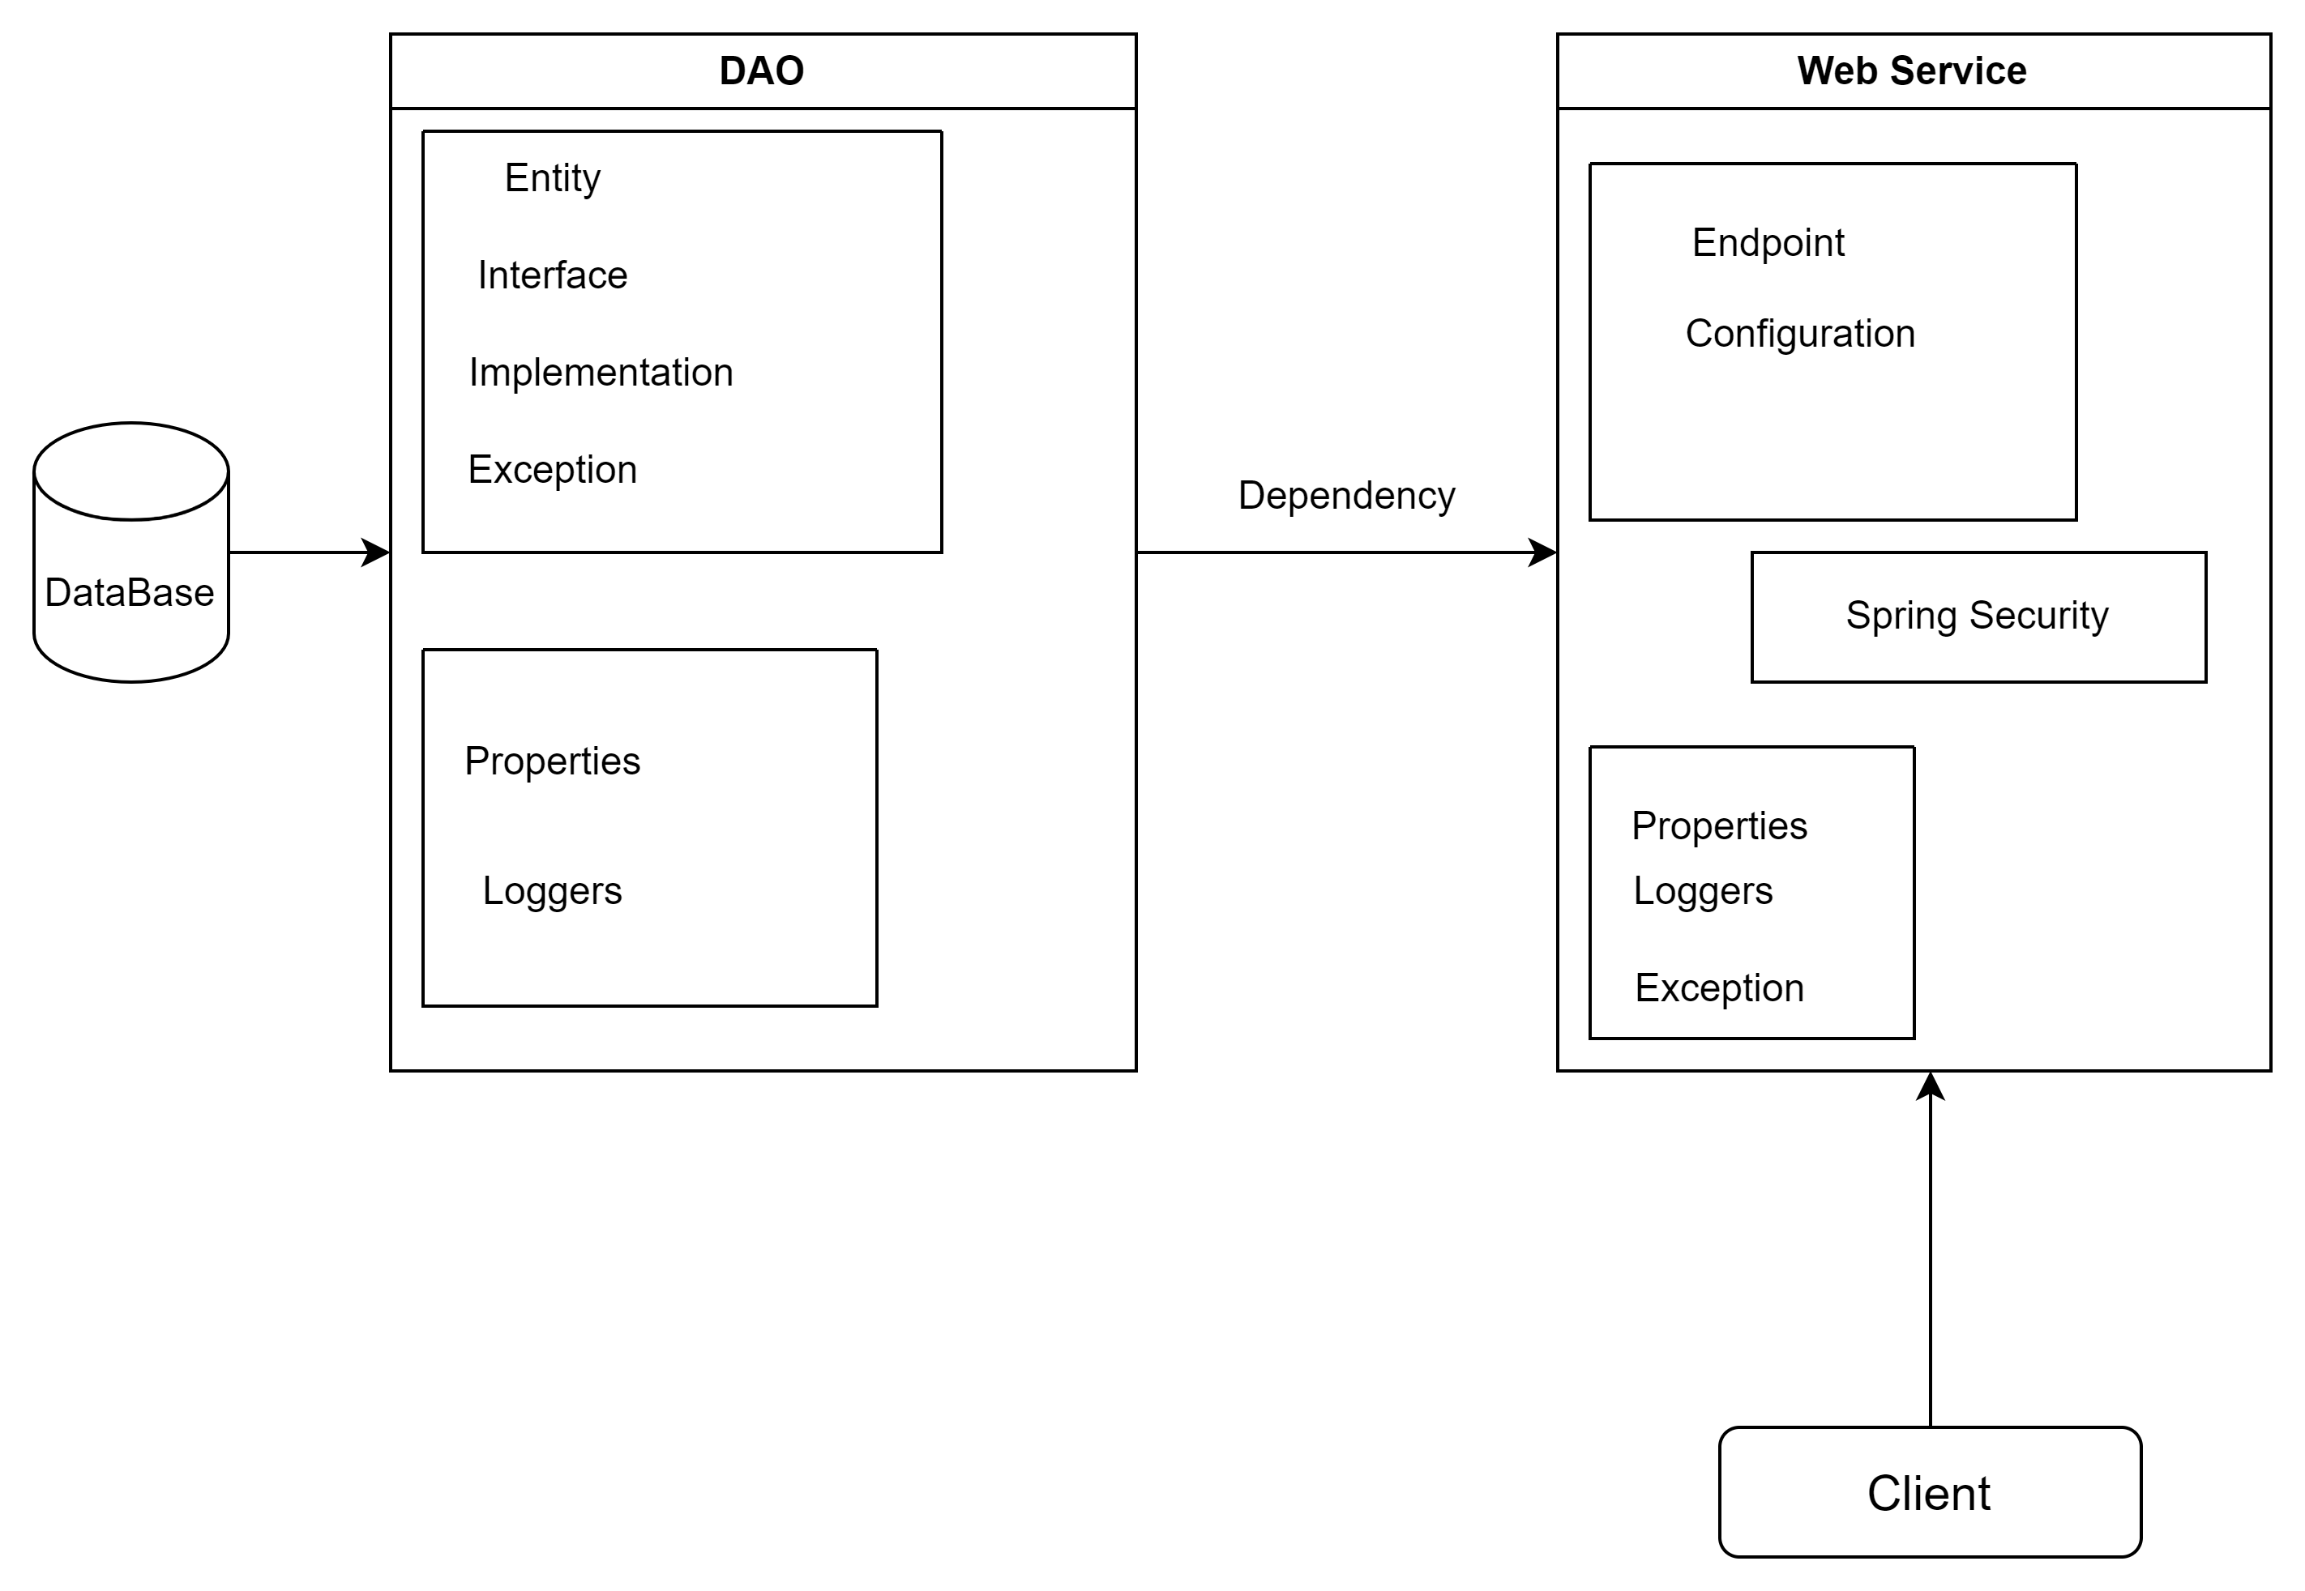
Architecture diagram

Slide 3
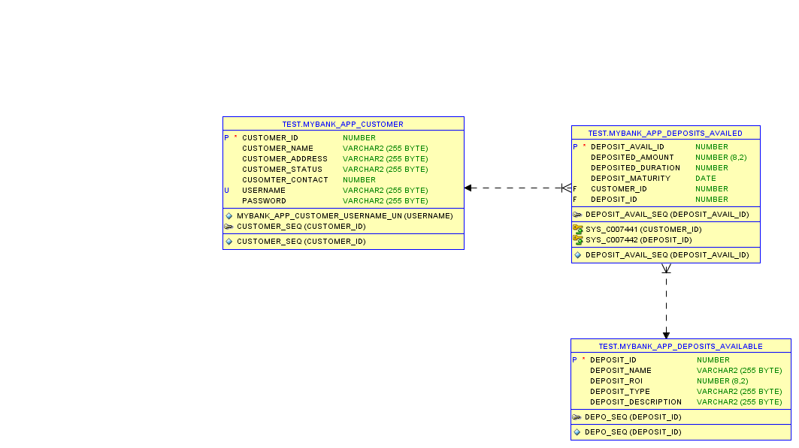
DB Design

Slide 4
Module Description
List all Deposits
Listing all the deposits available in MyBank for the customers to get information about the different deposits options available.
WebService: Soap
Custom Exception: DepositException
Occurs when there are no deposits option available in MyBank.

Slide 5
2. Search deposit based on ROI
Allow user to enter a particular ROI.
Display the deposits available in MyBank based on the ROI entered.
WebService: Rest – Get Mapping
Custom Exception: DepositException
Occurs when there are no deposits available in MyBank for the given return of interest.

Slide 6
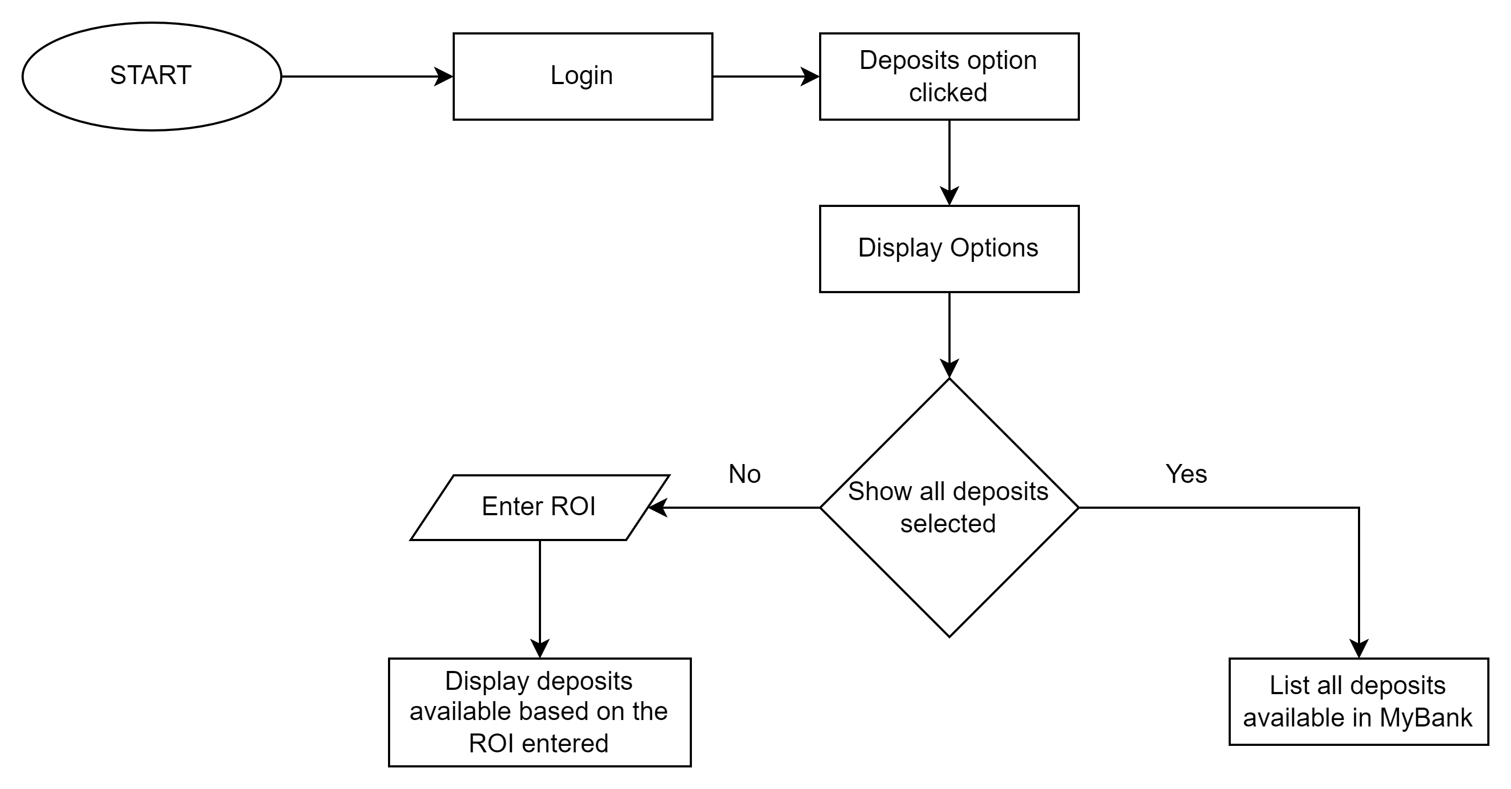
Flow Diagram

Slide 7
Jar File:
mybank-deposits-0.0.1-SNAPSHOT.jar
GitHub Link:
https://github.com/Nishmitha0904/DLTE-JavaFullStack-Nishmitha-2024/tree/master/MyBank-Project

Slide 8
THANK YOU

