Slide 1
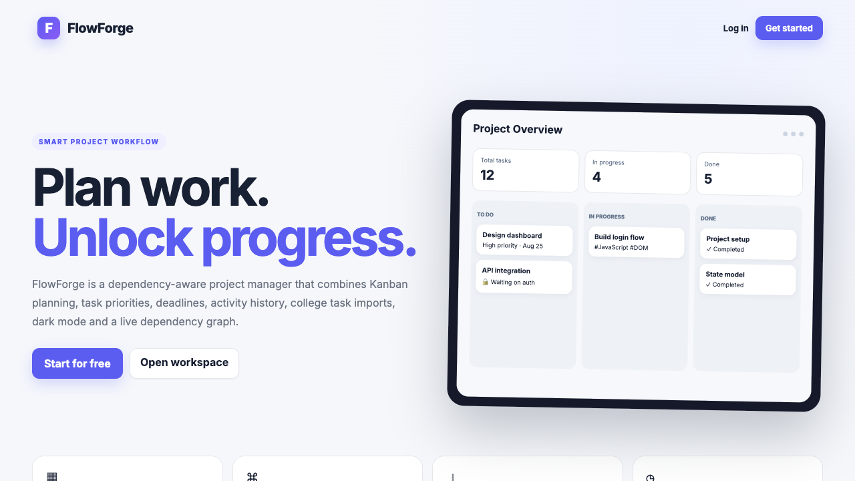
STUDENT PROJECT — DEPENDENCY-AWARE TASK MANAGEMENT
FlowForge.
Forging a structured flow of work.

Slide 2
THE CONCEPT
A task manager built for how students actually work.
Most tools only track whether a task is pending or done. FlowForge understands the work behind the work — which tasks are blocking which, and in what order things need to happen.
“
It represents creating — or forging — a structured flow of work.
WHY THE NAME
Straight from the app — not a mockup.

Slide 3
WHY IT'S DIFFERENT
A checklist isn’t enough. Real work has an order.
Standard task manager
FlowForge
— Pending
Understands prerequisites, and blocks dependent tasks until the required work is complete.
— Completed
Because real work isn’t a checklist — it’s a chain.

Slide 4
UNDER THE HOOD
Built with the fundamentals. Nothing more.
The stack.
Four pages, four jobs.
HTML
index.html
→
Landing page
CSS
login.html
→
Authenticates existing user
Vanilla JavaScript
signup.html
→
Creates a new user
No frameworks. No build step.
board.html
→
The core application

Slide 5
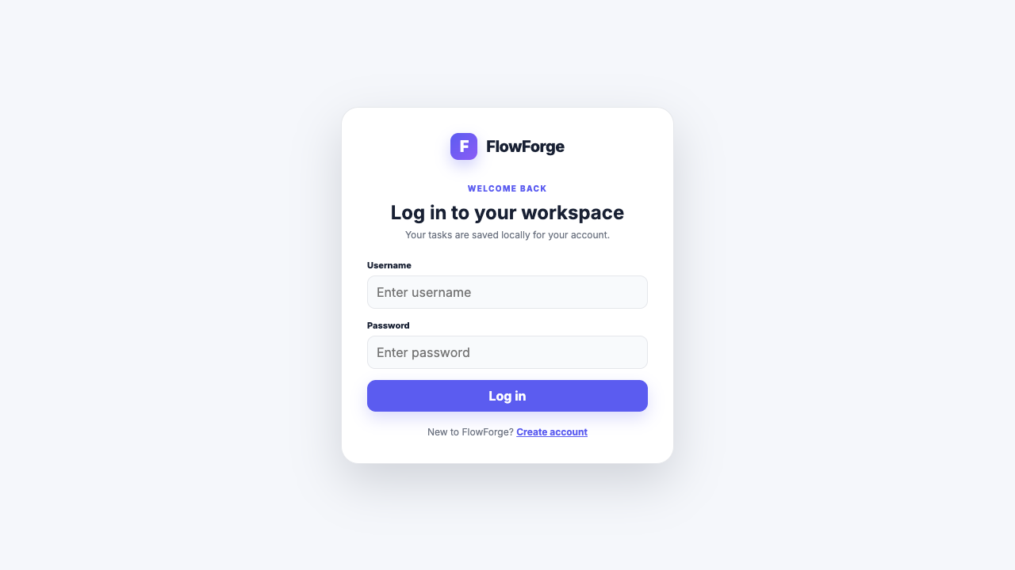
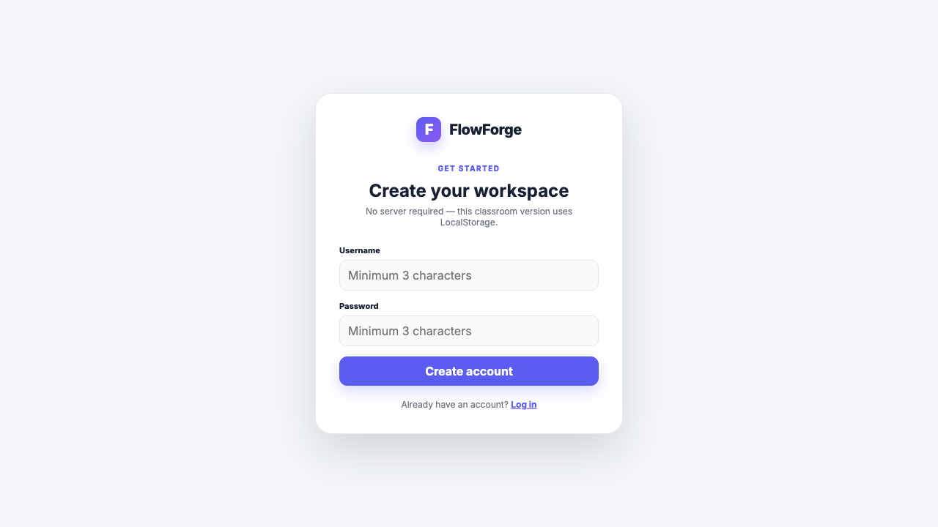
GETTING STARTED
From first visit to first task, in three steps.
Landing
Login / Signup
Board
LOG IN
CREATE ACCOUNT

Slide 6
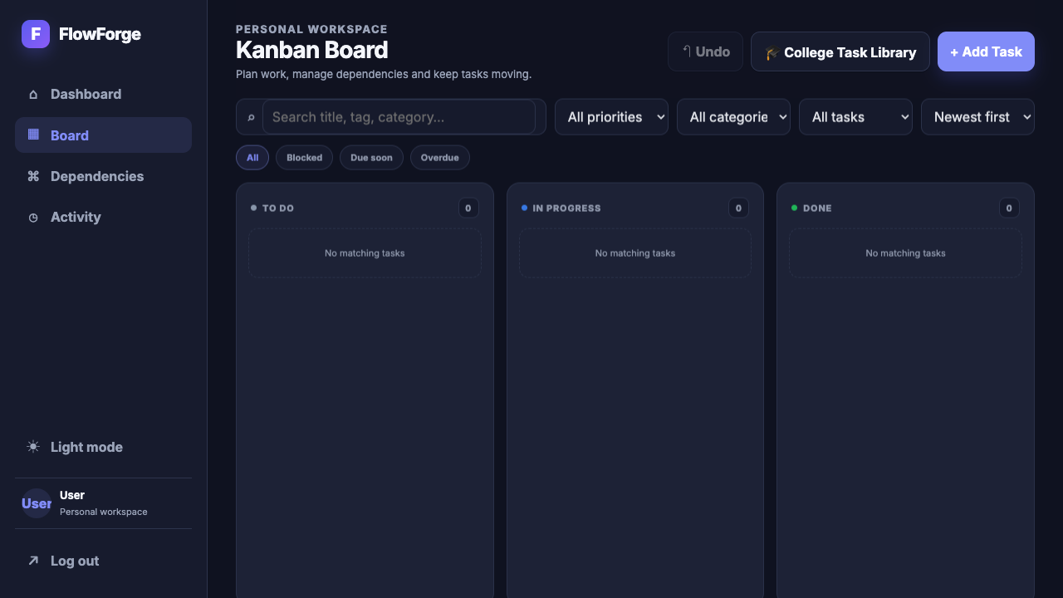
THE WORKFLOW
Every task moves through exactly three states.
To Do
Ready or waiting to start.
In Progress
Currently being worked on.
✓
Done
Completed successfully.

Slide 7
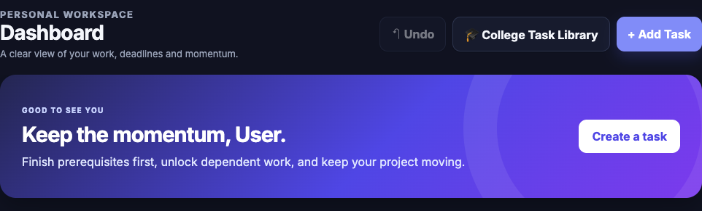
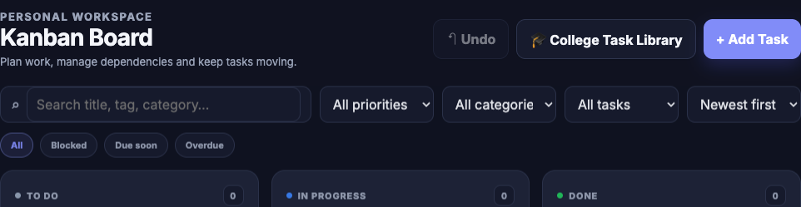
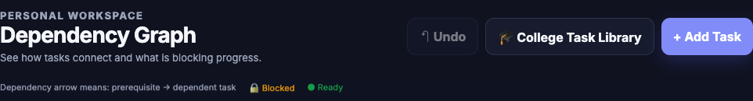
INSIDE BOARD.HTML
board.html is the hub — four views, one workspace.
Dashboard
Board
High-level project metrics and focus insights.
The main drag-and-drop task view.
Dependencies
Activity
Maps out task prerequisites and blocks.
A chronological log of recent updates.

Slide 8
F
FLOWFORGE
Plan the work.
Respect the order.

